Slide 1




12 GeV Upgrade of Cryogenics at
Jefferson Laboratory (Jlab)
Dana Arenius
Engineering Division
Cryogenic Systems
ILC08
Nov 16-21 2008
This work is supported by the United States Department of Energy (DOE) contract #DE-AC05-060R-23177

Slide 2
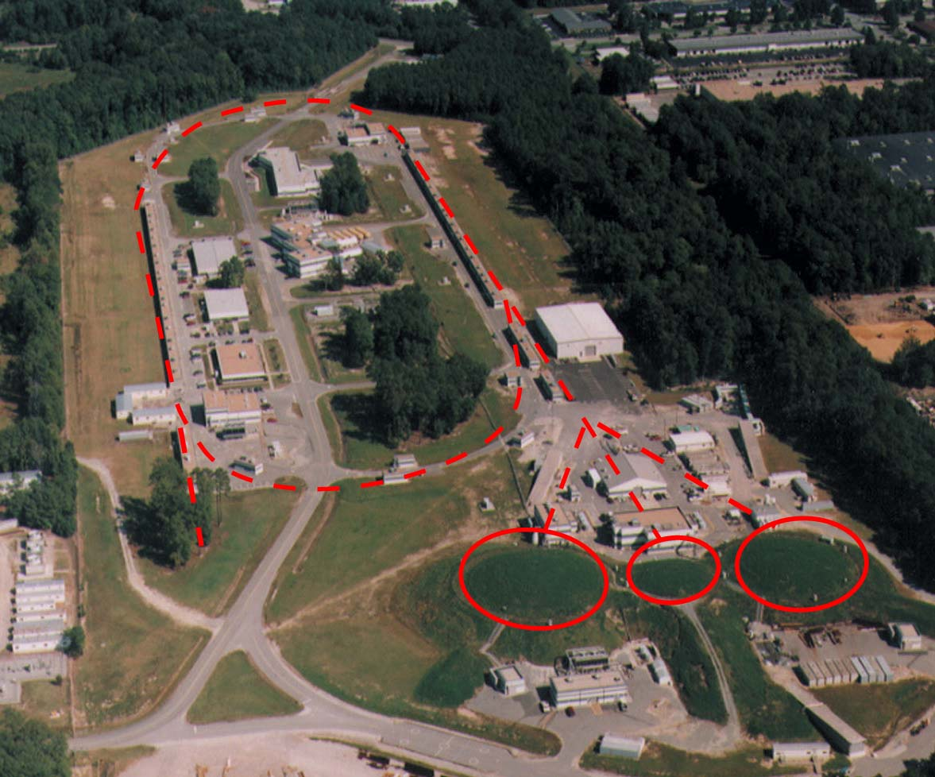
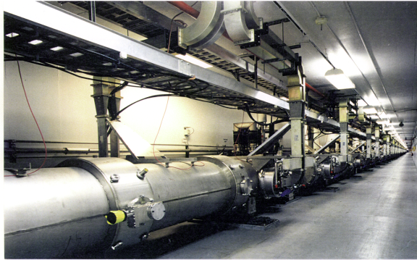
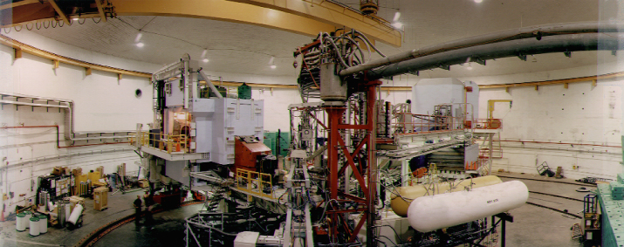
Jefferson Lab Today
2000 member international user community engaged in exploring quark-gluon structure of matter
Superconducting accelerator provides 100% duty factor beams of unprecedented quality, with energies up to 6 GeV
CHL
A
B
C
CEBAF’s innovative design
allows delivery of beam with unique properties to three experimental halls simultaneously
Each of the three halls offers complementary experimental capabilities and allows for large equipment installations to extend scientific reach

Slide 3
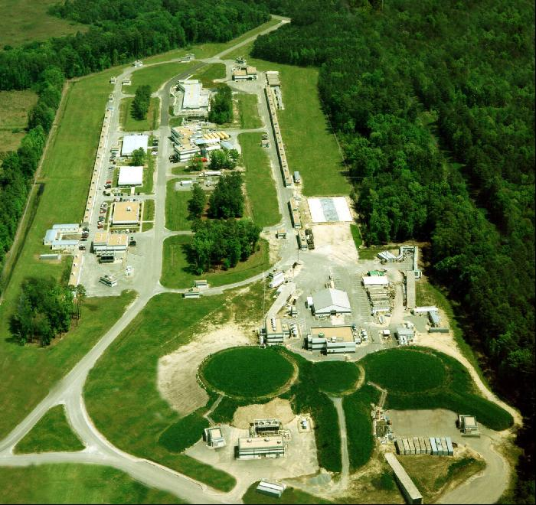
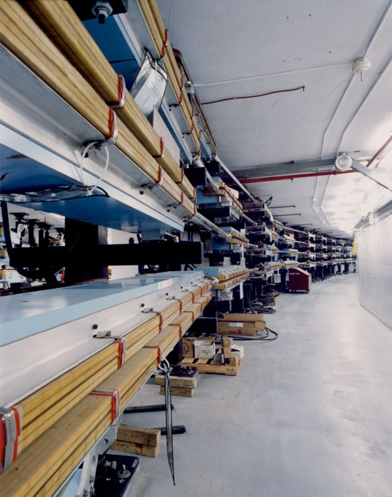
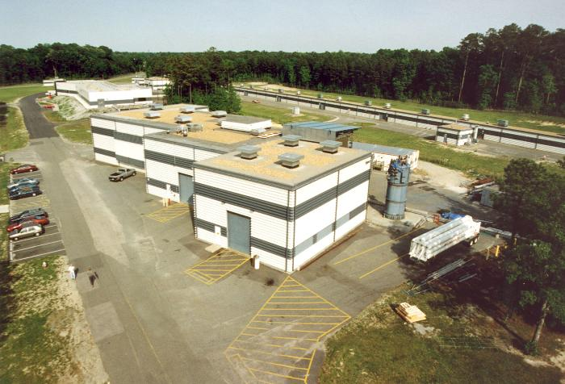
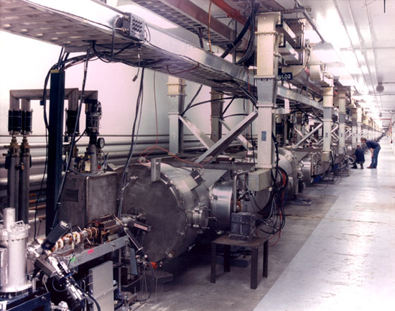
Jefferson Lab Today
ARC
CHL
A
C
B
LINAC
HALLS
Notes:
Be brief

Slide 4
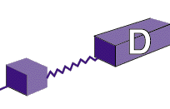
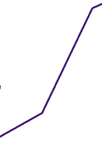
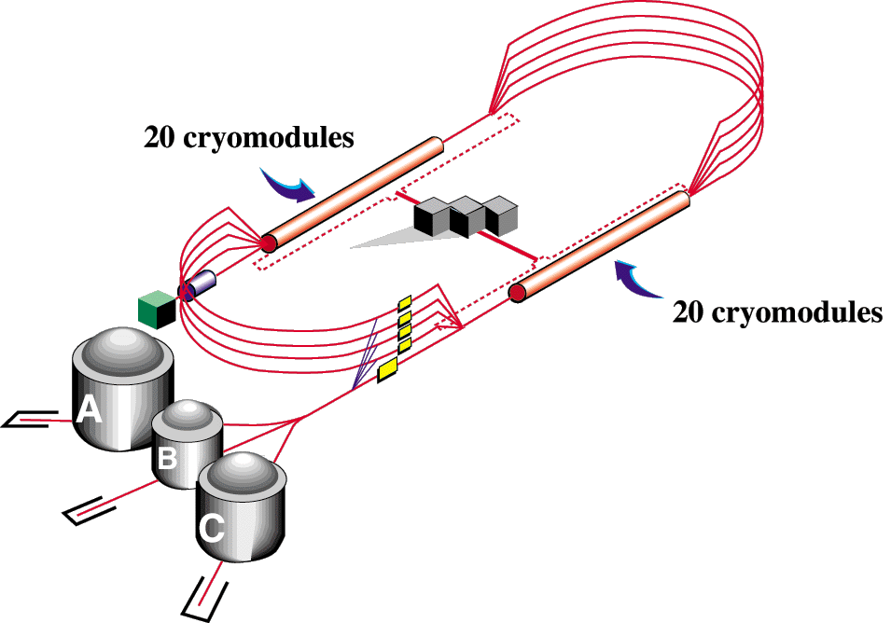
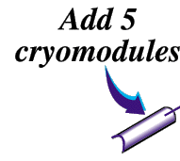

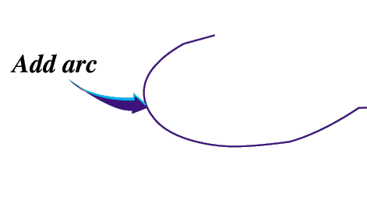

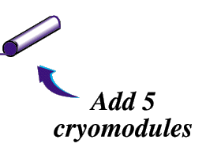
12
6 GeV CEBAF
11
Upgrade magnets and power supplies
CHL-2
Two 0.6 GV linacs
1.1
Enhanced capabilities
in existing Halls
Lower pass beam energies
still available
Notes:
help me

Slide 5
Additional Loads of 12 GeV
CEBAF Accelerator (Each new cryomodule)
  Up to 300 W at 2.1K, Primary Load
  Up to 300 W at 35 K, Shield Load
Hall D (inclusive of cryogen distribution system)
  100 W at 4.5K refrigeration
  0.7 g/s of liquefaction (lead cooling)

Slide 6
CHL Max Capacity
Current vs. New
Current 6 GeV (CHL #1)
  Load: 4.25 kW @ 2.1K, 11.65 kW @ 35K
  Capacity: 4.6 kW @2.1K, 12 kW @ 35K
  10 g/s liquefaction
New 12 GeV (CHL #1 + new CHL#2)
  Load: 7.25 kW @ 2.1K, 14.65 kW @ 35K
  Capacity: 9.2 kW @ 2.1K, 24 kW @ 35K
  25 g/s liquefaction

Slide 7
Loads/Capacities: CHL 6GeV vs.12GeV
Color key
6 GeV ops
12 GeV ops
Both

Slide 8
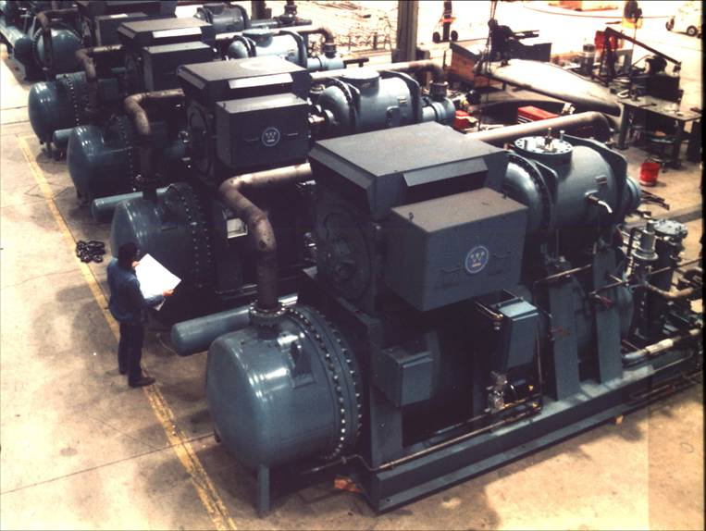
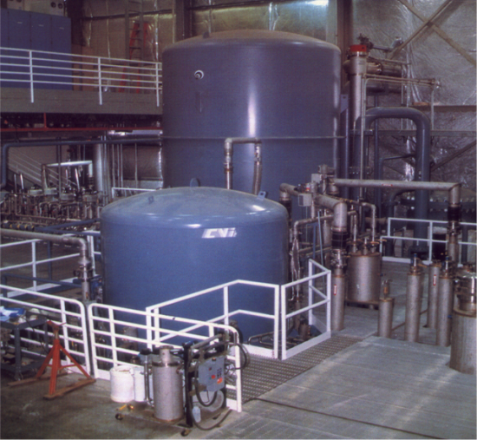
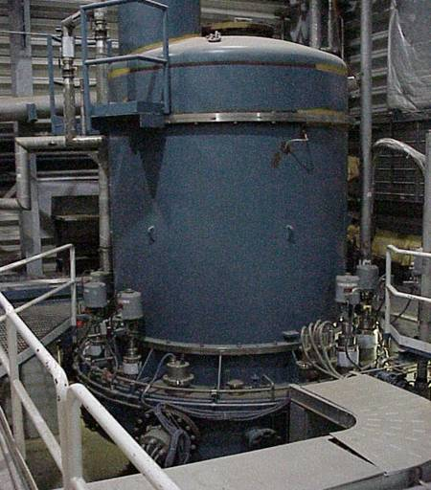
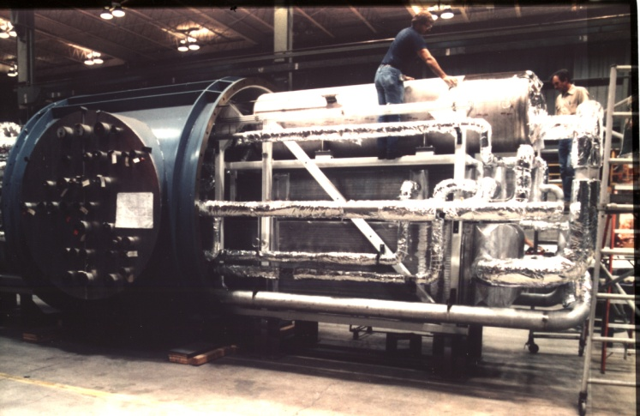
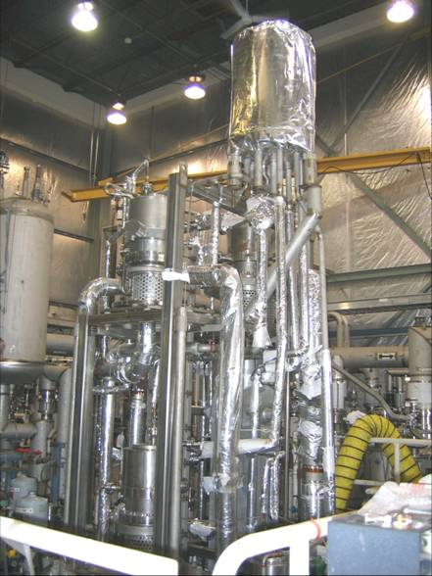
Existing 6 GeV 4600W 2.1K CHL Helium Plant
Helium Compressors
4K and 1st 2K Cold Box
JLab 2nd 2K Cold Box
4K Cold Box Internals
2K Cold Box Internals

Slide 9
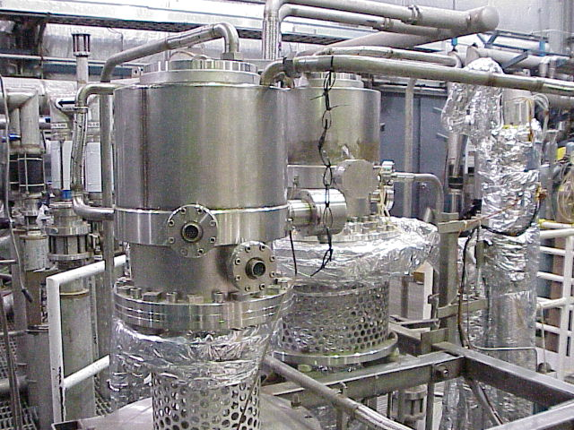
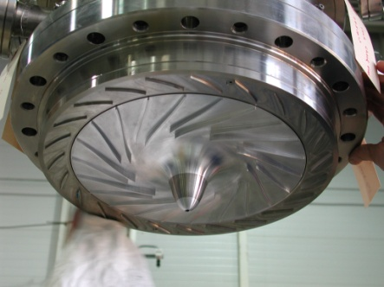
2K Cold Compressors

Slide 10
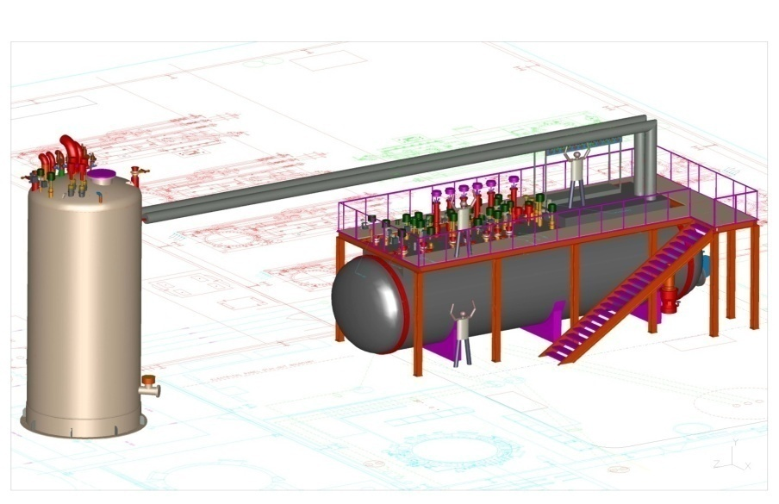
12 GeV “Split” 4.5K Cold Box Design
Uses JLab Ganni Helium Cycle In “Split Cold Box Design”
Moves large upper temperature section (>80K) out-of-doors for smaller indoor system foot print and easier field construction for facility cost reduction, eliminates special building feature requirements such as large building access doors and cold box insulating vacuum floor pits, enables use of existing building without modifications
Has lower temperature (<80K) section indoors which contains turbines, valves, etc. which require personnel access and controlled work environment

Slide 11
New Process Example
NASA-JSC “Ganni” Efficiency vs. Load
(Jlab/NASA JSC Collaboration)
JLab Design 12.5kW Plan Existing 3.5kW Plant
Ganni Cycle High Efficiency, 3 to 1 Turn Down

Slide 12
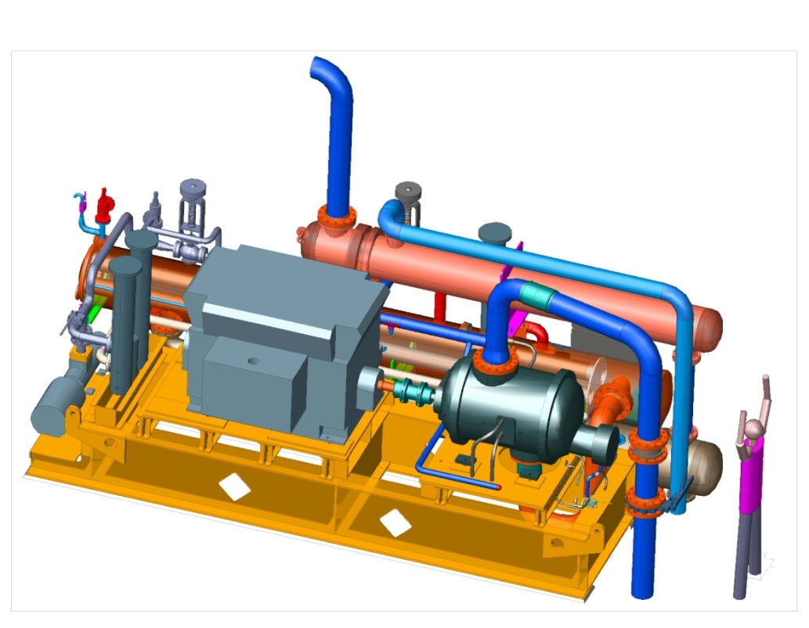
12 GeV Compressor Design Model
Design Goals
Improved Efficiency (highest current system losses)
Development outlined in FY07 JLab S+T R&D Review Goals
Lower Equipment Cost
Solves current common reoccurring industrial design problems (ex: oil removal, maintenance requirements, etc.) using “lessons learned”
Provides new design model using newly vendor developed internal oil injection system

Slide 13
12 GeV Refrigerator System Impacts
Uses the Jlab patent “Ganni Process Cycle” as baseline
    Same 4600W @ 2.1K CHL capacity as existing CHL-1 facility
    High system efficiency (28% Carnot) and stability for wide operating refrigeration operating domain
    5.5 MW utility reduction to <4 MW power reduction based on vendor feedback
    Vendors unable to suggest lower cost system during RFI

Slide 14
12 GeV Refrigerator System Impacts
Uses Newly developed JLab Compressor R+D Design Model
    Design fully funded by NASA-JSC for James Webb Telescope test facility compressor development to correct operational problems experienced by JSC since late 1990s
    identical to JLab 12 GeV project compressor requirements saving 12 GeV project engineering or DOE development costs (~$200K)
    Curbs current rapidly rising carbon steel prices by substantially reducing compressor skid vessel sizing (Ex: 48” 24” diameter) and eliminating costly high pressure flange ratings (carbon steel costs up 52% since Jan 08)
    Uses JLab oil removal process technology to eliminate current industrial system oil carry over problem plaguing many current helium refrigeration systems
    Utilizes compressor built-in volume adjustment control and lower pressure loss to increase overall compressor skid efficiency to 55%

Slide 15
Key 12 GeV Cost Advantages
Half of needed CHL buildings exist
Original Linac transfer lines can support twice the flow
Linac liquid inventory in linacs changes only 5%
The 2K cold compressor system already installed
480V Power source for new CHL building exists
Some shared equipment design cost with NASA

Slide 16
Existing 6 GeV CHL Systems
Gaseous Helium Storage
LN₂ Storage Dewars (twin 80,000 liter)
Cold Compressor Sets (twin 245 g/s)
Helium Gas Purification and Contamination Monitors
Guard Vacuum Subsystem (2.1K operations)
Building for lower 80-4.5 K Cold Box
Outdoor Foundation for upper 300-80 K Cold Box
Linac Cryogen Distribution Piping (ok for double flow)

Slide 17
New Equipment for CHL#2
4.5 K cold box and warm helium compressors
  Two sectional 4.5K cold box, (300-80K, 80K-4.5K)
  Design baseline is JLab’s Ganni Helium Process Cycle
  Supports 4600 W @ 2.1 K and 12 kW at 35 K
Compressor oil removal system
Computer distributive control system
Cooling Water System (twin 15,200 l/min)
Electrical Power (twin 5 MW, 4160V)
Helium Dewar, 10,000 l
4800 ft² compressor building

Slide 19
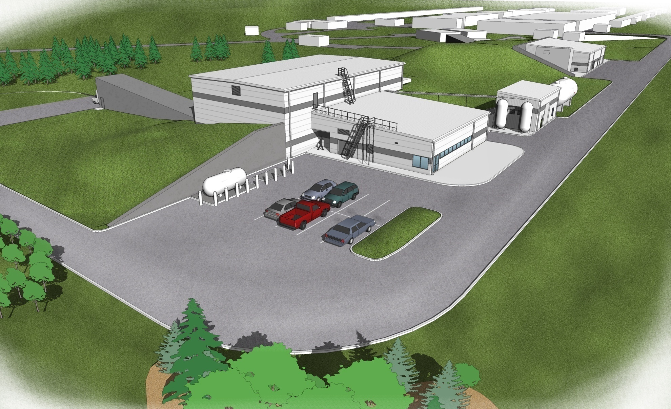
Hall D Rendering
Hall D
Counting House
Cryo Bldg
N

Slide 20
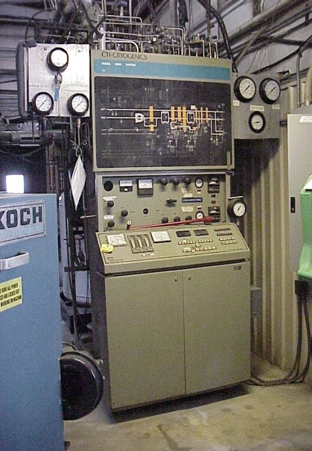
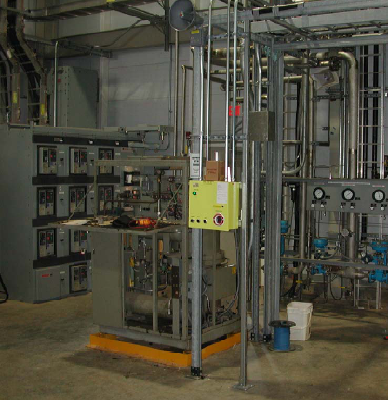
Hall D Refrigerator Equipment “On Hand”
    Two CTI Cryogenics Helium RS Compressors
    CTI M2800 200W 4.5 K Helium Refrigerator
    LHe Subcooler Dewar
    Motor Starters, 480V

Slide 21
Hall D Cryogenic Equipment Requirements
    Gas Management Valve Control Rack
    LN2 storage, 10,000 liter dewar
    One 4000 cf Helium Gas Storage Vessel
    Integrated Refrigerator Computer Controls
    Instrument Air System, 15 scfm
    Purification Loop Piping to the CHL via N. Linac
    640 ft² building
    Compressor/Turbine Cooling Water
    480V, 200 kW compressor power

Slide 22
12 GeV Cryogenic Schedule
October 2006 – October 2008 CD-2, Project Engineering and Design Status
October 2008 CD-3, Project Construction Status
January-April 2009 CHL#2 Major Component Purchase
October 2009 CHL#2 Building Construction Complete
October 2010 CHL#2 Utilities Construction Complete
February 2011 CHL#2 Major Equip Delivery/Installation
Hall D Refrigerator Building BOD
May-November 2011 Hall D Refrigerator Installation
October 2011-April 2012 CHL#2 Commissioning
February 2012 Hall D Refrigerator Commissioning

Slide 23
Current Cryogenic Status
Construction Phase Approved (CD-3)
Currently evaluating 4.5K Refrigerator Bid Proposals
CHL Civil Design ~100% Complete and Bids Received
Hall D Civil Design ~100% Complete
Major Cryogenic Specifications Developed
System P&IDs and system drawings generated (~120)
Detailed Process Cycle Analysis Complete
Equipment Cost Baseline Established
Equipment Installation Design FY09
Have completed 8 Major Reviews Successfully
Ahead of Schedule and Budget

Slide 24
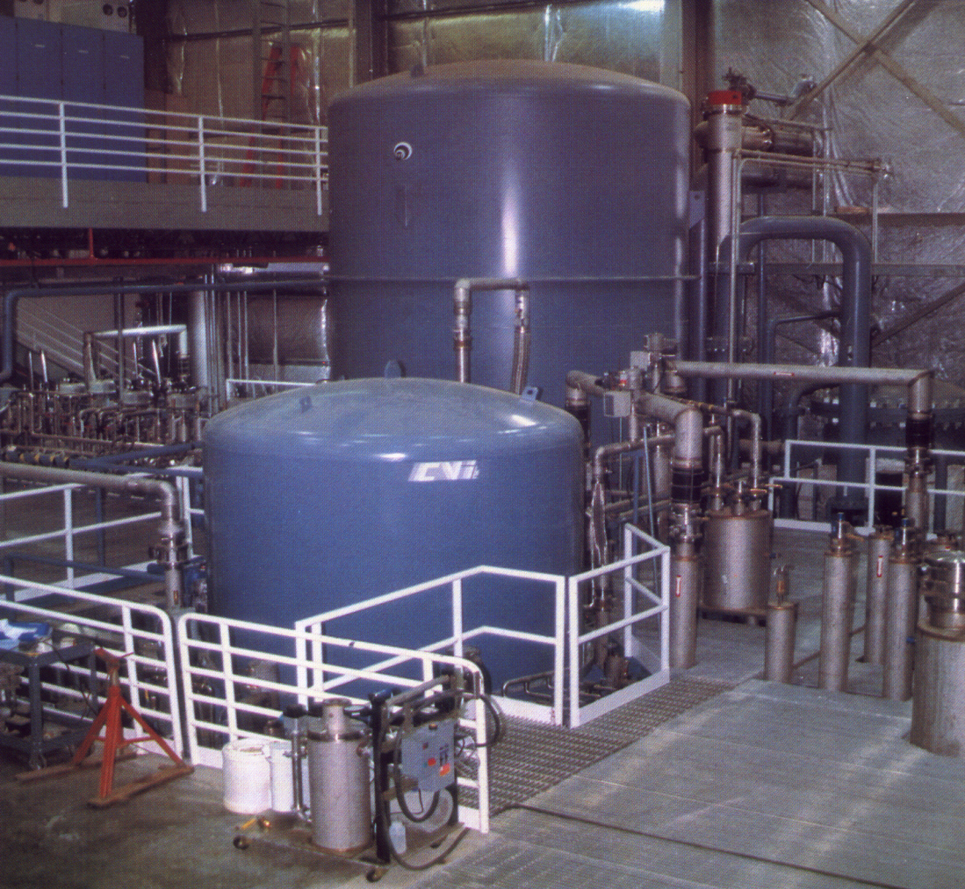
Thank You for Your
Kind
Attention
May We Answer Your Questions ?

Slide 26
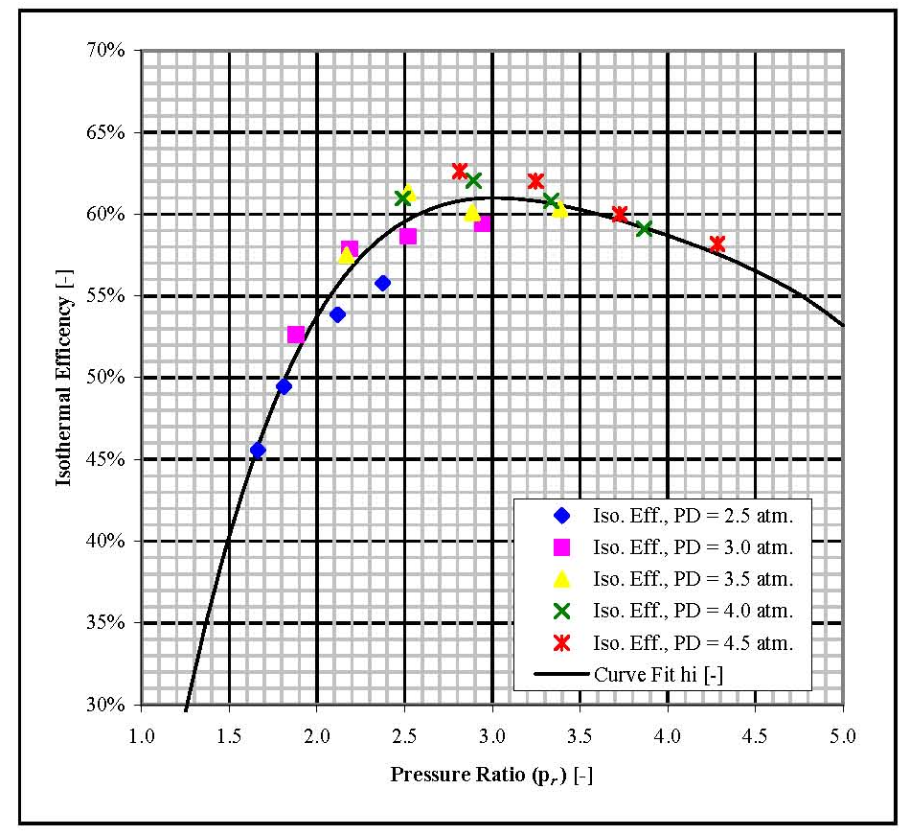
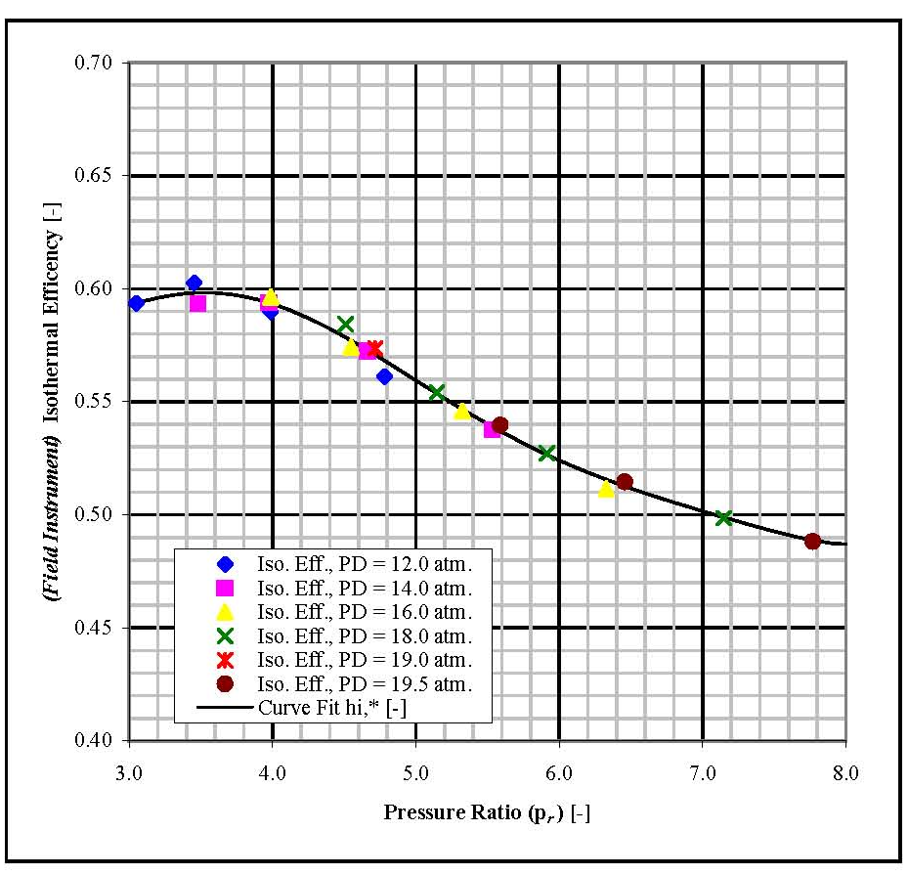
Compressor Characteristics
FIGURE 1.3 BRV=2.2 1st Stage
FIGURE 1.4 BRV=2.6 2nd Stage

Slide 27
Standard Cycle

Slide 28
Ganni Cycle

