Slide 1
Update on Large Grain/Single Crystal Activities at JLab
Peter Kneisel
April 15, 2009

Slide 2
Single Cells
Reproducibility tests with single cell cavities made from large grain niobium of different suppliers ( W.C.Heraeus, CBMM, Ningxia and Tokyo Denkai ) continues with slow progress
Six cavities have been fabricated from Tokyo Denkai material and all have been treated with the same procedure.
Two have been tested before and after baking
Two have been tested before baking ( one was limited by FE and needs to be re- rinsed)
The plan is to post-purify all cavities after their initial tests as outlined above and retest them before and after baking.

Slide 4
TD #4

Slide 5
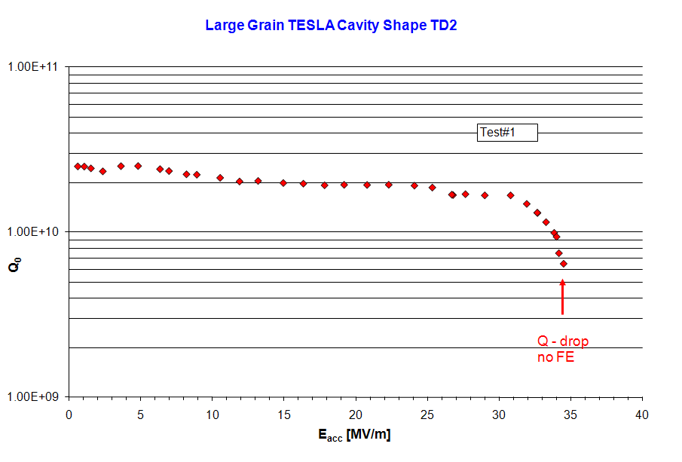
Tokyo-Denkai #2

Slide 6
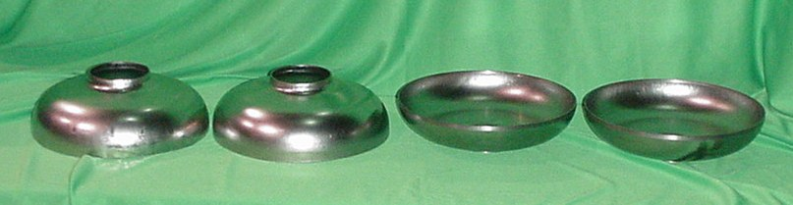
Single Crystal
A thick sheet of a large crystal from a large grain ingot provided by CBMM has been enlarged at DESY ( X.Singer, W.Singer)
Six sheets could be prepared, large enough to deep draw half cells for TESLA/ILC – type single half cells
We are in the process of fabricating 3 single cell cavities

Slide 7
Multi-cell Cavity Manufacturing/Procedure
Based on Jlab’s experience over the past years, we want to apply the following steps to the manufacturing and testing of our next cavities ( two 7-cell LL cavities for the Jlab FEL and two 9-cell Ichiro/LL cavities):
  Deep drawing of half cells
  Cleaning ,bcp ~ 30 micron
  Stress relieving at 600C for 10 hrs
  Re-stamping
  Trimming for EBW with a butt weld joint
  Bcp 10 micron , welding of dumbbells
  Mechanical grinding to remove blemishes and grain boundary steps
  10 micron bcp for welding of equators
  Bulk bcp ~ 60 micron
  Hydrogen degassing at 600C, 10 hrs
  Tuning
  Final bcp , ~ 50 micron, HPR, drying

Slide 8
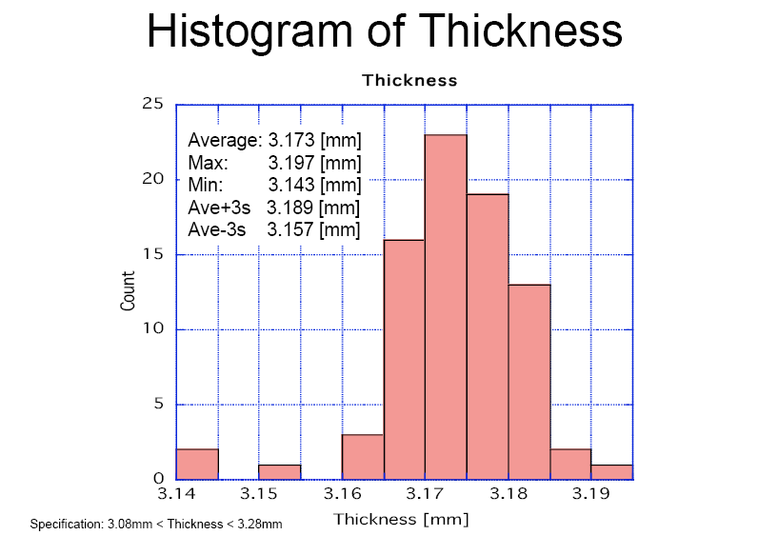
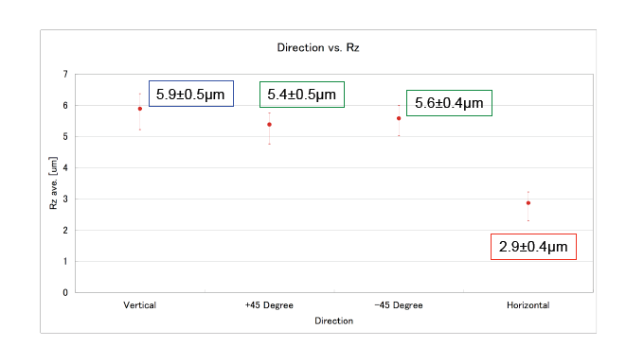
Multi-cell Cavities for ILC
The fabrication of two LL/Ichiro-type 9-cell cavities has started; niobium from CBMM and Tokyo-Denkai will be used
The 20 sheets of TD material were sliced simultaneously by multi-wires – development done by K.Saito with Japanese Industry – with very good tolerances and surface quality.
The sheet slicing produced very smooth surface finishes and small deviations in thickness. App. 60 sheets were slice simultaneously in only 40 hrs.
Graphs courtesy of H. Umezawa, Tokyo-Denkai
Surface Roughness

Slide 9
Other Cavities
Fabrication of two 7-cell upgrade cavities for the FEL
Fabrication of one (of two) 3.5 cell photo-injector cavities
( CRADA with FZD)
Fabrication of a 2-cell CRAB cavity
Fabrication of a 1050 MHz, beta = 0.47 single cell cavity
Fabrication of a 2.45 GHz cavity for studies with a magnetron
Fabrication of two R&D cavities for investigation of the influence of surface roughness on performance
Half cell cavity for laser heating/flux trapping/flux moving to study effect on Q-drop
All these various projects are intended to demonstrate the
usefulness/reproducibility of large grain material and bcp
treatment

Slide 10
Final Remark
It has been shown in the past that single cell cavities made from large grain niobium and treated by bcp only are comparable in performance with cavities made from fine grain niobium and electropolished.
The proof/ extension to multi-cell cavities is still missing
Several ( 8 in total) cavities have been made by ACCEL for DESY. Two of them performed quite nice, the 6 new one’s need testing
At KEK, K.Saito has several Ichiro-type cavities in the “Pipeline”; also Jlab is fabricating two Ichiro cavities
The cost advantages of cavities made from large grain material have been discussed at several occasions; with the inexpensive slicing method developed by K.Saito a cost reduction in material and streamlined procedures by a significant amount is not out of the question.
Therefore it seems “puzzling” , that the GDE and/or the regional organization or not pursuing this option with some more support.

