Slide 1
ILC Accelerator R&D Status
Marc Ross
Nick Walker
Akira Yamamoto

Slide 2

Lepton Colliders beyond LHC
Energy Frontier
ILC
→ By far the easiest!
E < 1 TeV
LHC Results
CLIC
E > 1 TeV
Multi TeV
or
Muon Collider
Notes:
2
2

Slide 3
RDR → 2012 Technical Design
Strong Basis for SCRF technology in each ILC region
  Cavity fabrication and test: Each region
  Global Cryomodule: KEK +
Large scale Costed technology demonstration
  EU XFEL (5% of ILC); first beam mid-2014
Siting: adaptation to best suit potential hosts
Beam – based studies and demonstrations
  High power SCRF linac operation: DESY +
  Electron-cloud beam dynamics: Cornell +
  Beam delivery technology: KEK +
Notes:
Primary paths

Slide 4
ILC R & D – 2010: Outline
Superconducting RF
  Cavities
  Cryomodules
  Linac ‘system’: High power beam tests
  Construction of EU-XFEL (13 partners, including China)
    Critically useful guidance for ILC SCRF Industrialization
Conventional Facilities / Siting
Beam Test Facilities: CESR TA / ATF2
Integrated Design: AD & I
Notes:
Denmark, France, Germany, Greece, Hungary, Italy, Poland, Russia, Slovakia, Spain, Sweden and Switzerland). China – XFEL
SCRF gradient – latest yield results from the database group
S1 Global – demonstration of global technical proficiency
FLASH – workshop results; full current dE/E; stability
XFEL cryomodule cost – TDR cost (published) and status of contract preparation (to be checked with Hans) 1.3 M€ 2005 / 2.48 M€ 2005 ;
M/S 24.31 97.54 CM / Cav. Total M/S for XFEL linac 199.69 = 2 M€ 2005/CM
Actual factor 1.2 for CM
main linac components 2750 MILCU / 1848 CM = 1.5 MILCU (1.2 conversion used for RDR 2006/7; 1.37 today) 1.6 factor difference – need 1.6 BILCU
ILC industrialization plan – multi-vendor scheme (2 per region) and cost impact compared with probable XFEL and with RDR.
Cavity production in each region (see S0); industrial meeting in Kyoto IPAC
Re-evaluation of the specified design gradient in 2010 - dominant cost threats: S0 R&D results, operational gradient including gradient spread, learning curve, availability.
SB2009 – an attempt to contain cost against the above
SB2009 Components and estimated impact (top level)
CFS highlights expected ILC2010 – Japanese design work; single tunnel safety
Beam test facility RD: CESR TA EC recommendation; 2010 completion milestone
Beam test facility RD: ATF2 optics and startup commissioning
Technical R & D: Sources (SLAC, LLNL, UK)
Technical R & D: Main linac HLRF (Marx, MBK and KCS, DRFS) and integration (SC quad)
2010 TDP1 completion – interim report and change control / review mechanics (bureaucracy)
2010 R & D milestone summary

Slide 5
Cavities:
Full ILC gradient performance in each region
  2009 achievement
  Production yield assessment process defined
Specified: <Gradient_average > 35 MV/m in low power test
  2009 Assessment:~ 44% production yield
    (2010 R & D Plan goal: 50%)
Diagnostic: imaging welds from the inside
  Precision imaging – Kyoto 2007
  Now deployed at each major lab

Slide 7
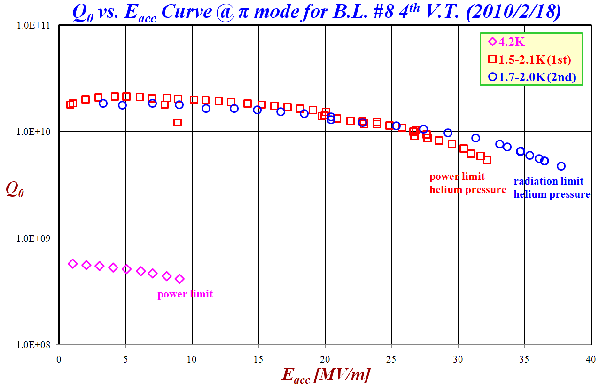
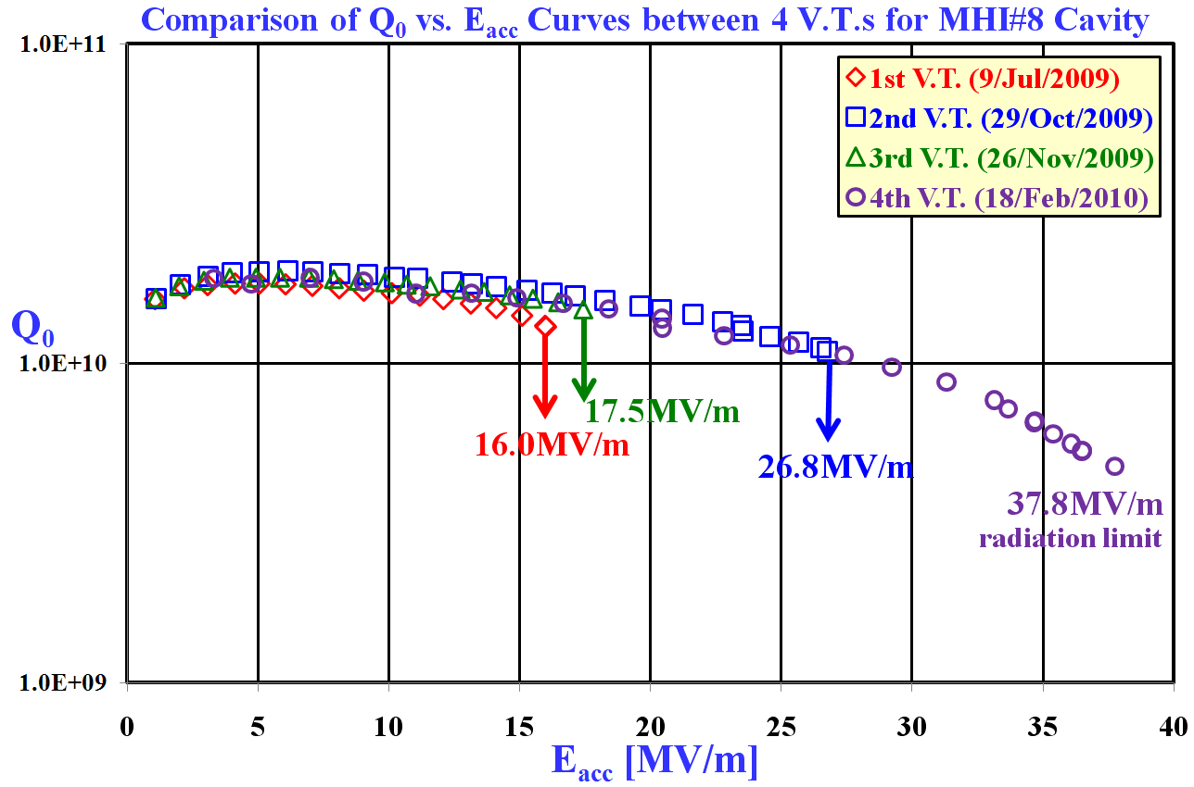
V.T. Results of MHI#8 – KEK 2010
MHI#8 did not have any quench in pi-mode
at 2K.
Limitation of RF test was the radiation level
and helium pressure.
9.1MV/m
power limit
32.2MV/m
test stop by power limit
& helium pressure
37.8MV/m
test stop by radiation limit & helium pressure
16.0MV/m@Cell#2
thermal quench by
defect or contamination
After the first V.T., local grinding was carried out
and the pit at heating location was removed.
After the second V.T., no grinding was done.
17.5MV/m@Cell#2
thermal quench by
defect or contamination
26.8MV/m@Cell#2
thermal quench by
defect or contamination

Slide 8
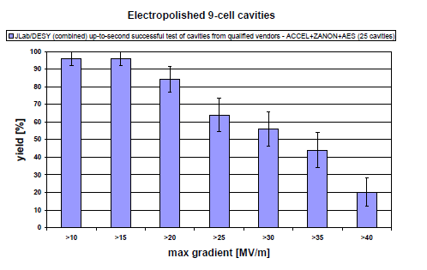
The Next Battles (1): Eliminate the Yield Drop near 20MV/m
Despite increased acceptance thanks to more flexible HLRF
31.5+/-20%

Slide 9
The Next Battle (2): Further Reduce Field Emission up to 40 MV/m
Flexible HLRF opens up possibility of
some individual cavity operations up to 38 MV/m
31.5+/-20%
- Operation at >35 MV/m significantly raises the bar for FE suppression.
- Recent R&D has shown proof of existence of “FE-free” 40 MV/m in 9-cell vertical test – further R&D is needed for reliable FE suppression
FE suppression

Slide 10
‘Production Yield’ – 2009
>35MV/m
35-41.8MV/m
44% yield
(RDR definition)
2009 proposal: high (> 35 MV/m) performance retained in system
‘Gradient spread’ – to ~20%
<36.5MV/m>
27.9-41.8MV/m
64% yield

Slide 14
Progress and Prospect of
Cavity Gradient Yield Statistics
 | Initial qualified set: Oct 2009 | New cavities added: Dec 2009 | Coming Prod/Test Jun 2010 | Research cavities
DESY | 14 (AC/ZA) | 4 | 5 | 8 (large grain)
JLAB FNAL/ANL/Cornell | 7 (AC) | 5 (AE) 1 (AC) | 12 (RI) 6 (AE) 2 (AC) | 6 (NW) (including large-G)
KEK/IHEP/PKU | 0 | 0 | 2 (MH) | ~5 (LL) 1 (IHEP) 2 (PKU)
Sum | 21 | 10 | 27 | ~ 22
Total |  | 31 | 58
Statistics for Production Yield in Progress to reach ~ 60, within TDP-1.
We may need to have separate statistics for ‘production’ and for ‘research’,

Slide 15
Predicted average (from low power test): 29.7 MV/m
Notes:
Average gradient: 29.7

Slide 16
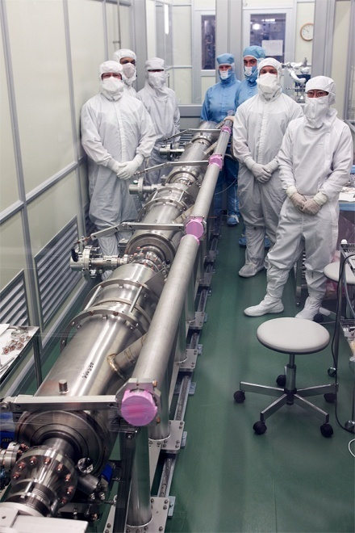
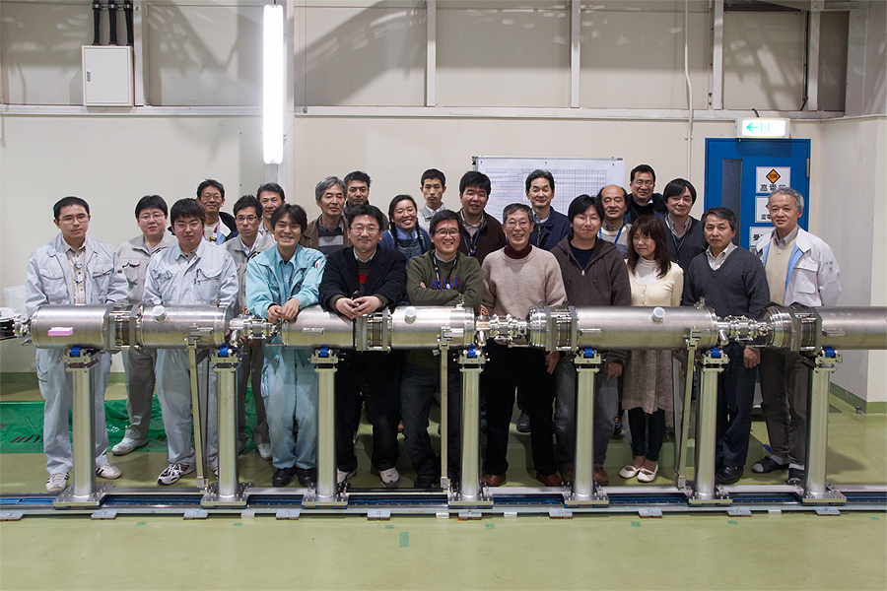
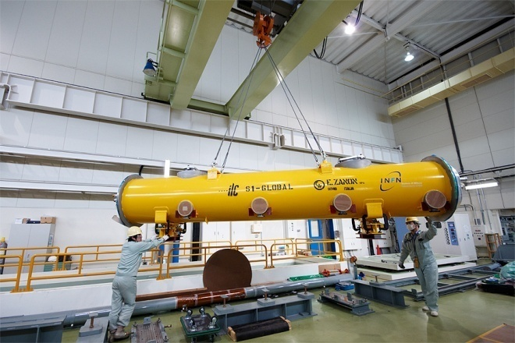
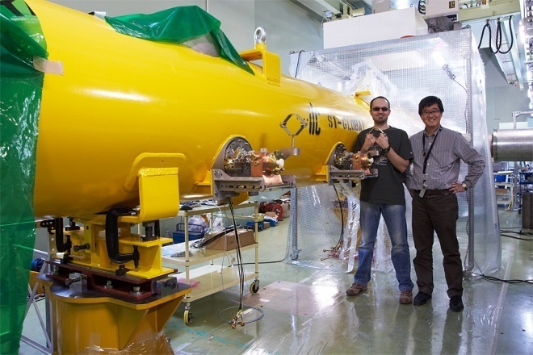
2010: Assembling the ‘S1’
Global ILC Cryomodule (at KEK)
Two 4-cavity half-CM:
  INFN/DESY/FNAL half installed 19.03
  KEK half now in assembly

Slide 17
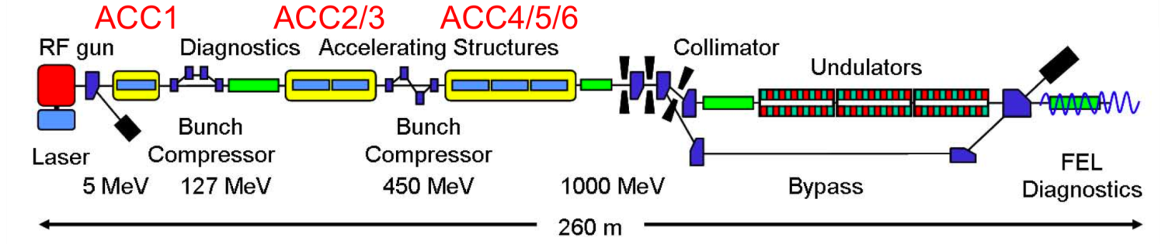


High Power SCRF Linac Operation
DESY/FLASH 9mA – 36 kW
 |  | XFEL | ILC | FLASH design | FLASH experiment
Bunch charge | nC | 1 | 3.2 | 1 | 3
# bunches |  | 3250* | 2625 | 7200* | 2400
Pulse length | μs | 650 | 970 | 800 | 800
Current | mA | 5 | 9 | 9 | 9
DESY, ANL, FNAL, SLAC, KEK

Slide 18
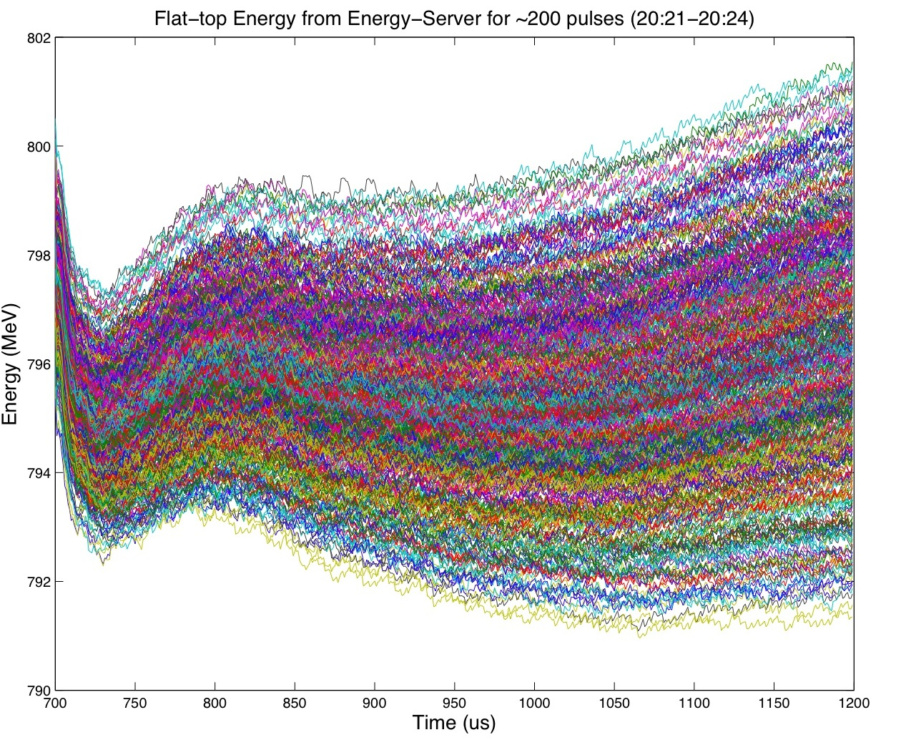
Example of pulse-to-pulse energy jitter
(500us, ~3mA, 200 pulses overlaid)
802MeV
+/- 0.6%
796MeV
790MeV
500us

Slide 19
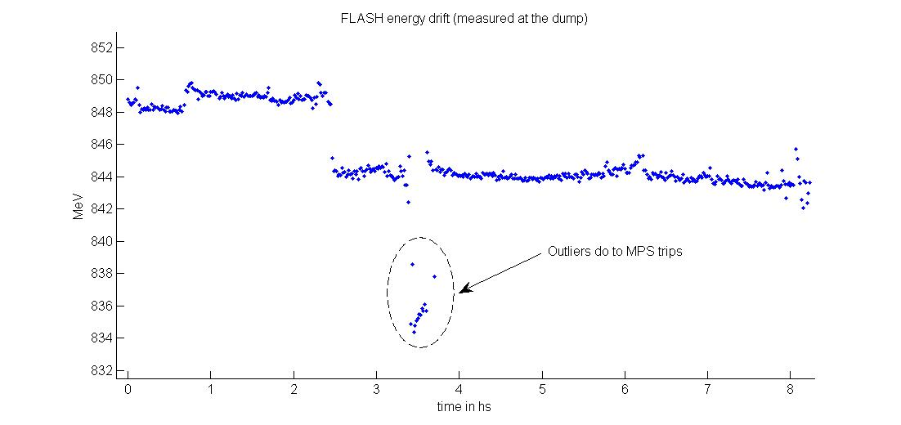
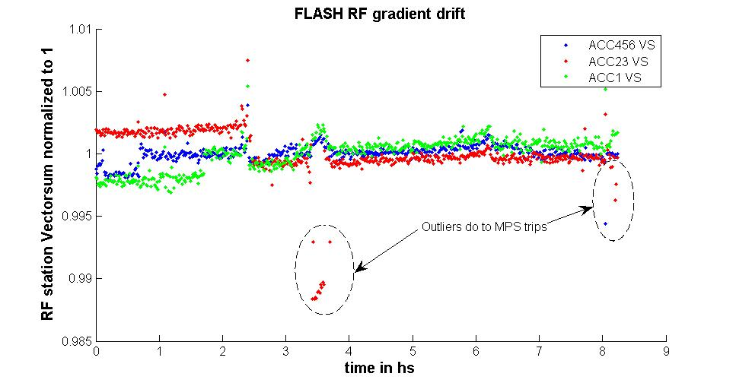
Energy stability over 8hrs
(3mA, 800us bunch trains)
Beam Energy
6MeV
(0.75%)
844 MeV
Tuning change
Time (hrs)
RF Vector Sums (Normalized)
1.0
0.5%
Time (hrs)
8 hrs

Slide 20
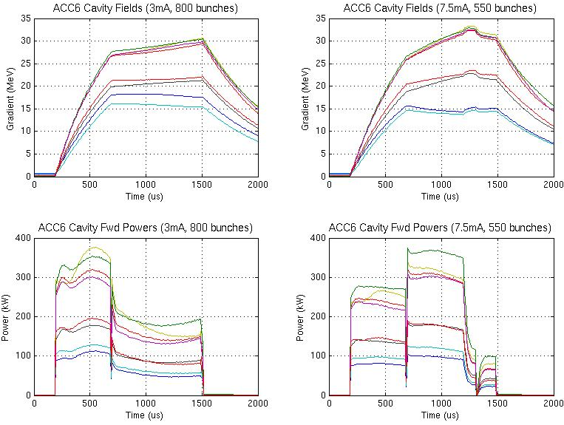
Cavity tilts with long bunch trains and heavy beam loading (3mA and 7.5mA, long bunch trains)
ACC6 gradients (3mA, 800 us)
ACC6 gradients (7.5mA, 550 us)
Gradient tilts are a consequence of using a single RF source to power cavities running at different gradients
At 7.5mA, ACC6 cavities #1 and #2 approached their quench limits at the end of the pulse
ACC6 Fwd Power (3mA, 800 us)
ACC6 Fwd Power (7.5mA, 550 us)
The RF power during flat-top is higher than the fill power for the 7.5mA case

Slide 21
ILC R & D - 2010
Superconducting RF
Conventional Facilities / Siting
  Trade-offs: technology v/v civil design – in each region
    “Bringing the RDR to the surface”
  Design: 3D and layout – in each region
  Interaction region design: 2010 effort – see parallel session
Beam Test Facilities: CESR TA / ATF2
Integrated Design: AD & I

Slide 22
Focus for Design Optimization:
Reduce CFS cost and ‘risk’
(CFS ‘risk’ ≡ unknowns inherent in underground construction)
consolidate and reduce underground construction
  Reference Design focused on technical / R & D ‘risk’
    RDR technical design is fundamentally sound and technically conservative
  2009 → Offset Civil construction through innovative accelerator / technical design →
  Necessarily an ‘integration’ effort…
    Because multiple ‘top-level’ groups are critically involved

Slide 23
At a glance: ILC CFS 2009
Comparison: RDR vs SB2009 →
Tunnel (TBM) length approaching minimum
  ≈ set by beamline enclosure length
To do: Analyze and consolidate Drill and Blast volume

Slide 24
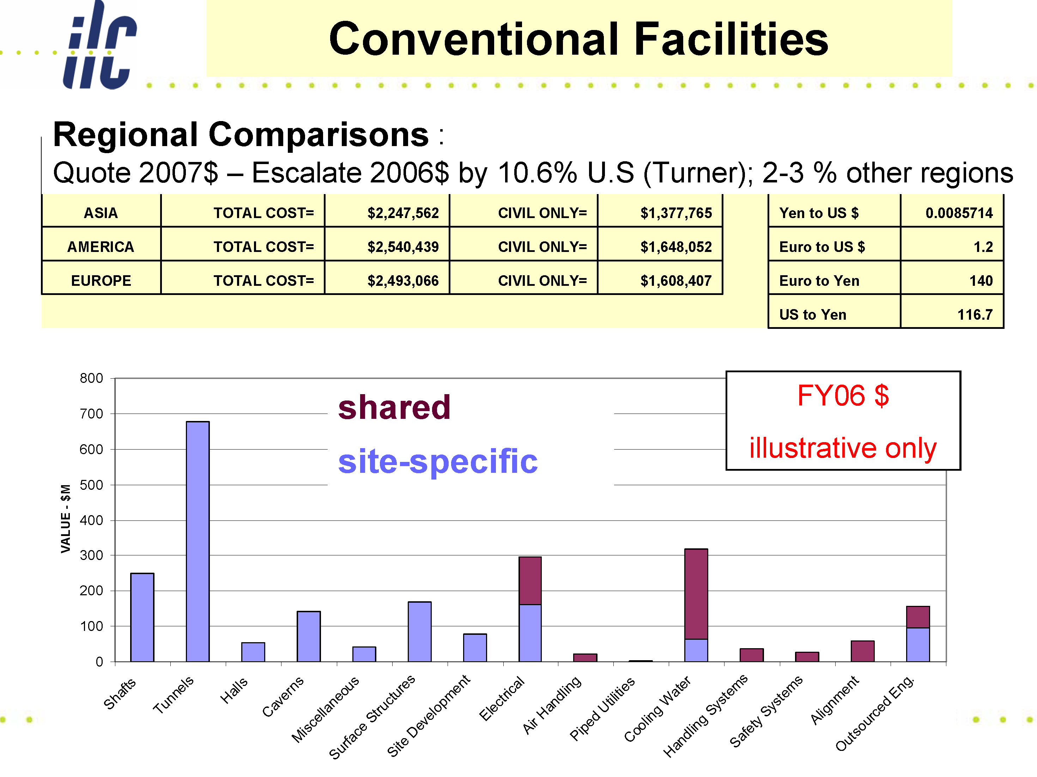
Underground volume reduction of 40% considered in 2009
(Support tunnel and
Damping Ring circumference)
0.4* 900MILCU ~ 400M ‘savings’ (6%)
(offset by technical and surface cost increase)

Slide 25
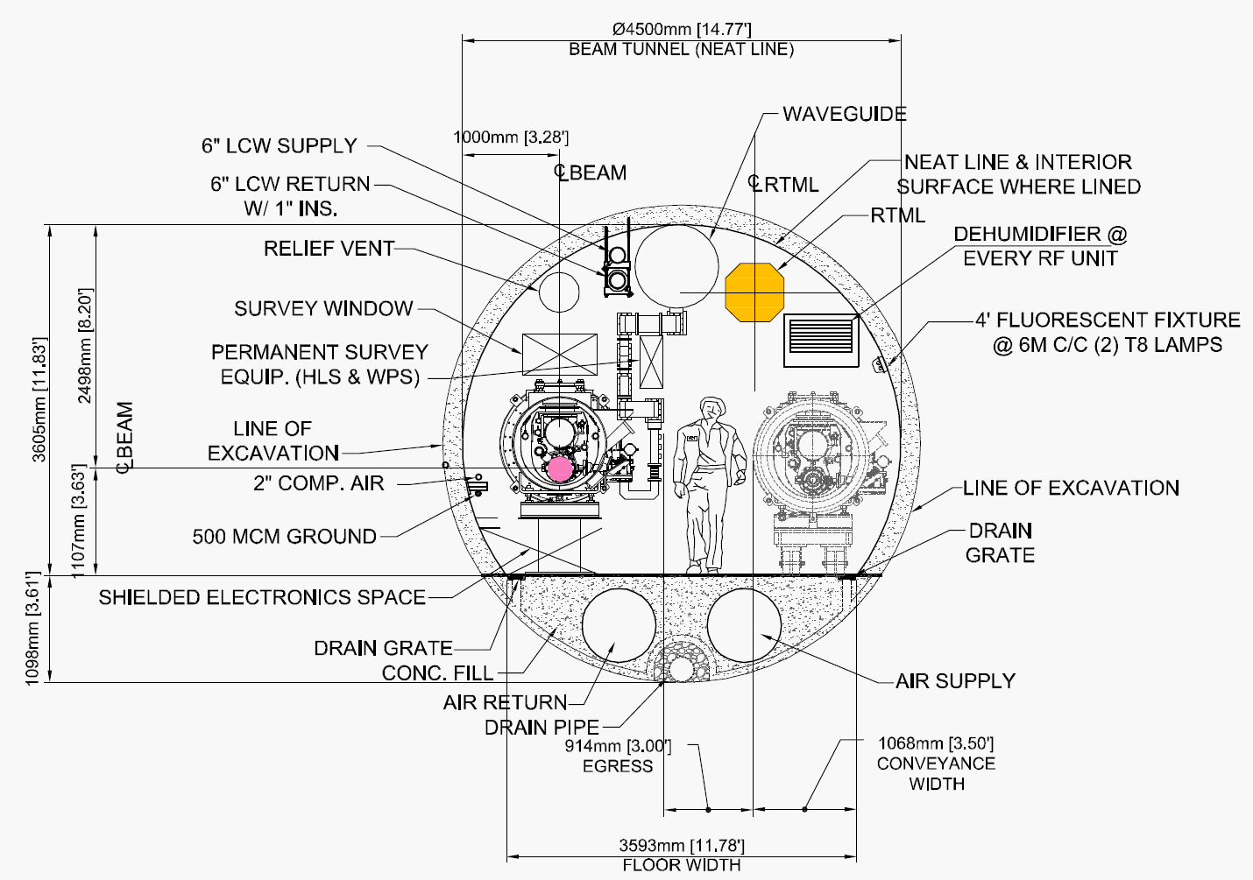
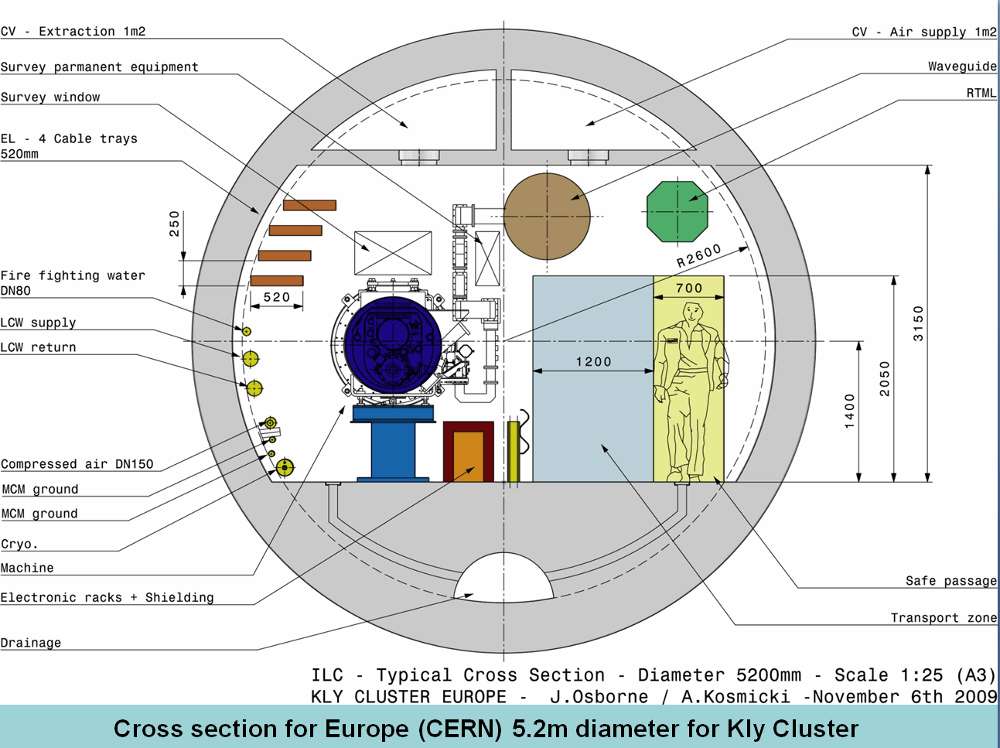
Regional / RF Power differences:
‘Klystron Cluster Scheme’
Current ML KCS Tunnel Cross Sections
Americas Region 4.5 m Dia.
European Region 5.2 m Dia.

Slide 26
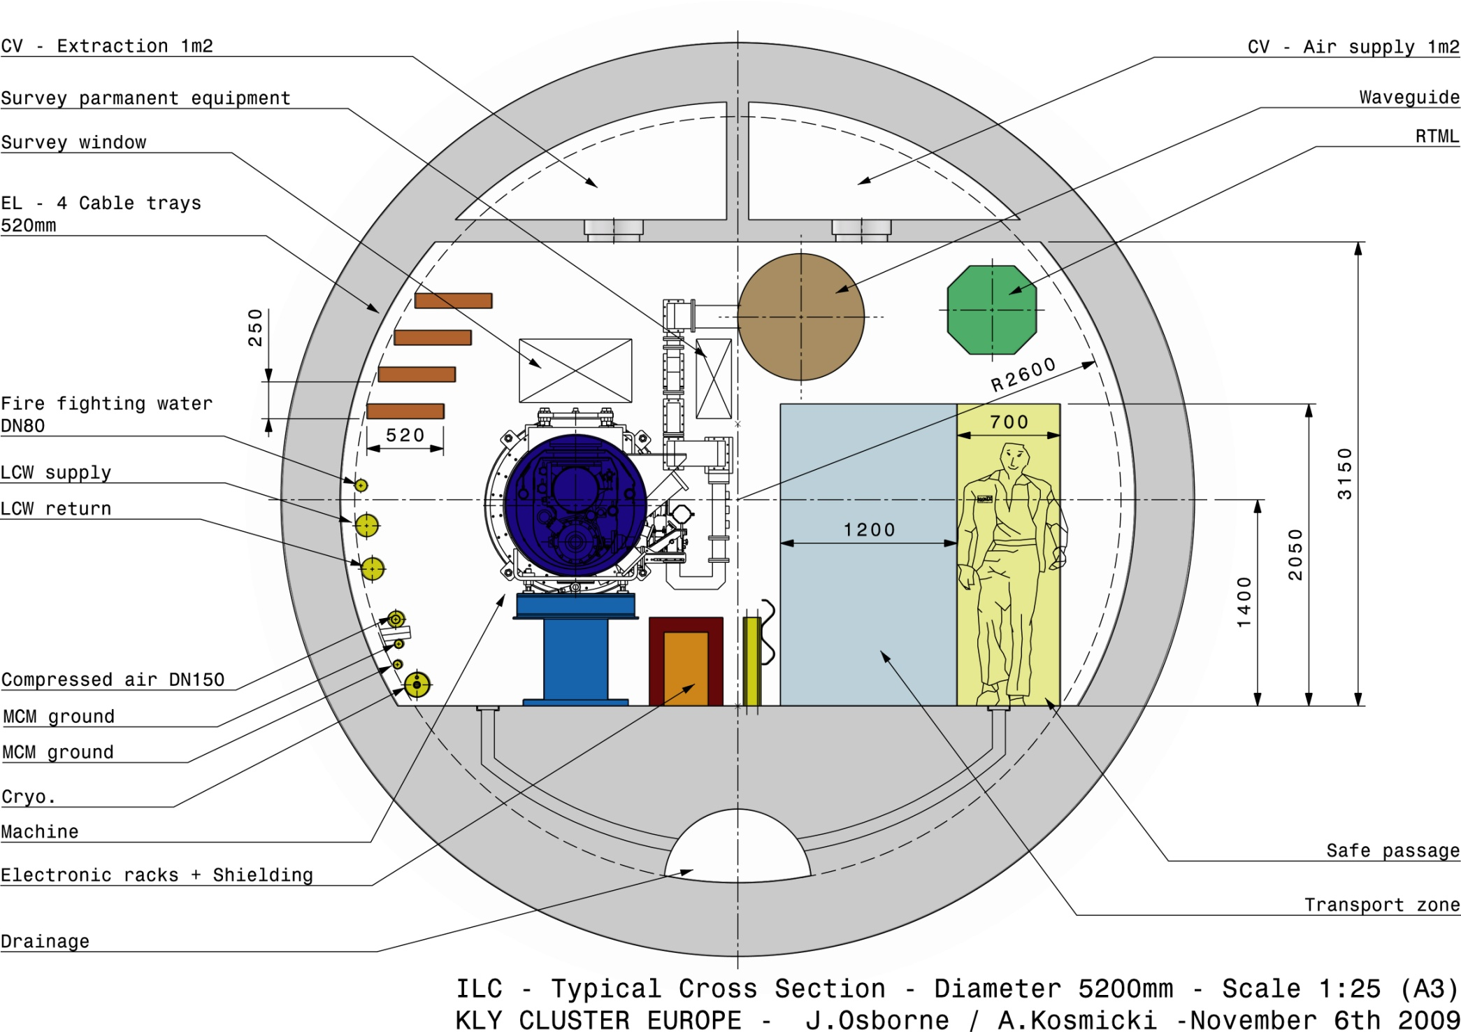
Cross section for Europe (CERN) 5.2m diameter for Kly Cluster

Slide 27
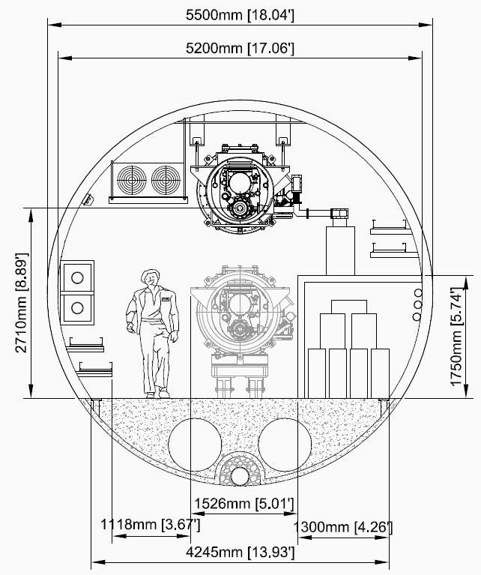
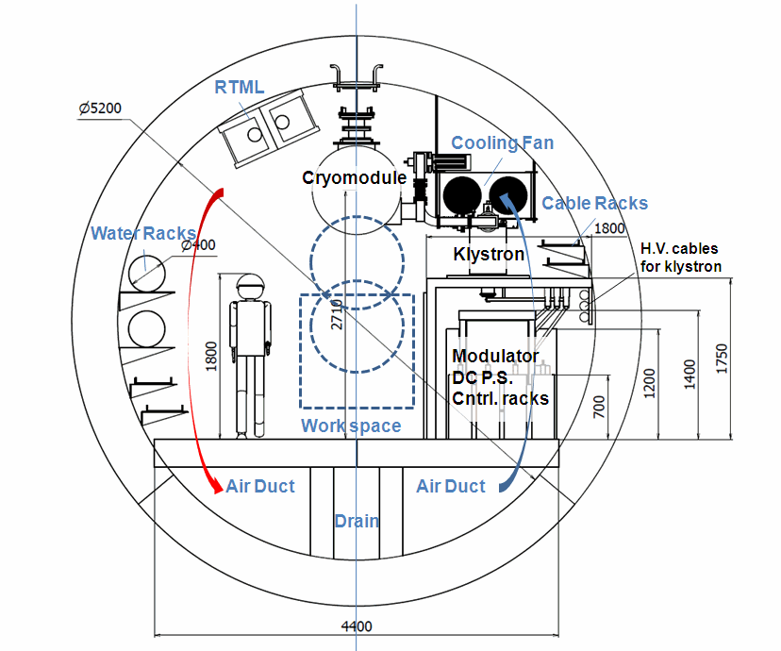
Regional / RF Power differences:
‘Distributed RF Scheme’
Current ML DRFS Tunnel Cross Sections
Americas Region 5.2 m Dia.
Asian Region 5.2 m Dia.

Slide 28
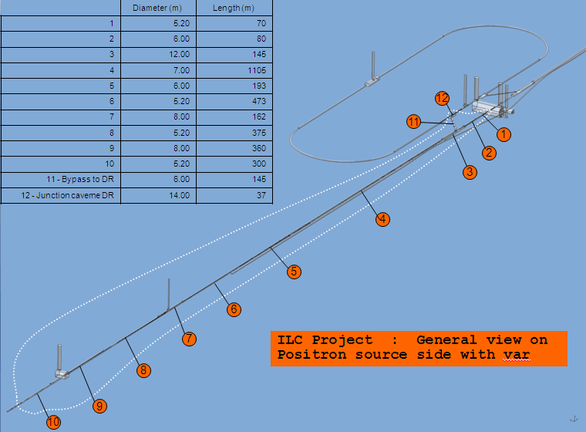
Central Region Design – 3D (1)
3D Examples
Of Central
Region Layout

Slide 29
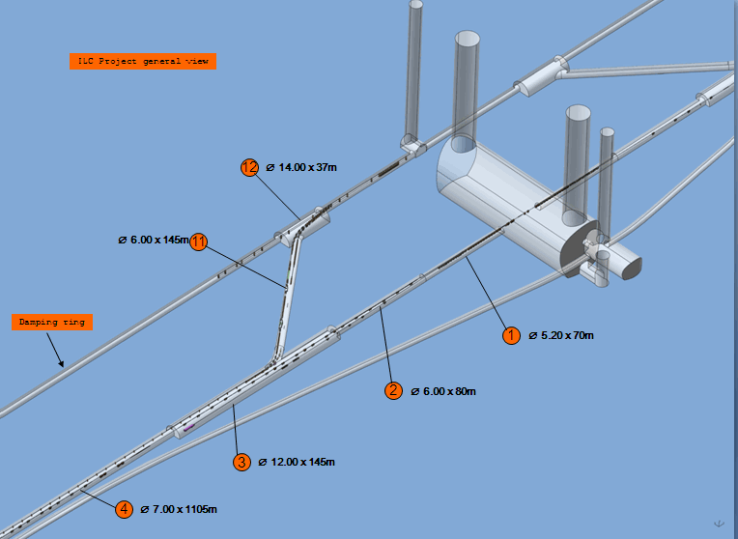
Central Region Design – 3D (2)
3D Examples
Of Central
Region Layout

Slide 30
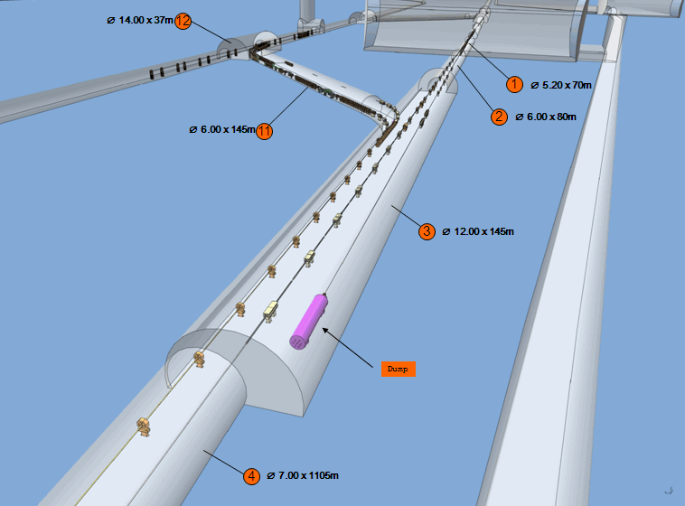
Central Region Design – 3D (3)
3D Examples
Of Central
Region Layout

Slide 31
ILC R & D - 2010
Superconducting RF
Conventional Facilities / Siting
Beam Test Facilities: CESR TA / ATF2
  Develop and prove Electron Cloud models
  Demonstrate vacuum chamber technology and related instrumentation
  Develop integrated ILC DR design
Integrated Design: AD & I

Slide 32
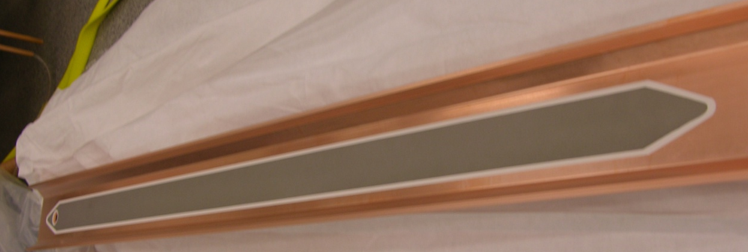
CESR Test Accelerator Status
  Reconfiguration as a damping ring completed in late 2008
    Operation with bunch spacings as short as 4ns and with both positrons and electrons
    Key instrumentation: upgraded turn-by-turn BPM system and high resolution x-ray beam size monitors for both beams – ring-wide digital BPM system and 2nd x-ray monitor online at end of 2009
    Vertical Emittance target of 20pm by conclusion of program – measured vertical emittance at end of 2009. Major effort aimed at taking full advantage of precision instrumentation in 2010.
  Installation of 4 planned electron cloud experimental regions completed in mid-2009
    Test region1: Wiggler straight with instrumented drifts and wigglers. Cu, TiN, and grooved surface mitigations tested to date - wiggler with clearing electrode presently being prepared for deployment
    Test regions 2&3 : Arc sections have instrumented versions of standard CESR chambers (dipole and drift; Al and Cu surfaces) as well as 2 dedicated locations for EC mitigation tests/comparisons - presently carrying out comparison tests of chambers with TiN and amorphous carbon coatings.
    Test region 4: PEP-II chicane, instrumented quadrupole chamber, and in situ SEY station. Al, TiN and grooved surfaces compared. NEG test chamber presently being prepared
    for deployment in early April.
  Ring EC instrumentation includes
    Segmented retarding field analyzers
    Shielded pickups for time-resolved measurements
    Microwave transmission experiments
    In Situ SEY measurement station
Contributing Institutes:
ANL
BNL
Cal Poly
CERN
  Cockroft Institute
  FNAL
  INFN-Frascati
  KEK
  LBNL
  Purdue
  SLAC
  Technion-Haifa
Wiggler clearing electrode after
shipment from KEK to LBNL

Slide 33
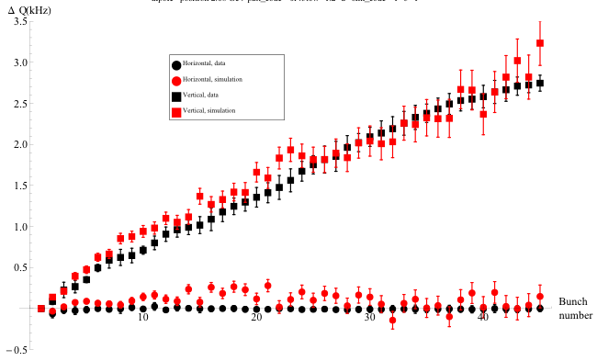
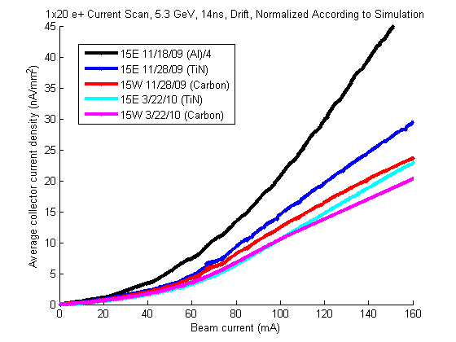
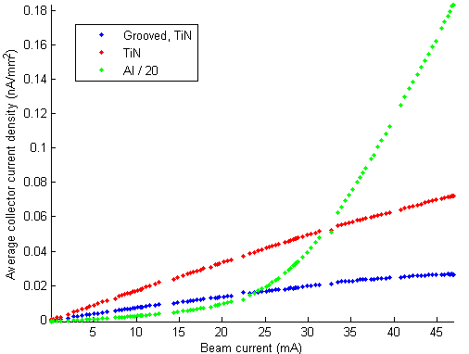
CESRTA Electron Cloud
Simulation effort – geared to detailed tests in
CESRTA followed by application to DR:
  Detailed 3D photon reflectivity model
    Important for both local and ring-wide measurements
    Key item for ILC DR evaluations
  RFA data-simulation comparisons to provide detailed model
  parameters (eg, PEY & SEY values)
  Ring-wide parameters via tune-shift data
  Studies of instability thresholds and incoherent emittance
  growth issues
COHERENT TUNE SHIFTS
Positrons, 45 bunches with 1.2×10¹⁰ particles/bunch
2.09 GeV, 2.6 nm horiz. emittance, 14 ns bunch spacing
Upcoming Operations Plans:
Next run begins at the end of April
Additional running time planned for
July, September and December
Review of results at ECLOUD10 –
October 8-12 at Cornell
Black:data; red:POSINST
Mitigations
  Confirm that grooves are very effective in dipole and wiggler fields
  Some challenges for manufacture
  Amorphous C and TiN coatings show similar EC mitigation performance
  Both coatings show somewhat poorer vacuum performance (dP/dI) than Al chambers
  Additional comparisons being prepared
EC Mitigations in Dipole Field
Al (÷20) vs TiN vs TiN+Grooves
EC Mitigations in Drift
Al (÷4) vs TiN vs Amorphous C
15E vs 15W response
normalized using
simulation
(different γ flux)
a-C

Slide 34
CESRTA – EC: Main Deliverables
Recommendation for the reduction of the ILC Positron Damping Ring Circumference
By March 2010
Recommendation for the baseline and alternate solutions for the electron cloud mitigation in various regions of the ILC Positron Damping Ring.
By Late 2010

Slide 35
ILC R & D - 2010
Superconducting RF
Conventional Facilities / Siting
Beam Test Facilities: CESR TA / ATF2
  Fast Kicker Studies: 30 bunch extraction successful
    jitter stability about 0.1% ILC goal
    Almost ready to deploy
  IP carbon wire scanner for initial optics tuning
  Recent results of ‘fringe monitor’ beam size measurements (see parallel session)
  Superconducting quadrupole final doublet studies
Integrated Design: AD & I

Slide 38
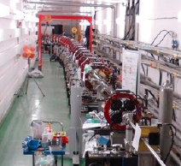
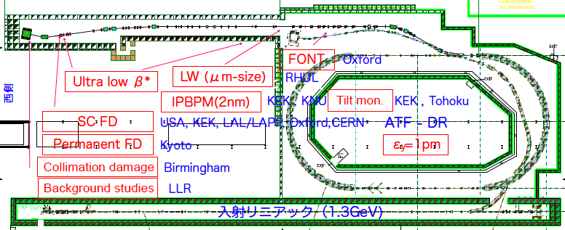
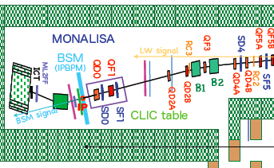
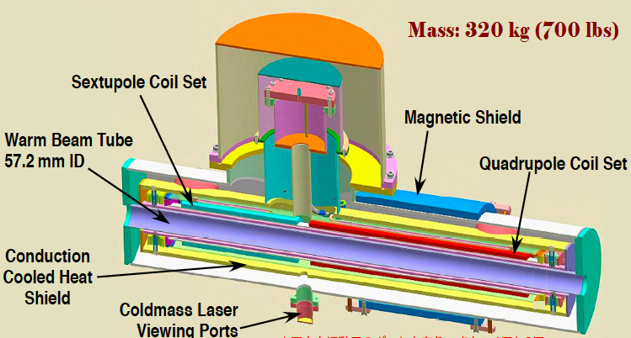
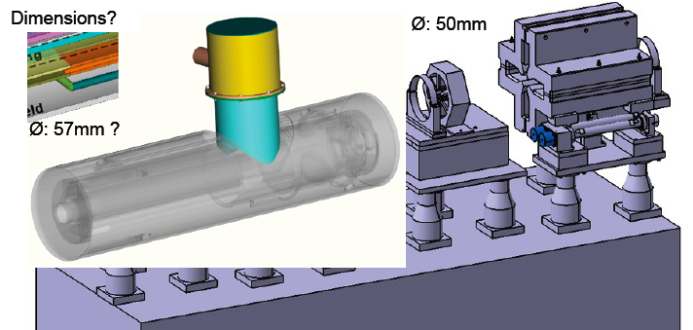
Final Focusing with SC Quadrupoles expected to be studied at ATF2
Proposed as a BNL-KEK collaboration prgram
Focusing stability of < 50 nano-meters to be achieved

Slide 39
ILC R & D - 2010
Superconducting RF
Conventional Facilities / Siting
Beam Test Facilities: CESR TA / ATF2
Integrated Design: AD & I
  EU XFEL will inform us: accurate SCRF production cost information → 04.2010
  ‘Performance Scope / Cost’ study: SB2009 allows flexible response – while maintaining RDR cost-constraint
    This is an all-inclusive, cumbersome, task
  Detector/Accelerator community participation

Slide 40
Lepton Colliders beyond LHC
Energy Frontier
“By far the easiest”: WHY? →
Proven International Basis –
necessary to make it
  Plug-compatibility / Industrial capability & support in each region
Demonstrated full beam intensity
Scalable energy →technology
Consistent Regional Siting schemes
Demonstrated key beam dynamics
Costed and cost-contained design
ILC
→ By far the easiest!
E < 1 TeV
LHC Results
CLIC
E > 1 TeV
Multi TeV
or
Muon Collider
Notes:
40
40

Slide 41
RDR → 2012 Technical Design
Strong Basis for SCRF technology in each ILC region
  Cavity fabrication and test: Each region
  Global Cryomodule: KEK +
Large scale Costed technology demonstration
  EU XFEL (5% of ILC); first beam mid-2014
Siting: adaptation to best suit potential hosts
Beam – based studies and demonstrations
  High power SCRF linac operation: DESY +
  Electron-cloud beam dynamics: Cornell +
  Beam delivery technology: KEK +
Notes:
Primary paths

