Slide 1

ILC Superconducting Final Doublet and the ATF2 Superconducting Magnet Upgrade ⁽Update⁾
Brett Parker*
BNL-SMD
*For BNL Superconducting Magnet Division and the ATF2 Superconducting Magnet Upgrade Collaboration

Slide 2
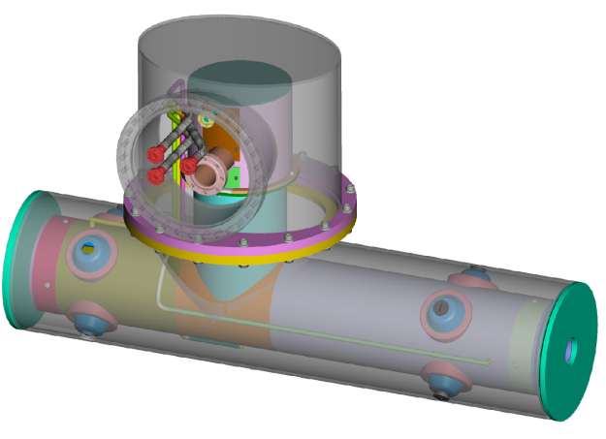
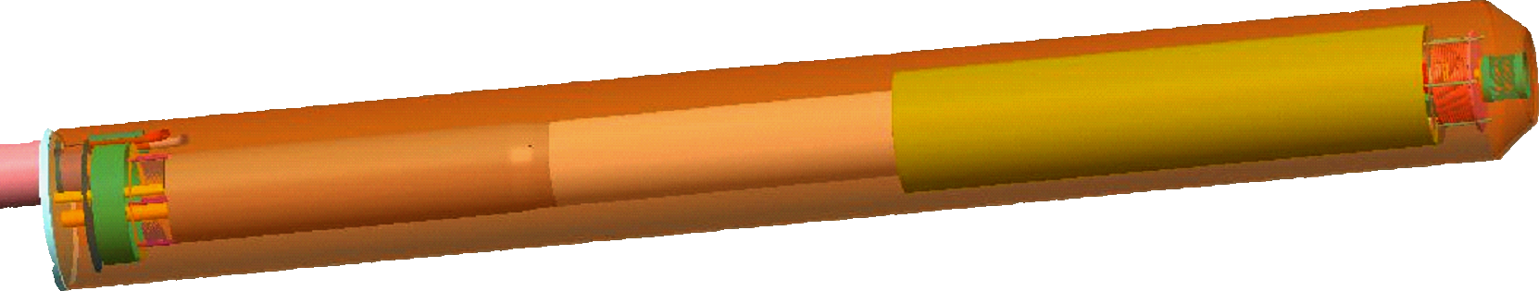
ILC R&D Prototype and ATF2 Comparison
Both are compatible with 1.9K testing via
an ILC-style Service Cryostat (SC) at BNL.
ATF2 magnet should be 4.2K tested at BNL
with SC and the ATF2 Cryogenic Box before
being shipped to KEK.
The ATF2 magnet can be tested with beam;
there is no way to beam test R&D prototype.
ATF2 Upgrade Magnet
(concept test with beam)
ILC QD0 Full-Length R&D Prototype Magnet Program
(a full-scale, instrumented, 1.9K ILC SC, systems test)

Slide 3
ATF2 Superconducting upgrade status update

Slide 4
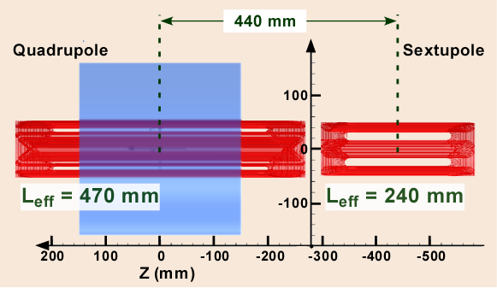
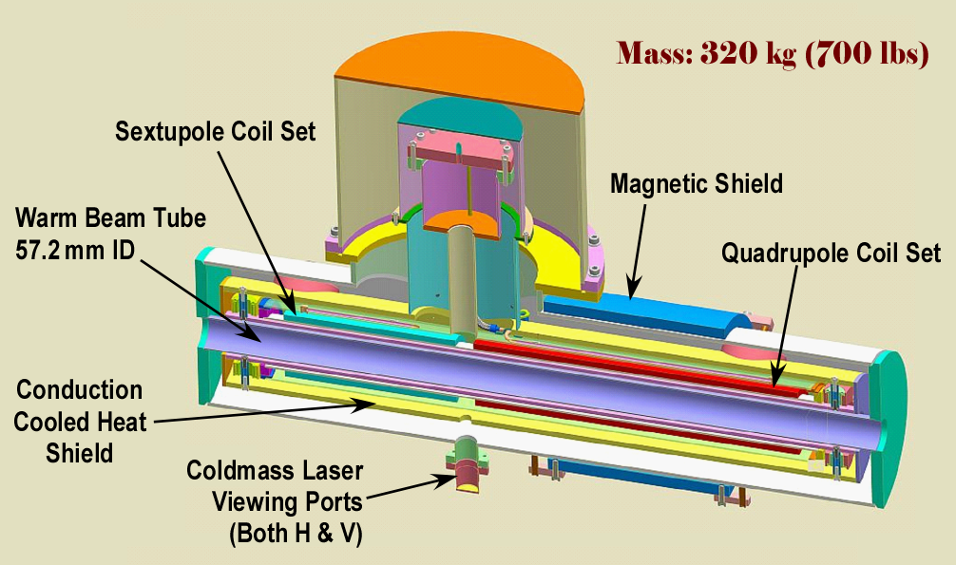
ATF2 Upgrade Production/Design Status
Main coil winding now complete.
Measured harmonics are small.
A first pass cryogenic interface made at ‘09 face-to-face meeting.
Magnetic shielding calculations (homework) done; results indicate we can make both Hor./Vert. laser penetrations (through the quad’s magnetic shield) at the center of each magnet coil without spoiling their good harmonics and still ensuring sufficiently low B-field at the external geophone locations.

Slide 5
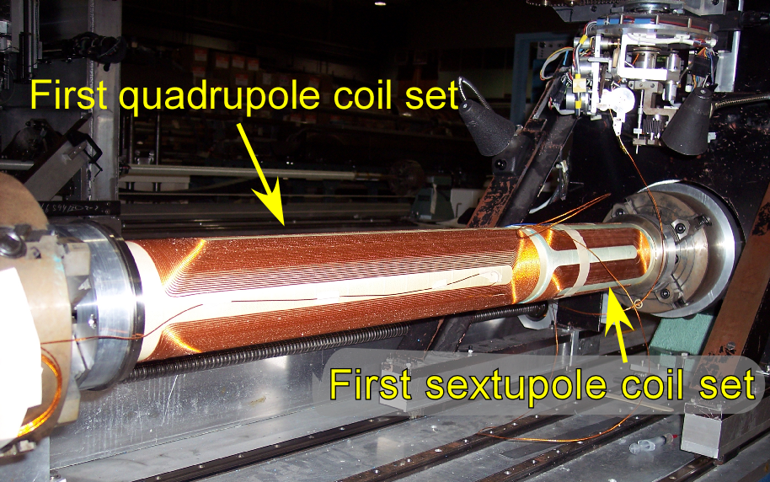
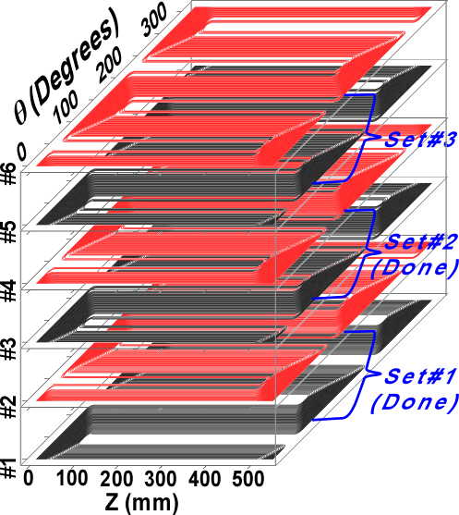
ATF2 Coil Winding Overview
Winding of the main quadrupole (six layers) and sextupole (four layers) coils now complete.
Production measurement results for field harmonics are consistent with our understanding of the requirements for future ATF2 “pushed β* optics” studies.
In order to keep to a “2012 delivery schedule,” we do need to start winding corrector layers soon (have resource conflict with QD0 long-coil winding).
Under the most aggressive delivery schedule, we would want to vertically cold test later this year (also resources).
All 3 coil sets now complete

Slide 6
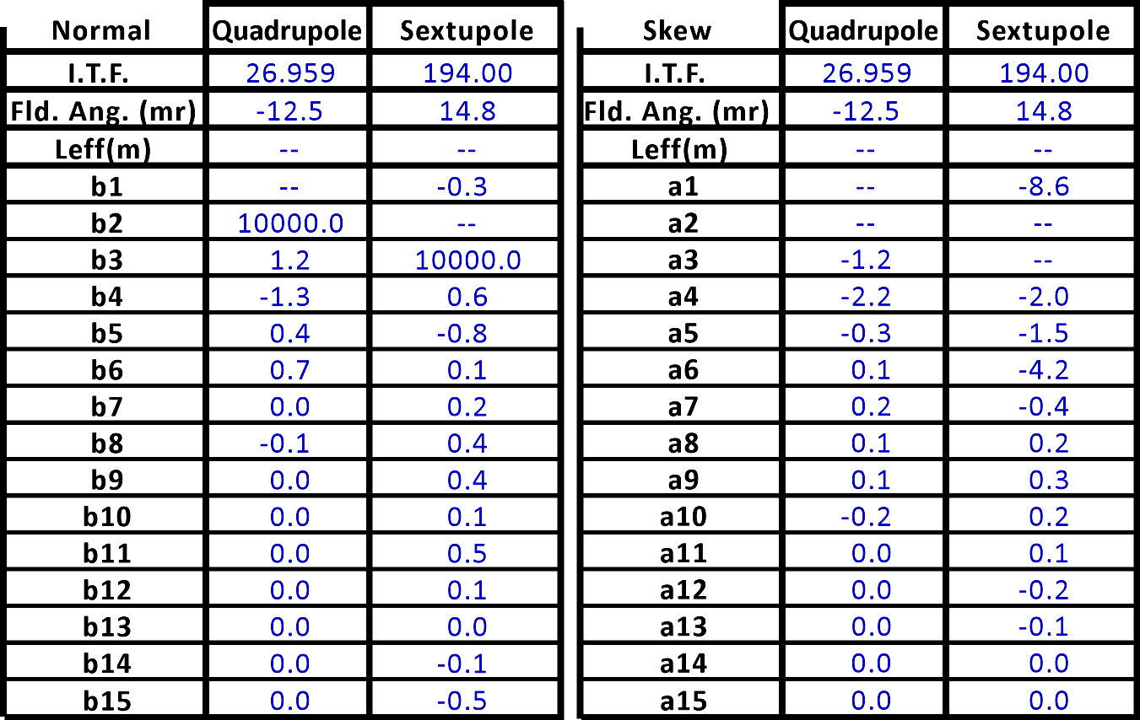
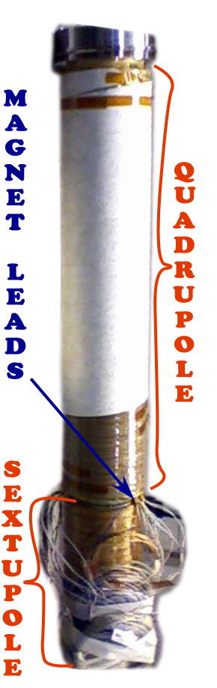
Summary of Integral Field Quality in ATF2 Magnet
ATF2 Coils
Harmonics are in "Units" of 10⁻⁴ of the main field at 25 mm as seen from the lead ends of respective magnets (yielding opposite sign of field angle in the two magnets). I.T.F for Quadrupole is in T/kA; ITF for Sextupole is in T/m/kA (Integral of B" in sextupole is two times the value reported for the I.T.F).

Slide 7
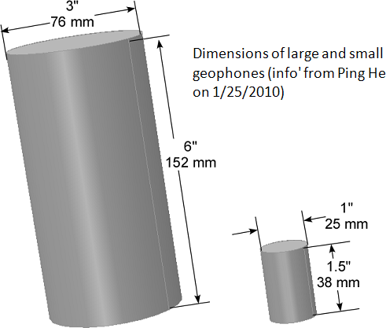
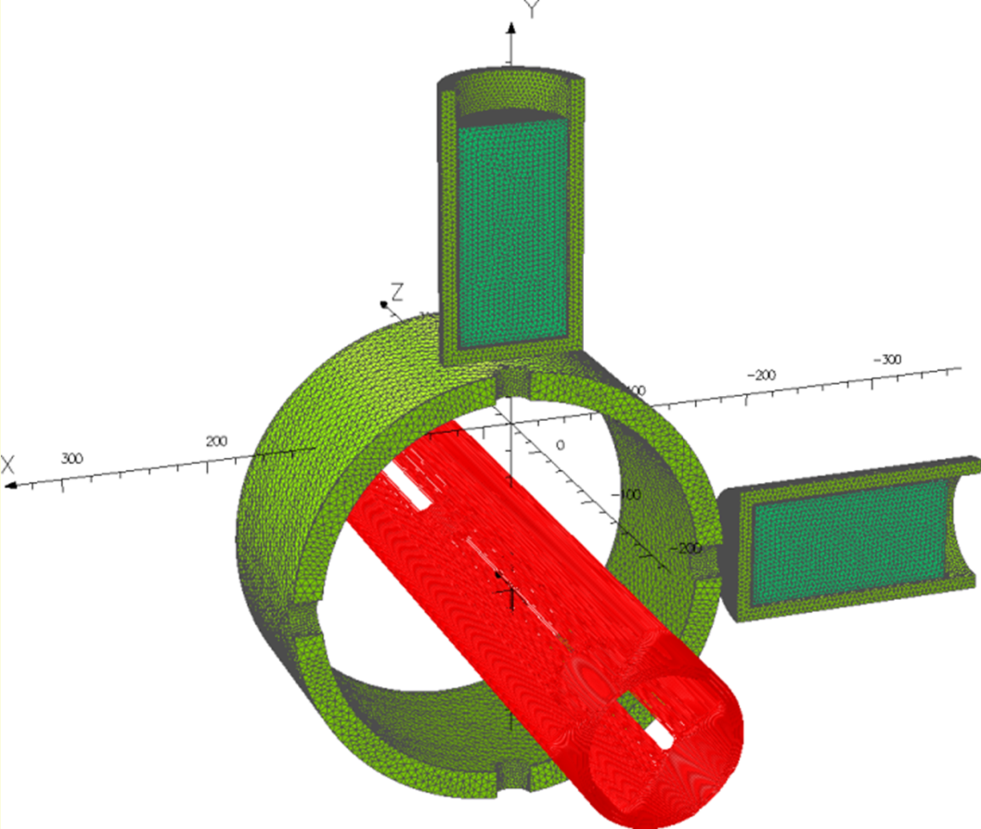
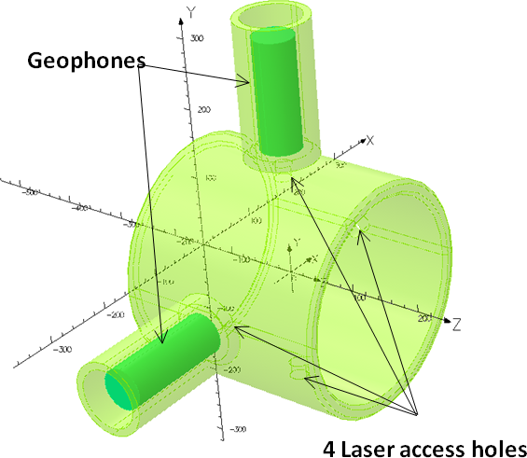
Laser View Port & Geophone Status
Our largest and
most sensitive geophones
Only two holes are needed for the laser access but we make four holes to keep quad’ symmetry.
At R_{ref} = 25mm, the harmonics change by less than 0.1 unit.
External field is low enough, even for our largest geophone.
Passive shielding still works even with 25 mm ID holes!

Slide 8
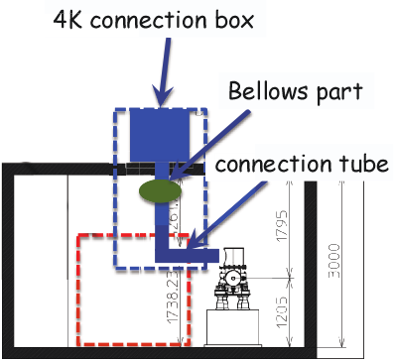
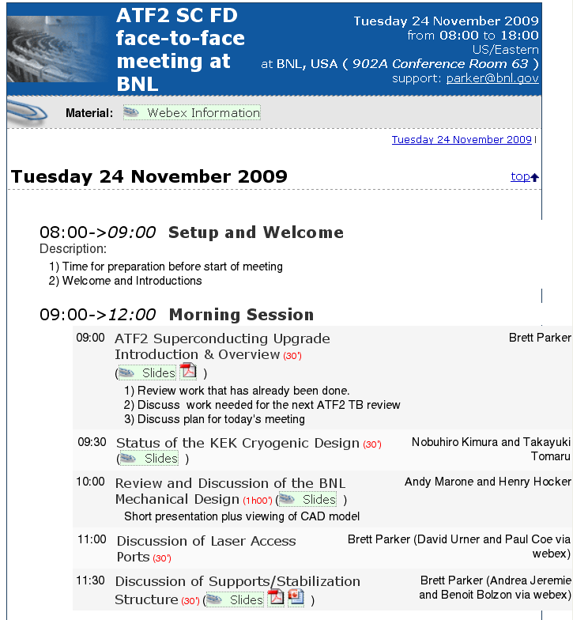
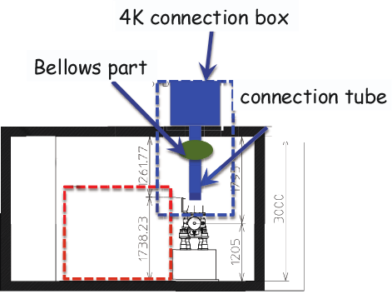
Cryogenics Interface Update
ATF2 Option 1
Our last meeting at BNL
ATF2 Option 2
(now the preferred
option)
Face-to-face meeting at BNL was very productive; do we need to schedule a new meeting? At KEK?

Slide 9
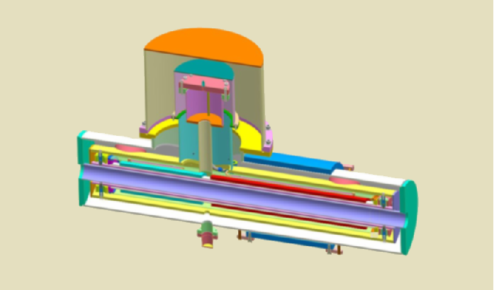
A Superconducting Magnet Upgrade of the ATF2 Final Focus: Collaboration List
Michael Anerella, John Escallier, Ping He, Animesh Jain, Andrew Marone, Brett Parker, Peter Wanderer, and Kuo-Chen Wu (BNL), Rogelio Tomas Garcia, Claude Hauviller, Eduardo Marin Lacoma and Frank Zimmermann (CERN), Nobuhiro Kimura, Kiyoshi Kubo, Tatsuya Kume, Shigeru Kuroda, Toshiyuki Okugi, Junji Urakawa, Toshiaki Tauchi, Nobuhiro Terunuma, Takayuki Tomaru, Kiyosumi Tsuchiya and Akira Yamamoto (KEK), Philip Bambade (LAL), Andrea Jeremie and Benoit Bolzon (LAPP), Paul Coe and David Urner (Oxford University), Andrei Seryi, Cherrill Spencer, and Glen White (SLAC)
Co-Spokesmen: Brett Parker (BNL), Andrei Seryi (SLAC)
and Toshiaki Tauchi (KEK)

Slide 10
ATF2 Upgrade Current Status
Recently the ATF2 Superconducting Magnet Upgrade Collaboration has grown considerably* and significant progress has been made (esp. during the 2009 face-to-face meeting).
Never-the-less BNL’s ATF2 effort is paused (waiting to wind corrector layers) so that we can concentrate more fully on the QD0 R&D Prototype.
The Service Cryostat design and production work supports both ATF2 and the R&D prototype.
We do look for feedback re. Japanese funding projections for upgrade cryogenic infrastructure.
*Please contact me if you want to join the collaboration (or possibly just the mailing list).

Slide 11
ILC QD0 r&D prototype (long coil) status update

Slide 12
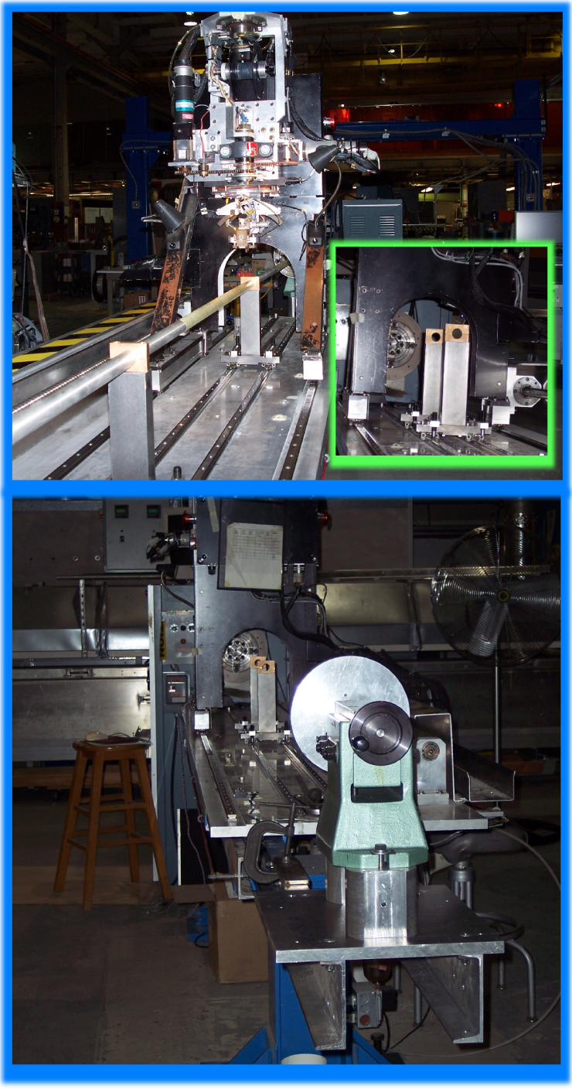
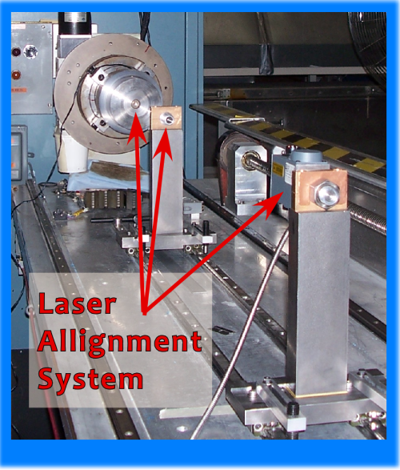
ILC QD0 R&D Prototype Long Coil Winding Challenges
We did not adequately control the coil support tube position (even with orthogonal machine-controlled rolling supports). Our first R&D coils had substantial harmonic errors.
We have therefore decided to go back to using a few fixed, rigid supports and have made modifications (shown here) to the ATF2
short coil winding machine.
We extended the machine & carefully positioned fixed supports between the coils.
The 2.2 m long QD0 R&D coil will be wound in two sections on a common tube.

Slide 13
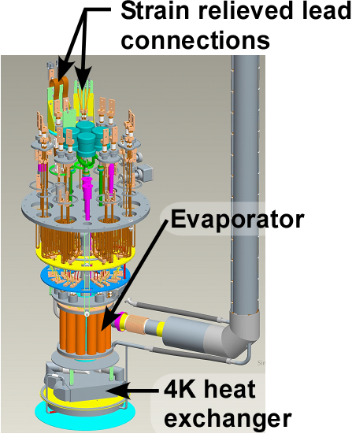
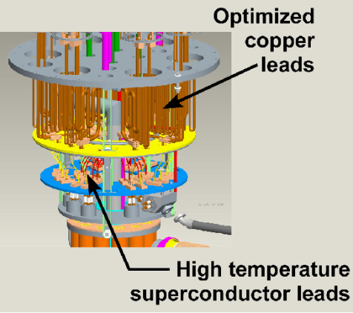
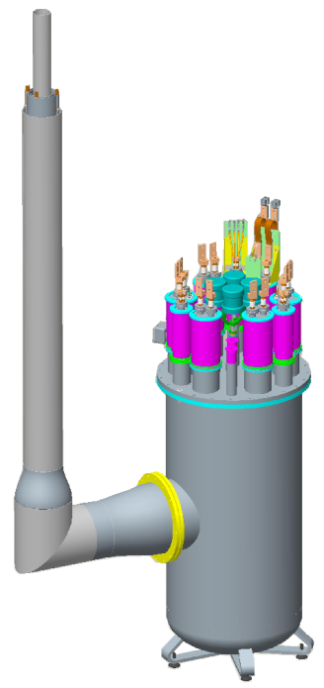
Service Cryostat & Other ILC Activities at BNL
SC design features for ATF2 mode nearly finished.
Detailed drawings for SC and QD0 now underway.
SC and QD0 long lead time items are identified (initiate critical orders).
For MDI, look to restart work on QF1 cryostat and the cryogenic transfer lines.
Demonstrate ILC-like FF magnet system production and operation.
Common ILC/CLIC work.
Service Cryostat Under Construction at BNL
Develop option that allows for ILC-like 1.9K tests at BNL and 4.2K operation at ATF2 (KEK) with cryo-coolers.

Slide 14
Backup slide

Slide 15
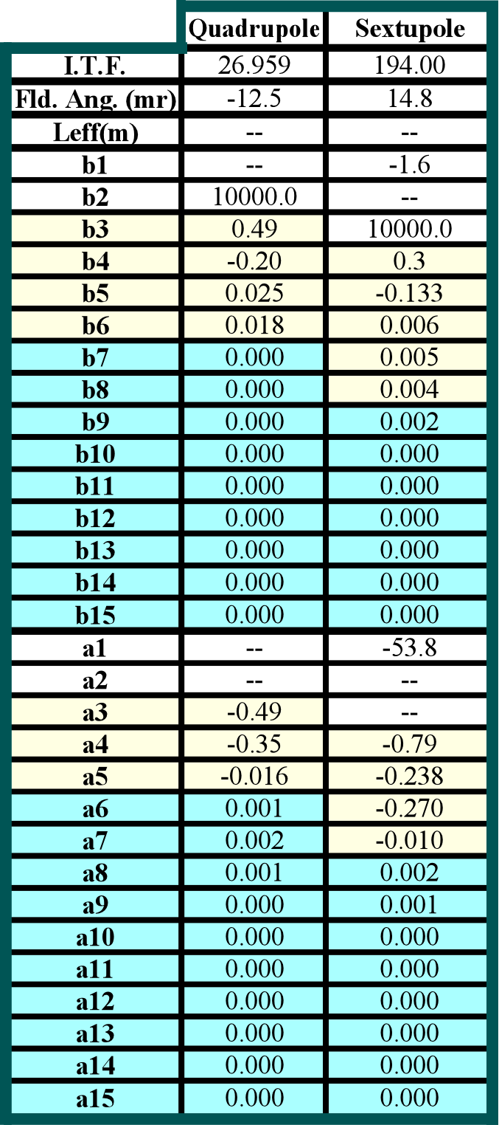
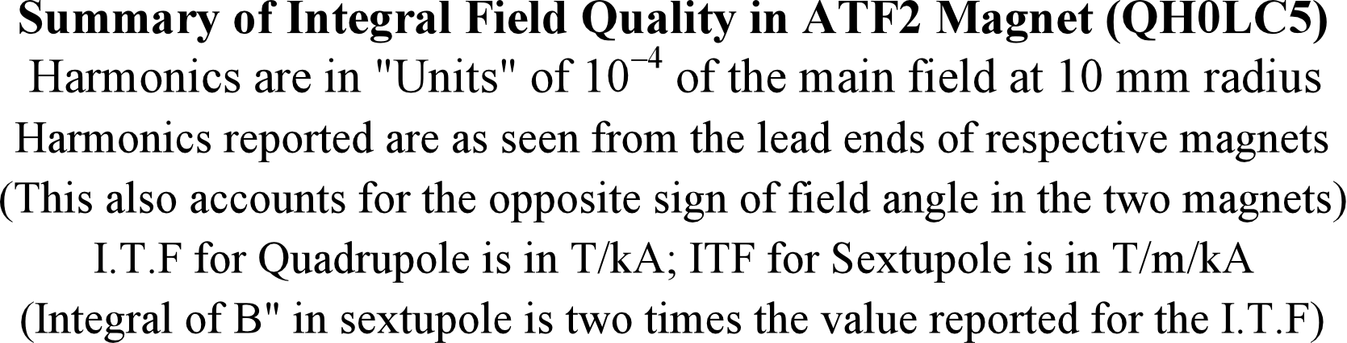
Summary of Integral Field Quality in ATF2 Magnet
Because field harmonics change rapidly with reference radius, we recalculated the measurements for R_{ref} = 10 mm (for easy comparison to the present ATF2 magnets).
The poorest quad harmonics (b3,a3), are now only 49. parts per million.
The areas highlighted in blue are all smaller than 200 parts per billion.

