Slide 1
NML - RF Unit Test Facility at Fermilab
Bob Kephart
March, 2010
(Acknowledgements: Jerry Leibfritz and Elvin Harms)

Slide 2
NML Project Overview
Overall Goals
  Build an RF Unit Test Facility at the New Muon Lab (NML)
    ILC RF Unit = 3 cryomodules
    10-MW RF system
    Beam with ILC parameters (3.2 nC/bunch @3 MHz, Up to 3000 bunches @ 5Hz, 300-μm rms bunch length)
  Build Test facilities for Project-X cryomodules
Phase-1 (FY07 – FY10)
  Prepare facility for testing first cryomodule (CM1) without beam
    Infrastructure, RF power, cryogenics (Tevatron satellite refrigerators #1 & #2)
    Install first cryomodule (CM1) and Capture Cavity-2 (CC2), cooldown, and RF test

Slide 3
NML Project Overview
Phase-2 (FY10 - FY11)
  Prepare for first beam
    Civil construction to expand facility (capability for 2 RF units)
    Move parts from FNPL photo-injector to NML
    Install new gun, injector, test beamlines, beam dump
    Install/test second cryomodule (CM2)
Phase-3 (FY11 – FY14)
  Complete RF Unit
    Upgrade RF system to 10 MW, install third cryomodule (CM3)
    Commission new Cryogenic Plant
    Operate full RF Unit with beam
    Begin installation of 2nd RF Unit

Slide 4
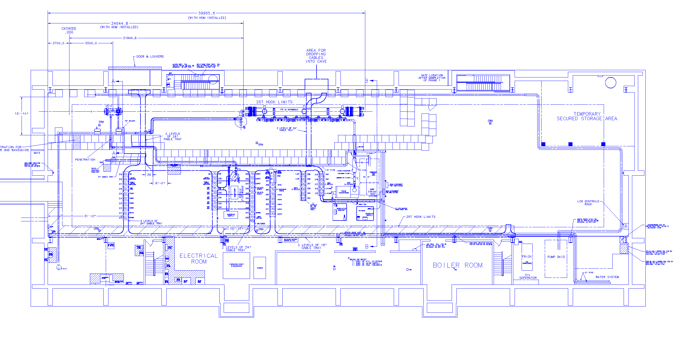
Phase-1 Layout of NML
Capture Cavity 2 (CC2)
Cryomodule-1 (CM1) (Type III+)
5 MW RF System for CM1
CC2 RF System
4

Slide 5
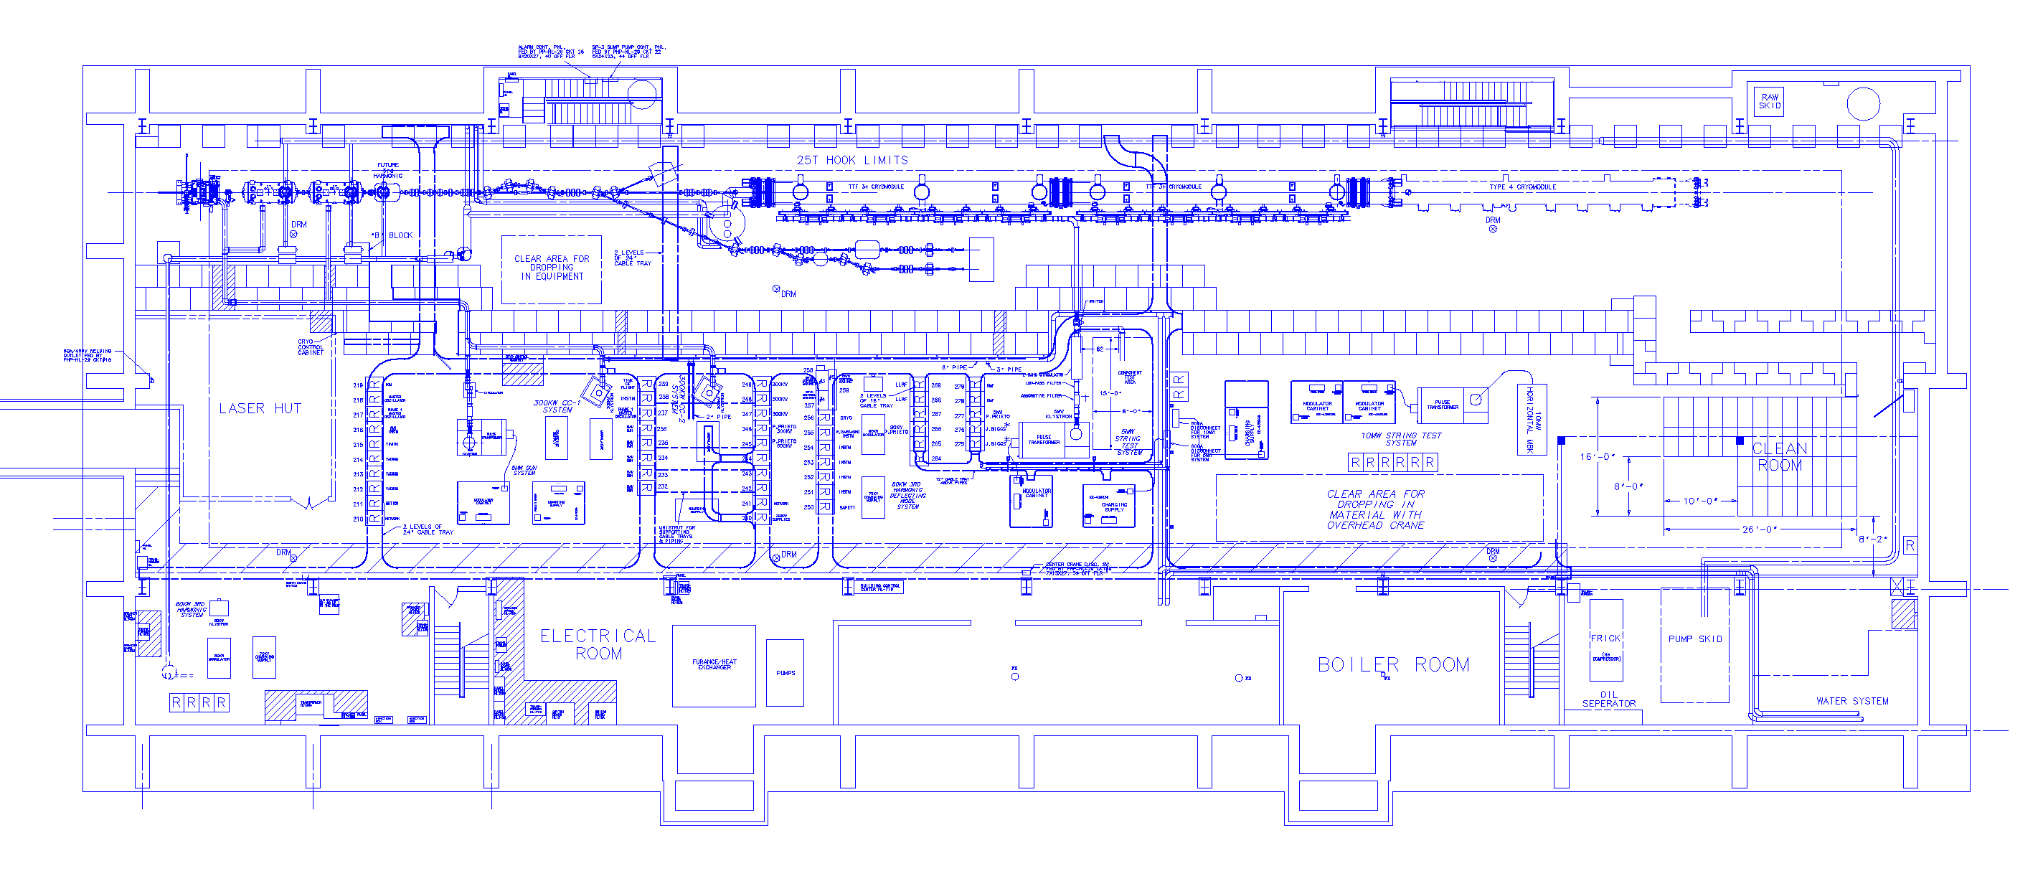
Phase 2/3 Layout of NML Building
Capture Cavity 1 (CC1)
Future 3.9/Crab Cavity Test Beamlines
Cryomodules
CC2
RF Gun
5MW RF System for Gun
CC1 & CC2 RF Systems
5MW RF System for Cryomodules
Future 10MW RF System
5

Slide 6
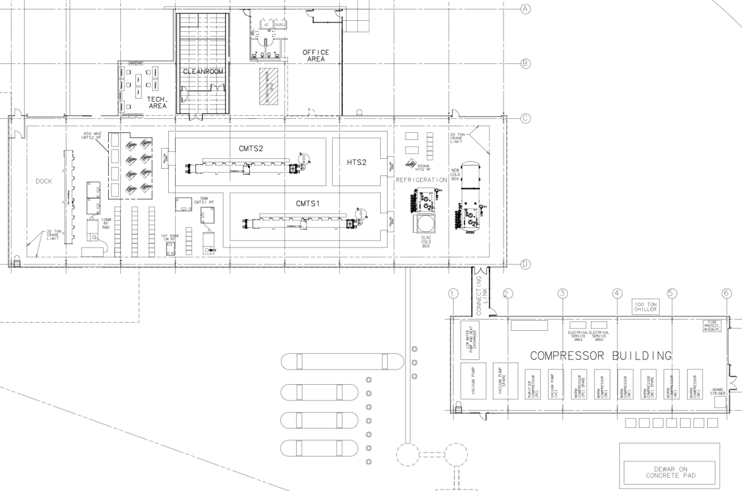
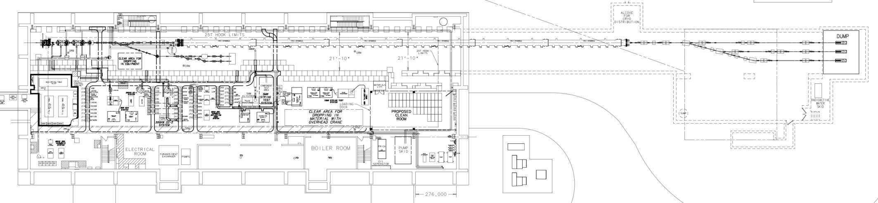
Expansion of NML Facility
New Cryoplant & CM Test Facility
(300 W Cryogenic Plant, Cryomodule Test Stands, 10 MW RF Test Area)
Funded by ARRA
New Underground Tunnel Expansion
(Space for 6 Cryomodules (2 RF Units), AARD Test Beam Lines)
Existing NML Building

Slide 7
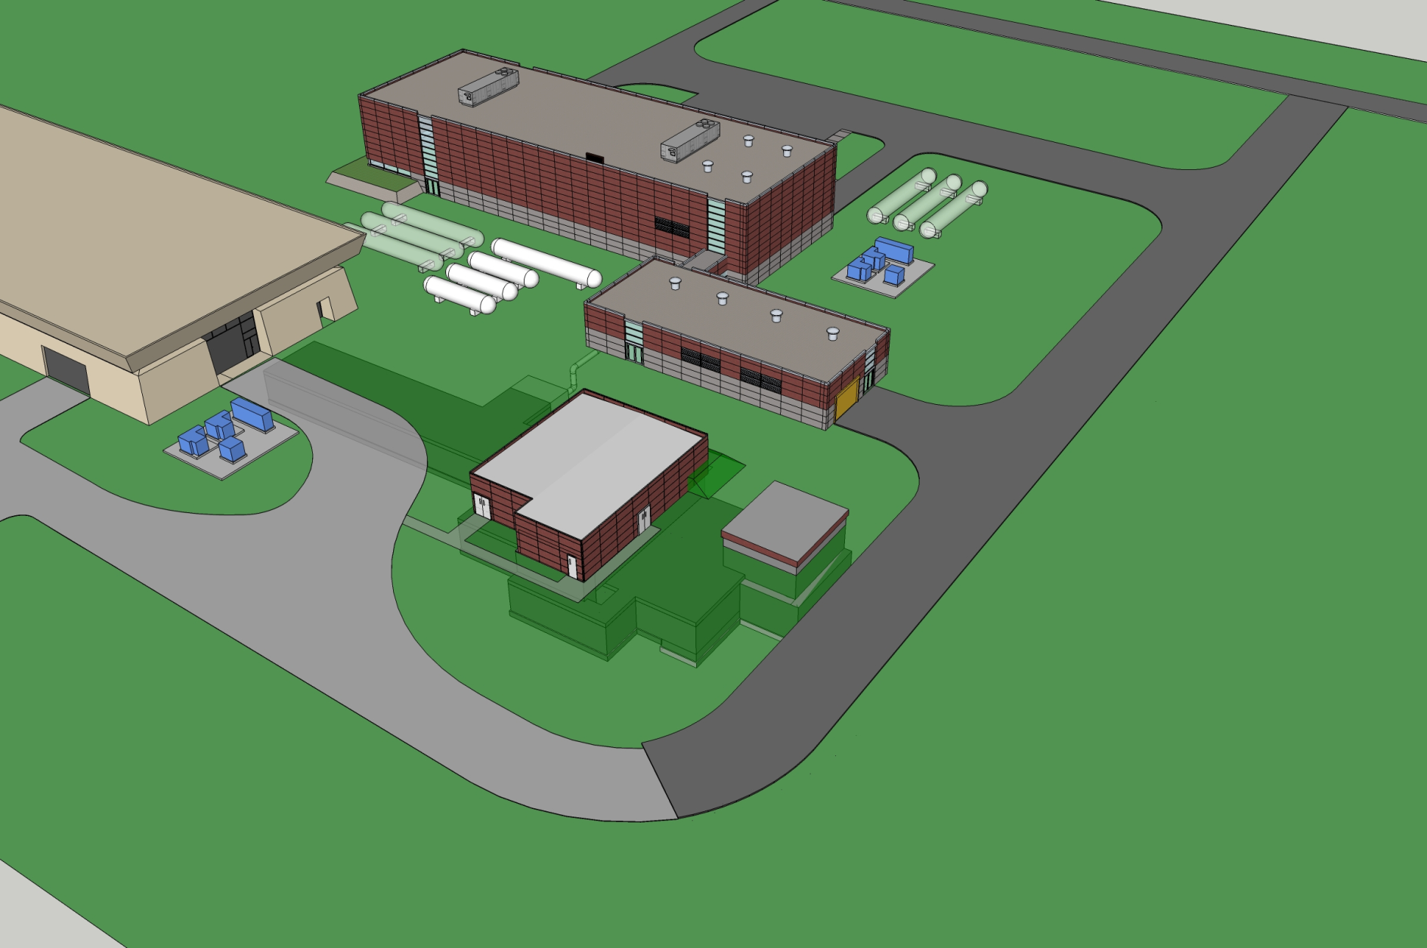
Future NML Complex

Slide 8
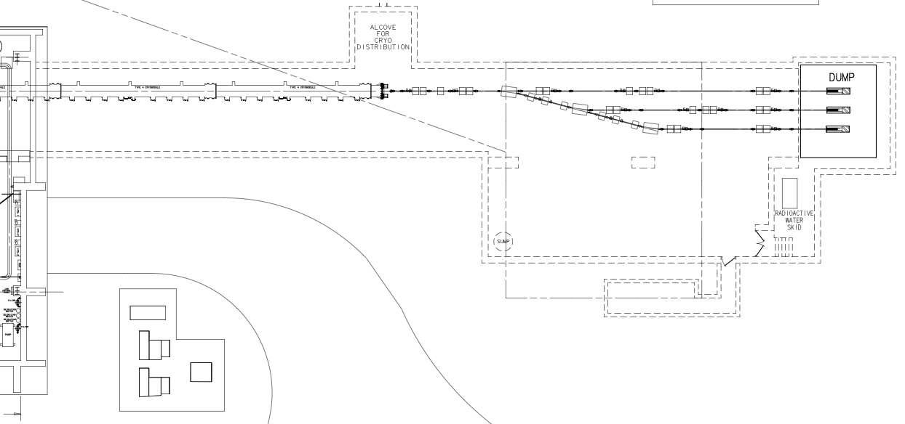
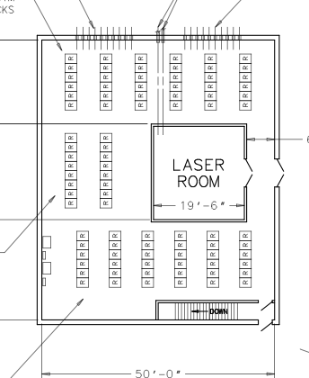
NML Expansion
Existing NML Building
Alcove for Cryoplant Tie-in
Test Beamlines/AARD Area
Beam Dump
CM5
CM6
Rack Room/Laser Lab
- Construction Began 3/10

Slide 9
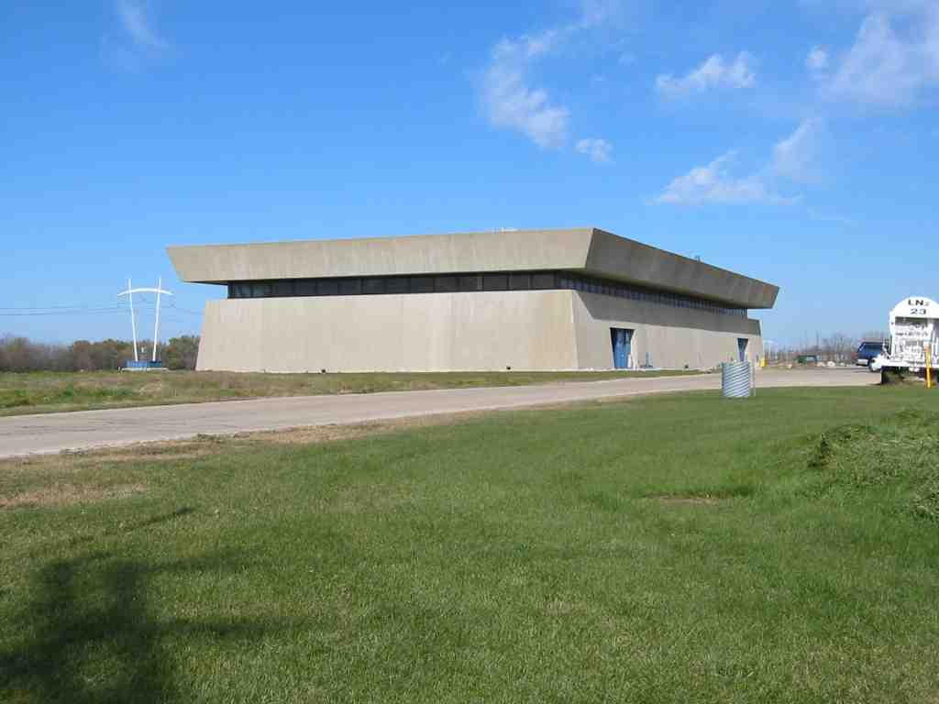
NML Technical Progress

Slide 10
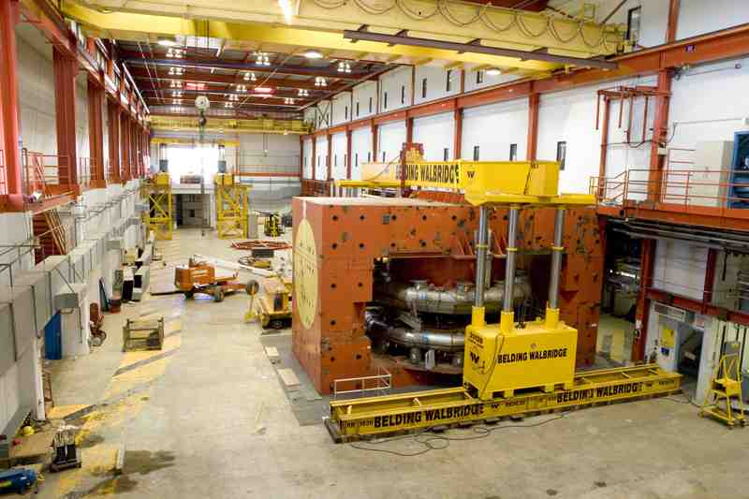
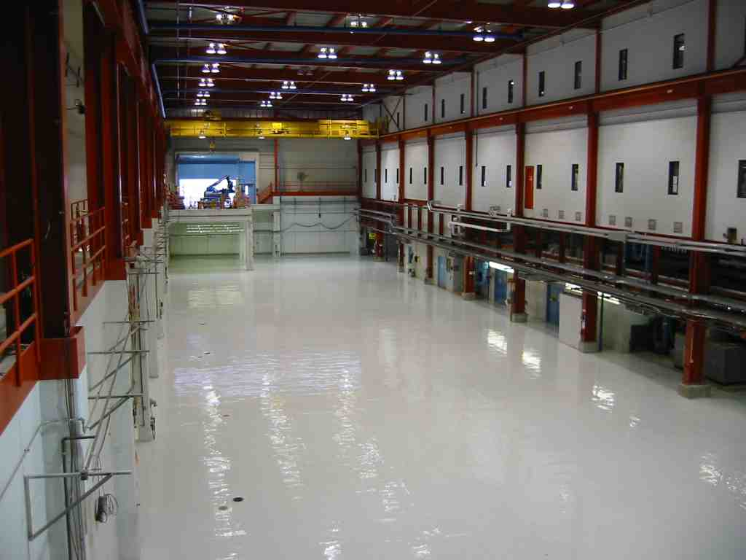
NML Infrastructure (FY07-08)
NML During Removal of Chicago Cyclotron Magnet(CCM) (September, 2006)
NML Facility after CCM Removal and Floor Painting (February, 2007)
Completed Removal of Chicago Cyclotron Magnet
Prepared Building Infrastructure
  AC power, network cabling, piping, cable tray, air ducts
  Cleaned out building, epoxy coated floor, alignment network
  Cave for Phase-1 (~3/4 of full cave), electrical racks
  Reused existing equipment (tray, racks, piping, shield blocks, gas storage tanks, cryo heat exchangers & refrigerator components)

Slide 11
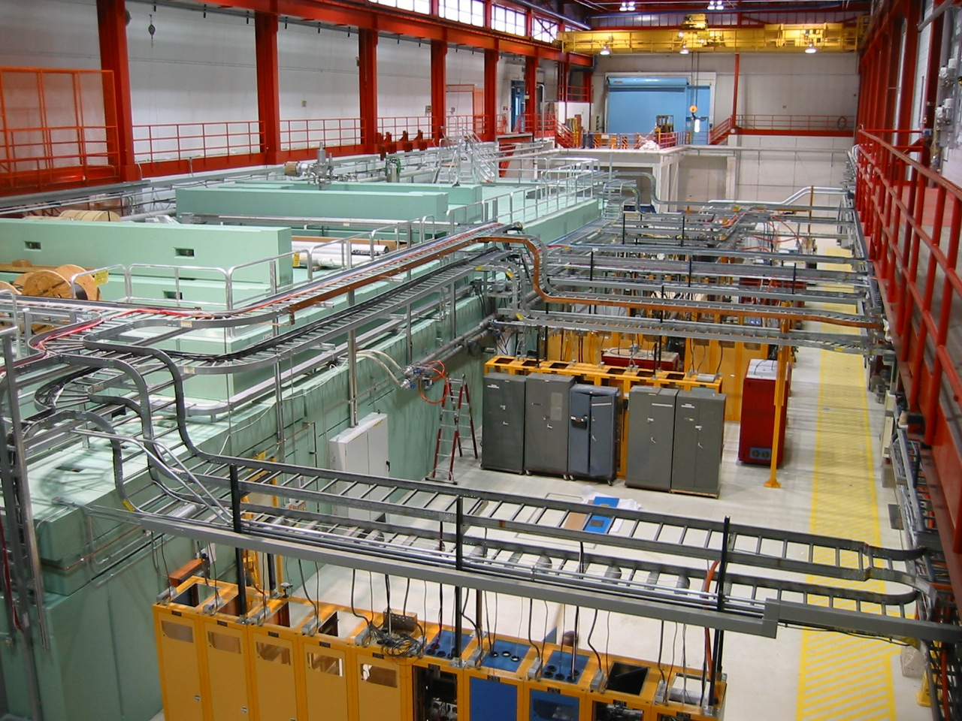
Recent Picture of NML Facility

Slide 12
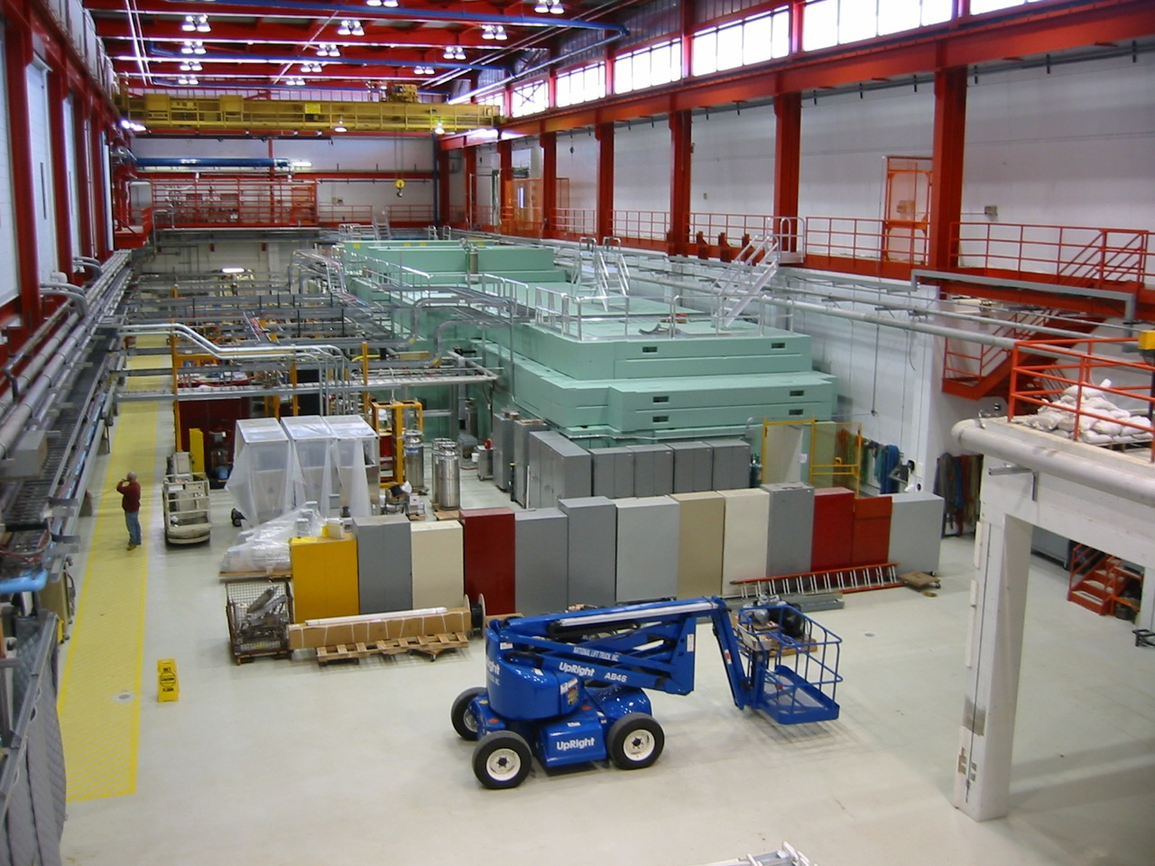
View From North

Slide 13
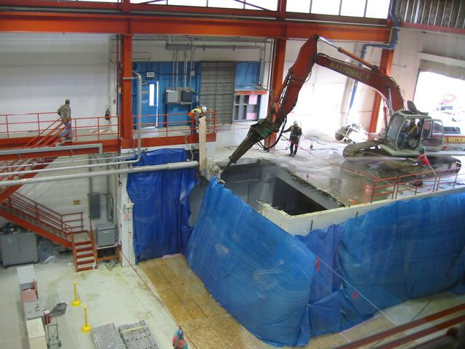
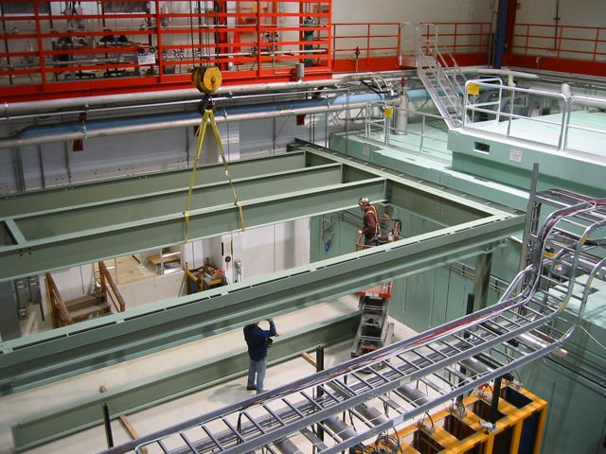
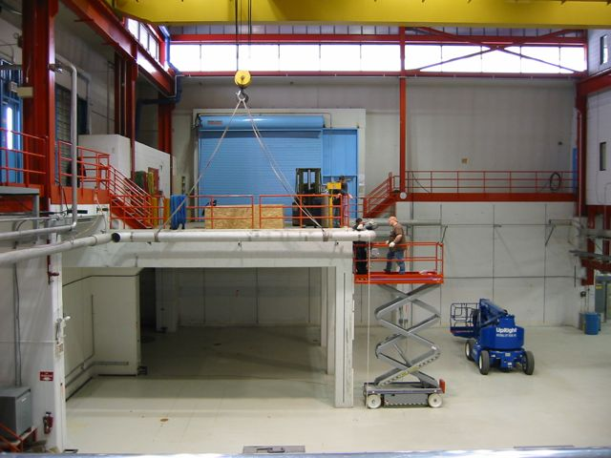
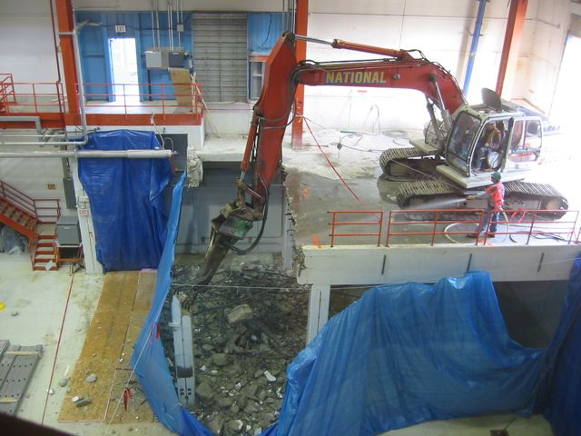
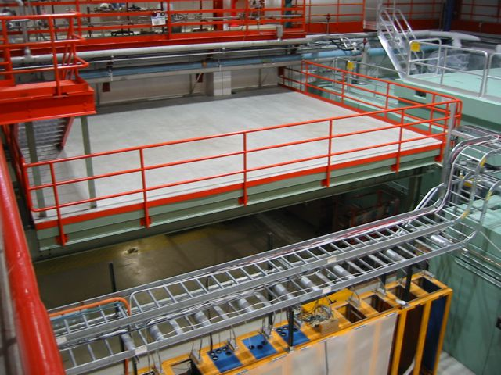
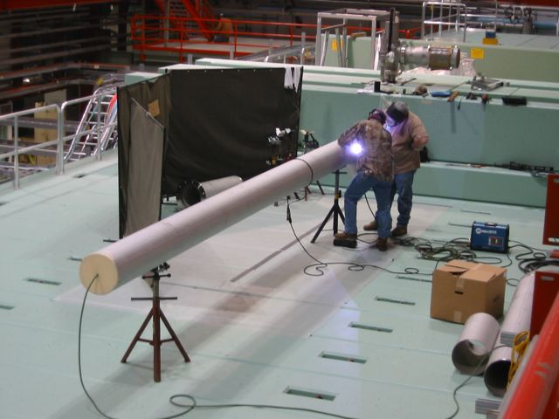
NML Expansion Construction
Loading Dock Demolition
Erection of Laser Deck
Cryo Pipe Installation

Slide 14
NML Cryogenic System
NML Cryogenic System Plan
  Start with two 625 W (4K) Tevatron satellite Refrigerators and large vacuum pump ( ~ 100 W at 1.8 K)
  Move 1500 W (4 K) BABAR refrigerator from SLAC
  Add new 300 W (1.8 K) refrigerator
Status
  Installed Refrigerator room & helium storage tanks
  Tevatron Satellite Refrigerator #1 operational - 8/07
  Tevatron Satellite Refrigerator #2 installed – 7/09
  Distribution system
    Feedbox, Feed Cap & End Cap installed
  Vacuum pump and Frick compressor
  Capture Cavity-2 (CC2) Cooled to 2K – 10/09
  Cryomodule-1 (CM1) Cool down to 2K – Spring, 2010

Slide 15
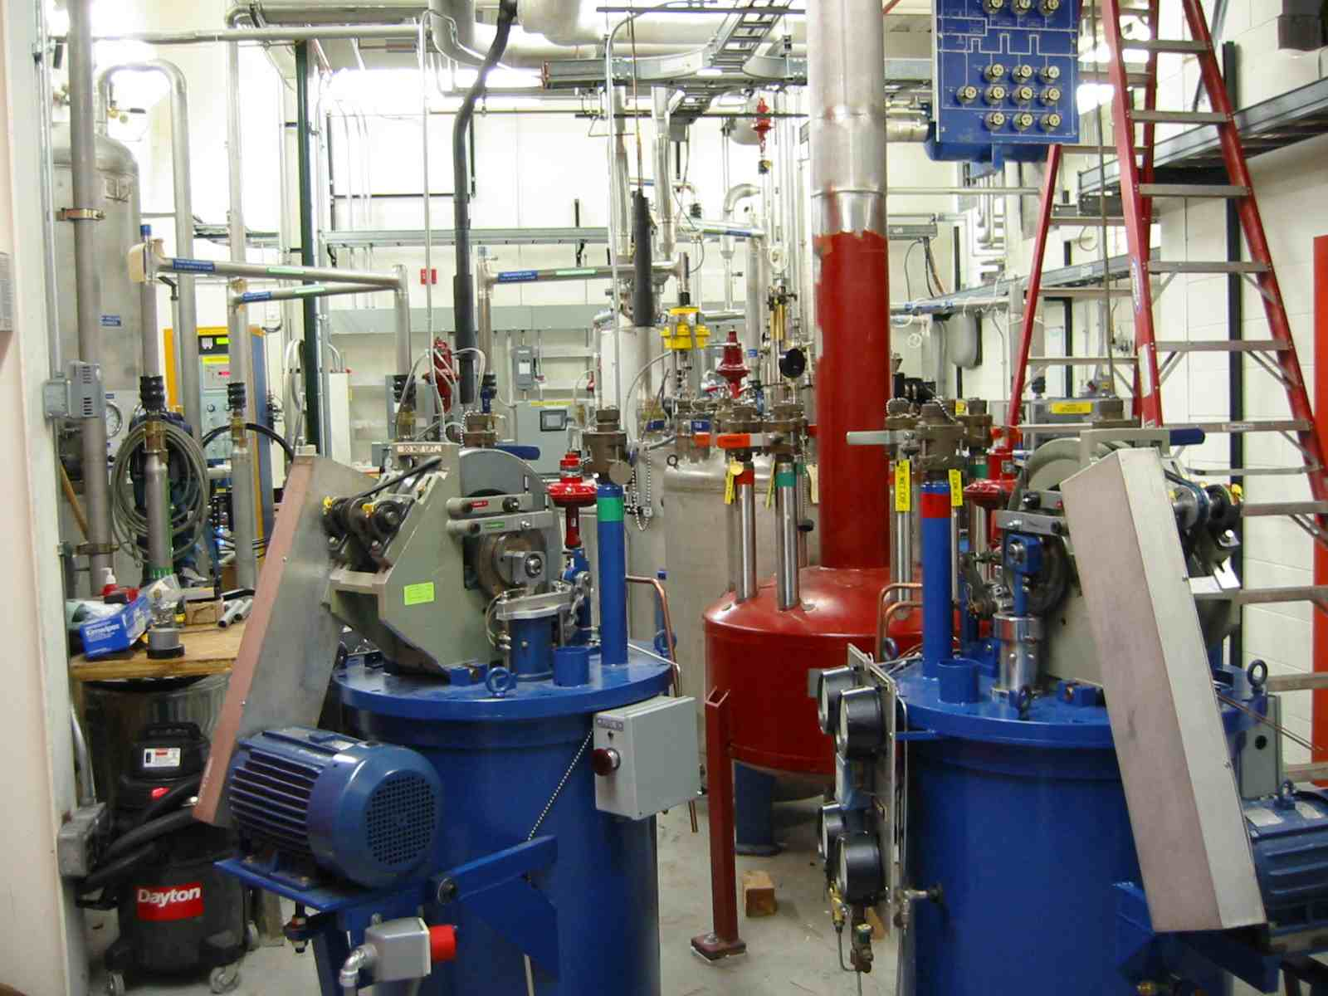
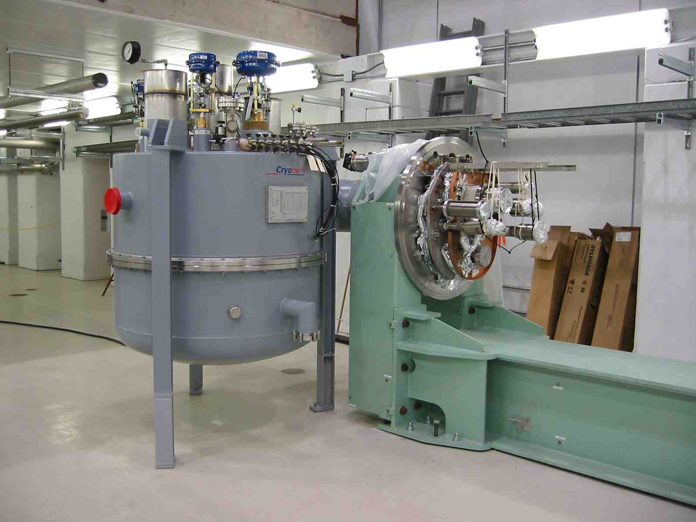
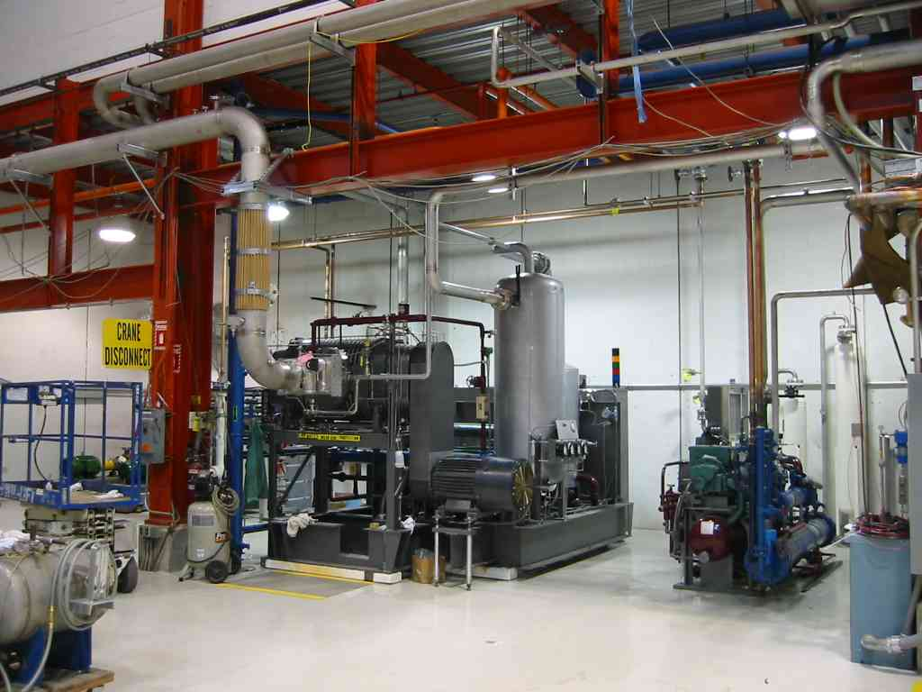
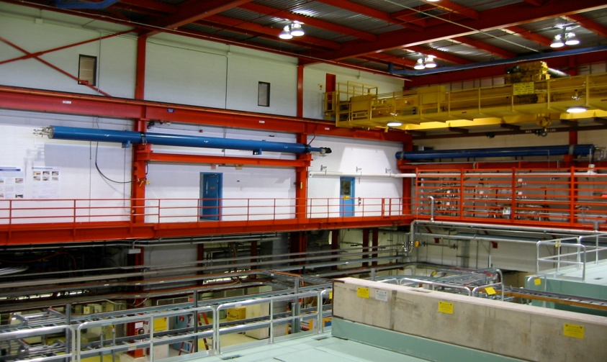
NML Cryogenic System
Refrigerator Room
Feedbox/Feedcap
Satellite Refrigerators
Cryo Vacuum Pump

Slide 16
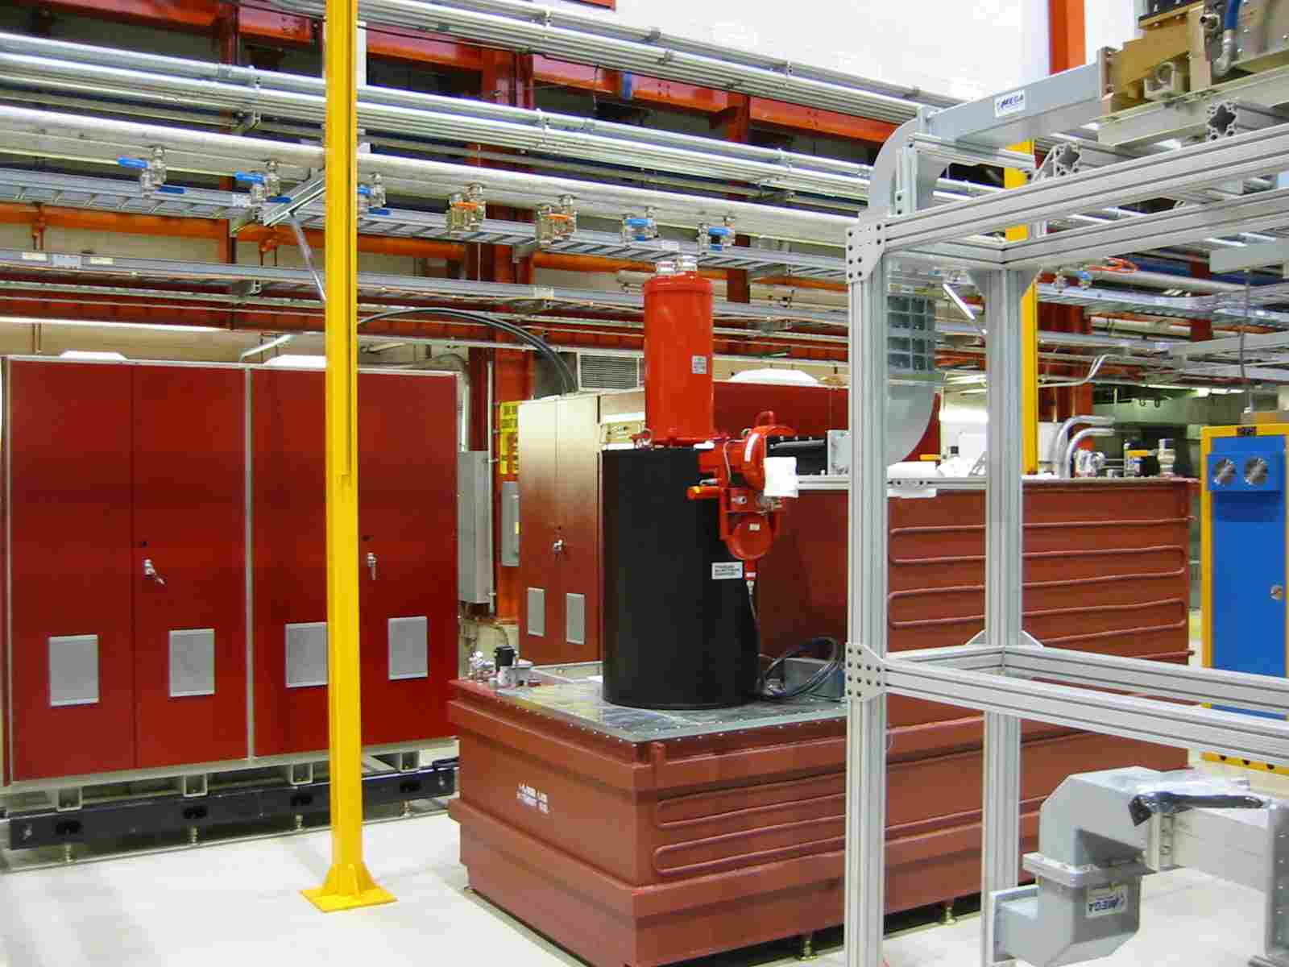
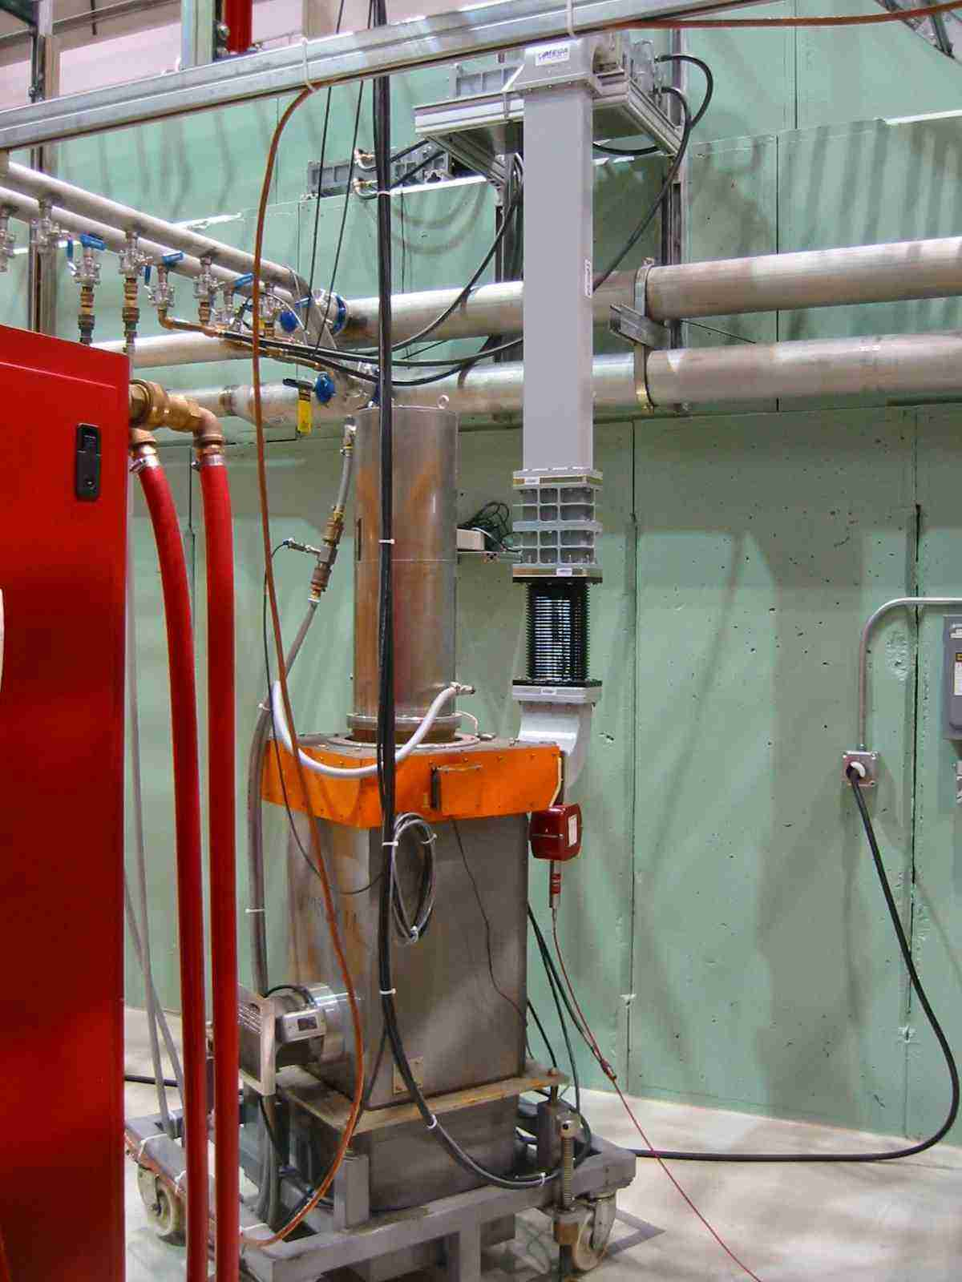
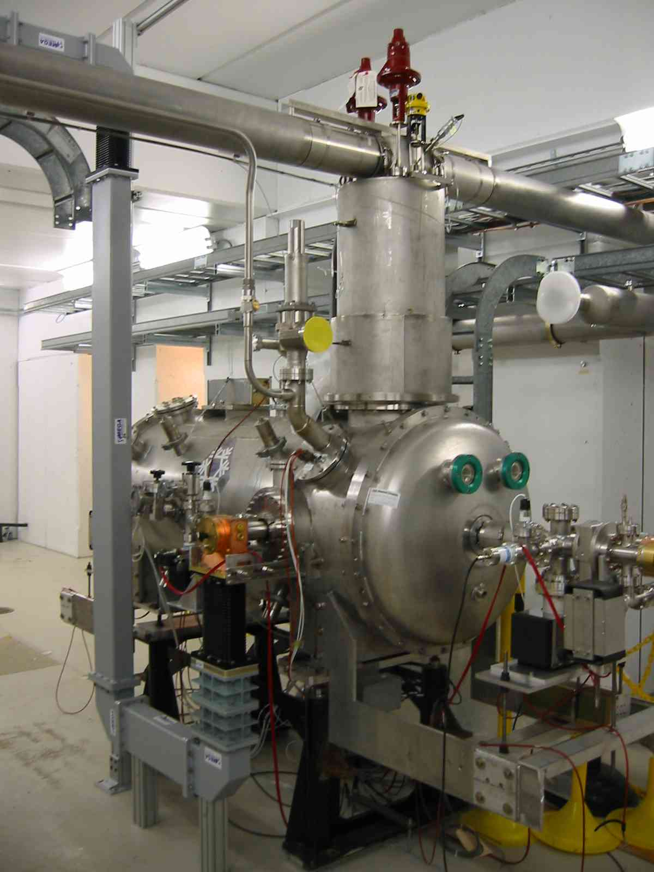
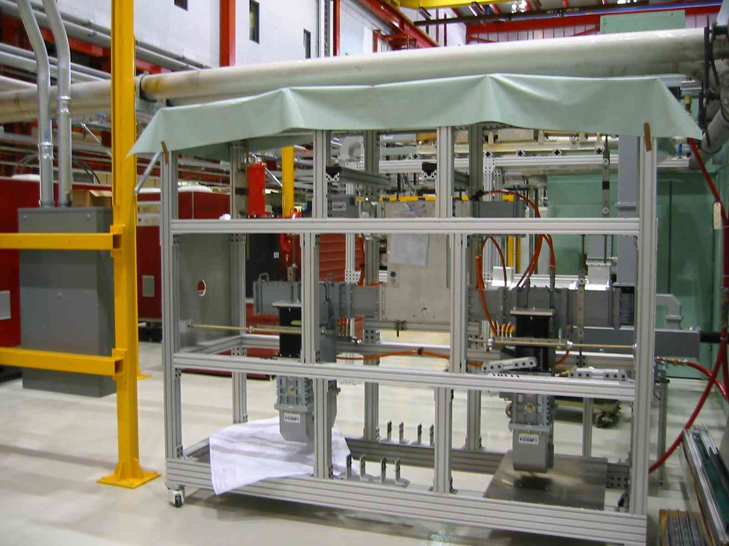
NML RF Systems
5 MW RF
Waveguide (SLAC)
300 KW RF
CC2 RF
RF System
  5 MW for CM1
    Commissioning underway
  300 KW for CC2
    Fully Operational
  Distribution
    CM1 distribution from SLAC (in-house)

Slide 17
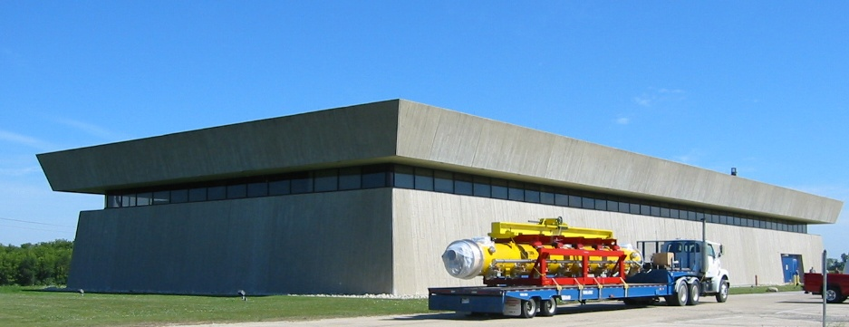
CM1 moving to NML

Slide 18
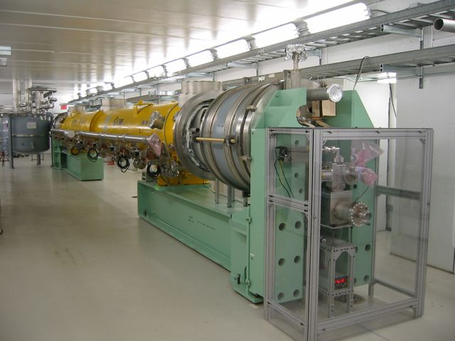
NML Accelerator
Injector
  Detailed Lattice designed
  New gun system being installed
    Collaboration with DESY, KEK & INFN
  CC2 (single 9-cell cavity) operational - 10/09
Accelerator
  CM1 installed, aligned, and under vacuum
Test Beamline
  Beamline layout complete
  Beam Absorber analysis complete

Slide 19
CC2 Operation At NML
Moved from MDB to NML – 2/09
Installation complete (vacuum, cryo., alignment) – 6/09
First warm RF powering – 6/09
Coupler conditioning complete – 7/09
CC2 operated at 2 Kelvin – 10/09
24 MV/m gradient (limited by Coupler PM Tube trips) – 2/10
  Similar to performance in MDB
Current Plans
  Operate at 4.5 K until construction allows resumption of 2K ops
    Studies of Low Level RF system and tuner, microphonics and Lorentz Force Detuning Compensation
  Resume 2K operation after construction, prior to CM1 cooldown

Slide 20
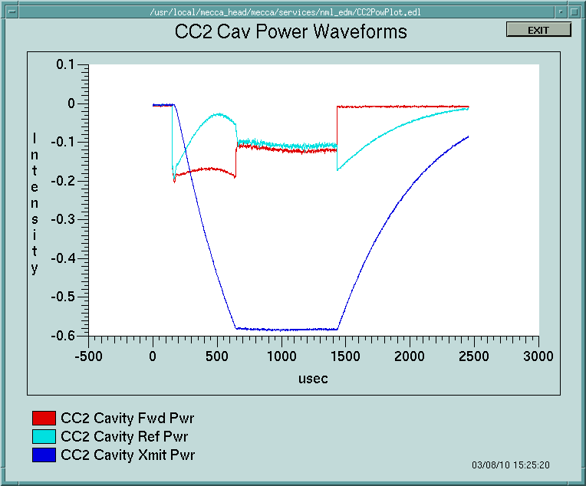
CC2 Operations at NML
Regulated operation
  LLRF feedback and feedforward enabled
  1.3 ms pulse width
  5 Hz
  20 MV/m
  Limitation is Coupler
March, 2010
LCWS 10

Slide 21
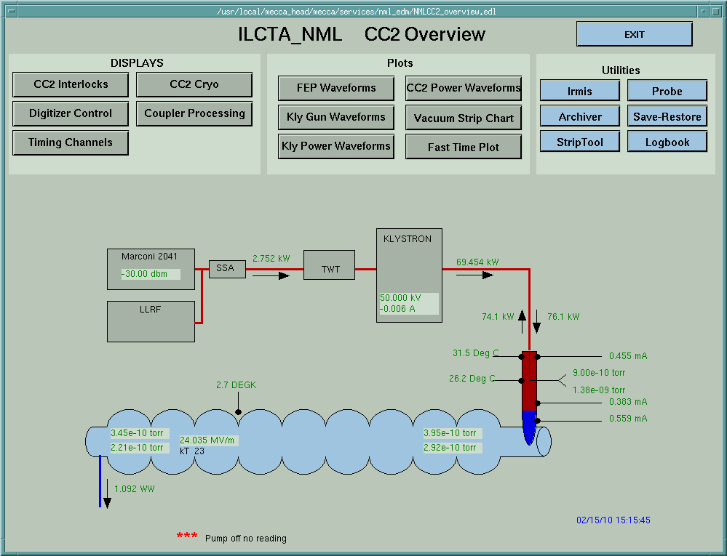
CC2 Performance at NML
Peak gradient - 24 MV/m
Limited by Coupler activity
Q_{L} = 2.92 X 10⁶
Similar performance as at MDB previously
March, 2010
LCWS 10

Slide 22
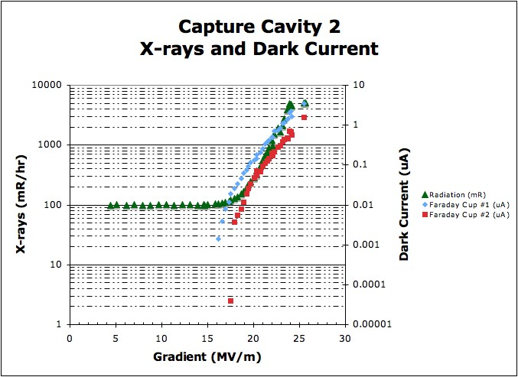
CC2 Performance at NML
Onset of field emission ~16 MV/m
Similar threshold for dark current
Largest amplitude at Coupler end
March, 2010
LCWS 10

Slide 23
CM1 Test Plan
March, 2010
LCWS 10
Virtually identical to DESY run plan for XFEL modules (courtesy of Dennis Kostin) and Fermilab experience at HTS and CC2
TEST PROCEDURE:
  1. RF Cable Calibration
  2. Technical Interlock / Sensor checkout
  3. RF source / Waveguides / LLRF
  4. Warm Input RF Coupler Conditioning
  5. Cooldown to 2K
  6. Cavity Spectra measurements
  7. Cavity Tuners Test and Tuning
  8. Coupler Q_{load} measurement
  9. Set Cavities On Resonance
  10. Cold Input RF Coupler and Cavity Conditioning
  11. Module Performance Measurement
  12. Single Cavity Measurements
  13. Cryo system performance test (if needed).
Expect 2-3 weeks to complete run plan

Slide 24

CM1 Test Plan
Our first goal is to understand the performance of cavities in CM1 compared to HTS tests at DESY
  We want to verify our assembly techniques in CAF
Note that the dressed cavities provided by DESY for CM1 are NOT 35 MV/M cavities
  We do not expect to meet the S1 goal of 31.5 MV/M
  Average of Chechia tests is 23.5 MV/M
  Anything close to this number will be a great success
It would be useful to understand what other tests might be useful for ILC with CM1

Slide 25
NML Auxiliary Systems
• Vacuum System
  Low-particulate vacuum cart built and tested
    Leak detectors, RGA’s, pumps, gauges, controls
  (4) portable cleanrooms built (capable of achieving Class-10)
  CM1 cavity string, and coupler systems under vacuum (10⁻⁹ Torr)
Water Cooling System
  System design complete
  New pumps and heat exchanger installed
  Temporary skid (for Phase-1) operational
Safety Systems
  Radiation, ODH, Interlock, and Safety Assessment documentation being prepared

Slide 26
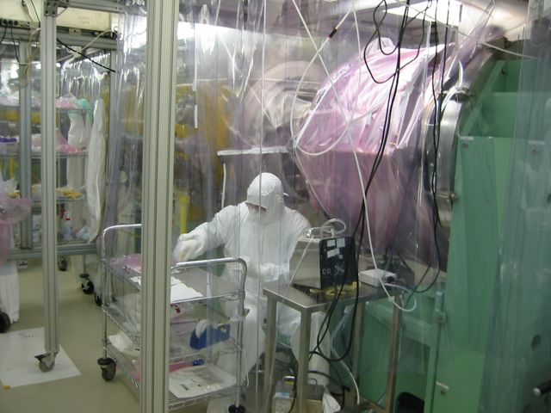
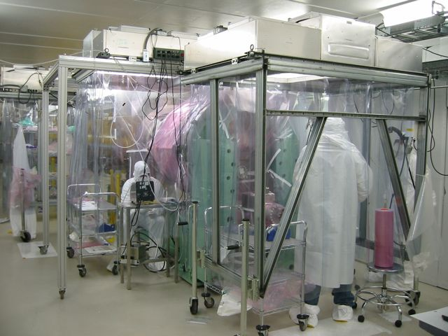
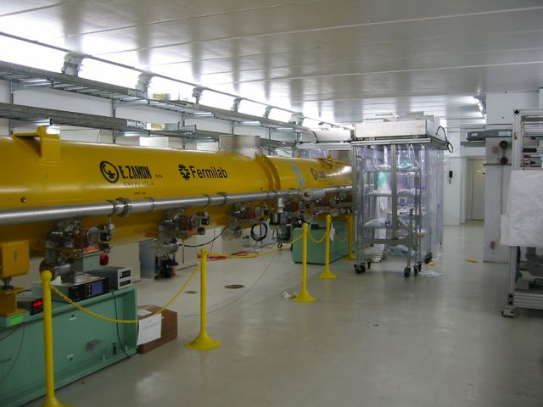
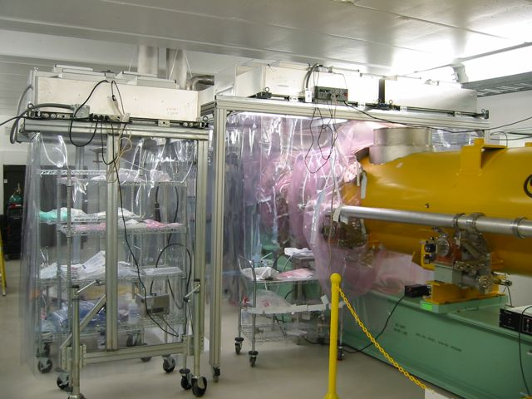
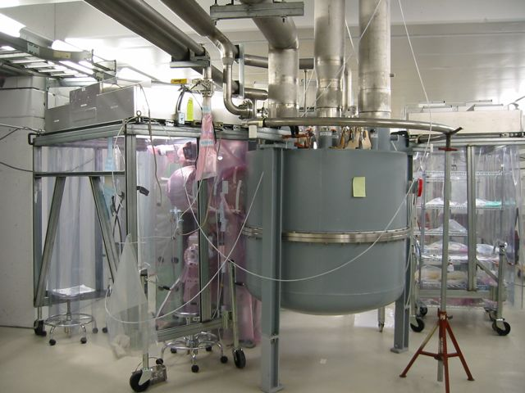
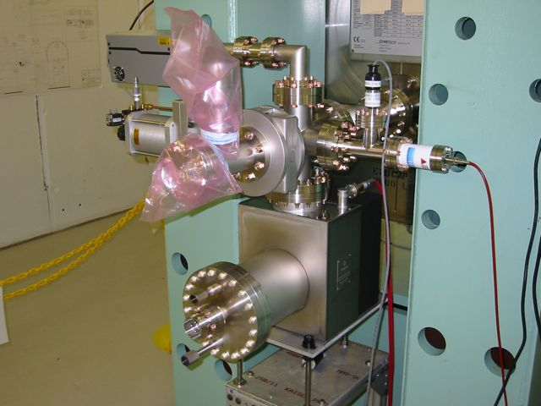
NML CM1 Vacuum Work

Slide 27
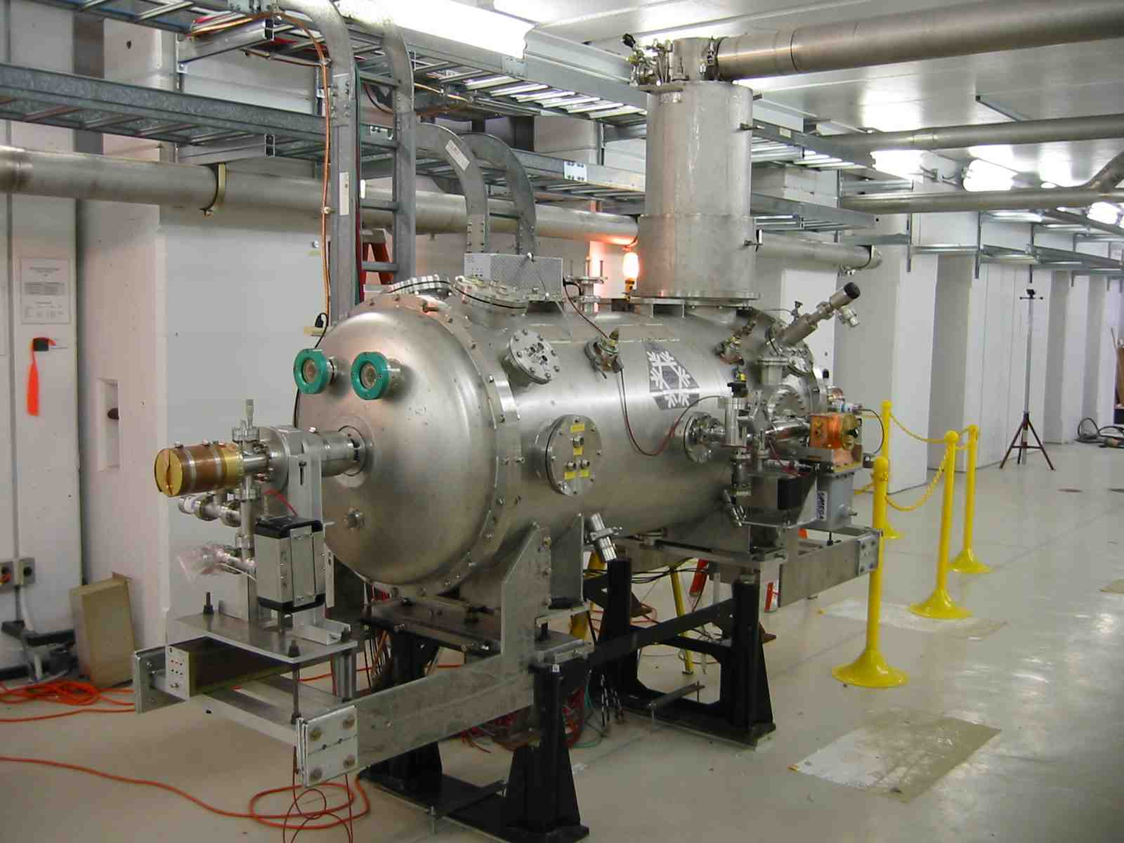
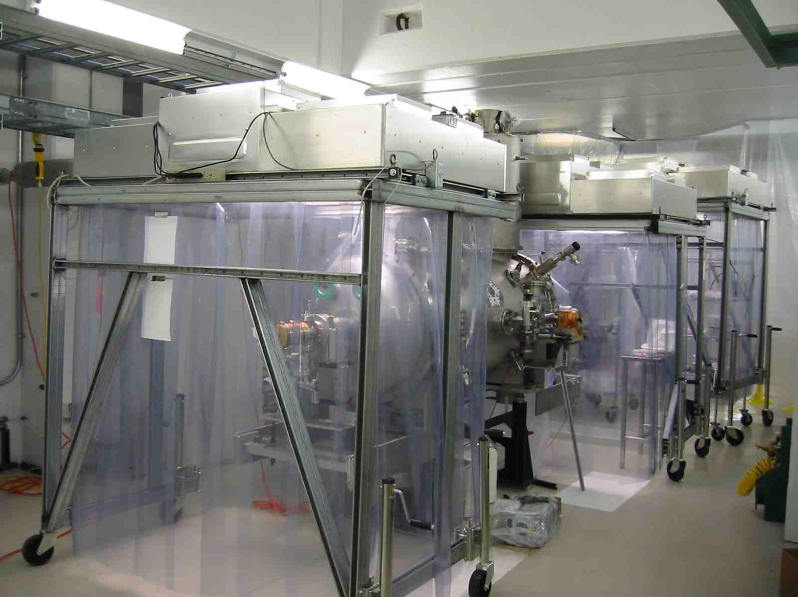
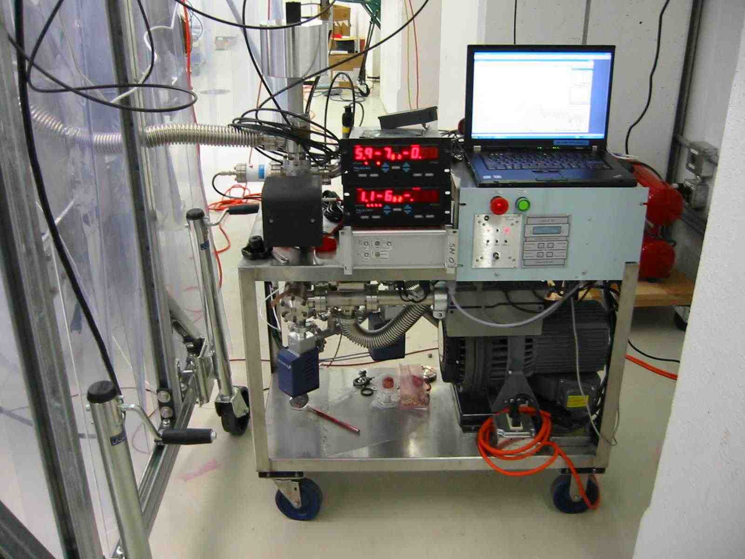
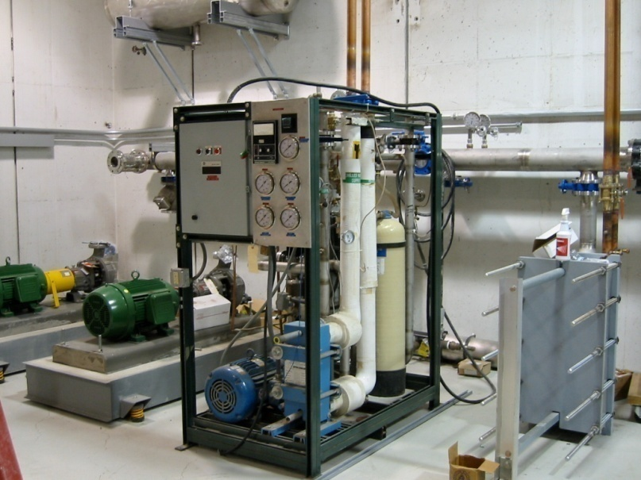
NML Auxiliary Systems
CC2 Installed
Cleanroom Work on CC2
Vacuum Cart
Water System

Slide 28
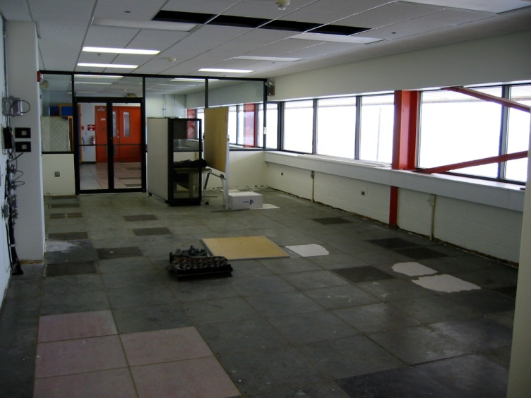
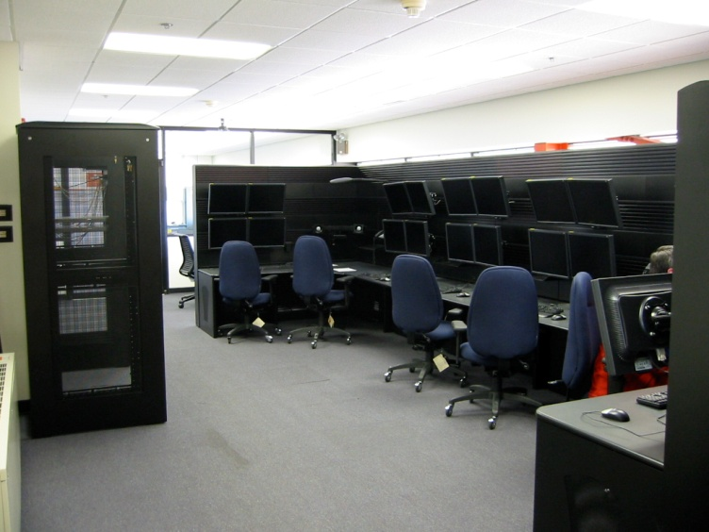
NML Controls/Instrumentation
Before
After
Controls
  Control Room finished and operational
  Wireless network installed throughout building
Instrumentation
  Wire Position Monitors for CM1 tested and installed in Endcaps
  Faraday Cups assembled
  RF protection/interlock system complete

Slide 29
NML Schedule/Milestones
Phase-1 Cryogenic System Operational (Aug. 2007)
Delivery of First Cryomodule to NML (Aug. 2008)
Begin Civil Construction of NML Expansion (March 2010)
First Cryomodule Ready for Cooldown (Spring 2010)
Cold RF Testing of First Cryomodule (Summer 2010)
Start Construction of CMTF Building (Fall 2010)
Delivery of 2nd Cryomodule to NML (S1) (2010)
Install Injector & Test Beam Lines (2011)
First Beam (2012)
New Cryoplant Installation/Operation (2013-14)
RF unit test with beam (2014)

Slide 30
Integrated SRF Plan (Cryomodules)
Page 30

Slide 31
Conclusions
RF unit test facility at NML is a new large facility under construction at FNAL in support of ILC and Project X goals
  Delayed by Omnibus bill more than a year
  ILC/SRF funding has been restored
  ARRA funds are a huge boost
NML Cryogenic and RF Operations have begun
  Tests of CCII and CM1 this year
Several opportunities to meet ILC S1 goal over next couple of years
Full test of ILC RF unit (S2 goal) by 2014

