Slide 1
Tunnel Electronics for Klystron Cluster System
Ray Larsen
Chris Adolphsen
Chris Nantista
ARD Division SLAC National Accelerator Lab
ILC GDE Meeting Beijing March 25-28 2010

Slide 2
Outline
Klystron Cluster Concept
Cryomodule Signal Summary
Proposed Hardware Solution
Chassis and Rack Space Estimates
Conclusion

Slide 3
Conceptual Design
Proposed by C. Adolphsen
  All klystrons & modulators located in surface building (Klystron Cluster System KCS)
  All klystrons drive single large circular waveguide
  Tap-offs every cavity
  Cryomodules (CM) consist of 8 or 9 cavities (9-8-9 cavity CM’s per klystron)
  Klystron Cluster drives ~99 CM’s ~ 1-km waveguide w/ ~33 klystrons
  In tunnel electronics shielded, LCW temp stabilized

Slide 4
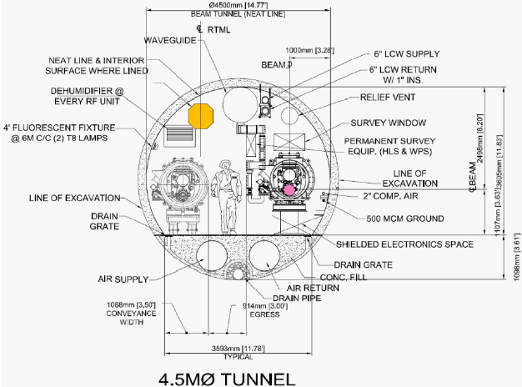
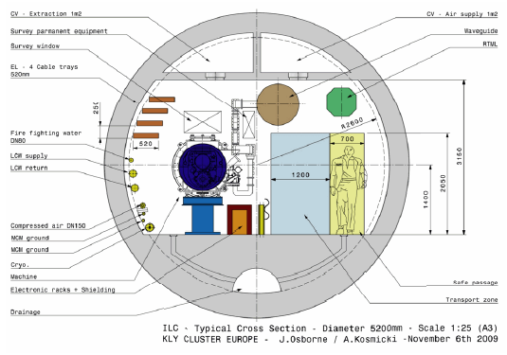
1-Tunnel Layout with KCS
C. Adolphsen et al
Americas Region
RF Waveguide
European Region
10 cm Concrete + 2 cm Lead over Electronics
Area for Electronics
Height = 0.58 m (although it looks like this can be increased by ~ 0.5 m if needed)
Width = 1.5 m (although may need a shielding in the front as well)
Length ~ 9 m between cryomodule floor supports – see next slide
Although this area would include supports for concrete/lead shielding
At minimum, under each CM, can have ~ 14, 18 inch high, 24 inch wide racks

Slide 5
CM Instrumentation Block Diagram
R. Larsen, R. Downing 2005

Slide 6
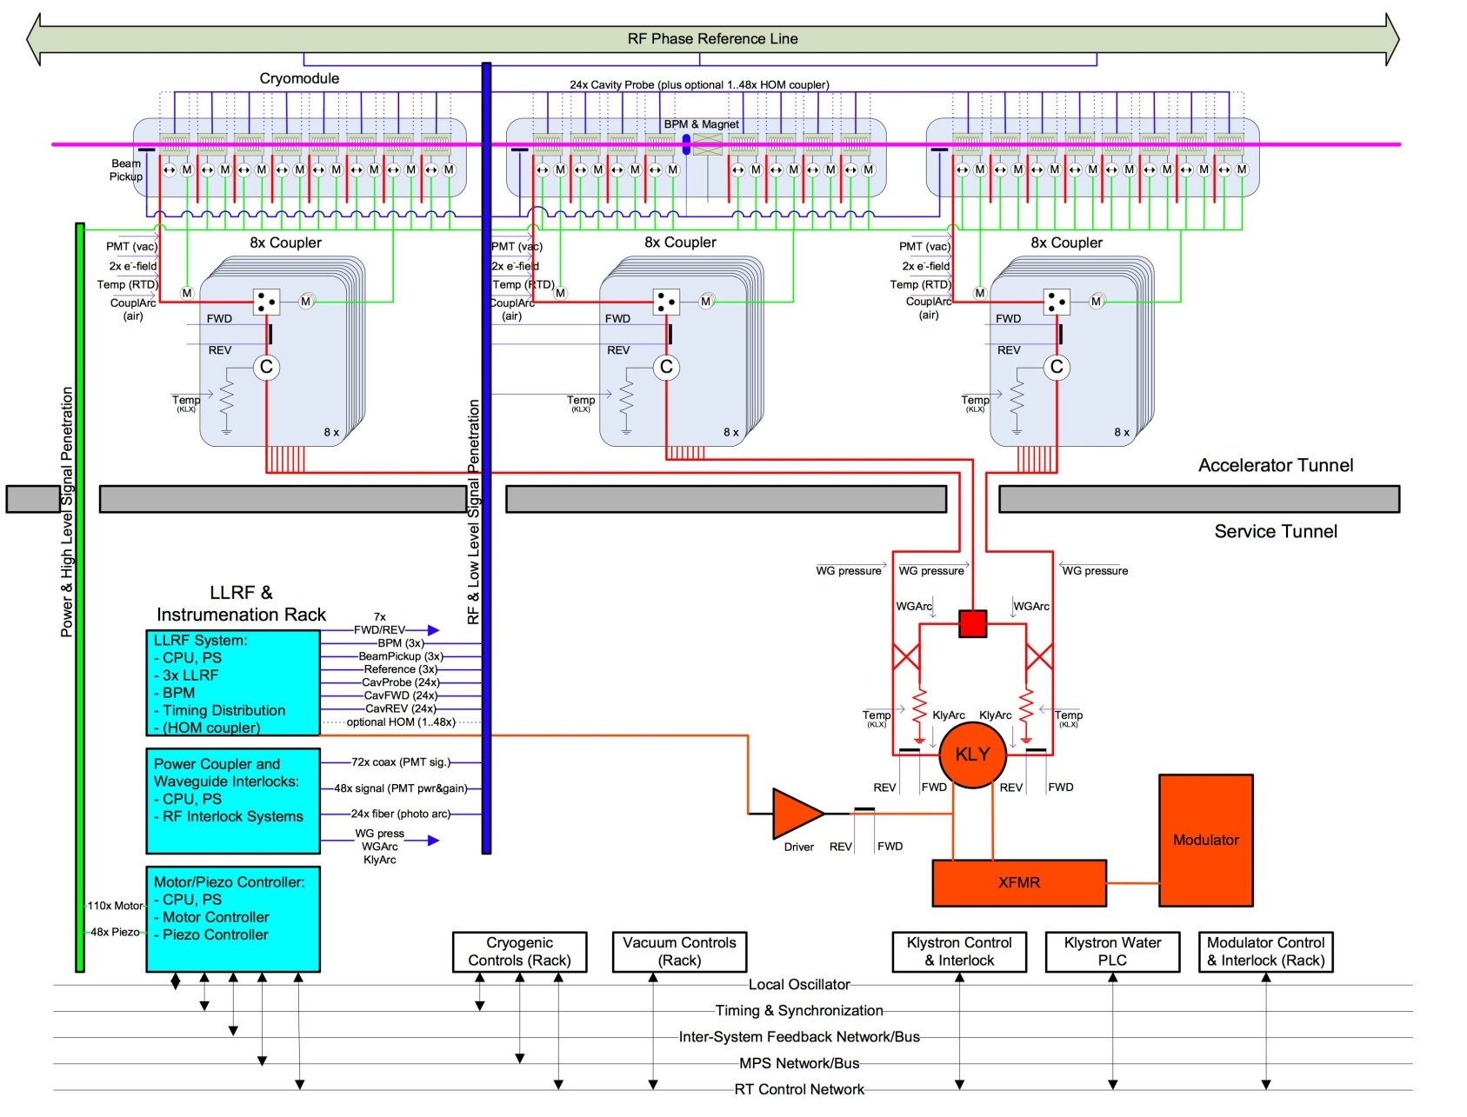
2-Tunnel RF Station w/ 3 CM’s
B. Chase,
S. Michizono, S. Simrock 2007

Slide 7
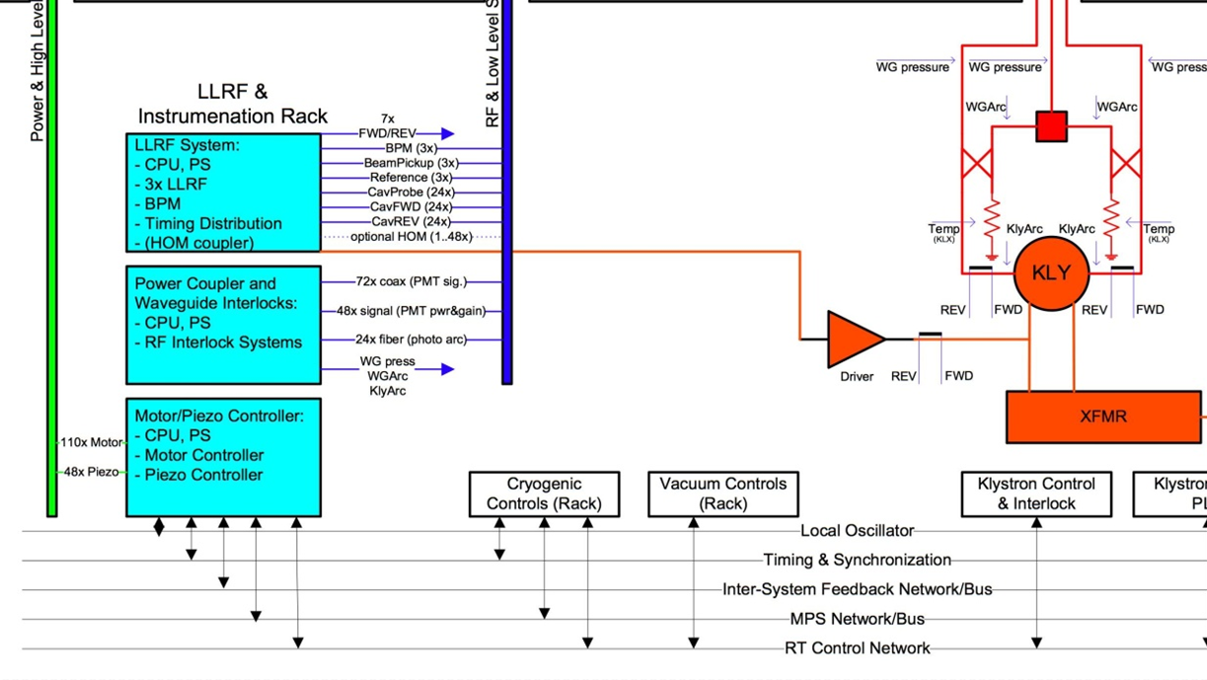
2-Tunnel Signal Details
B. Chase,
S. Michizono, S. Simrock 2007

Slide 8
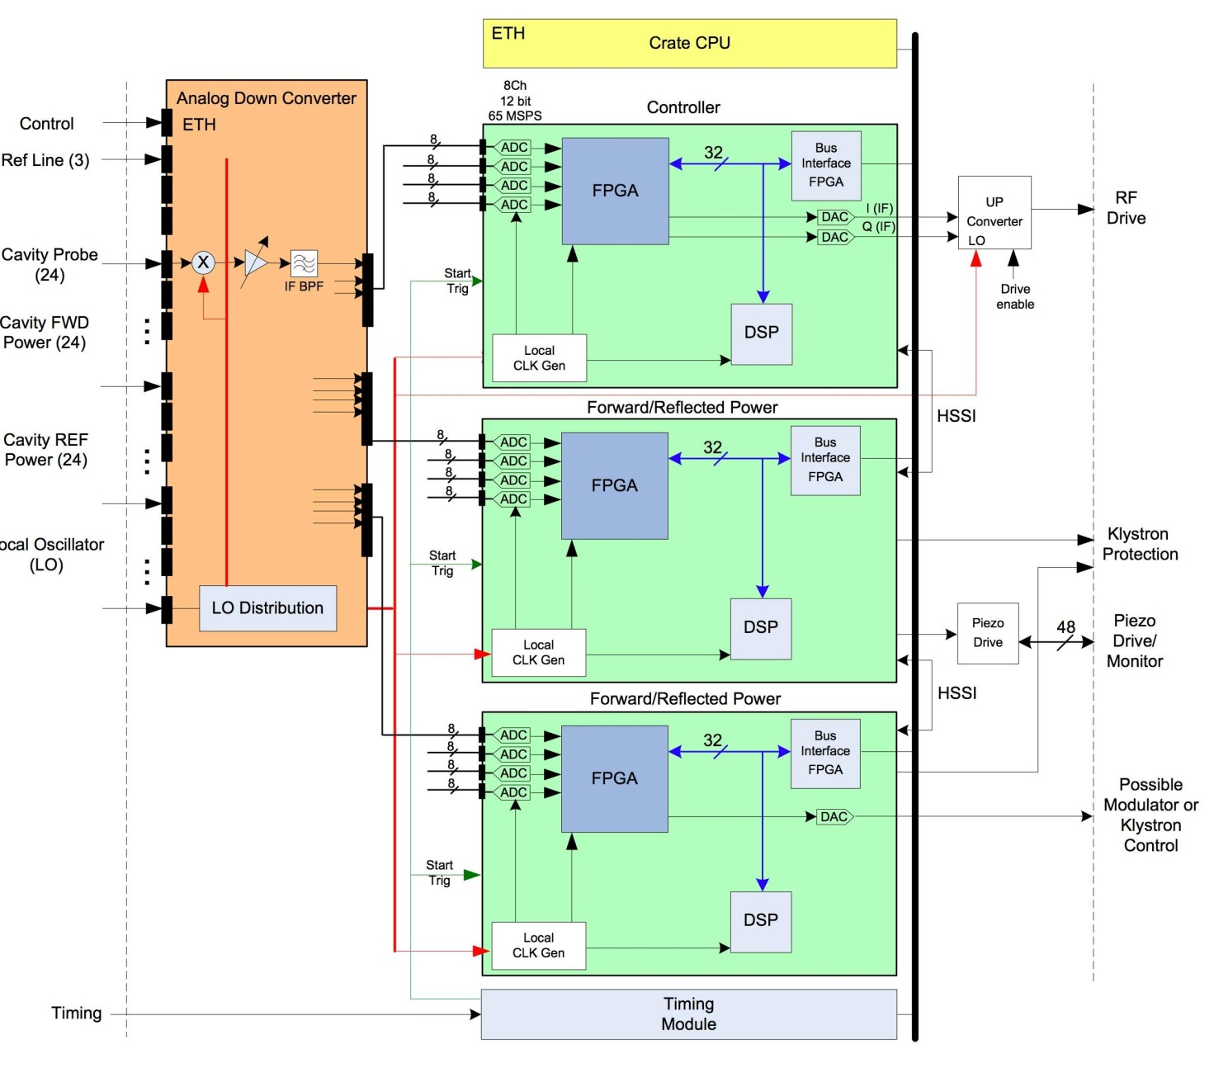
2-Tunnel LLRF ATCA Crate Detail
1-Tunnel Model:
Fiber Optic
Link to KCS
B. Chase,
S. Michizono, S. Simrock 2007

Slide 9
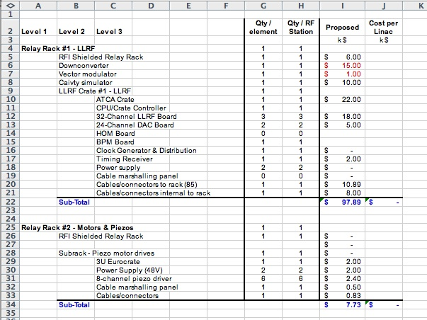
CM Instruments Summary- 2 Racks
B. Chase,
S. Michizono, S. Simrock 2007

Slide 10
1- Tunnel Electronics Summary
Per Cavity
  Cavity voltage probe readout (1)
  Piezoelectric tuner drivers & readout(2)
  Blade tuner driver motor & readout(1)
  Window arc detect PMT readout (2)
  Directional coupler FE, RE readout (2)
  Phase Shifter motor driver & readout (1)
  Power coupler (1)

Slide 11
1-Tunnel Electronics Summary 2
Per Cryomodule (CM) (8-9 cavities)
  Above components (x8-9)
  Probe down-conversion & digitizing channels (8-9)
  Vector sum controller per CM
  Beam position monitor readout (1)
  SC Quad power supply & protection (1)
  Vacuum pump power supplies (2)
  Helium monitoring & control (1)
Per Girder of 3 Cryomodules
  Above x3

Slide 12
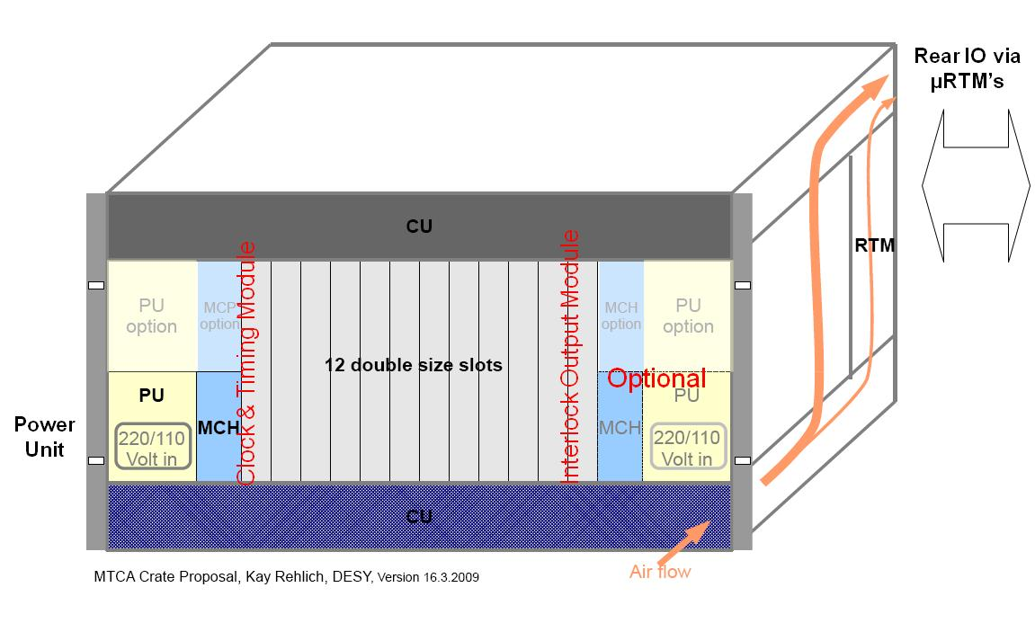
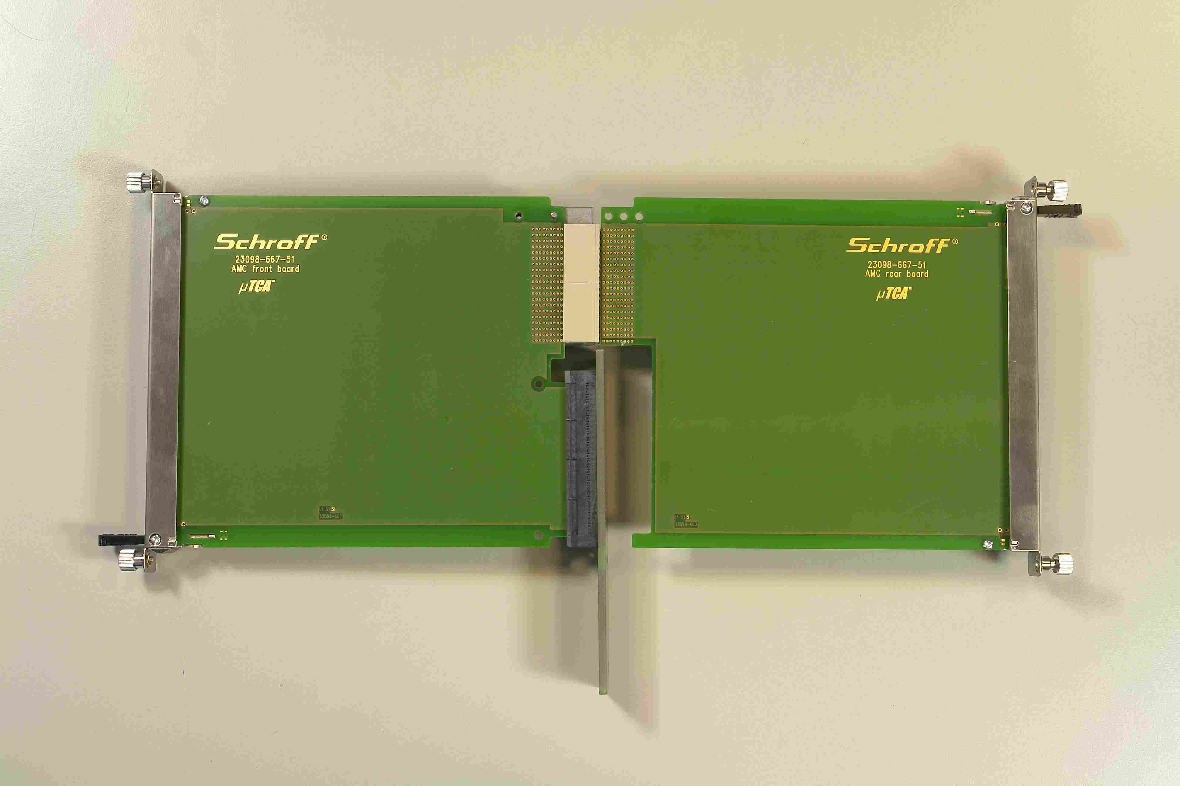
Proposed Platform: MicroTCA New Standard for Physics
Double Wide Advanced Mezzanine Card (AMC)
Same size Rear Transition Module for IO signal conditioning, cable - connector interface
12 Payload slots with RTM’s
Supports Redundancy for High Availability

Slide 13
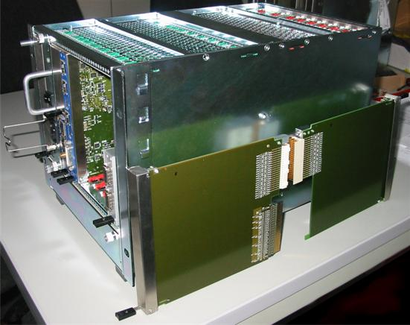
Industry Demonstration Unit
First 6-Slot Test Prototype Crate from Schroff
Double-Wide Application Card with Rear Transition Module
Production Unit will be 12-slot
Supports redundancy, rear cable entry, managed platform, module hot swap
Quotes received for 12-slot units.
Courtesy Schroff, DESY

Slide 14
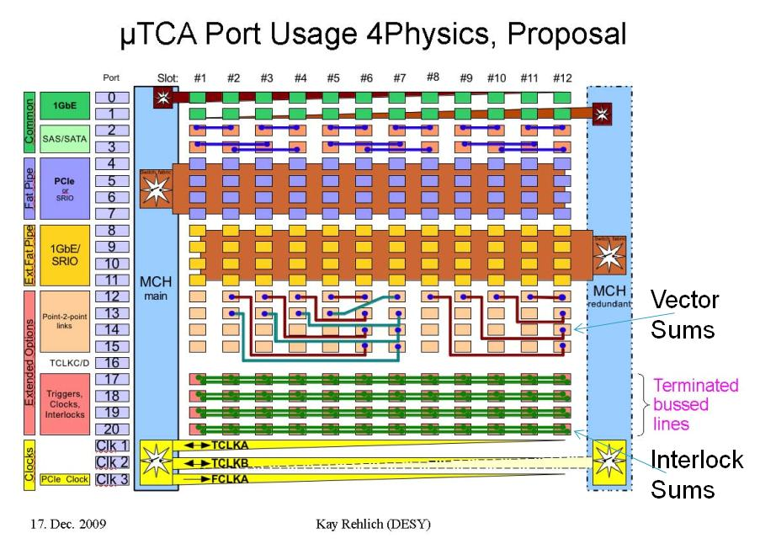
MicroTCA Backplane w/ Vector Sum, Interlock Sum Support

Slide 15
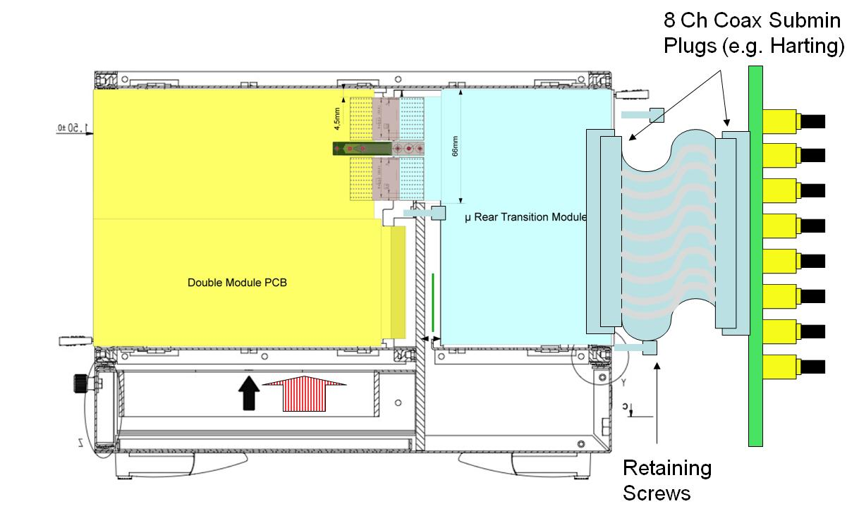
µRTM Connection Concept

Slide 16
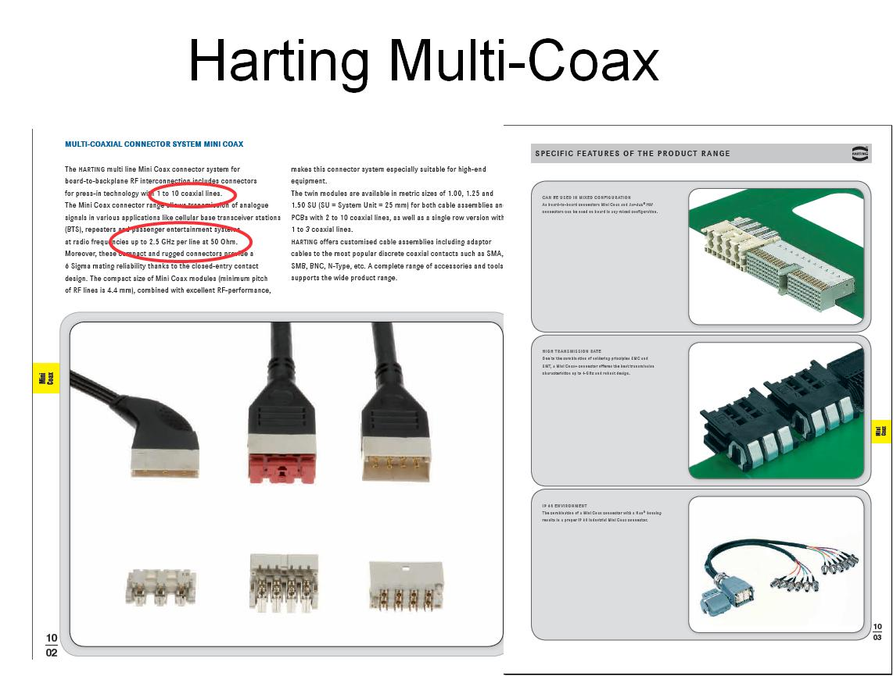

Slide 17
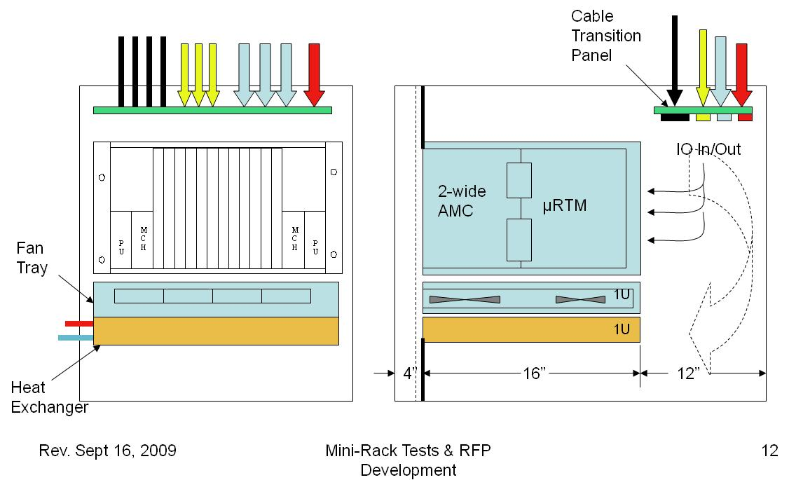
Air-Water Cooled Mini-Rack (e.g.)

Slide 18
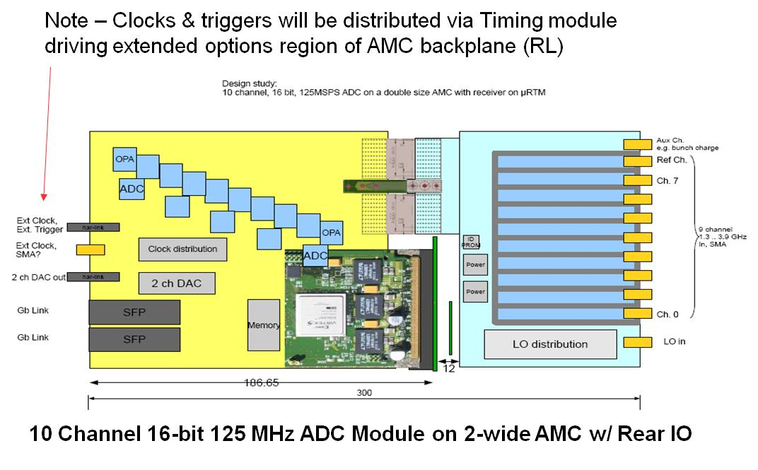
Generic ADC w/RF Down-Converter

Slide 19
Overall Packaging Concept
ADC Conversion
  Design applications to mate with generic ADC’s on 2-wide AMC via application-specific µRTM’s
  100 MS/s, 10 MS/s, 1 MS/s, 100kS/s speed ranges, 16 bits
  AMC’s have FPGA’s for all real-time operations
DAC Outputs
  Fast outputs for RF drive feedback (same card as fast ADC)
Fast Digital Outputs
  Needed for klystron –modulator interlocks for arc-detect located in tunnel
Slow Monitoring and control (e.g. motors)
  Commercial Industry Pack modules mounted on AMC cards
  All IO routed via RTM’s
Chassis
  Redundant power, MCH (Controller Hub) options
  Timing as needed via locally installed module in each crate
  Local controller sets up, directs traffic
  All external communications by Ethernet
Rack
  Install applications in µTCA 12-slot chassis
  Mount chassis in short rack installed horizontally under each CM unit to minimize lengths, standardize cable runs
  Racks are sealed, air-water cooled as in Baseline proposal

Slide 20
AMC-µRTM Boards per Cryomodule
Item | Chan. | Function | AMCRTM | Channels/Unit | Extend | Rack Ht
Probes | 9 | 125 MS/s Vc | 1 | 10 @ 125 MS/s)
PMT’s | 18 | 10 MS/s Intlks | 2 | 10@ 10 MS/s
BPM | 4 | 125 MS/s | 1 | 10@125 MS/s
Piezos | 18 | 10MS/s DAC | 5
Motors | 36 | Tuners, Couplrs | 0 | 8 | 5 @ 3U | 15U
FE/RE | 18 | 10 MS/s Intlks | 2 | 10@ 10 MS/s
Intlk Sum |  | 1 per chassis | 2
Quad Supply | 1 | 1 per CM |  |  | 1@ 1U | 1U
Cntrlr |  | 1 per chassis | 2
Timer |  | 1 per chassis | 2
Chassis |  | 2 per CM |  | 12 AMC cards | 2@9U | 18U
Rack |  | 1 per CM | 17 min |  | 48U (213 cm) | 34U Min. for Payload

Slide 21

Crymodule Horizontal Rack
Lead-Concrete Shielding
Heat Xchgr
& Fans
µTCA Crates
Motor Drivers, PS
213 cm (7.0 ft)

Slide 22
Concluding Remarks
All estimates of numbers of cards, chassis and rack space are preliminary
Approximately 2 m of standard rack space is needed per Cryomodule
The height of the CM’s may have to be increased slightly to allow adequate room for cabling & cooling channels
The rack may have to be slightly longer (taller) to accommodate redundant heat exchangers
Prototype crates & cards are on order from which better estimates can be made. In general the µTCA chassis and modules are more compact.
The estimates for motor drivers are based on a known catalog unit but the piezo and quad drivers are guesses.
For completeness a study should be done of the entire system concept to verify the assumptions of the architecture down to the card level.
Costs should be comparable with the Baseline since only slight changes in partition and function are assumed.

Slide 23
Acknowledgment
Brian Chase and John Carwardine provided very useful information from the cost analyses done for the Baseline Controls and LLRF Models.

