Slide 1
Coupler kick and wake simulations upgrade
N. Solyak,
Fermilab
(on behalf of the team: N. Solyak
A. Lunin, I. Gonin, and V. Yakovlev)

Slide 2
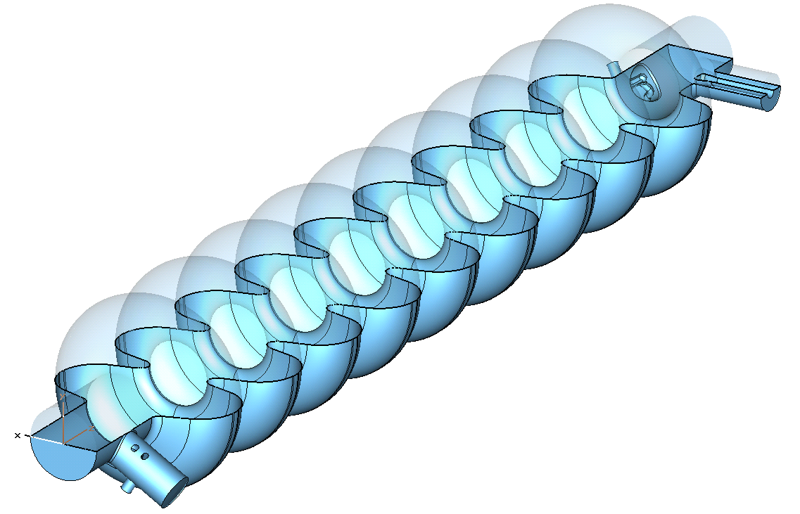

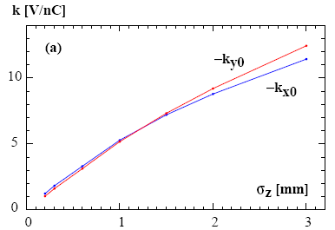
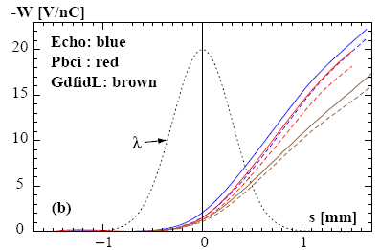
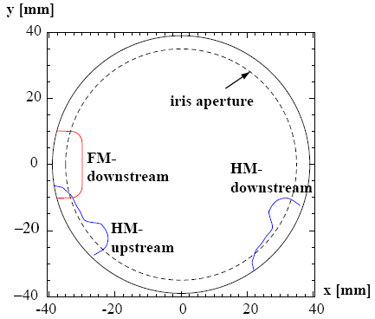
Simulations of Coupler Kick and Wakes
(2008)
Downstream
HOM coupler
Main coupler
. Simulations: DESY/FNAL/SLAC
Total RF KICK (FNAL):
RF cavity
Coupler Transverse Wakefield
Upstream
HOM coupler
bunch shape
The profiles of the 3 couplers, as seen from the downstream end.
W_{x}(s)-solid,,W_{y}(s)-dashed for σ_{z} = 300 μm.
On-axis kick factor vs. σ_{z}
Notes:
2

Slide 3
Effect of asymmetry, caused by couplers
The couplers break the RF field symmetry and cause transverse RF kick and Wake fields. Both RF kick and wake fields may be a reason of a beam emittance dilution in ILC BC and ML.
DESY* made the first calculations of the RF kick and Wake fields.
FNAL, SLAC, DESY, and TEMPF completed the calculations**
*I. Zagorodnov, and M. Dohlus, ILC Workshop, DESY,31 May, 2007.
**K.L.F. Bane, C. Adolphsen, Z. Li, M. Dohlus, I. Zagorodnov, I. Gonin, A. Lunin, N. Solyak, V. Yakovlev, E. Gjonaj, T. Weiland, EPAC2008, TUPP019.

Slide 4
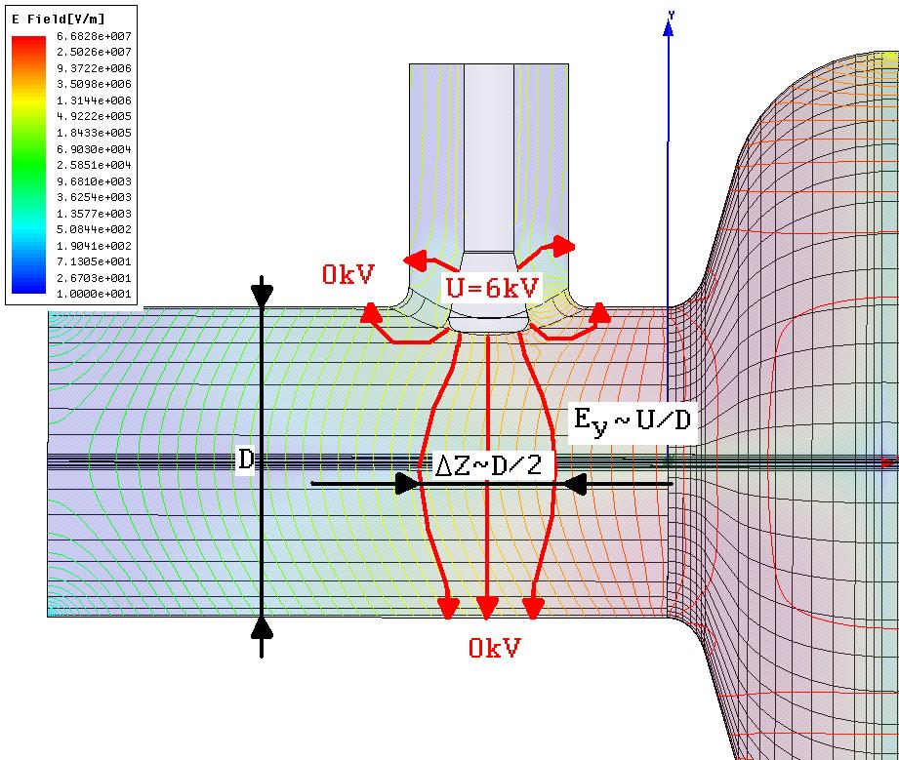
Estimation of RF kick from the main coupler
Simple estimations of the transverse fields caused by the main coupler:
RF voltage: U=(2PZ)^{1/2}, Z–coax impedance;
For P=300 kW and Z≈70 Ohms → U ≈ 6 kV
Transverse kick:
Δp_{y}∙c ≈ eE_{y} ΔZ ≈eU/D∙D/2=eU/2.
The RF field calculation precision should be better than 10⁻⁵ !!!
Transverse kick caused by the couplers acts on a bunch the same direction for all the RF cavities of the linac.
  - Real part may be compensated by the linac feedback system;
  - Imaginary part dives the beam emittance dilution.

Slide 5
First results of RF kick calculation (2008)
Three groups made rf kick simulations:
  1. FNAL: N. Solyak, et al, EPAC2008, MOPP042
  2. DESY: I. Zagorodnov, and M. Dohlus, LCWS/ILC 2007
  3. SLAC: K.L.F. Bane, et al, EPAC2008, TUPP019
ALL the three groups have different results!
 | FNAL Q=3.5×10⁶ HFSS | DESY Q=2.5×10⁶ MAFIA | SLAC Q=3.5×10⁶ OMEGA3P
10⁶ · (V_{x} / V_{z}) | -105.3+69.8i | -82.1+58.1i | -86.0-60.7i*
10⁶ · (V_{y} / V_{z}) | -7.3+11.1i | -9.2+1.8i | -4.6+5.6i
*Probably, typo in [3]
Big difference in calculated vertical imaginary part of coupler kick !!!

Slide 6
Main reasons for difference:
Effect is extremely small, about 5-6 orders of magnitude smaller than the longitudinal fields;
In additions, cancelation takes place between upstream and downstream coupler.
It demands very high precision of the field simulations, better than 10⁻⁶, that is a severe challenge for all numerical methods and codes.
Possible other reasons:
Different calculated geometries or numerical models;
Different assumptions (loaded Q, etc);
Different numerical approximation of the fields (in some codes E and H fields are calculated with different precision that should be taken into account);
Different methodical convergence for the methods used.

Slide 7
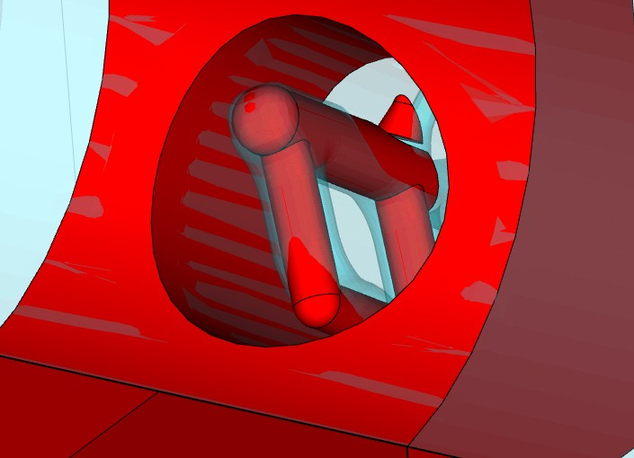
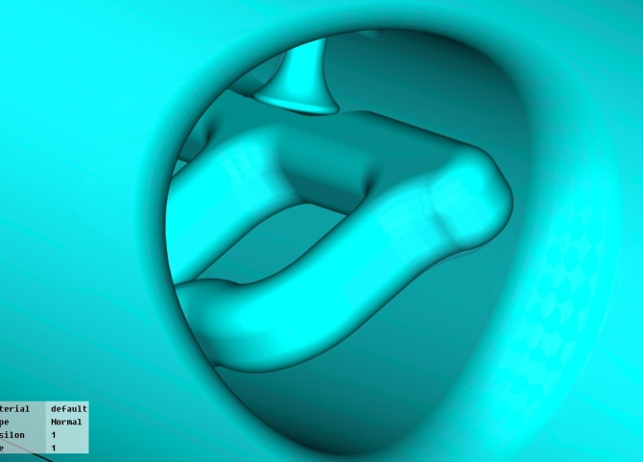
Geometry
DESY provided to FNAL the geometry used for wake simulations. Geometry is different (no rounding, simplified coupler geometry, etc). We have no information whether it was used for rf kick.
FNAL and SLAC used same geometries, but results for vertical rf kick is different
Acceptable vertical (most critical) emittance dilution in BC < 5 nm
Emitannce dilution is proportional to the rf kick squared. Calculated vertical kick differs ~6 times → ~36 times in emittance growth !
DESY (red)
and
FNAL (blue)
FNAL and SLAC (the same now, but the results still differ)

Slide 8
FNAL approach:
Different codes were used for calculations – HFSS, CST, COMSOL ;
A special meshes were used that allows accurate filed description near the axis and eliminate the mesh noise;
Calculation convergence was investigated and achieved;
Cross-check of the direct rf kick calculations by Panofsky – Wenzel theorem application;
Full geometry calculations in order to avoid phase-lock mistakes;
More accurate normalization was used.
All the three codes gave the same results in simulations done for separate couplers and for full geometry.
Effect of couplers kick in vertical plane is higher than it was shown in our the first simulations in 2008 !!!

Slide 9
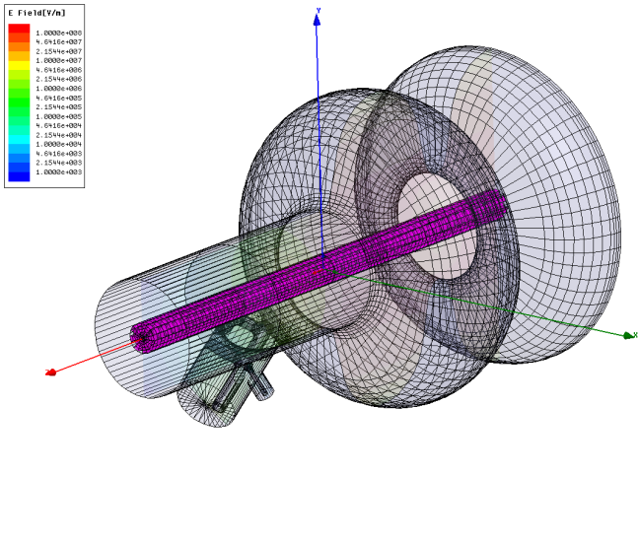

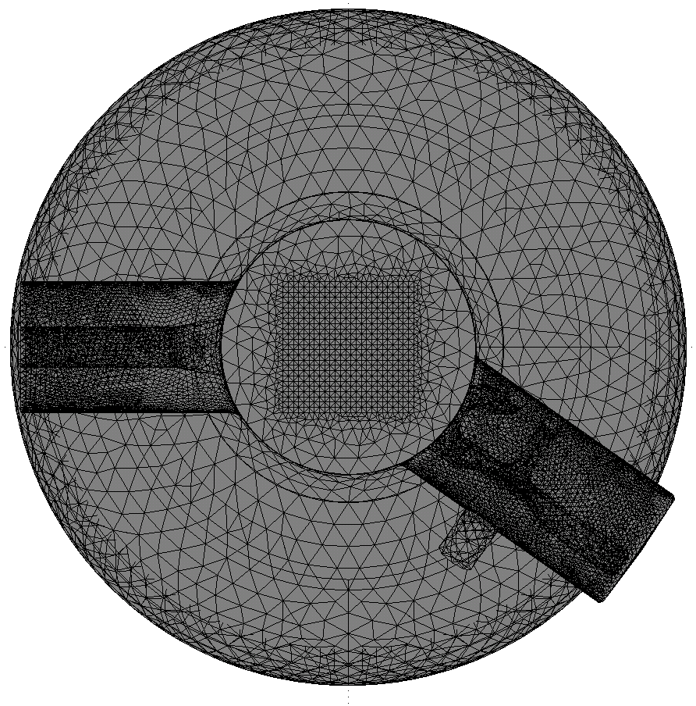
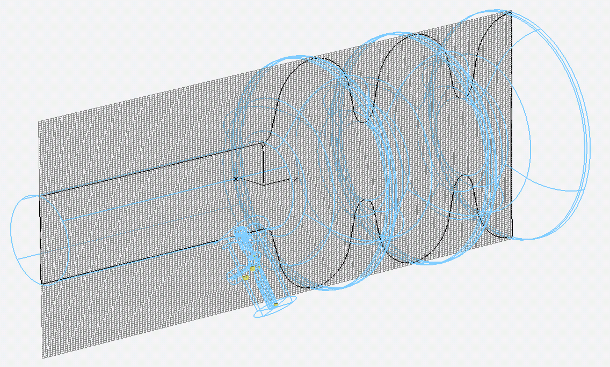
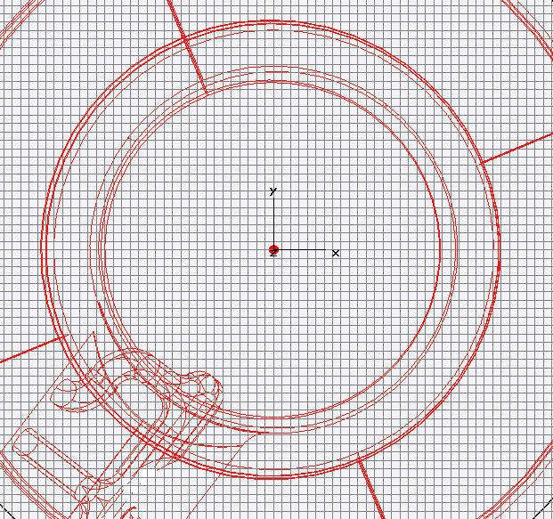
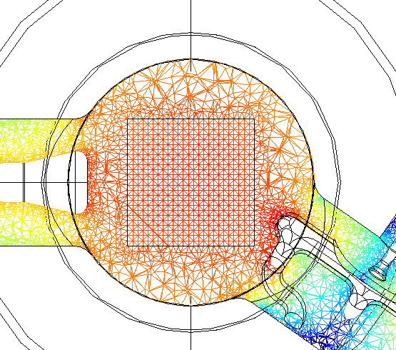
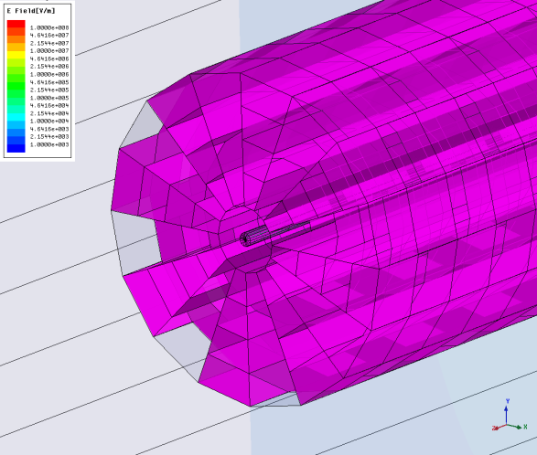
Model for Meshes used in different codes
HFSS
CST
COMSOL

Slide 10
CST Convergence

Slide 11
HFSS Convergence

Slide 12
Upstream Coupler
 | NEW FNAL* (HFSS & CST MWS) |  | OLD FNAL (HFSS) |  | SLAC (Omega3P) | DESY (Mafia)
 | Direct | PW | Direct | PW | Direct | Direct
KickX 10⁶ · Vx Vz | -64.5+19.5i (HFSS) -64.8+19.6i (CST) -64.9+18.6i (COMSOL) | -65.1+19.6i -64.8+19.5i -64.9+15.9i | -68.8+3.7i | -65.6+7.6i | -57.8+7.0i | -57.1+6.6i
KickY 10⁶ · Vy Vz | -47.3+4.6i (HFSS) -46.1+4.8i (CST) -46.5+4.1i (COMSOL) | -46.4+4.8i -46.2+4.9i -46.4+2.7i | -48.3-3.4i | -53.1-2.1i | -40.9-3.5i | -41.4-3.5i
Downstream Coupler
 | NEW FNAL* (HFSS & CST&COMSOL) |  | OLD FNAL (HFSS) |  | SLAC (Omega3P) | DESY (Mafia)
 | Direct | PW | Direct | PW | Direct | Direct
KickX 10⁶ · Vx Vz | -34.0+65.7i (HFSS) -32.2+68.4i (CST) -35.1+68.7i (COMSOL) | -33.1+66.1i -32.2+68.4i -35.5+65.2i | -36.5+66.1i | -27.3+67.2i | -25.1+51.4i | -25.0+51.5i
KickY 10⁶ · Vy Vz | 39.4+14.9i (HFSS) 41.2+15.8i (CST) 41.7+14.7i (COMSOL) | 39.8+12.4i 41.1+15.9i 41.4+15.8i | 41.0+14.5i | 40.9+12.8i | 36.5+8.9i | 32.2+5.2i
* The End Group effect is taken into account during V_{z} calculation.
** A phase-lock mistake was found in a post processing.

Slide 13
Total RF-kick
 | NEW FNAL* (HFSS & CST MWS & COMSOL) |  | OLD FNAL (HFSS) | SLAC (Omega3P) | DESY (Mafia)
 | Direct | Direct | Direct | Direct | Direct
KickX 10⁶ · Vx Vz | Up & Down Ends | Full Structure | -105.3+69.8i | -86.0+60.7i | -82.1+58.1i
 | -98.5+85.2i (HFSS) -97.0+88.0i (CST) -99.9+87.3i (COMSOL) | - - -104.3+80.0i**
KickY 10⁶ · Vy Vz | Up & Down Ends | Full Structure | -7.3+11.1i | -4.6+5.6i | -9.2+1.8i
 | -7.9+19.5i (HFSS) -4.9+20.6i (CST) -4.8+18.8i (COMSOL) | - 0.1+21.2i** -8.3+17.1i**
* The End-group effect is taken into account during V_{z} calculation
** A phase-lock mistake was found in a post processing.
*** For reference only, results were not checked for convergence

Slide 14
Conclusions
Calculation convergence checked and achieved;
RF kick calculation results made by three codes coincide very well;
Results for separate coupler calculations and for the full structure are the same;
Normalization factor is checked and improved;
Phase lock mistake in upstream coupler calculation was found and fixed;
The RF kick results may be trusted.
The result for Q_{ext}=3×10⁶ (averaged over results of different codes)
V_{y}/V_{z} = (- 5.9+19.6i) ×10⁻⁶;
V_{x}/V_{z} ≈ (-98.5+86.8i)×10⁻⁶.

