Slide 1

Status Update
18MW ILC Beam Dump Design
John Amann
Mechanical Engineer
SLAC National Accelerator Laboratory
LC Beam Delivery Systems

Slide 2
Outline
Introduction.
Mechanical Design Concept.
Beam Parameters used for FLUKA studies.
FLUKA studies.
Thermal-hydraulic studies (conjugate heat transfer).
Summary.
LCWS 2010
Amann - 3/26/10

Slide 3
Introduction
ILC Beam Dump Design Team
SLAC National Accelerator Laboratory:
J. Amann, R. Arnold, D. Walz, A. Seryi
Bhabha Atomic Research Centre: P. Satyamurthy, P. Rai, V. Tiwari, K. Kulkarni
Starting Point for Work
SLAC 2.2 MW Water Dump, The Stanford Two-Mile Accelerator,
R.B. Neal Ed, (1968).
High Power Water Beam Dump for a LC, M. Schmitz,
TESLA Collaboration Meeting, 16 Sept 2003.
ILC Main Beam Dumps -- Concept of a Water Dump,
D. Walz Snowmass, 18 Aug 2005.
Dumps and Collimators, ILC Reference Design Report, 2007
T. Davenne, O. Caretta, C. Densham and R. Appleby, Pressure Transients in the ILC Beam Dump, LC-ABD Collaboration meeting, Birmingham University, 17 April 2008
LCWS 2010
Amann - 3/26/10

Slide 4
Introduction
The task force team studied the various aspects of the SLAC’s 2.2MW water beam dump and used it as the starting basic reference design for an ILC Beam dump, since it has all features required of an ILC beam dump (but at a lower power level) but proven design. This includes the use of a vortex-like flow pattern to dissipate and remove the energy deposited by the beam, the beam dump entrance window and its special cooling method, a remote window exchange mechanism, a hydrogen re-combiner, handling of radioactive ⁷Be, a tail catcher to attenuate the residual beam energy remaining after the vortex flow region, as well as related primary and secondary cooling loops.
LCWS 2010
Amann - 3/26/10

Slide 5
Mechanical Design Concept
The 18MW LC beam dump mechanical design is driven by parameters and constraints developed from FLUKA simulations, CFD thermal hydraulic simulations and analytic calculations.
The existing 2.2MW SLAC beam dump provides a baseline mechanical design to consider features which might be incorporated into the 18MW beam dump mechanical design concept.
The first step in creating a mechanical design concept for the beam dump is to establish the basic mechanical design parameters of the beam dump vessel and thin window.
The beam dump is a pressurized vessel containing heated and radioactive water and consequently for operation within the USA, must conform to the design and safety standards of the American Society of Mechanical Engineers Boiler and Pressure Vessel Code.
LCWS 2010
Amann - 3/26/10

Slide 6
Mechanical Design Concept
Table of Beam Dump Design Parameters and Constraints
Operating Parameters
Maximum Operating Temperature | <180°C
Maximum Operating Pressure | 20bar or 290psi
Minimum Operating Pressure | 10bar or 145psi
Beam Dump Vessel
Internal diameter | 1.8m
Length | 10m
Beam Dump Inlet Headers
2 @ Up beam end of vessel | 8” (203mm) ID with longitudinal slots
Inlet header location | 0.7m from center on horizontal plane
Beam Dump Outlet Header
1 @ Up beam end of vessel | 10” (254mm) ID with perforations all around
Outlet header location | Center axis of vessel
Beam Dump Thin Window
Hemispherical shape | Pressure on concave side
Internal diameter | 300mm
Maximum thickness | 1mm
Window location | 0.35 - 0.45m from center of vessel vertical plane
Window cooling | Single water jet
LCWS 2010
Amann - 3/26/10

Slide 7
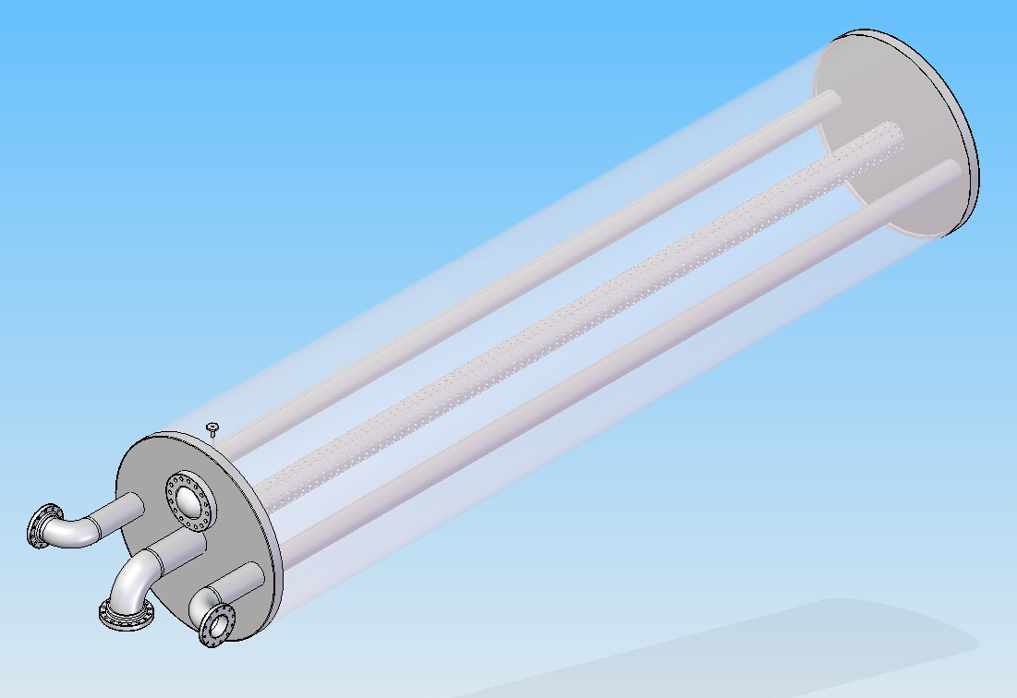
Mechanical Design Concept
Vessel Shell
Inlet Headers
Window Cooling
Nozzle Supply Pipe
Thin Window
Outlet Header
Flat Heads
LCWS 2010
Amann - 3/26/10

Slide 8
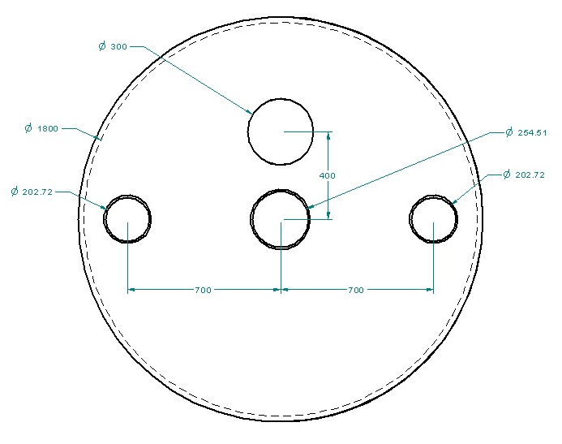
Mechanical Design Concept
Mechanical Design Parameters
(ASME BPVC Div. VIII)
Vessel Material – 316LN
Minimum Shell Thickness – 21mm
Minimum Flat Head Thickness – 70mm
Window Material – Ti-6Al-4V
Max. Design Pressure, 1mm Thick
Hemispherical Window – 32bar or 464psi
LCWS 2010
Amann - 3/26/10

Slide 9
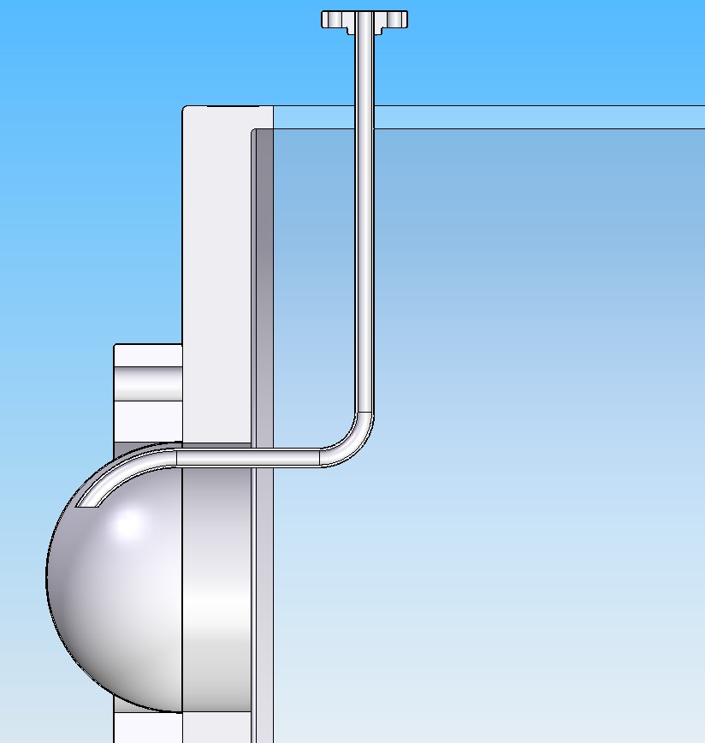
Mechanical Design Concept
Window Cooling Nozzle
Thin Window
LCWS 2010
Amann - 3/26/10

Slide 10
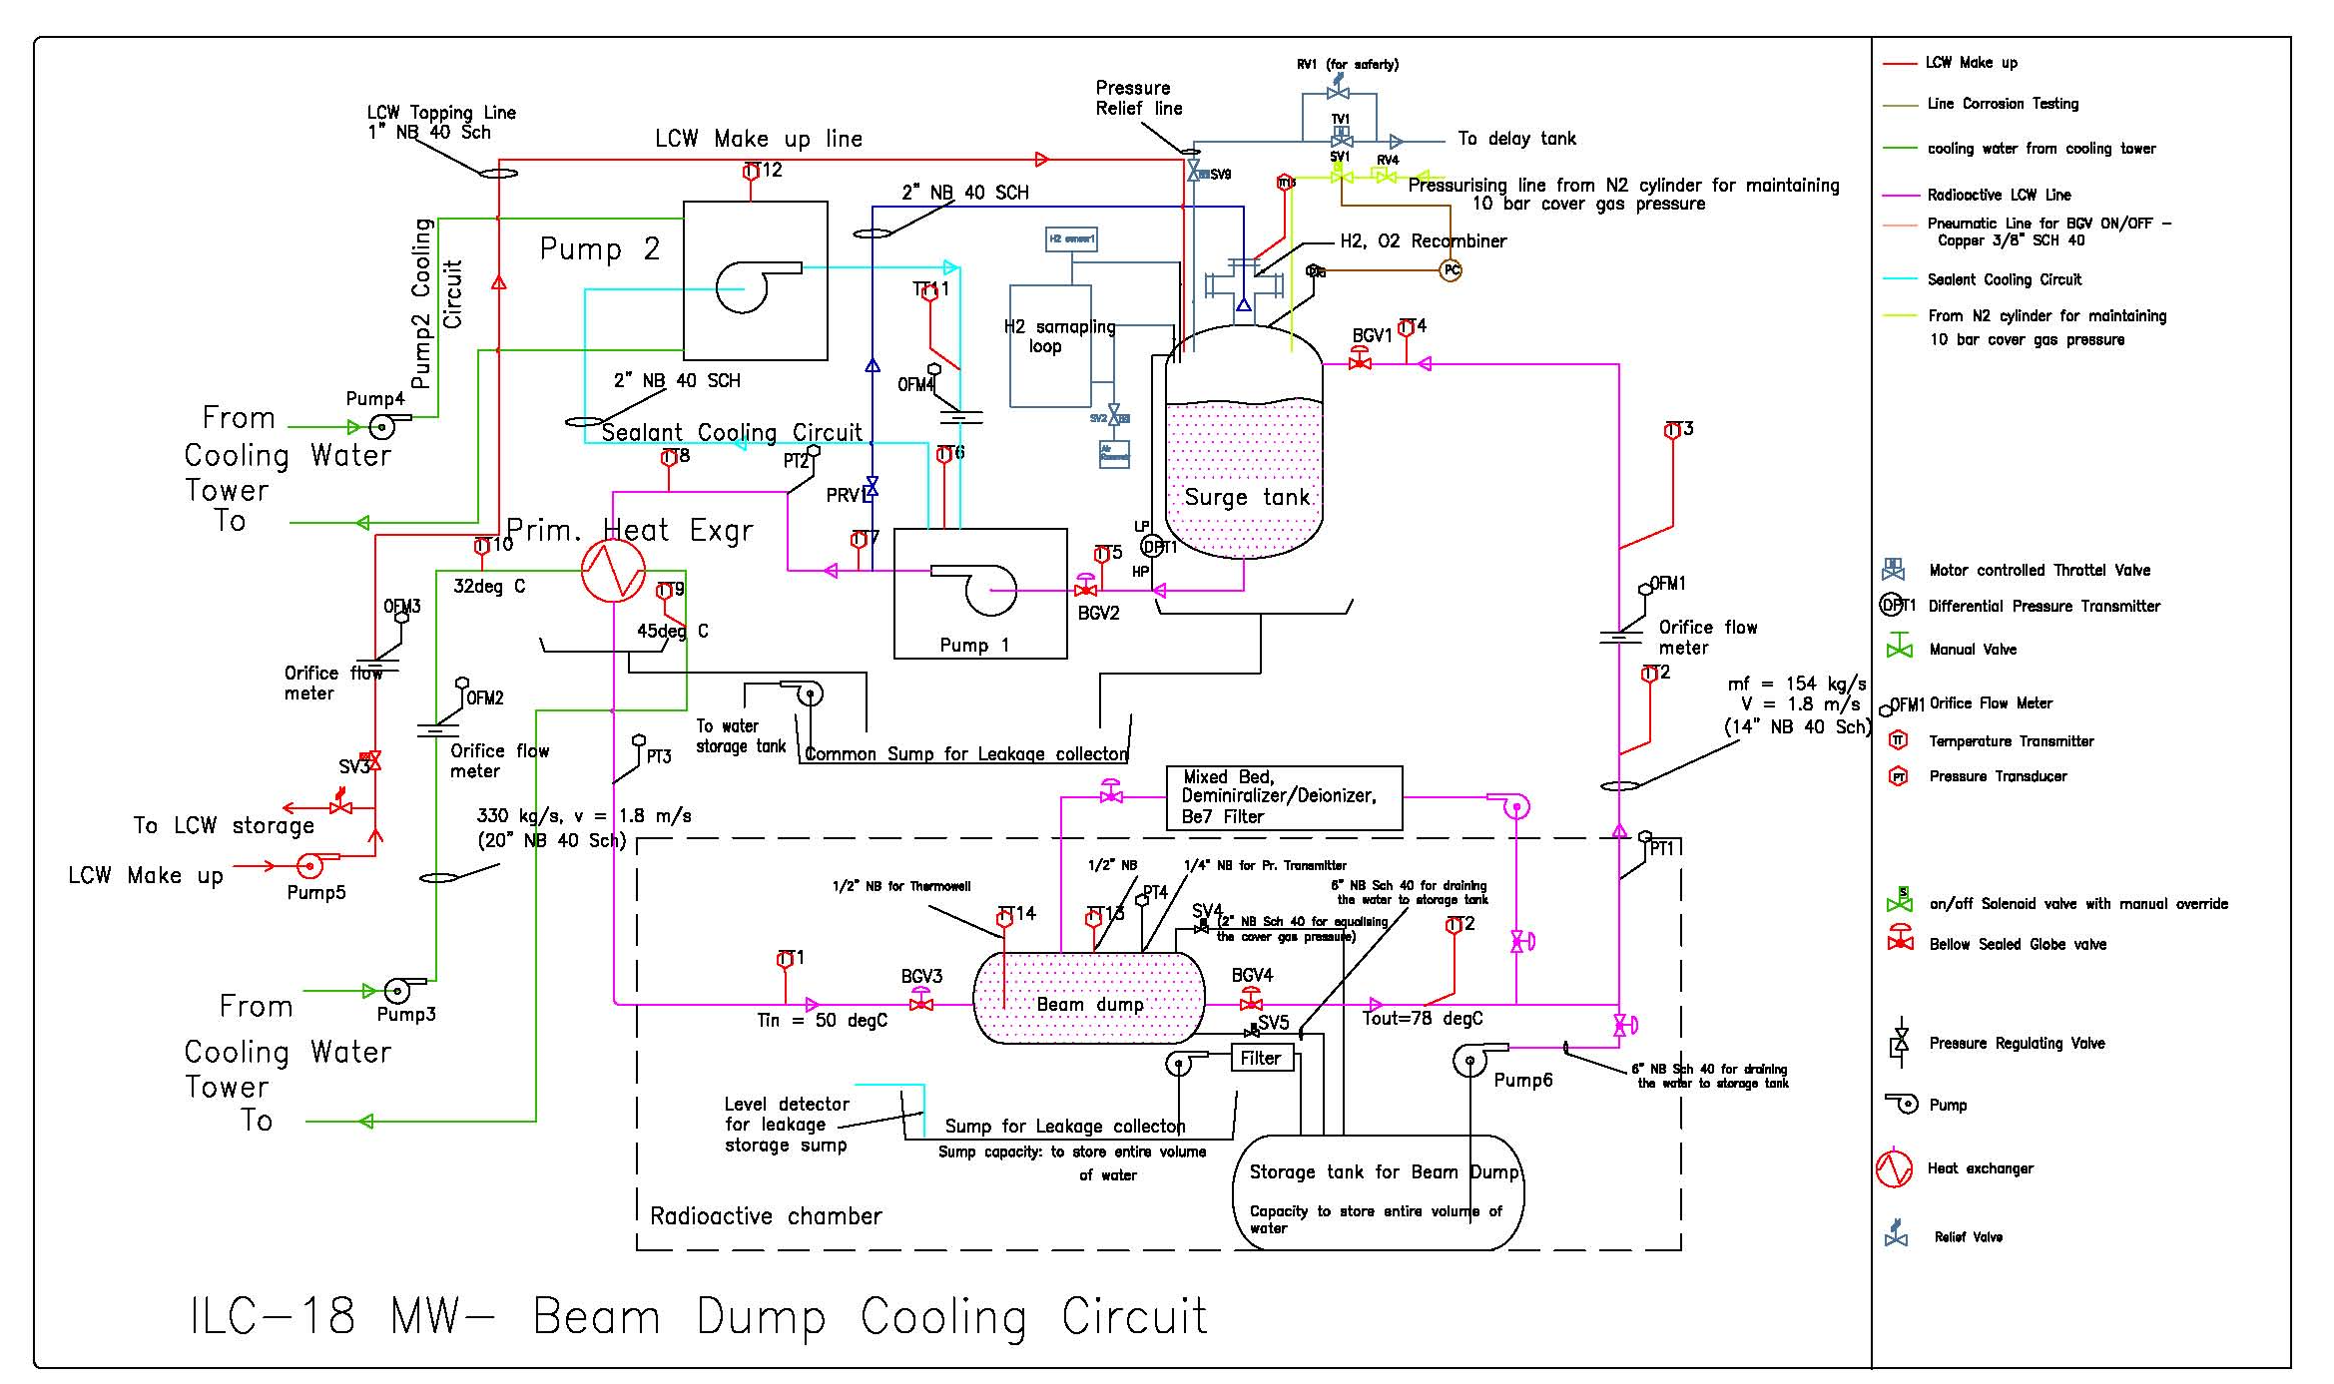
Coolant Loop
LCWS 2010
Amann - 3/26/10

Slide 11
Beam Parameters
The following beam parameters have been taken as reference for
designing the beam dump:
Electron/Positron energy: 500 GeV
Number of electrons/positrons per bunch: 2x10¹⁰
Number of bunches per train: 2820
Duration of the bunch train: 0.95 ms
Beam size: σ_{x} = 2.42mm
σ_{y} = 0.27 mm
Energy in one bunch train: 4.5 MJ
Number of bunch trains per second: 4
Beam power: 18 MW
Beam sweep radius: 6 cm
LCWS 2010
Amann - 3/26/10

Slide 12
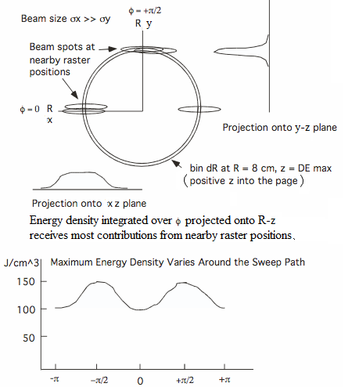
Energy Density Modulation Around Sweep Path
Interaction of electrons/positrons with Beam Dump (FLUKA Studies)
LCWS 2010
Amann - 3/26/10

Slide 13
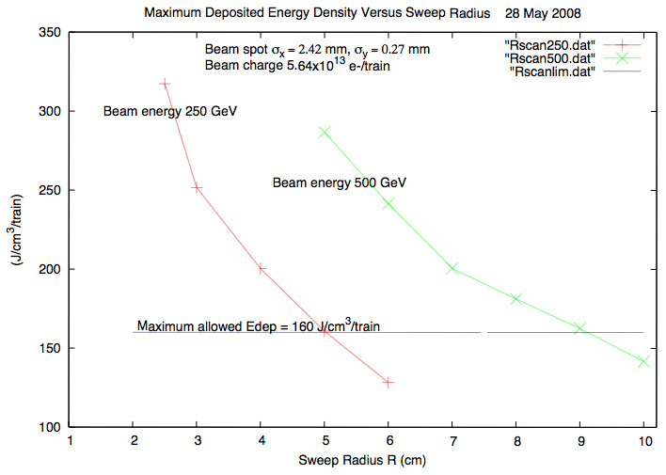
Interaction of electrons/positrons with Beam Dump
LCWS 2010
Amann - 3/26/10

Slide 14
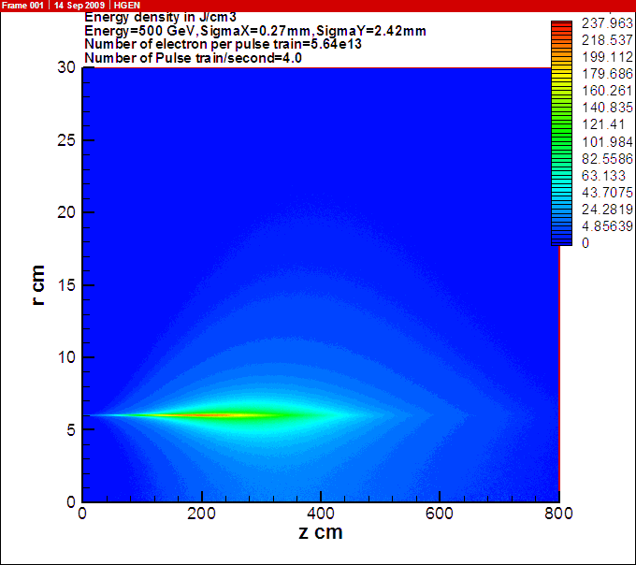
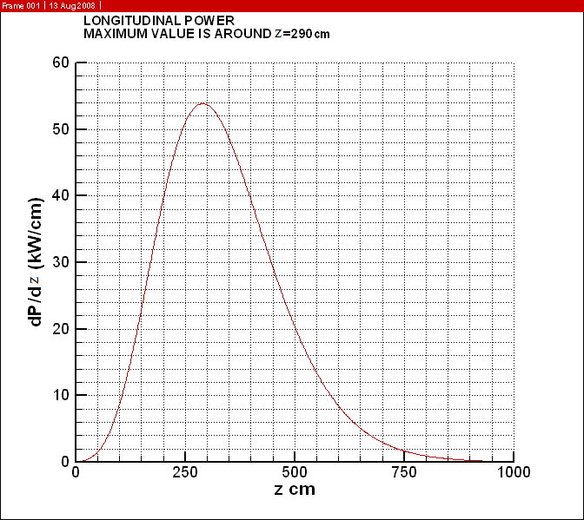
Interaction of electrons/positrons with Beam Dump
Energy deposited by one bunch train in the water (beam travelling along z-axis) max @ z=1.8m
Radially integrated longitudinal linear power
density max @ z=2.9m
LCWS 2010
Amann - 3/26/10

Slide 15
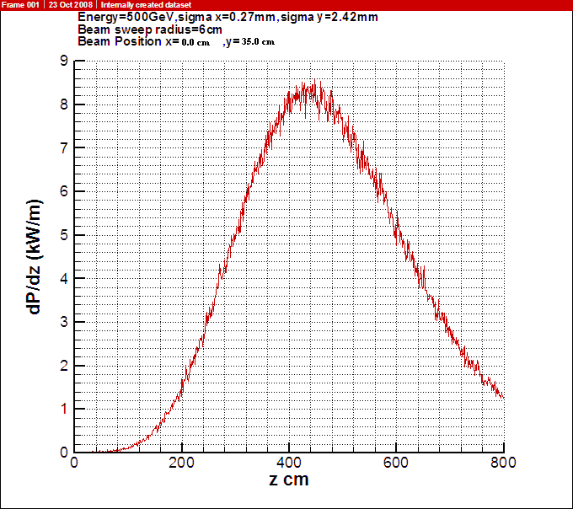
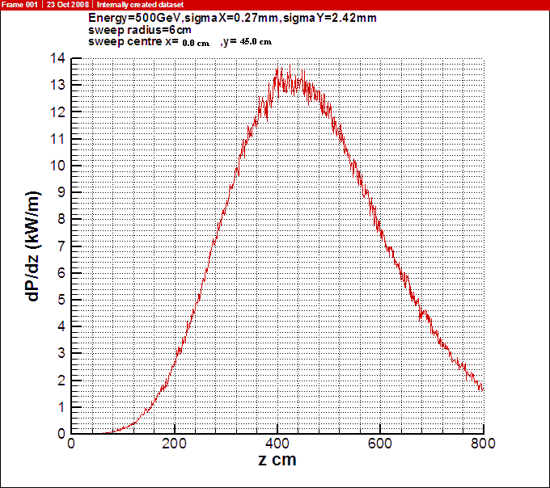
Interaction of electrons/positrons with Beam Dump
Longitudinal Power Density in Vessel Wall
(20mm thick 316L SS)
Beam @ r=45cm
Beam @ r=35cm
LCWS 2010
Amann - 3/26/10

Slide 16
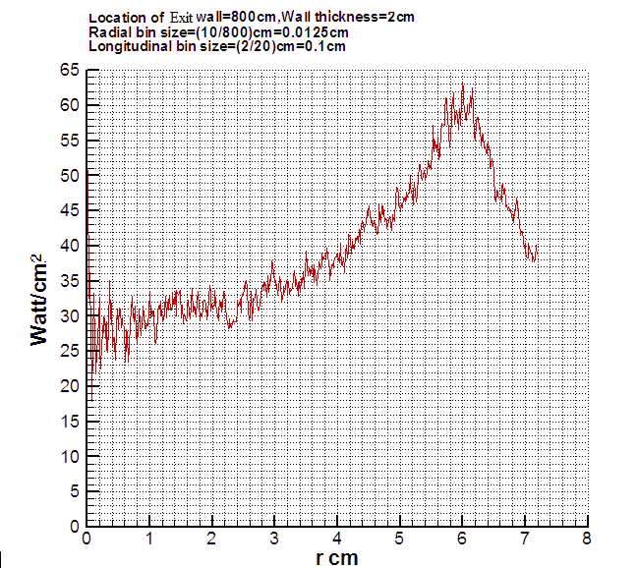
Interaction of electrons/positrons with Beam Dump
Heat Flux – Down Beam Head
LCWS 2010
Amann - 3/26/10

Slide 17
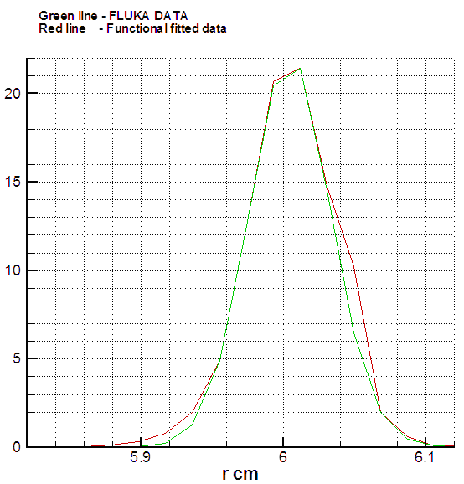
Interaction of electrons/positrons with Beam Dump
A FLUKA analysis was carried out to
determine the beam power distribution
in the thin window.
The total power deposited is ~25 W
with a maximum power density of
21W/cm³.
Functional fitted data is the
input for the CFD analysis.
W/cm³
LCWS 2010
Amann - 3/26/10

Slide 18
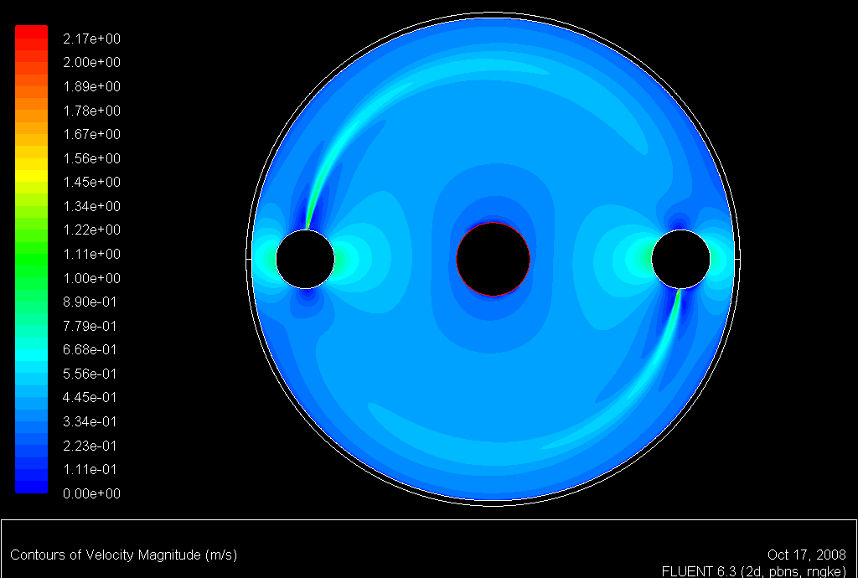
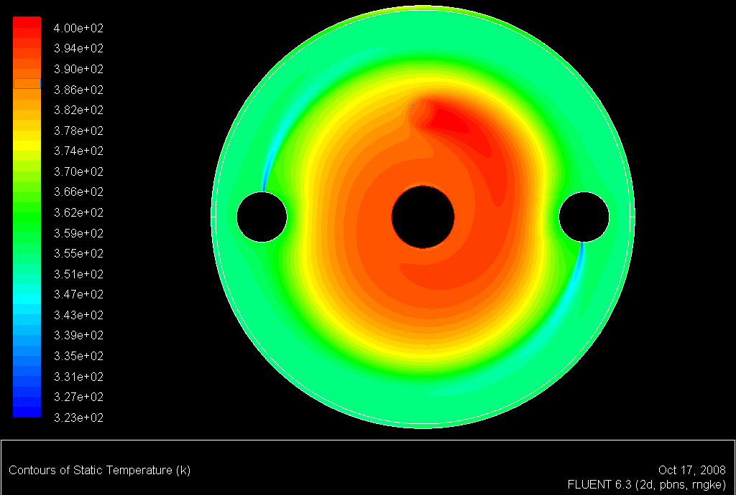
Thermal hydraulic Studies(by FLUENT)
Total mass flow rate of water taken was 190kg/s. Water inlet was assumed to be at 50⁰C as dictated by the primary coolant loop. The bulk outlet temperatures would be ~73⁰C for 18 MW average beam power. The water inlet velocity at the slit exit is 2.17 m/s.
Velocity contours at z = 2.9m
Steady state temperature distribution at z = 2.9m (Max average temperature : 127⁰C )
LCWS 2010
Amann - 3/26/10

Slide 19
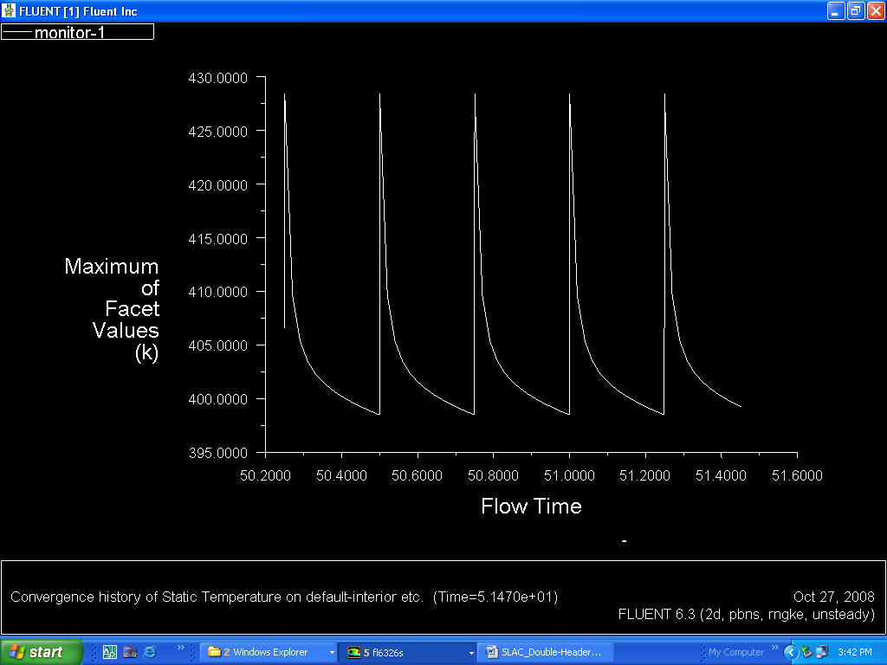
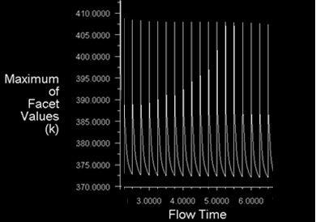
Thermal hydraulic Studies-cont.
Maximum temperature variation as a
function of time at z = 2.9m
Maximum temperature variation as a
function of time at z = 1.8 m
Maximum temperature ~155⁰C and
variation with time ~30⁰C
Maximum temperature ~135⁰C and
variation with time ~36⁰C
LCWS 2010
Amann - 3/26/10

Slide 20
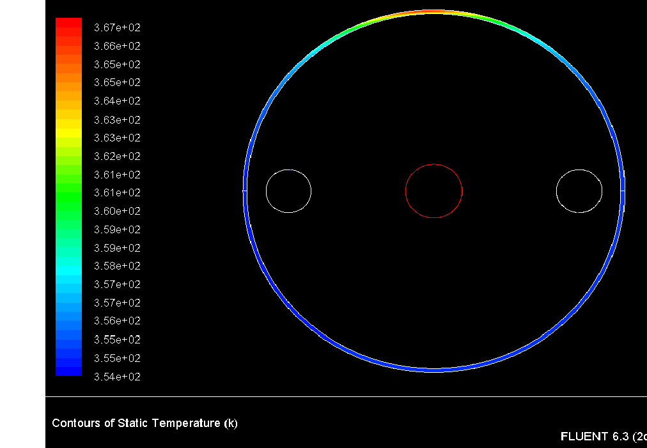
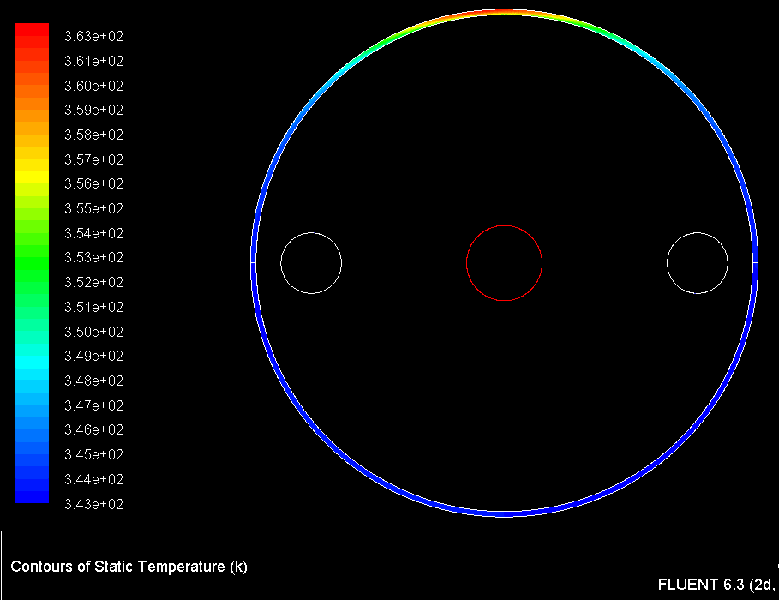
Thermal hydraulic Studies-cont.
Temperature distribution in the vessel at
z = 2.9m for the 0.45m radial beam location
Temperature distribution in the vessel at
z = 4.2m for the 0.45m radial beam location
max vessel temperature - 94⁰ C
min vessel temperature - 81⁰C
max vessel temperature - 90⁰ C
min vessel temperature - 70⁰C
LCWS 2010
Amann - 3/26/10

Slide 21
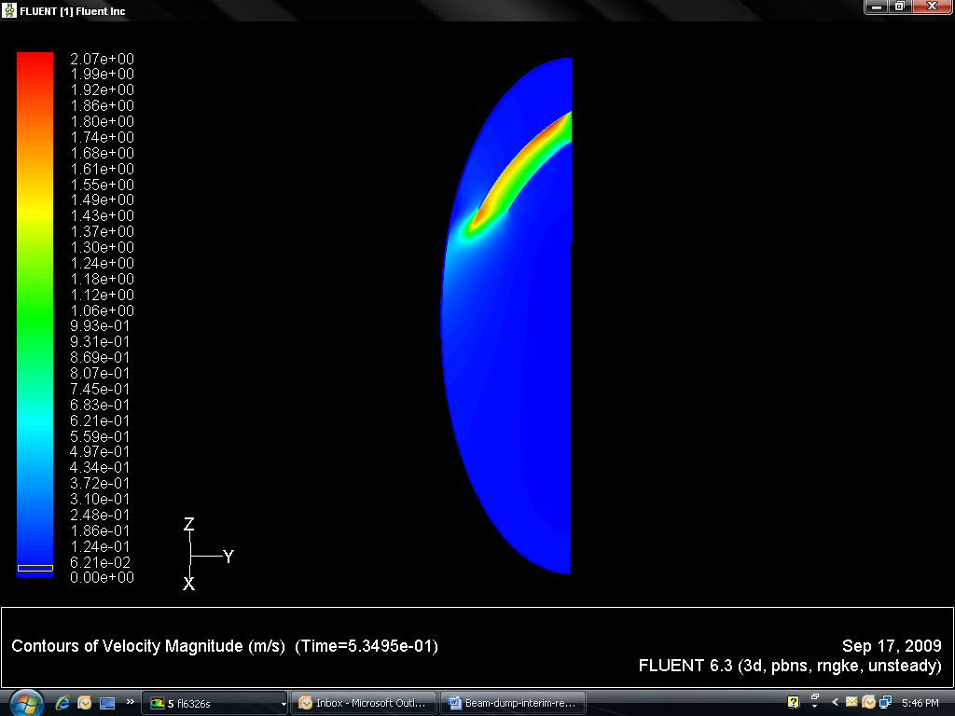
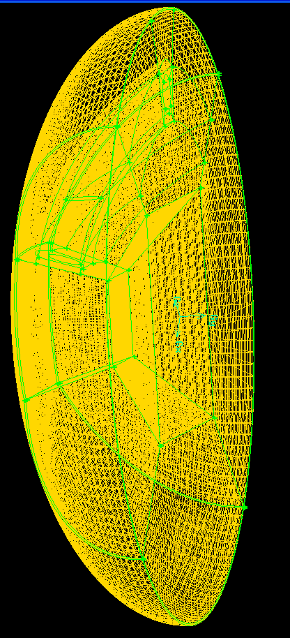
Thermal hydraulic Studies-cont.
Window Cooling - Work In Progress
LCWS 2010
Amann - 3/26/10

Slide 22
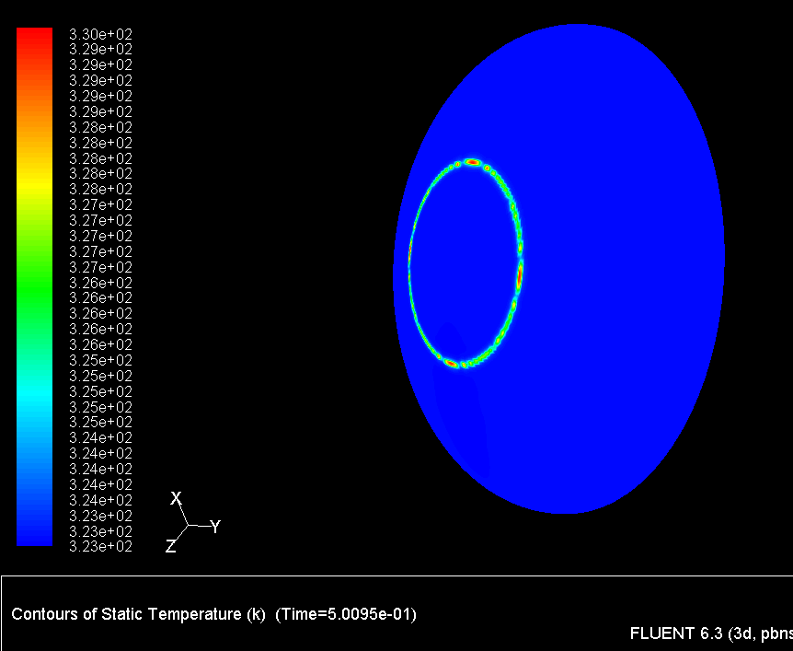
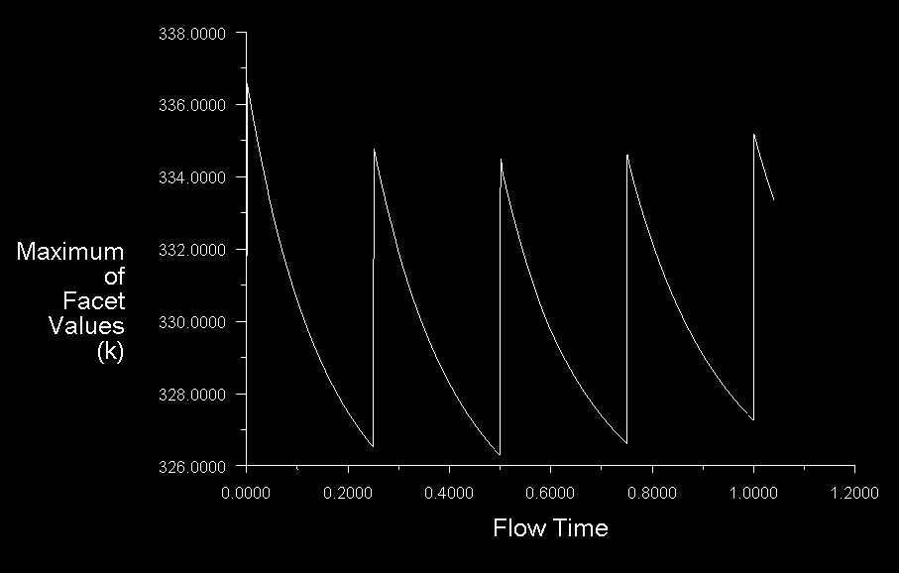
Thermal hydraulic Studies-cont.
Window Cooling - Work In Progress
LCWS 2010
Amann - 3/26/10

Slide 23
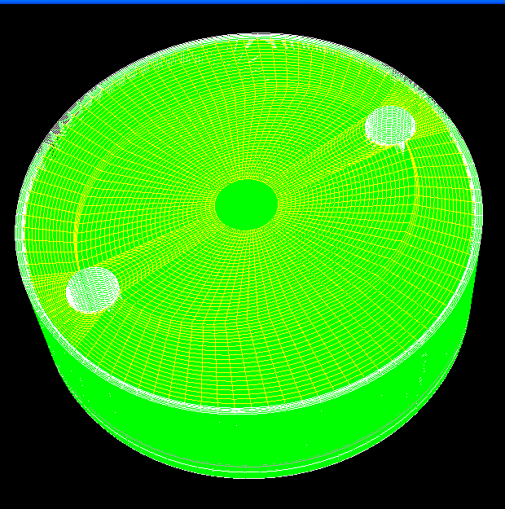
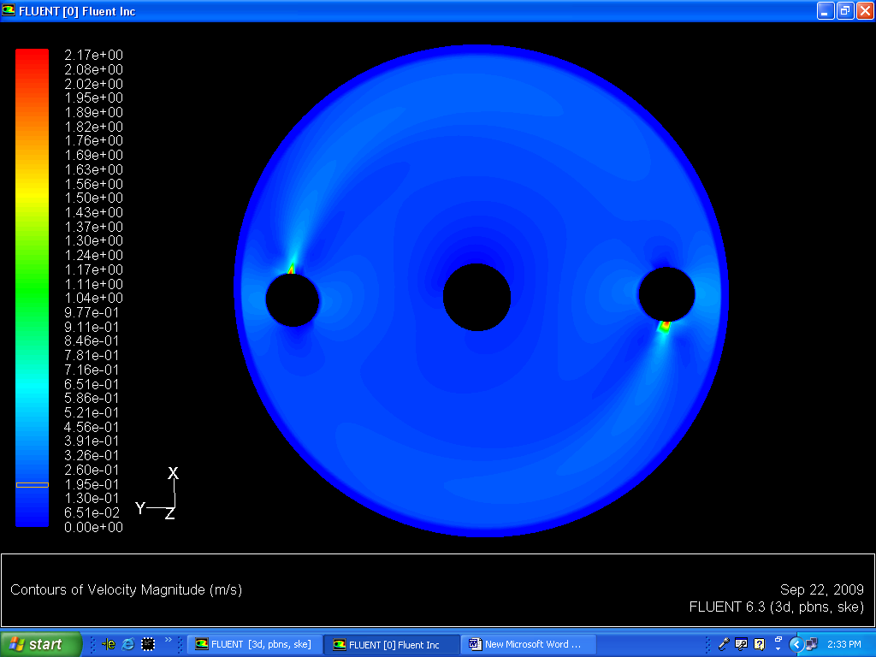
Thermal hydraulic Studies-cont
Flat Head Cooling - Work In Progress
LCWS 2010
Amann - 3/26/10

Slide 24
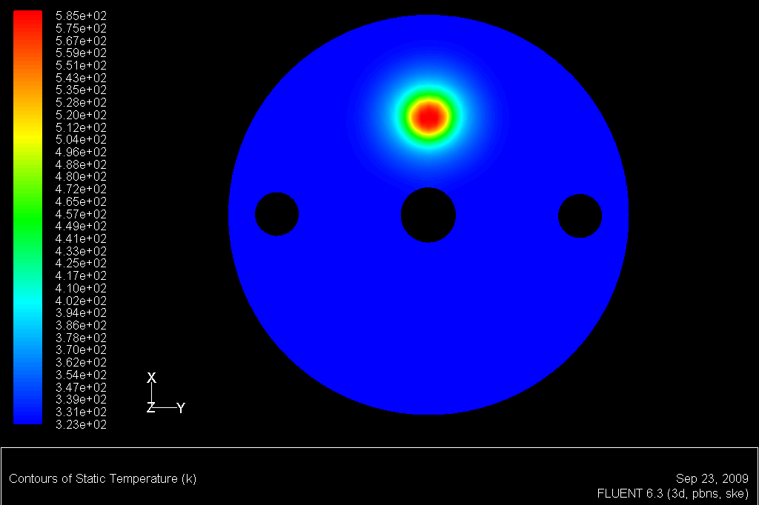
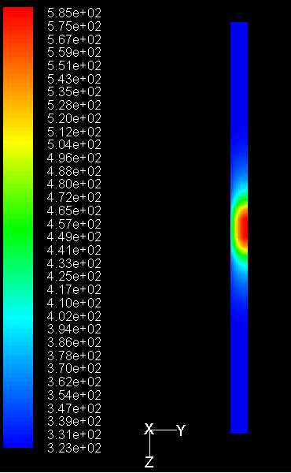
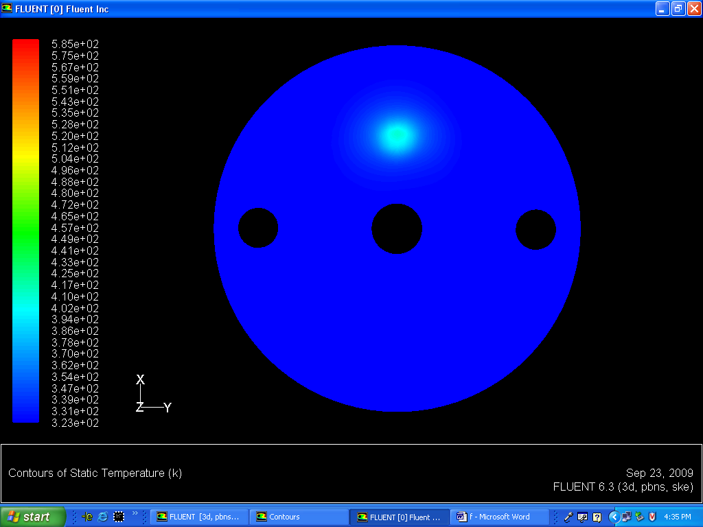
Thermal hydraulic Studies-cont.
Flat Head Cooling - Work In Progress
LCWS 2010
Amann - 3/26/10

Slide 25
Inlet header studies-(In progress)
Design of Inlet Headers
Flow analysis in the Header indicated that there was significant velocity component along z- direction (v_{z}) in the initial exit region of the Header, reducing the required outlet v_{Φ} (Φ component of the velocity). In order to enhance (v_{Φ}) and reduce the v_{z} , two alternative approaches are currently being considered; i) providing flow blocks at various locations in the exit slit of the Header, ii) providing water to the Header by multiple pipes along the z. The final configuration will be based on the outcome of this analysis.
LCWS 2010
Amann - 3/26/10

Slide 26
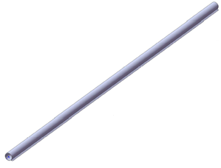
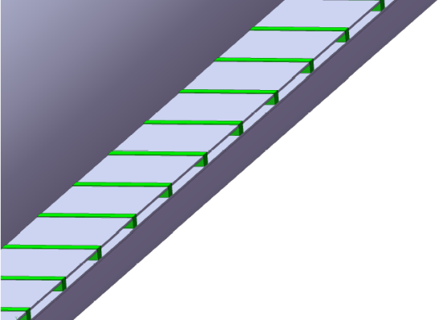
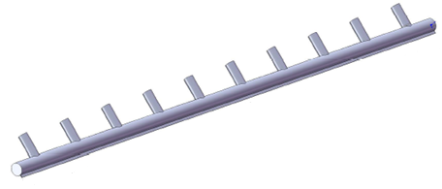
Inlet header studies-(In progress)
Configuration-1
Flow blocks each of width of 5mm
Exit nozzle of inlet header each of length 95mm
Water outlet
Water inlet
Configuration-2
water inlet pipes with 1 meter spacing along the water inlet Header
Water outlet
LCWS 2010
Amann - 3/26/10

Slide 27
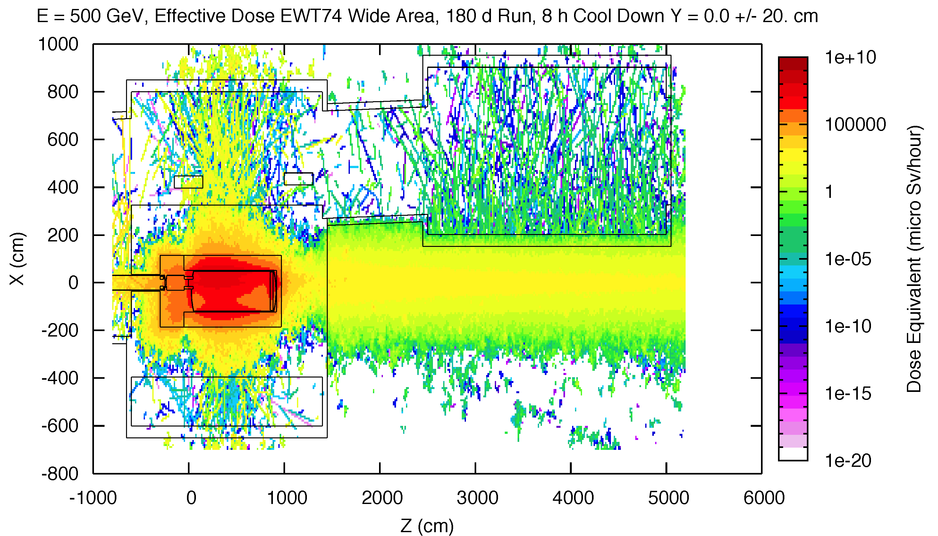
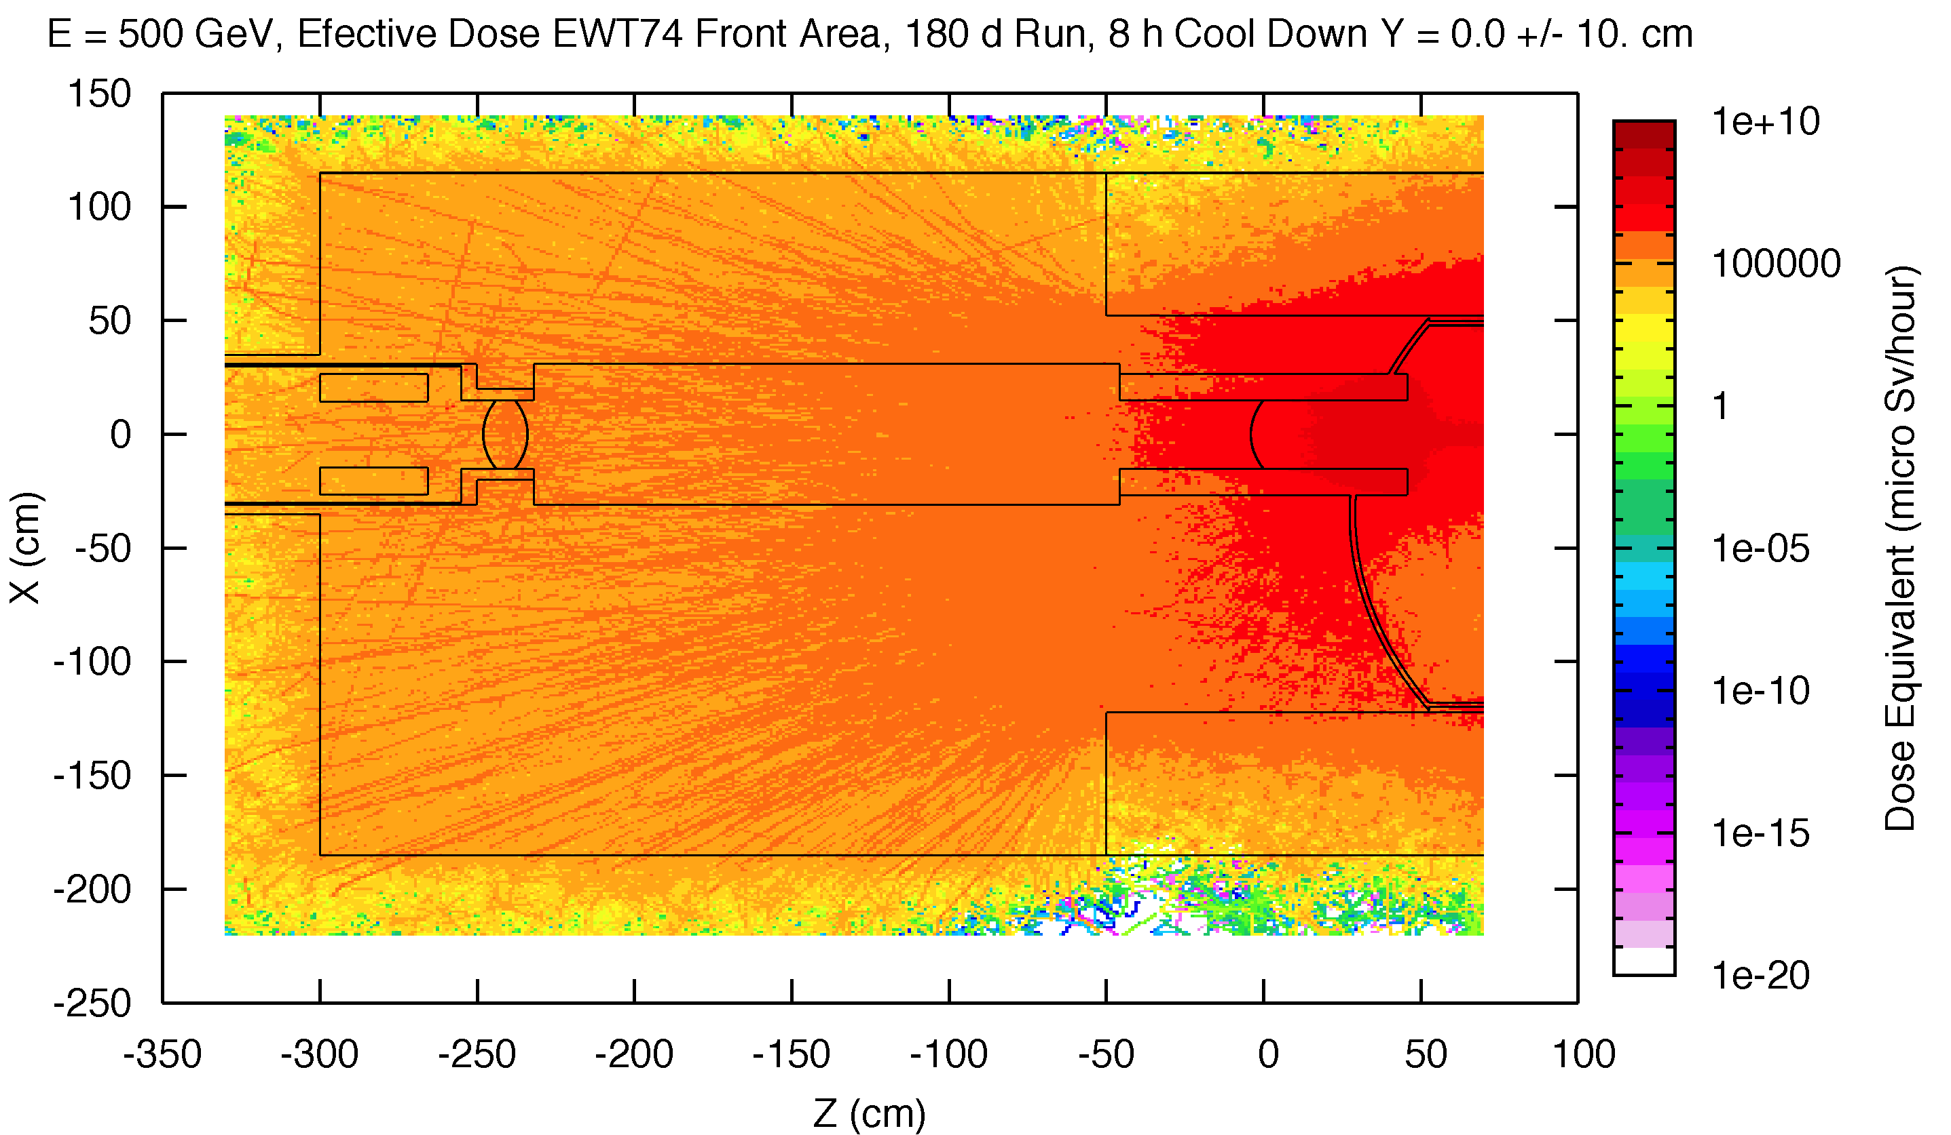
FLUKA Studies
Preliminary Activation Studies – First Design Concept
LCWS 2010
Amann - 3/26/10

Slide 28
Summary
Mechanical design concept under development.
  Basic mechanical parameters established. More detailed analysis of inlet header in progress
  Window sealing design and remote exchange system still needs work.
  Preliminary process design complete.
Thermal-hydraulic studies nearly complete.
  Beam dump parameters determined by physics.
  Inlet headers, outlet header, and window locations optimized.
  Working to finalize window cooling and down beam head cooling.
Shielding design and overall system integration still needs work.
Future work we feel is critical.
  Build a scaled down version of beam dump to verify FLUENT studies.
  Beam damage testing of thin window materials.
LCWS 2010
Amann - 3/26/10

