Slide 1
Damping Rings
Summary
S. Guiducci, INFN, M. Palmer, Cornell,
Y. Papaphilippou, CERN, J. Urakawa, KEK
IWLC , Geneva 22 October 2010

Slide 2
DR Agenda – Wednesday 20
Opening session, Chaired by M. Palmer
9:00 | Working group organisation | Y. Papaphilippou, CERN
9:15 | Design progress for the ILC Damping Rings | S. Guiducci, INFN/LNF
9:45 | Conceptual design of the CLIC Damping Rings | Y. Papaphilippou, CERN
10:15 | ATF status | J. Urakawa, KEK
Lattice design and Low emittance tuning, Chaired by R. Bartolini
11:15 | Update of 3.2 km ILC DR design | J. Gao, IHEP
11:40 | Low emittance tuning at CERTA | J. Shanks, Cornell
12:05 | ASLS low-emittance tuning progress | E. Tan, R.Dowd, ASLS
X-ray storage rings and kickers, Chaired by S. Guiducci
14:00 | DIAMOND status | R. Bartolini, JAI/DIAMOND
14:30 | ATF fast kicker progress (Webex) | T. Naito, KEK
14:55 | Update on fast pulser design/prototyping for the ILC kickers (Webex) | C. Burkhart, SLAC
15:20 | CLIC extraction systems (common WG6, 7, 8,) | M. Barnes, CERN
RF systems (Common WG8 and 4), Chaired by A. Grudiev
16:00 | Introduction | S. Guiducci, INFN
16:10 | Transient beam loading correction at ILC DR | K. Kubo, KEK
16:35 | RF system issues due to pulsed beam in ILC DR | S. Belomestnykh, Cornell
17:00 | Conceptual design of the CLIC DR RF system | A. Grudiev, CERN
17:25 | Discussion on 50% duty cycle operation of the ILC DR and synergies with CLIC DR RF design | ALL

Slide 3
DR Agenda – Thursday 21
Instabilities, Chaired by J. Urakawa
9:00 | Collective instabilities simulations for the CLIC damping rings | E. Koukovini-Platia, CERN
9:30 | Observations and Analysis of Fast Beam-Ion Instabilities at SOLEIL | R. Nagaoka, SOLEIL
10:00 | Coherent synchrotron radiation for damping rings: theory and experimental proposal | F. Zimmermann, CERN
E-cloud, Chaired by G. Rumolo
11:00 | Electron Cloud instability measurements | M. Billing, Cornell
11:30 | Electron cloud mitigation at CESRTA | M. Palmer, Cornell
IBS, Chaired by Y. Papaphilippou
14:00 | Simulation of Intrabeam scattering | A. Vivoli, CERN
Wigglers (Common with WG8), Chaired by H. Schmickler
16:00 | Design and prototyping of Nb3Sn wigglers for the CLIC damping rings | D. Schörling, CERN
16:20 | Short period NbTi wiggler prototype for CLIC damping ring | A. Bragin, BINP
16:40 | Progress on the superconducting undulator for ANKA and on the instrumentation for R&D | S. Casalbuoni, ANKA
Closing session, Chaired by Y. Papaphilippou
17:00 | Recommendation on ILC DR EC mitigation (webex) | M. Pivi, SLAC
17:30 | Discussion on future R&D planning, experimental program and LER collaboration

Slide 4
ILC DR - 6.4 km Lattice
Lattice for the 6.4 km is mature
  Racetrack layout optimal for CFS
  Flexible momentum compaction (2.9 10⁻⁴ ÷ 1.3 10⁻⁴)
  DA large enough for injection acceptance
Technical design is in progress for:
  Arc layout
  Wigglers
  vacuum system
Vacuum chamber Impedance including bpms with bellows and wiggler SR absorbers has been evaluated

Slide 5
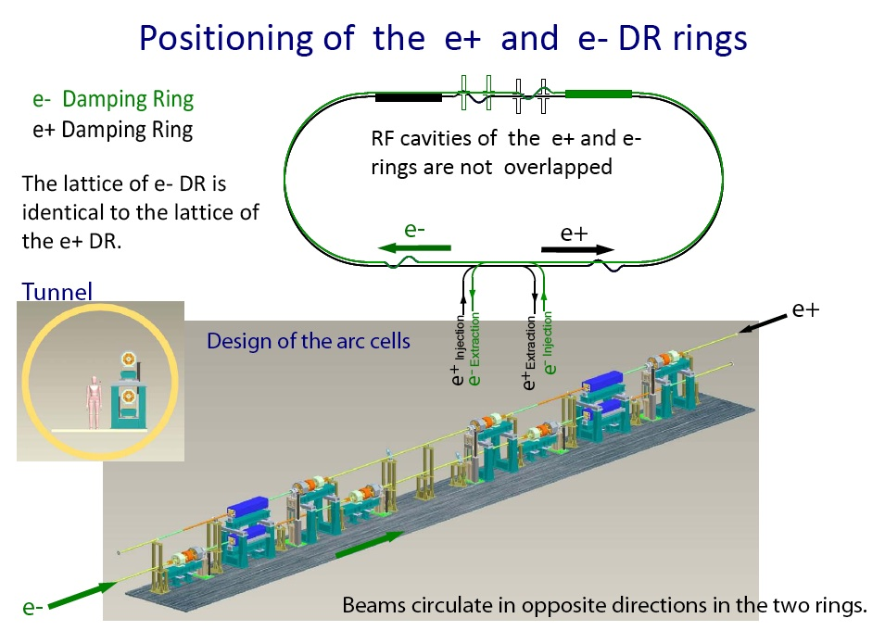
A. Wolski et al. Damping Rings Design Work at the Cockcroft Institute, ILC10 Beijing

Slide 6
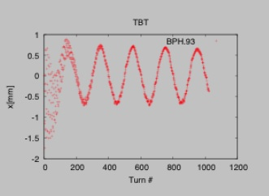
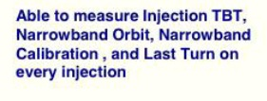

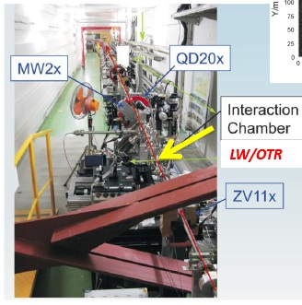
BPM Circuit upgrade (FNAL)
Upgrade of Beam Instruments
  DR BPM readout (FNAL digitizer)
  EXT Strip-line BPM readout (SLAC-LCLS digitizer)
  Multi-OTR monitors
Upgrade of Accelerator
  Two LINAC klystron Modulators
  EXT corrector PS
R&D
  Fast Kicker
  EXT Laser Wire
  4-mirror optical cavity installation
  Cold BPM
  Single- and Multi-bunch instability
Laser wire monitor
JAI(RHUL,Oxford) / KEK

Slide 7
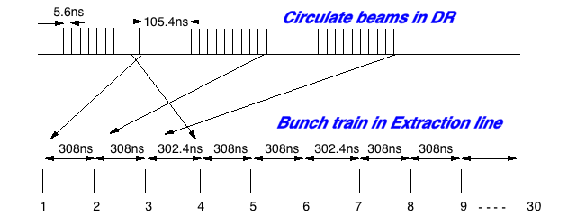
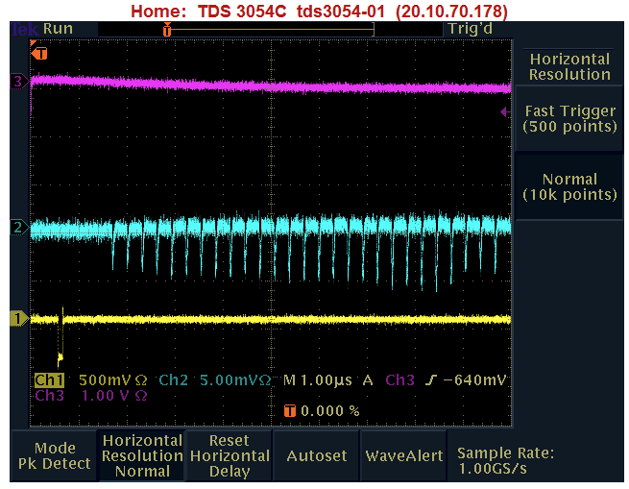
Multi-bunch beam extraction by the Fast kicker
Kick angle was stable as 4x10⁻⁴ < ILC requirement.
A pulse train delay circuit will be installed to stabilize the HV pulser for multi-bunch extraction.
in DR:
  3 Trains,
  9(max 10) bunches/train with 5.6 nsec spacing
Extracted:
  27(max 30) bunches with 308 ns spacing
  bunch-by-bunch profile follows that in the DR.
  bunches were extracted from the last bunch to the first bunch.
10/22/10
7
T. Naito, WG2, Wed 14:30

Slide 8
SB2009 Studies
Low-power option (1312 bunches) → Smaller circumference damping ring (6.4 km → 3.2 km)
2 lattices with the same racetrack layout as the DCO4 and similar straight sections are at present under study
  FODO arc cells with variable momentum compaction 2.8•10⁻⁴ ÷ 6.2•10⁻⁴ (D. Wang, J. Gao and Y. Wang, IHEP)
  SuperB-like arc cells, low momentum compaction 1.3•10⁻⁴ (M. Biagini, S. Guiducci, INFN)
Different configuration options
  Low power: 1312 bunches, 5 Hz repetition rate
  Low power: 1312 bunches, 10 Hz repetition rate
  High power: 2625 bunches, 5 Hz repetition rate

Slide 9
2nd Baseline Assessment Workshop
Main DR issues for BAW2 (SLAC 18-21st Jan. 2011):
ECLOUD evaluations
  Comparison of 6.4km ring (2600 bunches) and 3.2km ring (1300 bunches)
    Both ring configurations exhibit similar performance for single bunch instability threshold
    3.2km ring is an acceptable baseline design choice
  Recommendation for mitigation techniques
  Characterization of electron cloud at different bunch spacing in 3.2km ring: 6ns (1300 bunches) and 3ns (2600 bunches)
RF issues for 50% duty cycle DR operation
  (discussion at RF session, common WG2, WG8, WG4, Wednesday 16÷18)

Slide 10
EC Working Group Baseline Mitigation Plan
Mitigation Evaluation conducted at satellite meeting of ECLOUD`10
(October 13, 2010, Cornell University)
EC Working Group Baseline Mitigation Recommendation
 | Drift* | Dipole | Wiggler | Quadrupole*
Baseline Mitigation I | TiN Coating | Grooves with TiN coating | Clearing Electrodes | TiN Coating
Baseline Mitigation II | Solenoid Windings | Antechamber | Antechamber
Alternate Mitigation | NEG Coating | TiN Coating | Grooves with TiN Coating | Clearing Electrodes or Grooves
*Drift and Quadrupole chambers in arc and wiggler regions will incorporate antechambers
Preliminary CESRTA results and simulations suggest the presence of sub-threshold emittance growth
  Further investigation required
  May require reduction in acceptable cloud density a reduction in safety margin
An aggressive mitigation plan is required to obtain optimum performance from the 3.2km positron damping ring and to pursue the high current option
S. Guiducci, M. Palmer, M. Pivi, J. Urakawa on behalf of the ILC DR Electron Cloud Working Group

Slide 11
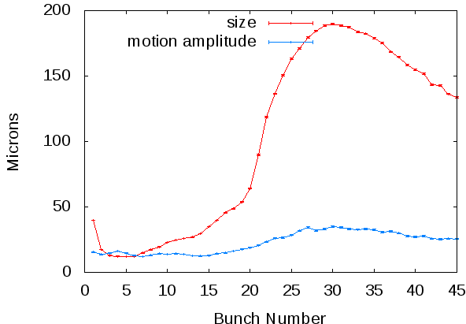
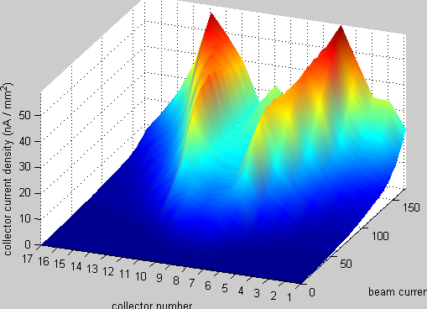
CESRTA Program
The final run in Phase I of the CESRTA program concluded on September 30, 2010
Program Highlights
  Achievement of ε_{y} = 20pm target
  Tests of a range of EC mitigations
  Beam dynamics studies
  Inputs for the ILC DR baseline design
xBSM
Bunch 1 sees
long lifetime
trapped EC
Consistent
with onset of
head-tail
instability
20pm
Must understand
sub-threshold
emittance growth
Dipole RFA –
Beam Current Scan
SLAC Chicane
Head-Tail Instability:
Onset of synchro-betatron
sidebands along bunch train
mA

Slide 12
ILC Damping Ring RF system 50% Duty Cycle
e⁻ linac runs at 10 Hz alternating:
  1 pulse for positron production and injection into e⁺ DR
  1 pulse for collisions at 5 Hz
e⁺ DR is empty half of the time (100 ms):
  Beam injected in ~1ms
  Beam stored for 100 ms for damping
  Beam extracted in ~1 ms
Main Concern:
  large beam loading variation in a very short time (1 ms)
  implications on RF system and beam stability
WG2 RF Session, Wednesday 16:00: Discussion to get advice from RF experts in preparation of BAW2 meeting, SLAC 18-22 Jan 2011
  Feasible? Needs more R&D? Cost implications?

Slide 13
Option #1: lower overvoltage factor
Alessandro Gallo (DAFNE RF system, LNF) performed further analysis and derived
where η is the overvoltage factor. One can see that for η ≤ 2 the cavities can be operated at fixed detuning while the power demand for zero beam current does not exceed the maximum beam power.
Questions:
Is it possible to reduce the overvoltage factor?
How it was chosen in the first place?
The 3.2 km ring has
η ≤ 2
for all the configurations

Slide 14
Summary
10 Hz operation of the ILC Damping Ring RF system seems to be feasible.
We have presented four different options. Each of them however have challenges.
Option #3 is the most attractive as the RF power demand is minimal under it. However, it requires extensive R&D.
Option #1 would be the most easily implementable if the overvoltage factor can be lowered to 2.
Common concerns & studies needed (in addition to those listed for individual options):
RF window/coupler power handling with full reflection (except option #3)
Feedforward to mitigate transients during beam injection/extraction
Pulsed operation of the RF system is worth considering as it will save power and reduce thermal load on RF window/coupler. Two options here: (i) pulsed RF and klystron mod anode; (ii) pulsed klystron HV.
(Option #3 Fast frequency tuner)

Slide 15
CLIC DR parameter optimization
Reasonable magnet strengths (magnet models already studied) and space constraints
DA significantly increased
TME optics with gradient in the bend and energy increase reduces IBS growth factor to 1.4 (as compared to 5.4 in original DR design)
Reduction of space charge tune-shift with combined circumference reduction and bunch length increase
Further optics optimization with respect to IBS and tracking code for comparaison with analytical theory
Parameters | Value
Energy [GeV] | 2.86
Circumference [m] | 420.56
Coupling | 0.0013
Energy loss/turn [MeV] | 4.2
RF voltage [MV] | 4.9
Natural chromaticity x / y | -168/-60
Momentum compaction factor | 8e-5
Damping time x / s [ms] | 1.9/ 0.96
Dynamic aperture x / y [σ_{inj}] | 30 / 120
Number of dipoles/wigglers | 100/52
Cell /dipole length [m] | 2.36 / 0.43
Dipole/Wiggler field [T] | 1.4/2.5
Bend gradient [1/m²] | -1.10
Max. Quad. gradient [T/m] | 73.4
Max. Sext. strength [kT/m²] | 6.6
Phase advance x / z | 0.452/0.056
Bunch population, [10⁹] | 4.1
IBS growth factor | 1.4
Hor./ Ver Norm. Emittance [nm.rad] | 400 / 4.5
Bunch length [mm] | 1.6
Longitudinal emittance [keVm] | 5.5

Slide 16
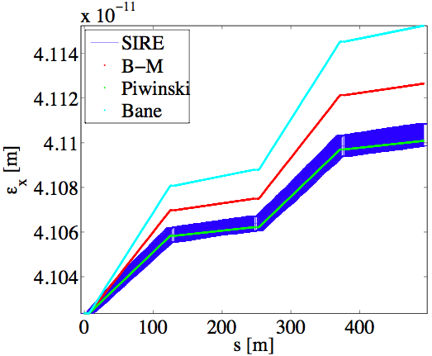
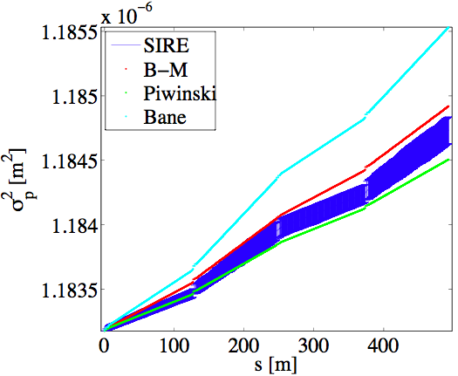
IBS tracking code
 | 1/Tx (s⁻¹) | 1/Ty (s⁻¹) | 1/Tz (s⁻¹)
MADX (B-M) | 1476.7 | 952.9 | 1010.6
Bjorken-Mtingwa (Martini) | 1579.4 | 739.1 | 968.5
SIRE (compressed) | 1224.6 | 732.5 | 815.6
SIRE (not compressed) | 1181.1 | 691.8 | 802.0
Mod. Piwinski | 1299.5 | 625.7 | 775.2
A. Vivoli, F. Antoniou, et al.
 | γεx (m) | γεy (m) | εz (eV m)
Injection | 74e-6 | 1.8e-6 | 130589
Extraction | 498e-9 | 4.3e-9 | 3730
Equilibrium (NO IBS) | 254e-9 | 3.7e-9 | 2914
Developed Monte-Carlo tracking code for IBS including synchrotron radiation damping and quantum excitation (SIRE, based on MOCAC)
Agreement between analytical emittance growth and the mean values obtained by 20 SIRE runs
Final emittances obtained by SIRE are just within the CLIC DR budget but for lower longitudinal emittance

Slide 17
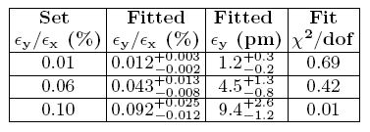
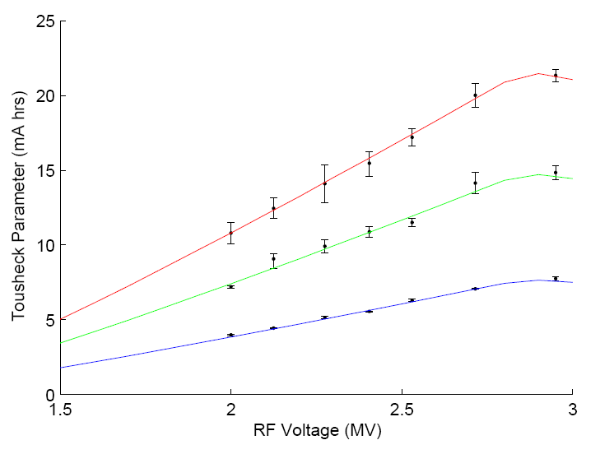
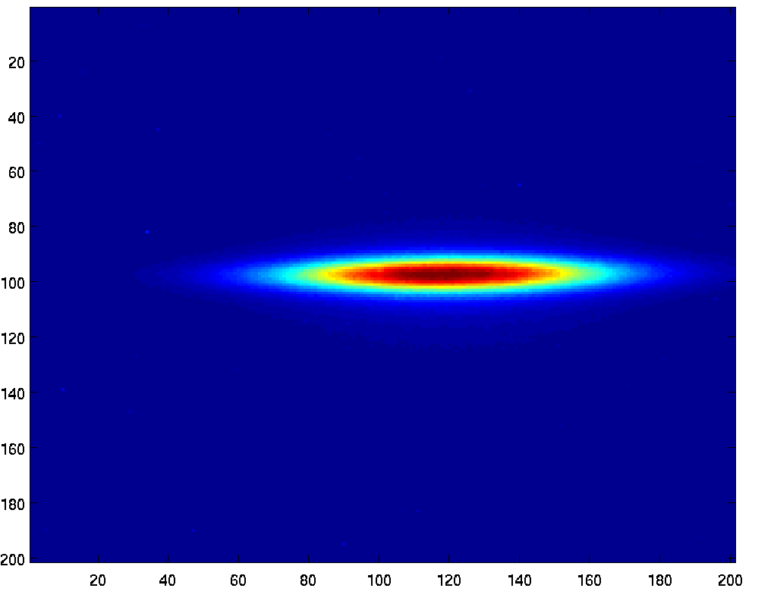

Reaching Quantum Limit Of Vertical Emittance
Tousheck component variation with RF voltage in ASLS
Blue curve fit corresponds to
ε_{y} = 1.24 ± 0.3 pm
Beam size measurement in Diamond after coupling correction
V beam size at source point 6 μm
Emittance coupling 0.08% →
V emittance 2.2 ± 0.4 pm
E.Tan, R. Dowd, R. Bartolini

Slide 18


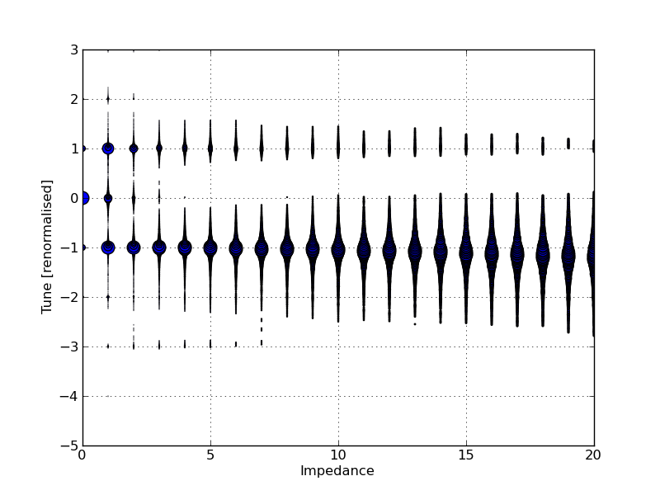
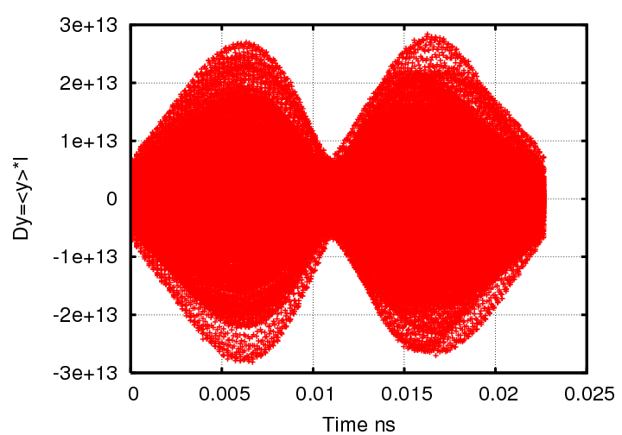
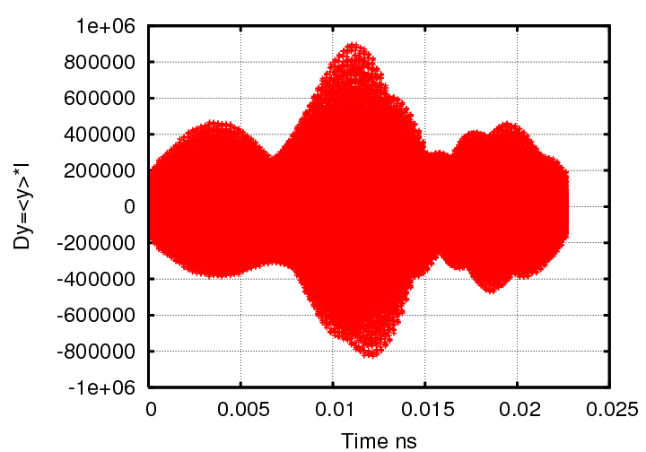
CLIC Damping Rings TMCI simulations
Results for round chamber
E. Koukovini-Platia, G. Rumolo
 | x | y | x | y
Chromaticity H/V | Threshold [MΩ/m] |  | Rise time (ms) τx=1.88, τy=1.91
0/0 | 10 | 11 | 0.38 | 0.49
9.2/1.9 | 16 | 3 | 1.92 | 2
18.4/3.8 | stable | 6 | stable | 1.81
27.6/5.7 | stable | 13 | stable | 1.81
36.8/7.6 | stable | 16 | stable | 1.81
46/9.5 | stable | 18 | stable | 1.81
For chromaticity 0, the TMCI threshold is at 10 and 11 MΩ/m for x,y respectively
For positive chromaticity, there is no TMCI but another instability occurs.
As the chromaticity is increased, higher order modes get excited, less effect, move to higher instability thresholds

Slide 19
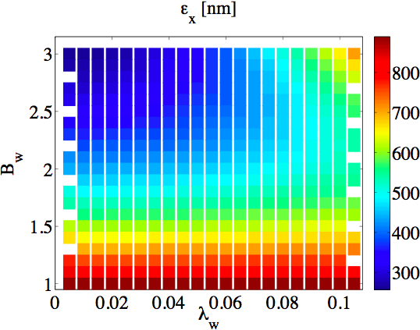
Wigglers’ effect with IBS
Stronger wiggler fields and shorter wavelengths necessary to reach target emittance due to strong IBS effect
Current density can be increased by different conductor type
Nb₃Sn can sustain higher heat load (potentially 10 times higher than NbTi)
Two wiggler prototypes
  2.5T, 5cm period, built and currently tested by BINP
  2.8T, 4cm period, designed by CERN/Un. Karlsruhe
Mock-ups built and magnetically tested
Prototypes to be installed in a storage ring for beam measurements
Nb₃Sn SC
wiggler
NbTi SC
wiggler
BINP PM
Wiggler
Parameters | BINP | CERN
B_{peak} [T] | 2.5 | 2.8
λ_{W} [mm] | 50 | 40
Beam aperture full gap [mm] | 13
Conductor type | NbTi | Nb₃Sn
Operating temperature [K] | 4.2

Slide 20
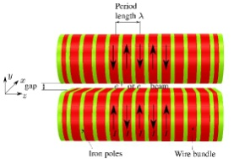
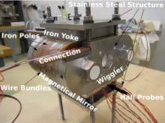
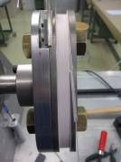
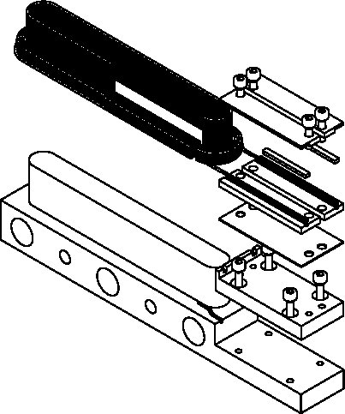
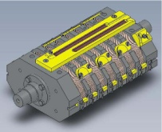
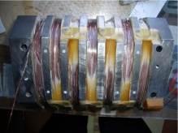
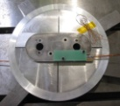
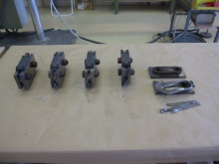
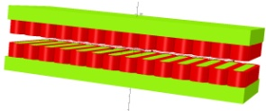
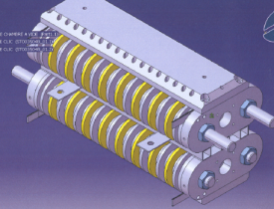
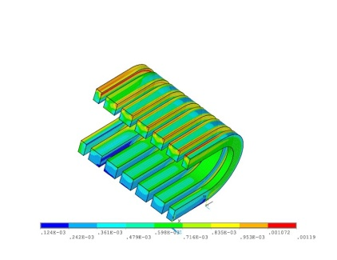
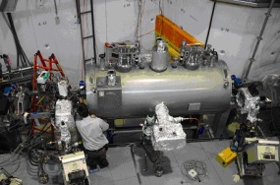
Nb₃Sn Technology
Nb-Ti Technology
CDR
SCU14 in ANKA
TDR
D. Schoerling, S. Russenchuck, A. Bragin et al.

Slide 21
Conceptual Design of CLIC DR RF system
All 3 options seems to be feasible but have different issues summarized below
 | “A la linac” |  | ARES |  | SC
Train length [ns] | 156 | 312 | 156 | 312 | 156 | 312
Total stored energy [J] | 0.3 |  | 77 | 154 | 77 | 154
Shunt impedance R [MΩ] | 36 |  | 1.9 | 0.95 | 20000 | 10000
Total rf power [MW] | 6 (3) |  | 6 | ~12 | 0.6 | 1.2
Total length [m] | 10 (5) |  | ~50 | ~50 | ~20 | ~40
Klystron bandwidth [%] | > 1 |  | < 0.1 |  | < 0.1
Voltage modulation | Strong: Phase + amplitude |  | No, or very small phase | Could be stronger | No, or very small phase | Could be stronger
Strong HOM damping | demonstrated |  | demonstrated |  | demonstrated in single cell
Transverse impedance | Highest |  | Lower |  | Lowest
Cryogenic power [MW] | 0 |  | 0 |  | >0.5
Main Challenge | Voltage modulation for transient compensation, Low efficiency |  | Low efficiency Big size |  | Low R/Q, Rf design both for fundamental and for HOM
φ_{s} reduction will help a lot here
A. Grudiev

Slide 22
Main Beam: Transverse Beam Impedance of CLIC DR and PDR Striplines
Allowable transverse broad band beam impedance, in the CLIC PDR & DR, is 10MΩ/m. Maximum transverse impedance per kicker system is assumed to be 2%, i.e. 200kΩ/m.
Damping Ring
Calculated transverse impedance, for 1.3m long striplines, is less than 200kΩ/m, for all frequencies, with or without tapers.
Calculated transverse impedance, for 3m long striplines, is less than 200kΩ/m, for all frequencies, with or without tapers.
For longitudinal impedance reasons, two sets of striplines with individual length of 1.5m may be used.
Transverse impedance of two sets of 1.5m striplines would be slightly greater than twice that shown for 1.3m striplines. Thus each PDR kicker system would meet the transverse impedance specification.
PreDamping Ring
Striplines will be prototyped under the Spanish Program “Industry for Science”.
M. Barnes

Slide 23
CLIC DR technology and experimental program
Super-conducting wigglers
  Demanding magnet technology combined with cryogenics and high heat load from synchrotron radiation (absorption)
High frequency RF system
  1 or 2GHz RF system in combination with high power and transient beam loading
Coatings, chamber design and ultra-low vacuum
  Electron cloud mitigation, low-impedance, fast-ion instability
Kicker technology
  Extracted beam stability
Diagnostics for low emittance
  Profile monitors, feedback system
Experimental program set-up for measurements in storage rings and test facilities
  ALBA (Spain), ANKA (Germany), ATF (Japan), Australia Synchrotron (Australia), CESRTA (USA), DIAMOND (UK), SOLEIL (France),…

Slide 24
Low Emittance Rings collaboration
Initiated by the ILC-CLIC working group on damping rings
Workshop organized in January 2010 at CERN identifying items of common interest among the low emittance rings community (synchrotron light sources, linear collider damping rings, b-factories)
Low emittance rings working groups formed
EU network proposal is being prepared
Next workshop to be organized during summer 2011
 | Working groups
1 | Low emittance cells design
2 | Non-linear optimization
3 | Minimization of vertical emittance
4 | Integration of collective effects in lattice design
5 | Insertion device, magnet design and alignment
6 | Instrumentation for low emittance
7 | Fast Kicker design
8 | Feedback systems (slow and fast)
9 | Beam instabilities
10 | Impedance and vacuum design
11 | RF design

