Slide 1
Report from Nextef
IWLC10, Genève, Oct. 20
T. Higo (KEK)

Slide 2
Contents
Nextef
TD18 results and related issues
Near future experimental plans
Nextef expansion status
Other associated activities

Slide 3
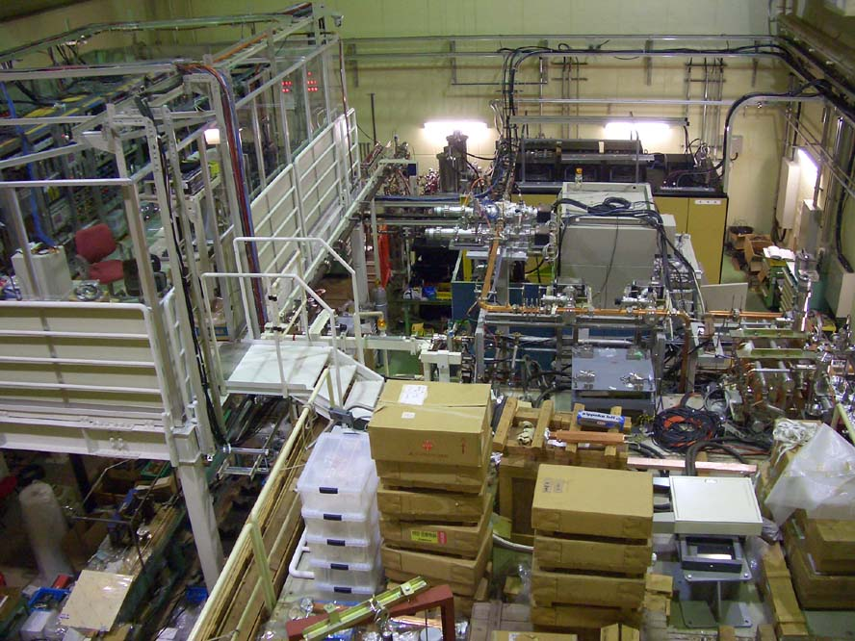
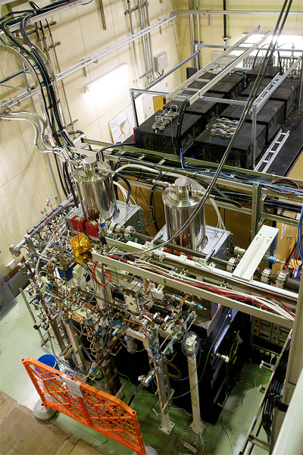
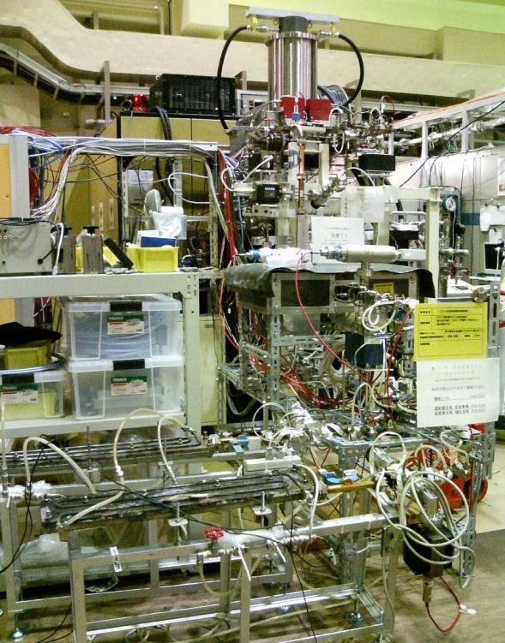
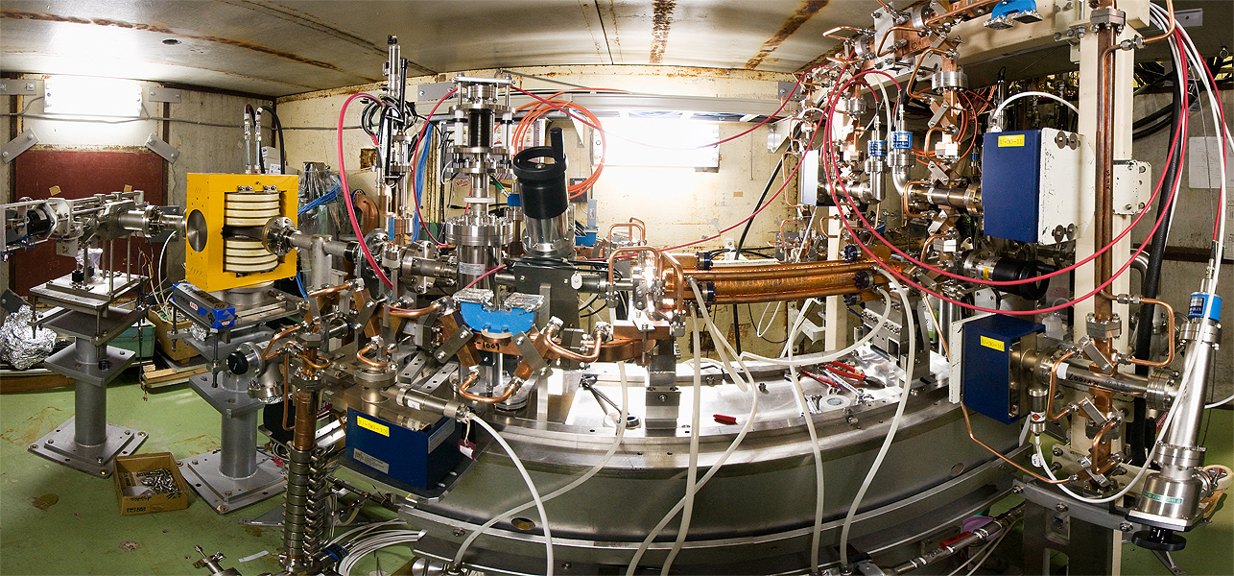
Nextef has been keeping the same configuration since 2007
Nextef
2 klystron setup
KT1
1 klystron setup

Slide 4
Studies at Nextef & KT1
2008 2009 2010 2011 2012
7 10 1 4 7 10 1 4 7 10 1 4 7 10 1 4 7 10
Nextef
Pulse compression?
Compete against structure test?
KX03 (60cm HDDS)
T18_Disk_#2
TD18_Quad_#5
TD18_Disk_#2
T24_Disk_#3
TD24_Disk_#
Choke T24R05, DDS, ……….?
KT1
Narrow waveguide test
High power components test
RF delivery from KT1 to shield-B
Feed basic studies at shield-B

Slide 5
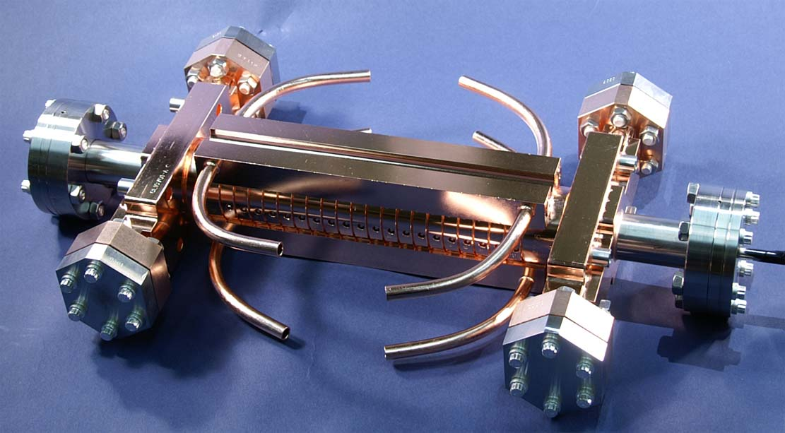
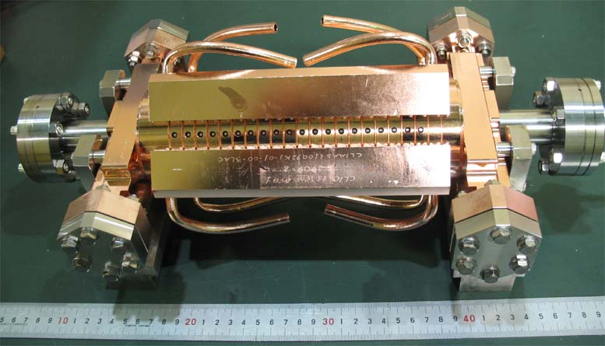
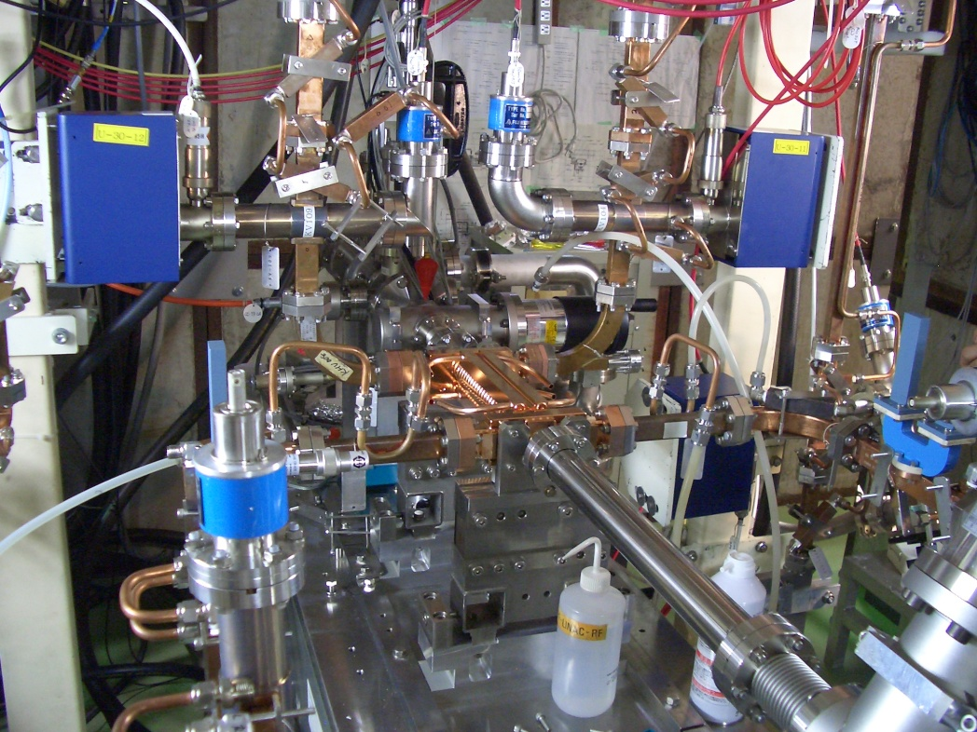
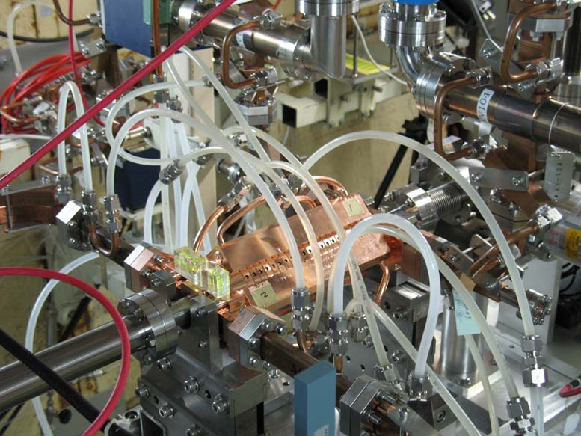
Structure test for CLIC study
T18_Disk_#2
TD18_Disk_#2

Slide 6
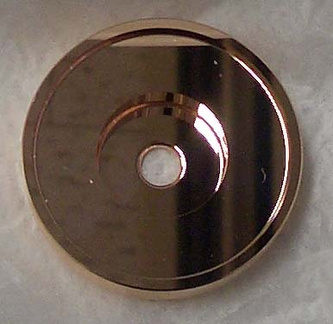
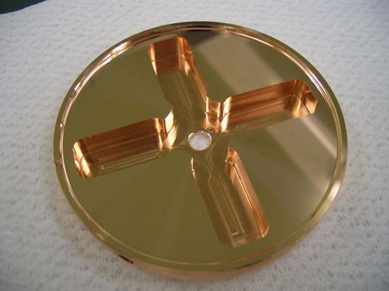
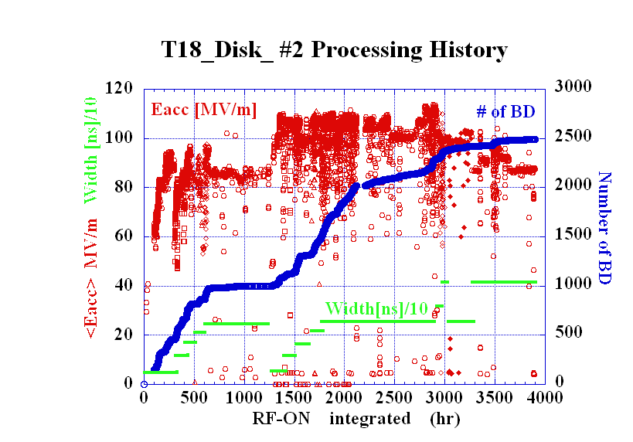
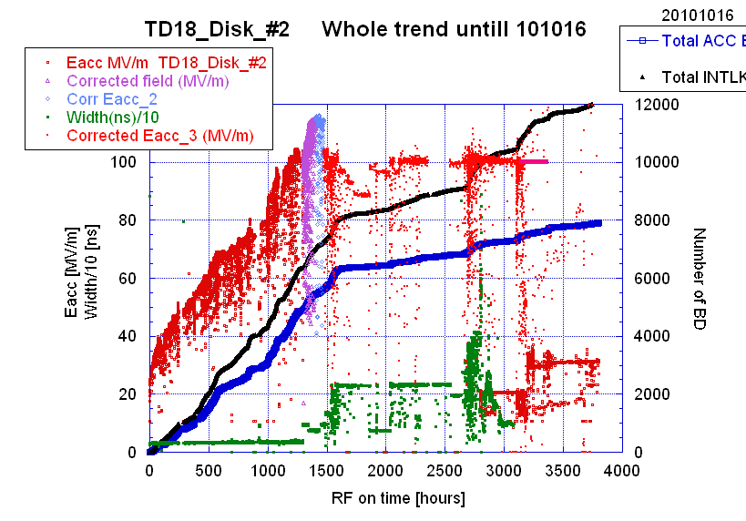
T18_Disk_#2
Undamped disk-based
Strategy
Disk-based
CLIC electric design
KEK mecha design +fab
SLAC assembly
Test at SLAC and KEK
TD18_Disk_#2
Damped disk-based

Slide 8
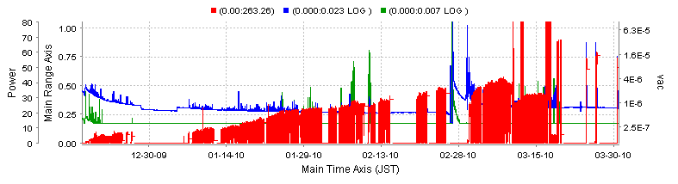
Vacuum level and low power feature
VAC-@OUT-WG
ACC-IN power
VAC@IN-WG
Vacuum level was not so good, ~1x10^-6Pa at worst position.
Now preparing an action to improve from the next structure.

Slide 9
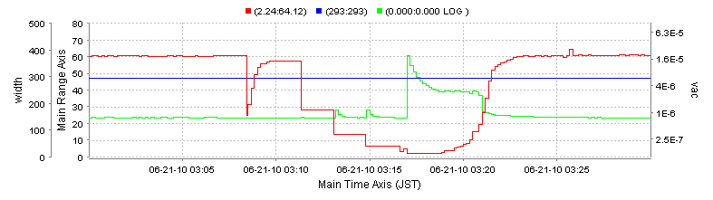
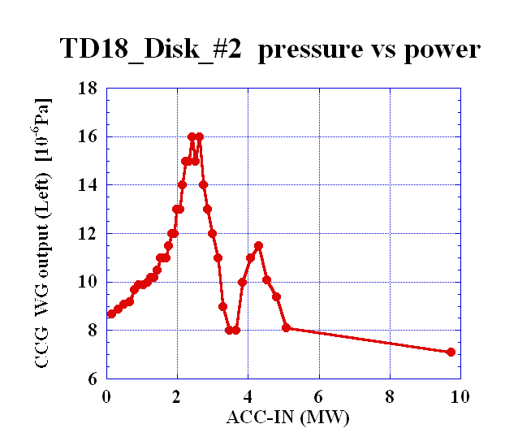
Pressure increase at low power level
Even after running at top power, the vacuum gets worse when it decreases power.
ACC-IN power
VAC@IN-WG
Even a few hour stop of RF pulses makes the vacuum level worse in the next startup process, because the recovery usually passes through this region.

Slide 10
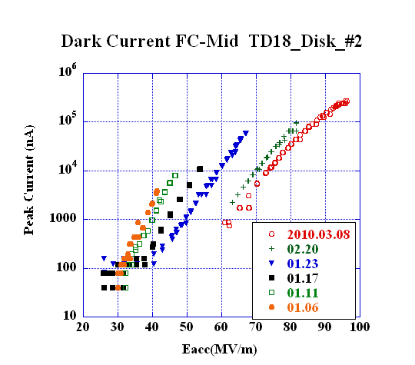
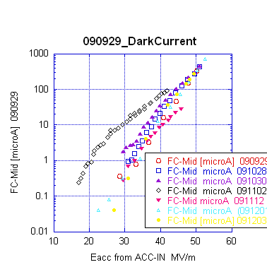
Presented to IPAC10
Comparison of dark current
T18_Disk
TD18_Disk
TD18_Quad
TD18_Quad
Eacc for peak dark current of 10 μA
90MV/m 70MV/m 40MV/m

Slide 11
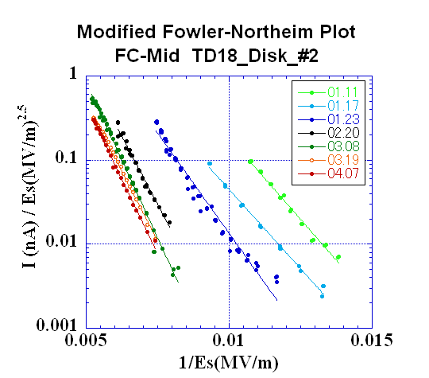
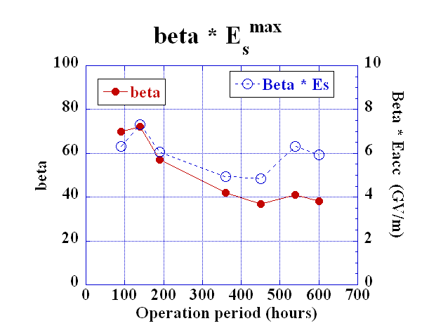
Evolution of dark current till early April
in TD18_Disk
IPAC10
Dark current reduced by three order of magnitude.
It followed roughly modified F-N formula.
β reduced from 70 to 40.
β * E_{s}^{max} ~ 5~7 GV/m

Slide 12
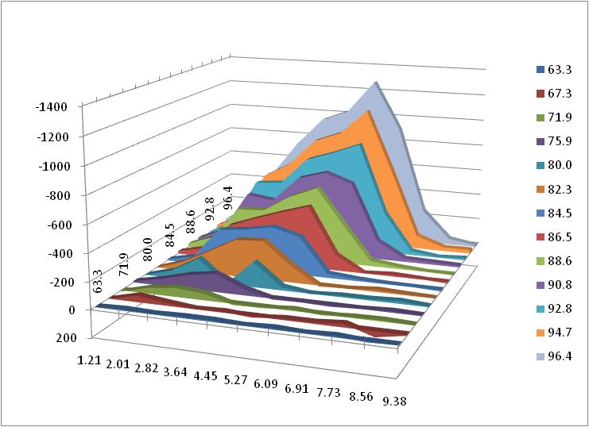
TD18 Dark Current Energy Spectrum
252ns RF, 50pps; 56MW==100MV/m
Averaged Gradient
(MV/m)
Peak Current
(nA)
MV/m
Electron Energy (MeV)
In T18_#2 at 108MV/m,
E peak at 7.5MeV and 3.5MeV.
This is similar to TD18 shown here.

Slide 13
BDR evaluations
Summarize all the taken data
Longer pulse characteristics
Double pulse with equal height
To taste with TD18_#2 in this week
  Switching among different pulse heights
  Following pulses without stopping at breakdown

Slide 14
BDR of TD18_#2 at 252 ns
TD18_Disk_#2 BDR~ 1.3 x 10⁻⁵ /pulse/m]
during Run 51&52 (60MW, 252ns)
as of the total RF-ON period of 2255 hours
# BD
BDR
10^-6 /pulse/m
Still decreasing in a logarithmic time scale BDR ~ t^-0.38

Slide 15
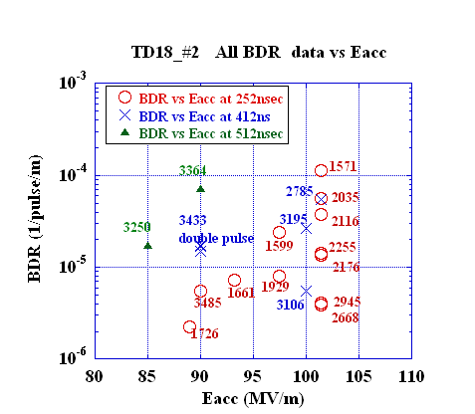
TD18_#2 all BDR vs Eacc
It seems difficult to get a smooth curve as function of Eacc by collecting all data points scattered in time and in operation parameter space.
Usually we get a smooth curve by measuring intentionally with focusing to take data of BDR vs Eacc!?

Slide 16
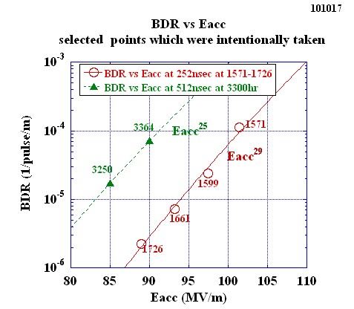
Relevant data points of BDR vs Eacc
Steep rise as Eacc, 10 times per 10 MV/m, less steep than T18

Slide 17
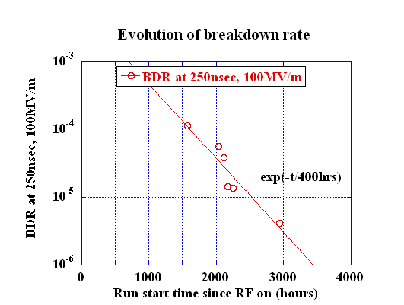
TD18_#2 Evolution of breakdown rate
Keep decreasing, but slow or already saturated?

Slide 18
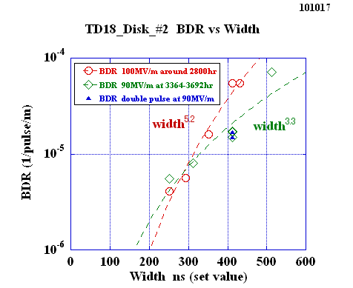
TD18_#2 BDR versus width at 100MV/m around 2800hr and at 90MV/m around 3500hr
Similar dependence at 90 and 100 if take usual single pulse?

Slide 19
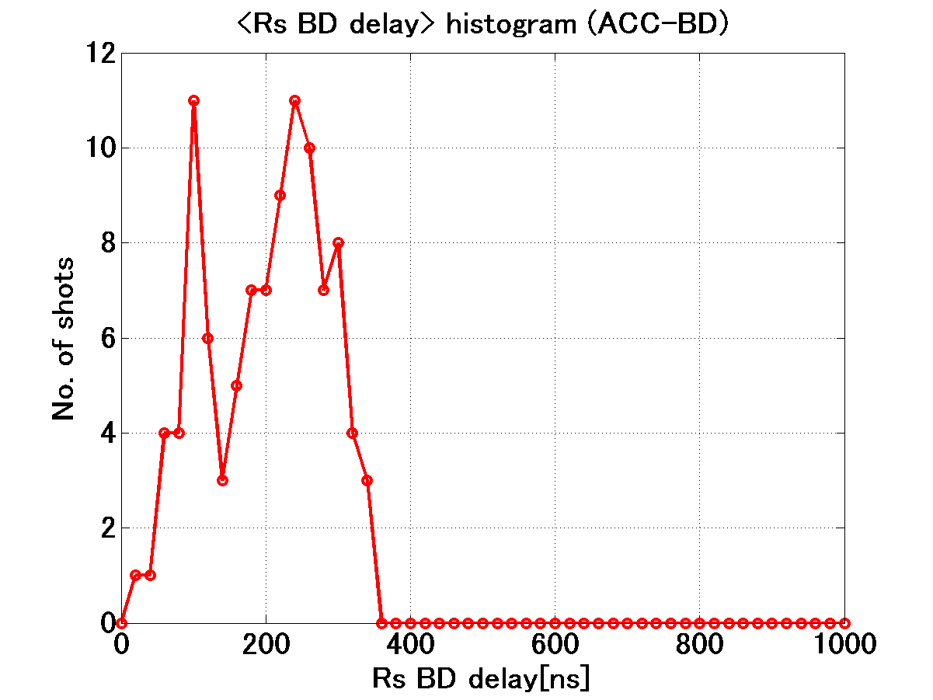
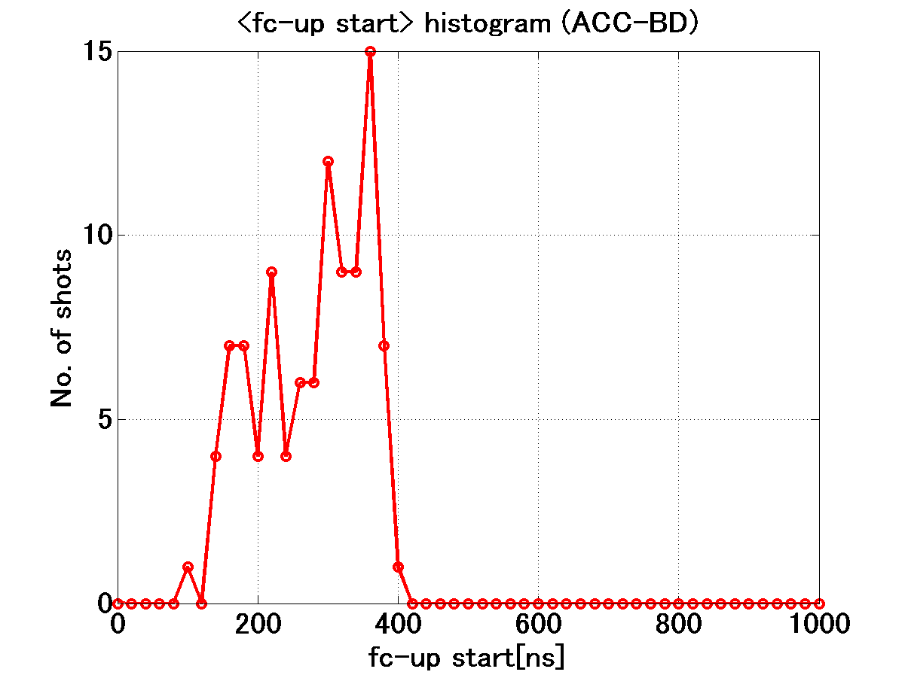
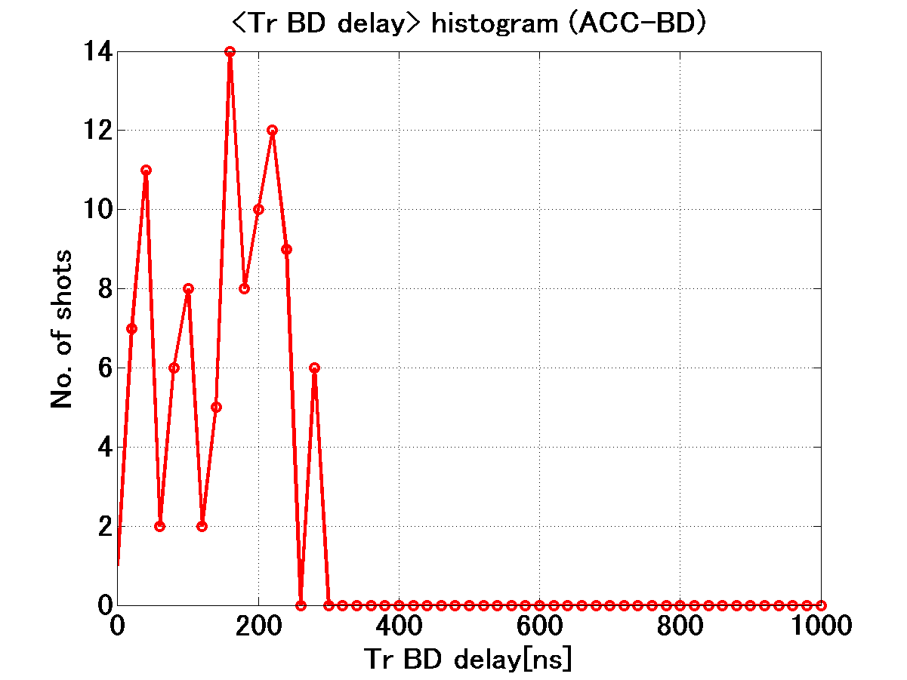
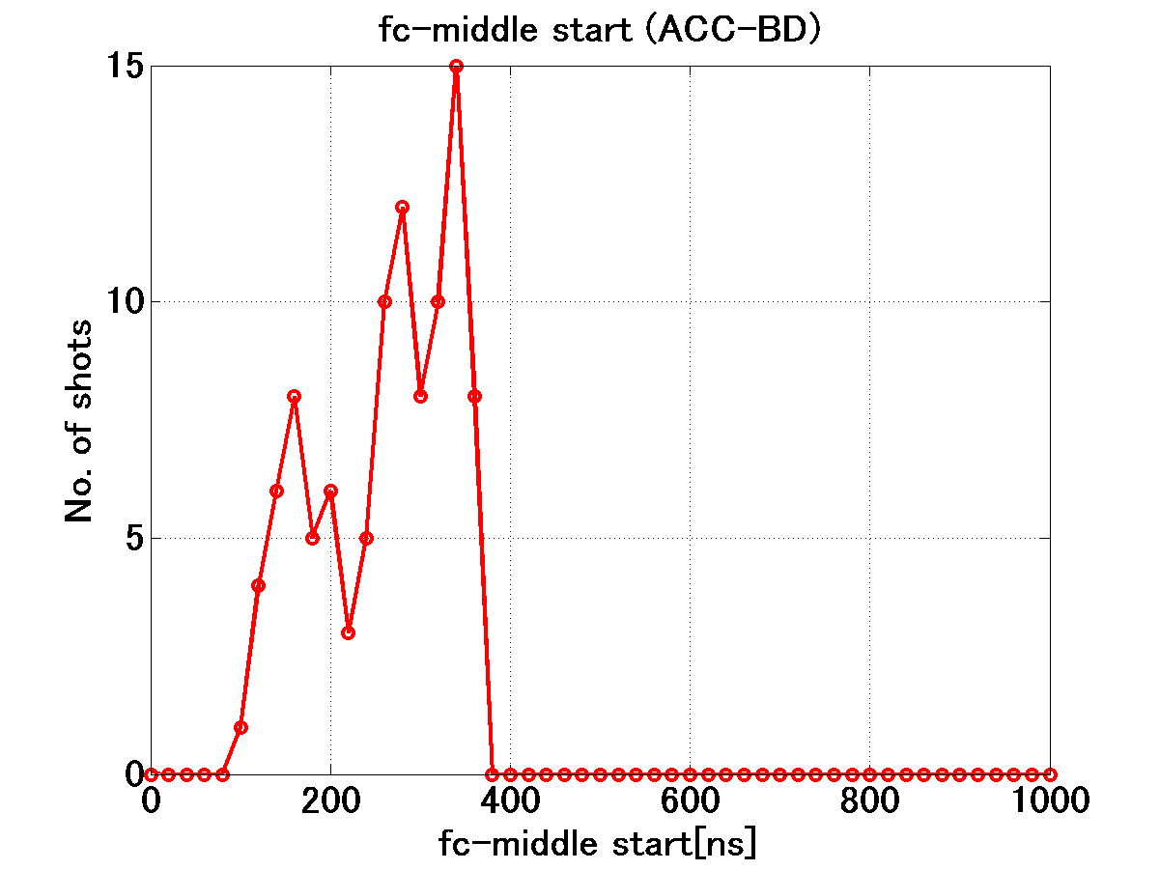
Run 51+52: 252nsec pulse BD start timing
Roughly judging that
fc-mid, Tr-delay = ramping as time
→ triggrt source building up as time?

Slide 20
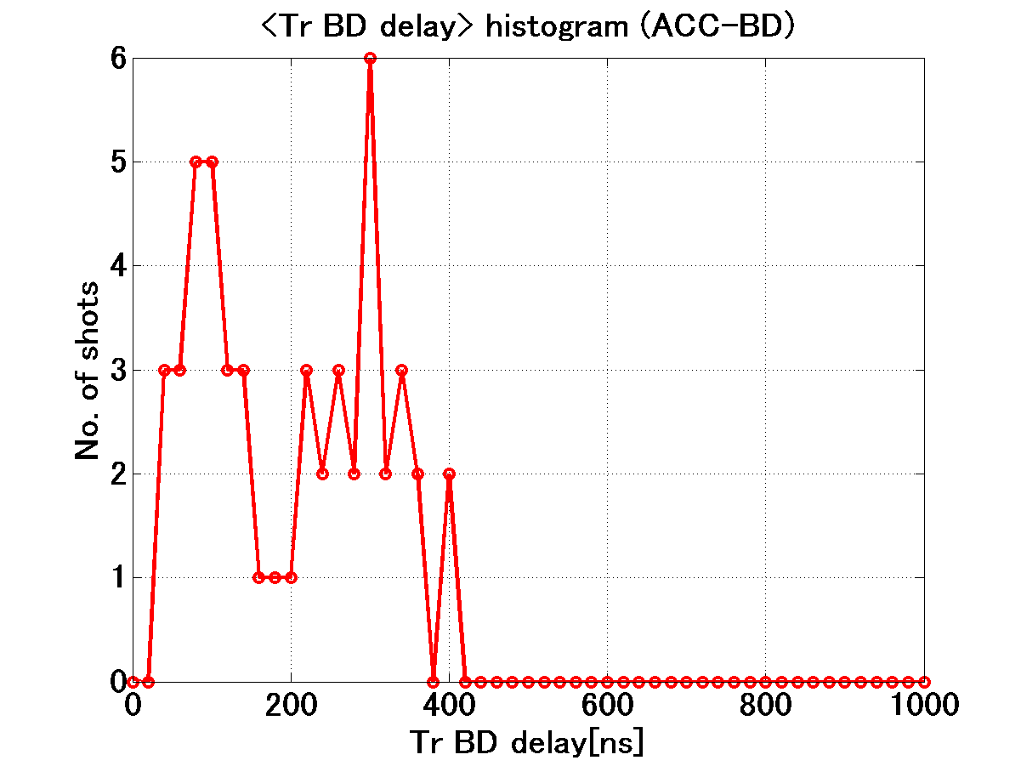
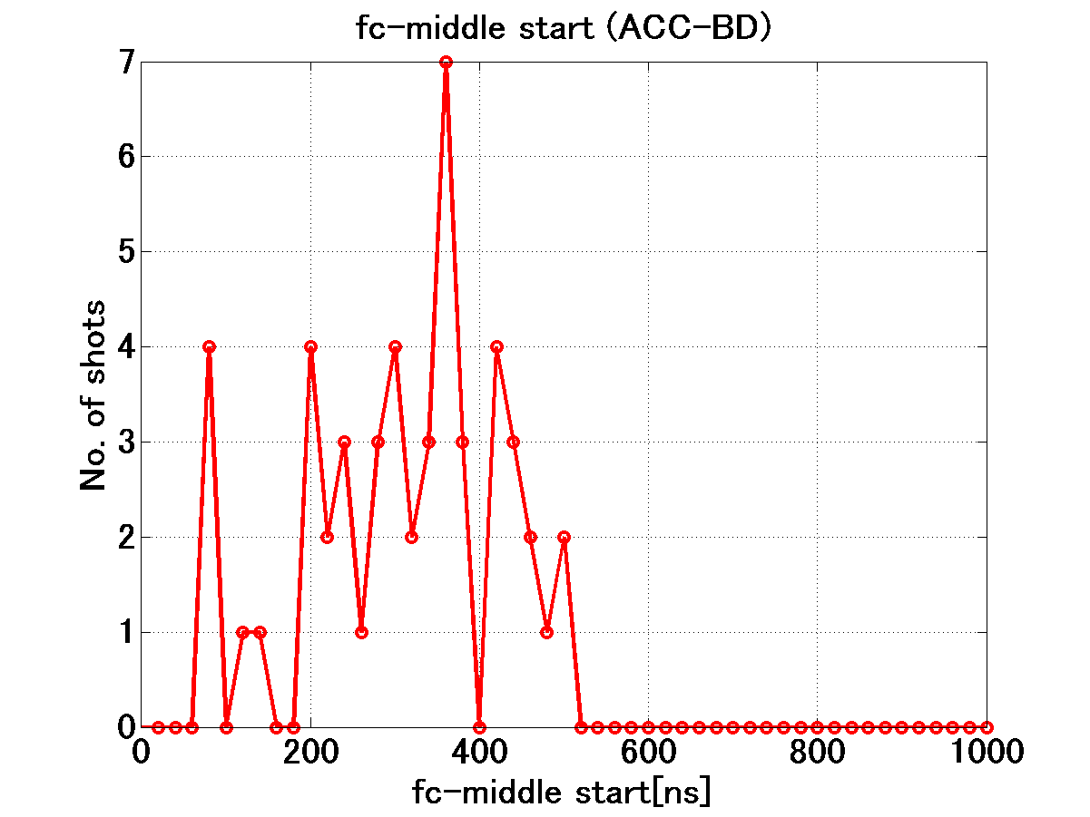
Run 82: 512ns BD start timing
These data does not show such high sensitivity as the previous page.
Distribution is not so heavily rising vs time comparing to the dependence of BDR versus pulse width such as width^{5~6}.

Slide 21
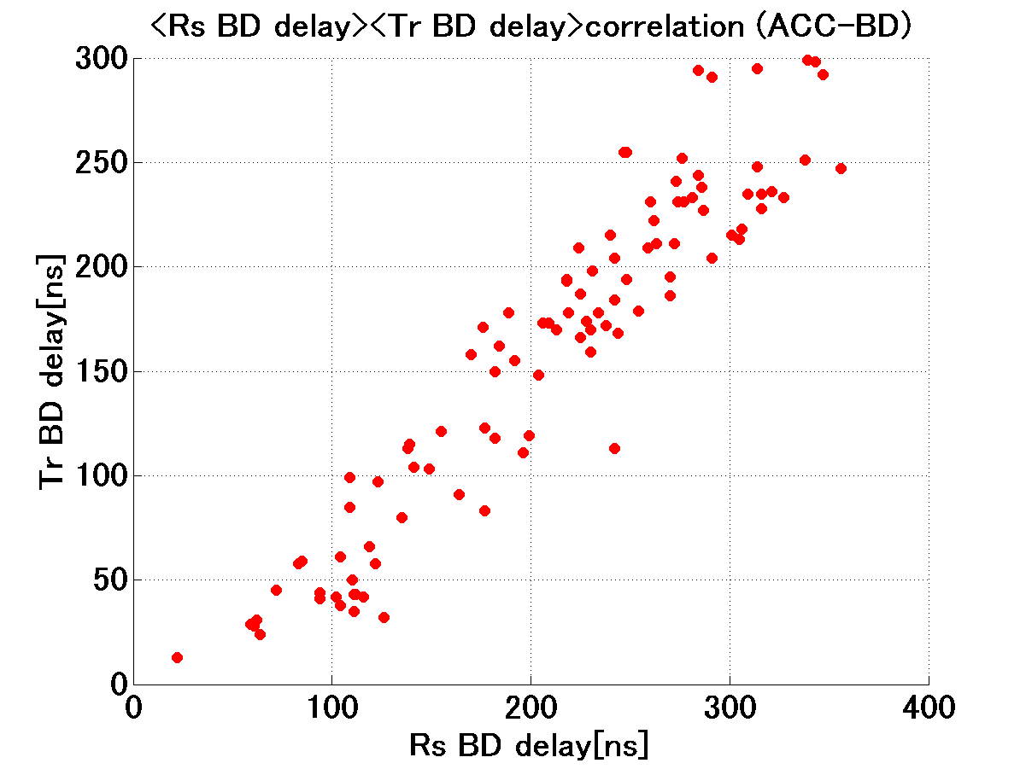
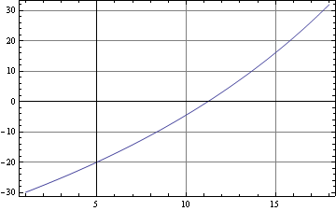
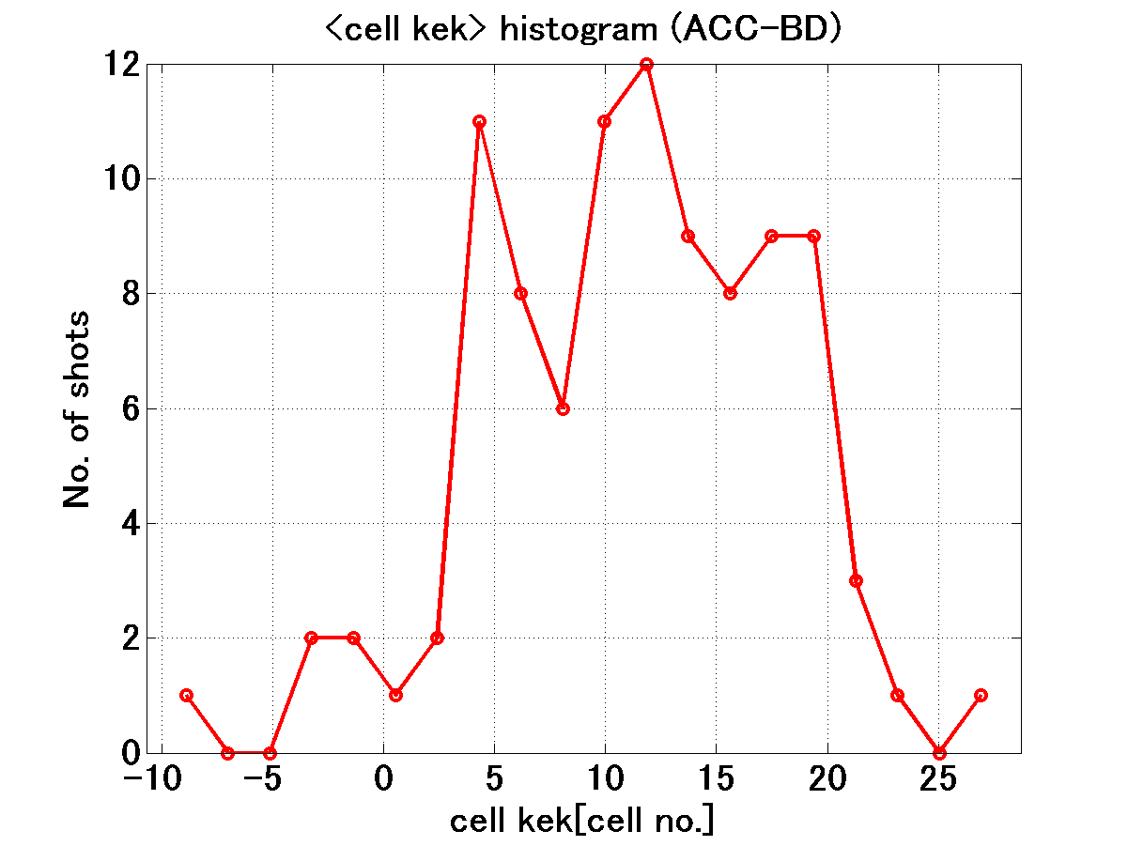
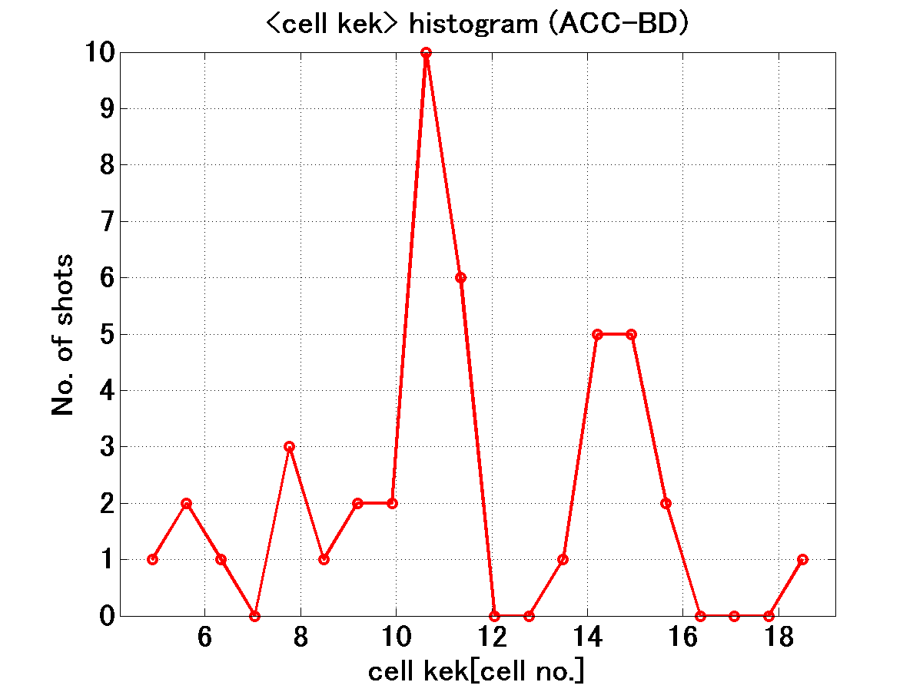
51+52 BD position
Where in the structure the breakdown happens?
Time difference
between Rs and Tr
Cell#
82 BD position
More statistics for us to be confident on distribution. Simply add all cases?

Slide 22
Double pulse operation
Period
Width
200ns
LE
5ns
TE
5ns
200 + 10 + 200
200 + 210 + 200
FG set value
Period=210ns
Width=200ns
FG set value
Period=410ns
Width=200ns
Double (200+10+200)
= Single (410ns eq.)
in Run 71
(30 June – 1 July ---)
Double (200+210+200)
= Single (2000 or 400ns eq.??)
in Run 72, 73, 74, 89, …

Slide 23
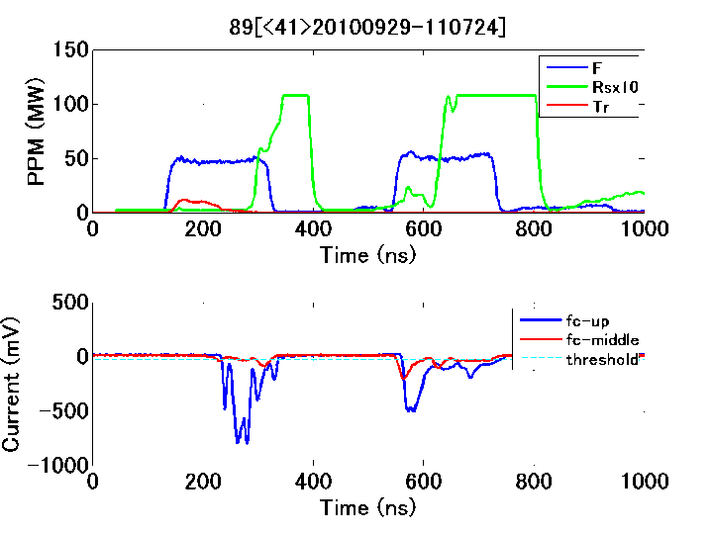
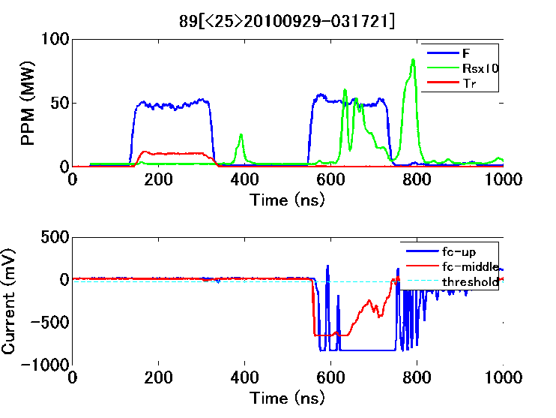
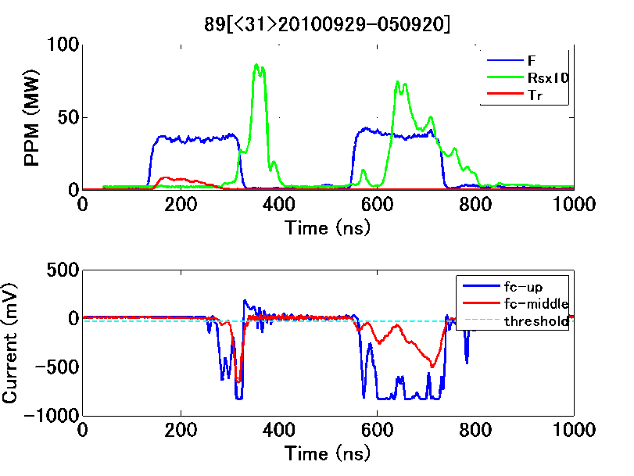
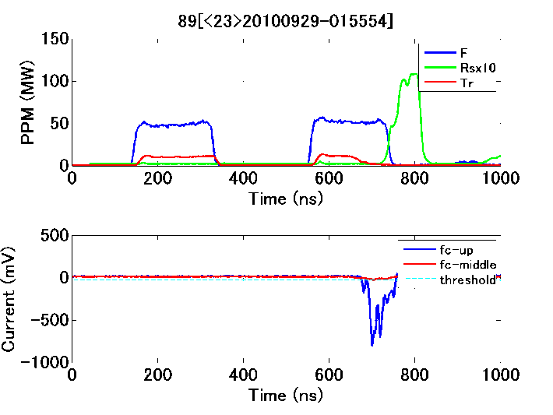
Run 89: Double pulse at 90 MV/m

Slide 24
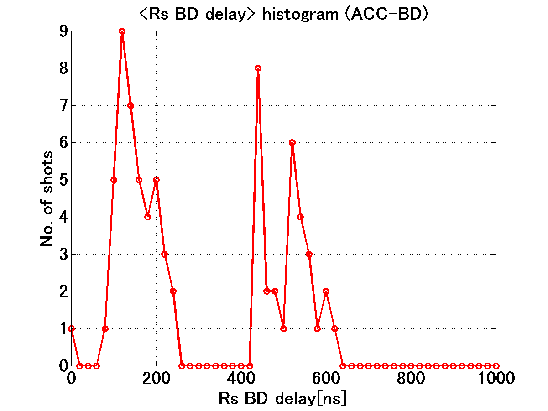
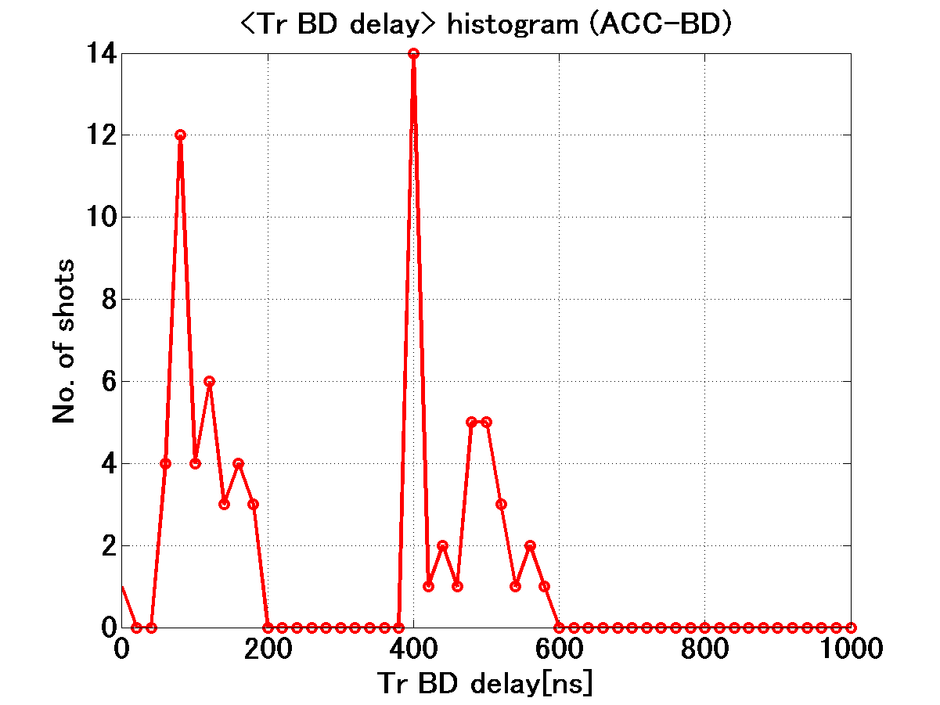
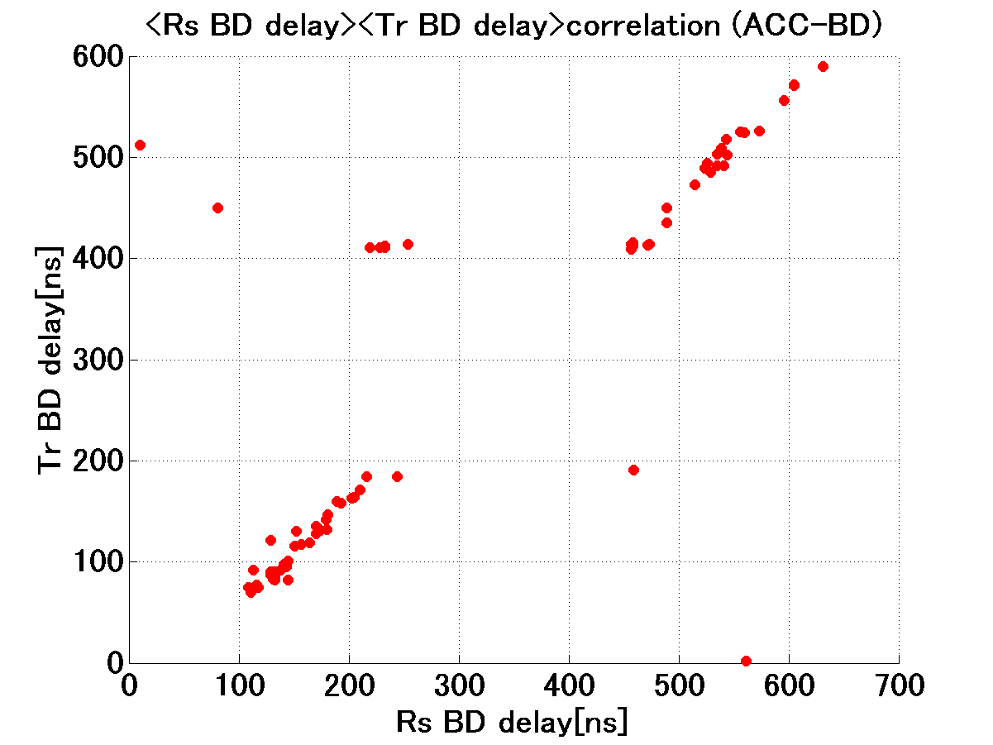
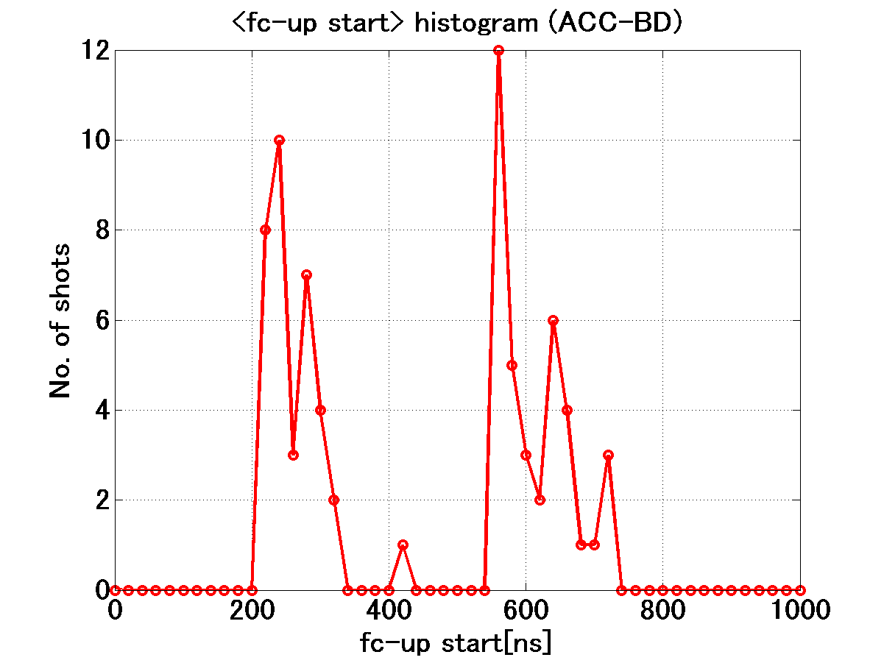
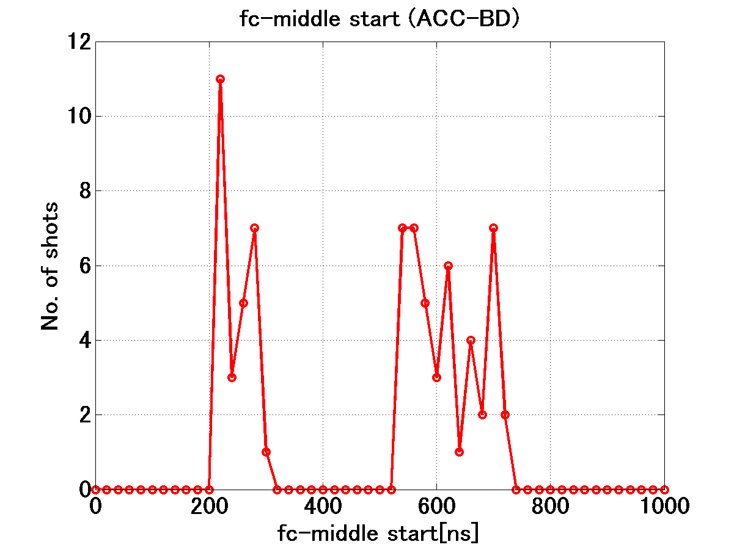
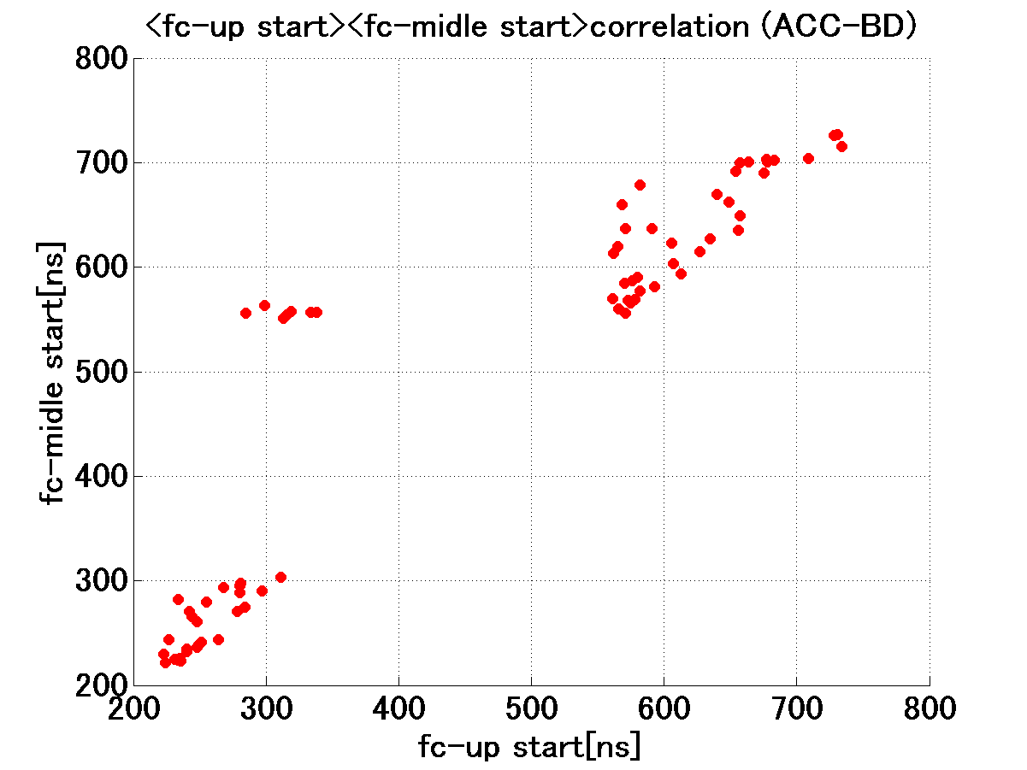
BD trigger timings are equally distributed in the former and latter halves
Rs delay
Tr delay
Tr delay vs Rs delay
UP delay
Mid delay
UP delay vs Mid delay

Slide 25
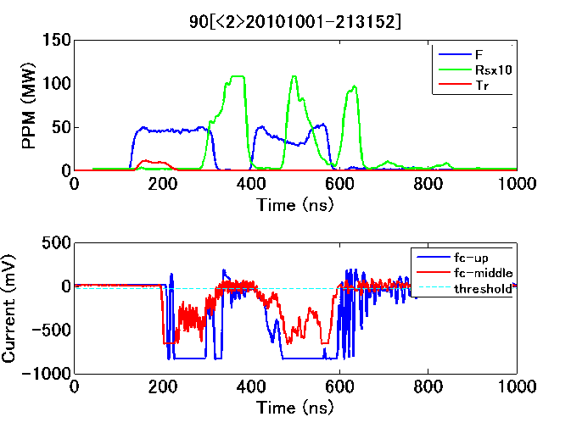
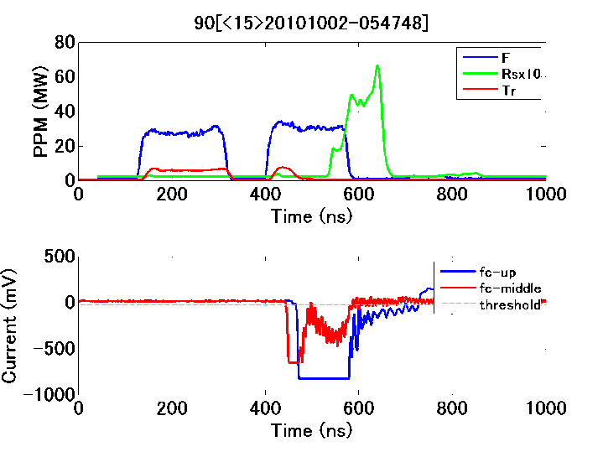
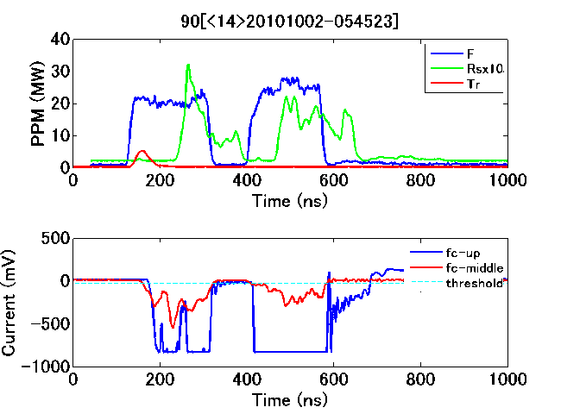
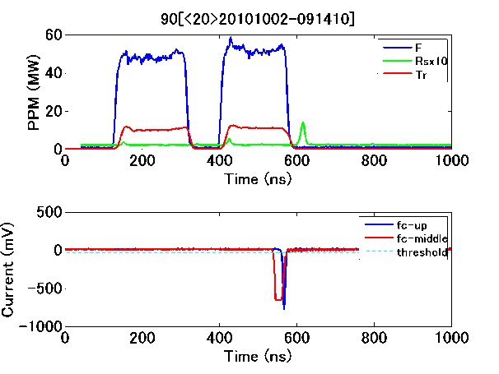
Run 90: Close double pulse at 90 MV/m

Slide 26
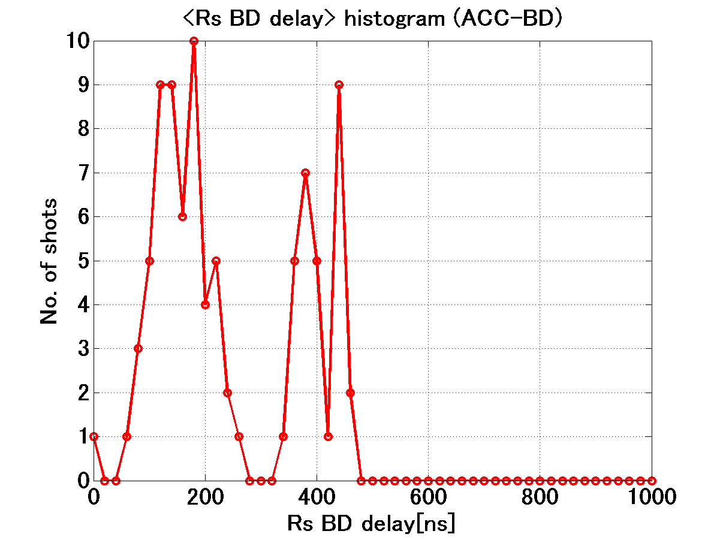
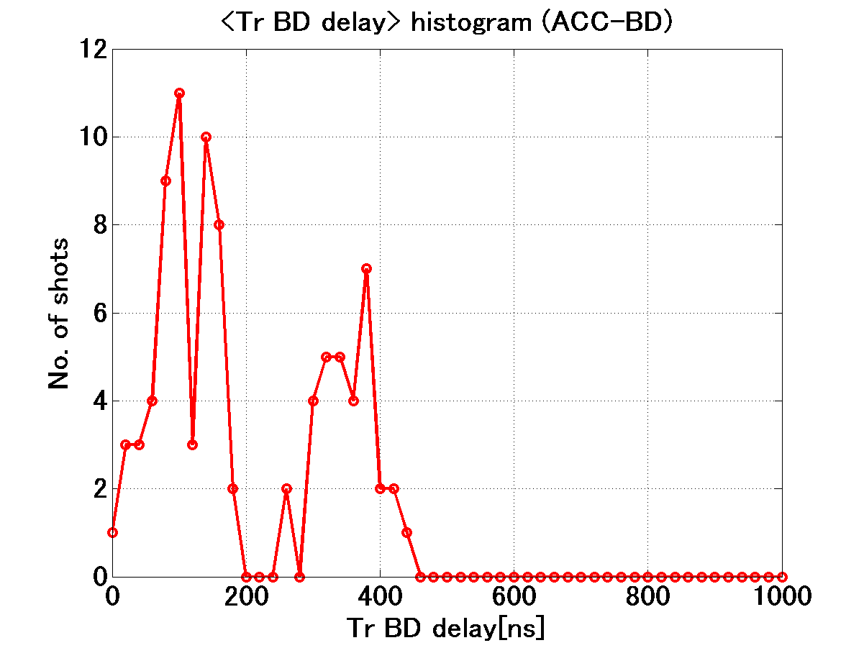




BD trigger timings are equally distributed in the former and latter halves
Rs delay
Tr delay
Tr delay vs Rs delay
UP delay
Mid delay
UP delay vs Mid delay

Slide 27
Run 90: 200+50+200 90MV/m double pulse
#BD vs time
BDR vs time
BD pulse shape confirmed by eye BDR[*10⁻⁵ BD/pulse/m]
BDR_Former pulse = 31BD/93hrs → 1.0
BDR_latter pulse = 26BD/93hrs → 0.84
BDR_total = 57BD → 1.84
Almost the same BDR for each pulse, former and latter

Slide 28
Structure fabrication related problem?
We see from SEM view of TD18_#3 got by CERN that there may be a gap between cells, especially at the most high magnetic field and periphery.
It may simply be due to chamfer.
I have still some concern on the flatness, important for robust diffusion bonding.
Flatness of T18 and TD18 was not good, in many cells it was more than a micron level. We accepted the cells with such big deviation from flat if it becomes better than 0.5 micron when sandwiched by flat surfaces. But this may not be good enough.
Happy to see the bonding quality check by cutting at CERN.

Slide 29
Diffusion bonding area
Final cut
Medium cut
SEM view of TD18_#3
by M. Aicheler

Slide 30




Flatness of cells for TD18_#2
TD18_#2_15b
TD18_#2_09b_2
Even ~3 micron flatness was accepted as long as the opposite side was reversely deformed. Mostly potato chip type but one or two cases the conical shape was accepted.

Slide 31

Nextef near future expansion
Pulse compression and
KT1~B line
In early 2010
Nextef
X-band
KT-1
X-band
B
A
KT-2
C-band

Slide 32

Fabrication of parts for PC and KT1-B
More than 80% fabricated.
A hole was made through a wall between KT1 and shield-B.
Installation of KT1-B in early next year.
Pulse compression setup will follow KT1-B setup.

Slide 33
Nextef neat future plan revised as of IWLC10
2010 2011 2012
9 10 11 12 1 2 3 4 5 6 7 8 9 10 11 12 1 2
TD18_Disk #3
T24_Disk #3
A
TD24_Disk #3
TD24_Disk_R05 ??
??
Components fabrication
??
PC commissioning
PC Construction
C-band Structure Test
B
Construction in shield-B
TERA C-band??
X-band basic studies
KT1 → B connection
PPM6B, Component tests, NWG test or serving shield-B, …….
KT-1

Slide 34

Higashi / Dolgashev activities
Fundamental study with SLAC is kept going such as Mo/Cu or SUS/Cu and Moly
We are thinking to start the similar experimental study but more carefully at moderate gradient level as 80-100MV/m.

Slide 35
Our programs as a conclusion from Nextef
Nextef will run fully dedicated for the feasibility study of CLIC high gradient evaluation
Nextef will boost peak power and high power stability by introducing pulse compression system
We try to establish a test area in addition to Nextef for key studies

