Slide 1
Seamless Cavity Development at FNAL
Andy Hocker
FNAL
ECFA-ILC-CLIC Meeting, WG3
21-OCT-2010

Slide 2
Introduction
Various routes to seamless cavities
  FNAL has chosen to pursue hydroforming based on the excellent results achieved by Singer et al. at DESY
Goal: fabricate 10-20 nine-cell TESLA-style cavities in order to make a statistically sound case (or not) for
  Gradient yield improvement
  Fabrication cost improvement
No dedicated cavity hydroforming facility exists in US
Various groups of people in US have dabbled in cavity hydroforming (or related issues) over the years
  No coordinated effort
First step was to gather these people together to chart a course for US hydroforming program

Slide 3
US Hydroforming Workshop
Workshop held at FNAL on 1-SEP-2010
  Link: http://ilc.fnal.gov/accelerators/workshop.html
35 participants --- from labs, universities, and industry
Ten presentations spread over two sessions:
  Niobium tube supply
  Facilities
Began with a nice “keynote” talk from Singer discussing the DESY hydroforming experience and history
Workshop provided a good overview of everyone’s work and ensuing discussions helped shape a path for the next few years

Slide 4
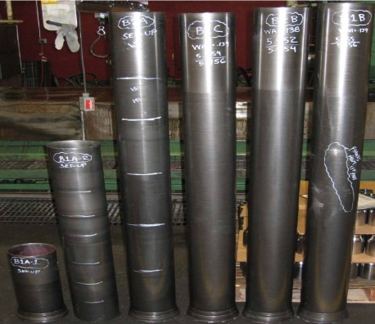
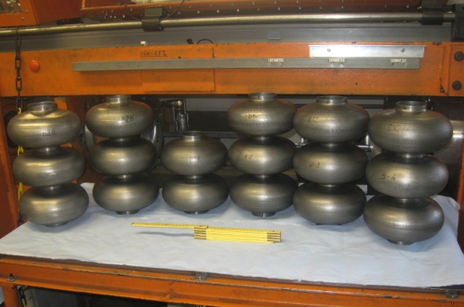
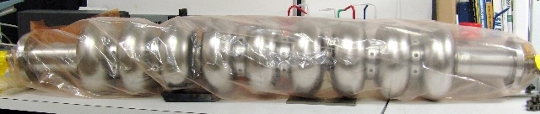
Black Labs/Wah Chang Nb tube
R. Crooks, BL
Tube extruded and flow-formed from fine-grained billet
Hydroformed at DESY, under assembly into 9-cell at TJNL
Tube formed well, we await the RF test results
Consider this our baseline tube supply
  Process still has room for optimization

Slide 5
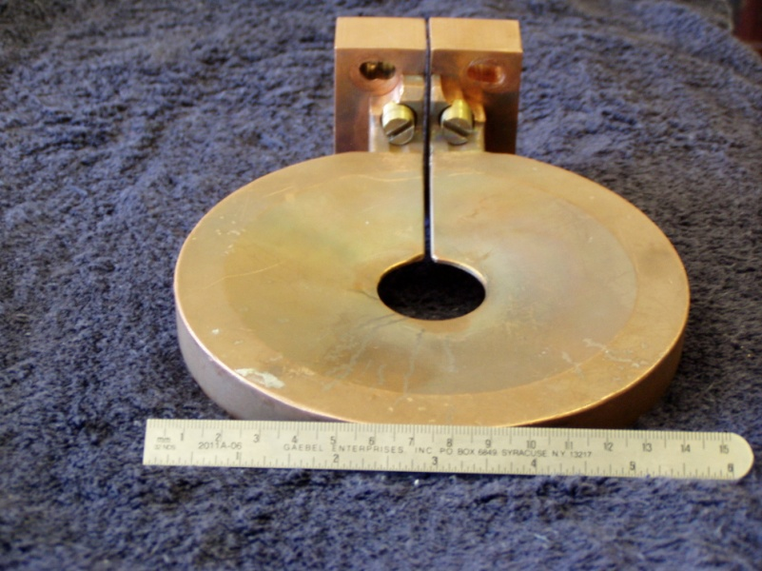
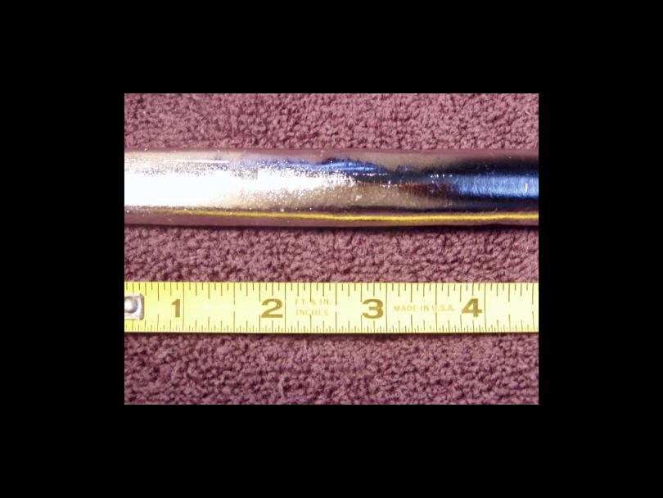
Single-crystal tubes
J. Murphy, UNR
Float-zone remelting of tubes via inductive coil
“Beyond the baseline,” but intriguing
  90% elongation --- possibility for eliminating necking step?
  All the other nice properties of single crystal cavities
Only small tubes so far, but scale-up possible

Slide 6
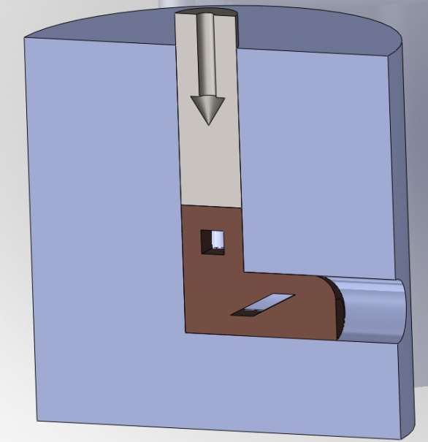
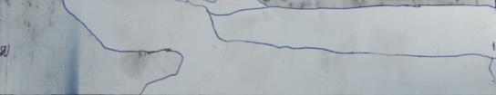
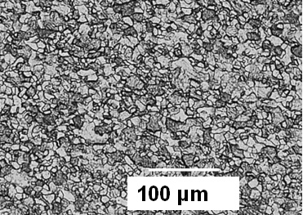
Fine-grain tubes via ECAE
T. Hartwig, TAMU
mECAE + HT
50mm
Achieving desired microstructure via severe plastic deformation (Equal Channel Angular Extrusion)
Selling points: 20-50 micron grains, long-range uniformity, some control over texture
This is an example of an alternative tube process
  More examples were provided via pre-recorded video from E. Palmieri (INFN):spinning, reverse deep-drawing

Slide 7
What foundation is needed?
Crystal Plasticity simulation of deformation and texture evolution
  This is at the microstructure scale
  Need to be able to predict both single and poly crystal evolution correctly
Evolution rules for yield surface based upon metal physics so that property evolution can be made more efficient to simulate deformation at the part (cavity) scale
Experiments designed to assist development and validation of material models
  Heavily instrumented hydroforming facility
Identify rules for Recrystallization
T. Bieler, MSU

Slide 8
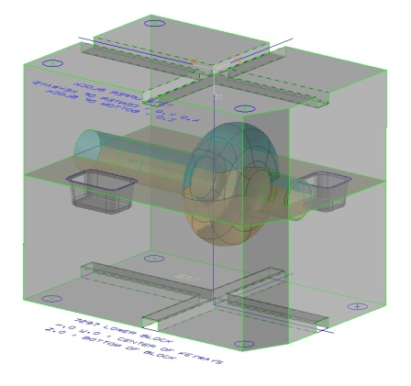
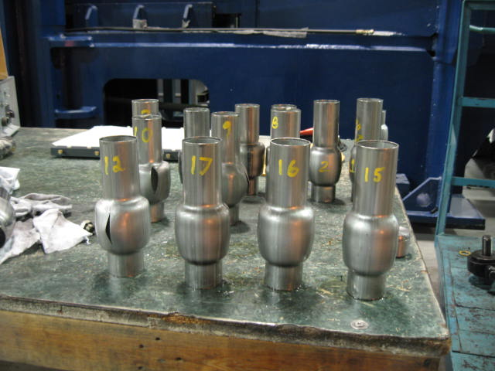
Facilities
OSU CSMM did some legwork to ID good companies willing to work on developing facility
  Also presented capabilities at OSU for tube bulge testing and SEM
Interlaken Technology Corp. in the business of designing and building machines like what we want
American Hydroformers, Inc. has presses of the appropriate scale and has played with cavity forming
  Confirmed that a simple expansion doesn’t work at all
T. Collings, OSU
M. Blasi, AHI
Cavity die
SST tubes

Slide 9
Fermilab’s plan of action
Funding in FY11 for this R&D effort has been provided by ART
Buy tubes
  Some extruded billet material left over from initial manufacturing run of Black Labs/Wah Chang tube
    Provide clear specifications on tube properties
  Provide samples to those doing materials characterization
Submit Request For Proposal for design/fabrication of equipment for a nine-cell cavity hydroforming facility
  We expect companies to draw upon the experience gained with the machines at DESY and KEK, but not necessarily copy/paste
  The proposals should include a plan for obtaining any material properties data needed for the design
  Target March 2011 for awarding a contract
Support “beyond the baseline” R&D where possible
  Leverage alternate sources of funding (SBIRs, etc.)

Slide 10
Conclusions
Seamless cavity R&D in the US is still in its infancy
  But we are not starting from zero!
FNAL workshop helped to chart a course for the future
Our plan right in line with what Singer identifies as the “next steps” for hydroforming
  Industrialization of the established process
  Real-world cost evaluation
The planned time scale is to be producing cavities in about two years
There are already a number of efforts underway to improve and/or optimize tube fabrication

