Slide 1
CLIC Schedule
K. Foraz
CLIC10 Workshop
18-22 October 2009

Slide 2
Outline
Main LINAC
  Schedule
  Installation versus Module production
  Resources
Injectors
  Method
  Schedules
  Resources
Global
  Schedule
  Rough estimation of resources

Slide 3
Main LINAC – Construction & installation Schedule
Site installation
El. Gen. services
Shaft construction
Piping
Tunnel excavation
Cabling
Tunnel construction
Machine transport
Survey
Machine inst.
Commissioning @ 500GeV
Comm.
Comm.
Comm.
Comm.
Comm.
Comm.
Commissioning @ 3.TeV

Slide 4
Main LINAC – Installation vs. Production
To+3 years

Slide 5
Main LINAC - resources
Nb of worksites/ contracts

Slide 6
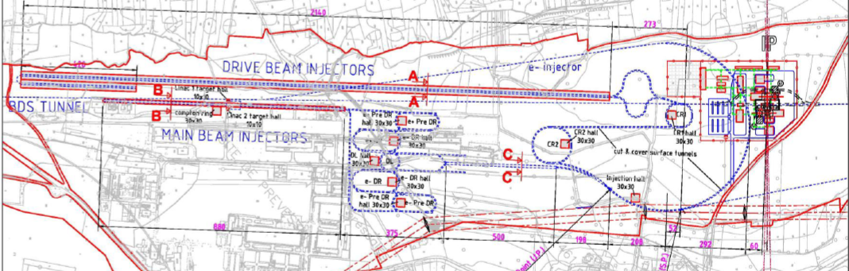
Injectors - Method
Schedules drawn with the experience on other machines, especially LINAC4 installation, which is just starting

Slide 7
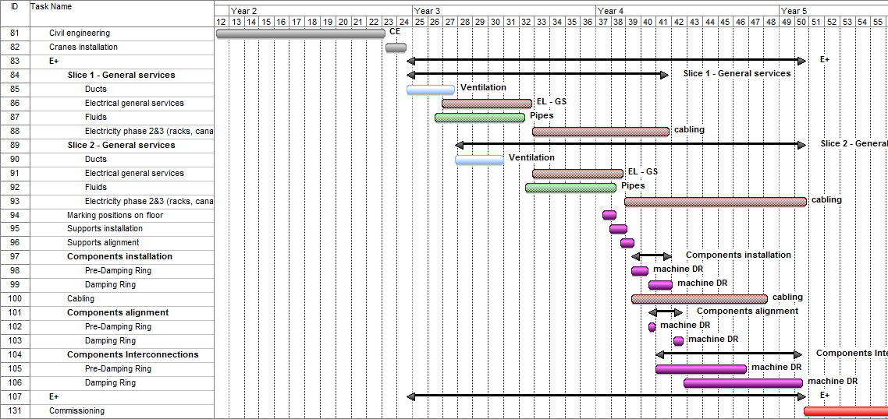
Injectors – Damping Rings

Slide 8
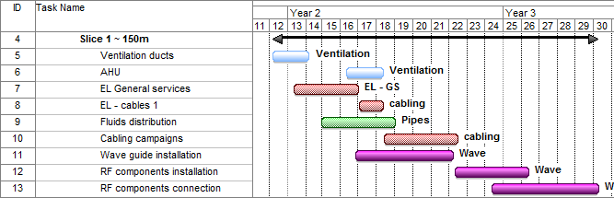
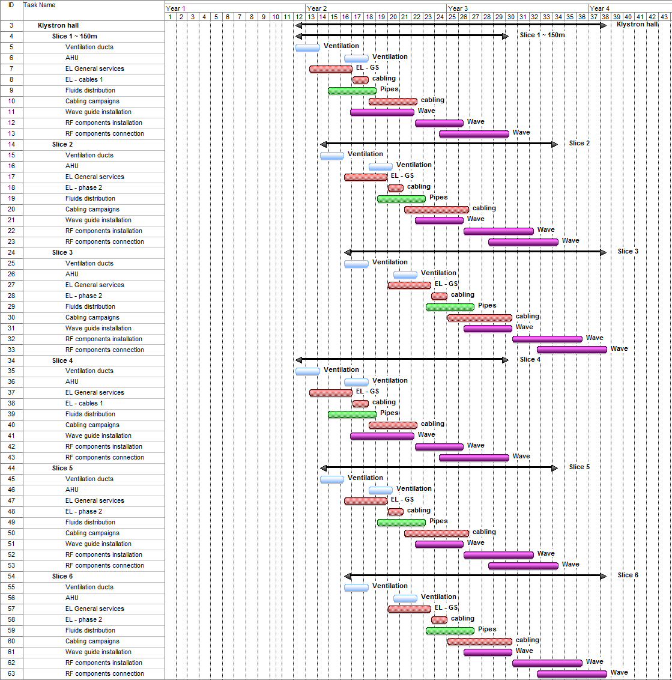
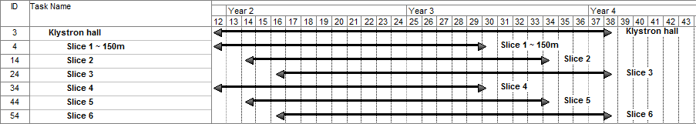
Injectors: Main Beam (1/2)
Klystron hall
  Divided in 6 splices of ~150m
  Resources doubled : 26 months

Slide 9
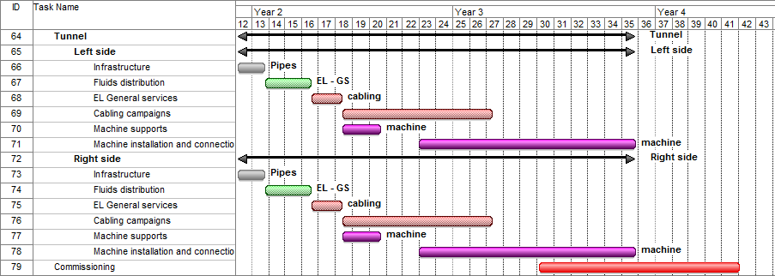
Injectors – Main Beam (2/2)
Main Beam Tunnel
  Effort doubled ► 30 months

Slide 10
Injectors – Drive Beam
Same strategy than for the Main Beam…but 2140 m !!!
  Surface building splitted into 12 splices ( 3 * 4)
  Tunnel: 2 entries
  35 months

Slide 11
Injectors – Summary schedule
Civil Eng.
Civil Eng.
Civil Eng.
Installation
Installation
Civil Eng.
Inst.
Inst.
Com.
Com.
Com.
Com.

Slide 12
Injectors - Resources
Nb of worksites/ contracts

Slide 13
General schedule
Commissioning @ 500GeV
Comm.
Comm.
Comm.
Comm.
Comm.
Comm.
Commissioning @ 3.TeV

Slide 14
Rough estimate of resources

