Slide 1


The CLIC Decelerator
Overview and beam physics
International Workshop on Linear Colliders 2010
October 20, 2010
Erik Adli, Department of Physics, University of Oslo and CERN

Slide 2
• Requirements
• Beam physics
• Component specifications
• Test facilities
• Conclusions

Slide 3
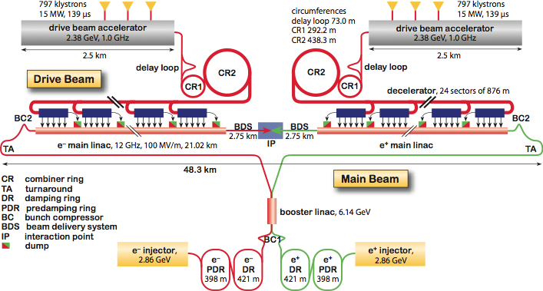
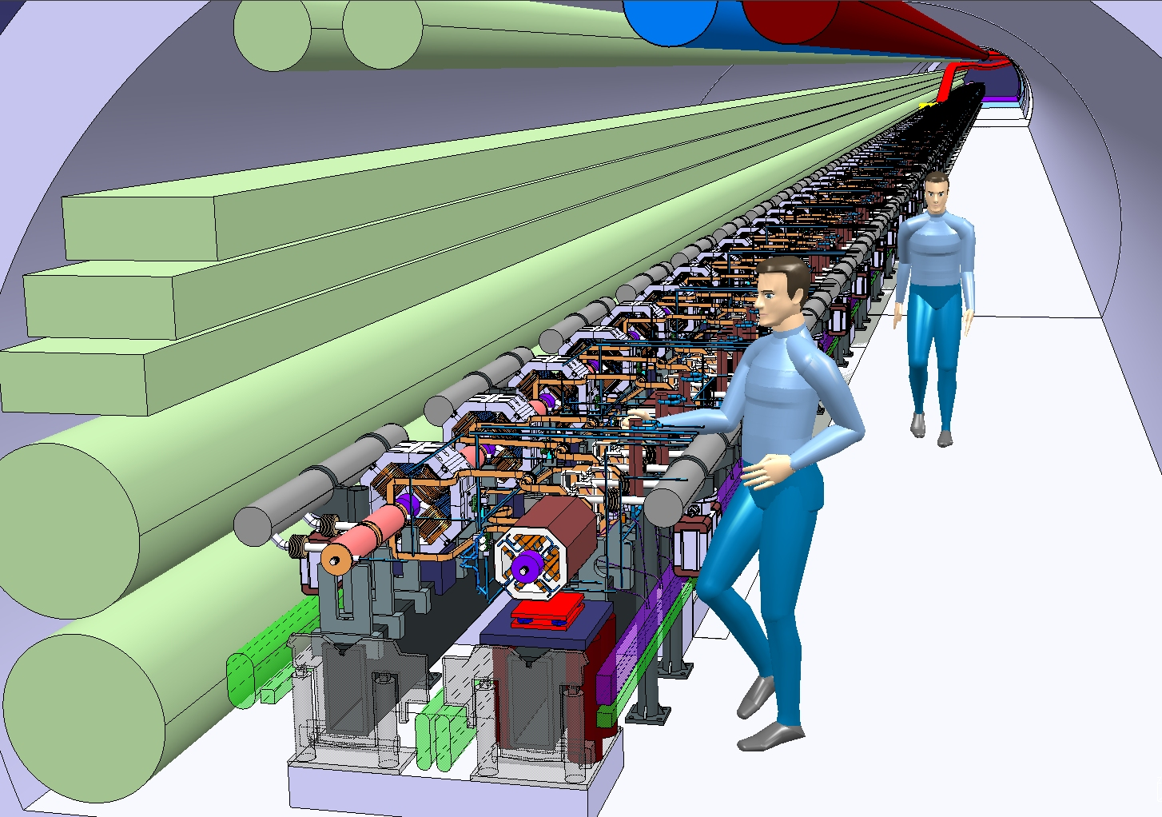
The CLIC Drive Beam decelerators
~1 km
Parameters:
I = 100 A
E0 = 2.4 GeV
f_{bunch} = 12 GHz
σ_{z} = 1 mm
ε_{Nx,y} = 150 um
100 A
2.4 GeV

Slide 4

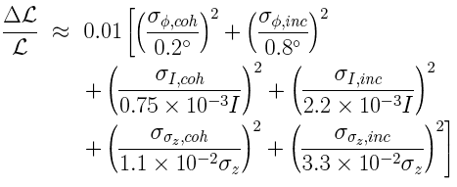
Requirements: power production
Decelerator: power source for main linacs. Power production:
Requirements for 1% luminosity loss: ΔE/E < 7 x 10⁻⁴. Converted to drive beam decelerator requirements :
D. Schulte, WG2,6,7,8, Wednesday 14:00
The drive beam generation is discussed separately :
Here we focus on the consequences for the decelerator.
WG6, Session5, Thursday 08:30

Slide 5
Decelerator requirements
Objective of the drive beam decelerator: to extract ~90% of the drive beam energy and convert it to rf power, while observing the stringent power production requirements.
Beam transport requirements :
Beam must be transported with very small losses ~ 0.1% losses dynamics variation). Large current -> static losses ~ 0.1% (machine protection issues)
Detailed beam physics studies has been performed with the aim to ensure minimal envelope growth along each decelerator sector (this talk).
Cost and power consumption requirements :
The decelerator beam transport : robust performance of each of the 2 x 24 decelerator sectors - 42 km beam line. Will require a very large number of components.
A number of studies have been performed to with the aim to optimize specifications, in order to contain cost and power consumption (this talk).

Slide 6
• Requirements
• Beam physics
• Component specifications
• Test facilities
• Conclusions

Slide 7
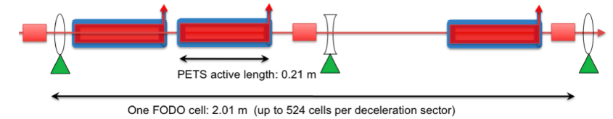
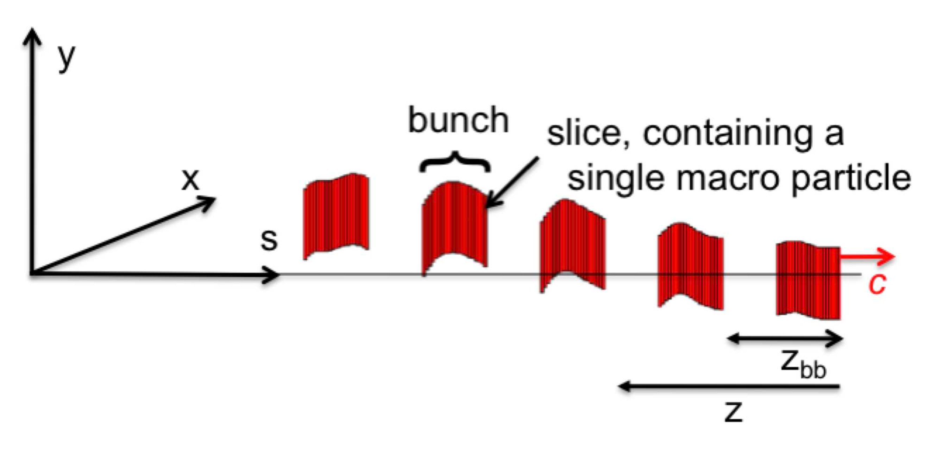
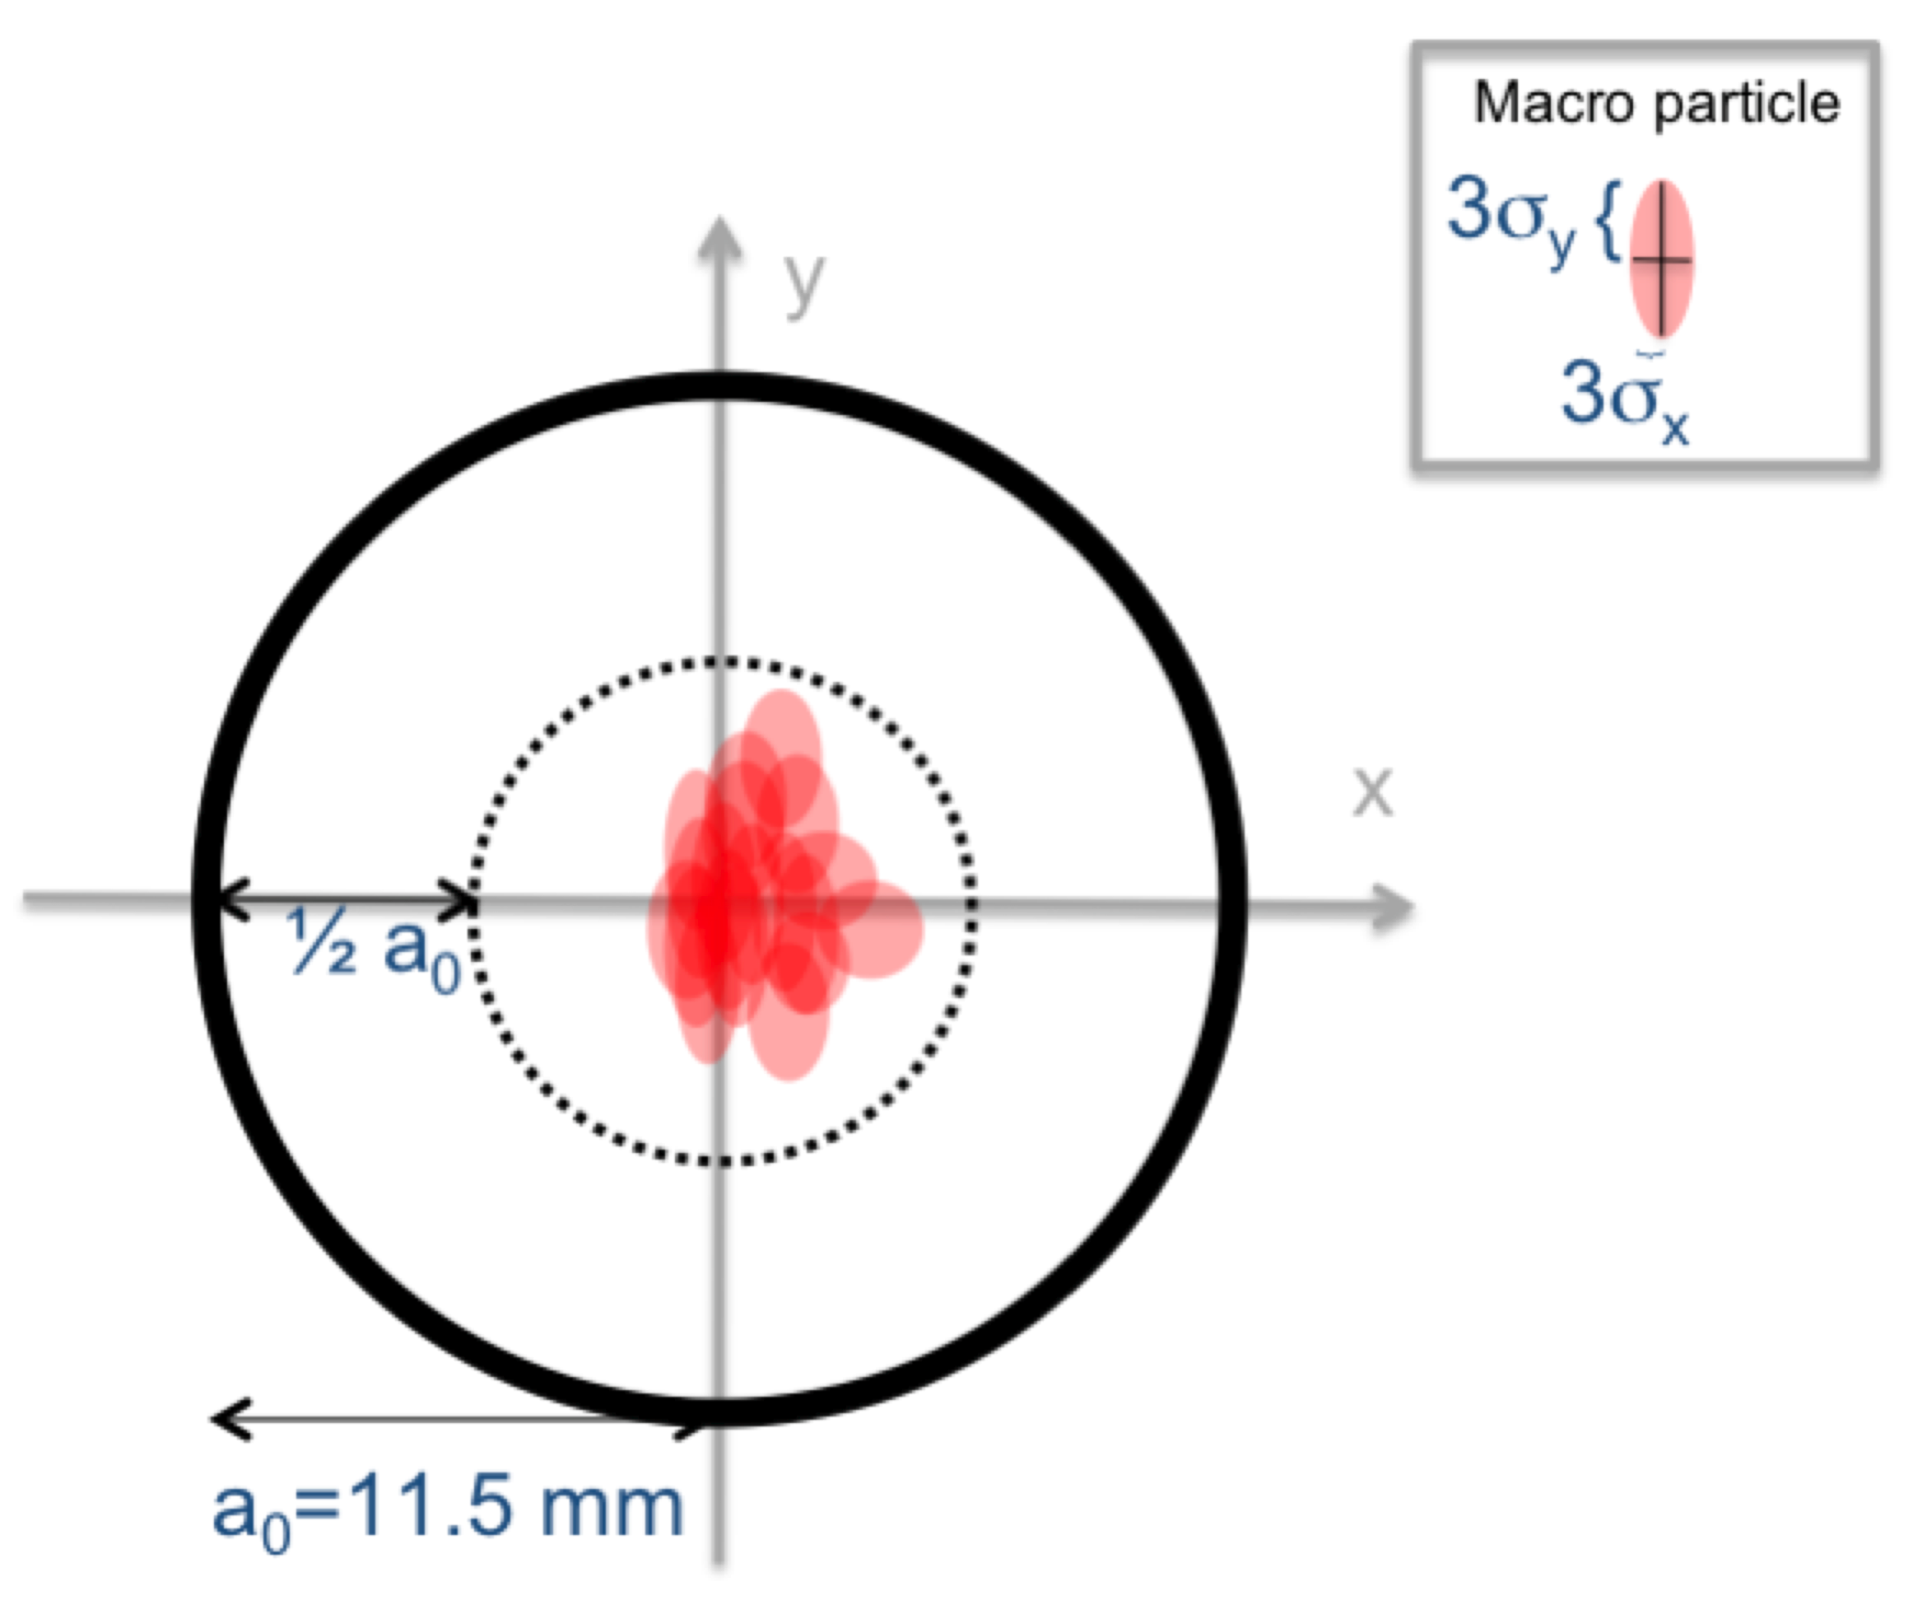
Decelerator studies
Main tool: simulation studies (tracking code PLACET), with an element representing the Power Extraction and Transfer Structures, including fundamental and dipole modes wake field calculations, and both single and multi-bunch effects.
r
Macro-particle beam model, sliced beam with tracking of 2nd order moments
Simulation metric: r = 3σ of worst beam slice

Slide 8
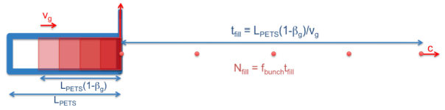

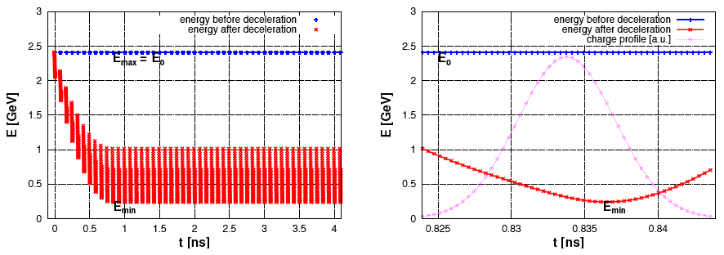
PETS induced energy spread
η_{extr} = 0.90
beam at decelerator end
(pilot beam, w/o beam loading compensation)
steady-state bunch at decelerator end
(pilot beam, w/o beam loading compensation)
Decelerator beam: the high group velocity PETS will induce up to 90% energy spread at the decelerator end, as well as significant intra-bunch energy spread. To ensure reliable rf power production it is of importance that electrons of all energies are robustly transported along the lattice.
Overall criterion for beam transport r < ½ radius (5.8 mm)

Slide 9
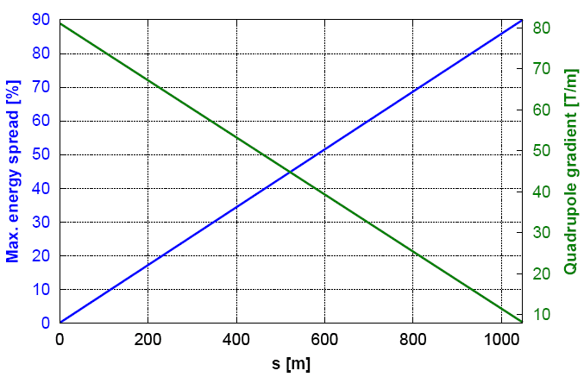
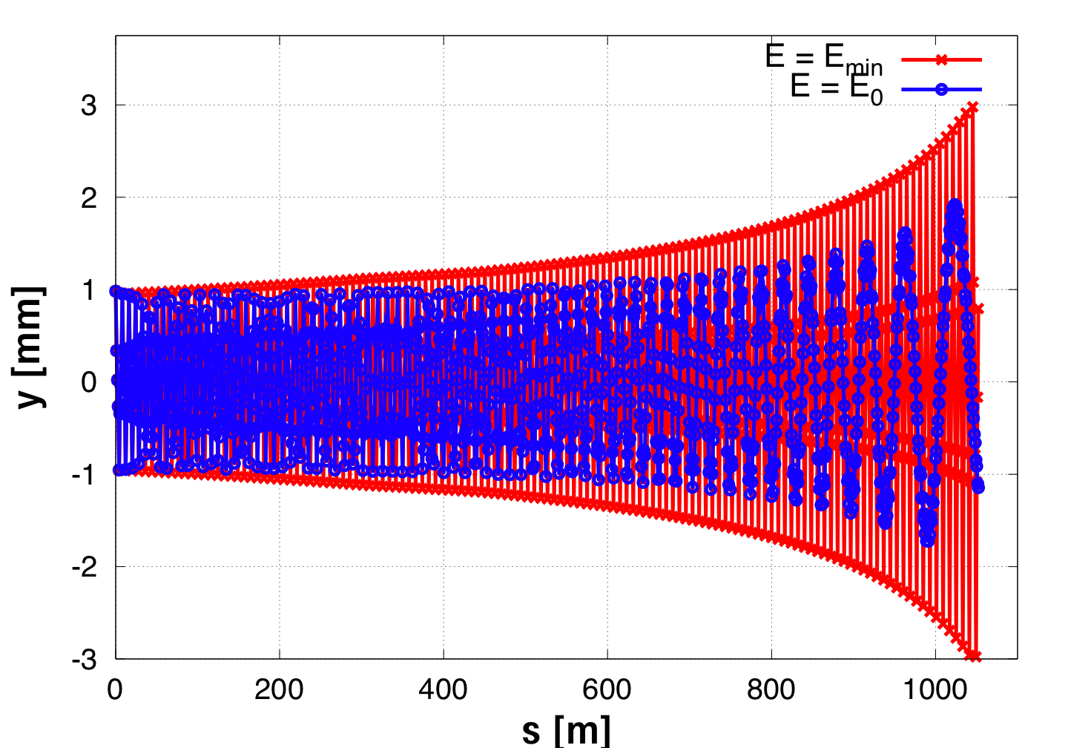


Focusing strategy
Focusing strategy: lowest energy particles ideally see constant phase-advance μ≈90°
Higher energy particles see phase-advance decreasing from μ≈90° to μ≈10°
  Perfect machine and beam : high energy envelope contain in low energy envelope
  Energy acceptance : -3% of E₀ at the entrance; but increasing along the lattice
  Each of quadrupoles should ideally have a different gradient
3-sigma particles in a perfectly aligned machine
Least decelerated particle has a tune of μ≈70, and an increase of β of β_{Fmax}(E₀)/β_{F0} = 4.
Most decelerated particle has a tune of μ≈135, and an increase of action of J_{max}(E_{min}) / J₀ = γ₀/γ_{f} = 10
3-σ envelope for perfect machine:
r_{ad} = 3 mm

Slide 10
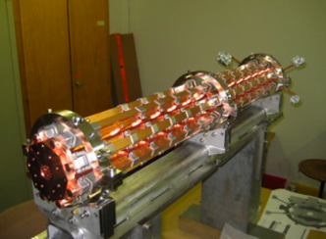
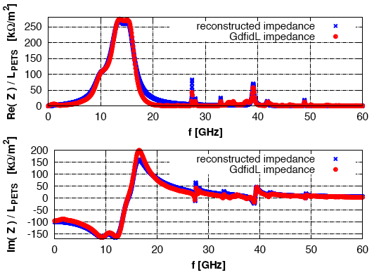
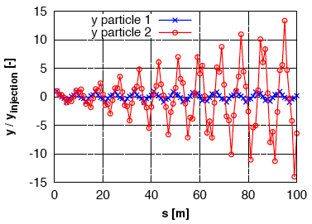

Transport challenge: dipole wake
Sufficient mitigation of transverse electro-magnetic forces, due to the PETS high group velocity dipole wake, has been a major challenge for the two-beam accelerator concept.
PETS 12 GHz prototype (TBTS 1 m)
Principal effect of dipole wake: resonant linear increase of betatron amplitude of driven particle.
Tracking simulations approximate simulated PETS impedance by a number of discrete modes, each characterized by {f,k_{T},Q,β}_{i}
A. Cappelletti, WG6, Wednesday 10:30
Transverse impedance spectrum : rf simulation and reconstruction

Slide 11
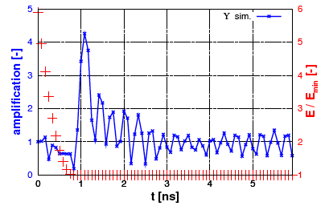
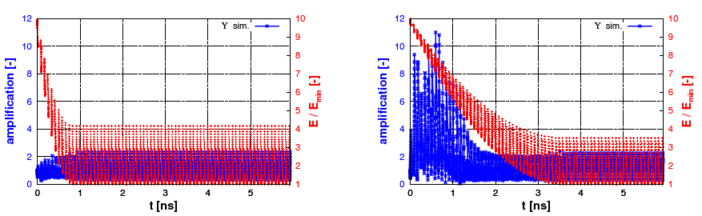
Transport challenge: dipole wake
The multi-bunch amplification due to the dipole wake is large. The PETS induced energy spread mitigates the amplification, however, to a level depended on the PETS design. Here illustrated by calculating the amplification of action due to dipole wakes, at the decelerator end.
Rf power production is proportional with (R'/Q) / v_{g} = const. However, PETS with too low group velocity do not develop energy spread fast enough to decohere the wake build-up.
Point-like bunches.
1 mm bunches, baseline PETS
1 mm bunches, "slow" PETS design

Slide 12
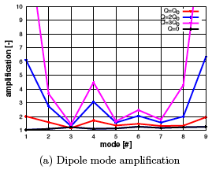
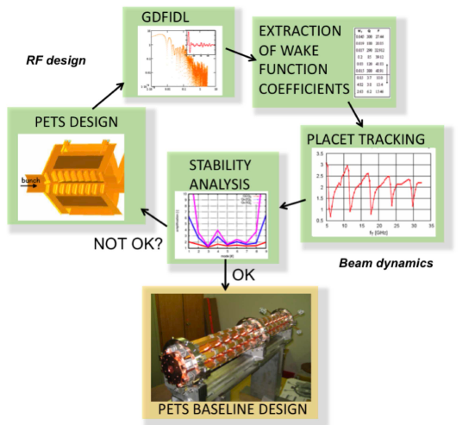
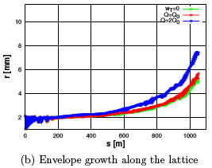
Dipole wake status: PETS baseline design
Large series of potential PETS design variants have been examined for robust mitigation of the transverse wake, for all beam modes, and all errors sources. After several iterations rf and beam dynamics expertise, a PETS baseline indicating adequate wake mitigation, has been secured.

Slide 13



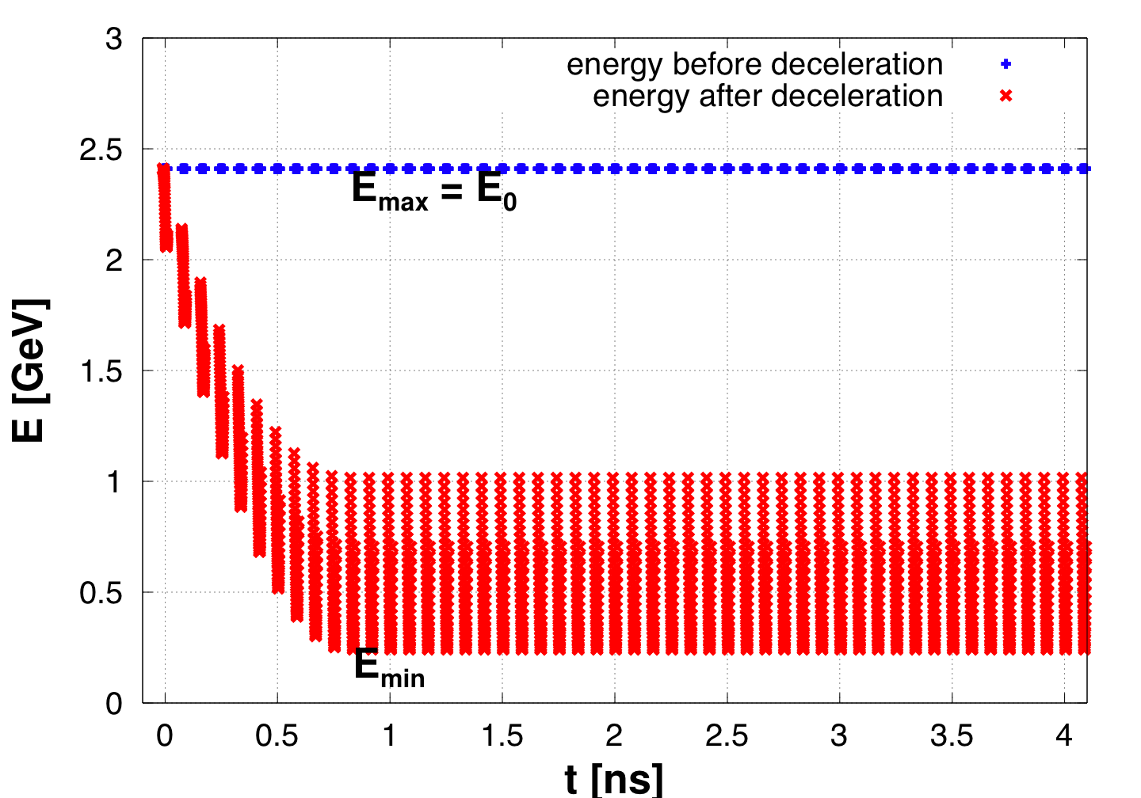
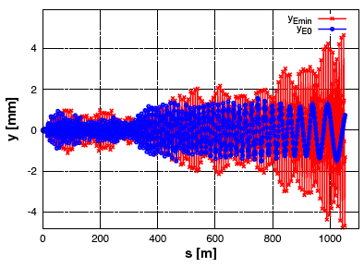
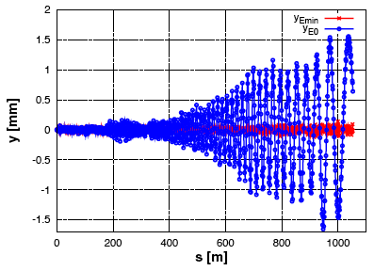
Transport challenge: orbit correction
Kicks from misaligned quadrupoles might drive beam envelope out of vacuum chamber, even for pre-alignment of 20 μm. Estimate for uncorrected machine sets scale :
With 1000 quadrupoles and 20 μm rms offset, the expected centroid envelope is ca. 4 mm.
90% energy spread of decelerator beam poses a challenge for beam transport :
Dispersive trajectories of higher / lower
energy particles : 1-to-1 correction does properly correct only the beam centroid.
Beam transport for ideal injection into a misaligned machine
Beam transport for ideal inj. into a 1-to-1 corrected machine

Slide 14
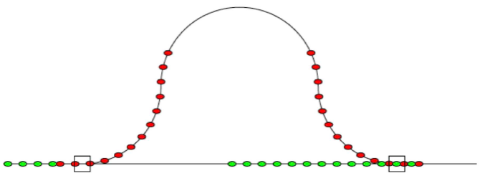
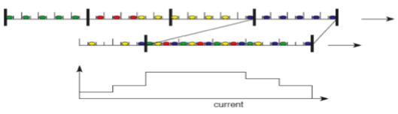
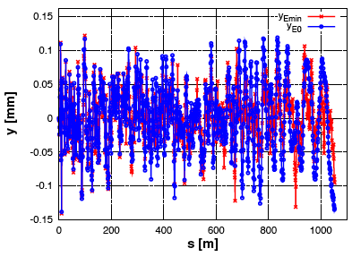
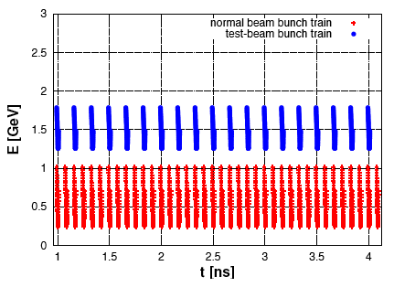
Transport challenge: orbit correction
We seek to improve the situation by imposing that particles of different energies shall follow same trajectory, i.e. minimizing the energy dependence of the trajectories; a dispersion-free correction.
We propose a scheme based on drive beam bunch-manipulation and exploiting PETS beam loading, to generate a test-beam.
Use of "delayed switching" in the drive beam generation. The test beam can have almost any energy leverage. One-pulse correction.
The effect of delayed switching
Beam transport for ideal inj. into a dispersion-free steered machine
Energy profile of main beam and example test-beam

Slide 15
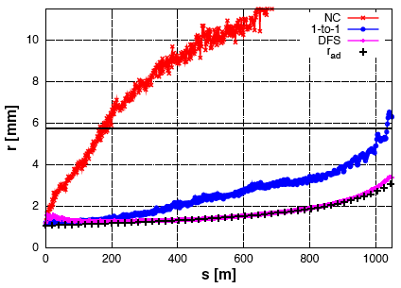
Beam transport with dispersion-free correction
Results of simulation including the combined effects of wake fields and misalignment, for the CLIC base line parameters :
3-σ envelope of 500 simulated machines (worst case r)

Slide 16
• Requirements
• Beam physics
• Component specifications
• Test facilities
• Conclusions

Slide 17
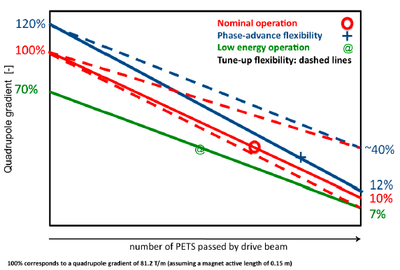
Decelerator operational scenarios
Tune-up beams: low current, negligible beam-loading. Not needed (nor optimal) to go to full phase-advance

Slide 18
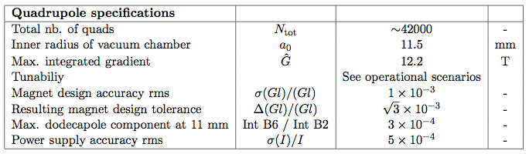
Quad specifications: baseline parameters
Specification: one quadrupole per meter gives beta function (for most decelerated particles) of <β> = 1.25 m
  Deemed necessary for robust mitigation of dipole wake
  Gives r = 3.3 mm (out of a₀ = 11.5 mm) for ideal beam
Results in ~42'000 decelerator quads
Powered magnets is the baseline
  failure tolerant serial powering scheme a necessity
Tuneable permanent magnets option investigated
  must cover all operational scenarios
A. Vorozhtsov, WG6, Wednesday 09:30
D. Siemaszko, S. Pittet, WG6, Wednesday 09:50
J. Clarke, WG6, Wednesday 11:40

Slide 19
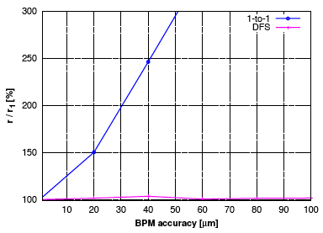
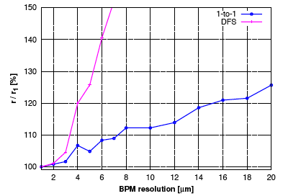
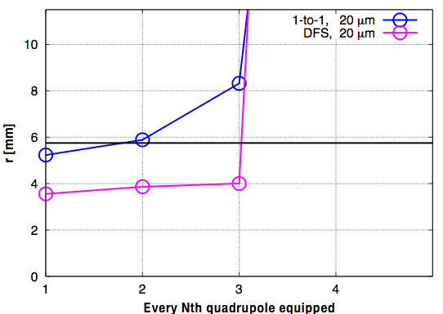
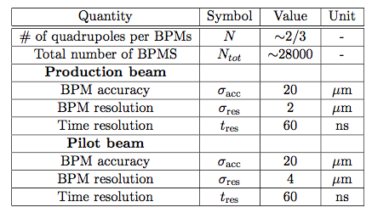
BPM specifications: baseline parameters
Beam-based correction performance drive the BPM specifications. Target: negligible envelope growth due to quadrupole kicks.
S. Smith, WG8, Wednesday 09:40
Effect of BPM accuracy
Effect of BPM resolution
Effect of # of BPMs
Results with baseline parameters

Slide 20
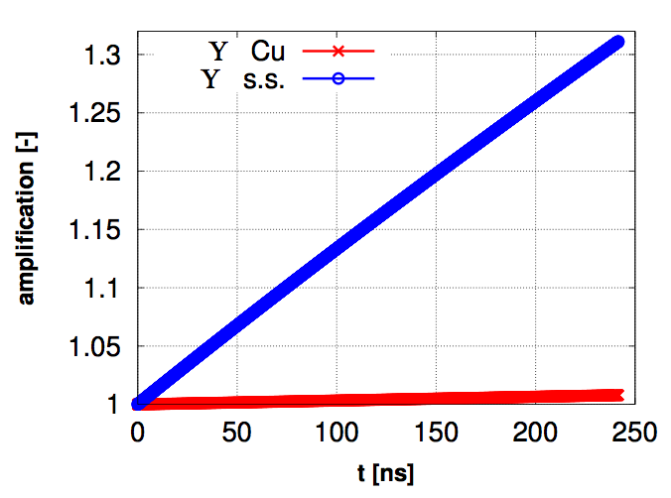
Vacuum system specifications
Collective effects studies for the 100 A drive beam :
Fast-ion instability
Analytic approximations, neglecting the large energy spread), yields one fast-ion instability rise-time with p = 40 nTorr.
Decelerator: p < 40 nTorr
2) Resisitive wall instability
Analytic calculations yield a significant (unacceptable) amplification of beam offsets for σ_{res} = σ_{s.s} while negligible for σ_{res} = σ_{Cu.}
Decelerator: σ_{res} ~ σ_{Cu}
Comparison with requirements for the rest of the drive beam long transfer lines :
B. Jeanneret, WG4,6, Thursday 08:30
Amplification of a coherent beam offset due to the resistive wall wake

Slide 21
Other specifications
Tolerance | Value | Comment
PETS offset | 100 μm | r_{c} < 1 mm fulfilled
PETS angles | ~ 1 mrad | r_{c} < 1 mm fulfilled
Quad angles | ~ 1 mrad | r_{c} < 1 mm fulfilled
Quad offset | 20 μm | Must be small to be able to transport alignment beam
BPM accuracy (incl. static misalignment and elec. error) | 20 μm | Must be small to be able to perform initial correction
BPM precision (diff. measurement) | ~ 2 μm | Allows efficient suppression envelope growth due to dispersive trajectories
Tolerance | Value | Comment
Quadrupole position jitter | 1 μm | r/r₀ < 5 %
Quadrupole field ripple | 5⋅ 10⁻⁴ | r/r₀ < 5 %
Current jitter | < 1% | Stability req. only – RF power constraints might be tighter.
Beta mismatch, dβ/β Injection offset, y/σ_{y} | ~10 % < 0.2 | r/r₀ < 5 % r/r₀ < 5 %

Slide 22
• Requirements
• Beam physics
• Component specifications
• Test facilities
• Conclusions

Slide 23
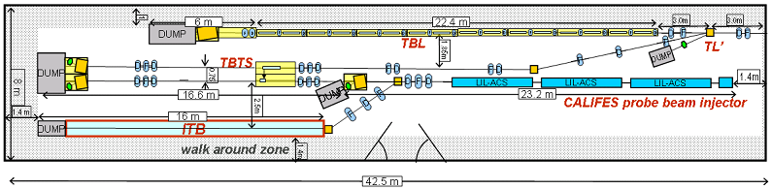
Decelerator test-facilities
Decelerator sector: ~1 km, ~90% of 2.4 GeV beam energy extracted
Two-beam Test Stand: test the characteristics of a single PETS
Decelerator Test Beam Line:
test of beam transport with > 50% of a 150 MeV beam energy extracted under betatron motion (16 PETS)
A. Palaia, WG6,
Thursday 09:30
R. Lillestøl, WG6,
Wednesday 11:00
CLEX

Slide 24
• Requirements
• Beam physics
• Component specifications
• Test facilities
• Status and conclusions

Slide 25
CLIC decelerator status
Simulation framework in place allowing for detailed specification
A CLIC baseline has been reached where simulations show satisfying beam transport for the baseline parameters
Component specifications are sometimes tight, but within the feasibility limits
Items outstanding :
  Experimental tests of heavily decelerated beam
  More detailed studies of collective effects for the decelerating beam
  More detailed machine protection and beam loss studies
  Benchmarking with other simulation codes would be comforting
  Further cost optimization (clever component design, further optimization); might be seen in context of a larger iteration of drive beam parameters (TDR?)

Slide 26
• Requirements
• Beam physics
• Component specifications
• Test facilities
• Conclusions
• Extra

Slide 27
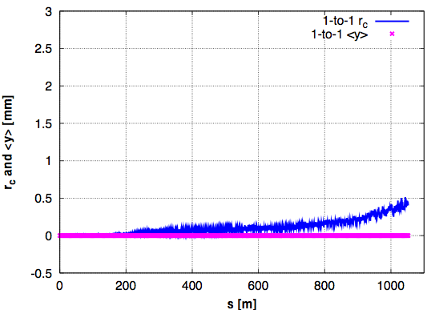
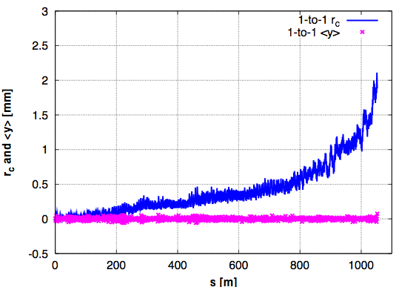
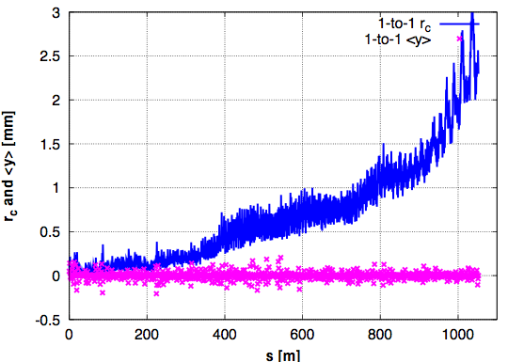
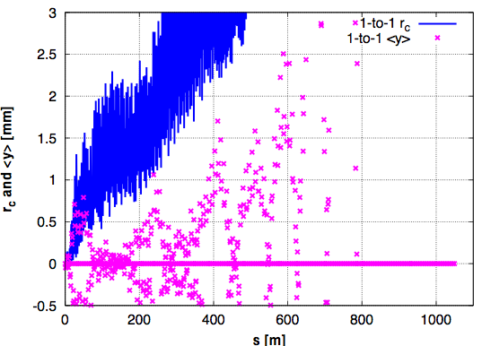
Effect on reducing number of BPMs
N=1
N=2
N=3
N=4
(perfect BPMs and single machine simulated, for illustration purposes)

Slide 28
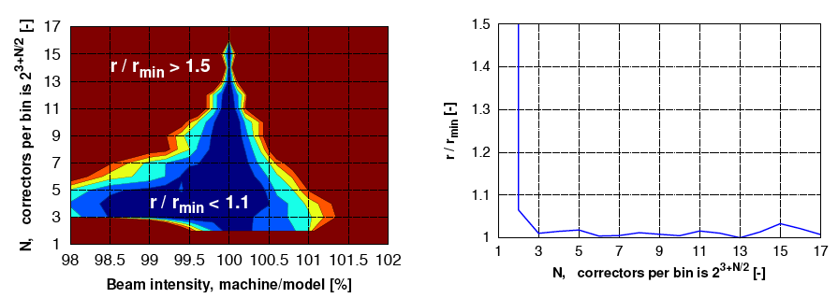
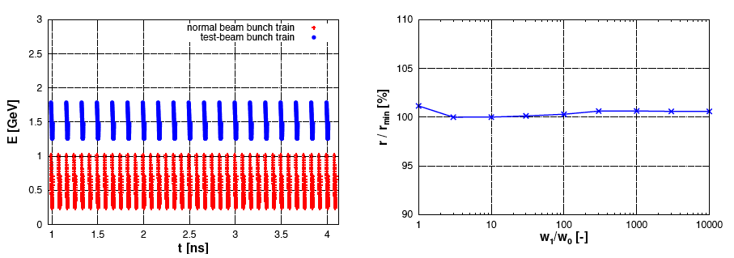
Dispersion-free steering details

Slide 29
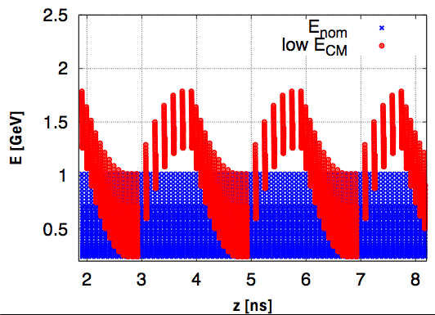
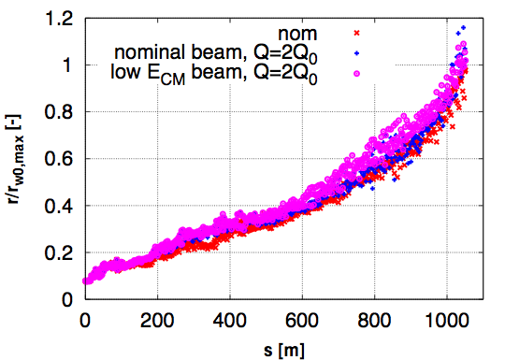
Delayed switching: low energy running

Slide 30
Power phase-lag in the decelerator

Slide 31
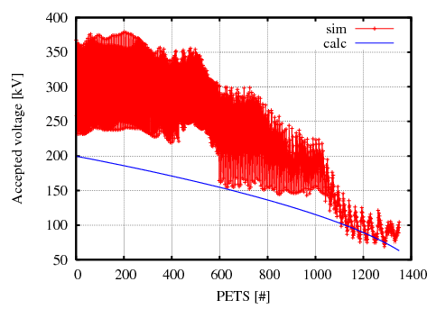
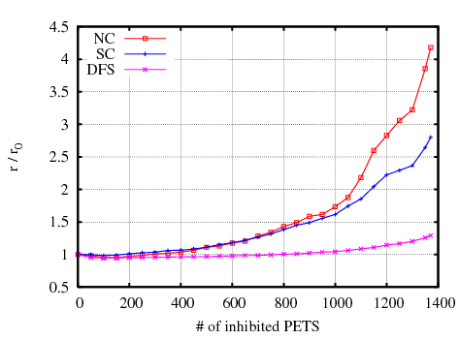
PETS on/off and kicks
A number of random PETS inhibited (averaged over 100 seeds)

