Slide 1
CLIC drive beam injector design
S. Bettoni, R. Corsini, A. Vivoli
(CERN)

Slide 2


Outline
CTF3 drive beam injector:
  Design, experimental verifications
CLIC drive beam injector layout:
  Optimization process and criteria
  Proposed layout
  Longitudinal and transverse beam dynamics simulations
  Critical view of the results and possible cures
Conclusions & outlook

Slide 3
Drive beam injector: CTF3 example
Gap creation and combination
Phase coding
Sub-harmonic bunching ν₀ / 2
even
buckets
odd buckets
180° phase switch
  RF deflector ν₀ / 2
Acceleration ν₀
Deflection ν₀ / 2

Slide 4
Drive beam injector: CTF3 experience
Key parameters for the SHB system:
    Time for phase switch < 10 ns
    Satellites (particles captured in 3 GHz RF buckets) population < 7 %
Phase switch:
Satellite bunch population:
Main
Satellites
Phase switch within eight 1.5 GHz periods (<6 ns).
Satellites bunch population
estimated to ~8 %.

Slide 5
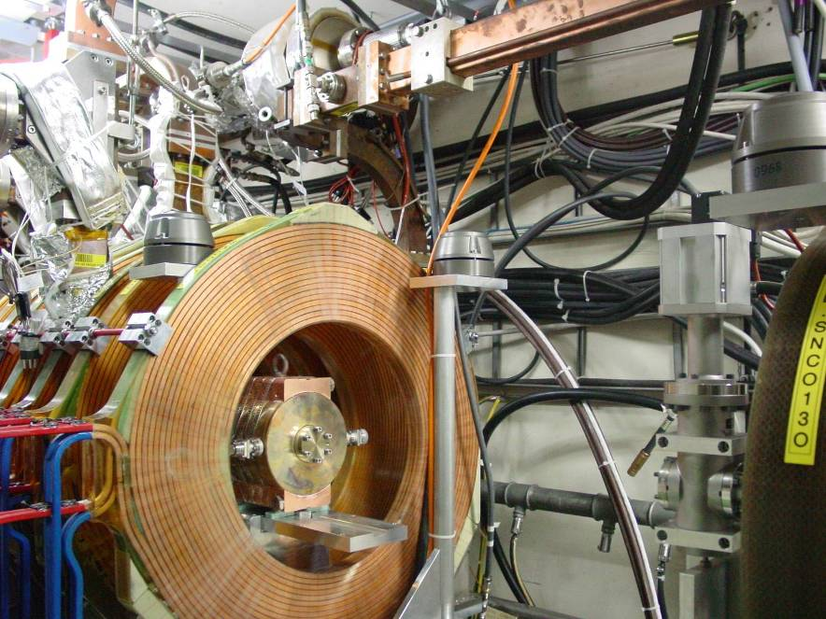
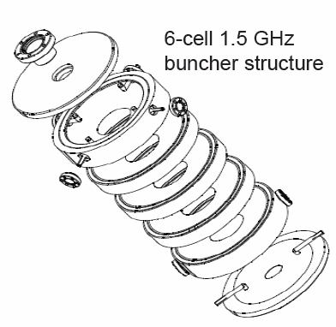
CTF3 first rescaling: the SHB system
Lshb = 3*Lshb_{CTF3} (6 cells)
Gshb = Gshb_{CTF3}/3
CTF3
Lshb = 2/3*Lshb_{CTF3} (4 cells)
Gshb = 3/4*Gshb_{CTF3}
Frequency (GHz) | 1.49928
Number of cells | 6
Iris diameter (mm) | 66
Cell length (mm) | 26
Input power (kW) | 40
Filling time (ns) | 10
Lshb = Lshb_{CTF3} (2 cells)
Gshb = Gshb_{CTF3}
 | SHB1 | SHB2 | SHB3
Phase advance/cell (º) | 74.82 | 70.21 | 68.23
Phase velocity/c | 0.63 | 0.67 | 0.69

Slide 6
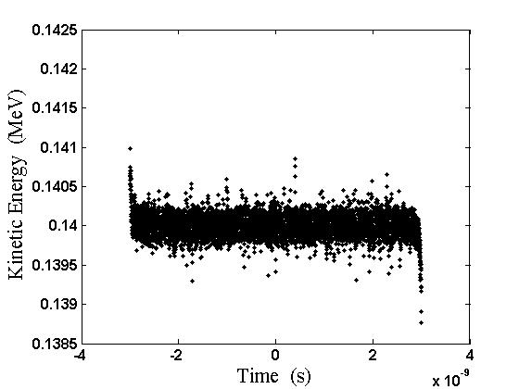
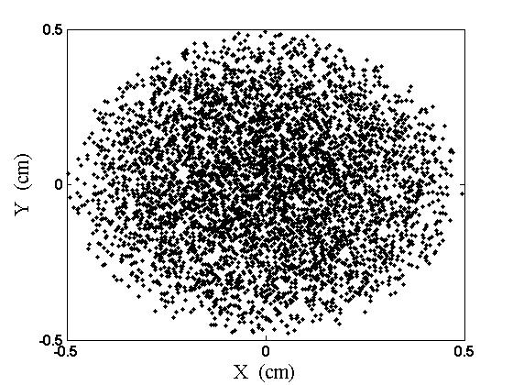
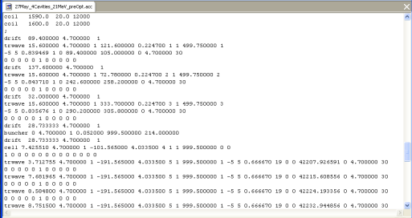
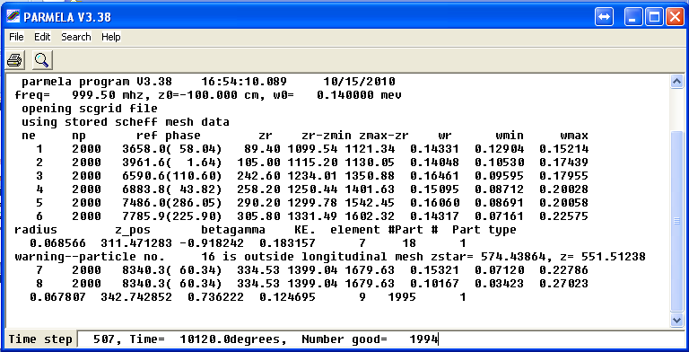
The Matlab driven optimization tool
Starting distribution
Parmela file input
Parmela run
Automatic minimization
process
Analysis of the results

Slide 7
The optimization process: some details
During the optimization:
  The code varies the parameters of the system and it does some checks on them
  From the output of Parmela the tool calculates the number of particles in the main of the reference particles cutting the distribution at the target bunch length
  The number of particles in this region is maximized

Slide 8
CLIC drive beam injector layout
Solenoids
Thermionic gun
SHB
Prebuncher
Buncher
Accelerating cavity
140 KeV
6 MeV
Slit
26 MeV
53 MeV
Quadrupole
Bend

Slide 9
Exit of the gun
Energy = 0.140 MeV
σ_{E}= 0.00016 MeV
ΔT= 6 ns
γβ ε_{x,y}= 3.48 μm rad
CLIC parameter | Unit | Value
Pulse duration Repetition rate | μs Hz | 140.3 50

Slide 10
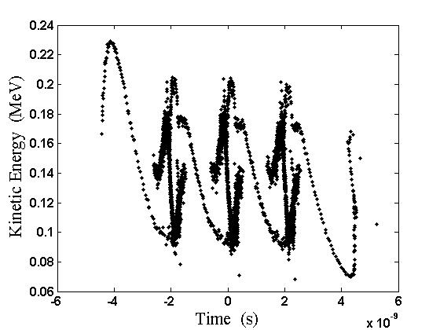
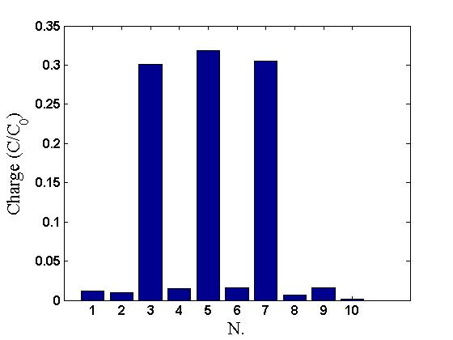
SHB system
SHB1 | Unit | Value
Length N. cells Frequency Phase velocity Voltage Aperture radius | cm MHz c kV cm | 15.6 2 499.75 0.93 35.0 4.7
SHB2 | Unit | Value
Length N. cells Frequency Phase velocity Voltage Aperture radius | cm MHz c kV cm | 15.6 2 499.75 0.61 36.5 4.7
SHB3 | Unit | Value
Length N. cells Frequency Phase velocity Voltage Aperture radius | cm MHz c kV cm | 15.6 2 499.75 0.73 38.8 4.7
Energy = 0.138 MeV
σ_{E}= 0.029 MeV
ΔT= 9.68 ns

Slide 11
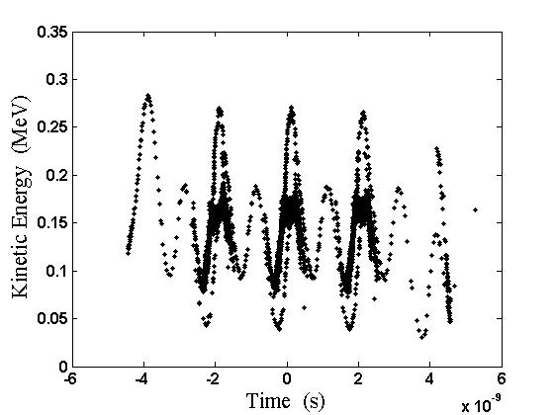
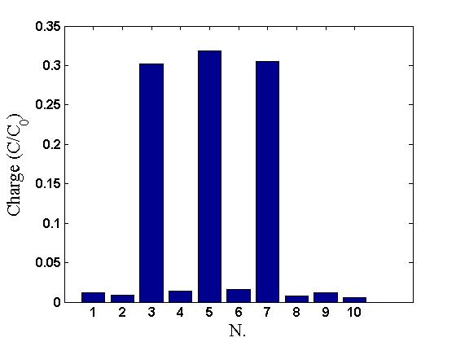
Prebuncher
Parameter | Unit | Value
Length Number of cells Frequency Accelerating gradient Aperture radius | cm MHz MV/m cm | 6 1 999.5 1.2 4.7
Energy = 0.147 MeV
σ_{E}= 0.035 MeV
ΔT= 9.7 ns
Satellites= 5.5 %

Slide 12
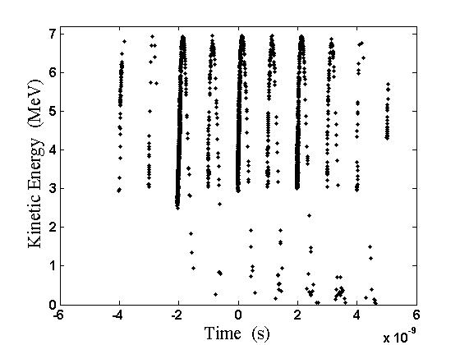
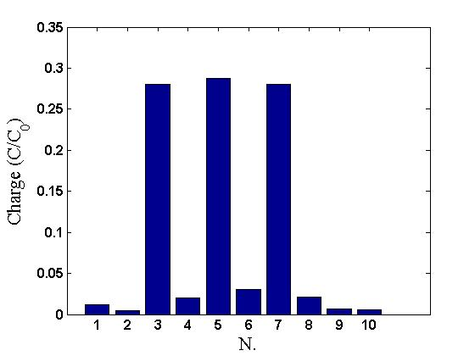
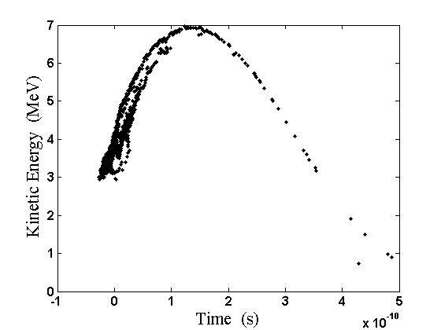
Buncher
Parameter | Unit | Value
Phase velocity: First 12 cells Last 6 cells Phase advance/cell Total length Accelerating field Beam aperture radius | c c π m MV/m cm | 0.68-0.99 1 2/3 1.681 4.2 4.7
Energy = 4.20 MeV; σ_{E}= 1.01 MeV; σ_{t}= 55.89 ps.

Slide 13
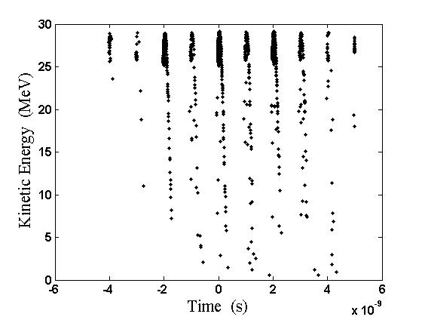

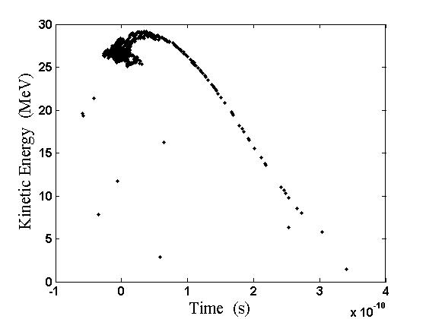
Exit of the solenoids (E∼30 MeV)
Accelerating cavities parameter | Unit | Value
Phase velocity Number of cells Phase advance per cell Total length Voltage Beam aperture radius | c π m MV cm | 1 10 2/3 0.9998 4.8 4.7
Energy = 26.34 MeV; σ_{E}= 2.16 MeV; σ_{t}= 36.58 ps.

Slide 14
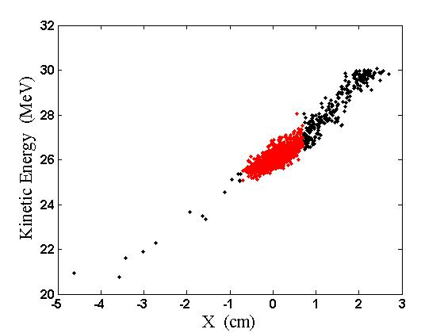
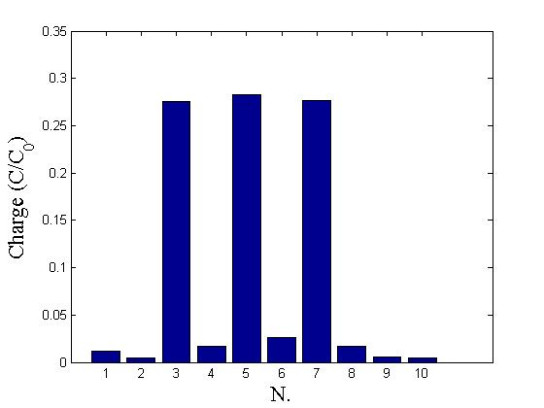
Cleaning chicane
R_{5,6} = 78 mm
CTF3
Before the chicane
After the chicane
Bend length = 15 cm; Bend angle = 14.32 deg; Reference E = 26 MeV; Slit aperture = 7 mm;
Intensity decrease = 24%.

Slide 15
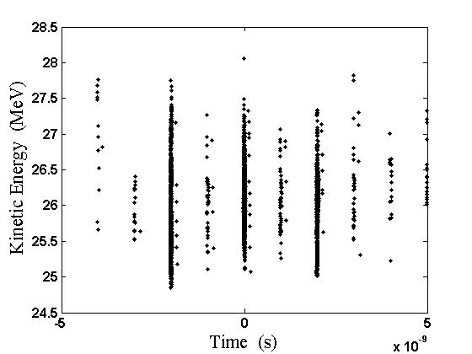
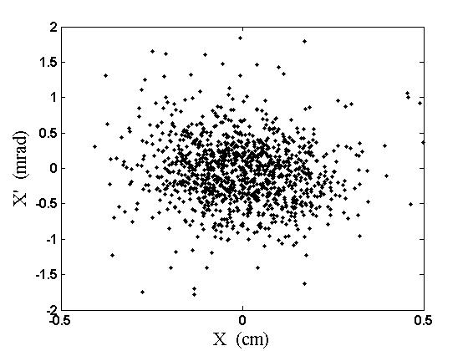
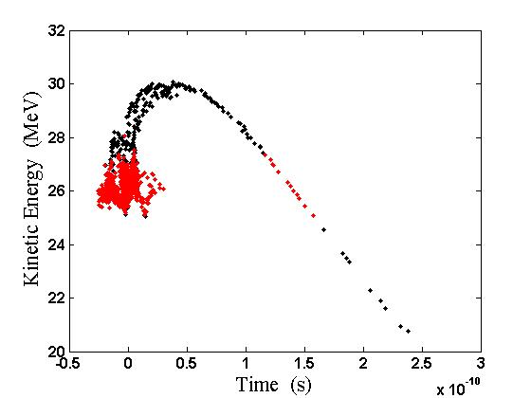
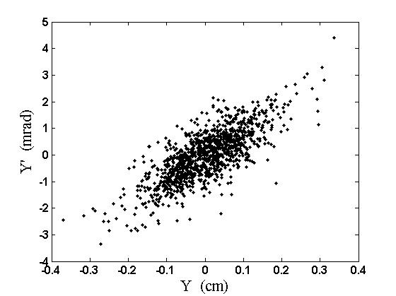
After the cleaning chicane
Before the chicane
After the chicane
Energy = 26.07 MeV; σ_{E}= 0.40 MeV; σ_{t}= 17.14 ps.

Slide 16
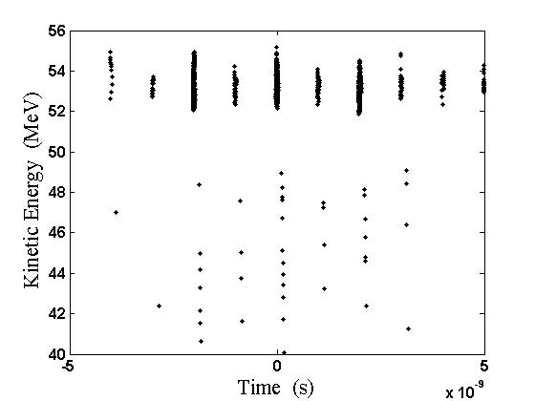
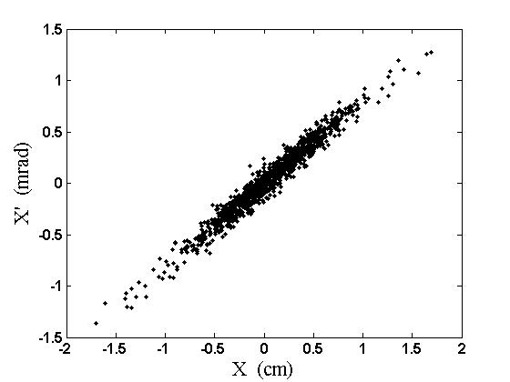
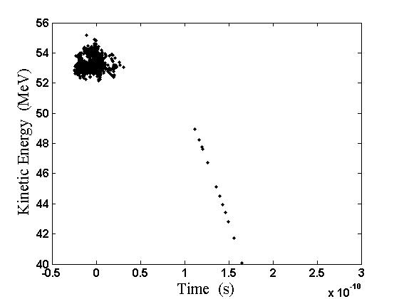
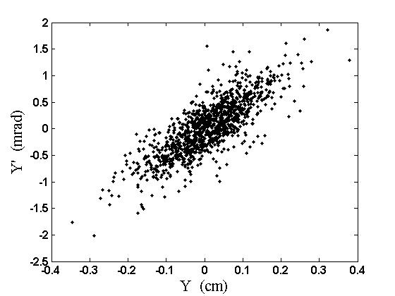
Injector exit (E∼50 MeV)
Energy = 53.25 MeV; σ_{E}= 0.45 MeV; σ_{t}= 9.45 ps.
γβε_{x}= 32.92 μm rad; γβε_{y}= 28.73 μm rad.

Slide 17
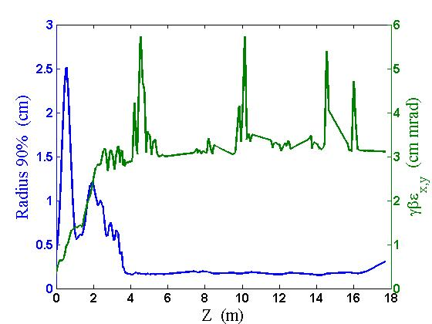
CLIC drive beam injector: transverse dynamics

Slide 18
CLIC requests and simulation results
Parameter | Unit | Simulations | CLIC
Energy Bunch charge Bunch length (rms) Energy spread (rms) Horizontal normalized emittance (rms) Vertical normalized emittance (rms) Satellites population | MeV nC mm MeV μm rad μm rad % | 53.2 8.16 2.83 0.45 (@53 MeV) 32.9 28.7 4.9 | ≥ 8 3 (@ 50 MeV) < 0.50 (@ 50 MeV) ≤ 100 ≤ 100 As less as possible
CLIC requets fulfilled

Slide 19
CLIC drive beam injector design: a critical view
More optimizations still ongoing:
  Intensity decrease at the chicane = 24% (close to CTF3 20%)
  Additional chicane needed
  (power???)
  Satellites population = 4%

Slide 20
Satellites minimization: possible cures
Identified two approaches to minimize the satellites content:
  Minimize the number of particles in the time interval of the satellites
  Use an additional SHB to shift the energy of the satellites
CDR version
Modified version
Starting from an idea by P. Urschütz (presently at Siemens)

Slide 21
Efficiency: an alternative solution
Re-optimization using as a figure of merit the energy spread at a fixed bunch length and optimization of the accelerating cavities:
  Intensity decrease at the chicane = 19% (24%)
  Total losses from the start = 22% (30%)
  Particles to be lost in the additional chicane reduced by a factor 2
Particles in a more confined E-t region

Slide 22
Conclusions
A design of the CLIC drive beam injector based on a thermionic gun has been studied
Parmela simulations verified that the challenging CLIC requests can be fulfilled (longitudinal & transverse)
Identified some possible improvements (beam losses, satellites content) and optimization already ongoing
Further studies (beam loading compensation, wakefields effects and beam stability) to be done
Proper RF design of the elements to be done

Slide 23
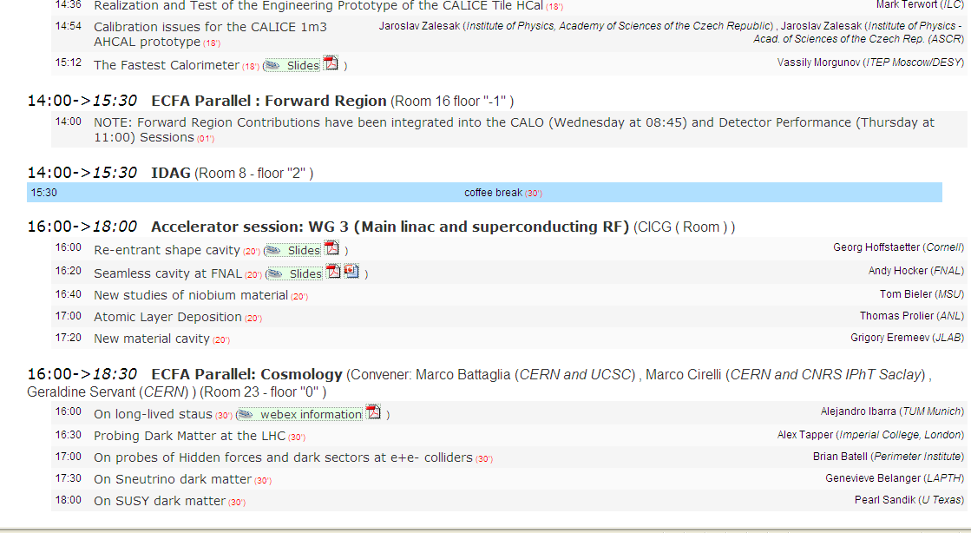

If you don’t have other questions …

Slide 24
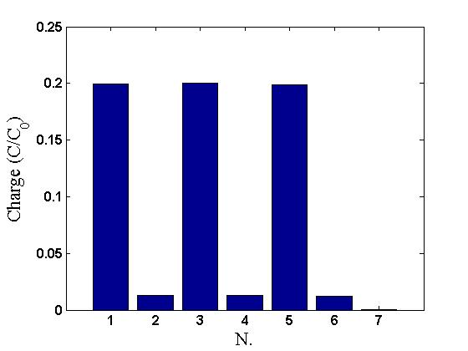
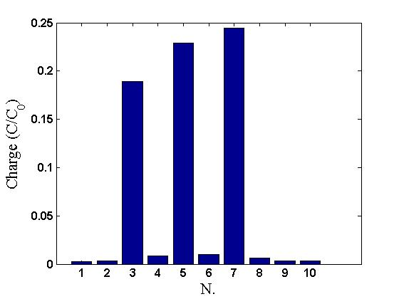
Spare slide: space charge
Without space charge
With space charge

