Slide 1

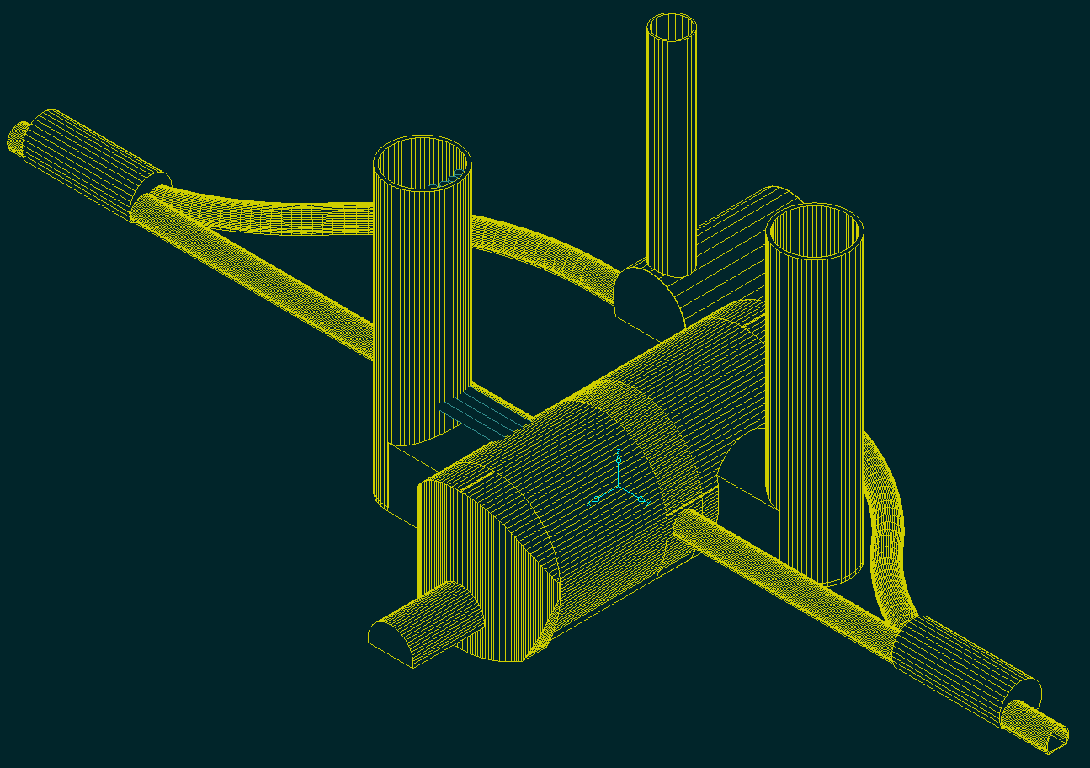
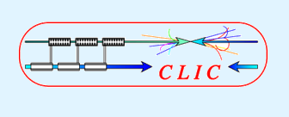
CLIC MDI
IWLC10 workshop 20-10-2010
Lau Gatignon / CERN
for the MDI team & related WG

Slide 2
MDI members and contributors
Robert Appleby, Armen Apyan, Guillermo Zamudio Ascensio, Antonio Bartalesi,
Marco Battaglia, Enrico Bravin, Helmut Burkhardt, Phil Burrows, Francois Butin, Barbara Dalena,Konrad Elsener, Arnaud Ferrari, Andrea Gaddi, Martin Gastal,
Lau Gatignon, Hubert Gerwig, Christian Grefe, Edda Gschwendtner,
Michel Guinchard, Alain Hervé, Andréa Jérémie, Michael Jonker, Thibaut Lefèvre,
Lucie Linssen, Helène Mainaud Durand, Sophie Mallows,
Michele Modena, John Osborne, Thomas Otto, Colin Perry,
Javier Resta Lopez, Giovanni Rumolo, André Philippe Sailer, Hermann Schmickler, Daniel Schulte, Jochem Snuverink, Markus Sylte,
Rogelio Tomàs Garcia, Davide Tommasini, Raymond Veness,
Alexey Vorozhtsov, Volker Ziemann, Franck Zimmermann

Slide 3
Outline
Introduction
Detector layout
The QD0 magnet
Anti-solenoid
QD0 integration in detector
QD0 stabilisation
Pre-alignment of QD0
IP feedback
Vacuum
Post-collision line
Input for cavern layout with Push-pull
Summary and Outlook

Slide 4
Some relevant CLIC parameters
L* = 3.5 m

Slide 5
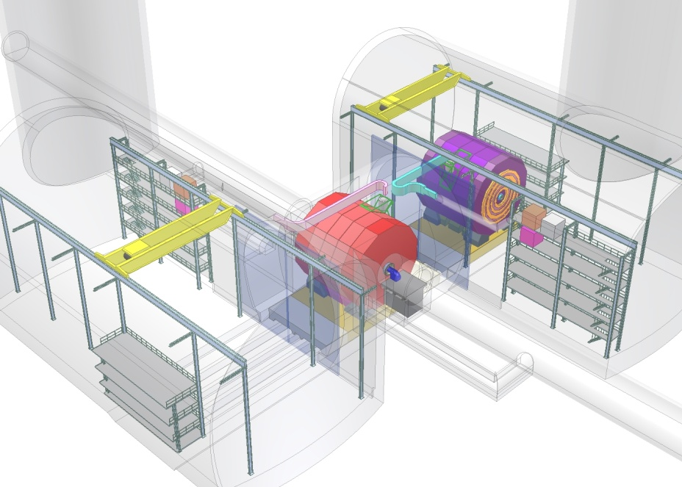
The CLIC interaction region: one IP, two Experiments
Push-Pull scheme
A.Gaddi, H.Gerwig, A.Hervé

Slide 6
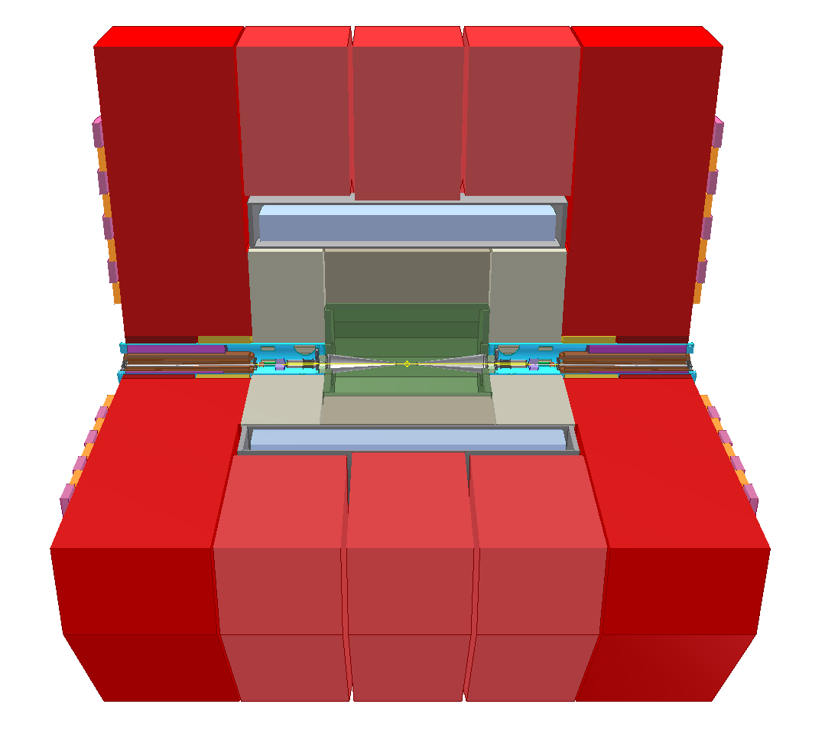
e.g.: LATEST VERSION OF CLIC_SID DETECTOR
N.Siegrist, H.Gerwig

Slide 7
ILD parameter drawing

Slide 8
Comparison between the two detectors
Note: detailed dimensions constantly evolving!
H.Gerwig et al

Slide 9
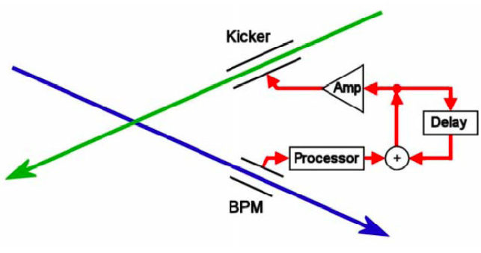
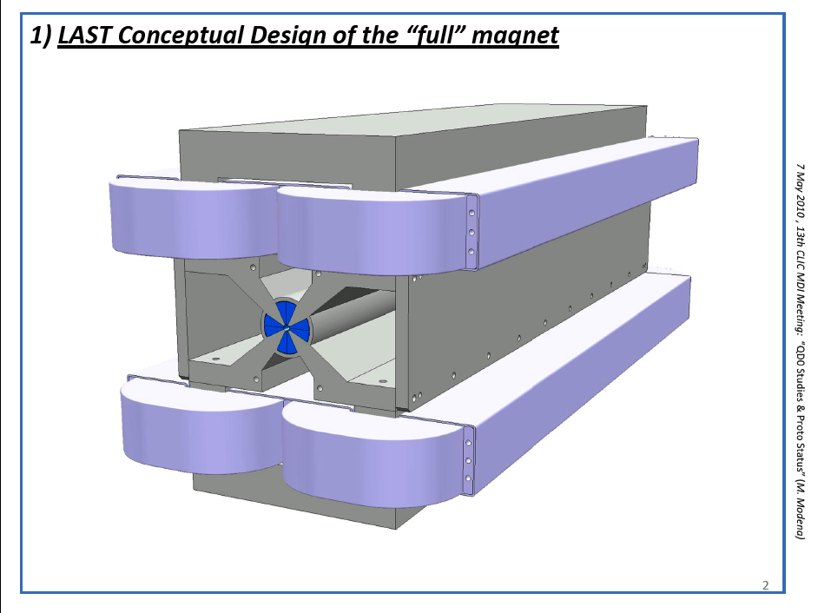
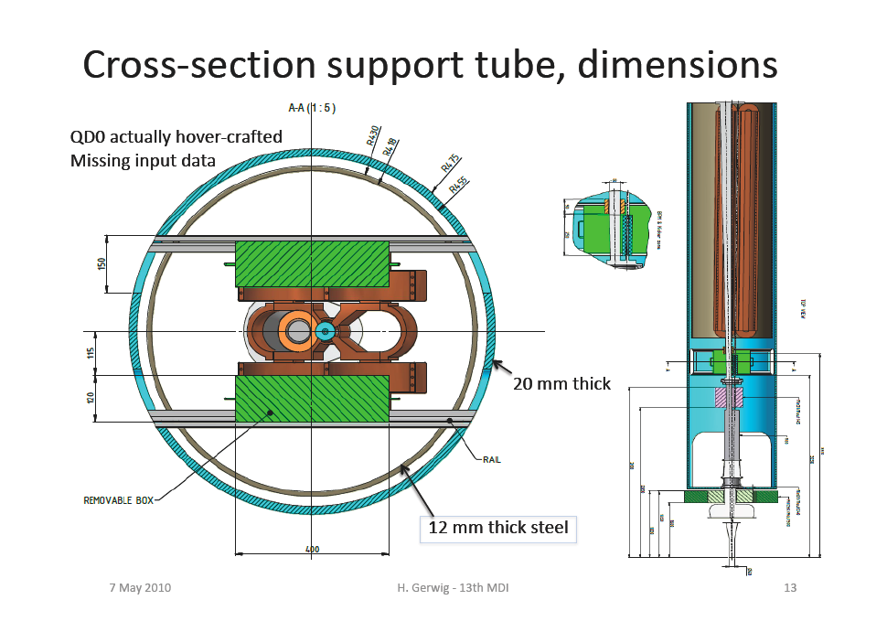
MACHINE DETECTOR INTERFACE
Plus others ………..
IP Feedback
Beamcal+
Lumical
Anti-solenoid
Vacuum
QD0 quadrupoles
Support
tubes
+Stabilization + prealignment

Slide 10
Final Focus Quadrupole (QD0): Parameter specifications
Parameter | Value
Gradient [T/m] | 575
Length [m] | 2.73
Aperture radius [mm] | 3.83
Outer radius [mm] | < 50
Peak field [T] | 2.20
Tunability of gradient from nominal | [-10%, 0%]
– for spent beam
+ Compatibility with stabilization requirements
Hybrid technology: permanent magnet + coils + Permendur

Slide 11
Concept of the hybrid QD0 magnet
See M.Modena, WG5
Modeling:
Obtain 531 T/m with Sm₂Co₁₇
590 T/m with Nd₂Fe₁₄B
Stabilised in position (double tube)
Coils mounted independent of yoke

Slide 12
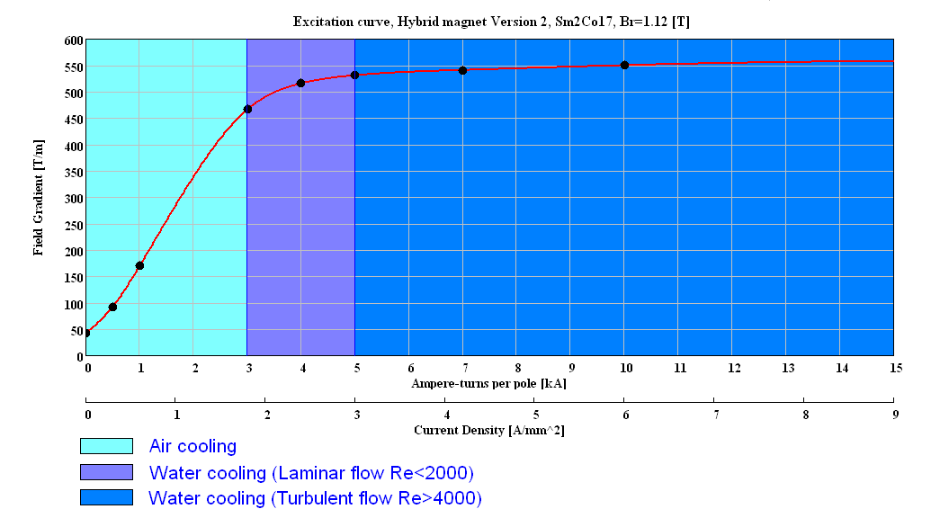
“Hybrid Short Prototype”:
“CLIC09 Workshop” 12-16 October 2009 , M. Modena

Slide 13
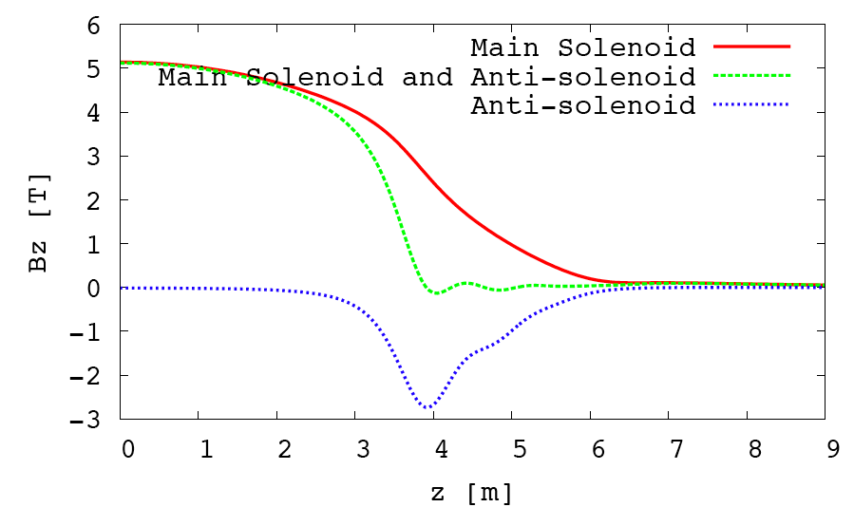
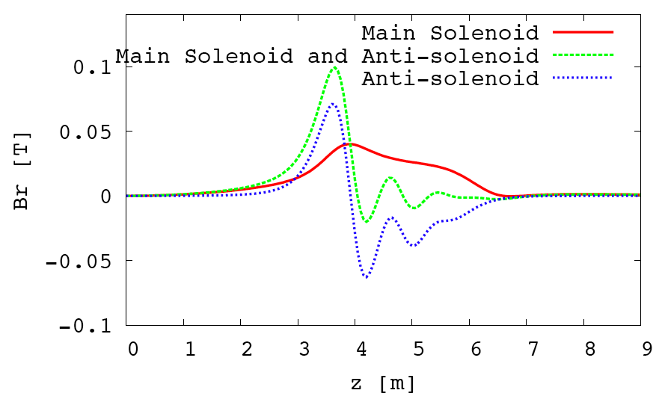
Anti-solenoid
The permanent magnet material and Permendur in QD0 are protected by the anti-solenoid,
that partly cancels the main solenoid field.
It surrounds QD0 and is made of several coils, powered with different currents.
It also compensates to a large extent the effect of the main solenoid on the beams.
See presentation by B.Dalena in WG5

Slide 14
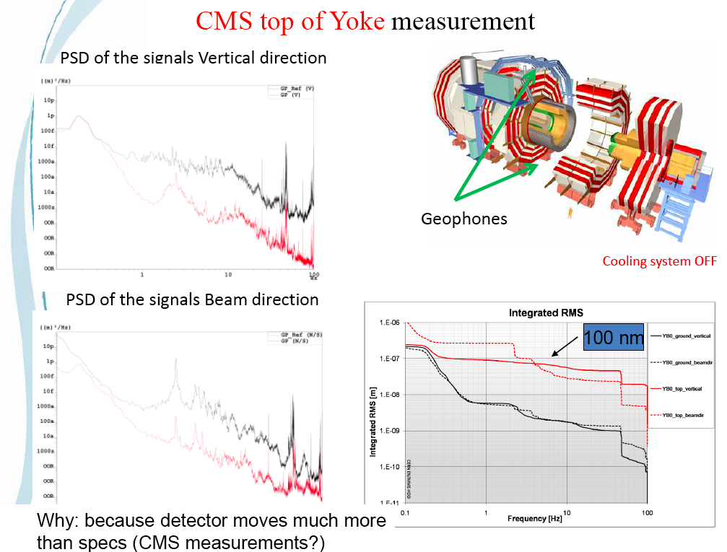
Note: Ground movements & vibrations
Suspend
QD0 from
the tunnel,
not from
the detector
M.Guinchard and A.Kuzmin

Slide 15
Courtesy H.Gerwig

Slide 16
Stabilization of QD0
Any vertical movement of QD0 moves the beam
at the Interaction Point by a comparable amount
Need to stabilize QD0 position
In particular vertical position to 0.15 nm RMS @ 4 Hz,
depending on performance of feedback loops
Need to measure QD0 position
Need to correct QD0 position
Feedback loop
Capacitive gauges + geophone
(relative + absolute measm’t)
Piezo-actuators
Elastomer support
Optimised controller

Slide 17
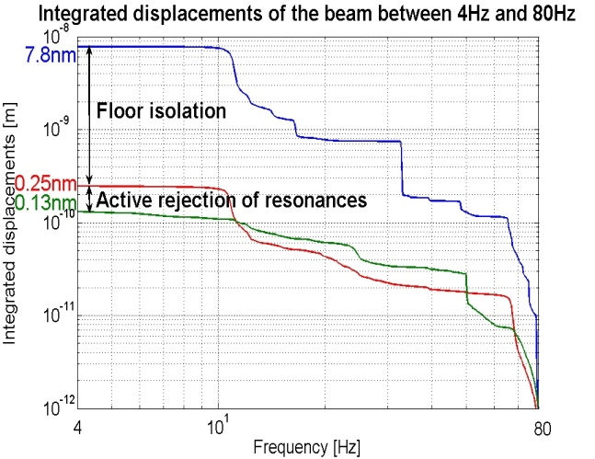
Stabilization to 0.13 nm at 4 Hz has been achieved in the lab
But on a large and massive table
Courtesy A.Jeremie / LAPP
To be adapted to the MDI environment

Slide 18
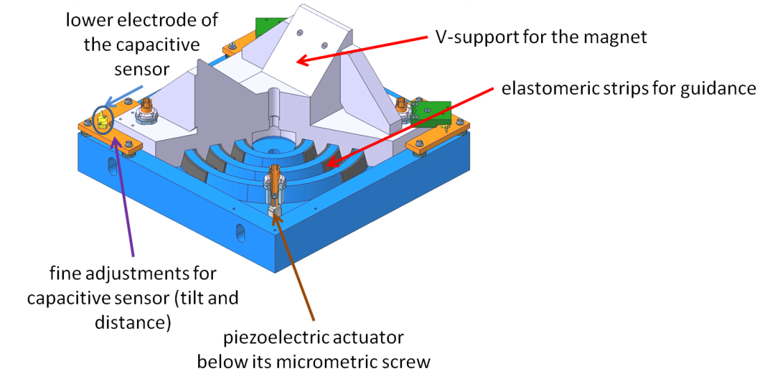
Preliminary design of a stabilisation device
See A.Jeremie’s presentation, WG5

Slide 19
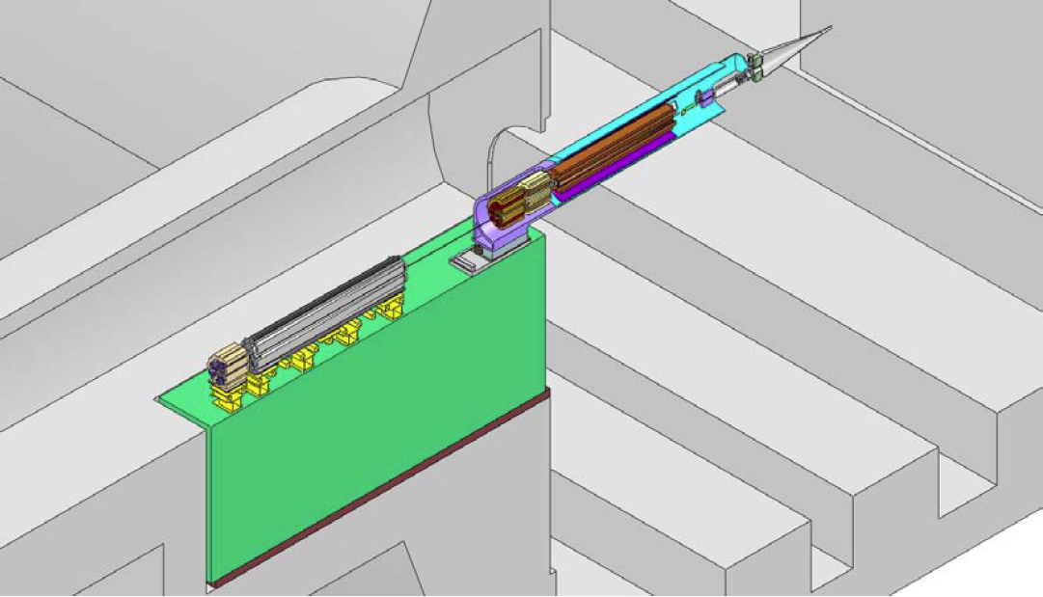
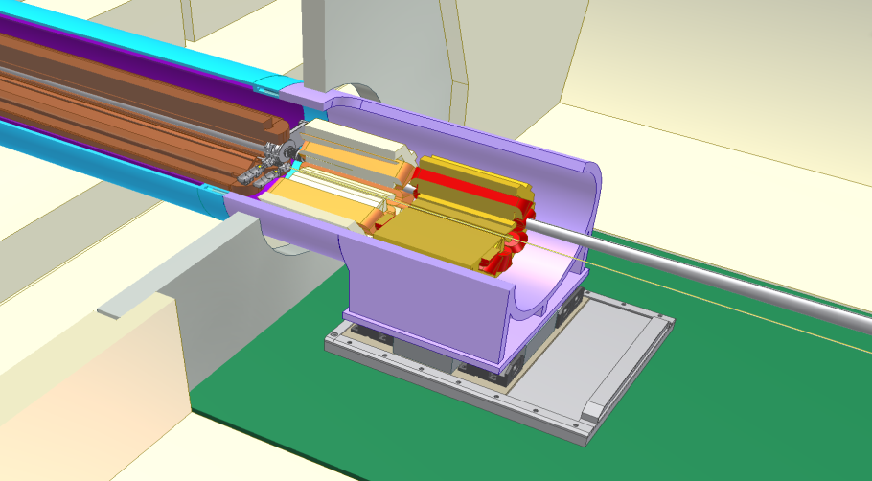
The QD0 support tube and QF1 are mounted on a pre-isolator
Concrete mass of ~ 80 tons mounted
on calibrated springs.
Eigenfrequency ~ 1 Hz.
Designed to reduce vibrations by
a factor of ~ 30.
See A.Gaddi talk, WG5

Slide 20
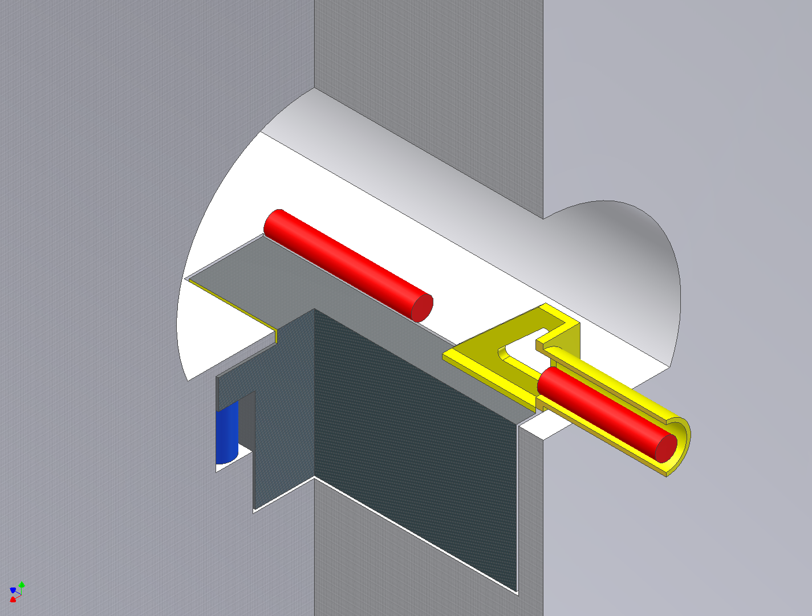
How can it be realized ?
QF1
Walk-on-floor
QD0
QD0 support tube
Mass
Elastic
support
conceptual design

Slide 21
QD0 Pre-alignment
The QD0 magnets have to be pre-aligned to 10 μm RMS precision
for the beam tuning algorithm to converge
QD0 w.r.t. the last 500 m
of the BDS line
One QD0 w.r.t. the other QD0
Adjustment equipment
Two Wire Positioning Systems per QD0,
One inclinometer with 2 axes
Hydrostatic leveling system for sag
Network of RASNIK systems
Channels through detector
CAM movers with 5 DOF
See H.Mainaud Durand in WG5

Slide 22
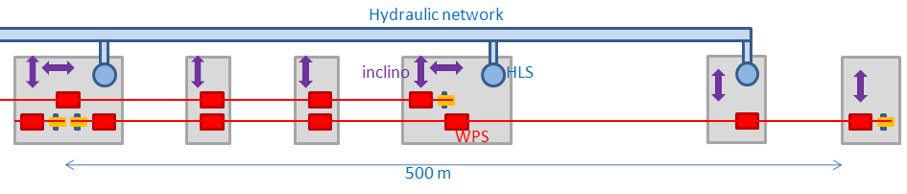
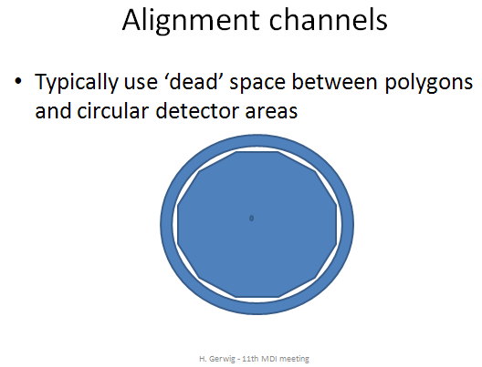
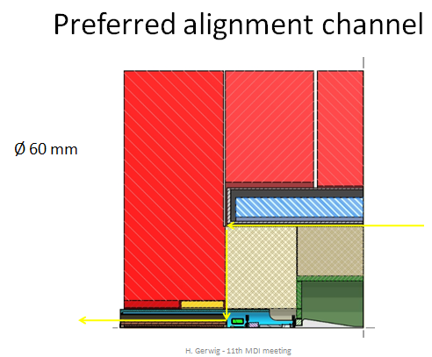
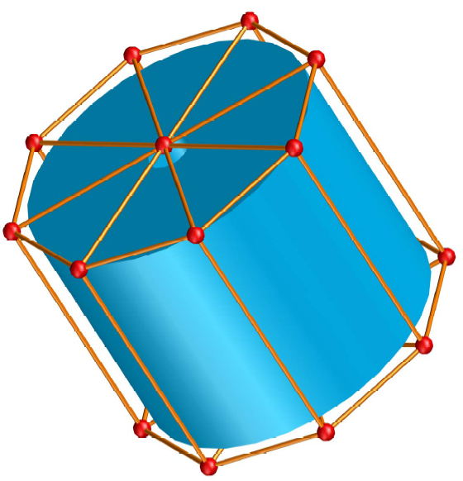
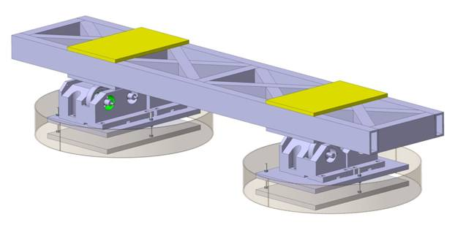
Wrt BDS:
QD0 vs QD0:
Cam mover:

Slide 23
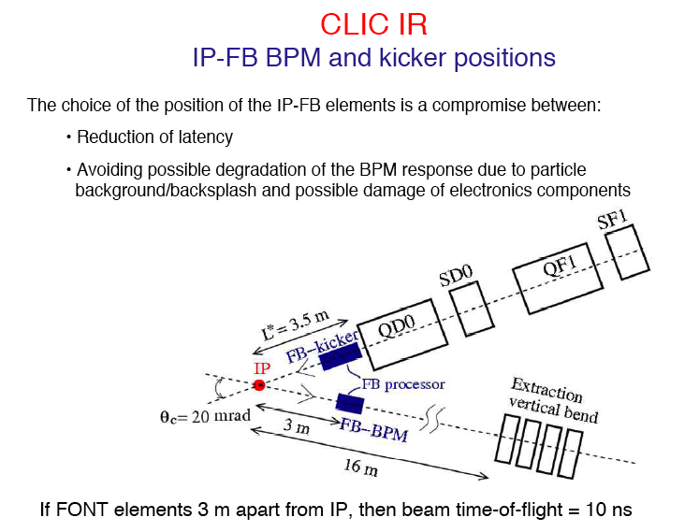

Slide 24
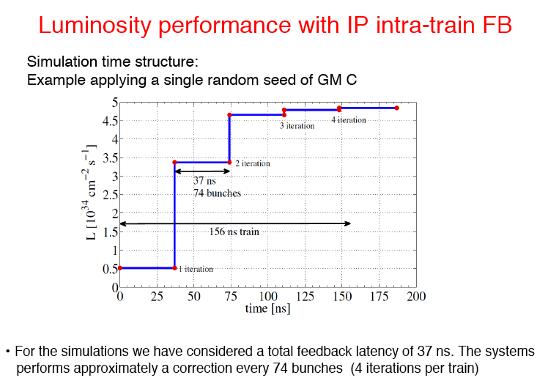
See Ph.Burrows, WG5

Slide 25
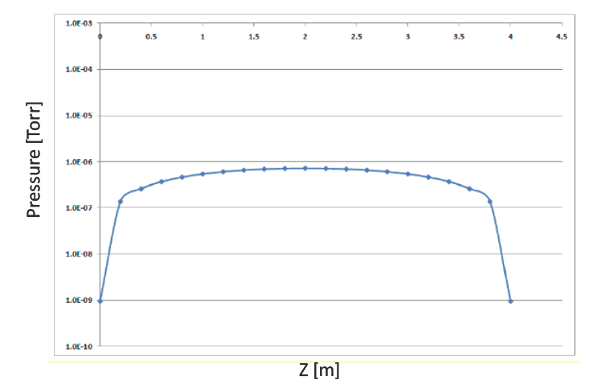
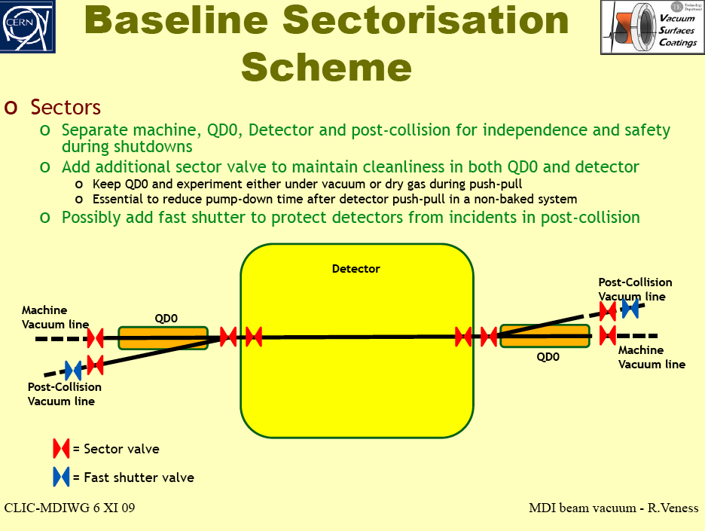
VACUUM SYSTEM
Vacuum pressure in IR not
so critical: 10³ – 10⁵ nTorr
Beryllium chamber in
the detector. May need
special coating against
electron cloud.
Unbaked chamber inside
QD0 is sufficient
Need sectorizarion and
isolation of QD0 chamber
to ensure “fast”
push-pull operation
Direct connection with
spent beam vacuum
(modest pressure, but
large volume and large
energy deposited on
dumps and absorbers).
Static pressure in QD0 after 100 hours of pumping
See R.Veness talk in WG5

Slide 26
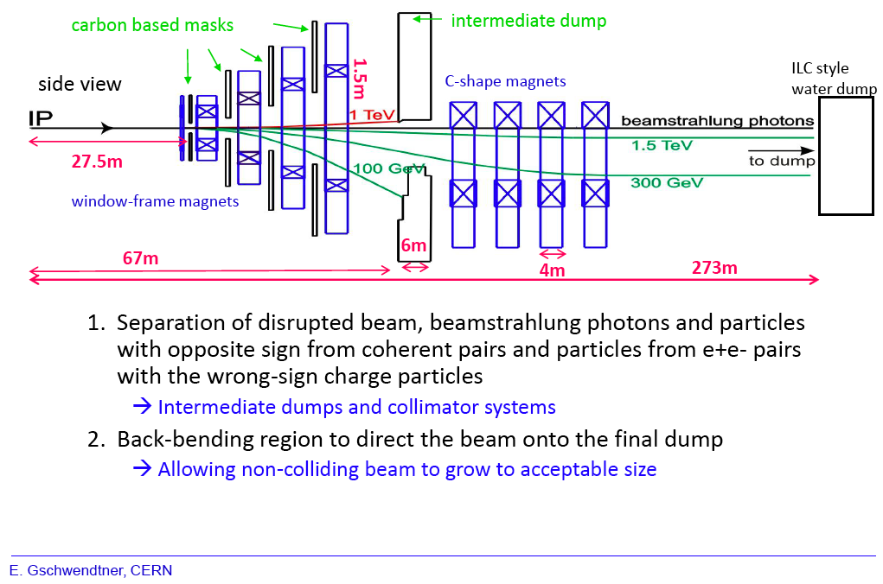
Post-Collision line present design:
315m

Slide 27
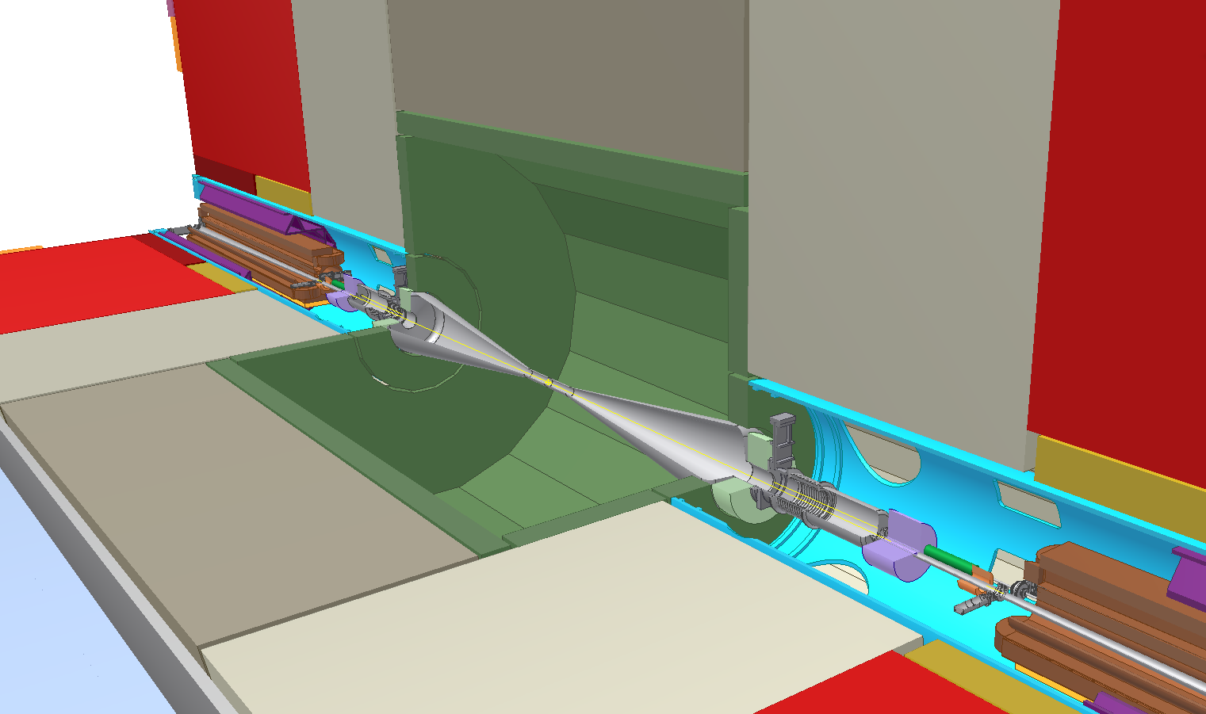
Integration of QD0 magnets and IP Feedback systems in IR
Lumical
BPM
Spent beam
Beamcal
Kicker
QD0
N.Siegrist, H.Gerwig

Slide 28
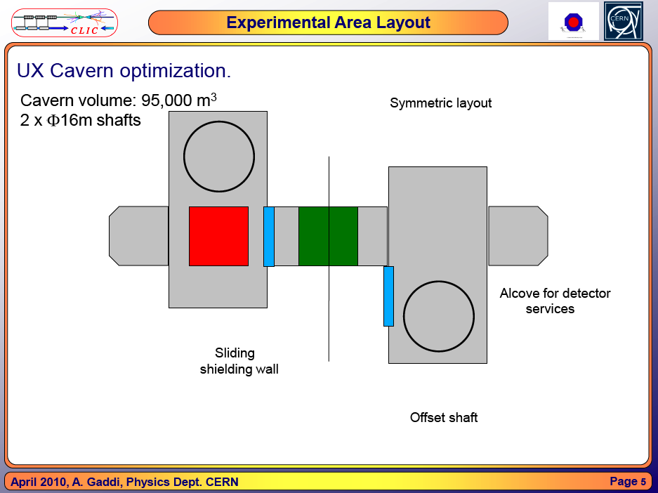

Slide 29
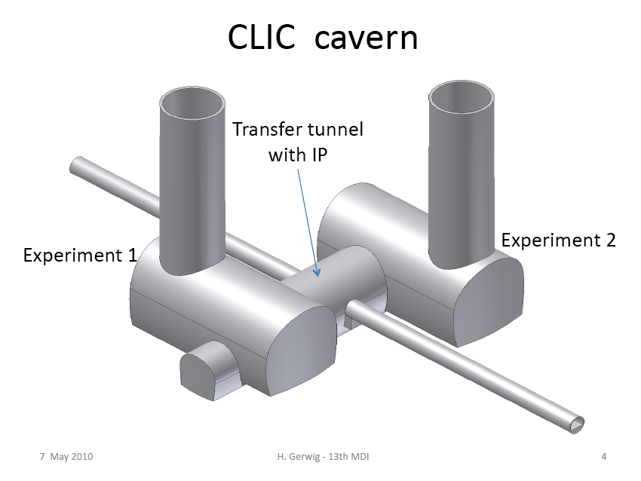
A.Gaddi, H.Gerwig, A.Hervé
See M.Gastal’s talk for Civil Engineering details

Slide 30
Top view:
Side view:

Slide 31
Summary and Outlook
The CLIC MDI has made enormous progress towards the CDR
Due to the suspension of QD0 from the tunnel and the mounting on a
pre-isolator, the push-pull system is decoupled from the QD0 stabilization
and pre-alignment issues
The integration of machine components inside detectors has been defined
Continuous progress is being made with stabilization and pre-alignment
Prototyping and/or tests are under way for QD0, IP feedback (FONT),
stabilization, pre-isolator, etcetera. Those will continue during the TDR phase
More details in the forthcoming MDI talks (WG5 and combined/related sessions)
Thanks for your attention!

Slide 32
Spares

Slide 33
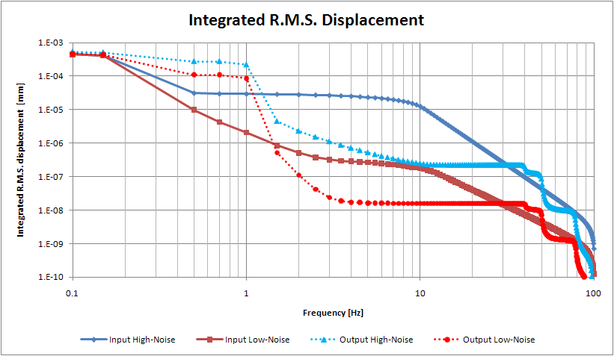
RMS vertical displacement reduced by a factor >10 from 4 Hz.
plots by F. Ramos

