Slide 1
Contents of the status report
ATF status
Junji Urakawa, KEK
Upgrade of Beam Instruments
  DR BPM readout (FNAL digitizer)
  EXT Strip-line BPM readout (SLAC-LCLS digitizer)
  Multi-OTR monitors
Upgrade of Accelerator
  Two LINAC klystron Modulators
  EXT corrector PS
R&D
  Fast Kicker
  EXT Laser Wire
  4-mirror optical cavity installation
  Cold BPM
  Single- and Multi-bunch instability

Slide 2
ATF/ATF2: 2010 Jan.-Jun.
Beam operation: 14 weeks
  Fast kicker mode … 3 weeks
  ATF2 continuous run … 1 week
Major hardware troubles
  PS for DR main dipole was broken (lost 2 days).
  CAMAC communication (several hours/day after April, hot days)
  Down of LINAC klystron modulators (several min/event)
Poor quality beams :
  Due to multi bunch instability
  lead the inefficient runs : FONT, Cavity Compton , Fast kicker, etc.

Slide 3
Beam
Time
Assignment in 2010
(Jan.-Jun.)

Slide 4
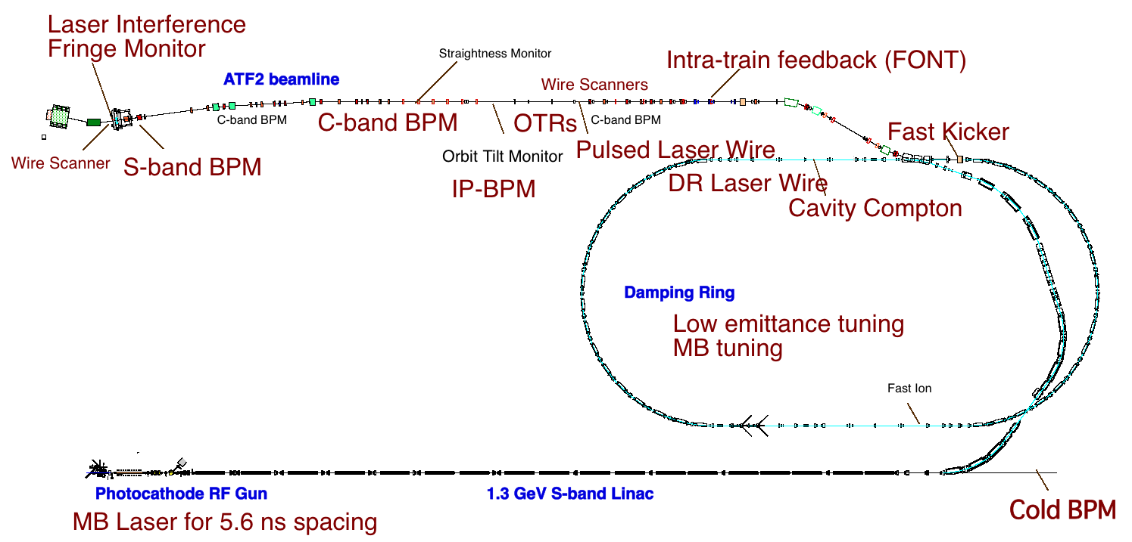
R&D: 2010 Jan.-Jun.

Slide 5
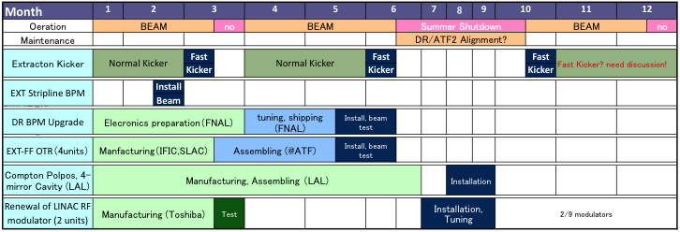
Major Hardware Installation in 2010
LCLS digital readout system
digital readout system
Fast emittance measurement

Slide 6


Slide 7
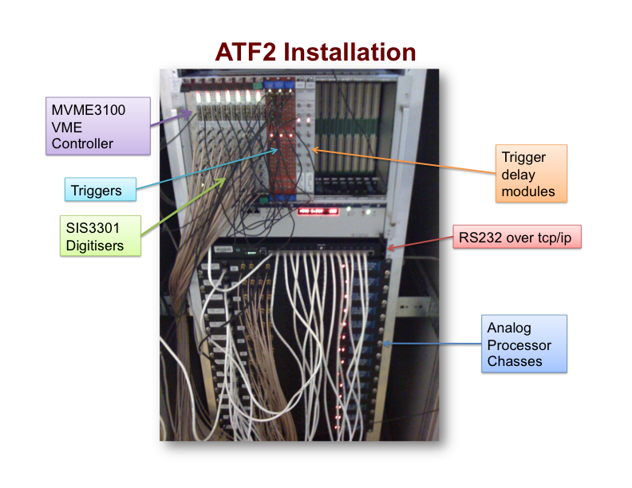

Slide 8
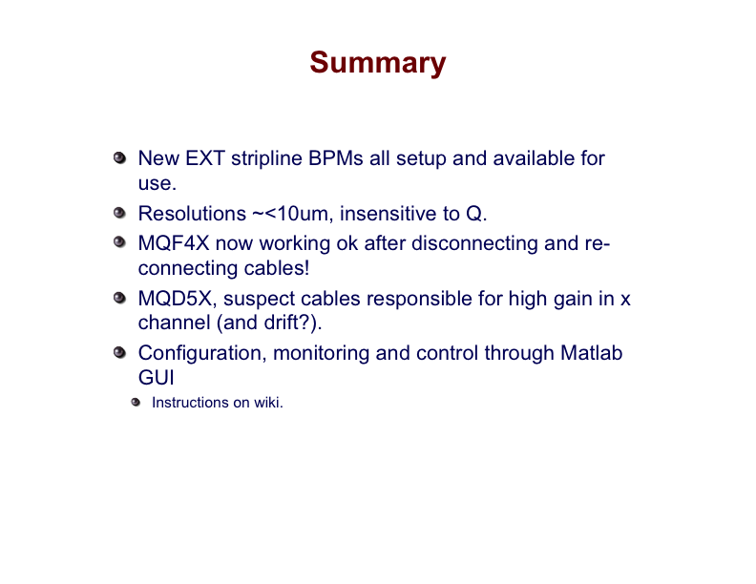

Slide 9
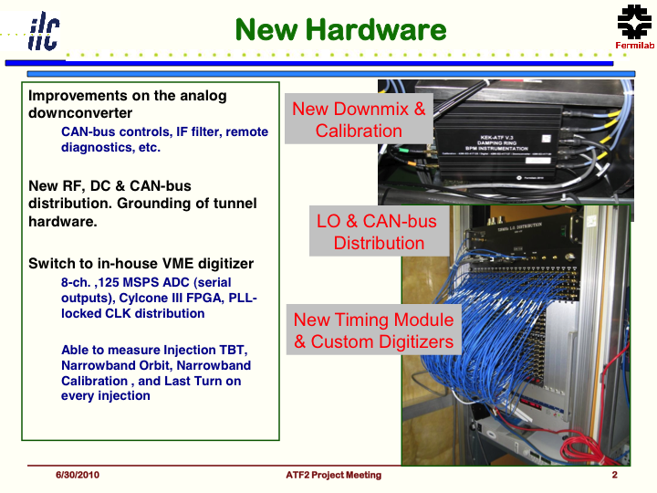
DR-BPM circuit upgrade

Slide 10
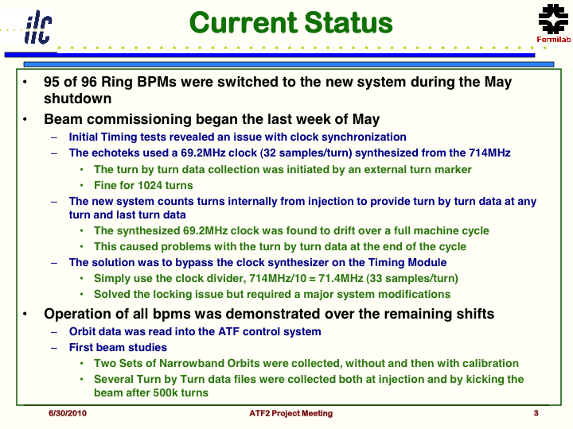

Slide 11
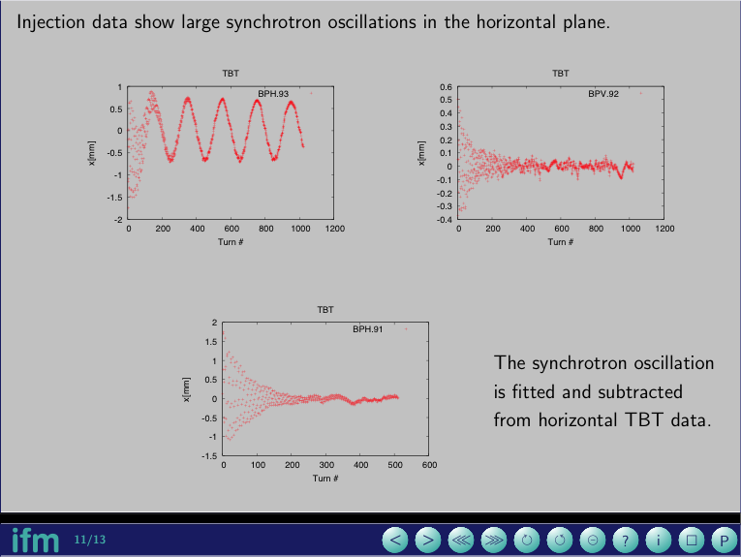

Slide 12
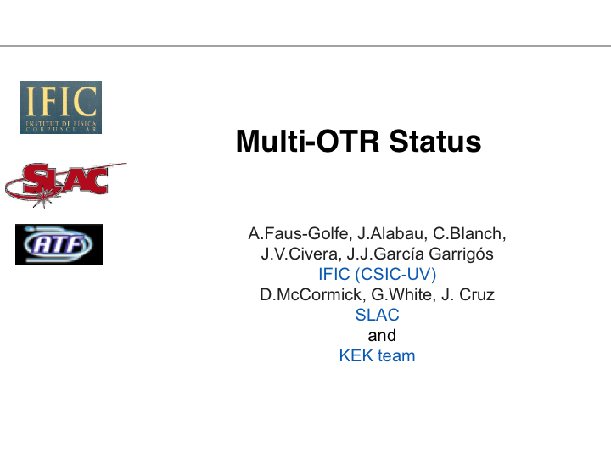

Slide 13
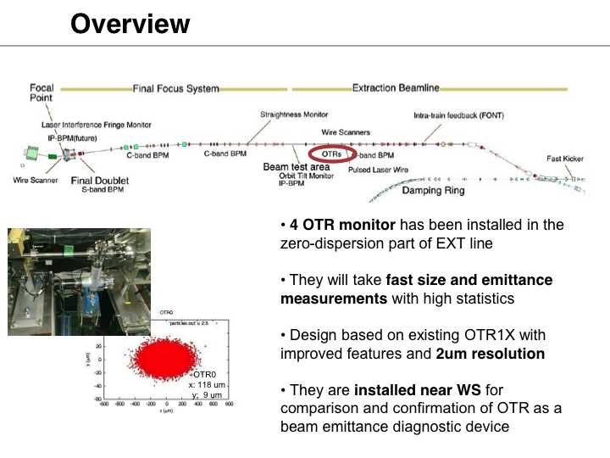

Slide 14
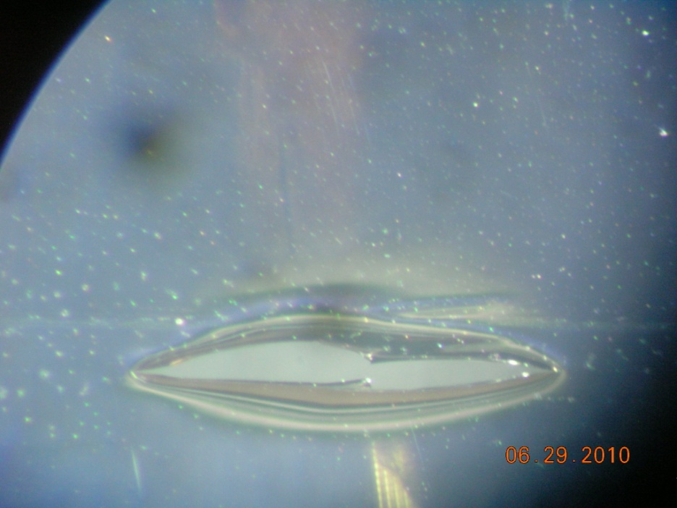
First calibration tests with beam
June 2010:
- Exercise and calibration of vertical and horizontal movers and read-back potentiometers
Tests of 4 OTRs during beam time: beam seen but 3 targets (nitrocellulose coated aluminum) were damaged (4x10⁹ e⁻ per pulse)
Cameras suffer from radiation, some pixel are dead.

Slide 15
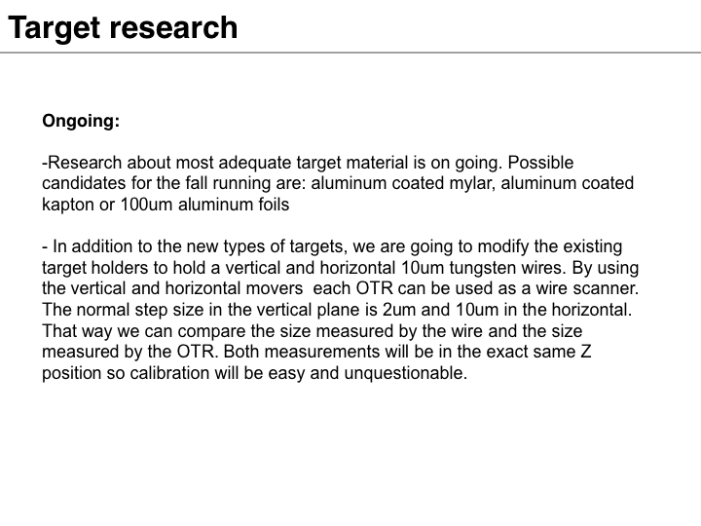

Slide 16
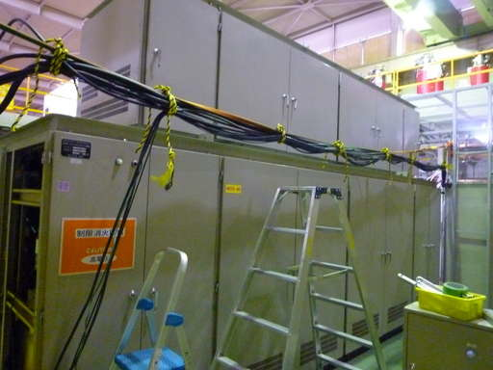
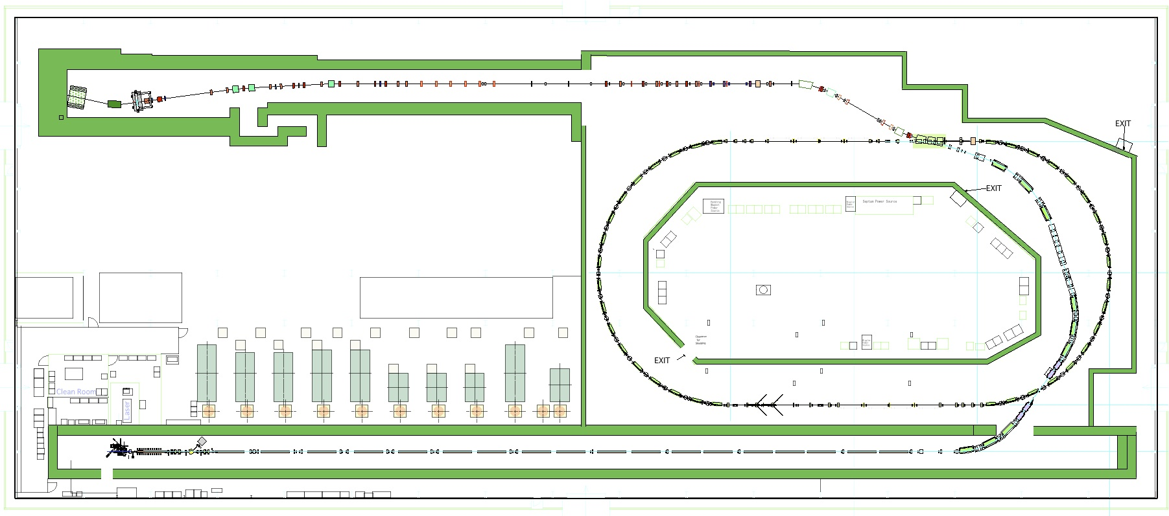
Renewal of the LINAC klystron modulators(#0 and #8)
Manufactured in 1988
  Availability
    We had a lot of troubles in past beam operations
  Stability
    Inverter charging
Two modulators were manufactured in JFY2009 by stimulated/supplemental budget.
Old modulators were removed.
Operation test of new modulators was done in August.
#0
#1
#8

Slide 17
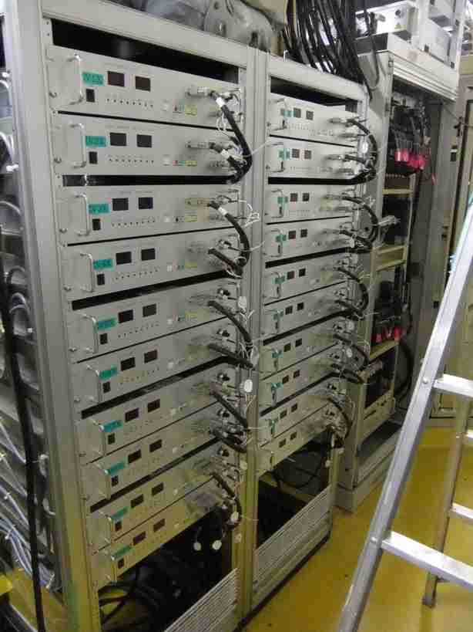
Upgrade of the ATF2 corrector PSs
18 corrector dipoles
recycled from TRISTAN collider
  before 1986, 10bits resolution
  Can not repair (except FAN)
  No spares
PLC controlled 16bits
EPICS
Installed in Feb.

Slide 18

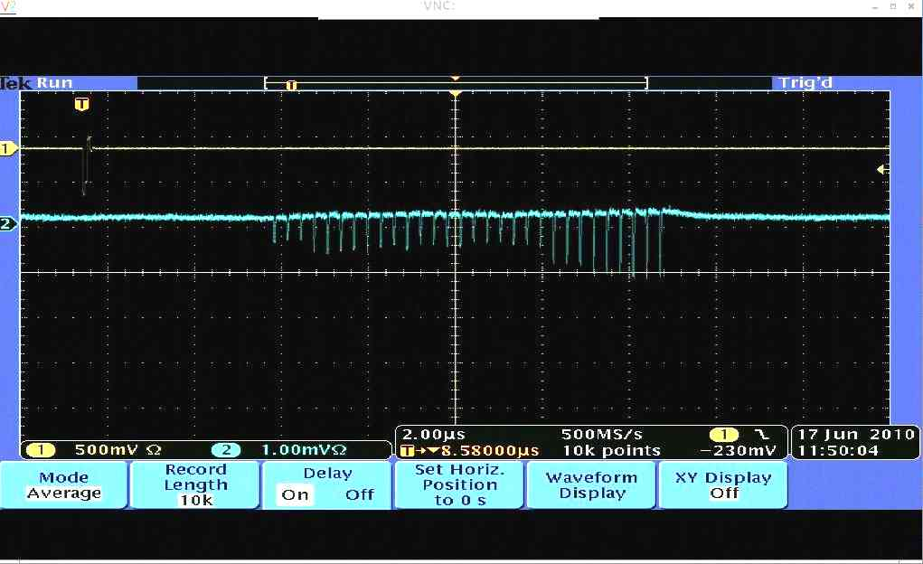
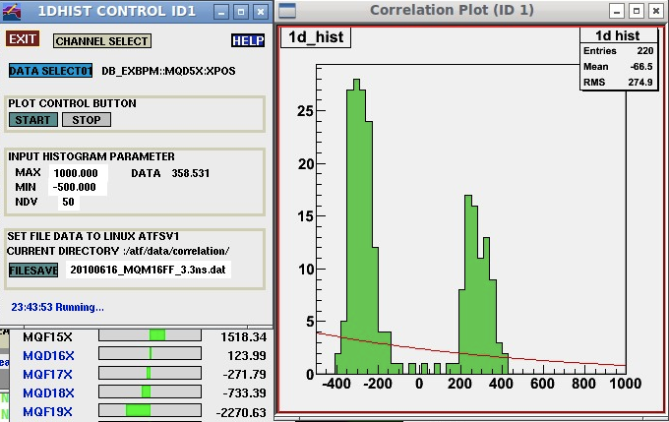
Fast Kicker Test Results by Naito
Multi-bunch extraction (30 bunches) with 308ns bunch spacing 2010/06/17
The intensity of each bunch is not flat and unstable.
The horizontal beam position was distributed to two position.

Slide 19
Next Beam Test
Fast kicker beam test, 2010 Oct. 2weeks
Goal of the next beam test,
To install and test the pulse train delay circuit.
To confirm the stable beam extraction up to 30 bunches, and to measure the each orbit of multi-bunch.
To confirm the long term stability of the fast kicker.

Slide 20


Slide 21

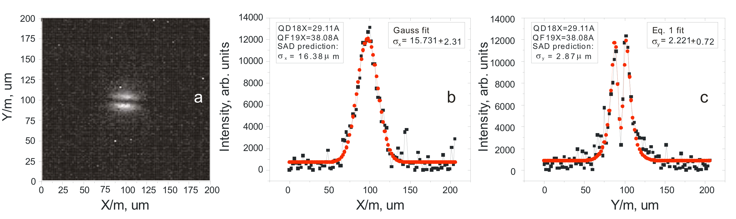
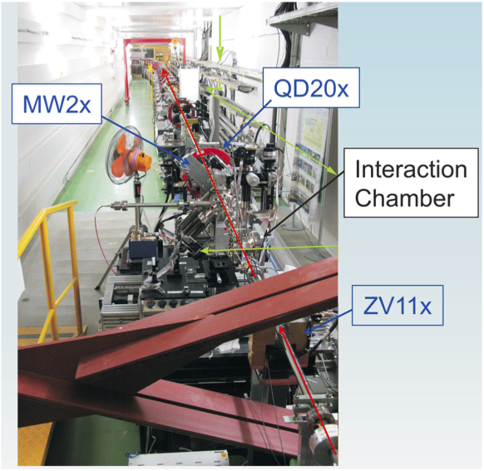
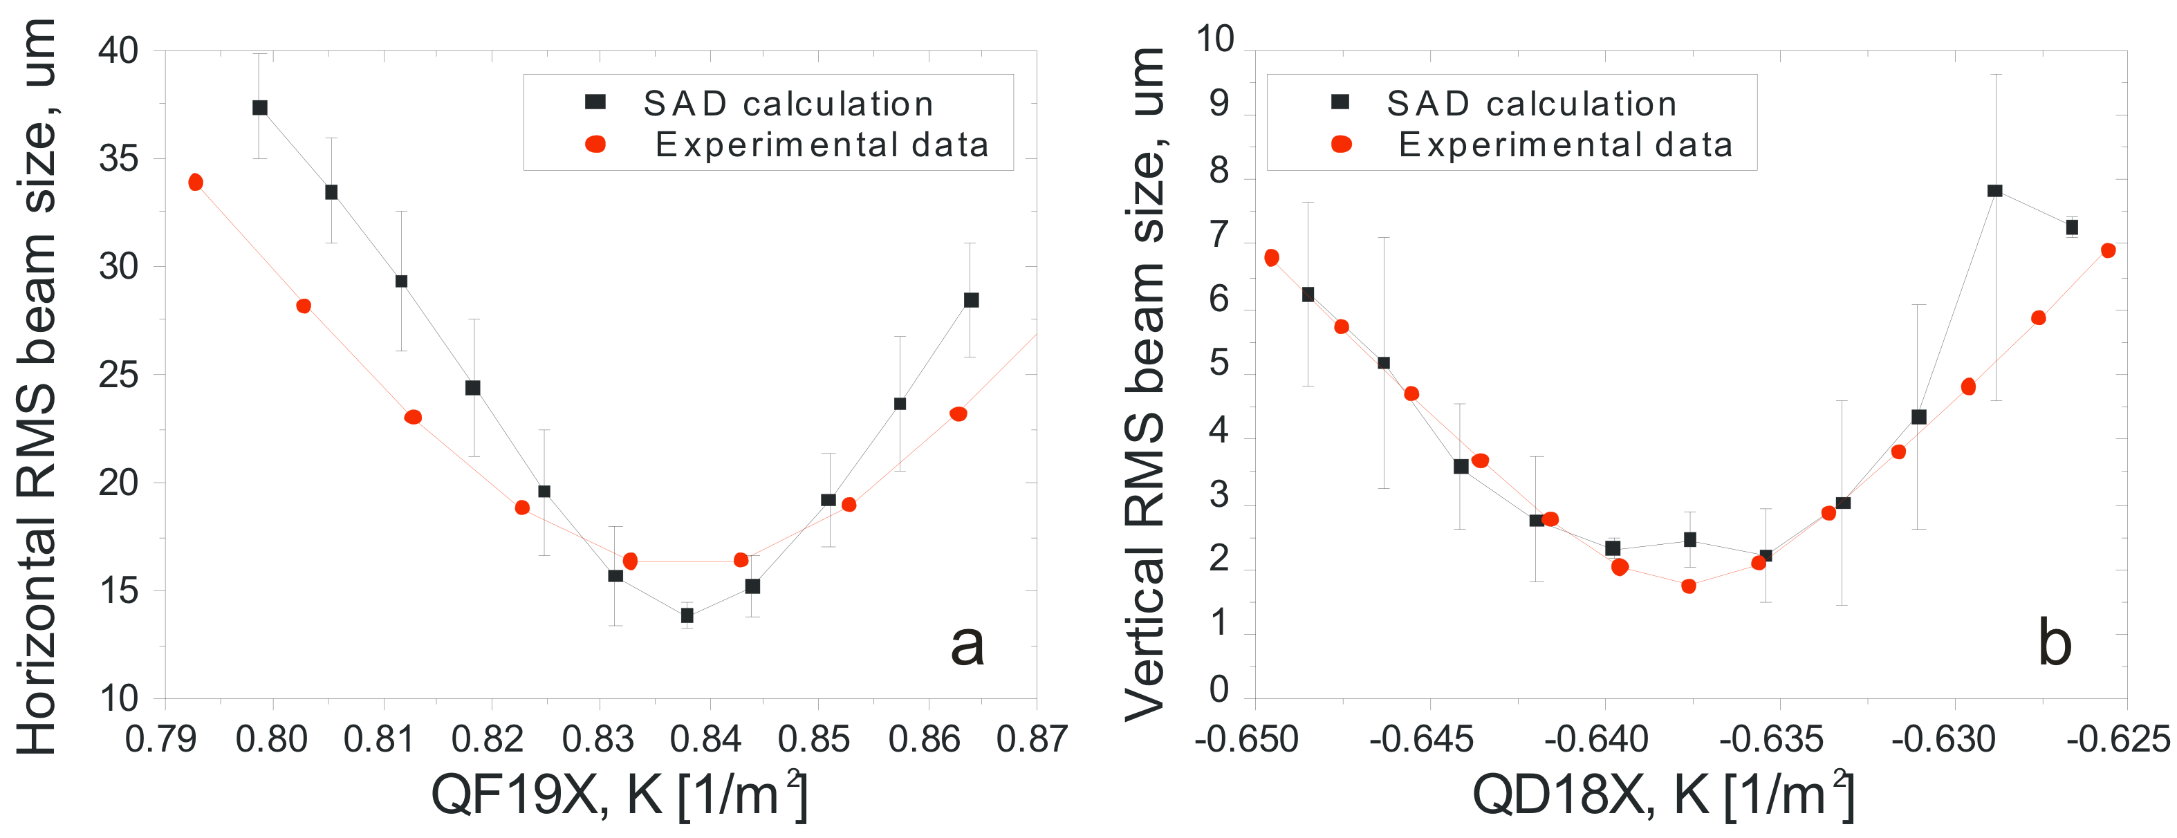
Upgrade of Laser wire monitor
JAI(RHUL,Oxford) / KEK
The system has been re-commissioned in the ATF2 after the re-location.
Improvement for ATF2
  inclusion of an OTR target in the system for collision optimisation and cross calibration.
LW/OTR
Beam size scanning by LW-OTR

Slide 22
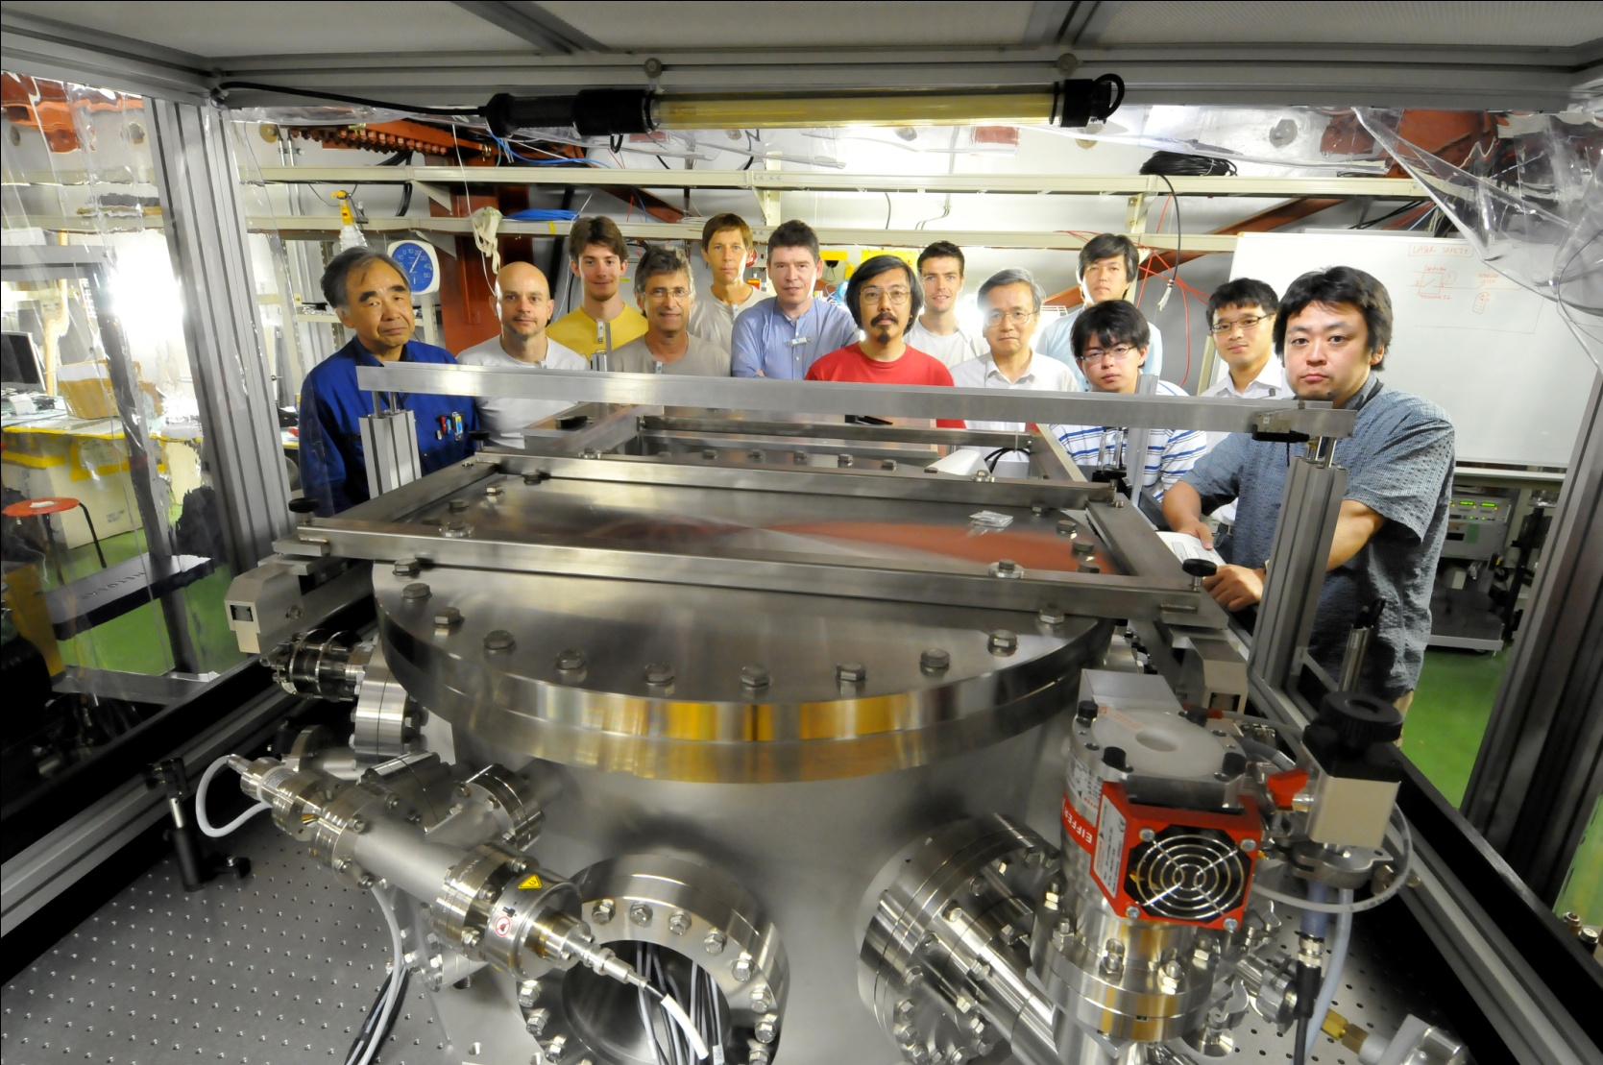
Four-mirror Fabry-Perot cavity R&D at ATF
French Japanese Collaboration
N. Delerue]
Araki-san

Slide 23
2 steps R&D
Started end 2008
STEP ONE: commissioning a 4-mirror cavity at ATF by end 2010
STEP TWO: upgrade mirrors & laser power
~50W
→200W
Oscillator
=0.2W, 1032nm
Δt~0.5ps frep=178.5MHz
Amplifier
photonic fiber
Yb Doped
4-mirror
Fabry-Perot cavity
Gain~1000
→10000
Digital feedback
ATF clock
STEP ONE
With cavity laser/coupling ~50% ➔Power_cavity~25kW
~50x1.5 vs 2-mirror cavity
➔~5 E9 γ/s (Emax=28MeV)
STEP TWO
With cavity laser/coupling ~50% ➔Power_cavity~500kW
~2000x1.5 vs 2-mirror cavity
➔~2 E11γ/s
Goal: to reach the MW average power
ATF 2-mirror cavity paper: Miyoshi, arXiv:1002.3462v1

Slide 24
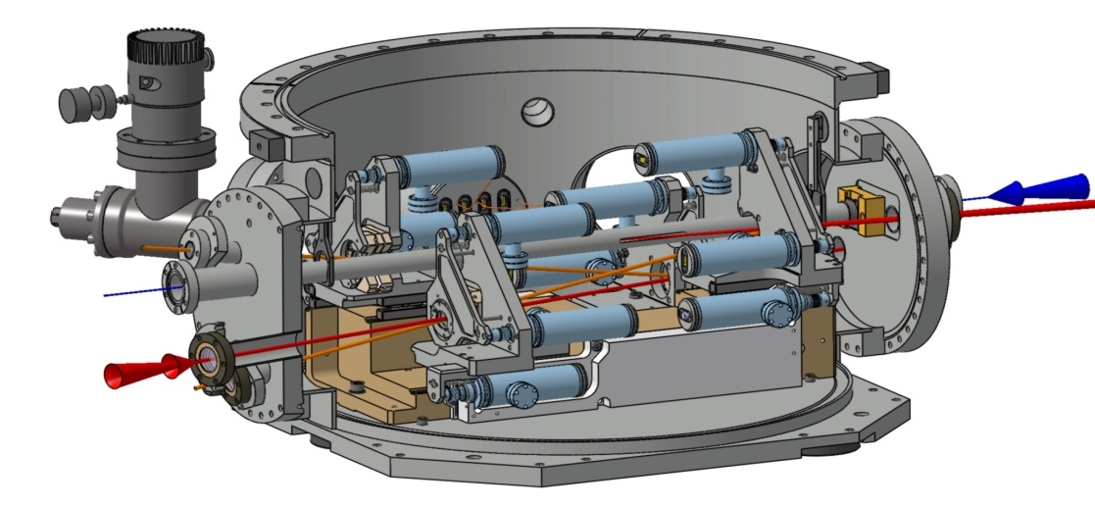
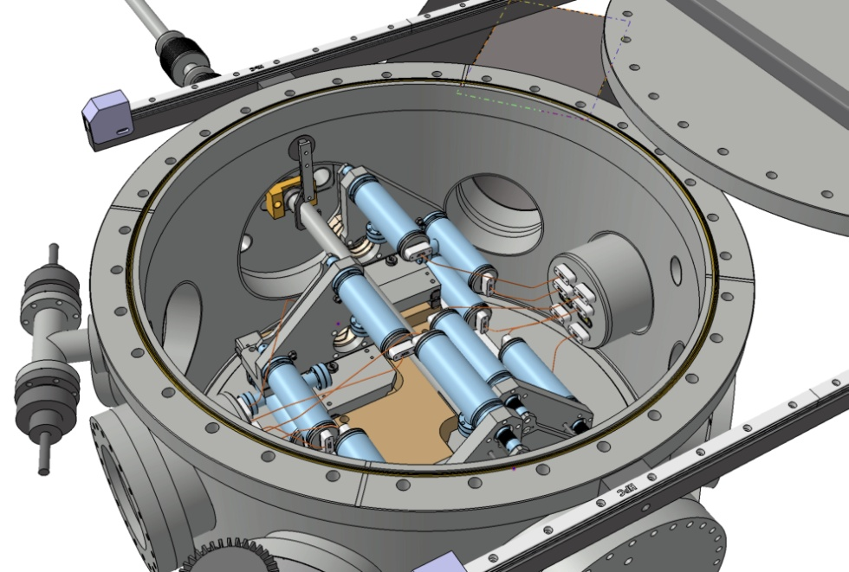
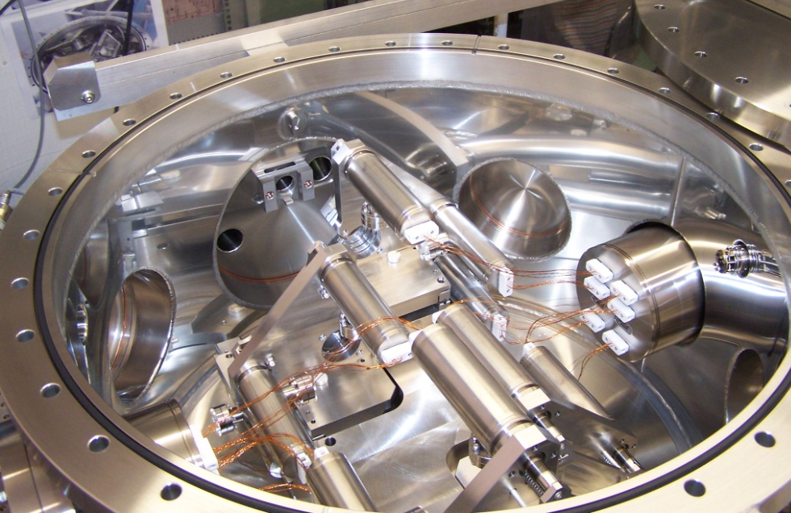
Vacuum vessel for ATF

Slide 25
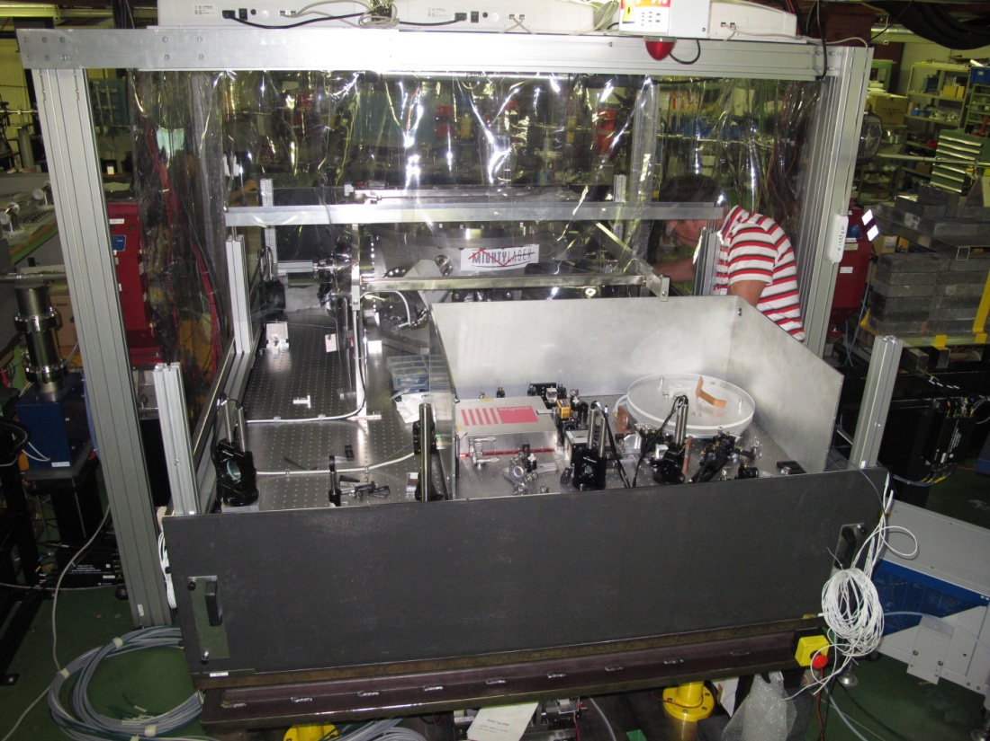
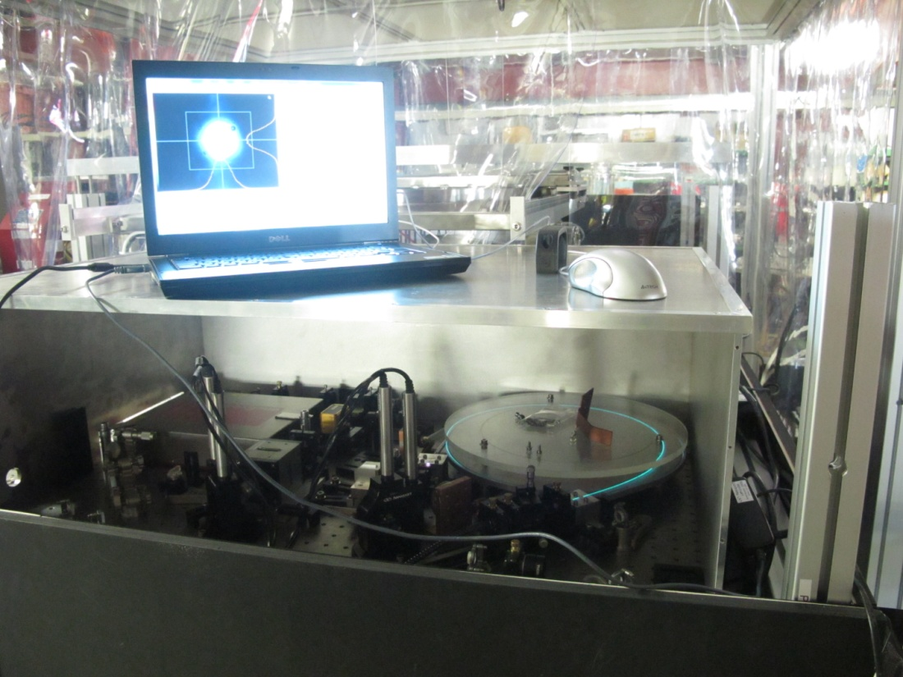
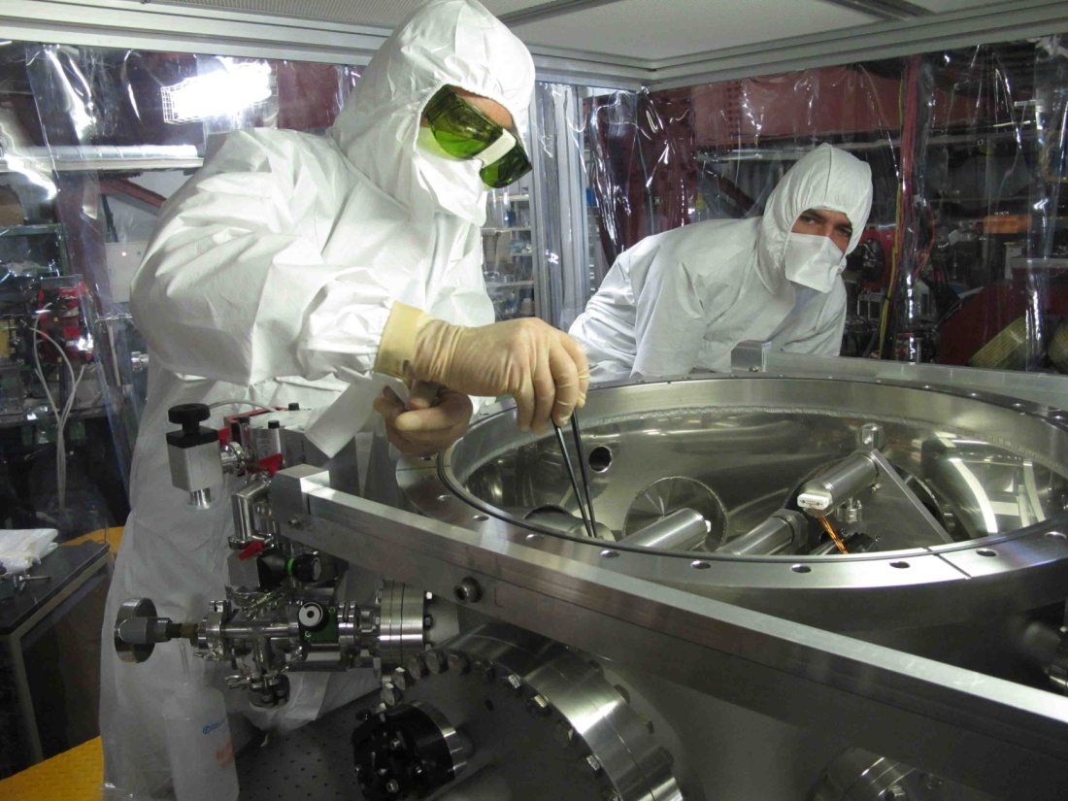
Optical elements
mounted
10th August
laser turned on
(low power)
To start cavity
mirrors
installation

Slide 26
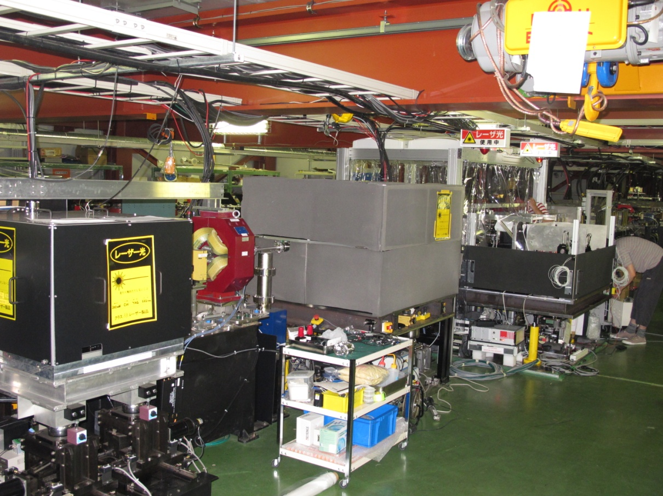
Compton scattering is a very useful process
But X-section is small➔huge laser power required➔R&D
There is now a new 4-mirror fabry-perot cavities in ATF to
contribute to this R&D effort
2-mirror cavity
pulsed laser
4-mirror cavity
pulsed laser
2X 2-mirror
cavities
cw laser
(laser-wire)
The new cavity has 4 mirrors and is non-planar to match requests
of futur Compton e+ polarised sources or compact X-ray machines

Slide 27
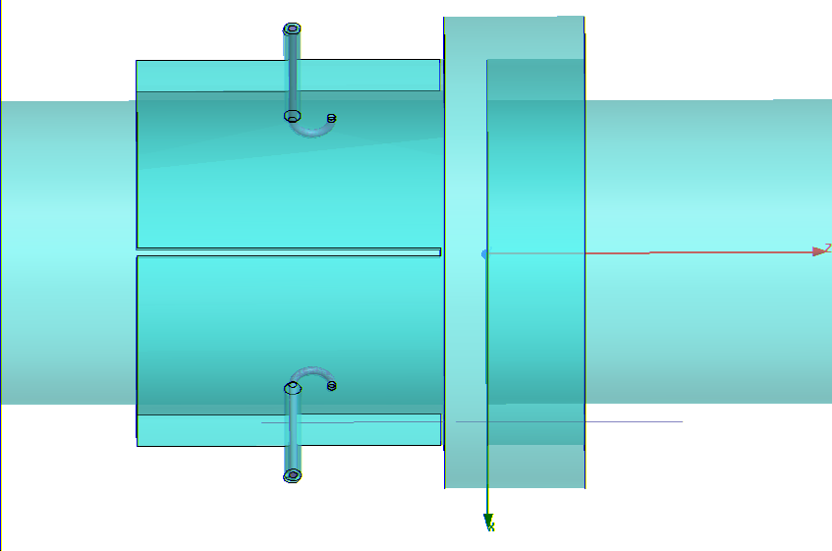
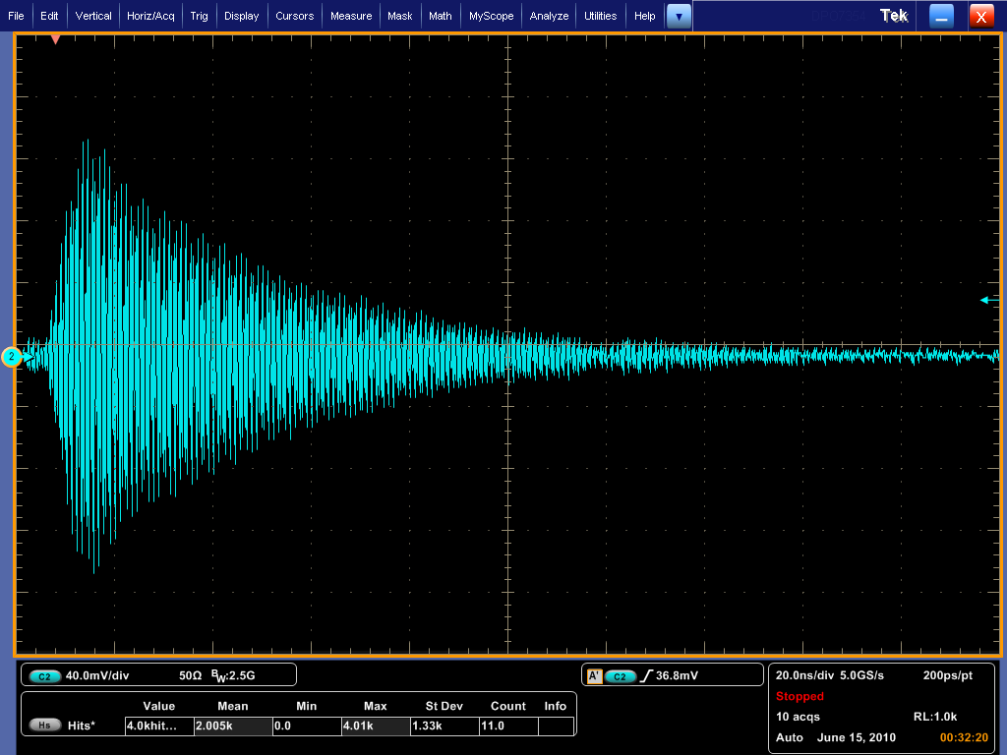
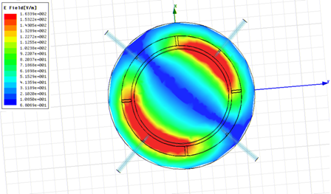
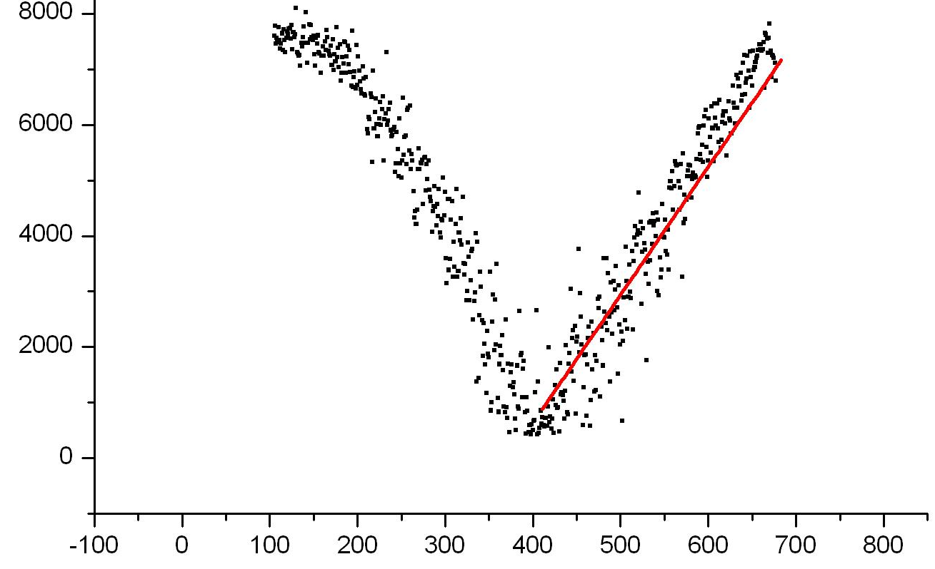
R&D of Cold BPM for ILC-ML at the end of ATF LINAC
Beam test of Re-entrant BPM (2.0GHz) for ILC Main Linac
YoungIm Kim (KNU), Jinyeong Ryu (KNU), Sunyoung Ryu (PNU), H. Hayano (KEK)
115mm
Φ99mm
dipole mode: 2.04GHz signal
in 200ns full span
Φ78mm
signal is well damped
after 300ns next bunch position
re-entrant cavity + coupling waveguide structure
slope=22 ADC-count/µm
2.04GHz detected signal [ADC count]
~0.5µm resolution
at 1x10¹⁰ intensity
dipole mode: 2.04GHz
estimated beam position by strip-line BPM [µm]

Slide 28
Single bunch - measured longitudinal jitter
Energy: ΔE = Δx/η at any location in DR
Use as many BPMs
Energy deviation is expressed as
assuming all BPM have the same resolution.
The shape (Non-Gaussian) of distribution suggests synchrotron oscillation.
RMS is about 1.4E-4.
(Natural energy spread ~ 5E-4)

Slide 29
Single bunch - measured transverse jitter
Fit a and b for each pulse, using measured position at i-th BPM as
East arc and west arc, separately
 | east+west | east-west | correlated | uncorrelated
x cos-like (a) | 6.114e-6, | 3.130e-6 | 2.62e-6 | 1.57e-6
x sin-like (b) | 5.976e-6 | 3.739e-6 | 2.33e-6 | 1.87e-6
y cos-like (a) | 6.244e-6 | 5.942e-6 | 0.96e-6 | 2.97e-6
y sin-like (b) | 3.305e-6 | 3.982e-6 | Imaginary | 1.99e-6
Correlated: Real betatron oscillation
Uncorrelated: Noise (limit of measurement)
Horizontal oscillation: 0.1 σ_x (if emittance = 1 nm)
Vertical oscillation: < 0.5 σ_y (if emittance = 4 pm)

Slide 30
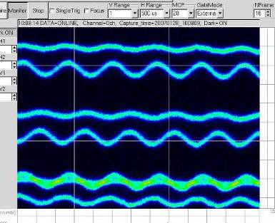
Longitudinal oscillation in tail bunches
Streak camera,
Multi bunch single train
Horizontal axis: long range time
Vertical: short range time
Each line is from one bunch.
(Should be flat for stable bunch)
Tail bunches oscillate larger than
head bunches.
[by Naito]
Each line shows on bunch in a train, not in order.
30

Slide 31
Transient transverse oscillation growth
Can be explained by cavity wakefield
Effectively increase damping time, but should be damped at last.
by Naito
31

