Slide 1
Determination of Heavy Smuon and Selectron Mass at CLIC
Outline
Physics motivation
Mass measurement methods (Energy scan, End Point)
Energy spread, ISR and Beamstrahlung
Event selection, efficiency and S/B
γγ→h pile up and beam polarization
Mass fit results
Summary and Outlook
Work done at generator level, validated with full simulation
and reconstruction using ILD software, Mokka and Marlin.
M.Battaglia, J-J.Blaising

Slide 2
Physics motivation
Scalar leptons are the supersymmetric partners of the right and left handed charged leptons. Their masses are ~ f (m0, m1/2, tanβ)
mo : the common squark, slepton and Higgs mass at Gut scale.
m1/2: the common gaugino mass at GUT scale.
tanβ : the ratio of Higss vacuum expectation values at Mz.
The main decay is:
Measuring and masses allows to constrain SUSY parameters.
The χ̃⁰ is also a good dark matter candidate.
In the talk I focus on the smuon analysis wich is challenging due to its very low cross section. For the CLIC CDR studies, the final state with e-, e+ will be included; the cross section is larger; but at 3TeV the bremsstrahlung spoils the e-/e+ momentum measurement.

Slide 3
Signal and Background
Cross Sections
Processes: e⁺ + e⁻ → μ̃⁺ + μ̃̄ˉ → χ̃⁰ μ⁺ + χ̃⁰ μˉ
e⁺ + e⁻ → ẽ⁺ + ẽˉ → χ̃⁰ e⁺ + χ̃⁰ eˉ
Generated with Isasugra, cMSSM parameters
m½=1300, m₀=1001, tanβ=46, Sign(μ)<0
-> m μ̃ = m ẽ = 1108.8 GeV m χ⁰ = 554.3 GeV,
hadronization done with Pythia.
Process | Cross section x B.R(fb)
S: e⁺eˉ → μ̃⁺μ̃̄ˉ | 0.7
S: e⁺eˉ → ẽ⁺ ẽ¯ | 4.2
B: e⁺eˉ → Inclusive SUSY | 0.1
B: e⁺eˉ → WW->lνlν | 10.5
B: e⁺eˉ → ZZ ->ll νν | 0.8
B: e⁺eˉ → μνe μνe | 135

Slide 4
μ̃ mass measurement
Energy Scan
σ=σ(mμ̃,√S)
Measuring the cross section at different C.M energies allows to derive the μ̃ mass. δm determined at generator level, assuming:
Selection efficiency =90%
S/B=0.5
mμ̃=(1109.13 ± 6.40839) GeV (ISR)
mμ̃=(1108.38 ± 7.03864) GeV (ISR+BS)
√S (TeV) | ∫Lumi (abˉ¹) | σ (fb)
2.5 | 0.7 | 0.33±0.033
2.7 | 0.3 | 0.58±0.060
3.0 | 2 | 0.82±0.026

Slide 5
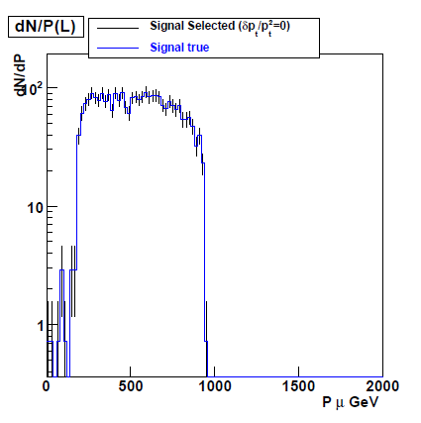
μ̃ and χ⁰ mass measurements
Momentum Spectrum End-point
The μ̃ -> μ + χ̃⁰ is a two body decay;
The minimum and maximum muon
momentun is given by (1). =>
mμ̃ is f(√s, EL,EH) (2)
mχ̃⁰ is f(mμ̃ ,√s, EL,EH) (3)
EL and EH are the lower and uper edges
of the muon momentum spectrum.
The μ̃ and χ⁰ masses are determined
from a 2 parameters fit to the muon
momentum spectrum.
The spectrum is modeled according
to eq (1). A smearing is applied to fold in
iSR, Beamstrahlung and momentum
resolution effects.

Slide 6
ISR and Beamstrahlung effects
In both methods m ~ f(√S)
Left: Contribution to the C.M energy spread: ISR. Middle: ISR + Beam spread
This distribution is used to fold in the energy spread in the fit.
Right: Muon momentum distribution; No ISR/FSR no BS; with ISR/FSR, no BS; ISR/FSR+B.S; the higher end of the distribution is most affected.

Slide 7
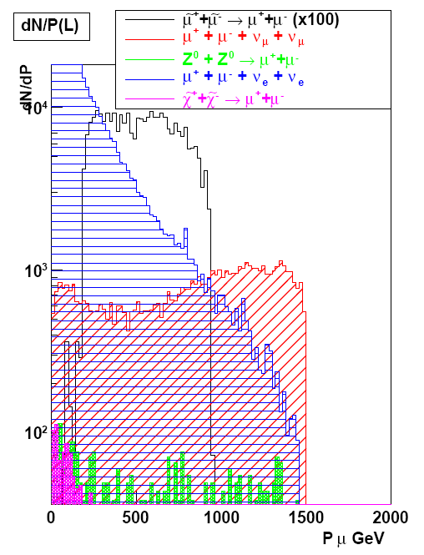
S, B Discriminating variables
dN/dPμ (for fit)
dN/dEvis, dN/dEtmiss, dn/d(∑Pt) and dN/dM(μμ) distribution for Signal and backgrounds after a pre-selection requiring two muons having |cos θ | < 0.985

Slide 8
Discriminating variables
Visible energy Evis
Missing transverse energy Etmiss
Acollinearity and acoplanarity
Sum of transverse momentum of muons Σpt
Polar angle of the missing energy vector θmiss
Invariant mass of the two muons Mμμ
unbalance of the muons momenta Δ
Missing mass Mmiss
With:

Slide 9
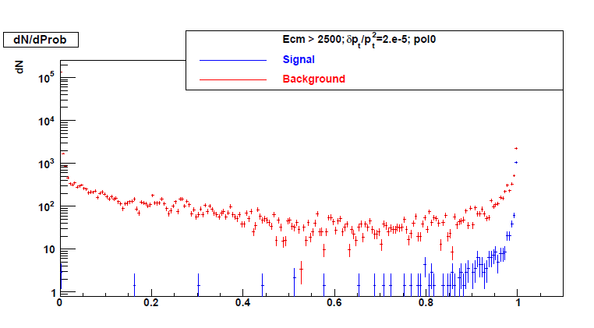
Combined Probability
After a preselection requiring two muons having |cos θ | < 0.985,
the normalized S/B values is computed for each variable and combined into a total probability used for the final selection.
dN/dProb for signal (blue), and background (red); δPt/Pt²=2.10ˉ⁵
Prob

Slide 10
Selection Efficiency and S/B
Selection efficiency (blue)
S/B ratio (red) for
δPt/Pt²=2.10ˉ⁵ and muon identification efficiency = 100%.
For Prob > 0.8, the selection efficiency is 93 % and S/B ~ 40%;
Prob

Slide 11
Selection efficiency
Left: Muon momentum distribution, δPt/Pt²=2.10ˉ⁵, no selection and for Prob>0.8
Middle:efficiency for Prob>0.8, δPt/Pt²=2.10ˉ⁵ . Ε ~ 93 % and S/B ~ 40%;
Right : efficiency for Prob>0.8 δPt/Pt²=2.10ˉ⁴ . Ε ~ 91 % S/B decreases to 33%
The degradation of the energy resolution distorts the shape of dN/dP

Slide 12
Efficiency and S/B, Beam Polarization
selection efficiency and S/B for δPt/Pt²=2.10⁻⁵ and different polarization conditions
Left: pol (eˉ/e⁺) (0/0); S/B~0.4 Middle: (80/0); S/B~0.95 Right: (80/60); S/B~1.1

Slide 13
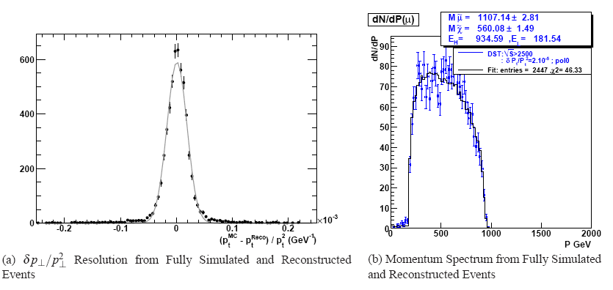
Signal (only) fit, no beam polarization no background
Left: muon momentum resolution; G4 simulation + reconstruction: δpt/pt² ~ 2.10ˉ⁵
Right: Momentum spectum fit, with ISR+B.S and δpt²/pt² ~ 2.10ˉ⁵ modeling.
mμ̃=1107.1±2.8 GeV and m χ̃°=560.1 ± 1.5 GeV ; validation of fit and modeling

Slide 14
Stacked Signal + Background
Pμ (GeV)
Pμ (GeV)
Left: Signal + backgrounds without polarization. Right: with (e⁻80, e⁺0) polarization; Signal x 1.8 and background x0.2; upper edge better preserved from WW bkg.
Background modeled for background subtraction

Slide 15
S-B Fits after B subtraction
Momentum spectum fits, with ISR+B.S and δpt/pt² modeling and B subtraction.
Smuon : δm/m ~ 2.0 % without polarization and 1.5 % with 80% eˉ polarisation
Neutralino: δm/m ~ 2.4 % without polarization and 1.2 % with 80% eˉ polarisation

Slide 16
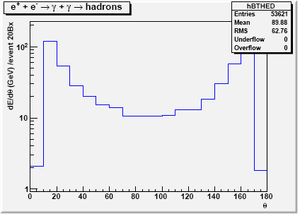
e⁺ + e⁻ → γ γ → hadrons
At 3 TeV ~ 3.3 e⁺ + e⁻ → γ γ → hadrons events / BX → ~ 13 particles/BX, 24 GeV/BX
Per train (312 BX) ~ 7.5 Tev are dumped in the detector. Low E/Pt hadrons, but requires time stamping to preserve the energy resolution and the missing energy measurements necessary to discriminate Signal and background
Background peaked in F/B region.
Fig1: dE/dθ for 20 Bx
Energy deposit in a ±10 ° cone:
~ 2 Gev in barrel region
~ 20 Gev in F/B regions
For 5Bx (2.5 nsec) the μ̃ selection efficiency
Is unchanged ~ 93%, for 20 Bx (10 nsec) it decreases to 91 % .
The mass fits where done for 5 and 20 BX

Slide 17
Table of Results
Data Set | √S> (GeV) | δpt/pt² (x10¯⁵ GeV¯¹) | Polarization (e¯ / e⁺) | BX Capability | Mμ̃ (GeV) | Mχ̃⁰ (GeV)
S | 2950 | 0 | 0/0 | 1 | 1106.3±2.9 | 558.8±1.3
S | 2500 | 0 | 0/0 | 1 | 1098.8±2.6 | 555.4±1.2
S | 2500 | 2 | 0/0 | 1 | 1104.6±2.9 | 560.0±1.7
S | 2500 | 6 | 0/0 | 1 | 1098.8±3.1 | 559.1±3.6
S | 2500 | 20 | 0/0 | 1 | 1107.5±4.2 | 575.7±5.3
S(G4+R) | 2500 | 2 | 0/0 | 1 | 1107.2±2.8 | 560.1±2.2
S+B | 2500 | 2 | 0/0 | 1 | 1107.4±20.2 | 533.8±13.1
S+B | 2500 | 2 | 80/60 | 1 | 1101.7±13.5 | 536.7±5.5
S+B | 2500 | 2 | 80/60 | 5 | 1102.4±12.9 | 548.9±7.1
S+B | 2500 | 2 | 80/60 | 20 | 1104.6±12.8 | 551.1±7.1
When δpt/pt² increases, S/B decreases, δm increases; for δpt/pt² >10¯⁴ , efficiency corrections are large ,introducing significant systematic errors.
B modeling/subtraction increases δm; it can be improved using polarization.
γγ-> hadron decrease S/B; up to 20 BX time stamping (10 nsec); there is no significant δm degradation.

Slide 18
Summary and Outlook
The μ̃ and χ̃⁰ masses can be obtained from energy scan and fit to the dN/dP.
The main sources of errors on the μ̃ and χ̃⁰ masses are:
The background estimation and subtraction.
The luminosity spectrum modeling.
The μ momentum resolution.
To reach a statistical accuracy δm/m~ 1 % , with dN/dP fit method, requires:
2 abˉ¹ of integrated luminosity
Electron beam polarization ~ 80% to increase the S/B ratio.
Good control of the luminosity spectrum, ISR and beamstrahlung.
Good muon ID and δpt/pt² < 5.10̄ˉ⁵ to minimize momentum spectrum efficiency correction
Time stamping capability <=20 BX to preserve S/B from γγ→h pile up.
For ẽ the measurement method and the requirements are similar. The
detector performances studies for μ̃ and ẽ will be done with full simulation
and reconstruction for the CLIC CDR.

