Slide 1
A few items for the round-table
B. Jeanneret CERN/ABP
WG6 at IWLC_2010

Slide 2
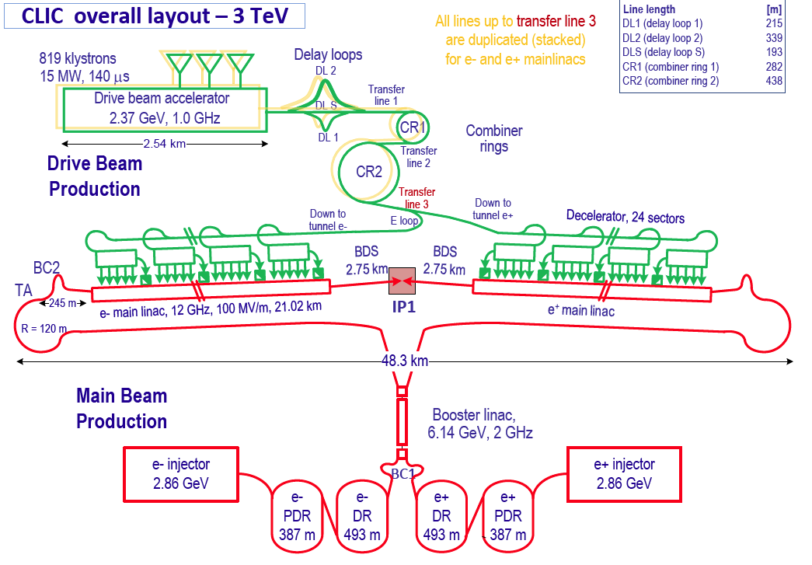
The way to produce these beams
292 -----
Why make it so complicated ?

Slide 3
Beam production
Gun must produce n = 2922×24×50 = 3.5×10⁶ bunches/s (current I = 4A)
Must alternate trains with odd/even bunches
Odd/even bunch structure must be programmable inside the rise-time period (Olexsiy)
Timing tolerance for the beam at the entrance of the DB Linac:
  Δφ₁ = 0.1°@1GHz ⇔ 85 μm ⇔ 0.3 ps
Timing at 12 GHZ (synchonisation DB/MB & MB e⁺/e⁻) :
  Δφ₂ = 0.2°@12GHz ⇔ 14 μm ⇔ 0.46 fs (46 × 10⁻¹⁵ s)
As for the DB Linac itself , in the segment before compression:
  Gradient : ΔG/G < 2×10⁻³ coherent over 100 klystrons, < 2×10⁻² per klystron
  Phase : Δφ = 0.05° to avoid undue bunch lenghtening (A. Aksoy, D. Schulte)
CTF3 with pulse compression:
Δφ ∼ 10-50° along train
What do we prove for CLIC Δφ?
Can a thermo-ionic gun,
followed by a bunching
System, do this ?
Will a reliable laser gun exist ?
What can CTF3 tell us about this ?
Will it give us a proof of principle ?

Slide 4
Options for Dipoles & Vacuum vs. SR
Super-conducting super-ferric magnets
  s.c coils, but classical C-yoke for field shaping
    More expensive, but power ÷5
    Cost savings with time
  Cold pipe (∼20-30K) → Thermal expansion vanishes
    Another vacuum regime to study
Classical resistive magnets
  Berylium pipe at SR-impact
    Transparent to 6 KeV X-rays
    SR absorbed in water behind
  Be disliked for safety reasons ⇔negotiable ?
→ Ageing solved

Slide 5
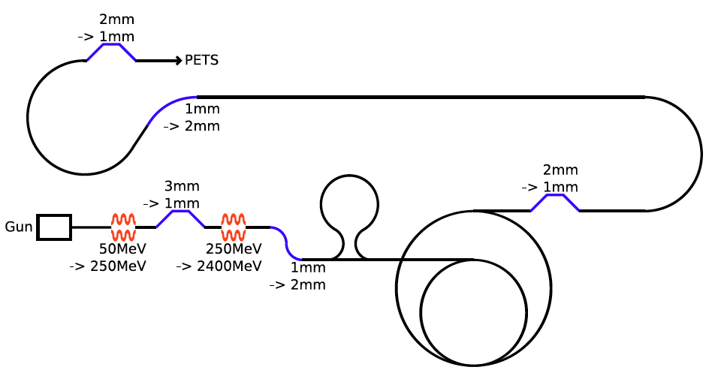
Operability
RF deflector
Total longest path for a train : 29 km
Through :
  820 klystrons
  14 RF deflectors
  3 Kickers
  5 compression chicanes
  1 RF kicker
  2 loops
  2 rings, several turns
Kicker
RF kicker (phase synchro)
24 times
The 24 trains
must Survive with:
Beam losses < 10⁻³
Bunch lenghtening < few %
δz ∼ 10 μm
Klystrons : 80 740
DB linac
∼20 km

Slide 6
Future (post-CDR)
Many oustanding issues to be worked-out
Can CTF3 validate the requirements for the CLIC Drive Beam ?
If not, what do we need to do so
My worries : Mismatch between work to do & manpower
Activity scattered in too many ‘sub-projects’
CTF3 | CTF3+ | CLIC-500GeV | KLIC | ILC
 | CTF3++ | CLIC-3TeV
 | CLIC0 | CLIC-var-E
Will we reduce this in 2011 ?

