Slide 1
Revisit parameters for
Conventional sources
Tohru Takahashi
contribution for positron collaboration meeting
July 15 2010 at DESY

Slide 2
Motivation
Preparation of positron sources by;
  well established scheme and/or developable with existing resources
300Hz scheme
  relaxes thermal problem on targets
    lower speed rotation target will do
  but still have the shock wave problem
survey (again)parameters of conventional targets in the
drive beam energy – target thickness plane
See if conventional sources survives the ILC criteria

Slide 3
Methods
Simulation by Ｇｅａｎｔ4 with Tungsten
  total positron yield
  accepted positron yield with AMD acceptance
    T.Kamitani, L.Rinolfi CLIC note 465
  Peak Energy Deposit Density (PEDD)
  Total Energy Deposit (TED)
In space Beam Energy – Target Thickness
  beam spot size at 2.5mm, 4.0mm

Slide 4
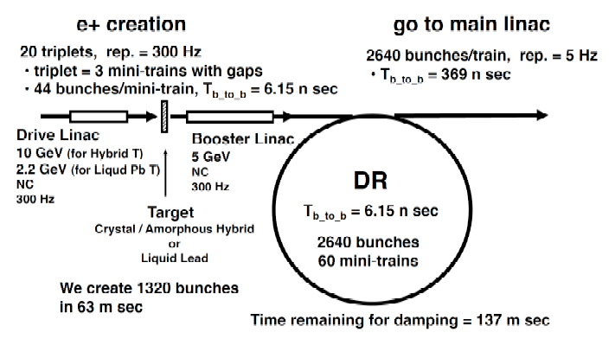
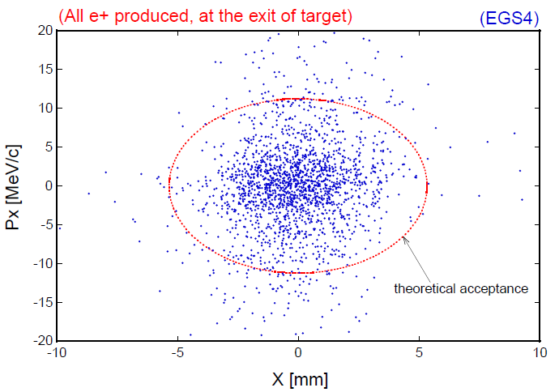
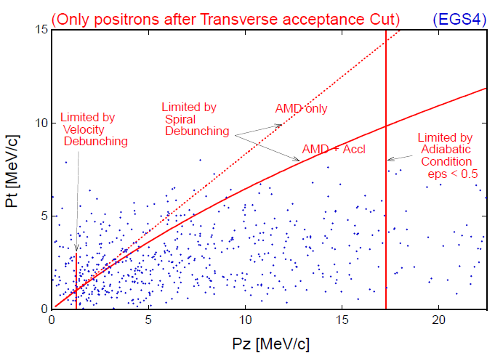
Acceptance estimate
CLIC note 465
[r/5.3[mm]]² + [pT[MeV]/11]² =＜1
pT < 0.1875 MeV/c + 0.625 pL
1.5 MeV/c < pL < 17.5 MeV/c
～# of e+ in DR (or booter linac)

Slide 5
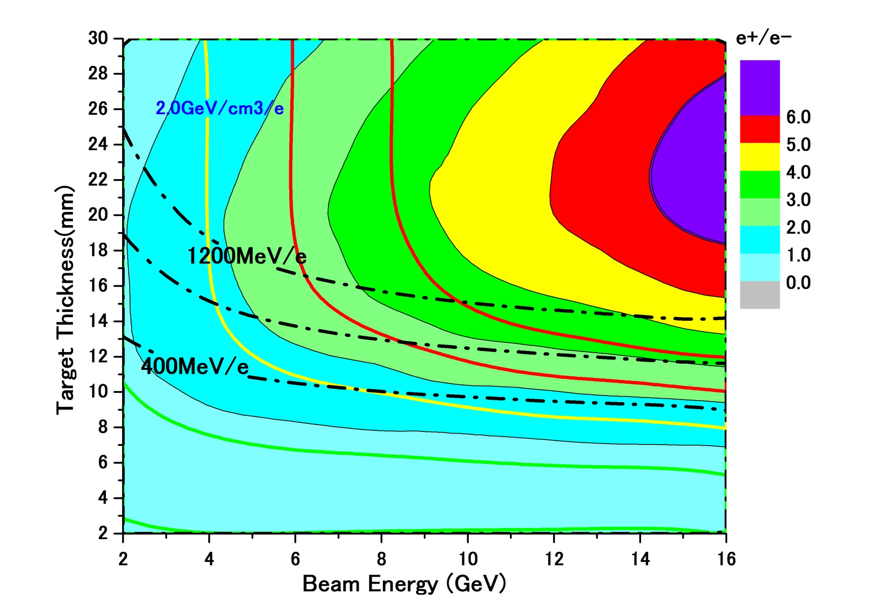
accepted e+ yield and PEDD with conventional scheme
e- beam size
σ=2.5mm
colored
accepted e+/e-
PEDD GeV/cm³/e-
ToTal deposit MeV/e-

Slide 6
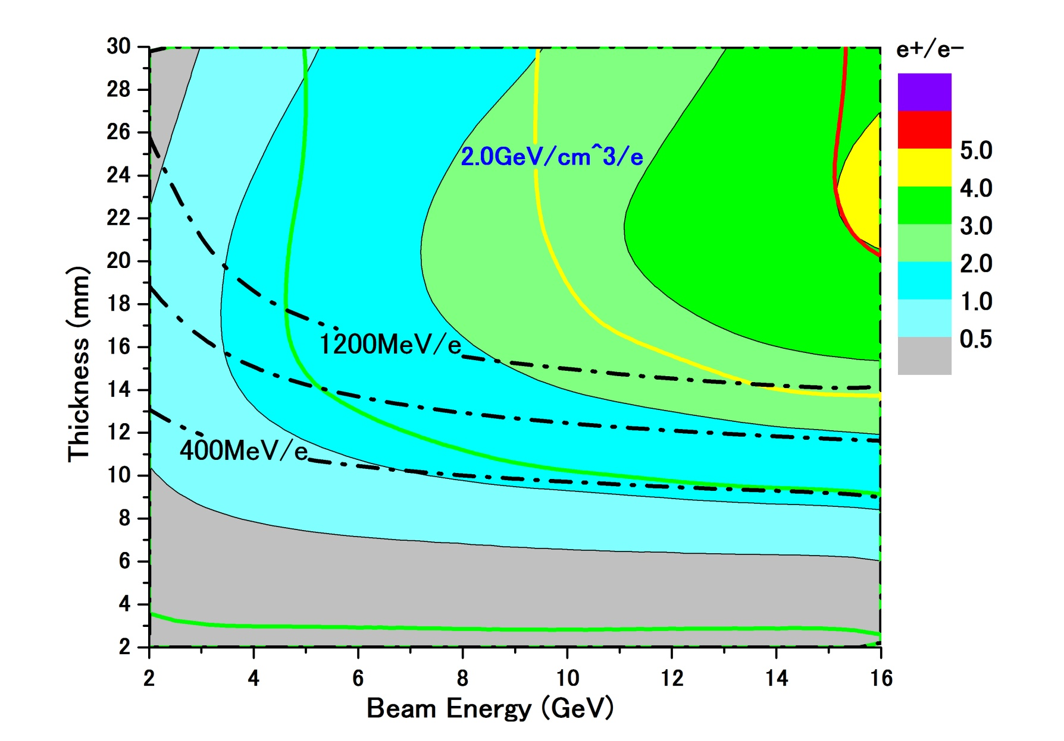
accepted e+ yield and PEDD with conventional scheme
e- beam size
σ=4.0mm
colored
accepted e+/e-
PEDD GeV/cm³/e-
ToTal deposit MeV/e-

Slide 7
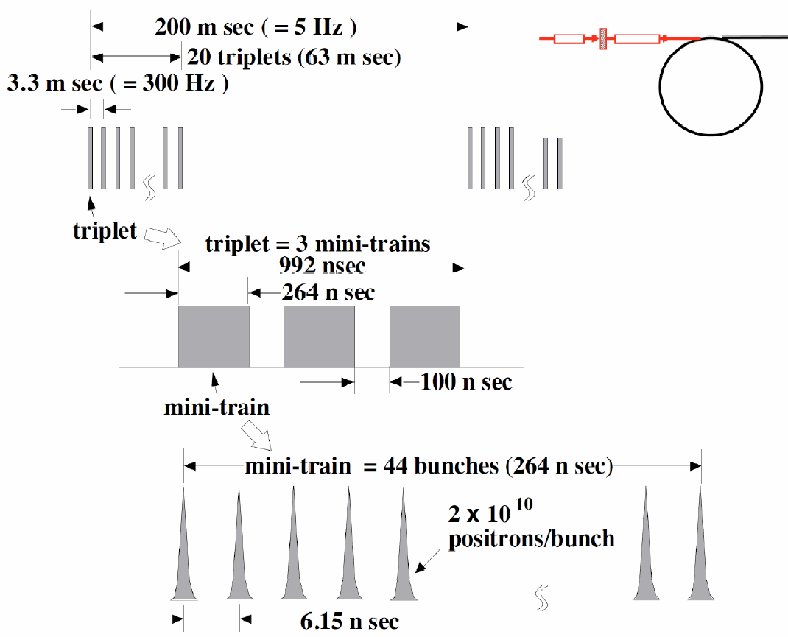
In the case of 300Hz scheme
spacing between triplets
=3.3ms
132bunches in 992ns

Slide 8
Assumption
132 bunches
make a shock wave
heat same position on the target
a triplet: 132 bunches 992ns
each triplet hits
different position on the target
3.3ms
a train: 20 triplet
= 2640 bunches 63ms

Slide 9
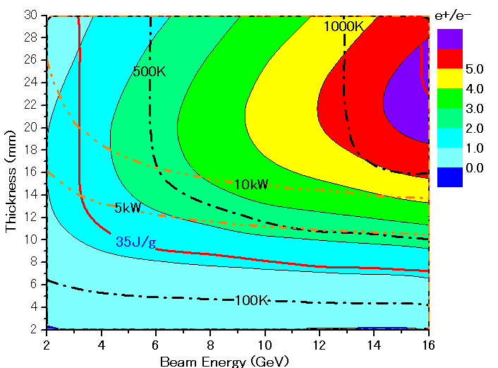
Parameter Plots for 300 Hz scheme
e- directly on to Tungsten
σ=2.5mm
colored band
accepted e+/e-
PEDD J/g
dT/triplet (132 bunc)
ToTal deposit kW

Slide 10
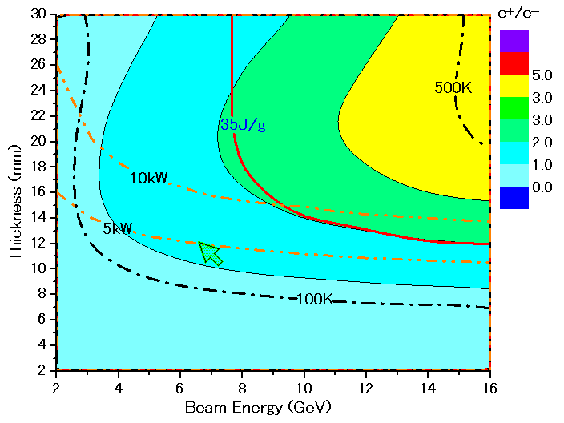
Parameter Plots for 300 Hz scheme
colored band
accepted e+/e-
e- directly on to Tungsten
σ=4.0mm
PEDD J/g
dT/triplet (132 bunc)
ToTal deposit kW

Slide 11
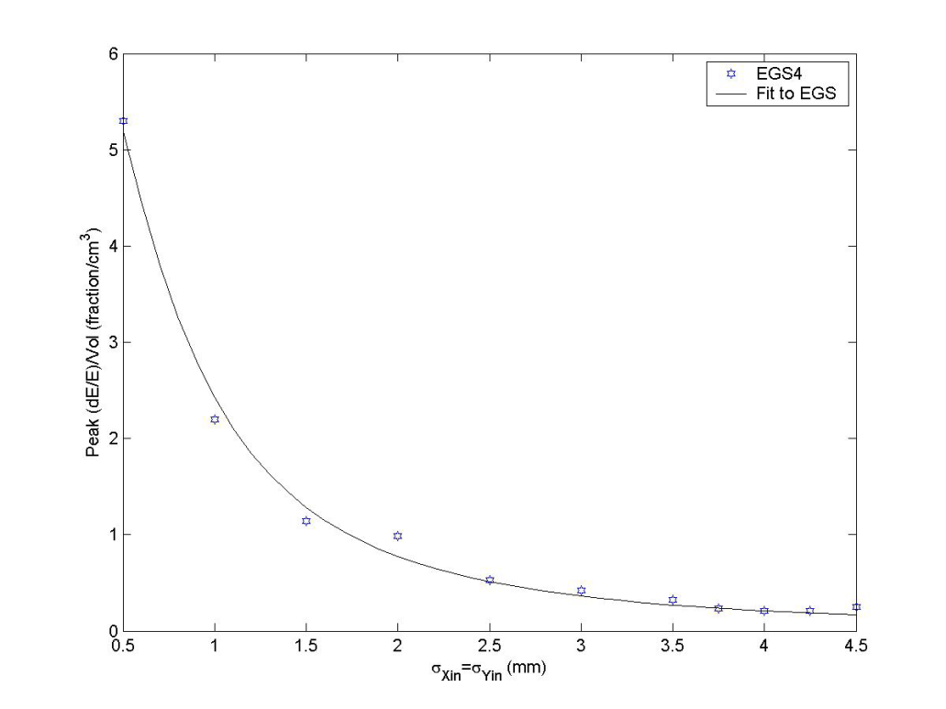
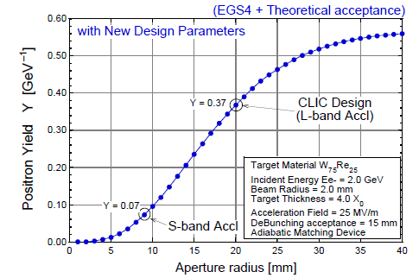
a few comments
numbers shown here are consistent w/
    independent calculation by a colleague in KEK and French colleague for Hybrid
comparison w/ SLC study
  both assumed AMD but acceptance for linac is;
    SLC S-band linac ←→ this study (CLIC) L –band
PEDD
John C. Sheppard
SLAC-TN-03-032
CLIC-note 465
consistent

Slide 12
Capture simulation with PPS-SIM
(very preliminary)
σ=4.0mm

Slide 13
Comparison at some parameters
analytic estimate by CLIC note
PPS-SIM simulation
Very Preliminary
numbers may change
e+ captured/e-
e- enegry(GeV)
target thickness(mm)
tracking simulation gives lower capture efficiency
but sill have area of parameter with good e+ yield

Slide 14
summary
Conventional target might have solution for ILC with 300Hz scheme
to go forward
  need detail study for capture section as
    relatively large beam size is preferred
    pps-sim gives lower capture efficiency but still have hope to get good e+ yield
  heating has to be studied including cooling system
  shock wave threshold has to be understood particularly under multi bunch condition

Slide 15
Assumption
each triplet hits different position on the target
relatively low (1~2m/s)rotational target
duration of a triplet ~ dumping time of shock wave
shoter than time scale of thermal dissusion
132 bunches in a triplet contributes both shock wave and thermal damage

Slide 16

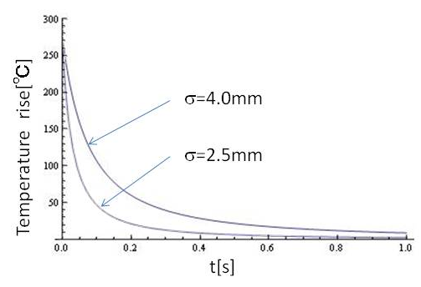
Thermal diffusion
time constant of the diffusion depends on beam spot size ~1/β
numerical calculation of
thermal diffusion shows
 |  | 1D | 2D | 3D
time constant | σ=2.5mm σ=4.0mm | 280ms 750ms | 80ms 200ms | 40ms 100ms
time constant is order of 100ms >> Ttriplet ~1μs

