Slide 1
New Generator Samples for the DBD
Tim Barklow (SLAC)
for the ILC Common Data Sample Subgroup - Akiya Miyamoto, Mikael Berggren and T.B.
Mar 22, 2011

Slide 2
Outline
ILC PEB Task Force Document on Benchmarks for the DBD
Changes in Event Generation Since the LOI
Status of Event Generation
  WW and 4-fermion background
  6-fermion event generation
  ttH and 8-fermion background

Slide 3
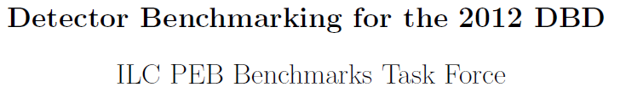
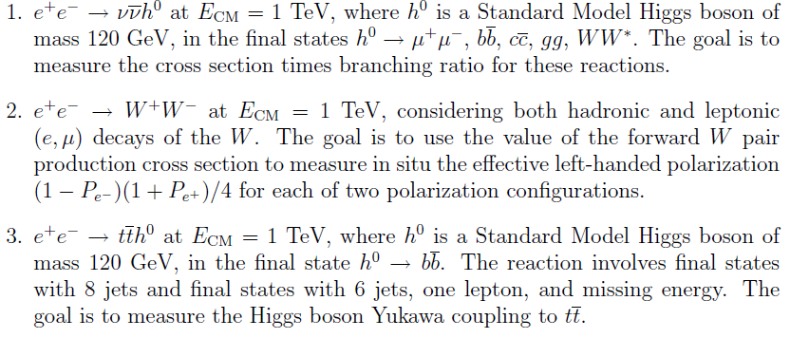

Slide 4
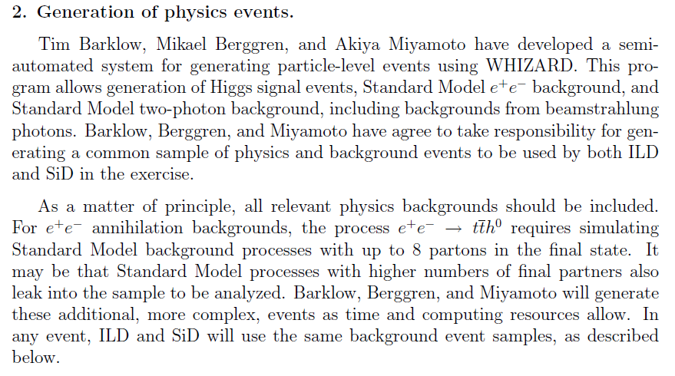

Slide 5
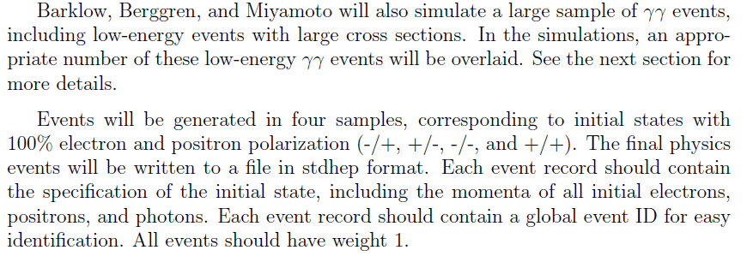

Slide 6
Changes Since the LOI
Distribute Event Generation between KEK, DESY and SLAC
Include initial state particles and final state polarization and color flow in event record
Improved data base for event generation information
Include amplitudes with CKM-suppressed vertices in event generation
Use particle aliasing to reduce the number of distinct WHIZARD processes (let the WHIZARD program do the flavor sums)

Slide 7
Aliasing
alias q u:d:s:c:b:U:D:S:C:B
alias r u:d:s:c:U:D:S:C
alias e e1:E1
alias l e2:e3:E2:E3
alias v n1:n2:n3:N1:N2:N3
alias x u:c:U:C
alias y d:s:D:S
alias k b:B
bbxxyy_o e1,E1 k,k,x,x,y,y omega w:c,c
bbxxby_o e1,E1 k,k,x,x,k,y omega w:c,c
bbxxbb_o e1,E1 k,k,x,x,k,k omega w:c,c

Slide 8
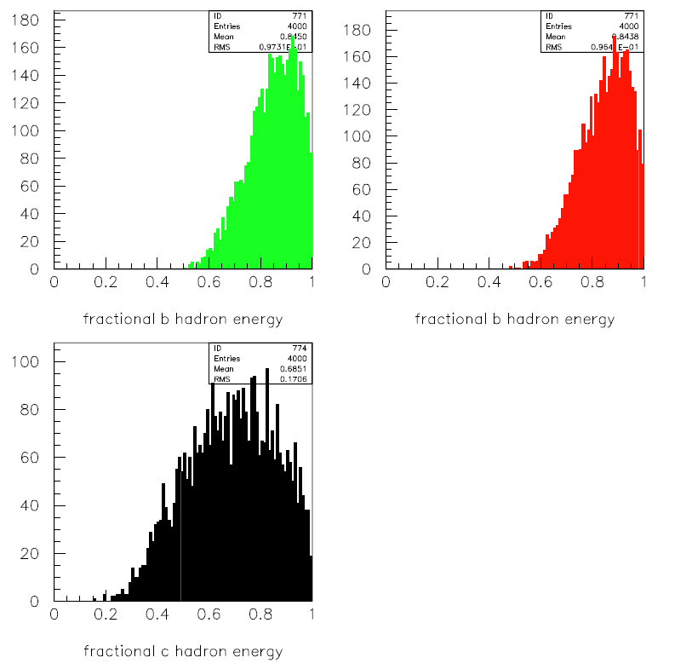
m_{b}=5.5 GeV
m_{b}=0
m_{c}=0

Slide 9
4-Fermion Production
With aliasing, number of processes changed from 45 without CKM-suppressed final states to about 18 including CKM-suppressed final states
Mikael Beggren has created a script that can generate all 4-fermion events with a specified lumi, fill a status file, copy stdhep files to grid and output other info (.log, .in, .out, .prc.,… files ) to a web directory.
Mikael recently tested the script by generating all 4-fermion processes excluding those with final state electrons and produced 1 ab-1 equiv overnight.

Slide 10
6-Fermion Production
Aliasing has allowed us to consolidate the processes
Compilation and MC integration take much longer than before because of the CKM-suppressed vertices. However, compilation and integration only has to be done once, so this ultimately should not hold us up.

Slide 11
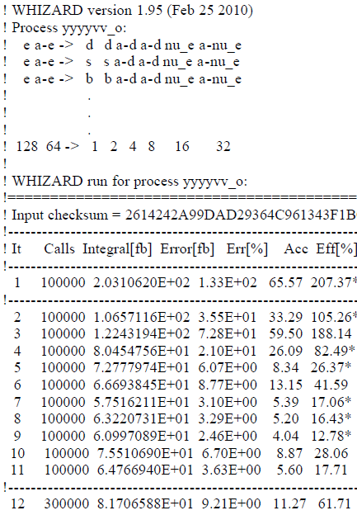
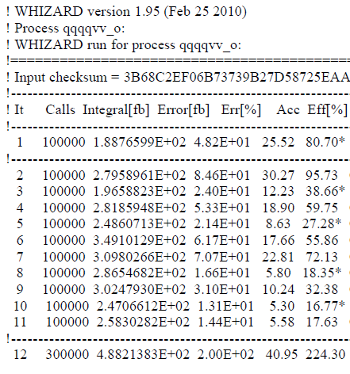

Slide 12
8-Fermion production
Production of tth suspended for the moment at KEK
Problems with ordering of final state fermions in the interface between WHIZARD and PYTHIA (not an uncommon problem)
Still looking for a solution to the problem of generating 8-fermion and 10-fermion backgrounds to ttH

