Slide 1

Noise and Cosmics in the DHCAL
José Repond
Argonne National Laboratory
CALICE Collaboration Meeting
University Hassan II
Casablanca, Morocco
September 22 – 24, 2010

Slide 2
Construction of the DHCAL
Description of the DHCAL
40 planes of RPCs to be inserted into the AHCAL structure
Each plane 96 x 96 cm² and subdivided into 3 RPCs (32 x 96 cm²)
Readout with 1 x 1 cm² pads
Each pad read with 1 – bit (digital) resolution
Total of ~350,000 readout channels
Status of the construction
Almost complete
Tests and measurements at every step in the construction process
Details → talk in the DHCAL session

Slide 3
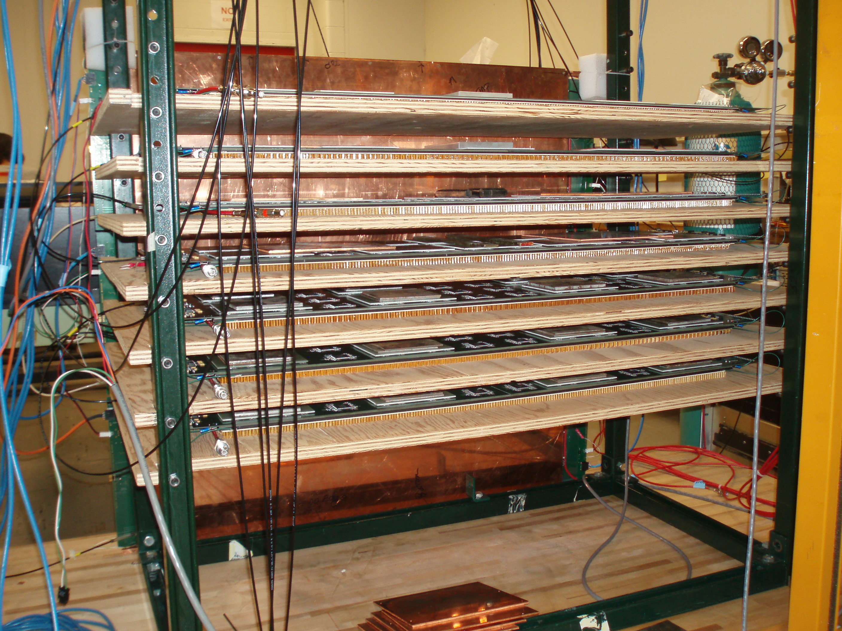
Setup for noise and cosmic ray measurements
Test stand
Up to 9 RPCs tested at once
RPCs in horizontal position
Operation of RPCs
High voltage set at 6.5 kV (default is 6.3 kV)
High voltage scans from 5.8 to 6.8 kV
Gas premixed (by us)
Data taking
Trigger-less mode: noise and cosmics
Triggered mode: noise and cosmics

Slide 4
Analysis effort
DAQ software ← Jim Schlereth
Event building ← Lei Xia (JAVA based)
← Jacob Smith (C⁺⁺ code)
Noise analysis ← Lei Xia (using binary files, C⁺⁺)
← Kurt Francis (using ASCII files, C⁺⁺)
← José Repond (using ASCII files, F77)
Cosmic ray analysis ← Daniel Trojand (trigger-less data, C⁺⁺)
← Jacob Smith (triggered data, C⁺⁺)
← José Repond (trigger-less data, F77)

Slide 5
Event building
Data format
Time-stamp (with 100 ns resolution), chip address, hit pattern
Task
Build events from list of unsorted time-stamps
(somewhat tricky)
Programs
JAVA – based (limited to 1 VME crate - out phased)
C⁺⁺(no limits)
Output
Binary file
ASCII file
Split into noise data and cosmic ray events with at least 3 layers with hits
Status
Complete, apart from possible need for event recovery
t -1 -1 -1
t x y z
t x y z
t x y z
t x y z
….
t -1 -1 -1
t x y z
t x y z
…..

Slide 6
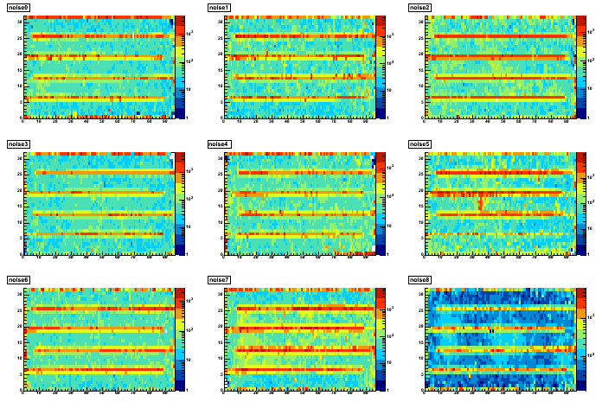
Analysis of trigger-less noise data
Typical run lasts 5 minutes
Fishing lines clearly visible

Slide 7
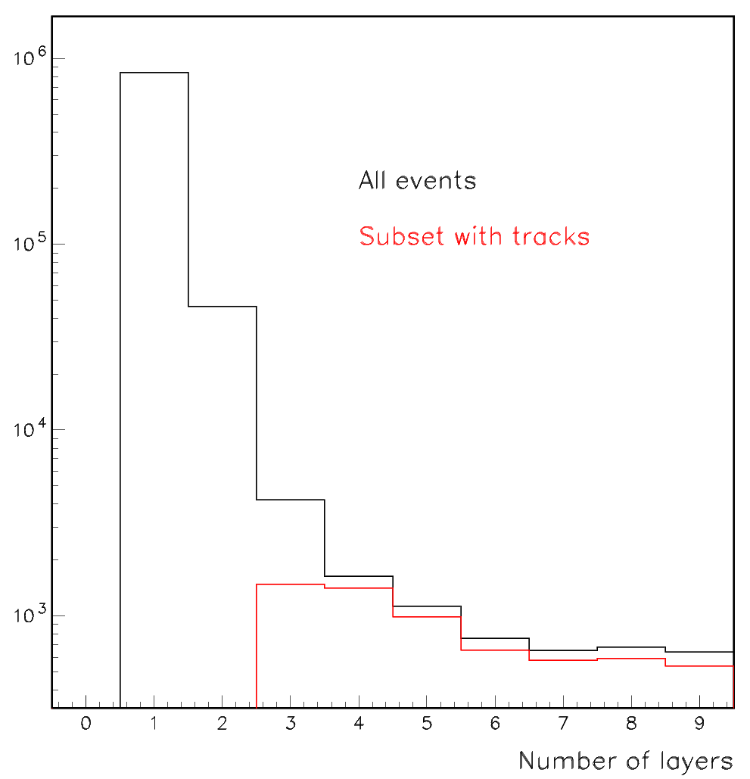
Number of layers with hits
Events with N_{hits} >300 removed
Tracks defined with a minimum length of
3 layers
χ²/DOF <1.0 (high quality tracks)
Most events with >3 layers have tracks
Some events without high quality
tracks and with > 3 layers:
showers?
(let’s not worry about them)

Slide 8
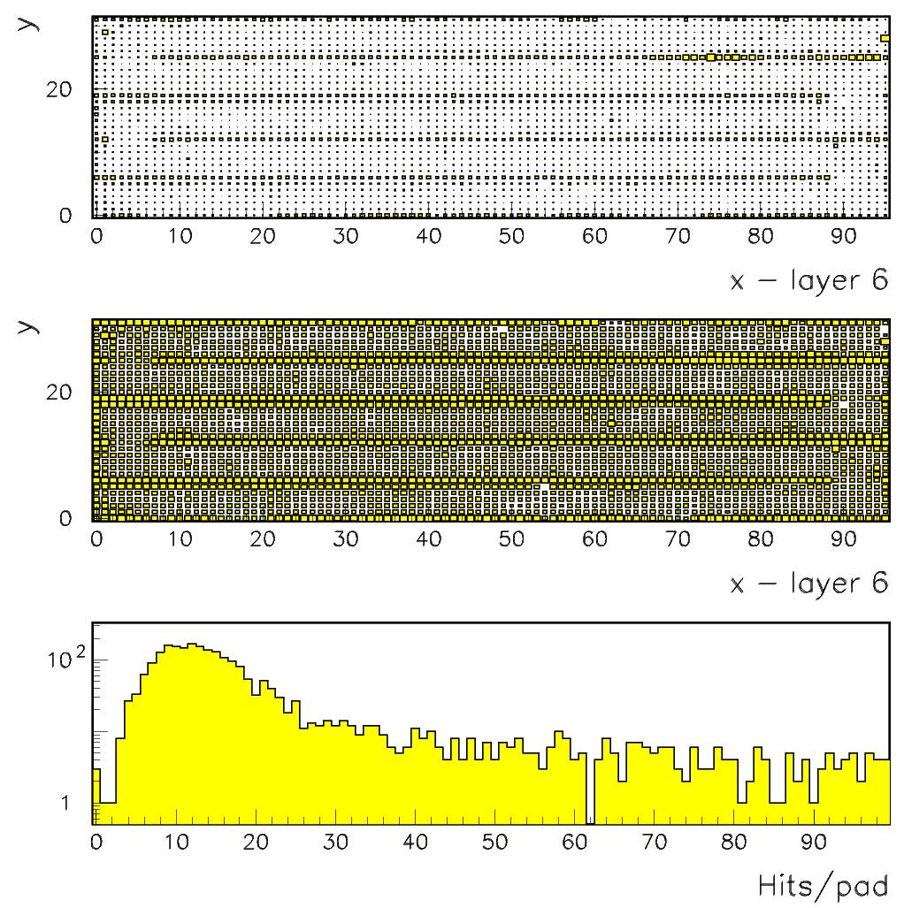
Cosmics removed: Detailed look at a specific layer (307,377 events)
Linear z scale
Logarithmic z scale
P(0) = e^{-μ}
= 4.54 x 10⁻⁵
(with μ = 10)
Probability of one
of the 3072 pads is
zero =
3072 x P(0) = 14%
Fishing lines clearly visible
Some dead channels

Slide 9
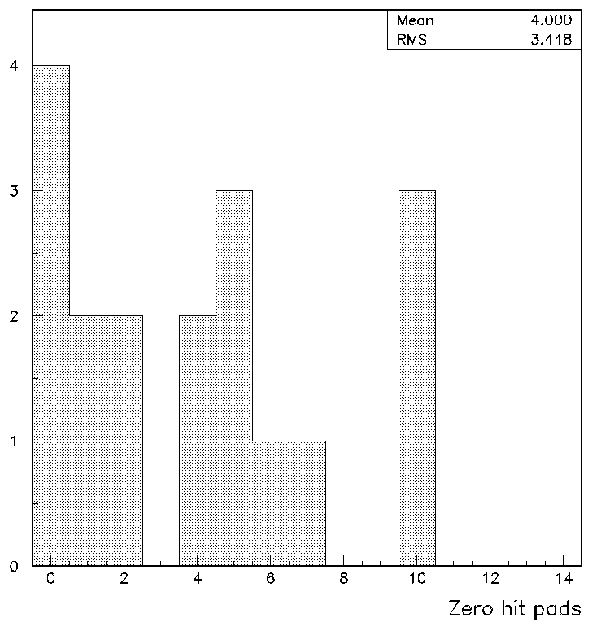
Summary at 6.5 kV
Layer | Total hits | Rate = N/300/2/1536 | Number of zero hit pads (left) | Number of zero hit pads (right)
0 | 356623 | 0.39 | 5 | 10
1 | 379405 | 0.41 | 5 | 2
2 | 328092 | 0.36 | 1 | 7
3 | 269035 | 0.29 | 2 | 6
4 | 322551 | 0.35 | 1 | 10
5 | 586540 | 0.64 | 0 | 10
6 | 307377 | 0.33 | 0 | 4
7 | 480360 | 0.52 | 5 | 0
8 | 368437 | 0.40 | 4 | 0
Dead channels/board
Noise rate in Hz/cm²

Slide 10
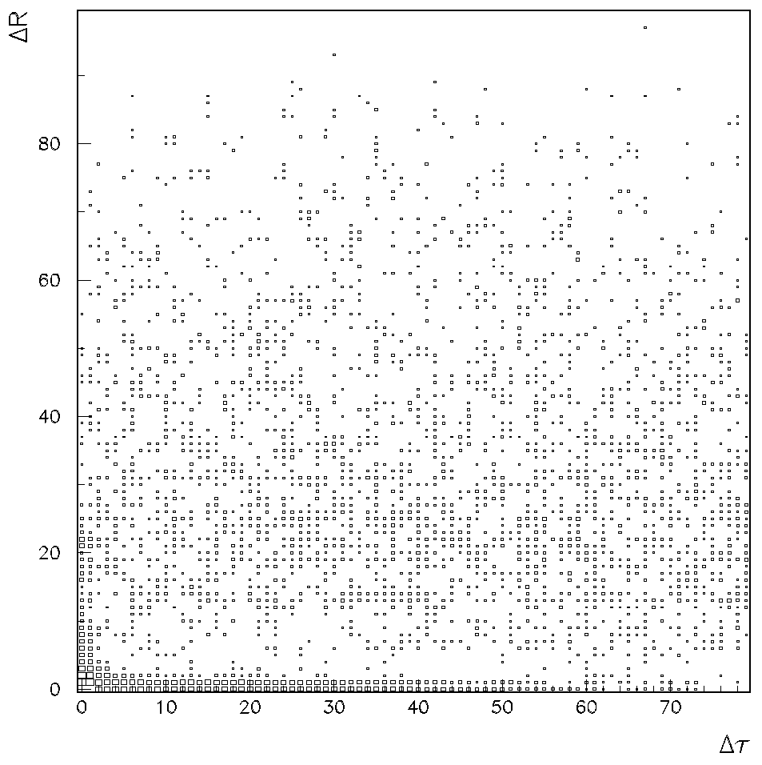
Single layer and low hit number analysis
Selection
N_{hit} =2,3,4
Plot
ΔR … distance between hits
Δτ … time bins between hits
Logarithmic z scale
3 regions
I ΔR < 4
II Δτ < 4
III Remainder

Slide 11
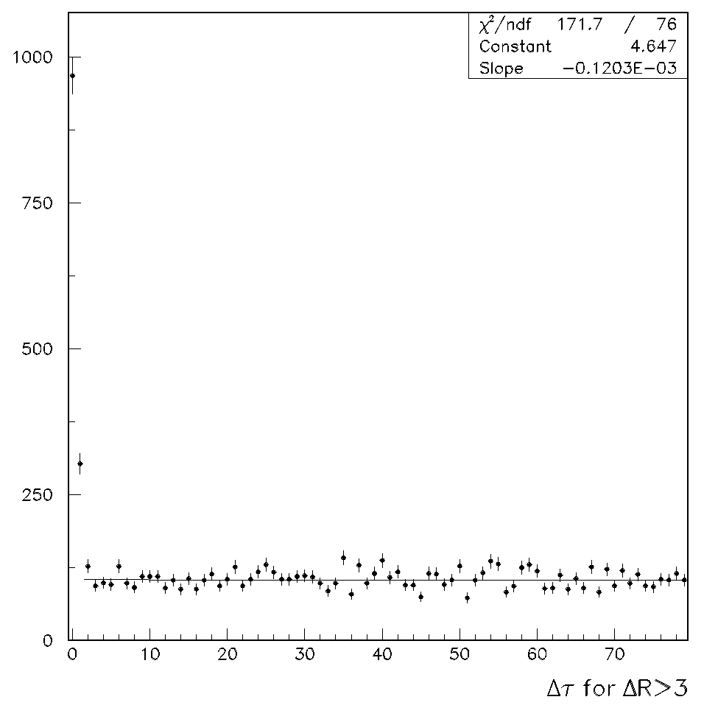
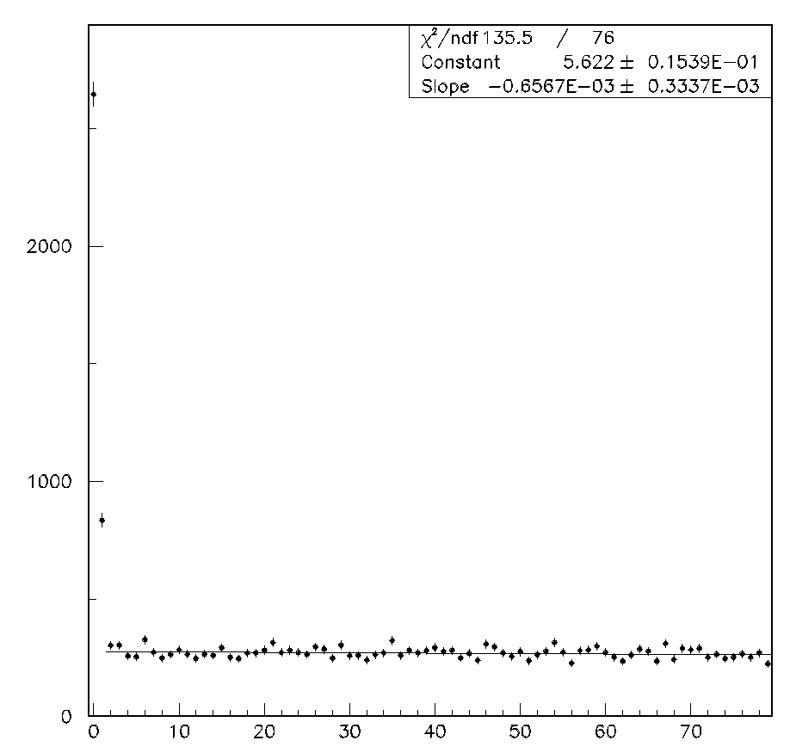
Large distances
Average time between hits =
1/slope = 1522 x 10⁻⁷ = 1.5 x 10⁻⁴ s
Noise rate = slope =
6.6 x 10⁻⁴ x 10⁷ /(18 boards x 1536) =
0.24 ± 0.12 Hz/cm²
Exponential: random hits
Showers?

Slide 12
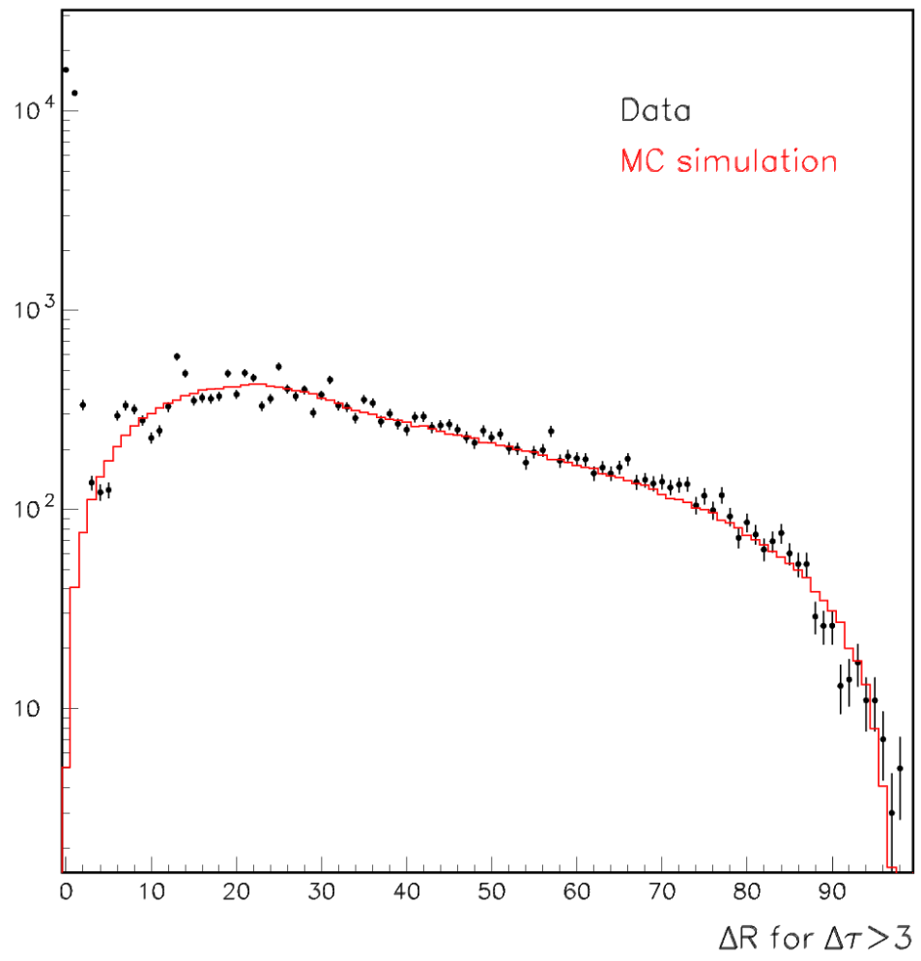
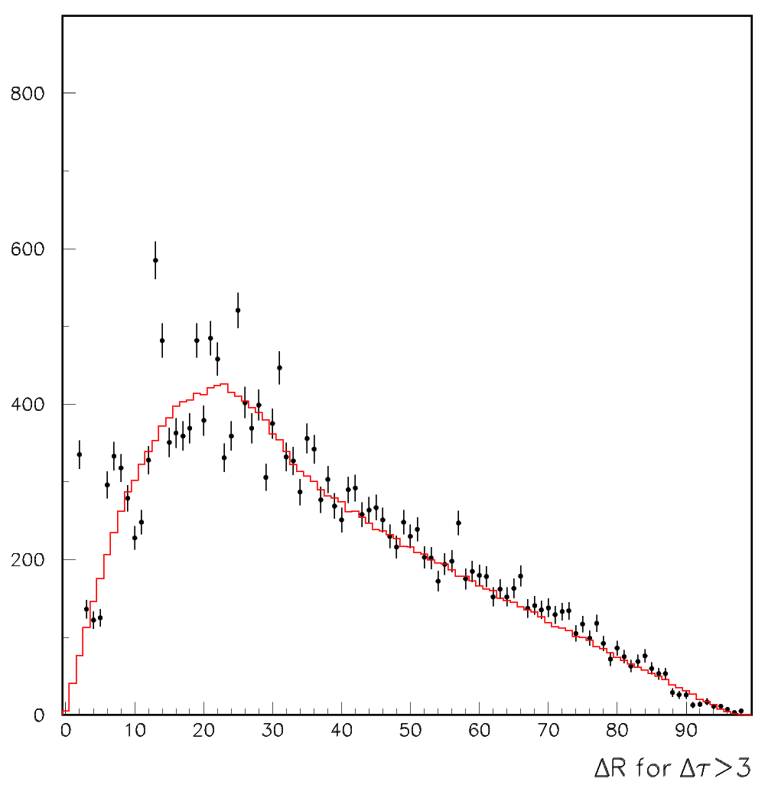
Large time differences
MC simulation
No correlation between hits
Pad structure not implemented
Hits obviously random
→ no correlations
Fluctuations in linear plot most
likely due to binning effects

Slide 13
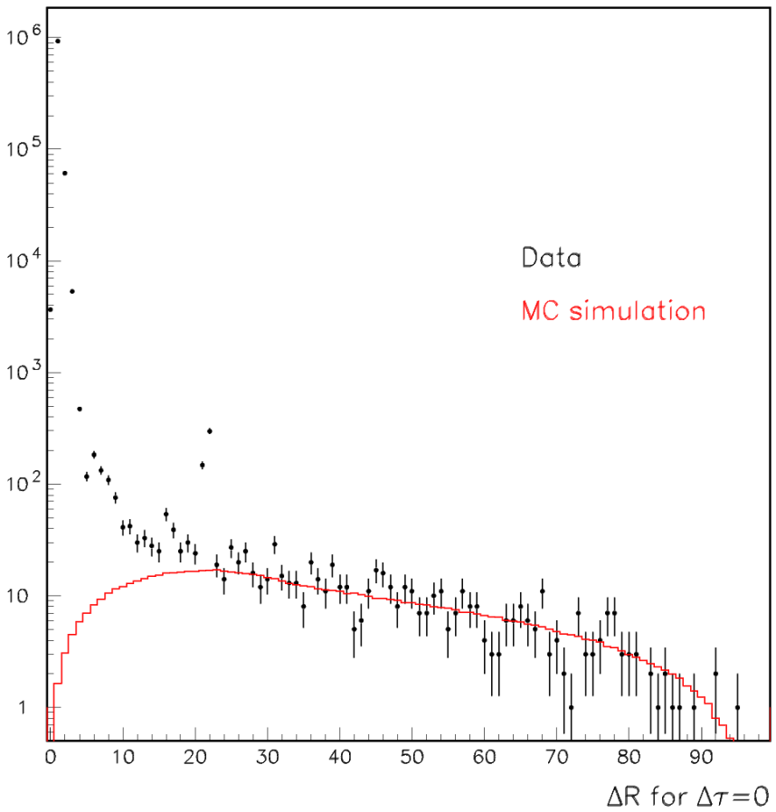
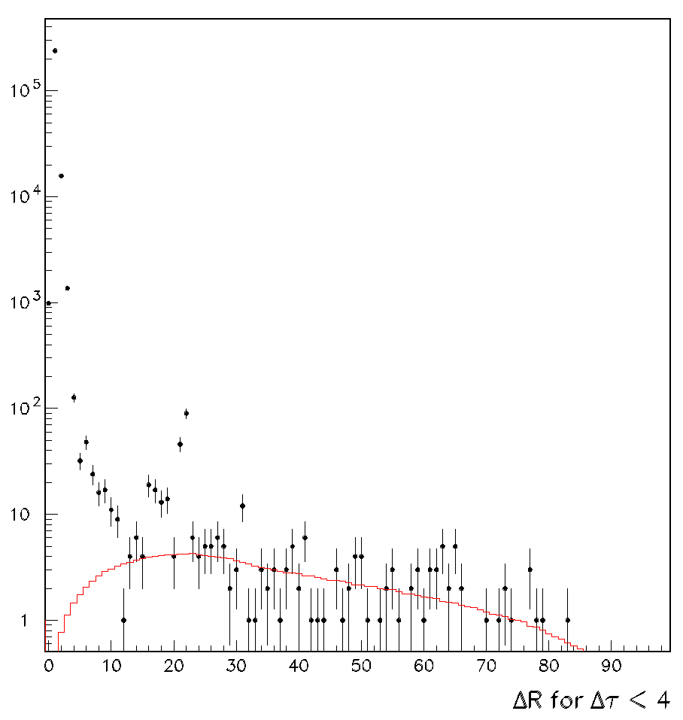
Small time differences
MC simulation
No correlation between hits
Pad structure not implemented
Hits at large ΔR obviously random
→ no correlations
Peak at 1 from pad multiplicity > 1
Peak at 20
→ faulty ground connections
(has been corrected)

Slide 14
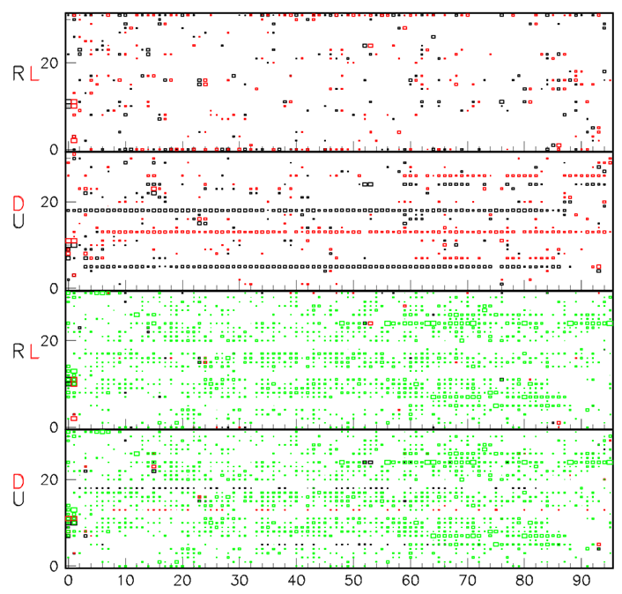
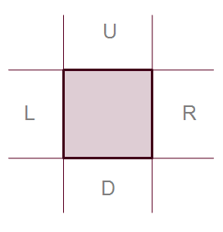
Correlations between pads
(possibly due to problems with pad- and front-end board gluing)
Hits with neighbors
normalized by ‘all hits’
Minimum z = 0.5
Hits with neighbors
normalized by ‘all hits’
Minimum z = 0.9
Single hits normalized
by ‘all hits’
Minimum z = 0.2
Look for RL or DU pairs
without singles
No evidence for correlations

Slide 15
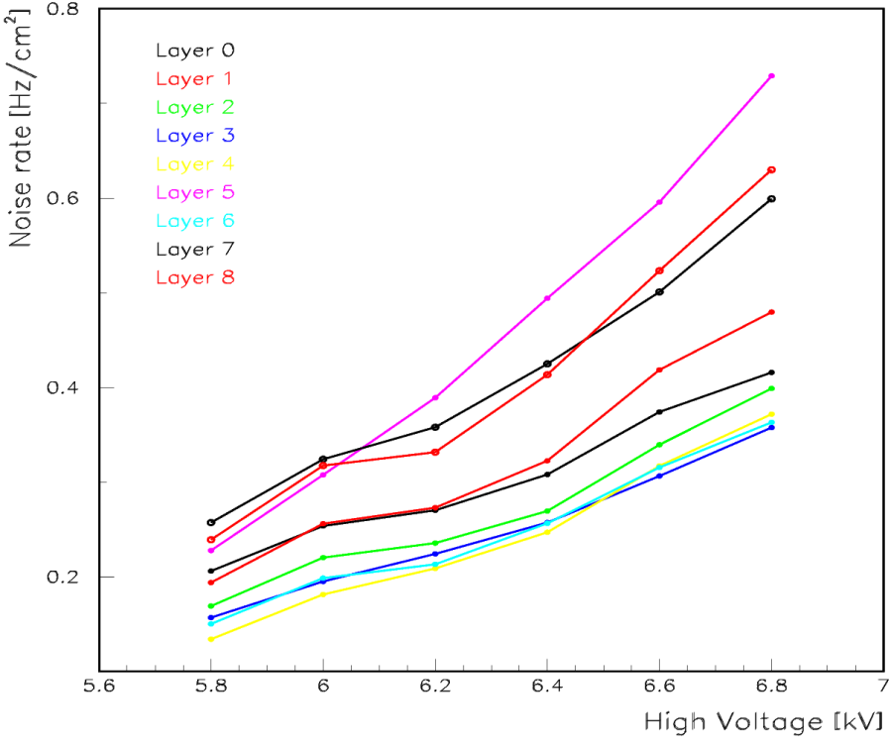
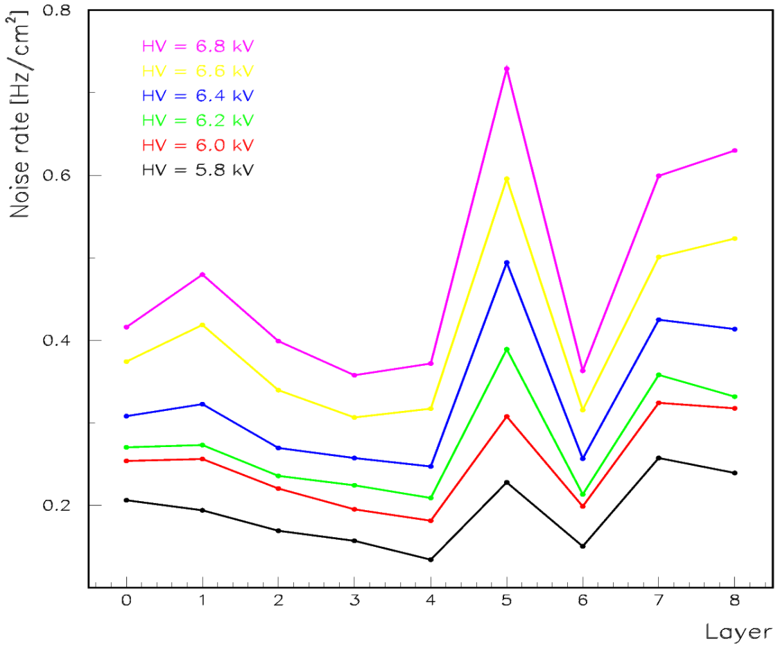
Study of the HV dependence
Results as expected
(higher noise rates due to
poor grounding?)

Slide 16
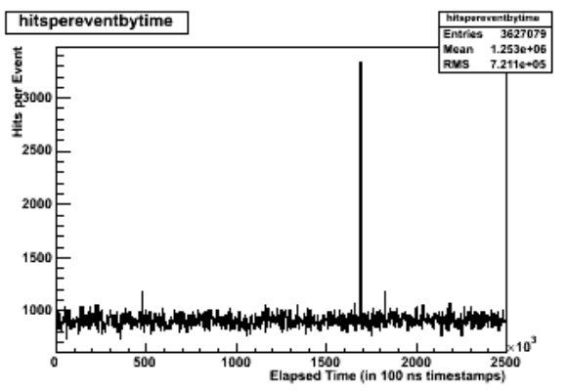
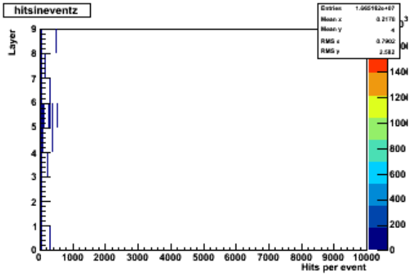
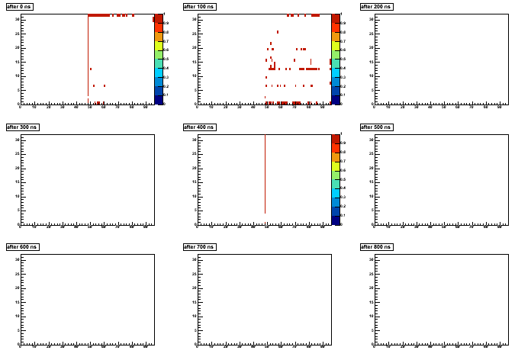
Problems: events with > 300 hits
These events are rare (a handful in 5 minutes)
They spill over several time bins
Their rate and their characteristics depend on the grounding scheme
These events will be studied further within the cubic meter structure
Hits in
bins of
200 ns
Grounding
scheme to be
finalized with
cubic meter

Slide 17
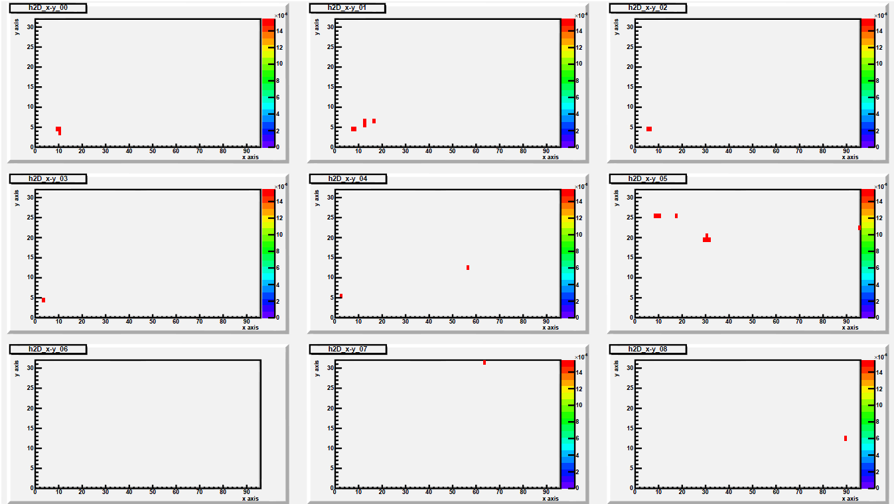
Analysis of triggered noise data
Data collected with random triggers at a rate of 500 Hz
9 RPCs with a total of 27,648 readout channels (8% of the cubic meter)
MIP detection efficiency ~ 95%
Collected 31,906 events in 60 seconds → Not a single hit
Collected 1,010,494 events in 3 x 10 minutes → 24 hits in 10 events

Slide 18
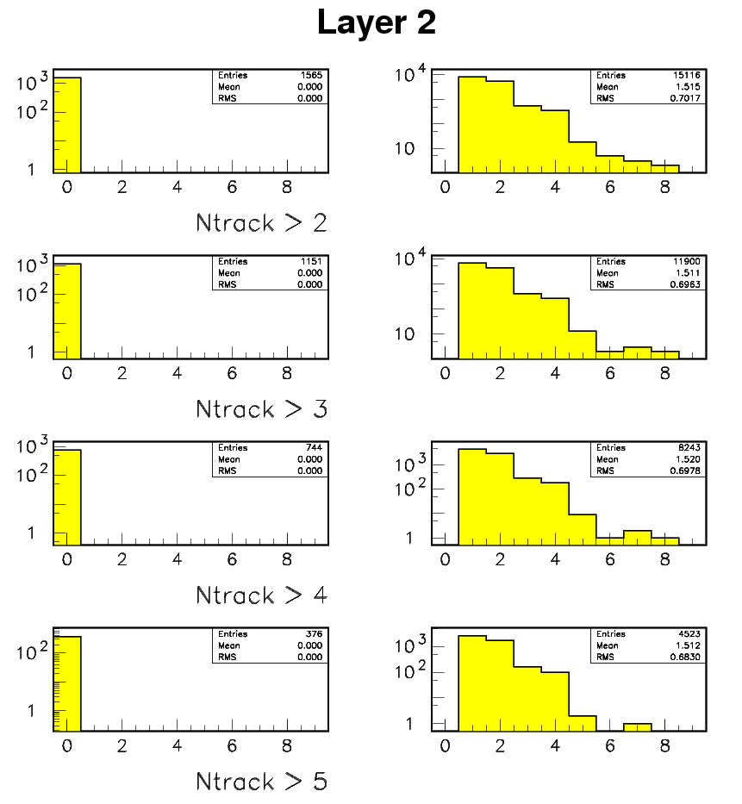
Analysis of trigger-less cosmic rays
Data selection
Select events among noise data requiring at least 2 layers with hits
(Obviously, no hardener of cosmic rays implemented)
(Top and bottom layer will show systematic differences)
Procedure for layer i
Cluster hits in layers individually
Request only 1 cluster in any layer but layer i
Fit track to clusters in any layer but layer i
Extra- or interpolate track to layer i
Reject tracks with χ² > 1.0
(calculated with σ_{cluster} = 1.0 cm)
Declare a match if cluster in layer i
within R = 2.5 cm
Calculate efficiency and pad multiplicity

Slide 19
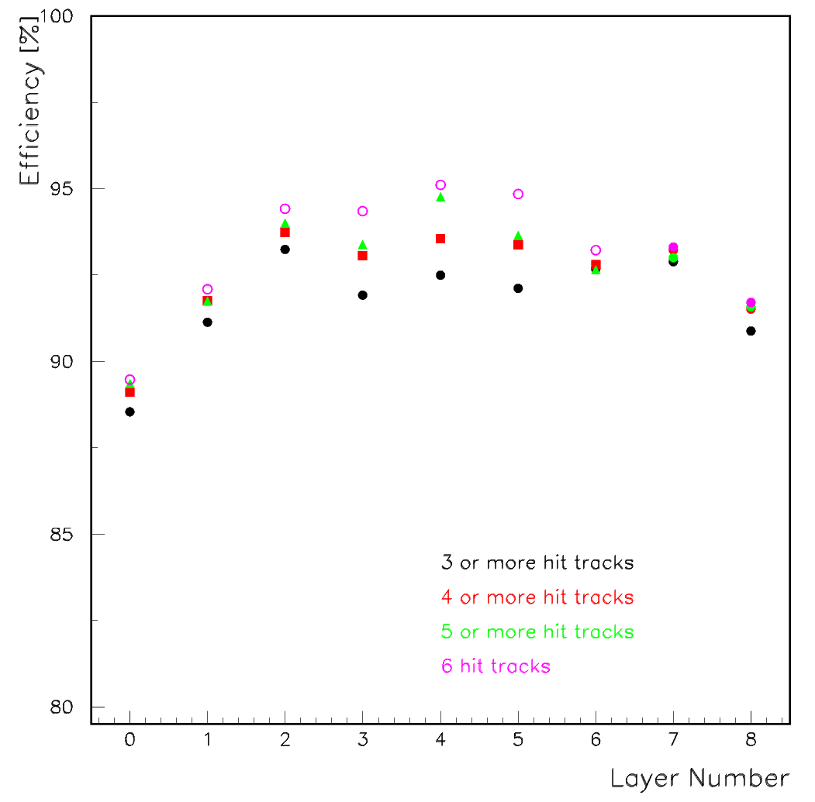
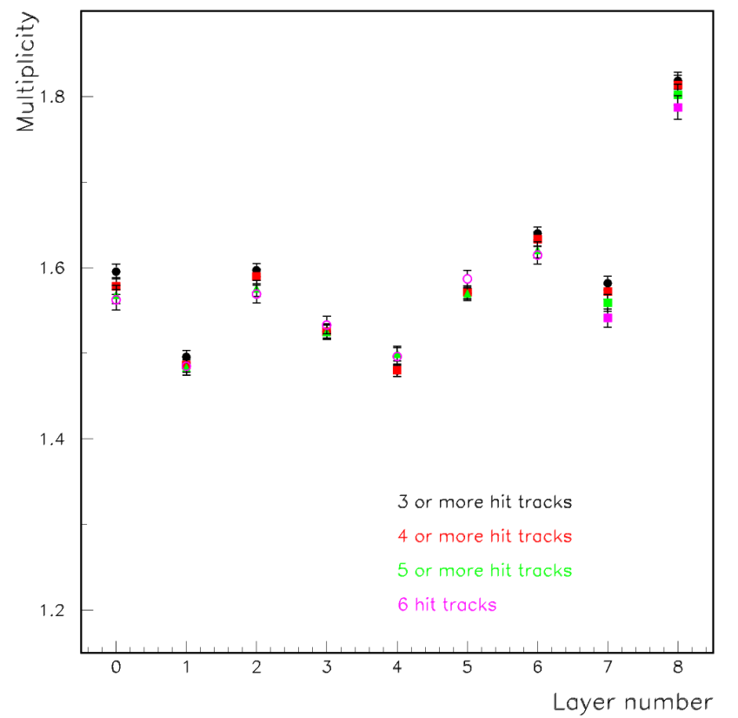
Efficiency and pad multiplicity
9 layers à 3072 channels = 27648 channels
Clear systematic dependence on track quality
High multiplicity of top layer most likely systematic effect

Slide 20
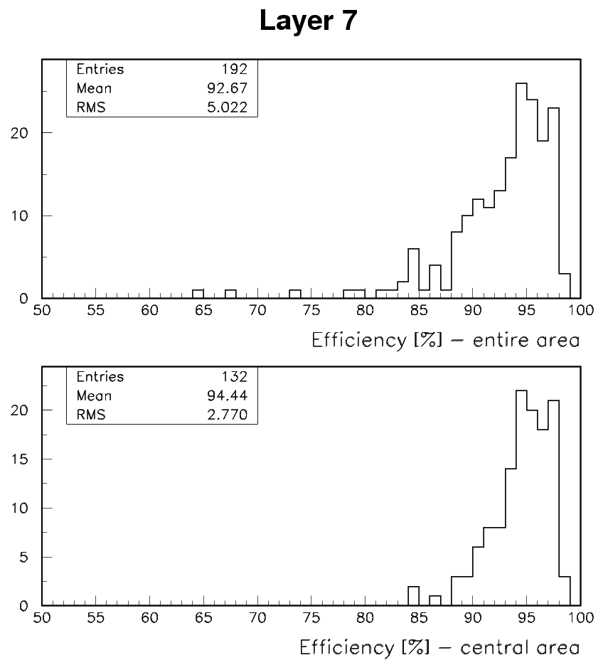
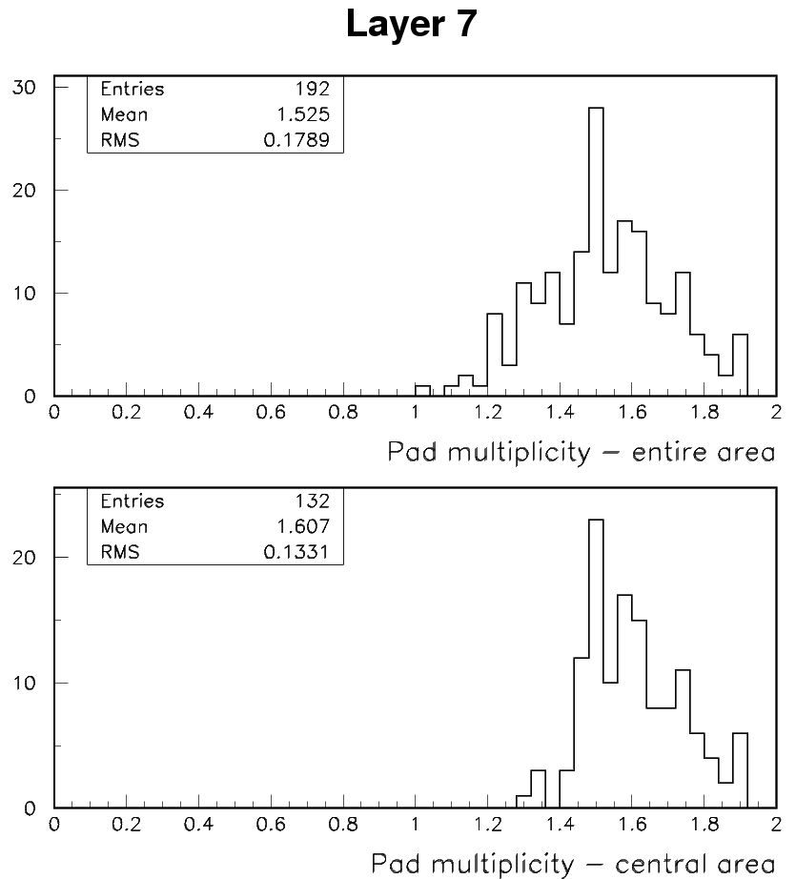
Distributions of ε, μ
For statistical reasons added binned in 4 x 4 cm² areas
Some smearing: due to statistic and angle of incidence
Some edge effects: in part due to the chambers
In general looks OK

Slide 21
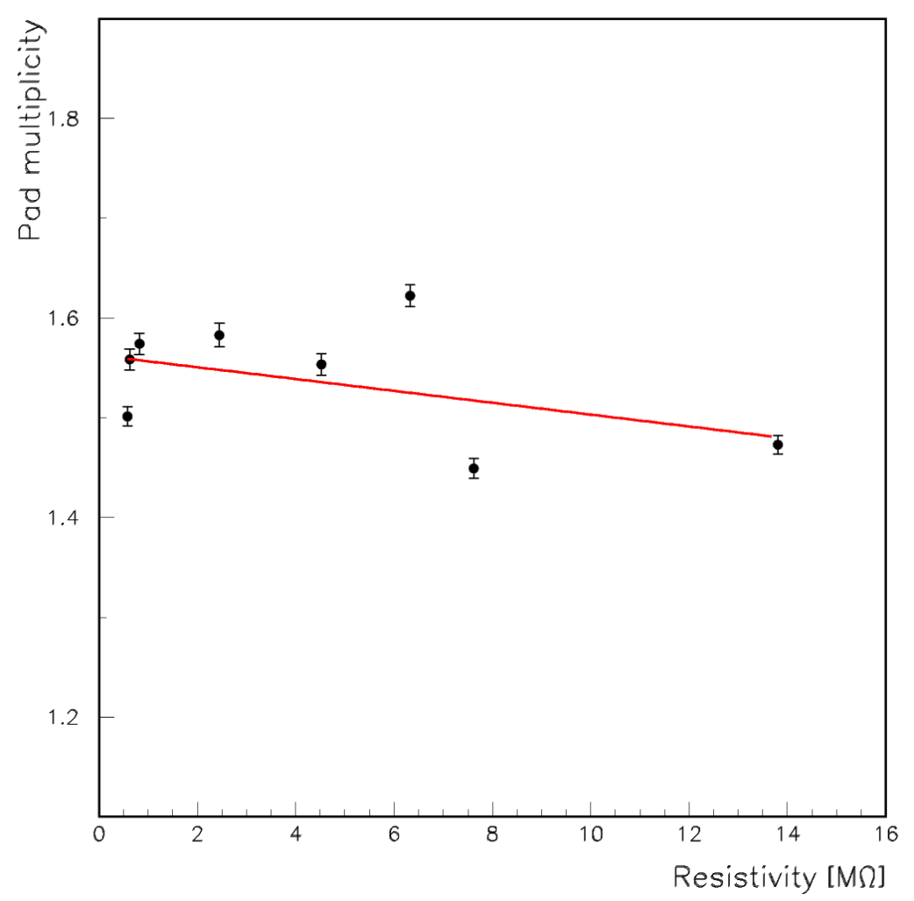
Correlation with Resistivity
Layer # | Chamber # | Glass # | Resistivity
0 | 31 | 107 | 2.45
1 | 33 | 92 | 7.62
2 | 18 | 50 | 0.58
3 | 15 | 48 | 0.82
4 | 30 | 113 | 13.81
5 | 17 | 49 | 0.62
6 | 26 | 84 | 6.33
7 | 12 | 46 | 4.52
8 | 25 | ? | ?
No obvious correlation
χ²/DOF – 29.5/(8-2) = 4.9

Slide 22
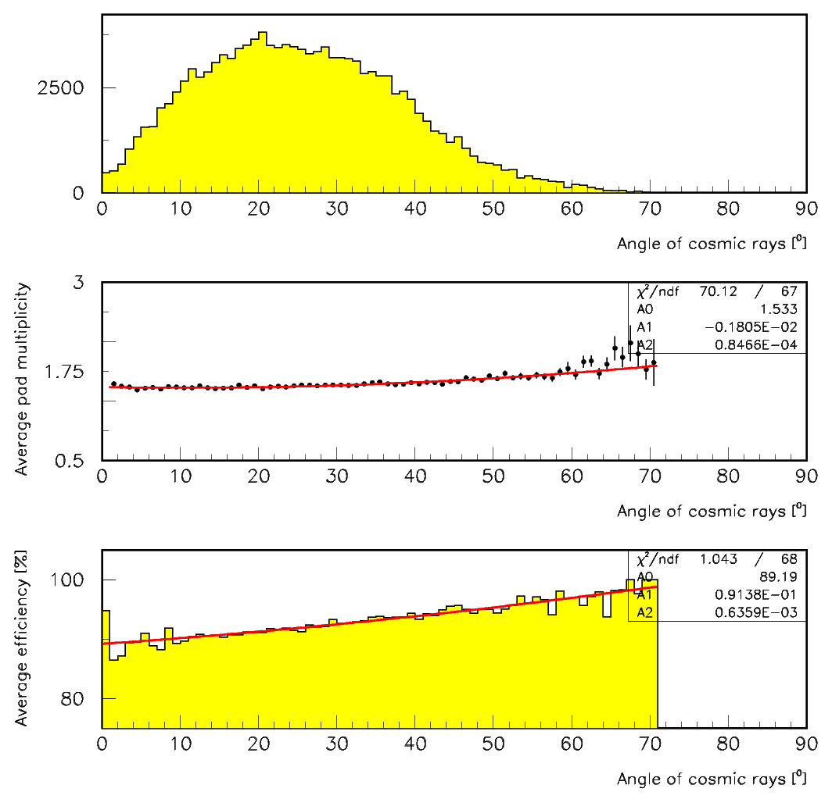
Angle of cosmic rays
Cuts
- At most 1 cluster/tracking layer
- χ²/DOF < 1.0
- N_{track} > 3
- x_{int} within 0.0 ÷ 95.0
- y_{int} within 0.0 ÷ 31.0
1.533 ÷ 1.831 or +19.4%
89.3 ÷ 98.9 % or +10.8%
____________________
136.9 ÷ 181.1 or 32.3%
≡Calibration
This effect has not (yet) been implemented into the RPC response simulation

Slide 23
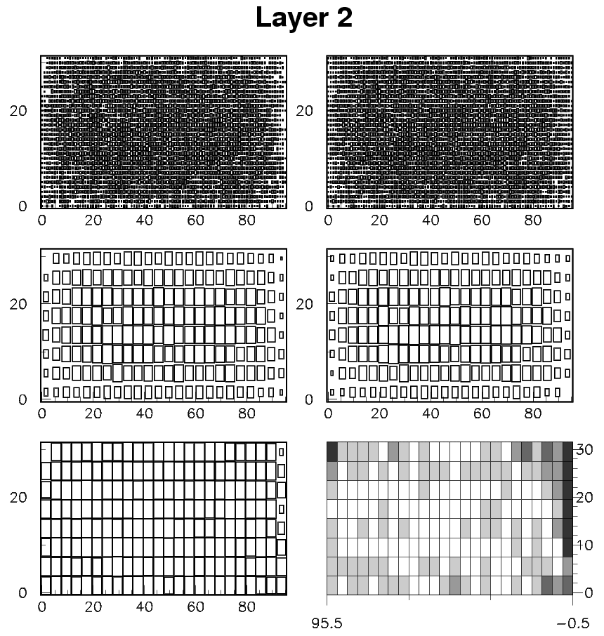
Efficiency maps
Hits
(Pad binning)
All tracks
(Pad binning)
Hits
(2 x 2 pad binning)
All tracks
(2 x 2 pad binning)
Efficiency
0 – 100%
Efficiency
75 – 100%
Reasonably uniform, edges difficult to measure

Slide 24
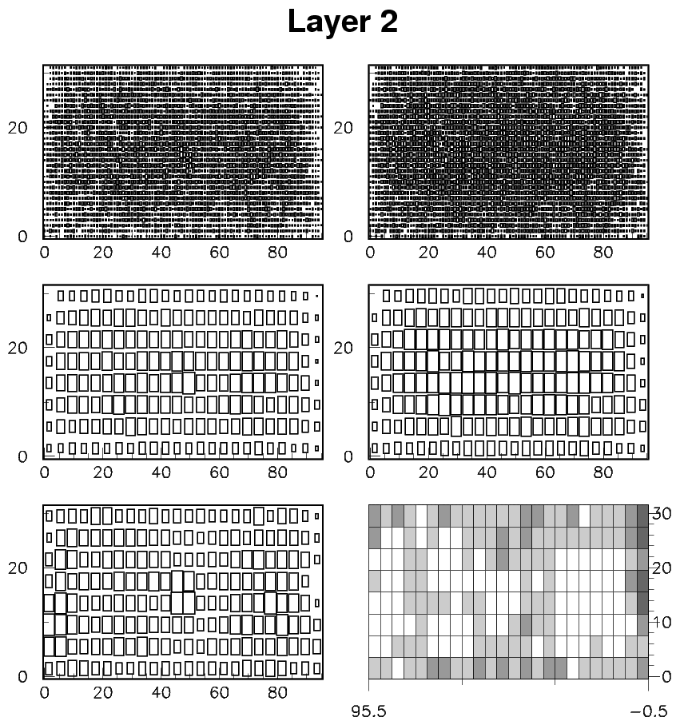
Pad multiplicity maps
Multiplicity
weighted
matches
(1 pad binning)
Matches
(1 pad binning)
Multiplicity
weighted
matches
(2 x 2 pad binning)
Matches
(2 x 2 pad binning)
Average
multiplicity
Scale 0 - max
(2 x 2 pad binning)
Average
multiplicity
Scale 0.8 – 1.8
(2 x 2 pad binning)
Reasonably uniform, edges difficult to measure

Slide 25
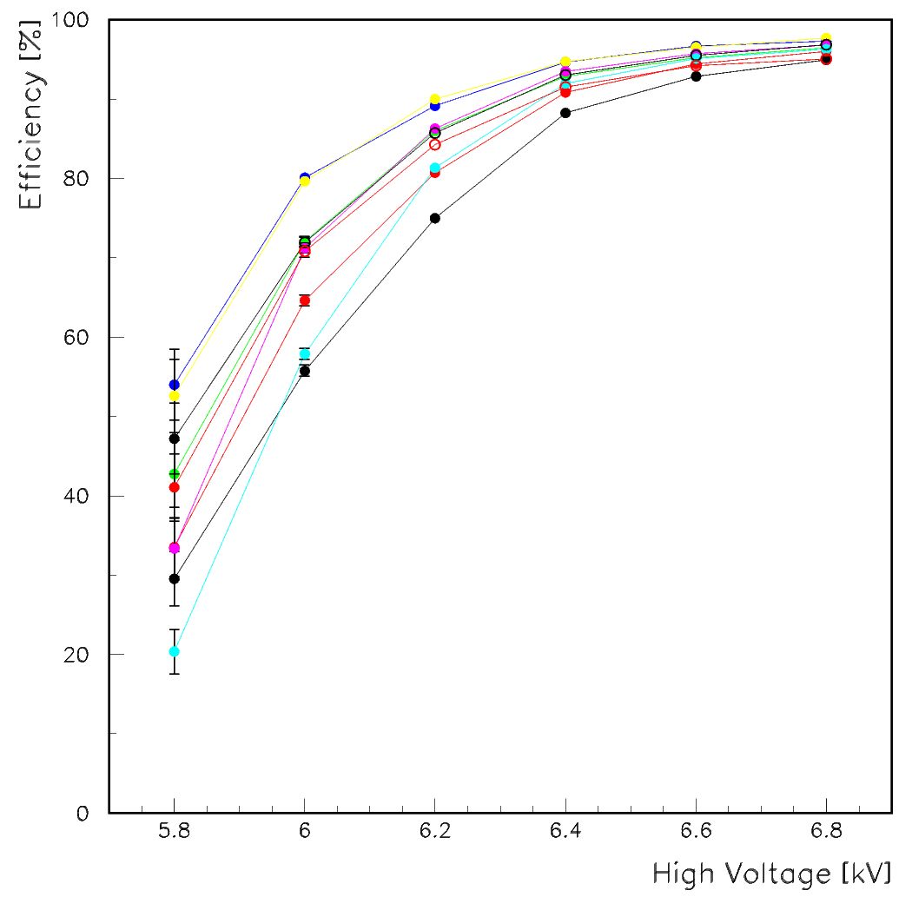
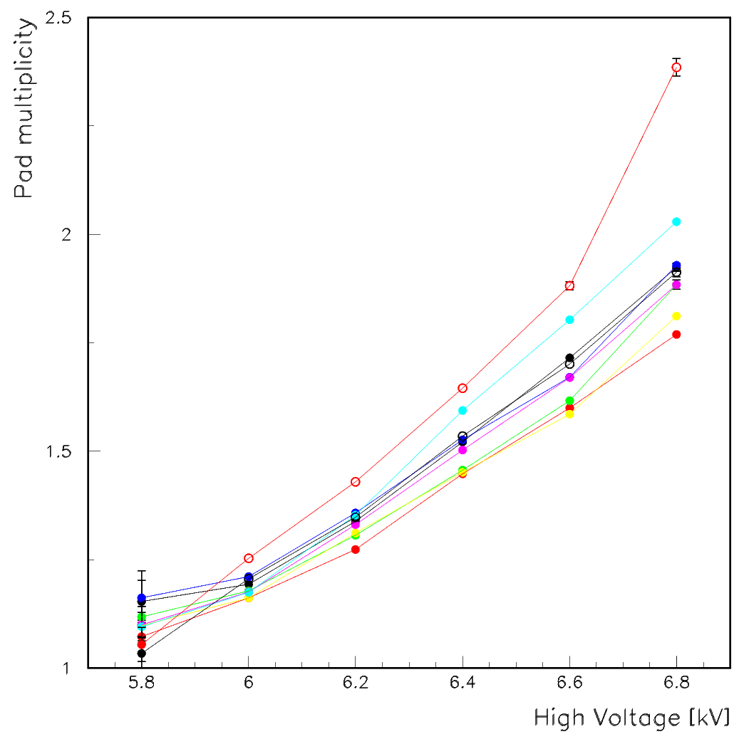
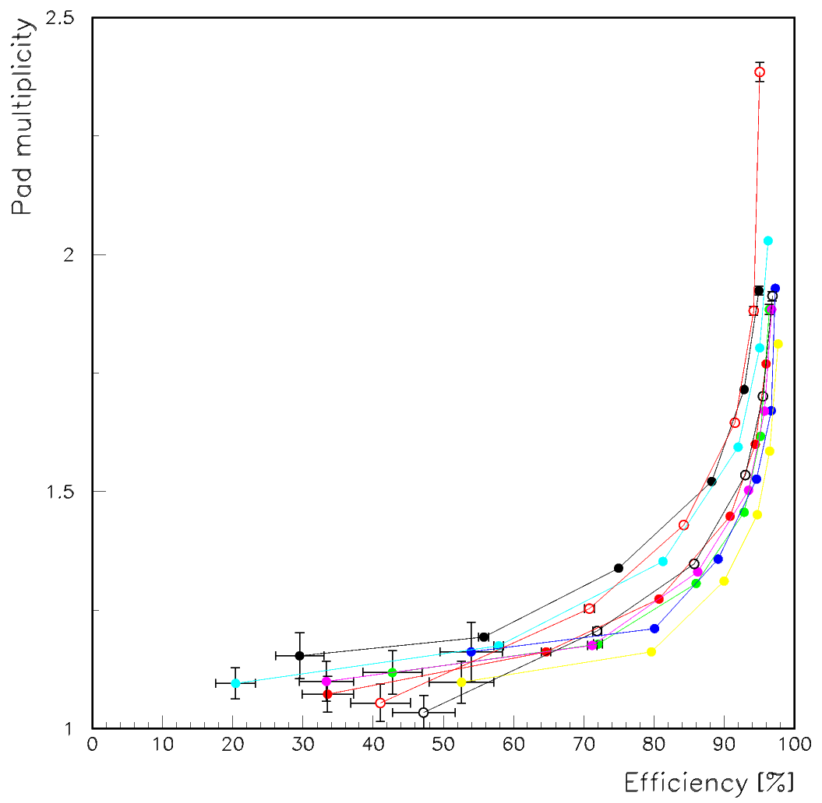
Dependence on high voltage
Cuts
- At most 1 cluster/tracking layer
- χ²/DOF < 1.0
- N_{track} > 5
- x_{int} within 0.0 ÷ 95.0
- y_{int} within 0.0 ÷ 31. 0
As expected

Slide 26
Analysis of triggered cosmic rays
3 sets of runs with different grounding schemes
(grounding in the cubic meter will be different)
2 Scintillator counters at bottom
Setting | Duration [hours] | Events | Grounding events | Grounding events [%]
I | 60 | 54,475 | 239 | 0.44
II | 18 | 16,842 | 152 | 0.90
III | 36 | 33,824 | 291 | 0.86
Identified through
cluster of hits close to
the grounding of the anode

Slide 27
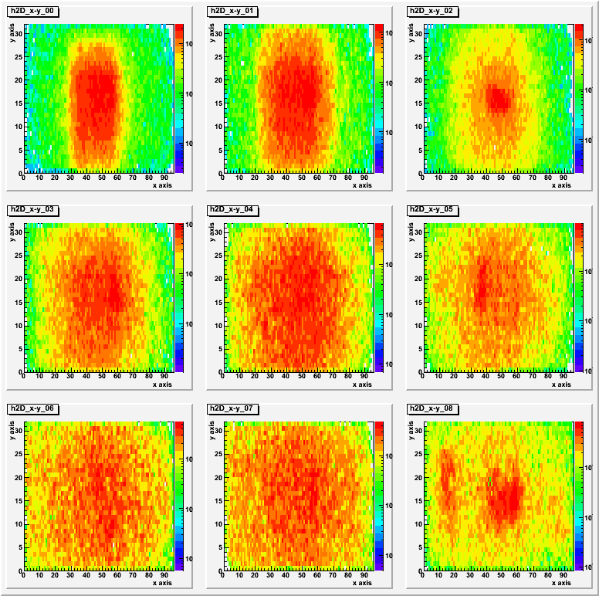
  Triggered cosmic rays in the 9 layers
Area grows with
layer number
due to increased
distance from
trigger counters

Slide 28
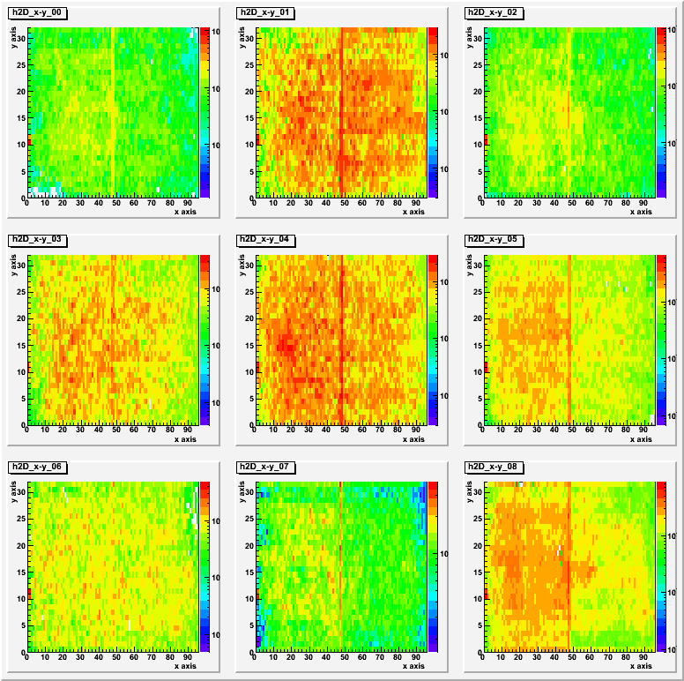
  Grounding events in the 9 layers
Note high rate at
(x,y) = (0,11) =
grounding
Line at x = 49 is
the boundary
Between the 2
Readout boards
This problem will
be sorted out with
the grounding of
the cubic meter
(suspicion of problems
with the trigger counters)

Slide 29
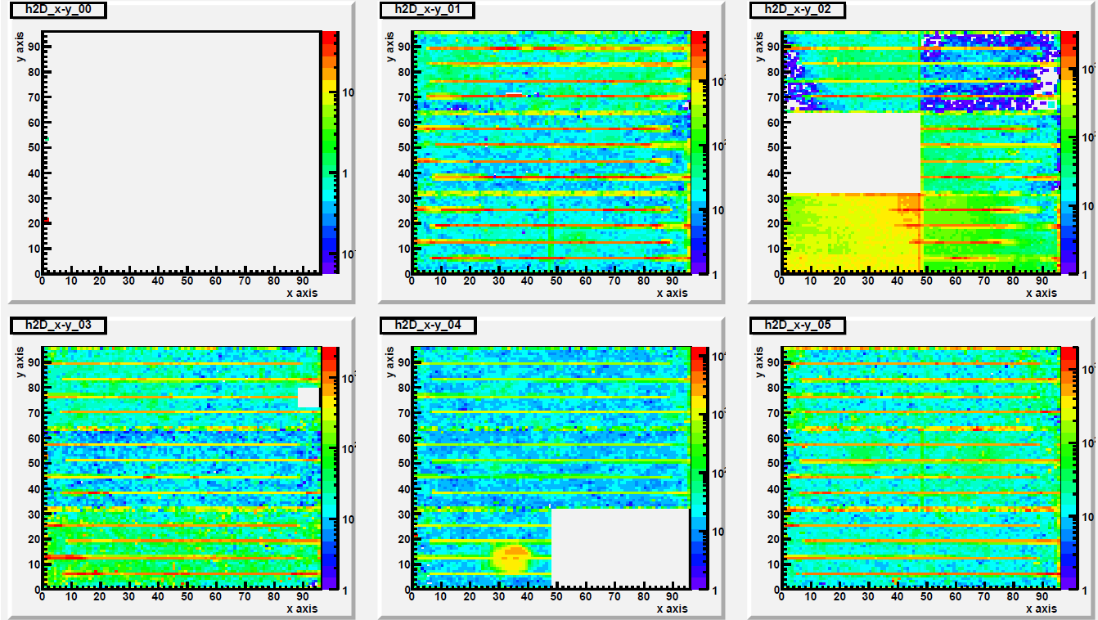
Powering up completed cassettes
First try at powering up complete cassettes
Not yet
powered up

Slide 30
Summary
9 RPCs with 27,648 readout channels thoroughly tested
Noise rate low and as expected
Efficiencies/pad multiplicities OK
Final grounding still to be established
Cassettes being powered up…

Slide 31
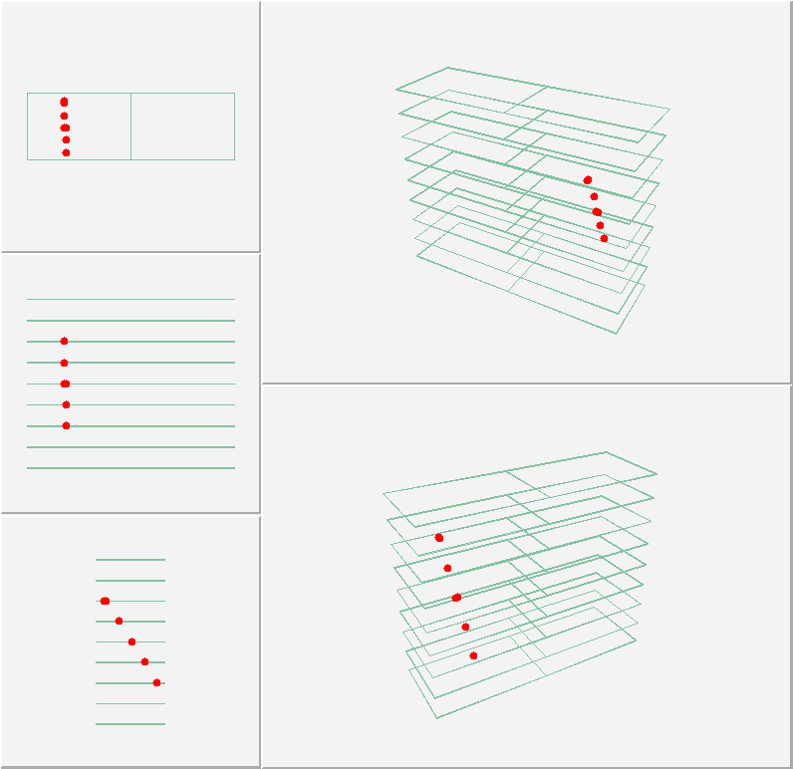
Trigger-less noise data with requirement of hits in > 2 layers
(no other tricks!!!!)
Look for
Noise
Hits
Actual
rate
a factor
~10
faster

