Slide 1



Optical calibration system – recent activities in Prague
DESY tests
Electronics developments
Optical developments
Outlook

Slide 2
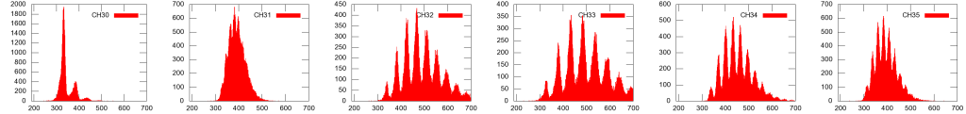
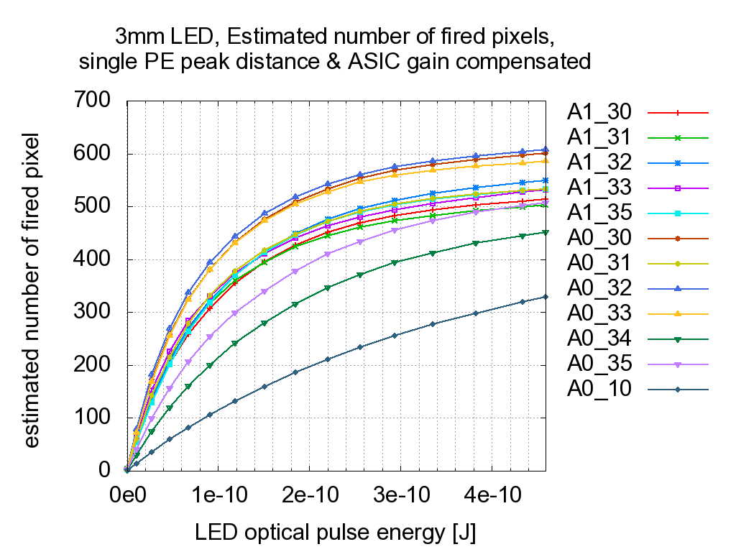
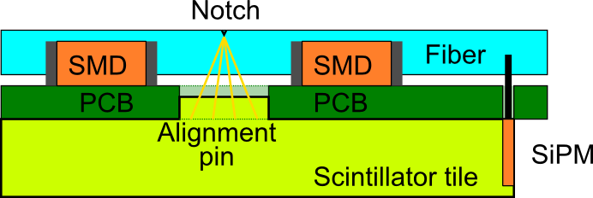
DESY test 1
HBU0 no. 1
ASIC1
Large spread of single_photon_peak distances - SiPM voltage settings?
Amplitude scan in LG, 400fF
  Fired pixels in LG estimated using single photon peaks in HG + HG/LG ratio
  QMB amplitude V1 converted to optical energy output
Notched fibre fixed in balsa frame
QMB6 performance on HBU0
  Single p.e. peaks in HG
  Amplitude scans at LG
  HG vs. LG ratio measurement
saturation
Calibration by notched fibre

Slide 3
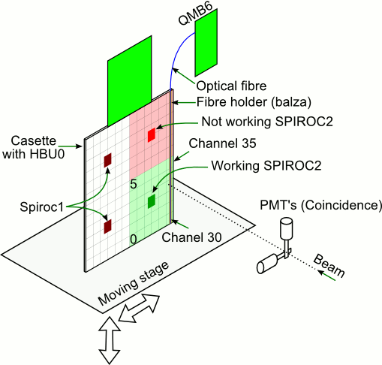
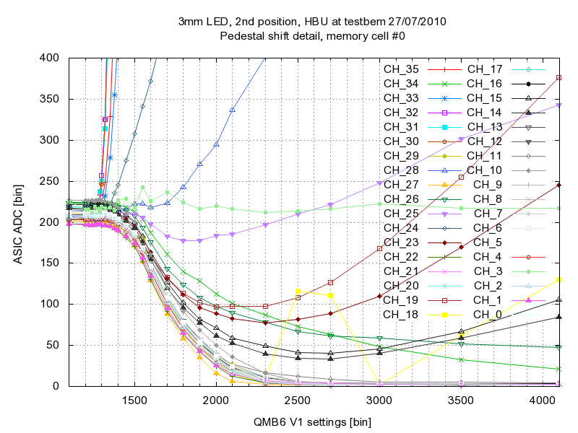
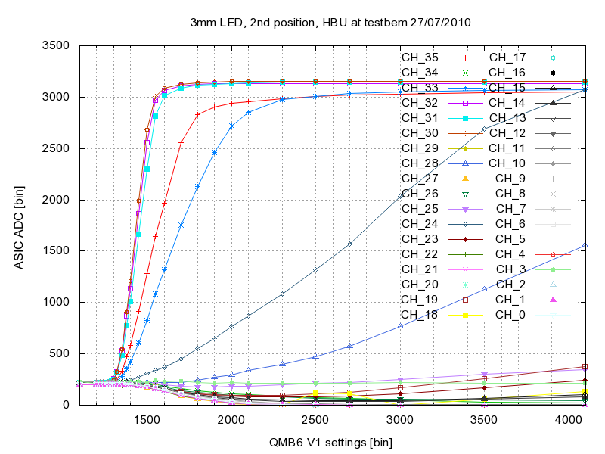
DESY test 2 – in beam
ASIC0 (green) fully working
ASIC1 (red) problems with programming
  trigger: beam or internal DIF trigger
Channels 30..35 were illumined
Measurements:
  MIP signal in High Gain and Low Gain
  Gain in HG and LG using MIP signal
  Scan over various V1 setting of the QMB6
  Pedestal shift for non-illumined
  cells
HBU0 no. 2
optical
crosstalk
ASIC saturation
dead ch
optical
crosstalk?
bad tile
pedestal shift
zoom
ASIC1, cells 30-35 illumined, HG

Slide 4
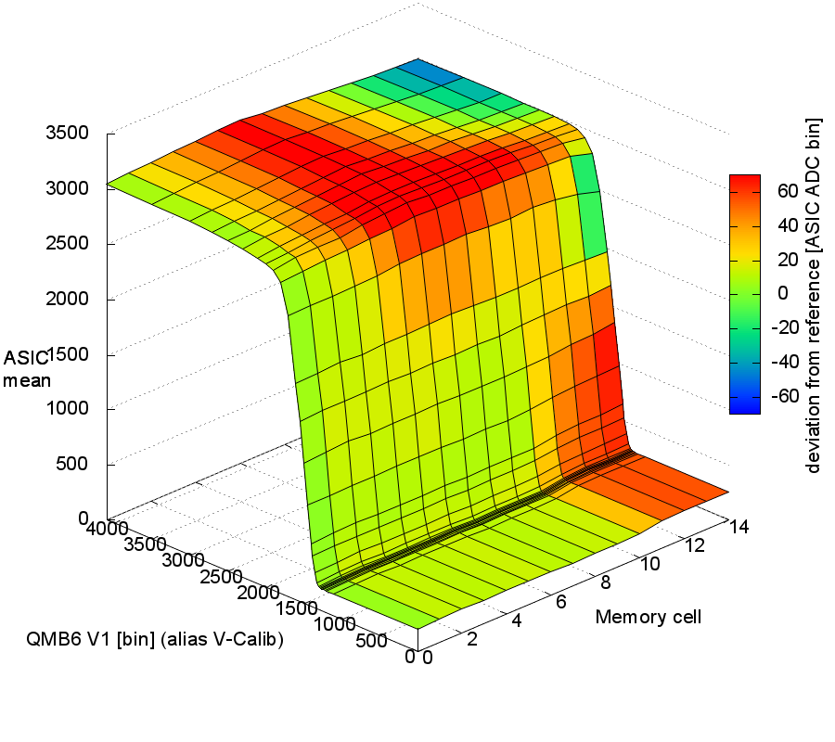
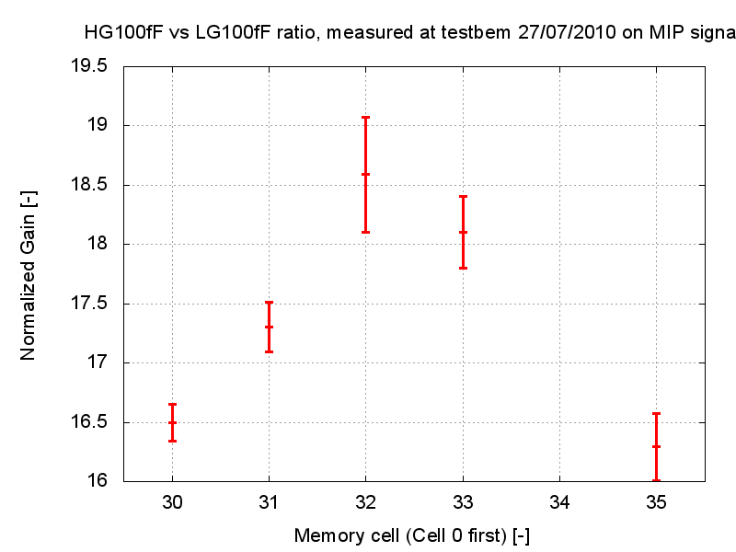
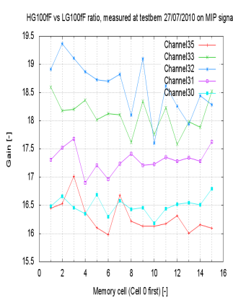
DESY test 2 – preliminary results
ADC
filling time
V1
ASIC channel no.
Analogue memory cells filling 1 ASIC channel – high gain:
  scan over various V1 setting of the QMB6, (0 – 4000)
  ASIC ADC values averaged over a run
  reference value (green) - last filled memory cell
  decrease of pedestal during filling!
Ratio HG/LG – important for calibration
  MIP signal in High Gain and Low Gain
  spread over memory cells
  spread over ASIC channels
  ratio channel dependent and > 10(?)
  Important parameter for energy scale setting

Slide 5
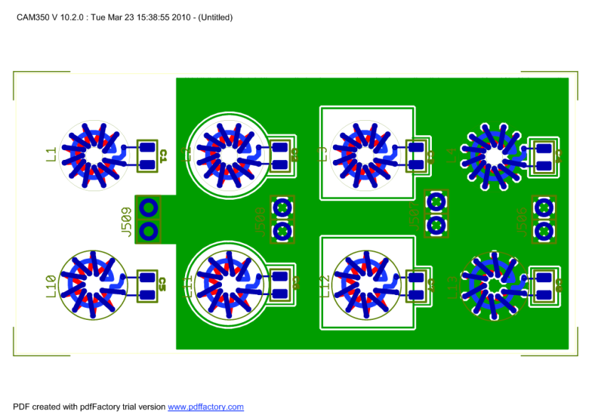
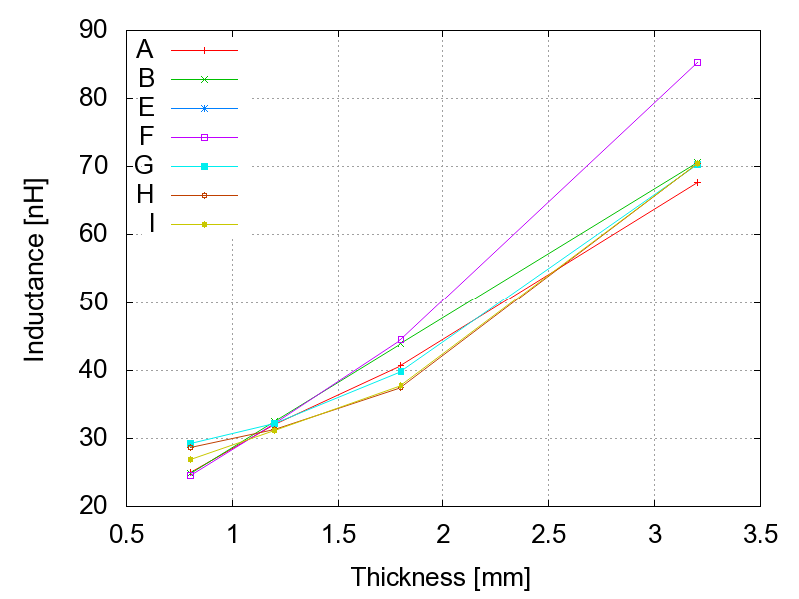
Electronics developments
B
C
D
E
Higher inductance improves linearity behaviour of the of the QRLED driver How to increase L?
    toroid size: 11 and 9 coil turns, and diameter
    thickness of PCB: 0.8, 1.2, 1.8, 3.2 mm
    GND-plane geometry
Inductance L measured via resonance frequency with parallel capacitance C (200 pF)
  accuracy needs improvement
  dominant effect of PCB thickness
  impact of the coil diameter? - still to be tested
Next version of the LED driver – modular based on single channel modules
L
C
GND
G
H
I
J
present QMB6

Slide 6
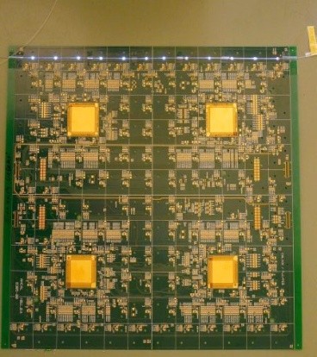
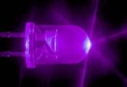
Optical developments
Full length plane = 72 tiles in row
Production of 1 fibre with 72 notches is tedious and expensive
Agreement reached: 3 parallel fibres, each with 24 notches (1 fibre for 2 HBUs)
For final calorimeter we plan to use full length fibre with 72 notches – automation needed
Order placed to SAFIBRA comp.: by the end of 2010 we shall get and test the first set of 3 fibres, beginning of 2011 – 3 more sets will be delivered
2 HBUs = 1 fibre with 24 notches
3 fibres receive light from 1 LED
HBU1
HBU2
HBU3
HBU4
HBU5
HBU6

Slide 7
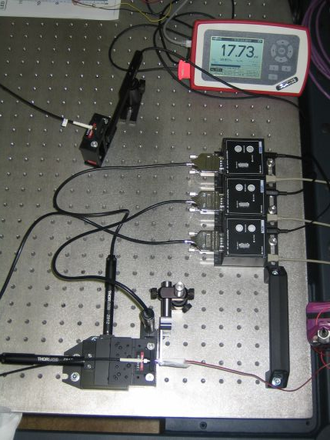
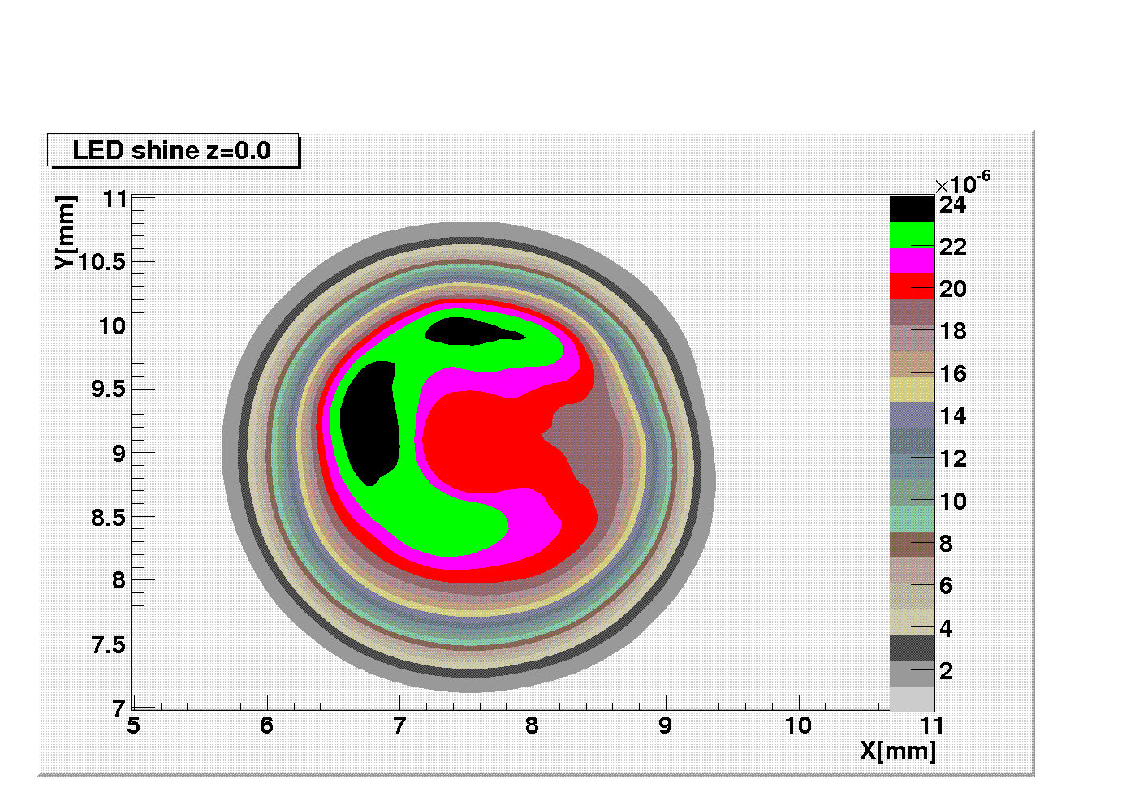
Optical developments 2
fibre
PM100D
sensor
Light intensity – surface 3 mm LED
3D fibre
holder
LED
1 LED for more fibres – distribution of light intensity on the LED surface?
We scanned a 3 mm LED S130VC by the THORLAB set up + PM100D
Light intensity shows asymmetry (chip position) – inhomogeneity ±10%
±15% observed for 5 mm LEDs used in 1m³ HCAL calibration system
Not a problem - inhomegeneity from notched fibres on ±20% level

Slide 8
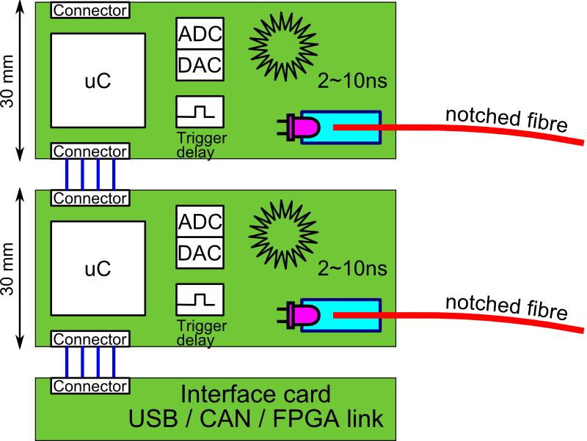
Outlook
Focus: increase of the optical performance:
increase of the pulse width from the current 3.5 ns
Improvement of the optical coupling from LED into the fibre
Improvement of the transmission to the scintillation tile
New QR LED driver prototype envisaged
only 1 electronic channel per board
different onboard inductors for different pulse width in range of 4 ~ 10 ns
3cm PCB width to match the tile size
Notched fibre production (Q4/10-Q1/11)
4 sets by 3 notched fibres each with 24 notches
Thanks to my Prague colleagues
M. Janata, J. Kvasnička, I. Polák, J. Smolík and M. Reinecke, M. Terwort and J. Zálešák for DESY tests support!

