Slide 1
CLIC Energy Stages
D. Schulte for the CLIC team

Slide 2
Current CLIC Energy Stages
Currently have two CLIC parameter sets
optimised and well studied 3TeV
not optimised 500GeV
main linac accelerating structure is not identical
  driven by more conservative emittance target at 500GeV
Considered upgrade from 500GeV to 3TeV
using same structure lengths, RF pulse lengths, drive beam components, …
small glitch is slightly larger structure input power at 500GeV
  should be corrected in next iteration
could re-use 500GeV structure at 3TeV

Slide 3
Current CLIC Energy Stages

Slide 4
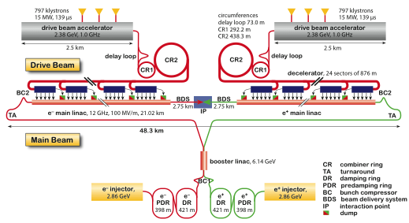
Layout at 3 TeV
Drive Beam Generation Complex
Main Beam Generation Complex

Slide 5
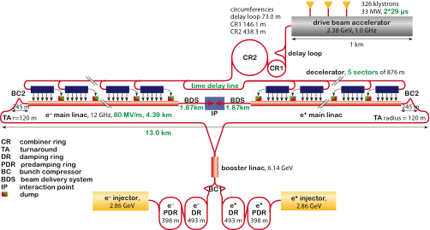
Layout for 500 GeV
Only one DB complex
Shorter main linac
Shorter drive beam pulse
Drive Beam Generation Complex
797 klystrons
15 MW, 2x29µs=58µs
2.5 km
Drive beam
Main beam
Main Beam Generation Complex

Slide 6
Energy Stages Strategy
CLIC has focused on demonstration of 3TeV, only indicative 500GeV
Need to have a real strategy
solid physics case, cost and schedule for each stage
optimise machine for different requirements at different energies
experience will help to improve following stages
Require input from physics
will have to wait
Prepare an example staging
low energy machine for Higgs, top, …
medium energy for SUSY, triple Higgs, …
high energy for more SUSY, …

Slide 7
Potential CLIC Staged Parameters
First stage ML structures are re-used

Slide 8
Potential CLIC Staged Parameters
First stage ML structures are not re-used

Slide 9
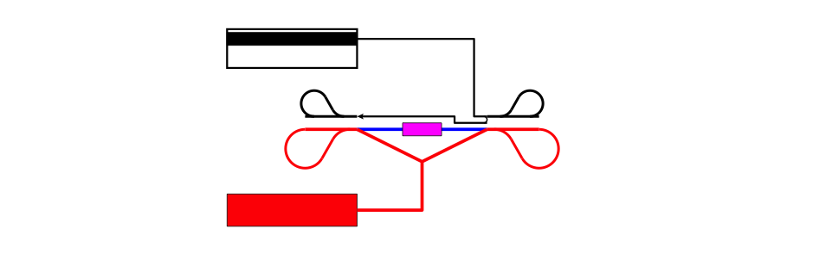

Concept First Stage
Concept! Not to scale

Slide 10

Concept Second Stage

Slide 11
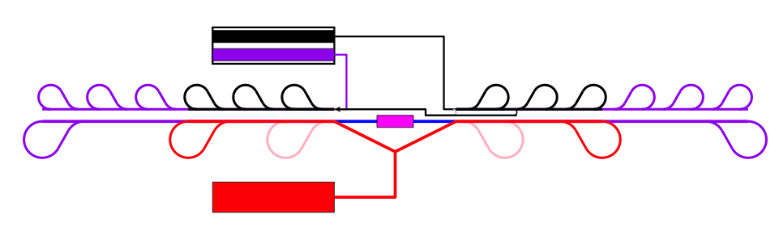
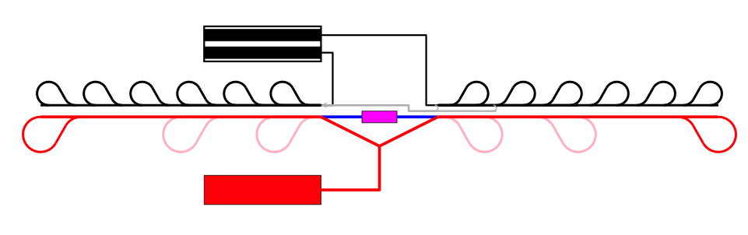
Concept Third Stage

Slide 12
General Construction and installation schedule
Site installation
El. Gen. services
Shaft construction
Piping
Tunnel excavation
Cabling
Tunnel construction
Machine transport
Survey
Machine inst.
Commissioning @ 500GeV
Comm.
Operation at 500 GeV
Comm.
Comm.
Comm.
Comm.
Injectors modification & first sector reinstallation
Comm.
Commissioning @ 3.TeV
Ph. Lebrun, K. Foraz, et al.

Slide 13
Beam Parameters at Other Energies
Preliminary, Indicative Choice
Based on design at energy E_{max} we can easily derive indicative parameters for E<E_{max}
leave injection complex the same
shorten the linac
adjust BDS
Obviously the beam parameters do not change before the BDS
slight changes would yield slightly better performance
correction with O(E^{-1/8}) could be possible
Use the CLIC 3TeV and 500GeV structure to design lower energy versions of CLIC
will optimise later

Slide 14
Potential CLIC Luminosity Above 500GeV
Blue line indicates luminosity that we can achieve with current BDS design

Slide 15
Potential CLIC Parameters Based on 3TeV
B. Dalena, D.S.

Slide 16
Potential CLIC Parameters Based on 500GeV

Slide 17
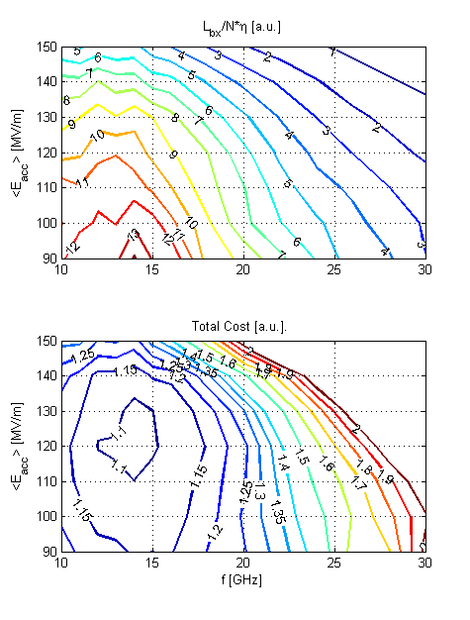
Reminder: 3TeV Parameter Optimisation
Optimisation 1
  Luminosity per linac input power
Optimisation 2
  3TeV total project cost
A.Grudiev, W. Wuensch, H. Braun, D.S.

Slide 18
Issues for Energy Stages
Consolidate the current cost/power model for 3TeV
e.g. use of permanent magnets reduces power (J. Clarke et al.)
Need to develop a cost/power/energy consumption model for varying energy
Need to review figure of merit
luminosity needs
  so far optimised for maximum energy
  will need (generic) running plan
cost, cost and power/energy consumption, average or maximum power?
cost of initial stage, integrated cost of all stages?

Slide 19
Conclusion
Have design for
3TeV, fully optimised
500GeV, partly optimised
Can stage the two designs
almost complete re-use of components possible
Can derive preliminary designs at lower energies based on the above
Can improve our design
improved cost/power estimates
improved input on requirements from physics
adding intermediate stage
to maximise physics at each stage
to best balance performance vs. cost and power

Slide 20
Reserve

Slide 21
Low Energy Operation

Slide 22
Sub-Stages: CLIC Higgs and Top Stage
Could consist of two installation stages
Build tunnel long enough for top
But install only enough structures for Higgs and run
Then add structures for top
Or only run at the top threshold
more tops but fewer Higgs
impact of missing mass analysis or others for the Higgs?

Slide 23
Luminosity and Parameter Drivers
Can re-write normal luminosity formula
Luminosity
spectrum
Beam Quality
(+bunch length)
Beam current
In the classical limit for beamstrahlung

Slide 24
Luminosity and Parameter Drivers
Main linac structure and design
Beam-beam
Main linac
BDS
RTML
Damping Ring
Damping Ring
BDS
(RTML)
Full optimisation done, but experience shows parameters are determined as shown

Slide 25
Parameter and Structure Choice
Potential structures designs
Beam physics constraints
RF limitations
Parameter set
Physics requirements
Structure chosen to work for beam physics
Will tell the story as if we had a structure given
Cost model
Design choice

Slide 26
Potential CLIC Staged Parameters

Slide 27
Corresponding Background
Background will go down
significantly
In particular coherent pairs
n_{γ} number of photons per beam particle
N_{had} number of hadronic events with W_{γγ>5GeV}
N_{coh} Number of coherent pairs, next slide coherent pair particles
N_{inc} Number of incoherent pair particles

