Slide 1
Testing the Higgs model with triplet fields at the ILC
Kei YAGYU (Univ. of Toyama)
S. Kanemura, KY, K. Yanase, Physical Review D 83 (2011)
27, September 2011 LCWS at Granada
Notes:
This work is based on the collaboration with Shinya Kanemura, Kazuya Yanase and Mariko Kikuchi.
And this talk is based on this published paper and this preparation work.

Slide 2
Contents
Introduction
Higgs models with triplet fields
- Rho parameter constraint
- Theoretical property of the H±W∓Z vertex
- Measuring H±W∓Z vertex at the ILC
Simulation results
Summary
Notes:
This is the flow of my talk.
As a introduction we discuss about the extended Higgs sectors which are contained
Higgs triplet fields.
Next, I talk about the theoretical prediction of the rho parameter and HWZ vertex.
Especially, in my talk, we focus on the HWZ vertex and its feasibility of measuring at the ILC.
Thirdly, we show its parton level simulation results. .
Finally I will summarize my talk.

Slide 3
Introduction
・ Higgs sector is unknown
- Minimal ? or Non minimal ?
- Higgs boson search is starting at LHC
・Some new physics models predict extended Higgs models
Neutrino mass
Hierarchy problem
Baryon asymmetry
of Universe
Dark matter
New physics at TeV scale
Prediction
Determination NP models
Extended Higgs models as a low energy effective theory
Two Higgs doublets
Higgs triplet
etc.
Notes:
The Higgs sector is unknown.
The structure of the Higgs sector may not necessarily be the minimal form as the SM.
There are various possibility for non-minimal Higgs sectors.
The Higgs boson search is starting at the CERN LHC and recently a lot of
Results appear about the Higgs boson.mass constraints.
On the other hand, there are some problems which cannot explain within the SM flamework
For instance, Hierarchy problem, neutrino mass, existence of DM and BAU.
Then NP models are considered to solve these problems.
Some NP models predict extended Higgs sector as a low energy effective theory, for example 2HD, triplet
Higgs models and so on.
Therefore, studying the extended Higgs models determine the direction of NP.

Slide 4
Higgs triplet fields
・ Introduced in various new physics models
- Type-II seesaw model
- Left-right symmetric model
Cheng, Lee, PRD22 (1980), Schechter, Valle, PRD22 (1980)
Pati, Salam, PRD10 (1974), Mohapatra, Pati, PRD11 (1975), Senjanovic, Mohapatra, PRD12 (1975)
・ Higgs sectors with triplet fields
- Φ＋η
- Φ＋Δ
- Φ＋η＋Δ etc.
Isospin doublet
Isospin triplet
η = (η⁺, η⁰, η⁻), Y = 0
Δ = (Δ⁺⁺, Δ⁺, Δ⁰), Y = 1
Φ = (φ⁺, φ⁰), Y = 1/2
・ Feature of Higgs models with triplet fields
- Singly- (doubly-) charged Higgs bosons: H⁺ , (H⁺⁺ ) appear.
- Rho parameter deviates from unity at the tree level.
- Exotic vertices, e.g., H±W∓Z appear at the tree level.
Relating to
triplet VEV(s)
predict
New physics
Models
Higgs triplet
VEV
ρ_{tree} ≠ 1
Exotic vertex: e.g., H±W∓Z
Constrain or
Determine
Measuring at LHC, ILC
Notes:
In this talk, we concentrate on Higgs triplet fields.
Higgs triplet fields are introduced in various new physics models,
for example, type-II seesaw model, Left-Right symmetric model and so on.
There are variations Higgs sector with triplet fields like these,
Where Phi is the Higgs doublet field, eta is the real triplet field and Δ is the complex triplet field.
In the Higgs triplet models, there are some exotic features.
Singly-charged Higgs and (its depending on the hypercharge of triplet fields) doubly-charged Higgs appear.
Rho parameter deviate from unity at the tree level.
And Exotic vertex for instance, HWZ vertex appear at the tree level.
These two features are relating to triplet VEV.
Concluding this slide, firstly, model with Higgs triplet fields
Are introduced in the BSMs.
Next, non-zero value of Higgs triplet VEV predicts some exotic phenomena like this.
Therefore, at the LHC and the ILC, precise measurement of these observables
Can be constrained or determined Higgs triplet VEV.
And finally we can test the NP models.

Slide 5
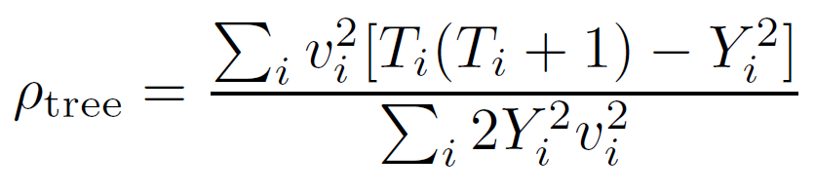
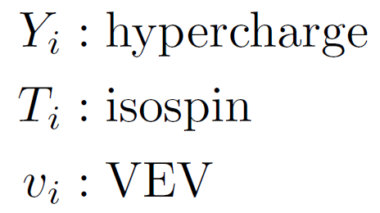
Constraint from the rho parameter
ρ_{exp} ~ 1
Experimental value of rho parameter is quite close to unity:
Theoretical prediction of rho parameter strongly depends on structure of Higgs sectors.
・ Multi-doublet models
→ Custodial SU(2) symmetry exists in the Higgs sector.
→ ρ_{tree} = 1 is predicted.
★ Rho parameter deviates from unity at the 1-loop level.
・ Models with Higgs triplets
→ Custodial SU(2) symmetry is broken in the Higgs sector.
→ ρ_{tree} ≠ 1 is predicted.
1. Triplet VEV is small compared with doublet VEV.
2. Imposing alignment among triplet VEVs, custodial SU(2) symmetry is restored.
Triplet VEV is constrained from rho parameter
Notes:
When we consider extended Higgs models,
The rho parameter is the most important observable to determine
the structure of the Higgs sector.
Experimental value of the rho parameter is quite close to unity.
Theoretical prediction of the rho parameter strongly depends on structure of Higgs sectors.
This is the tree-level expression for the rho parameter,
where Y is hypercharge, T is isospin and v is VEV.
We can classify extended Higgs models to multi-doublet models and models with
Higgs triplets.
In the case of multi-doublet models, custodial SU(2) symmetry exists in the kinetic term of Higgs fields.
Then the tree level rho parameter equals unity is predicted.
Rho parameter deviates from unity at the one loop level.
On the other hand, in models with Higgs triplets,
Custodial SU(2) symmetry is broken in the kinetic terms,
So that tree level rho parameter deviate from unity.
Of course, this is contradicted from experiment, however
There are two ways to avoid this contradiction.
One; assuming that triplet VEV is small compared with doublet VEV.
Two; Imposing alignment among triplet VEVs, custodial SU(2) symmetry is restored.
Any way triplet VEV is constrained from the rho parameter.

Slide 6
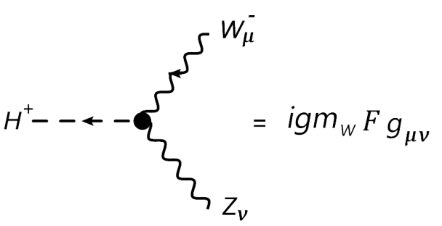
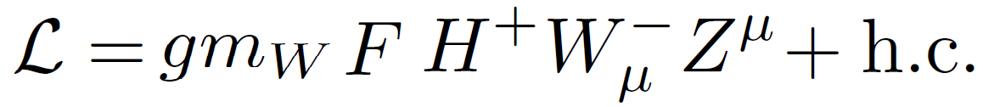
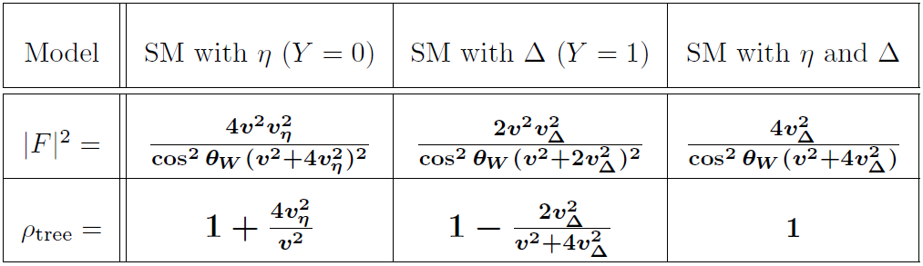


H±W∓Z vertex
Tree level formula
・Multi-doublet models → F = 0 at the tree level, it appers at the 1-loop level.
・Models with triplets: η (I = 1, Y = 0), Δ (I = 1, Y = +1)
In general, |F|² and ρ are independent quantities. Measuring H±W∓Z vertex can be a complementary tool to the ρ to test triplet Higgs models.
Notes:
Next, we discuss about the HWZ vertex.
The magnitude of this vertex can be expressed in terms of the form factor F.
Tree-level formula of |F|^2 can be written as this.
In the case of multi-doublet models, F=0 is predicted at the tree level, it appears at the 1-loop level.
In the case of models with triplet fields, |F|^2 and tree level rho parameter can be expressed in this table,
Where v_delta and v_eta are each triplet VEVs.
In these two models, both |F|^2 and rho tree are proportional to the VEV.
While in the model with real triplet and complex triplet under this vacuum alignment,
Tree level rho parameter is unity and |F|^2 is expressed like this.
Therefore, in this model |F|^2 is not constrained by rho parameter.
The important point is that in general, |F|^2 and rho parameter are independent quantities,
So that measuring HWZ vertex can be a complementary tool to the rho parameter to test triplet Higgs models.

Slide 7
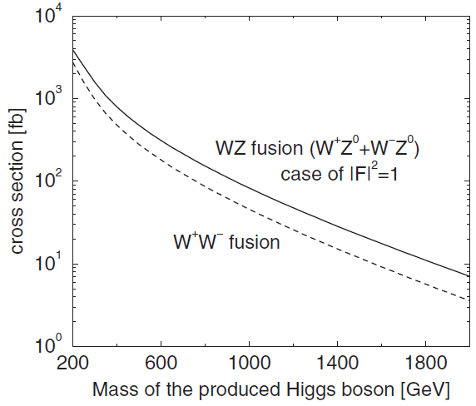
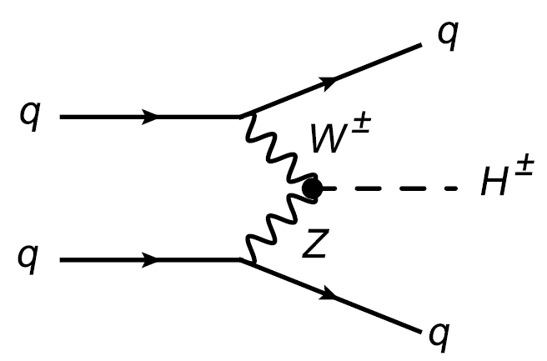
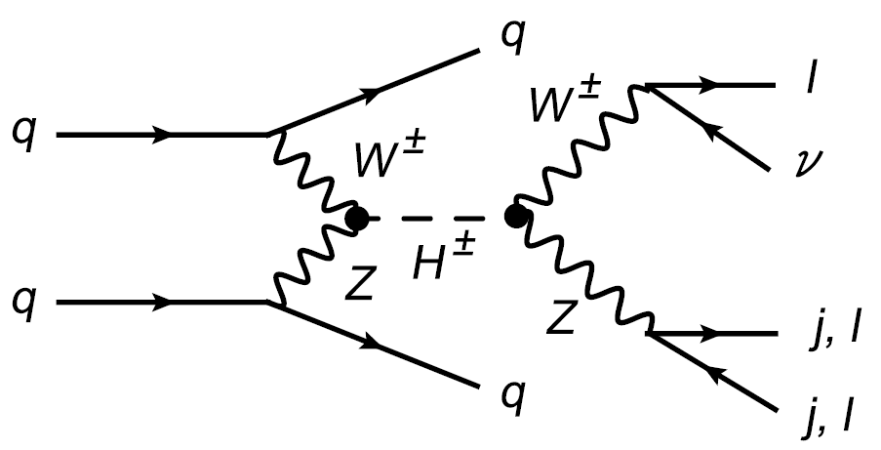
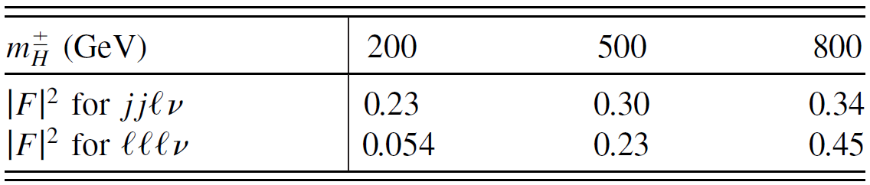
Measurement of H±W∓Z vertex at the LHC
Asakawa, Kanemura, Kanzaki, PRD 75 (2007)
WZ fusion process
H± → W±Z → lνjj, lllν
Required values of |F|² to reach S/root(B) = 3
The vertex can be measured, if m_{H+} ~ 200 GeV and |F|² > 10⁻².
Notes:
Let us discuss about the feasibility of the HWZ vertex at the collider experiments. First we discuss its measurement at the LHC. The detector level simulation is performed in this paper.
At the LHC, charged Higgs boson is produced via the WZ fusion and the produced charged Higgs boson decay into W and Z.
In this table the required values of the |F|^2 to reach S/root(B) to 3 are listed.
As we can see the table, the vertex can be measured if mass of the charged Higgs boson
Is around 200 GeV and |F|^2 > 10 to the minus 2.
To measure the vertex more precisely, we need to go to the ILC.

Slide 8
Measurement of H±W∓Z vertex at the LHC
Asakawa, Kanemura, Kanzaki, PRD 75 (2007)
WZ fusion process
H± → W±Z → lνjj, lllν
Required value of |F|² to reach S/root(B) = 3
To measure the vertex more precisely → We need to go to the ILC.

Slide 9
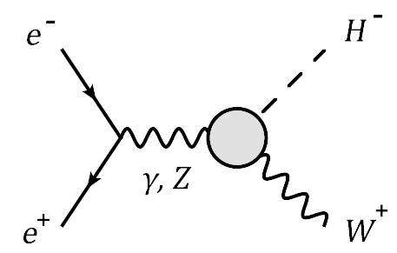
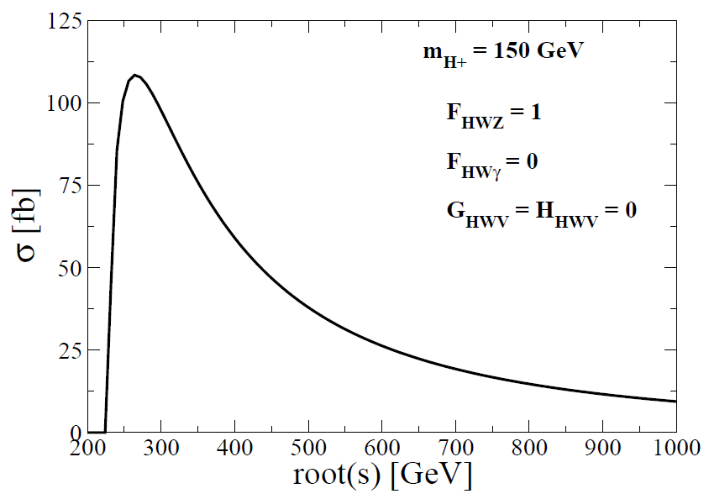
Measurement of H±W∓Z vertex at the ILC
・We focus on the process e⁺e⁻ → H⁻W^{+ .}
・This process contains the information of H±W∓Z vertex directly.
Cross section of e⁺e⁻ → H⁻W⁺
m_{H+} = 150 GeV
|F|² = 1
Z
Notes:
We discuss about the possibility of measuring the H±W∓Z vertex at the ILC.
We focus on the process e⁺e⁻ → H⁻W⁺ .
This process contains the information of HWZ vertex directly.
This figure shows that the cross section for this process as a function of the root(s)
in the case of the mH = 150 GeV and |F|^2 = 1.
As you can see, the cross section becomes maximum ,that is 100 fb, near the threshold of this process.

Slide 10
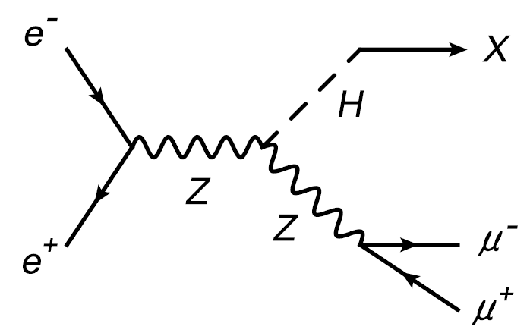
Reconstruction of the SM Higgs boson mass by the recoil method.
Advantages of ILC
1. Information of the collision energy
2. Beam polarization
3. Less QCD background
root(s)
E_{di-lepton}, m_{di-lepton}
By using the information of the initial energy and the di-lepton system,
the recoil mass can be constructed as:
Notes:
Before discuss about the feasibility of the HWZ vertex,
I would like to talk about the reconstruction of the SM Higgs boson
By the recoil method.
The SM Higgs boson is produced through the Z boson strarlung process
at the ILC.
And there are some advantages of ILC.
The most important advantage is that
we can use the information of the collision energy.
By using the information of the initial energy root(s),
Di-lepton invariant mass and di-lepton energy from the produced Z boson
The recoil mass of the Higgs boson can be constructed as

Slide 11
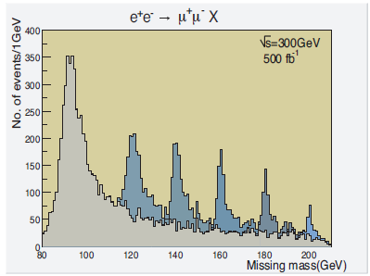
Recoil mass distribution
Background
m_{H} = 120 GeV
140 GeV
160 GeV
180 GeV
200 GeV
ILC technical design report
Without using information of the Higgs boson decay, It can be possible to determine the Higgs boson mass and HZZ vertex.
Notes:
This figure shows the recoiled Higgs boson mass distribution.
This peak comes from background and the other peaks come from the signal for each Higgs boson mass,
respectively.
From this simulation,
Without using information of the Higgs boson decay, It may be possible to determine the Higgs boson mass and HZZ vertex.

Slide 12
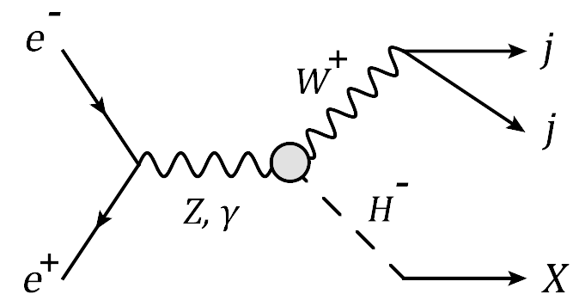


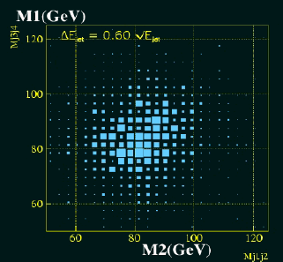
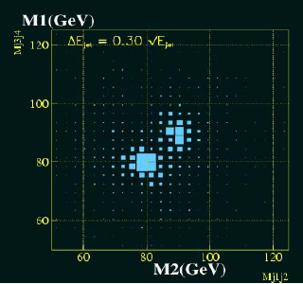
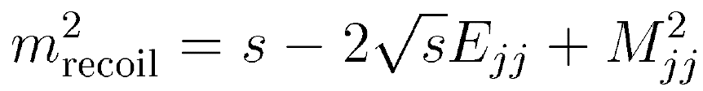
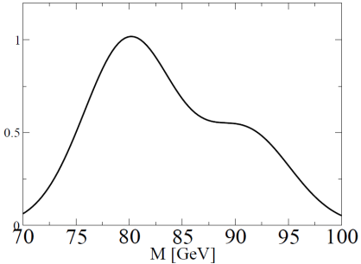
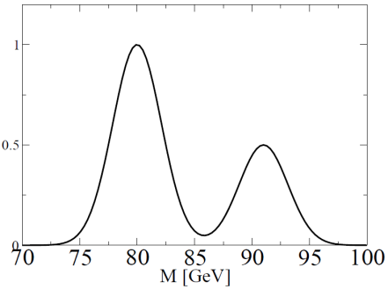
Application of the recoil method to e⁺e⁻ → H⁻W⁺
We consider that can be applied the recoil method to H±.
Detector resolution
LEP-II
ILC
Z
Produced W boson decays into di-jet.
Talk by H. Yamamoto
Detector resolution for the di-jet system
becomes important.
Two jets from W or Z may be distinguished at the ILC
Notes:
From now on, we discuss the feasibility of the HWZ vertex by using the recoil method.
We consider that can be applied the recoil method to H± case ?
The different point from the case of SM Higgs boson recoil is that we have to use the 2-jet information
Instead of lepton pair.
In this case recoiled charged Higgs boson mass is expressed in terms of the
Root(s), 2-jet invariant mass and 2-jet energy as this equation.
So, detector resolution for the di-jets system becomes important.
These figures show the 2-jet signal from W and Z boson at the LEP-II and at the ILC. .
It is clear that at the ILC detector, two jets from W or Z can be separated with the expected detector performance.

Slide 13
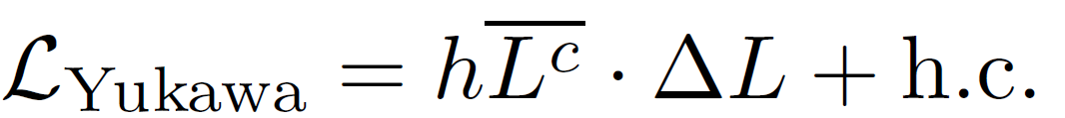
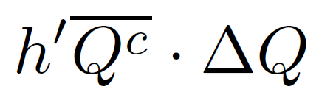

Lepton specific charged Higgs boson scenario
SU(2) triplet (Y = 1) : Δ
Forbidden by U(1)_{Y} gauge invariance.
H± from triplet field decays into lepton pair or W±Z.
If H± is lighter than m_{W} + m_{Z} , H± decays into lepton specific.
In this talk, we assume that charged Higgs boson decays into lepton specific.
Notes:
Here we comment on the lepton specific charged Higgs boson scenario.
In the model with SU(2) triplet field with hypercharge Y = 1 Δ,
The triplet Higgs can only couple to lepton through this Yukawa interaction.
Coupling between triplet Higgs and quark is forbidden by U(1) hypercharge gauge invariance.
So that H± from the triplet Higgs models decay into lepton pair or WZ.
In addition, If H± is lighter than m_{W} + m_{Z}, H± decay into lepton specific.
Here after we assume the lepton specific scenario and consider the lνjj final state as the signal.

Slide 14
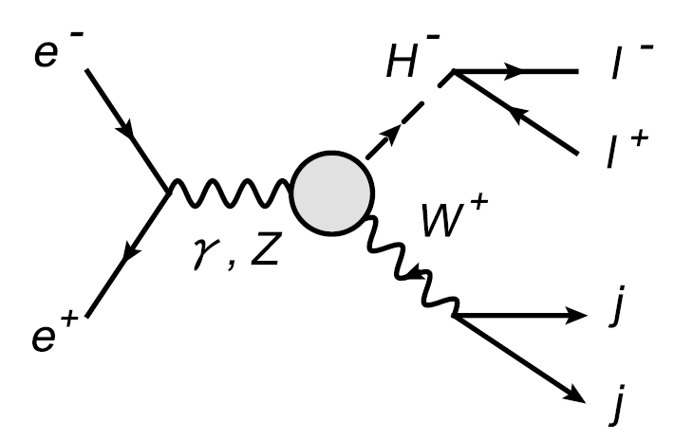
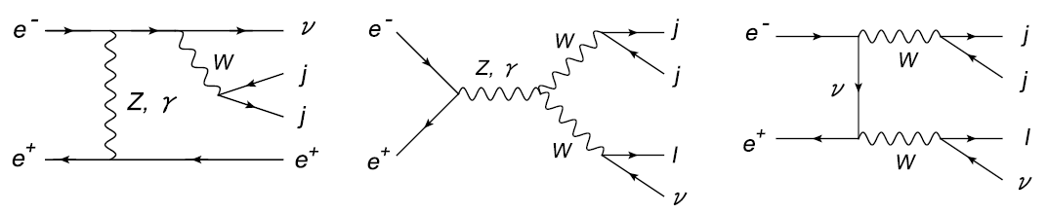
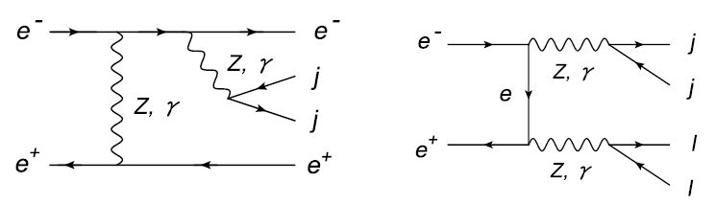
Signal and background analysis
lνjj
ν
Z
lljj
SIGNAL
BACKGROUD
Basic cut : 10º < A_{j} < 170º, 5º < A_{jj} < 175º, E_{jj} > 10 GeV
Invariant mass cut : m_{W} – 2σ_{E} < M_{jj} < m_{W} – 2σ_{E}
σ_{E} = 3 GeV
Beam polarization ： Electron beam → 80% right-handed, Positron beam → 50% left-handed
 | Basic cut | M_{jj} cut
SIGNAL | 0.15 fb | 0.14 fb
lνjj B.G. | 820 fb | 720 fb
lljj B.G. | 330 fb | 5.2 fb
S/root(B) | 0.14 | 0.16
root(s) = 300 GeV
m_{H+} = 150 GeV
|F|² = 10⁻³
Int. luminosity = 1 ab⁻¹
Additional kinematic cuts are necessary to reduce lνjj background.
Notes:
In the lepton specific charged Higgs boson scenario,
The final state of the signal is lnjj.
Then there are two types of the corresponding BG processes.
One is lnjj background and
The other is lljj BG.
Lljj events can be BGs if one of the outgoing charged lepton escapes from the detector.
Firstly, we impose following the kinematical cuts.
This is the basic cuts.
And Invariant mass cut is imposed around W boson mass plus minus 6 GeV.
By the invariant mass cut, lljj background can be reduced significantly, since jj comes from Z boson.
And we use the polarization for electron and positron beam.
(For the electron beam, 80% dominantly polarized RH,
For the positron beam, 50% dominantly polarized LH.)
By the polarized beam, t-channel WW pair production background can be reduced.
This table show the signal and BG cross sections for each step of the kinematical cuts in this parameter sets.
After imposing the invariant mass cut, S/root(B) becomes 0.16.
Therefore, additional kinematic cuts are necessary to reduce lnjj BG.

Slide 15
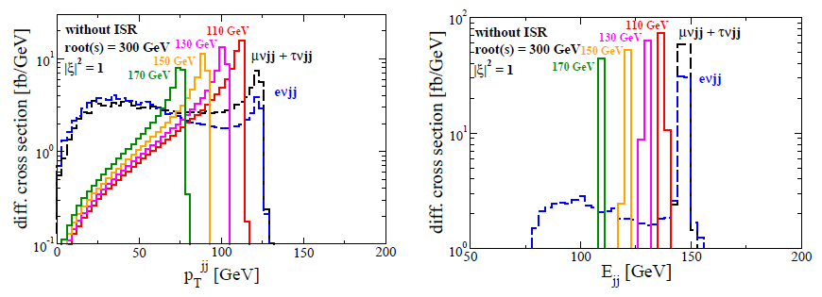
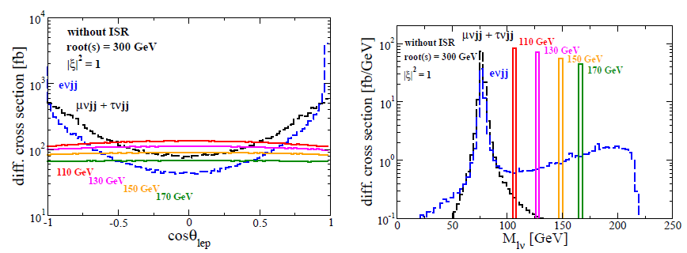
Various distributions
Kanemura, Yagyu, Yanase PRD83 (2011)
|F|² = 1
|F|² = 1
|F|² = 1
|F|² = 1
Notes:
These figures show the various distribution after imposing the Mjj cut, 2-jets transverse momentum, 2-jets energy,
Charged lepton angle with beam axis and charged lepton and missing momentum inv. Mass.
4-solid lines are the signal distribution for each charged Higgs boson mass,
and blue dashed line is the enjj background distribution,
and the black dashed line is mu nu jj + tau nu jj background distribution.
If charged Higgs boson is already discovered at the LHC and ILC and the mass is measured some acculacy,
,For instance mH+ is found at 150 GeV,
We take additional kinematic cuts following.

Slide 16
Additional kinematic cuts
Kanemura, Yagyu, Yanase PRD83 (2011)
75 GeV < p_{T}^{ｊｊ} < 100 GeV
115 GeV < E_{jj} < 125 GeV
-0.75 < cosθ_{lep} < 0.75
144 GeV < M_{lν} < 156 GeV

Slide 17
Results
Kanemura, Yagyu, Yanase PRD83 (2011)
root(s) = 300 GeV, m_{H+} = 150 GeV, |F|² = 10⁻³ , Int. luminosity = 1 ab⁻¹
 | M_{jj} cut | p_{T}^{jj} cut | E_{jj} cut | cosθ_{lep} cut | M_{lν} cut
SIGNAL | 0.14 fb | 0.089 fb | 0.089 fb | 0.070 fb | 0.070 fb
lνjj B.G. | 720 fb | 120 fb | 7.4 fb | 1.5 fb | 0.80 fb
lljj B.G. | 5.2 fb | 0.30 fb | 0.025 fb | 0.012 fb | 0.0064 fb
S/root(B) | 0.16 | 0.26 | 1.0 | 1.8 | 2.5
・ Only using 2-jets system： S/root(B) = 1.0
・ In addition to 2-jets system, using charged lepton
and missing momentum system : S/root(B) = 2.5.
The model with H±W∓Z vertex |F|² > 10⁻³ can be excluded at 95% CL.
Notes:
As the result with these parameter sets, the value of the signal over root(B) improve at the each step of the kinematic cus.
If we use the information only from two jet system, we can reach the S/root(B) =1.0.
If we also use the information of charged lepton and missing momentum system in addition to the 2-jet system,
We can reach the S/root(B) to 2.5.
So that after imposing all the kinematic cuts, The model with the HWZ vertex with |F|² > 10⁻³ can be excluded with 95% CL.

Slide 18
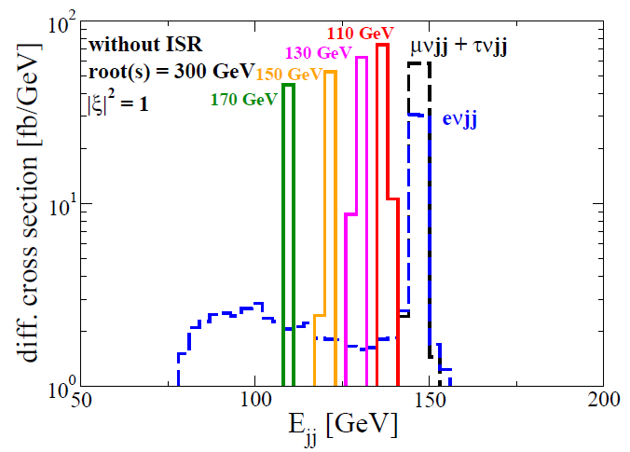
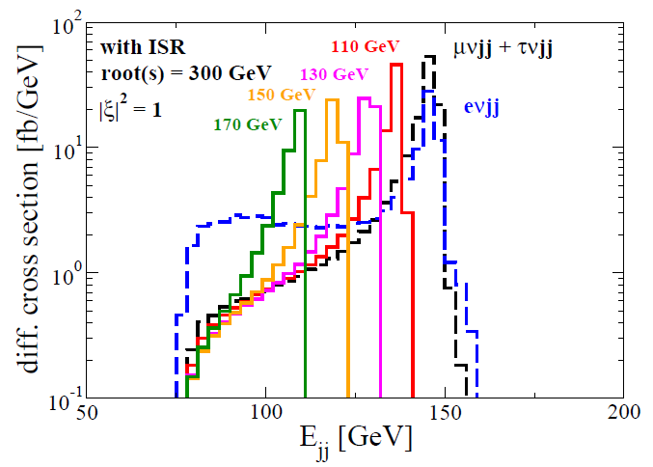
Analysis including Initial State Radiation (ISR)
Without ISR
With ISR
|F|² = 1
|F|² = 1
・The biggest change appears in the E_{jj} distribution.
・ After imposing all the same kinematic cuts, S/root(B) is smeared
from 2.5 to 2.0.
Even including ISR, the model with H±W∓Z vertex |F|² > 10⁻³ still can be excluded at 95% CL .
Notes:
Finally we discuss the case with ISR.
The biggest change can be seen in the E_{jj} distribution.
After all the same kinematic cuts, S/root(B) is smeared from 2.5 to 2.0.
However we emphasize that even in the case with ISR,
the HWZ vertex with |F|² > 10⁻³ still can be excluded with 95% CL.

Slide 19
Summary
・We focus on Higgs models with triplet scalar fields.
・Precise measurement of H±W∓Z vertex becomes important combining the
rho parameter data. These observables constrain triplet Higgs VEV.
・ We discuss the process e⁺e⁻ → H⁺W⁻ → lνjj at the ILC and apply the recoil method.
・ Model with |F|² > 10⁻³ can be excluded with the 95% CL even including the ISR.
It is a similar accuracy to the rho parameter data.
SM ＋ η (Y=0)
SM ＋ Δ (Y = 1)
SM ＋ η + Δ
Rho parameter (95% CL) 6 GeV 8 GeV -
H±W∓Z vertex (LHC) 11 GeV 16 GeV 11 GeV
H±W∓Z vertex (ILC) 3 GeV 4 GeV 3 GeV
・ This study can be applied to the concrete triplet Higgs models
(e.g. the type-II seesaw model) .
Notes:
Let me summarize of my talk.
We focus on Higgs models with triplet scalar fields.
These Higgs models are predicted as a low energy effective theory in the new physics models
Which explain the neutrino masses.
In order to test such kind of Higgs models,
This table shows upper bound of triplet Higgs VEVs of each triplet models
by using the rho parameter data and HWZ vertex constraint at the LHC and the ILC.

Slide 20
Back up slides

Slide 21
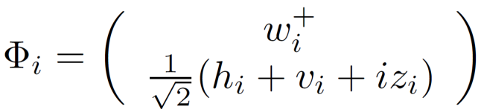
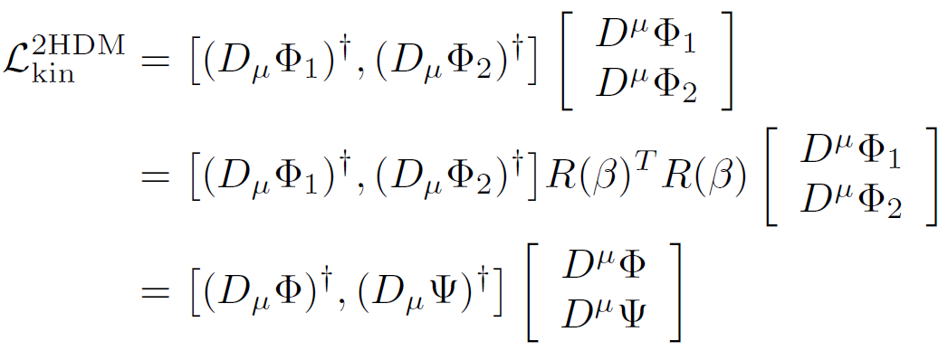
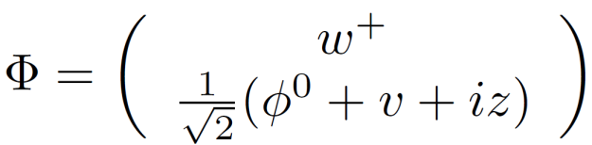
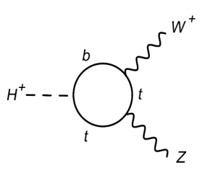
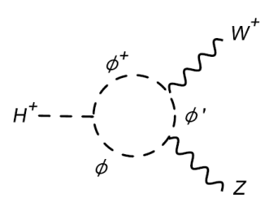
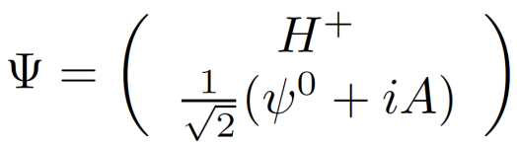
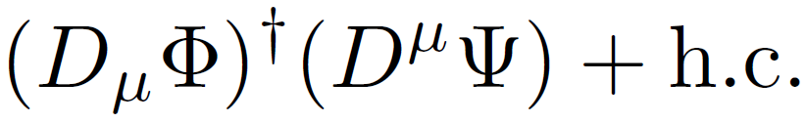
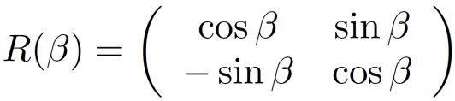
The H±W∓Z vertex (normal models)
Kinetic term (2HDM case)
NG boson
Charged Higgs
H±W∓Z vertex comes from
CP-odd Higgs
W_{μ}
v
Z^{μ}
H⁺
Loop induced
|F|² < 10⁻³
It appears at the loop-level.
In multi-doublet models, H±W∓Z vertex appear at the loop level

Slide 22
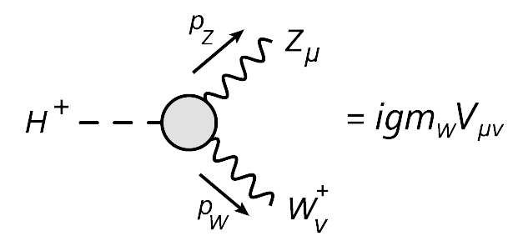
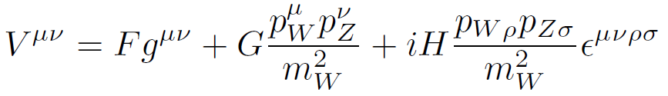


H±W∓Z vertex
Form factors
Effective Lagrangian
Dim. 3
Dim. 5
Dim. 5
Only f_{HWZ} may appear at the tree level. Therefore the form factor F can be a dominant
contribution for H±W ∓ Z vertex.
Notes:
Here we give a brief review of the HWZ vertex.
This is the feynman diagram of the HWZ vertex and it is expressed in terms of the three form factors; F,G and H.
This vertex is related to the eff. Lagrangian which is given by the equation.
This operator is dim. 3 and the other dim. 5, so that
Only f_{HWZ} may appear at the tree level. Therefore the form factor F can be a dominant
contribution for H±W ∓ Z vertex.

Slide 23
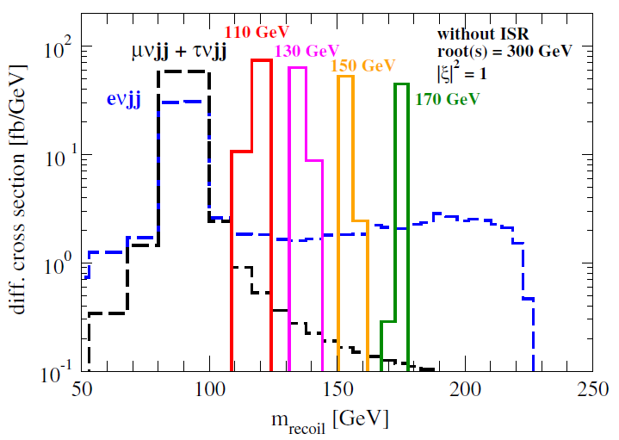
Recoil mass distribution

Slide 24
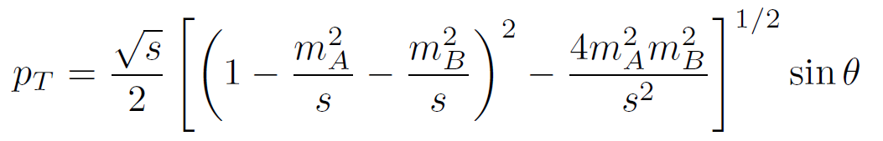
Transverse momentum
y
x
A
p_{T}
θ
e⁺
e⁻
z
B
-p_{T}
m_{A} = m_{jj} = m_{W} ~ 80 GeV
m_{B} = m_{H+} = 150 GeV
Root(s) = 300 GeV
p_{T} < 94 GeV

Slide 25
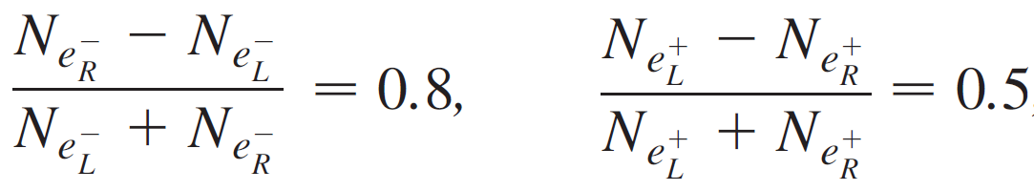

Slide 26
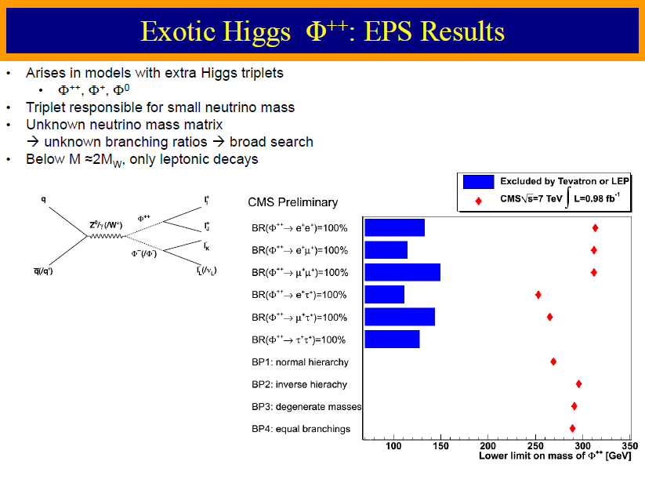
V. Sharma, Lepton Photon 2011

