Slide 1
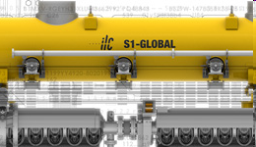
Part 1: 5 K Shield Studies
Norihito Ohuchi – KEK
(presented by P. Pierini - INFN)

Slide 2
Objective
Towards industrialization: Explore the feasibility and consequences of removing the inner 5 K shield of the cryomodules
  a possible cost reduction measure
    some decrease in fabrication costs
    possible simplifications of the assembly operations
Concept tested at KEK on STF 6 m cryomodule
  heat load measurements w & w/o shield

Slide 3
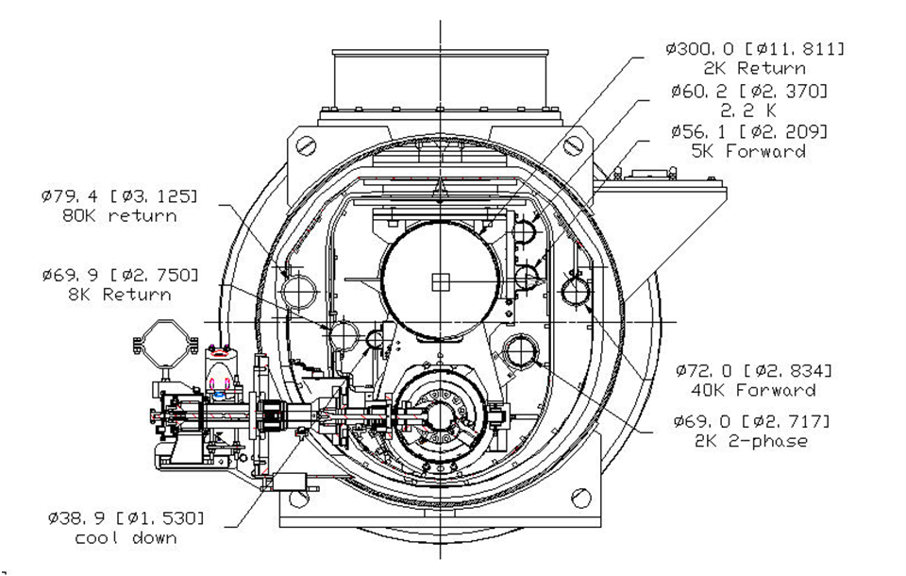
Type III TTF Module (STF variant)
Inner “5-8 K” shield
[radiation to 2 K is negligible]
“40-80 K” shield

Slide 4
5 K shield elimination
Both shields also provide surface for thermalization of direct conduction path for penetrations to the 2 K environment
A “5 K” circuit is needed for thermalization
  coupler, HOM, current leads, RF cables…
Complete elimination not feasible, therefore evaluation of a possibly simplification
  retaining top part and removing lower part
  a revised cooling scheme needed to decrease radiation to 2 K

Slide 5
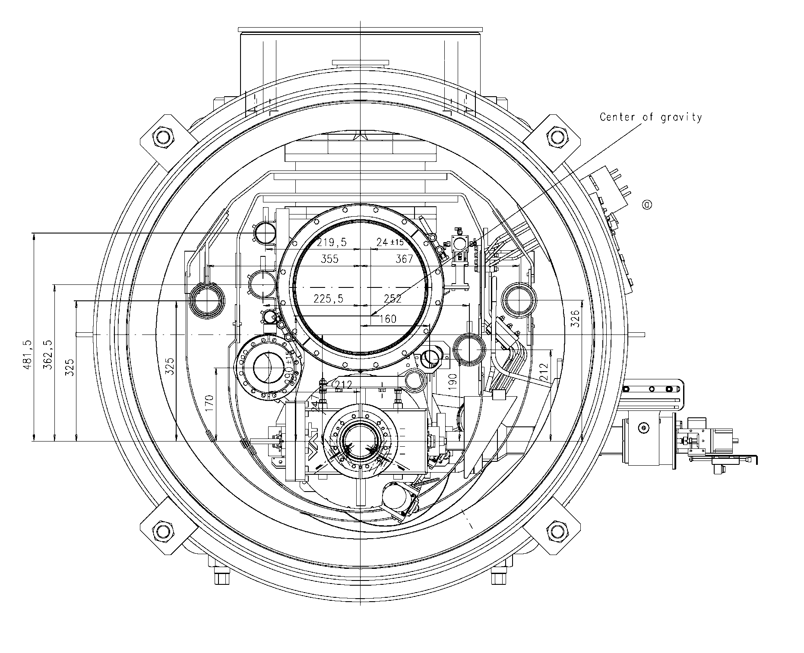
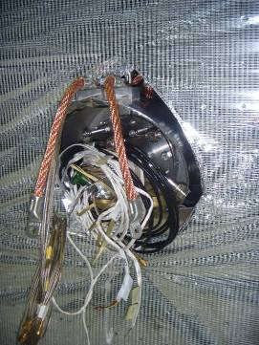
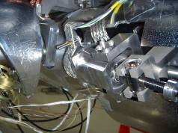
5 K thermal anchors with shield
shield proves to be a
convenient surface for
the use of short / cheap braids

Slide 6
Removal of bottom shield parts
Only top part left
“40-80 K” shield

Slide 7
Heat load measurement
Heat loads were measured at KEK with and without bottom shield parts to support and validate heat load estimation obtained by FEM models
  Assess differences in heat loads to 2 K level in the two conditions
  Also allows to derive emissivity coefficients from the measurements in order to devise a revised cooling scheme, to assess the possibility to remove portions of the 5 K shield

Slide 8
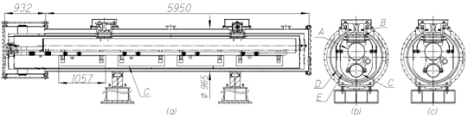
Test Cryomodule in STF
Two configurations: with and without shields
  cavities have been replaced by SS dummy vessels, with no main and HOM couplers
    Instrumented with T sensors
    Integral heat load by evaporated He flow
Dummy Vessels

Slide 9
Measurements of 2 K load
Performed measurements with different static load conditions (varying LHe level)
  Removal of bottom shield leads to an increase of 0.78-0.80 W
5 K shield condition | Temp. LHe, K | T 5K shield, K | T 80K shield, K | LHe Evaporation g/s | Heat load, W
Full 5 K shield | 1.93 | 4.82 | 84.5 | 0.132 | 3.07
Without 5 K lower shield | 1.96 | 4.51 | 84.2 | 0.167 | 3.85
Full 5 K shield | 1.93 | 4.81 | 84.9 | 0.048 | 1.11
Without 5 K lower shield | 1.96 | 4.51 | 84.0 | 0.083 | 1.91

Slide 10
Measurements of shield loads
Stopping coolant flow (in each circuit independently) and measuring T rise of the thermal shields
  From the enthaply increase the average total heat load is derived
    5 K: 2.8 W
    80 K: 35.5 W
  Conductive heat load from the posts and sensor wires is then subtracted to derive radiation load
    5 K: 0.58 W (0.04 W/m²)
      Literature: 0.05-0.1 W/m²
    80 K: 25.1 W (1.5 W/m²)
      Literature: 0.5-1.2 W/m²

Slide 11
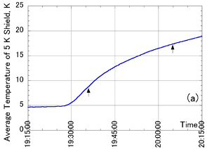
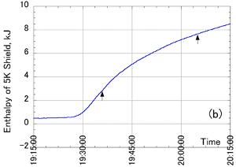
Results
T → H
 | Measured heat load, W | Two support posts, W | Sensor wires, W | Thermal radiation, W
5 K shield | 2.80 | 1.69 | 0.53 | 0.58
80 K shield | 35.5 | 10.42 | 0.007 | 25.1
Conductive loads

Slide 12
ANSYS MLI model
T₁, A₁, ε₁
Measurements allowed the
derivation of ε₂ for the MLI,
in order to feed it into the
ANSYS FE models
T₂, A₂, ε₂
 | SI Layer # | A₁, m² | A₂, m² | T₁, K | T₂, K | ε₁ | ε₂ [effect. emissi.]
5 K shield | 10 | 16.6 | 14.0 | 84 | 5 | 0.06 | 0.022
80 K shield | 30 | 22.3 | 16.6 | 300 | 84 | 0.2 | 0.0036

Slide 13
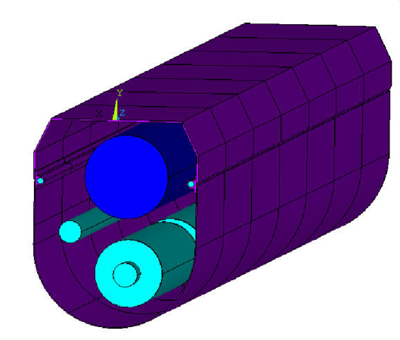
ANSYS 3D Model
Radiation model implemented into ANSYS with the previous values from exp.
  Removal of shield leads to 0.76 W increase
  well matched to measurements (0.78-0.80 W)
 | Vacuum vessel | 80 K shield outer/inner | 5 K shield outer/inner | GRP LHe sup. | Dummy vessel
Temperature, K | 300 | 84 | 5 | 2 | 2
Emissivity | 0.2 | 0.0035/0.06 | 0.02/0.06 | 0.03 | 0.2
Heat load [with 5K shield], W | NA | 27.2 | 0.68 | 0.19E-3 | 0.57E-3
Heat load [w/o 5K low shield], W | NA | 26.7 | 0.74 | 0.20 | 0.76

Slide 14
Alternative cooling scheme
Removing the bottom shield part in the present design leads to an increase of heat losses in the 2 K circuit
An alternative arrangement for the cooling circuit (proposed by TP, see his contribution) allows to avoid this heat load increase

Slide 15
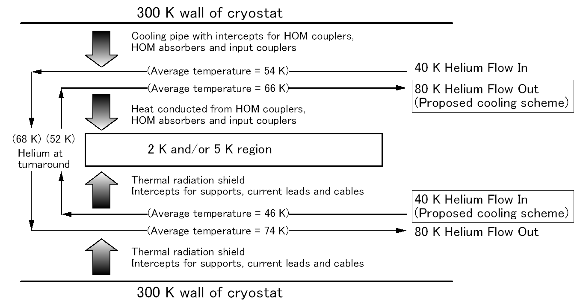
RDR cooling scheme vs. Alternative
Conduction intercepted on input (colder) flow
RDR
Conduction intercepted on output (hotter) flow
Radiation intercepted on input (colder) flow
RDR
Radiation intercepted on output (hotter) flow

Slide 16
Cooling schemes
RDR
  Forward Line (<54 K>)
    conduction load: HOM, HOM abs, input couplers
  Return Line (<74 K>)
    radiation load (pipe welded to the shield), supports, current leads and cables
Alternate (Flow reversal)
  Forward Line (<46 K>)
    radiation load (pipe welded to the shield)
  Return Line (<66 K>)
    conduction load: HOM, HOM abs, input couplers

Slide 17
Adoption of cooling scheme
Static load case
 | Full set of 5 K shield |  |  | Without 5 K lower shield
 | 2 K | 5 K | 40 K | 2 K | 5 K | 40 K
Thermal radiation | < 0.001 | 1.14 | 54.4 | 0.10 | 0.18 | 54.6
Supports | 0.32 | 2.06 | 16.6 | 0.23 | 1.06 | 19.0
Input coupler | 0.26 | 1.29 | 17.6 | 0.26 | 1.60 | 16.8
HOM coupler (cables) | 0.01 | 0.22 | 1.81 | 0.01 | 0.27 | 2.03
HOM absorber | 0.14 | 3.13 | -3.27 | 0.14 | 3.13 | -3.27
Current leads | 0.28 | 0.47 | 4.13 | 0.28 | 0.47 | 4.13
Cables | 0.12 | 1.39 | 2.48 | 0.12 | 1.39 | 2.48
Sum | 1.13 | 9.70 | 93.8 | 1.14 | 8.10 | 95.8

Slide 18
Power consumption kept constant
W_{300K}/W_{2K} = 702.98, W_{300K}/W_{5-8K} = 197.94, W_{300K}/W_{40-80K} = 16.45.
Overall static/dynamic
 | Full set of 5 K shield |  |  | Without 5 K lower shield
 | 2 K | 5 K | 40 K | 2 K | 5 K | 40 K
Static load, W | 1.13 | 9.70 | 93.8 | 1.14 | 8.10 | 95.9
Dynamic load, W | 10.02 | 7.06 | 83.0 | 10.02 | 7.06 | 83.0
Sum (static +dynamic) | 11.15 | 16.76 | 176.8 | 11.16 | 15.16 | 178.9
Work at 300 K, W | 7838.2 | 3317.5 | 2908.4 | 7845.3 | 3000.8 | 2942.9
Sum (2K+5K+40K), W | 14064 |  |  | 13789

Slide 19
TDR scenario, Module
To properly evaluate this cooling scheme the transverse cross section should be rearranged, “flipping” some cold mass components
  cross-section update (see next)
Concerning mere fabrication cost the bottom 5 K shield is very marginal (basically limited to material cost)
  We have to avoid introducing the long bulky braids which were used in the first generation TTF modules, that turned out to be very expensive

Slide 20
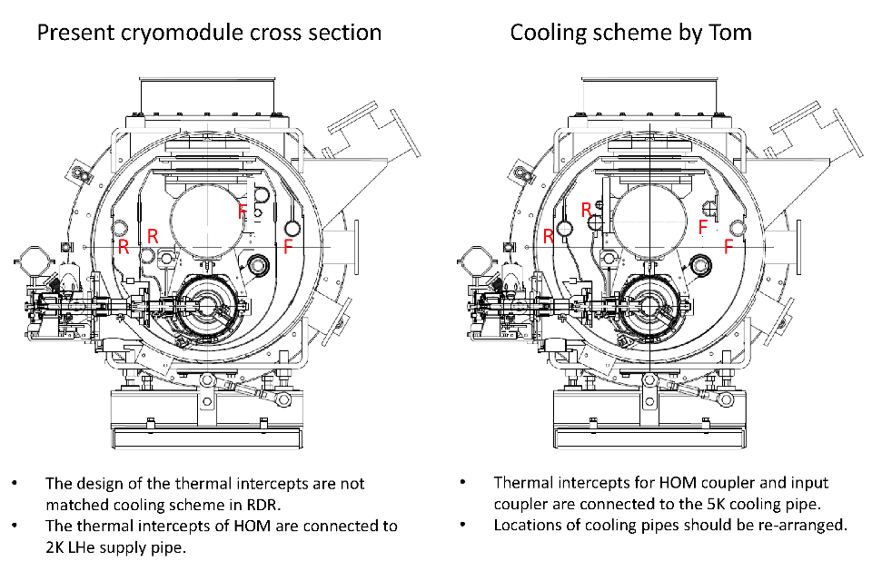
N.O. ILC CM 2011/5/24

Slide 21
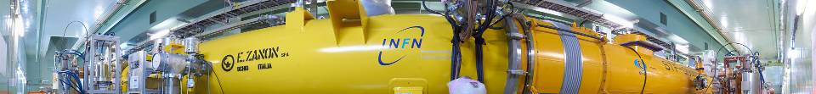
Part 2: S1 Global
Thermal Measurements

Slide 22
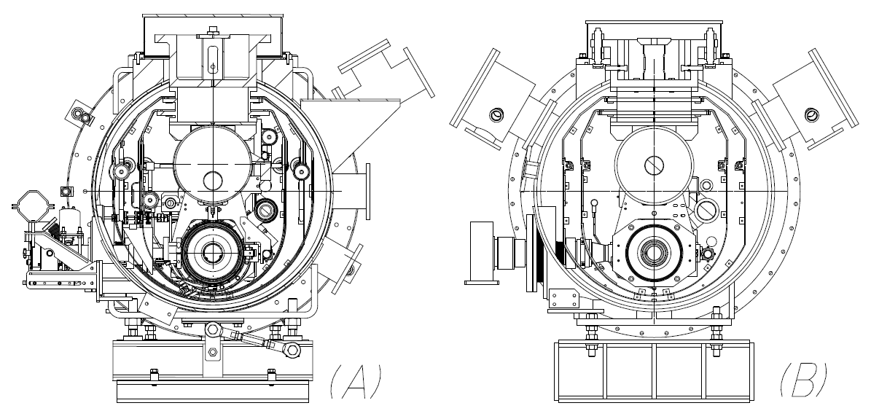
Module C and Module at S1-G
INFN Design (Type III)
KEK Design

Slide 23
 |  | Module-A, [W] | Module-C, [W]
2K | Thermal radiation | ~0.0 | ~0.0
 | 4 input couplers | 0.29 | 0.08
 | HOM RF, Piezo cables | 2.1 | 0.71
 | 4 tuner driving shafts | 0.48 | NA
 | Temp. sensor wires | 0.18 | 0.18
 | WPM, Pin diodes wires | 1.72 | 0.82
 | WPM connection pipe | 0.17 | ~0.0
 | 2 support posts | 0.25 | 0.25
 | Beam pipe | 0.02 | <0.01
 | Total | 5.2 | 2.1
5K | Thermal radiation | 0.66 | 0.68
 | 4 input couplers | 4.00 | 0.92
 | 2 support posts | 1.54 | 1.54
 | Beam pipe | 0.1 | 0.05
 | Sensor wires | 0.9 | 0.9
 | Total | 7.2 | 4.1
80K | Thermal radiation | 16.6 | 15.9
 | 4 input couplers | 9.60 | 7.28
 | 2 support posts | 10.78 | 10.78
 | RF cables | 6.88 | 1.30
 | Beam pipe | 0.37 | 0.10
 | Sensor wires | 0.08 | 0.08
 | Total | 44.3 | 35.3

Slide 24
Static Measurements
Static loss measurement at 2 K
  Evaporation rate of LHe in the 8 vessels
    Evaporation of LHe= 6.87 m³/h (= 0.314 g/s at latent heat 23.045 J/g at T=2.0 K)
Static loss at 5 K and 80 K
  Measuring temperature rises (enthalpy rise) of the shields at 5K and 80 K after stopping the LHe and LN2 flow
    15 PtCo thermometers (on 5 K shield) and 13 Type-T thermocouples ( on 80 K shield) for each module

Slide 25
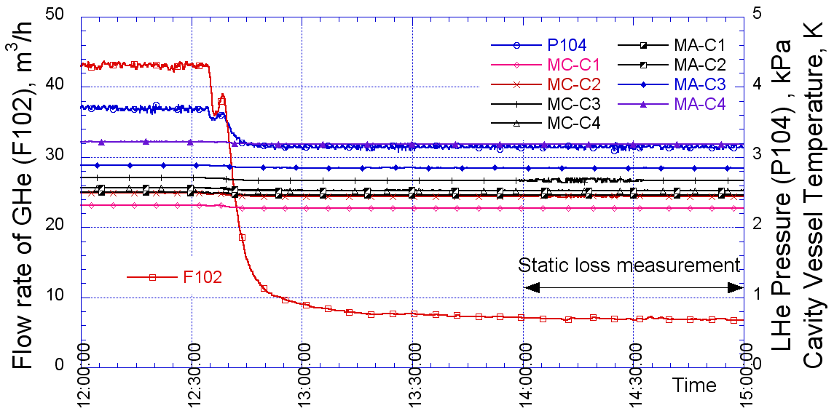
2 K circuit
Static loss measurements at 2 K:
flow rate of He=F102, pressure of 2K He=P104,
T of cavity vessels =MC-C1~C4, MA-C1~C4.

Slide 26
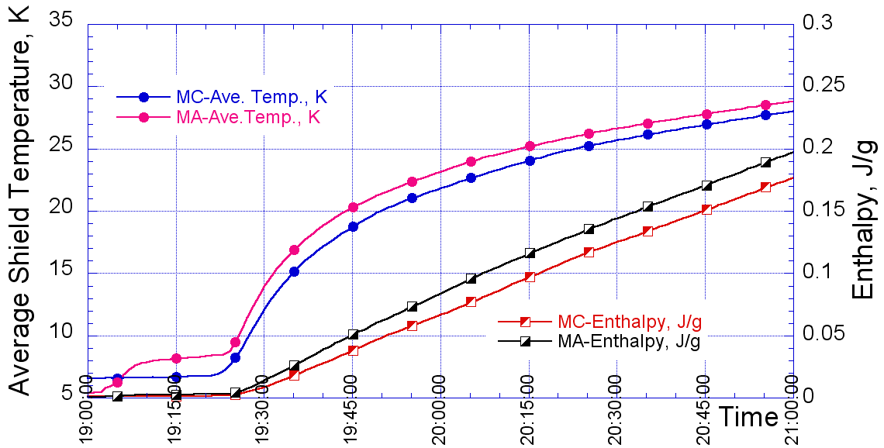
5 K shields

Slide 27
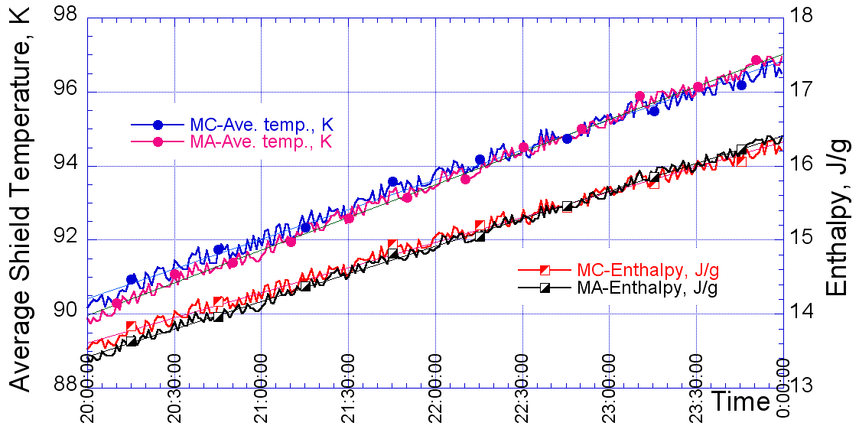
80 K shields

Slide 28
Estimation vs. Measurements
Comparison of the estimated (in parenthesis) static heat loads vs. the measured values at S1 Global
 | Module-A | Module-C
2K | 7.2 W [ 6.8 W ]
5K | 7.3 W [ 7.2 W ] | 5.3 W [ 4.1 W ]
80K | 48.7 W [ 44.3 W ] | 34.4 W [ 35.3 W ]

Slide 29
Dynamic losses meas: procedure
Dynamic loss by single cavity
  Measure Dynamic/Static losses:
    on resonance : Q_{D1},Q_{S1}
    in detuned conditions : Q_{D2},Q_{S2}
  Dynamic loss at cavities and couplers ：
    Q_{D} = Q_{D1} － Q_{S1}
  Dynamic loss at detuned condition ：
    Q_{D-det} = Q_{D2} － Q_{S2}
  Dynamic loss at cavities (and then Q)：
    Q_{D-cav} = Q_{D} － Q_{D-det}

Slide 30
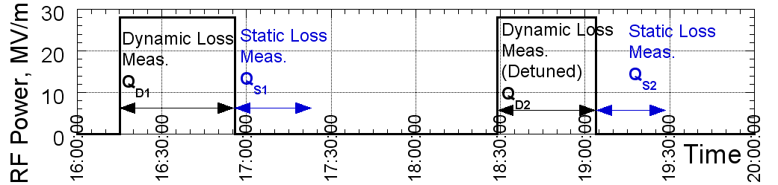
Measurement cycle

Slide 31
Single cavity values
Q₀ values in the range 4-9 10⁹ at ~30 MV/m
Higher coupler loads in the KEK cavities
 | MC-4 | MC-1 | MA-3 | MA-2 | MA-2
 | Z109 | AES004 | MHI07 | MHI06 | MHI06
G, MV/m | 28 | 25.2 | 32.3 | 38 | 32
Q_{D}, W | 0.84 | 1.4 | 2.8 | 4.8 | 2.6
Q_{D-det}, W | 0.09 | 0.18 | 0.7 | 1.8 | 1.2
Q_{D-cav}, W | 0.75 | 1.3 | 2.0 | 2.9 | 1.3
Q₀ | 8.8×10⁹ | 4.3×10⁹ | 4.3×10⁹ | 4.2×10⁹ | 6.5×10⁹

Slide 32
Dynamic losses by 4 & 7 cavities
  Average gradient of the cavities is G_{ave}
  Detuned at (equivalent) 32 MV/m
    Coupler losses of Module-C and A
      0.5 W (TTF-III design is 0.06 W each)
      4.6 W (consistent with single cavity measurements)
 | MC | MC | MA | MA | MC-MA
 | 4 cav. | 4 cav. | 4 cav. | 4 cav. | 7 cav.
G_{ave}, MV/m | 20 | 32 (det.) | 26.9 | 32 (det.) | 25.4
Q_{D}, W | 2.7 | NA | 6.9 | NA | 9.6
Q_{D-det}, W | 0.2 | 0.5 | 2.5 | 4.6 | 2.6
Q_{D-cav}, W | 2.5 | NA | 4.4 | NA | 7.0

Slide 33
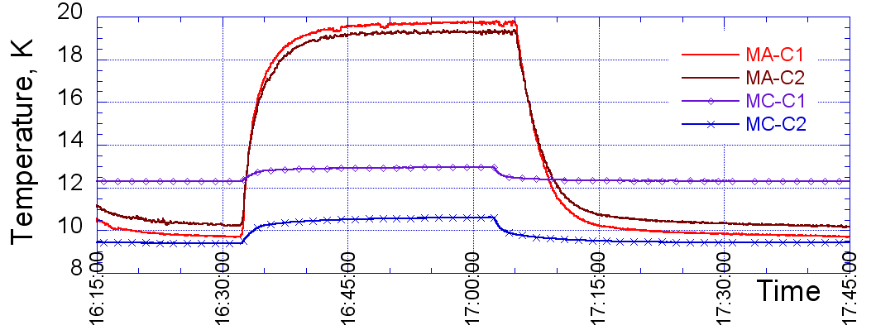
KEK STF-2 couplers
T rises of ~ 10 K at the connection flanges
  TTF-III couplers < 1 K

Slide 34
STF couplers: Explanation
This temperature rise is considered to be due to heat generation at the Cu layer of
3 µ meter thickness on the inner surface of the outer conductor
Couplers for the QB cryomodule are designed with a reduced static/dynamic heat loss (different coating) and more performant thermal anchoring
  will be tested thoroughly

Slide 35
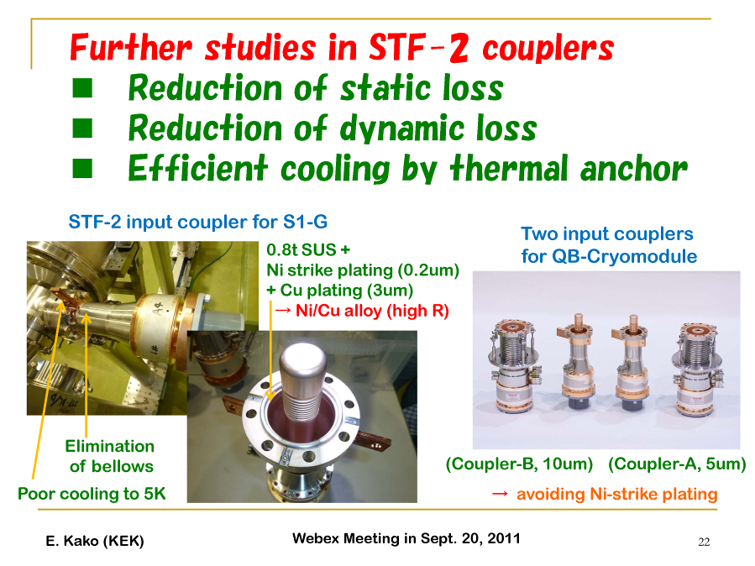

Slide 36
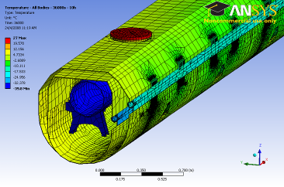
Simulation agreement
In the past even transient conditions for the shield cooling were benchmarked with good agreement with DESY CMTB data
EPAC08
5 K
70 K

Slide 37
Summary
Static and Dynamic heat load estimations were confirmed with a very good agreement in the S1 Global experiment
  Thanks to the large amount of diagnostics planned and handled by the KEK team
  Tools to compare design optios with respect to thermal performances
This provides solid ground for the TDR activities

