Slide 1
New test structures for CLIC
(RF design)
A. Grudiev
27/09/2011
LCWS11, Granada, September 2011

Slide 2
Outline
Motivations
Alternative to CLIC-G for CLIC main linac
  Same last iris (CLIC-M)
  Similar <a> (CLIC-N)
  Same degree of tapering as T18 (CLIC-O)
  XXL tapering (CLIC-P)
Single feed input/output couplers for CLIC_G
What is not covered in this presentation
  CLIC DDS (CERN-UK collaboration)
  Choke mode damped structure (CERN - Tsignhua Uni. Collaboration, Jiaru talks next)
  CLIC Crab cavity (CERN-UK collaboration, A. Dexter talks on Wednesday afternoon)

Slide 3
Motivations
The CLIC_G structure has been designed in 2008. We have learned a lot since then but the structure is not tested yet and we cannot say for sure if it satisfied CLIC requirements or not.
All what we learned so far indicate that CLIC_G is on the edge. We need a reliable test results in order to see where is(are) the weak point(s) of CLIC_G, then we can try to improve it.
Moreover, CLIC parameters are frozen since 2008. There is no need in a design of a new structure with different parameters (length, aperture, gradient, etc.).
In summary, there is no strong motivation on the new RF design, nevertheless, several new structure prototypes are being designed along two lines:
  improve high gradient performance for the same bunch charge by tuning the structure tapering
  simplification of the associated RF network by introducing compact couplers with single feed (CCSF)

Slide 4
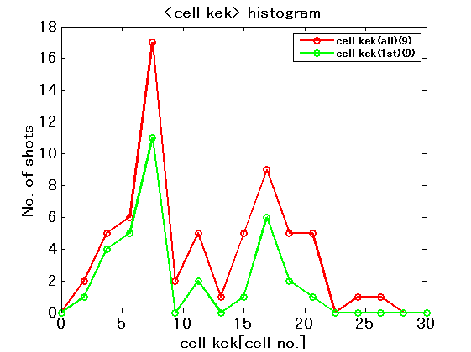
Gradient versus tapering
T18_vg2.6_disk
If we forget for the moment about the hot cell #7, the BDR is higher in the last cell, where field quantities are higher.
N.B., in T24, the BDR distribution is more flat but there are also other differences
What is the optimum tapering ?
T18_SLAC#1
T24_SLAC
T24_vg1.8_disk
T24_KEK

Slide 5
CLIC-G disk R05 regular cells (reference)
24 regular cells unloaded
26 regular cells unloaded
26 regular cells loaded,
N=3.72e9, Nb=312
The difference between TD24 and TD26 is only 1-2 % in field quantities, which is most probably un-measurable in high-gradient experiments
That means
  we can compare TD24_vg1.7_R05 <-> TD26_vg1.7_R05CC for compact coupler performance evaluation
  we can also use it for comparison with possible alternatives to CLIC_G equipped with “mode launcher” power coupler

Slide 6
Constant Sc with the same last iris: CLIC-M
26 regular cells unloaded
26 regular cells loaded,
N=3.72e9, Nb=322
TD26_vg2.0_diskR05
N=4.1e9, Nb = 322
Parameter changes CLIC-G -> CLIC-M:
1st iris radii [mm]: 3.15 -> 3.41
Input group velocity [%]: 1.65 -> 1.99
<a>/lambda: 0.11 -> 0.117
N: 3.72e9 -> 4.1e9
Nb: 312 -> 322
Efficiency is higher due to higher bunch charge

Slide 7
Constant Sc with the reduced last iris: CLIC-N
26 regular cells unloaded
26 regular cells loaded,
N=3.74e9, Nb=306
TD26_vg1.9_diskR05
Parameter changes CLIC-G -> CLIC-N:
1st, last iris radii [mm]: {3.15,2.35} -> {3.342.24}
Input,output vg/c [%]: {1.65,0.83} -> {1.89,0.74}
<a>/lambda: 0.11 -> 0.1116
N is the same
Nb: 312 -> 306
Efficiency is a bit lower due to shorter bunch train

Slide 8
Same degree of tapering as T18: CLIC-O
26 regular cells unloaded
26 regular cells loaded,
N=3.73e9, Nb=295
TD26_vg2.3_diskR05
Parameter changes CLIC-G -> CLIC-O:
1st, last iris radii [mm]: {3.15,2.35} -> {3.6,2.1}
Input,output vg/c [%]: {1.65,0.83} -> {2.25,0.64}
<a>/lambda: 0.11 -> 0.114
N: is the same
Nb: 312 -> 295
Efficiency is lower due to shorter bunch train

Slide 9
Even more tapering: CLIC-P
26 regular cells unloaded
26 regular cells loaded,
N=3.74e9, Nb=282
TD26_vg2.9_diskR05
Parameter changes CLIC-G -> CLIC-P:
1st, last iris radii [mm]: {3.15,2.35} -> {4.04,1.94}
Input,output vg/c [%]: {1.65,0.83} -> {2.94,0.53}
<a>/lambda: 0.11 -> 0.1196
N: is the same
Nb: 312 -> 282
Efficiency is lower due to shorter bunch train
Quasi-constant loaded Sc, thanks to Walter for pushing to this direction

Slide 10
Summary table for new CLIC structure prototypes
Structure | CLIC-G-CDR | CLIC-G | CLIC-M |  | CLIC-N | CLIC-O | CLIC-P
Average loaded accelerating gradient [MV/m] | 100
RF phase advance per cell [rad] | 2π/3
Average iris radius to wavelength ratio | 0.11 |  | 0.1152 |  | 0.1116 | 0.114 | 0.1196
Input, Output iris radii [mm] | 3.15, 2.35 |  | 3.41, 2.35 |  | 3.34, 2.24 | 3.6, 2.1 | 4.04, 1.94
Input, Output iris thickness [mm] | 1.67, 1.00
Input, Output group velocity [% of c] | 1.65, 0.83 |  | 1.99, 0.83 |  | 1.89, 0.74 | 2.25, 0.64 | 2.94, 0.53
First and last cell Q-factor (Cu) | 5536, 5738
First and last cell shunt impedance [MΩ/m] | 81, 103
Number of cells: Regular + Coupler | 26+2 | 26+0
Structure active length [mm] | 230 | 217
Bunch spacing [ns] | 0.5 ns
Filling time, rise time [ns] | 67, 21 | 62.6, 22.4 | 57.4, 22.4 |  | 62.3, 25.7 | 62.4, 31.0 | 61.1, 38.9
Number of bunches in the train | 312 | 312 | 322 |  | 306 | 295 | 282
Total pulse length [ns] | 243.7 | 240.5 | 240.3 |  | 240.6 | 240.4 | 240.5
Bunch population [10⁹] | 3.72 | 3.72 | 4.1 | 3.72 | 3.74 | 3.73 | 3.74
Peak input power [MW] | 61.3 | 60.0 | 65.2 | 63.3 | 60.4 | 60.7 | 62.5
RF-to-beam efficiency [%] | 28.5 | 27.9 | 29.2 | 27.3 | 27.3 | 26.1 | 24.3
Maximum surface electric field [MV/m] | 230 |  | 246 | 243 | 245 | 268 | 304
Max. pulsed surface heating temperature rise [K] | 45 |  | 45 | 43 | 43 | 48 | 59
Maximum Sc [MW/mm²] | 5.4 |  | 5.3 | 5.2 | 5.1 | 4.2, 5.6 | 3.5, 6.9
P/C [MW/mm] |  | 3.0 | 3.0 | 3.0 | 2.9 | 2.7, 2.0 | 2.46, 2.27
Luminosity per bunch X-ing [10³⁴/m² ] | 1.22 |  | 1.32 |  | 1.22 | 1.21 | 1.24
Figure of Merit [10²⁵%/m²] | 9.15 |  | 9.42 |  | 8.93 | 8.46 | 8.03

Slide 11
Summary on the CLIC-G alternatives
CLIC-M (const Sc): More charge in the bunch (higher efficiency and luminosity) for the same Sc as in CLIC-G
CLIC-N (const Sc): Lower Sc for the same bunch charge as for CLIC-G
CLIC-O (50 % tapering, same as in T18): Same bunch charge as CLIC-G but lower Sc if loaded with nominal CLIC current
  If P/C is more important then also unloaded gradient will be higher
  Efficiency lower than in CLIC-G due to longer rise time
CLIC-P (100% tapering, approximately const loaded Sc): Same bunch charge as CLIC-G but even lower Sc if loaded with nominal CLIC current
  In my opinion, it can show its potential only in loaded conditions. That means we have to test CLIC-G in loaded conditions for comparison which is already foreseen in CTF3 (dog-leg experiment).
  Needs careful powering/conditioning if there is no/low beam loading in order not to damage the downstream end
Un-damped matching cells to be used to ease the design and to lower the fields
  In case of problems in the TD24_R05 matching cells (or maybe in any case), a 26 cells long CLIC-G with un-damped matching cells can be build to be a reference for the above alternatives and also for structures with compact couplers: double feed (TD26_vg1.7_R05_CC) and single feed (comes later).

Slide 12
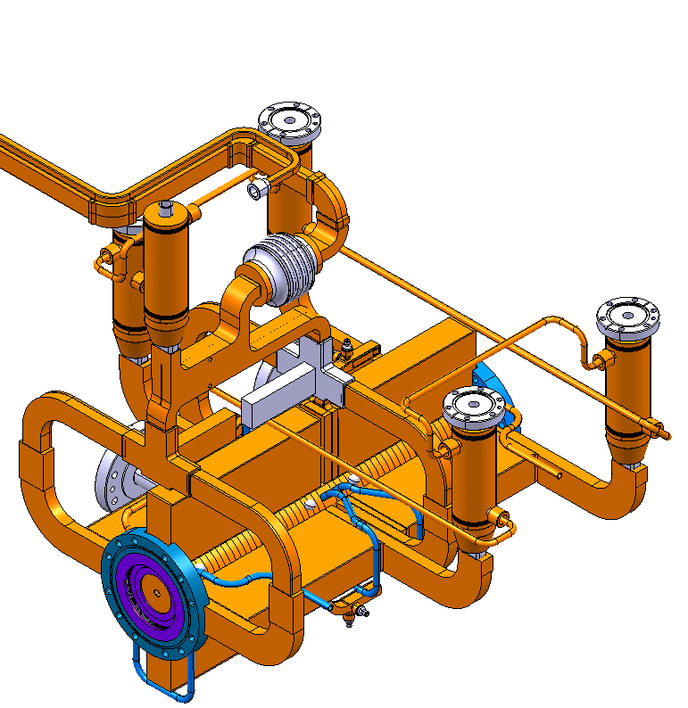
Alternative layout of CLIC SAS based on compact coupler with single feed (CCSF)
Image courtesy of A. Samoshkin
Alternative layout:
Input and Output kicks are compensated independently within one SAS = AS1 – AS2
Baseline layout
Load
Hybrid
Load
AS1
AS2
Load
Advantages:
No splitters (HOMagic-T)
3 loads per SAS instead of 5
less waveguides
group delay difference between two AS can be adjusted to 0
more space for input/output waveguide connection to the AS

Slide 13
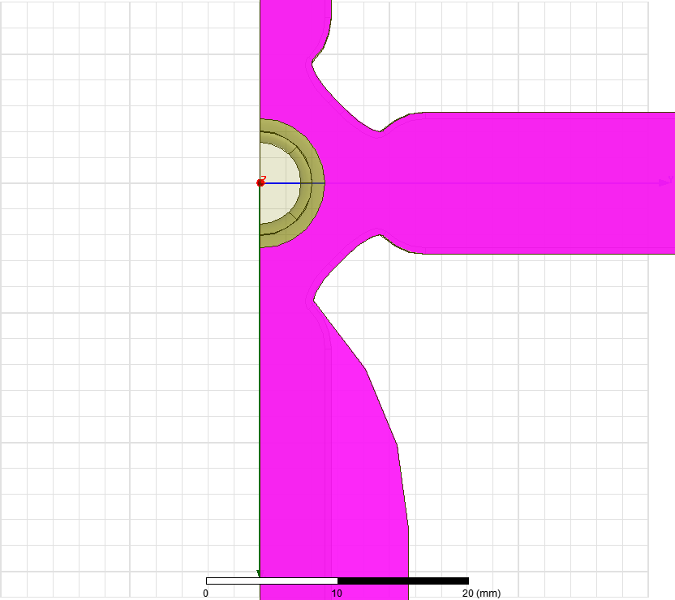
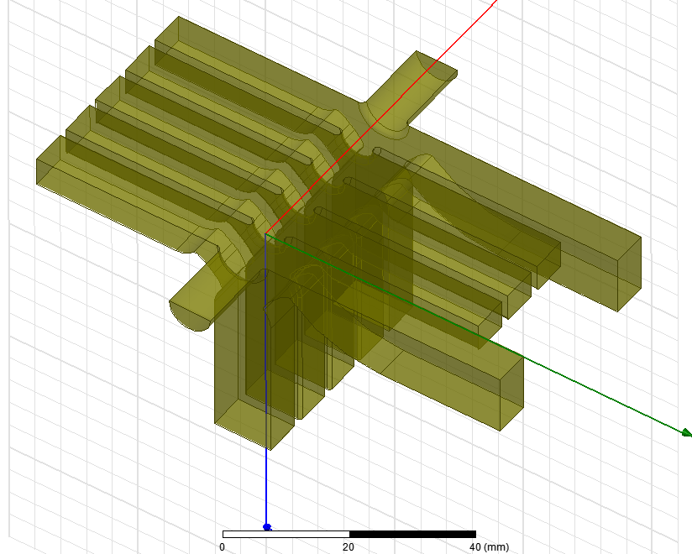
Compact coupler with single feed, geometry
idw
b
idw
idw
ipw
idw = 8 mm
b and ipw are matching parameters

Slide 14
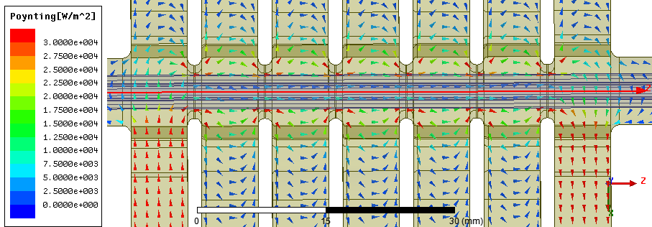
Dipolar kick on crest
Dipolar kick for particle on crest is mostly magnetic (-Z₀H_{y})
H_{y} is needed to let power flow cross the middle plane: S_{x} = H_{y} x E_{z}, that is why it is in phase with accelerating field E_{z}
The kick is proportional to the input power (fixed) divided by Ez (fixed) and by the cell radius (more or less fixed by the cell frequency)
The sign is given by the direction of the power flow. It is asymmetric in the input/output couplers
If the gradient in the coupler cell has to stay high (as in the case of CLIC) the dipole kick will stay
there as well.
The kick can be
minimized by reducing
accelerating gradient
in the coupler cell
2.5 V
-2.5 V
Complex mag of Real Poynting vector

Slide 15
Dipolar kick 90º off crest
Dipolar kick for particle 90º off crest is again mostly magnetic (-Z₀H_{y})
H_{y} comes from the offset of the EM field centre with respect to the beam axis, that is why it is in phase with H_{φ} and 90º out of phase with the accelerating field E_{z}
The kick is proportional to the accelerating field (fixed) and the offset between the beam and EM field axis (can be optimized improving the EM field symmetry),
The sign depends on the sign of the accelerating field and of the offset. It is symmetric in input/output couplers
This kick can be optimized down to zero if necessary!
0.5 V
0.5 V
For the presented case at 2 W input power: on crest kick of 2.5 V is already much larger than 90º off crest kick of 0.5 V due to very high degree of symmetry of the EM field. Still can be fine tuned if necessary.
The impact of the dipole kicks on the beam dynamics is under investigation (talk on 29/9)

Slide 16
Summary and Outlook
Several new structure prototypes are proposed which have a potential of improving CLIC_G performance or/and cost
Both new high-gradient test results for CLIC_G and possible reconsideration of CLIC parameters can significantly change motivations and the boundary conditions for the CLIC accelerating structure design.

