Slide 1
High power RF components
F. Peauger, A. Branco, M. Desmons, W. Farabolini,
P. Girardot, A. Hamdi, A. Maugueret
CEA Saclay, France
I. Syratchev, A.Olyunin, N. Chritin , S. Doebert, D. Gudkov, J. Kovermann, S. Lebet, G. Riddone, K. Schirm, V. Soltadov
CERN, Geneva, Switzerland

Slide 2
High power RF components main features
    « Manipulate » the high power RF in the CLIC module or in test stands (couple, convert, compress, attenuate…)
      Objective: avoid RF components problems during operation
      → get enough margin in the RF components design in order to concentrate our efforts on CLIC critical items (Accelerating structures, PETS…)
    Long experience at SLAC-KEK and at CERN (at 30 GHz)
      Try to scale existing design
      Develop new concepts
      SLAC flanges
    Cheap fabrication
      As compact as possible
      General tolerance of ~20 µm and surface roughness of 0.1 – 0.2 µm
      → not necessarly diamond machining
      No etching
      Vacuum brazing
    Only new developments presented here

Slide 3
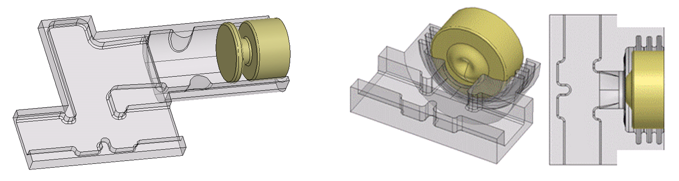
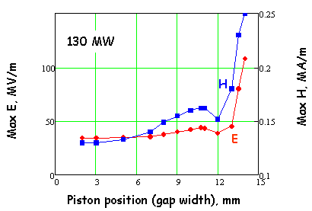
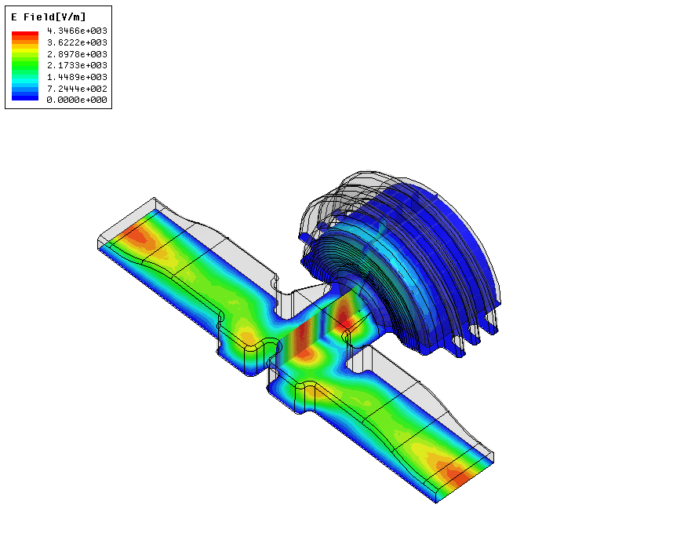
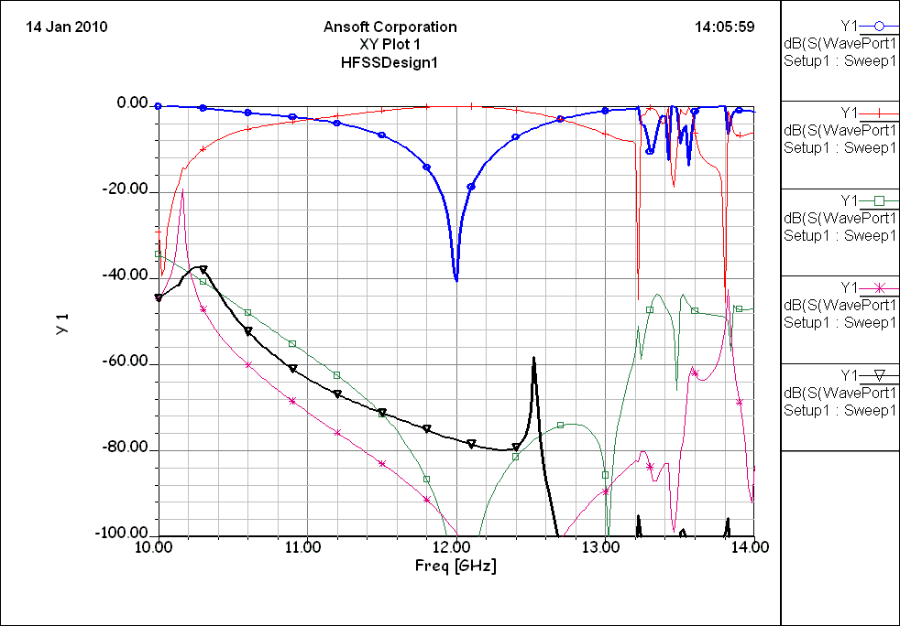
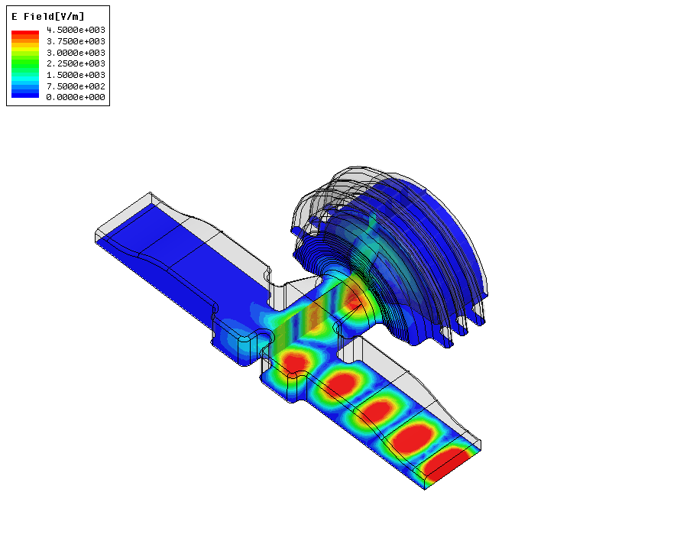
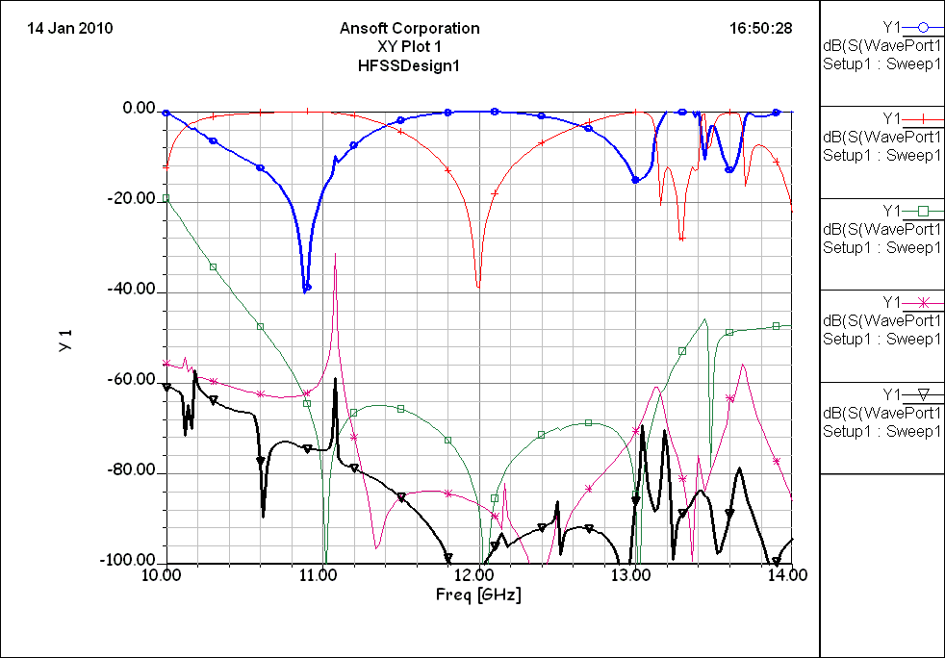
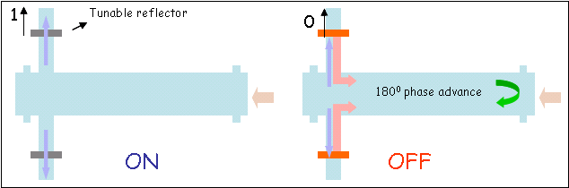
Compact design of the broadband high RF power variable (mechanically) reflector
ON
OFF
Transmitted
RF power, dB
Reflected
Stroke 8.0 mm
Piston position (gap width), mm
The variable reflector is a core element of the PETS ON/OFF mechanism
It is activated when the local termination of the RF power production in PETS is required.
ON
S-parameters, dB
Radiation through the chokes
S-parameters, dB
OFF

Slide 4
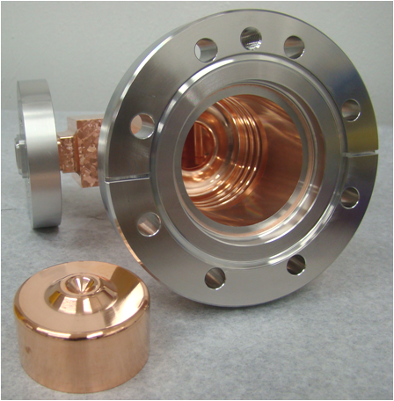
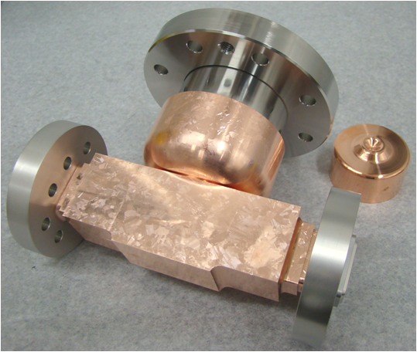
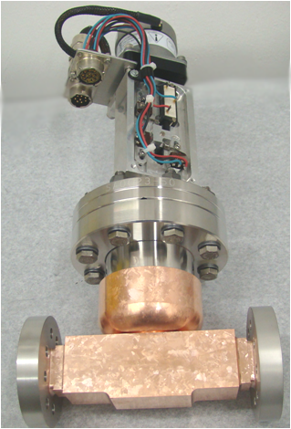
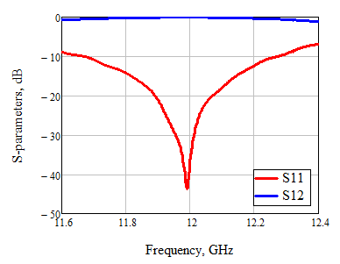
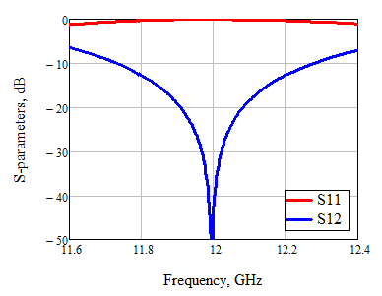
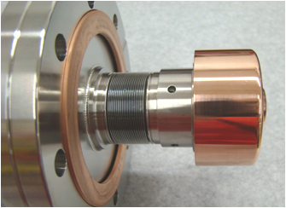
Broadband high RF power variable reflector prototype
RF measurements
ON
OFF
Stroke 8 mm

Slide 5
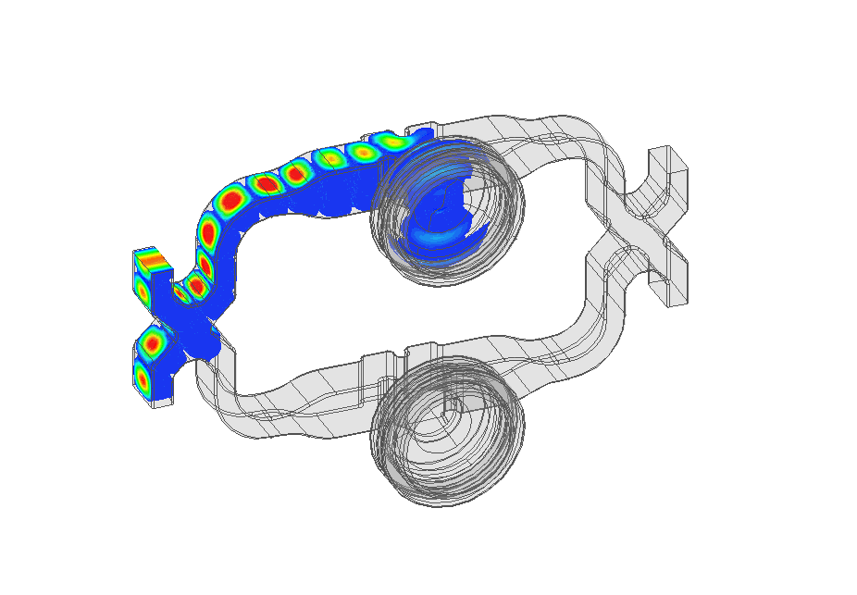
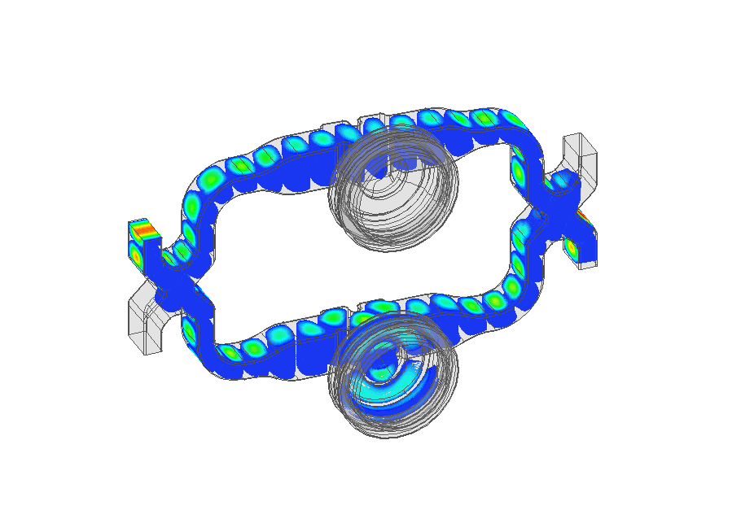
High RF power variable reflector: Other applications: Compact Variable splitter
#3
#1
#4
#2

Slide 6
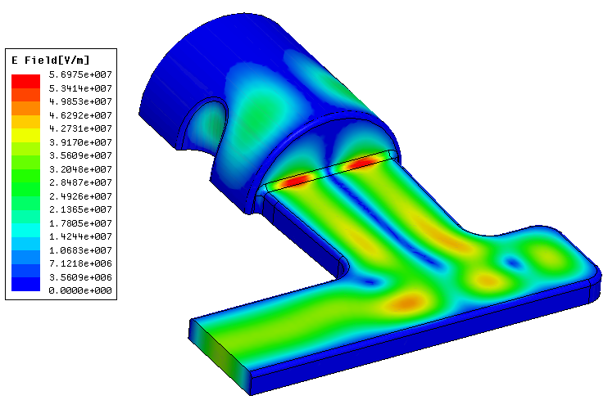
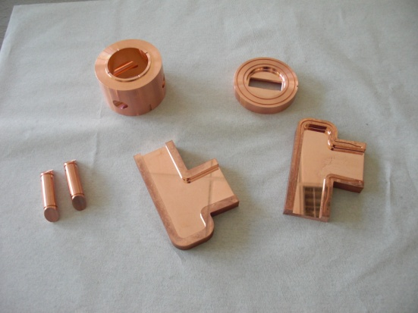
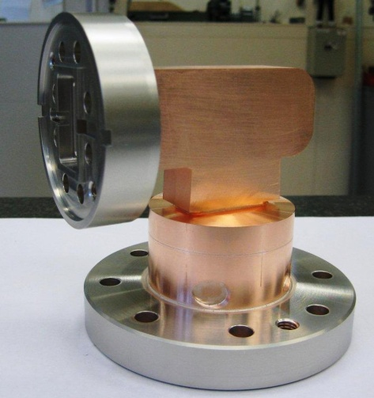
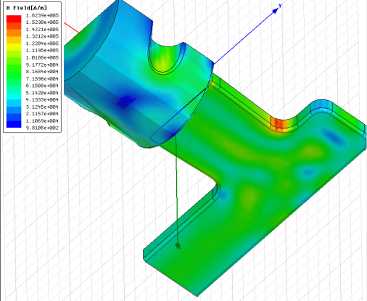
Mode Converter
At 12 GHz, losses on the H₀₁^{O} propagation mode are reduced by a factor of 4 in 36 mm dia circular waveguide (and by a factor of 8 in 50 mm dia)
Original idea:
S. Kazakov (KEK)
H₀₁^{O}
E_{surf}^{max} (130MW)=48.9 MV/m
H₁₀□
E Field
H_{surf}^{max} (130MW)=151 kA/m ΔT(250 ns)=5.1°
H Field
HFSS results 11.9942 GHz:
S12 = -0.0618 dB, S11= -40 dB
Bandwidth = 40 MHz at -30 dB reflection

Slide 7
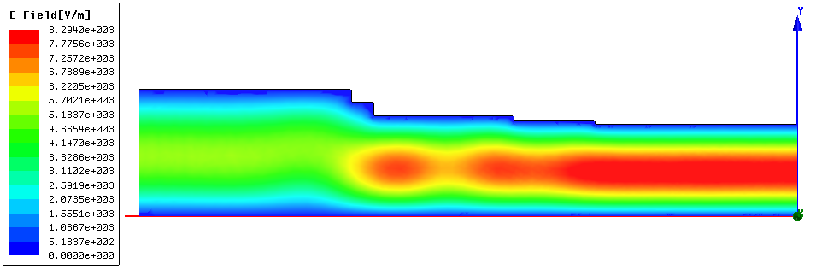
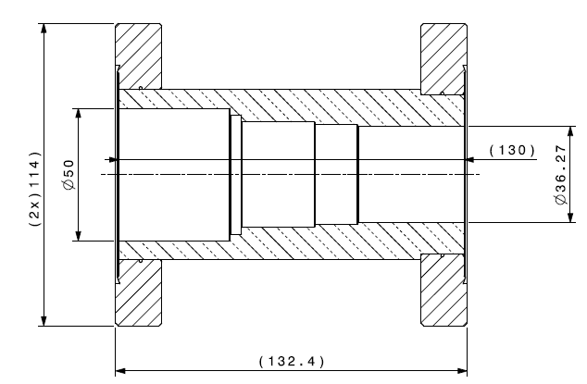
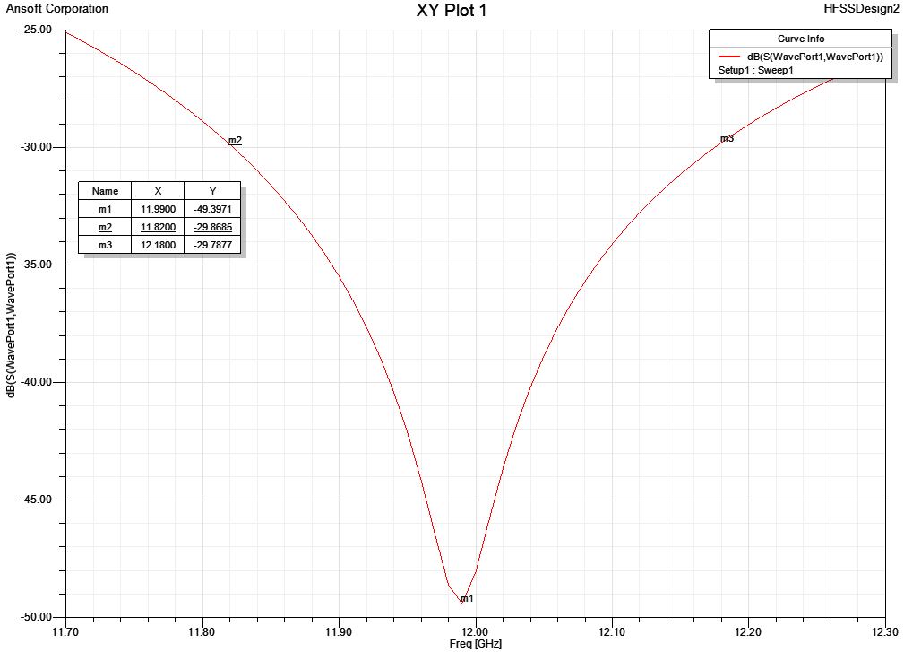
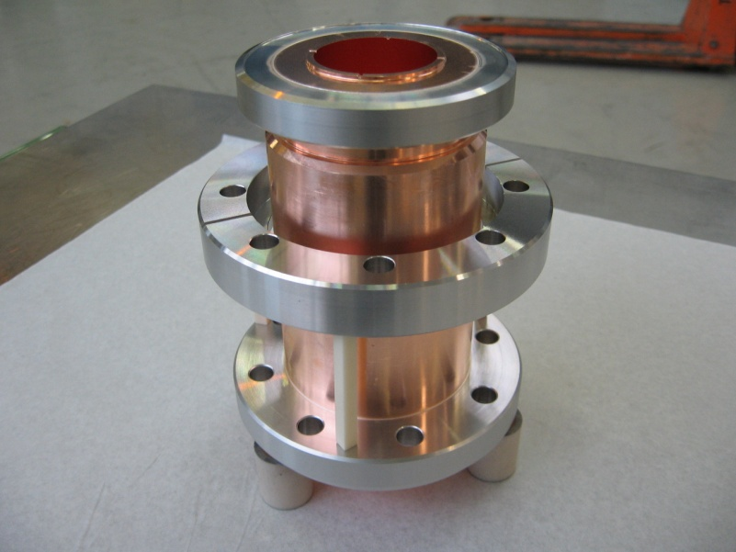
36 / 50 mm Circular Taper
Circular waveguide with stepped diameters (single mode)
Compatible with existing 50mm diameter circular waveguide
E Field
H₀₁^{O}
HFSS results:
S12 = 5.4e-5 dB at 11.9942 GHz
S11 < -30 dB between 11.82 and 12.18 GHz Bandwidth =360 MHz

Slide 8
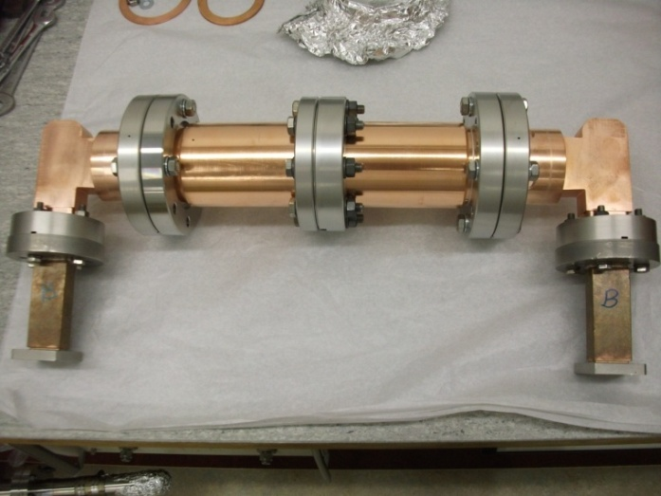
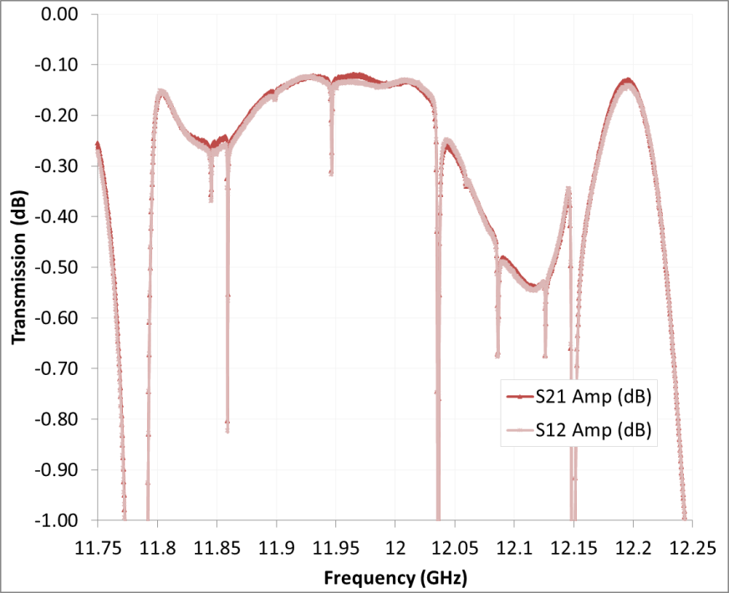
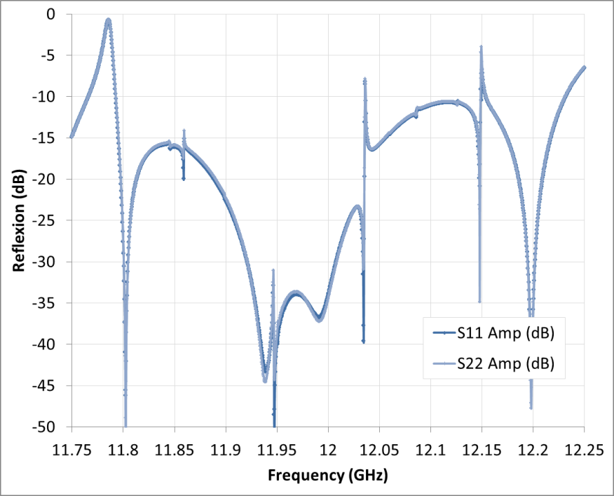
RF measurements (Oct. 2010)
MC#1
MC#2
At 11.9942 GHz:
S12= -0.14 dB
S11= -36.3 dB
BW at -30 dB reflection: 150 MHz

Slide 9
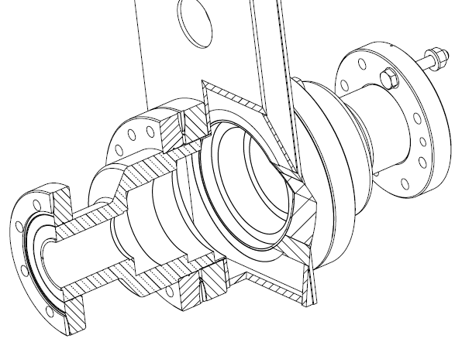
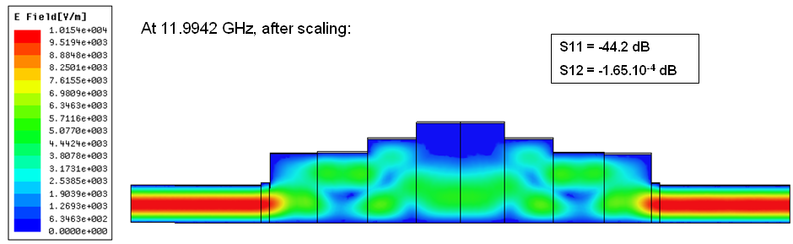
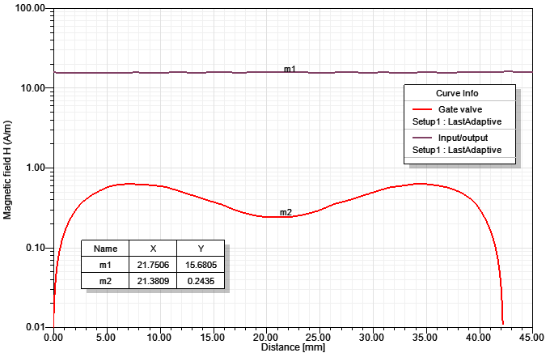
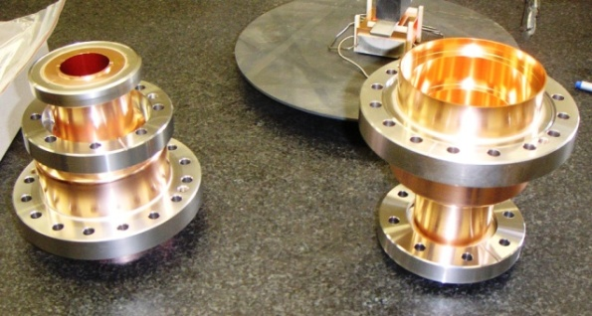
H-double moded RF Valve
Circular waveguide with stepped diameters
Mixing of two modes (H₀₁^{O} and H₀₂^{O}) so that there is almost no field in the valve area
Original idea:
A. Grudiev (CERN) (at 30 GHz)
H₀₁^{O}
E Field
20 dB
Surface H field (A/m)
HFSS result:
S12 = -0.000165 dB, S11= -44.2 dB
Bandwidth = 105 MHz at -30 dB reflection

Slide 10
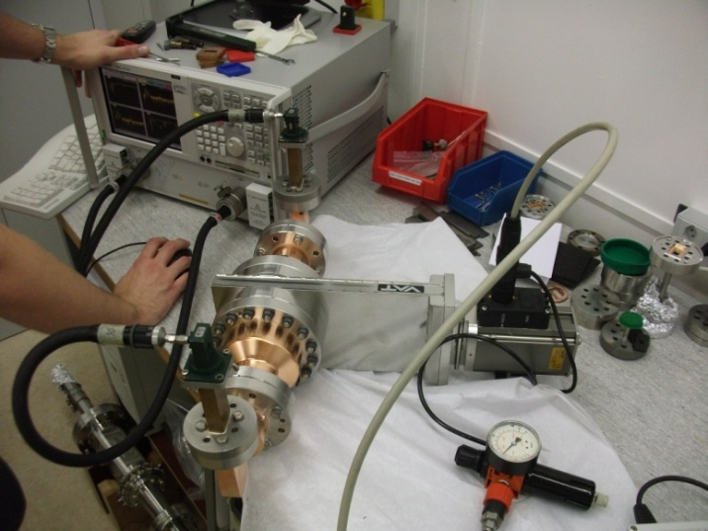
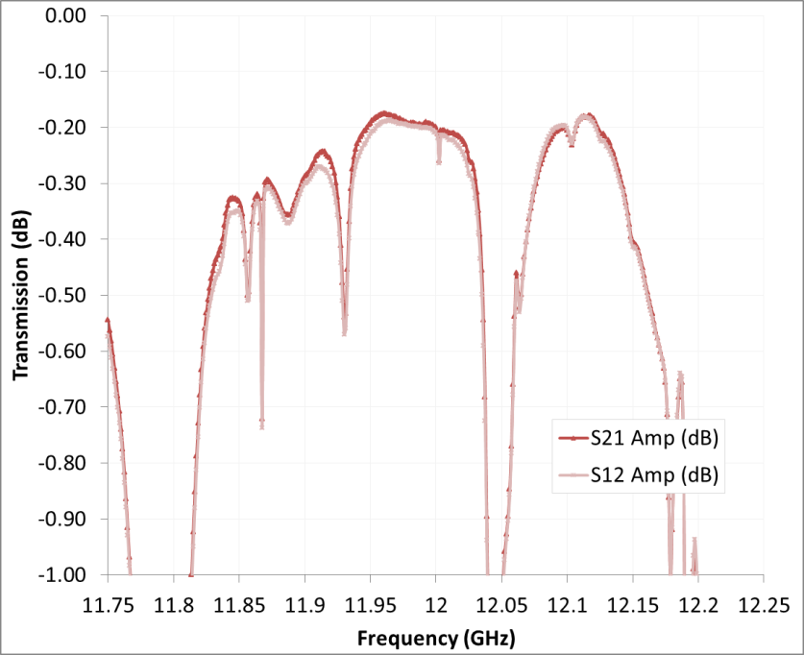
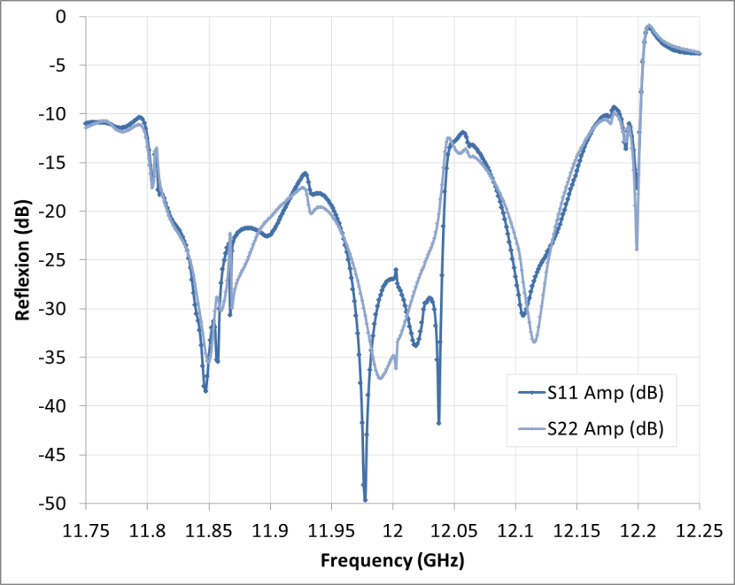
RF measurements (Oct. 2010)
At 11.9942 GHz:
S12 = -0.2 dB
S11 = -27 / -36 dB
BW at -30 dB reflection: 37.5 MHz
MC#1
MC#2

Slide 11
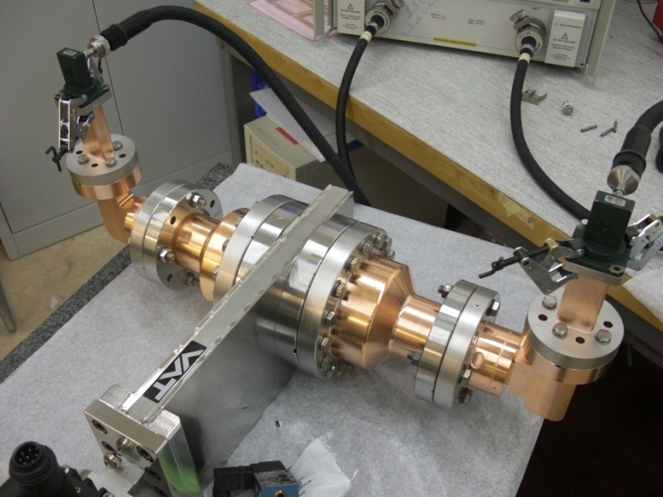
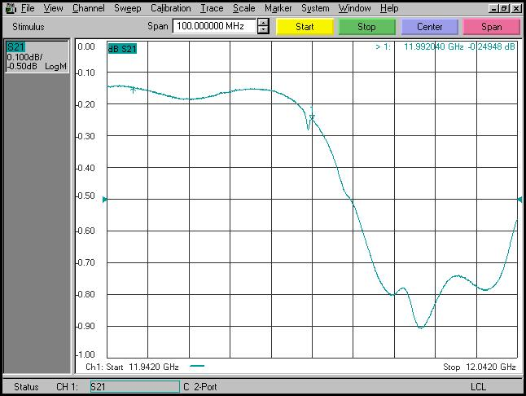
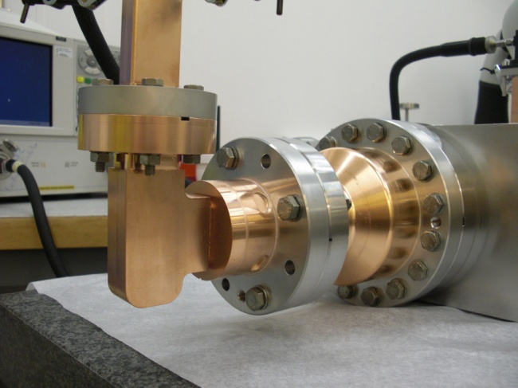
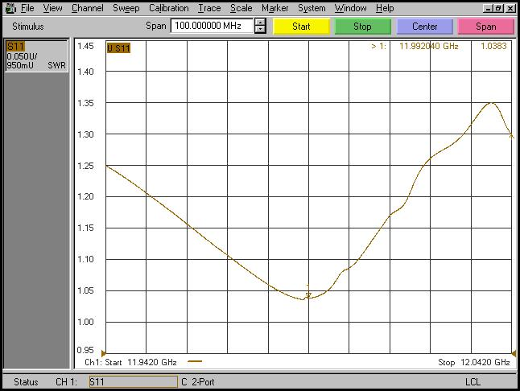
RF measurements (Sept. 2011)
4 additional mode converters (MC) and 2 valve tapers (VT) built:
2 MC + 2 VT measured -> OK
2 MC ready for measurements
MC#3
MC#4
S12 = -0.24 dB
S11 = -34 dB
Claudio Serpico (Elettra Trieste)

Slide 12
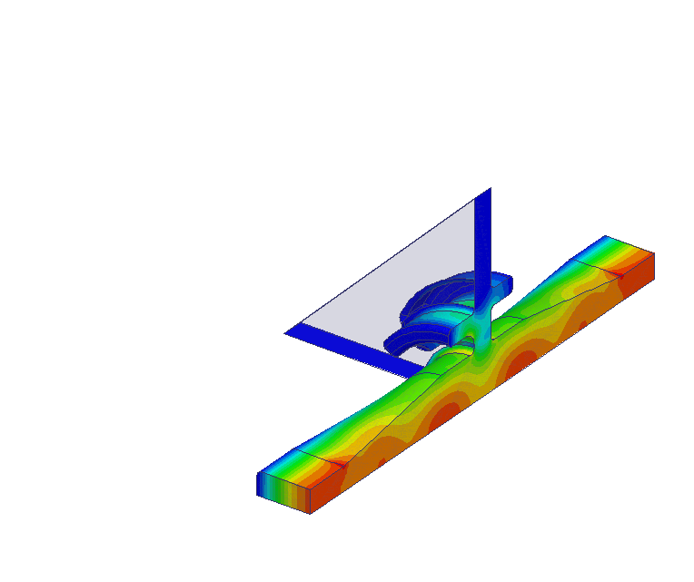
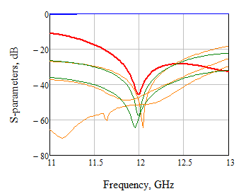
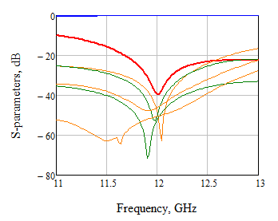
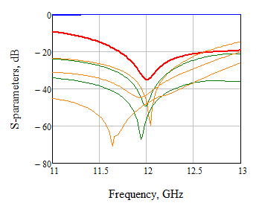
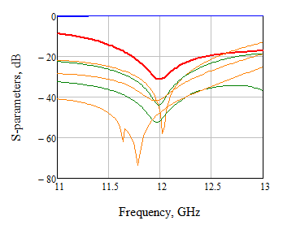
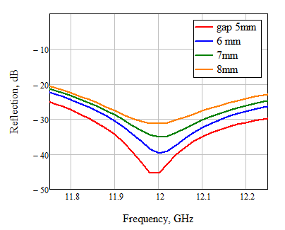
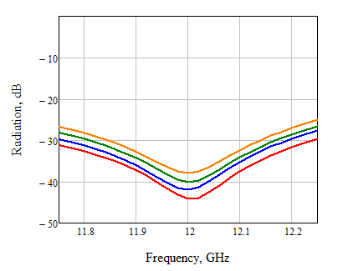
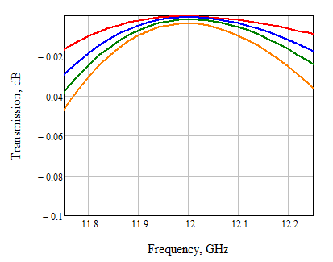
(∅_{out}=43mm)
Gap
Port 1
Double asymmetric choke junction with wide gap opening.
Port 3
82.7 mm
g/λ: 0.20-0.34
Port 2
gap 5mm (g/λ=0.2) tuned
gap 6mm (g/λ=0.24) tuned
gap 7mm (g/λ=0.28) tuned
gap 8mm (g/λ=0.34) tuned
5 modes radiation into port 3
Power sum of 5 radiating modes

Slide 13
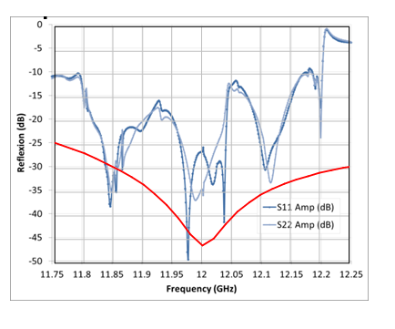
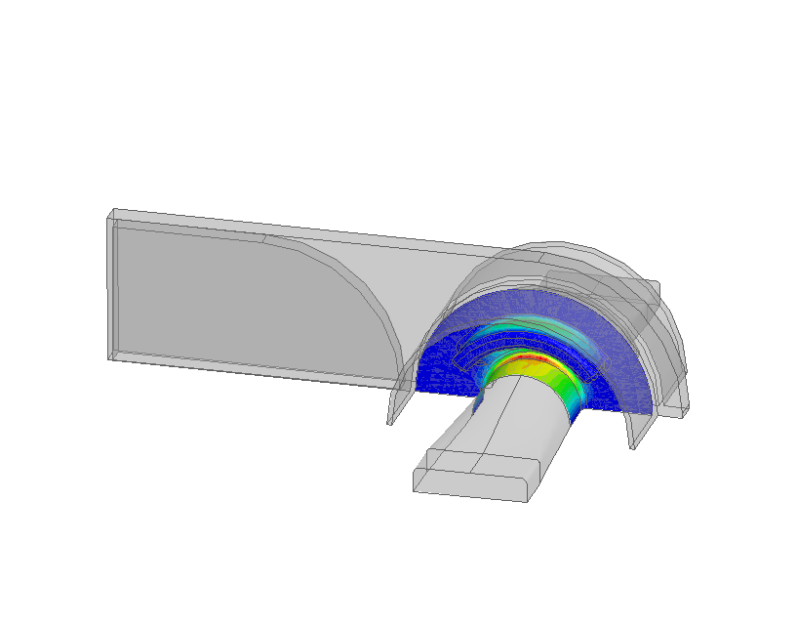
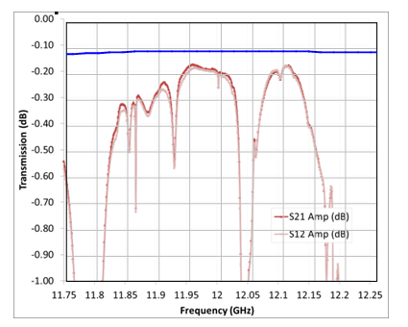
Choke-type RF valve
Very compact RF valve alternative design (replace 2 MC + H-double moded RF valve)
Better performance expected in terms of matching and peak surface electric fields
choke
choke
E max (100 MW)=23.7 MV/m
(0.75xEmax in WR90 and 0.5 x Emax in MC)

Slide 14
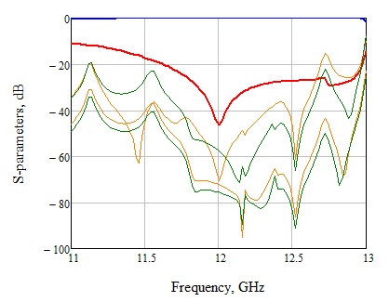
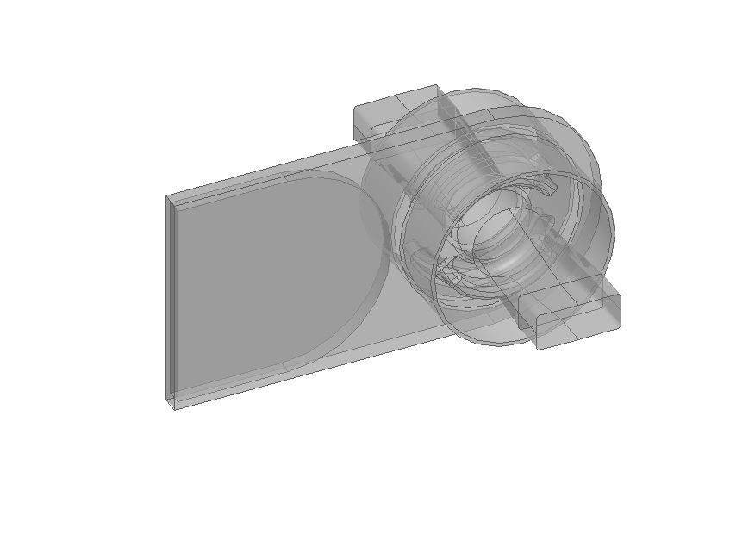



choke based RF/vacuum gate valve performance
Reflection
4 modes radiation into port 3
RF/vacuum gate valve S-parameters
Port 3:
Open
Closed
Port 3 (5 mm gap)

Slide 15






Jog mode converter
Convert in straight direction, less surface field enhancement
2 prototypes built
Original idea:
S. Tantawi (SLAC)
H₁₀□
E_{surf}^{max} (130MW)=34.6 MV/m
H₂₀□
E Field
H₀₁^{O}
HFSS result:
S12 = -0.007 dB, S11= -40 dB
Bandwidth = 110 MHz at -30 dB reflection

Slide 16



Circular 90° waveguide bend
1 prototype will be ready by the end of Dec. 2011
E_{surf}^{max} (130MW)=27 MV/m
HFSS results:
S12 = -0.042 dB, S11= -27.5 dB
H₂₀□
E Field
H₀₁^{O}
90° bend part under fabrication
H₀₁^{O}
H₀₁^{O} → H₂₀□ converter: two parts built

Slide 17



SLED Pulse compressor (preliminary design)
Important need for the 12 GHz klystron test stands
Requirements
  50 MW – 1.5 µs to 130 MW – 250 ns
  Compact
  Inexpensive: easy to fabricate and use of existing devices
  Reliable and flexible
Solution
  SLED concept with resonant cavity working on a single H_{01n} mode
H₀ ₁ ₃₀ Cavity
Φ79mm
Hybrid Splitter
H₀₁ Mode Converter Φ36.27mm
Iris
Short circuit + pumping port
H₀ ₁ ₃₀ Cavity
Φ79mm
H₀₁ Circular Taper (Φ36.27mm→ Φ54mm)
F = 11.9943 GHz
n=30
QL = 10101.7
Qx = 10708.1
Q0 = 178380
beta = 16.6
= 0.27 µs
G = 0,88
E Field

Slide 18




SLED Pulse compressor (preliminary design)

Slide 19






Double Height 3 dB 90° Hybrid Coupler
1 prototype built
RF measurements
At 11.9942 GHz:
S12 = -2.98 dB, S13 = -3 dB
S14 = -32.1 dB
Reflections < 23.3 dB

Slide 20




RF Loads for TBL
Material: Stainless Steel AISI430, µ_{r}=6, σ=1.1e6 S/m
HFSS results:
At 11.9942 GHz: S11= -50 dB, S12 = -50 dB
ΔF = 60 MHz @ -30 dB
E_{surf}^{max} (80MW)=50 MV/m
RF Pick-up with -50 dB coupling
E Field
Total length = 500 mm
H₁₀□
WR90
H_{surf}^{max} (80MW) = 135 kA/m
ΔT(140 ns) = 200°
H Field
(half of the geometry represented)

Slide 21





RF Loads for TBL
RF measurements
2 prototypes built, will be installed in TBL soon
Reflection coefficient not as good as expected
→ need to review the design before series production
At 11.9942 GHz:
S11 = -22 / 26 dB
S12 = -63 / 67 dB

Slide 22







Moderate peak power ‘dry’ RF load with SiC absorber
The 15 MW peak RF power loads are the most common components in CLIC module:
→ ~ 350 000 loads will be needed for 3 TeV CLIC option
All the mechanical part are ready, waiting for the bulk copper deposition technology approval test
The first sample of SiC tube with 2 mm electro chemically deposited bulk copper. Undergoing low temperature brazing and EBW tests.

Slide 23
Conclusion
A wide variety of high power RF components developed
A challenge to fabricate the components in different labs and companies (call for tender mandatory) with a good and constant quality
Most of the prototypes built are well matched without tuning
It is important now to test them at high power

