Slide 1
High-power activity in cell-to-cell contacts
Mostly Markus Aicheler’s talk at
http://beam.acclab.helsinki.fi/hip/mevarc11/programme.php
but a bit of new stuff too.
W. Wuensch
LCWS 2011
28 September 2011

Slide 2
Introduction
During post-mortem inspections of T18 and TD18 structures we have observed evidence of high-power related activity in cell-to-cell contacts.
We see two categories of activity:
One fixed at the specific points in the TD18 where the surface current density is highest.
The other at random points around the circumference at points of much lower current density.
All the images after high power testing I will show are from KEK/SLAC fabrication.

Slide 3
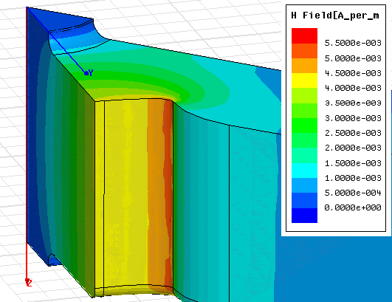
Features in high current region of TD18
Current density around 2x10⁸A/cm² during test
Damping waveguide
Inner cell

Slide 4
Pulsed surface heating temperature rise during high power operation
<dT> - step-wise function of const dT_{n} during dN_{n} rf pulses.
[∑dT_{n}dN_{n}]/N = 67.5 K,
where N = 276394719 is the total number of pulses
BUT
Different dT_{n} cannot be averaged like this to get average value for the whole operation period !!!
Alexej Grudiev

Slide 5
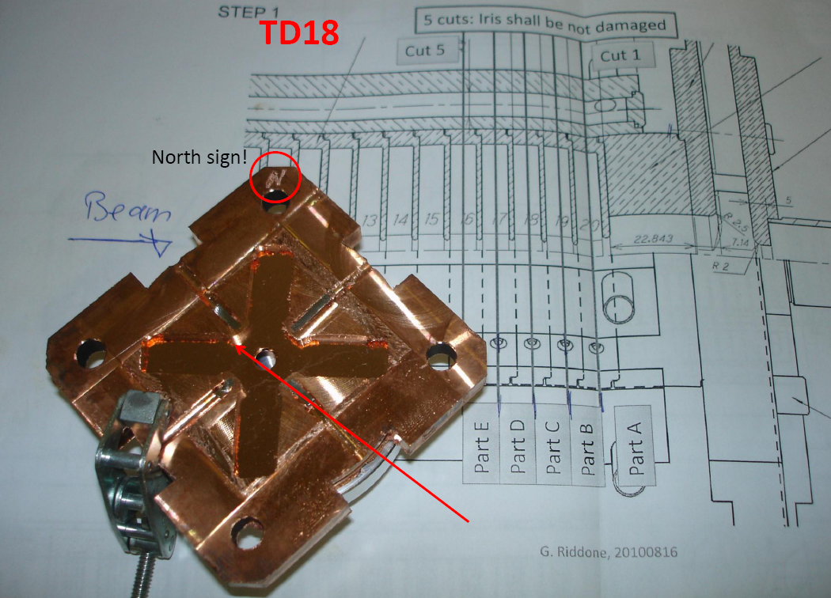

Slide 6
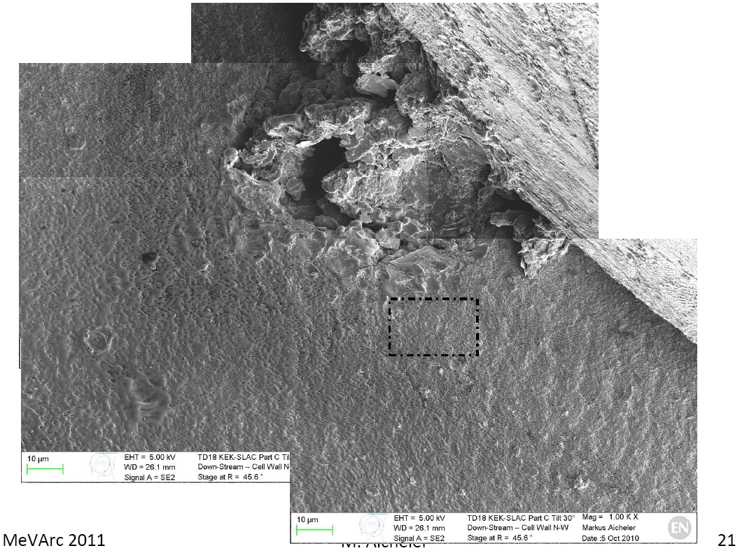

Slide 7
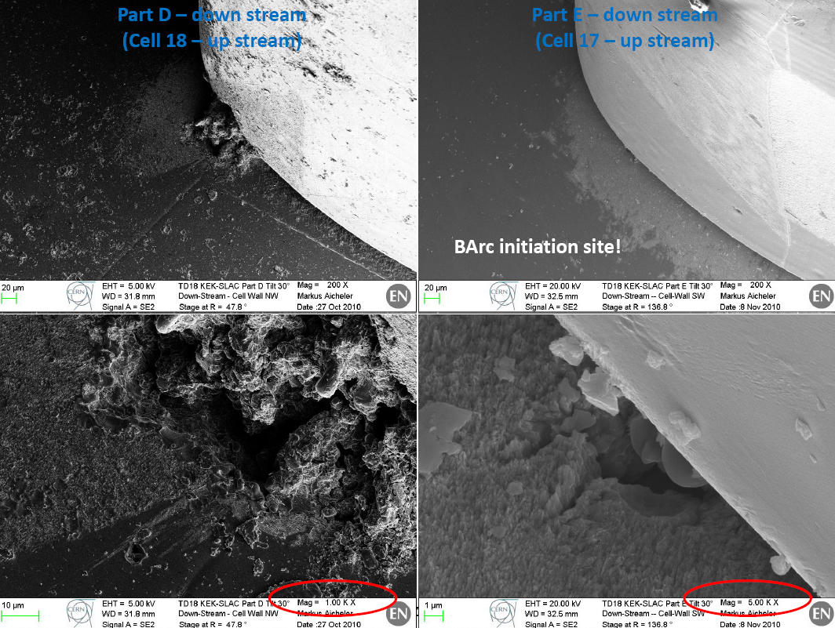

Slide 8
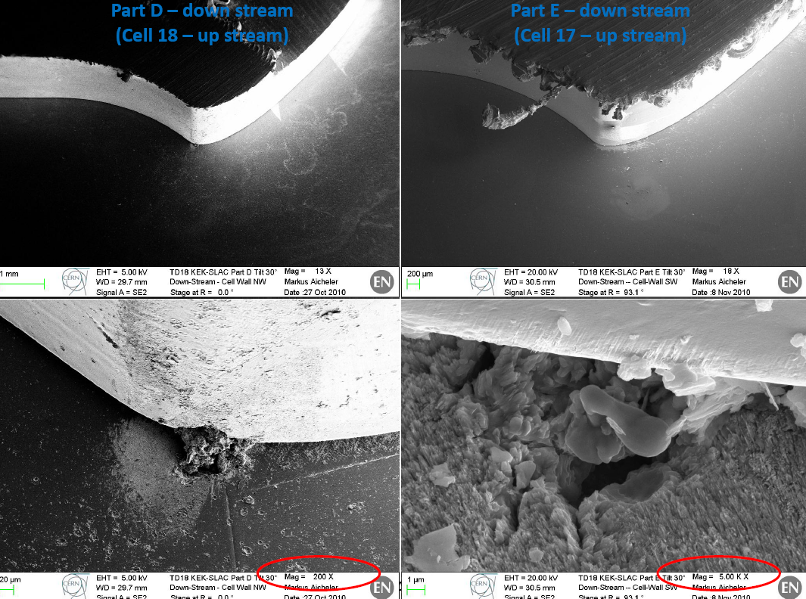

Slide 9
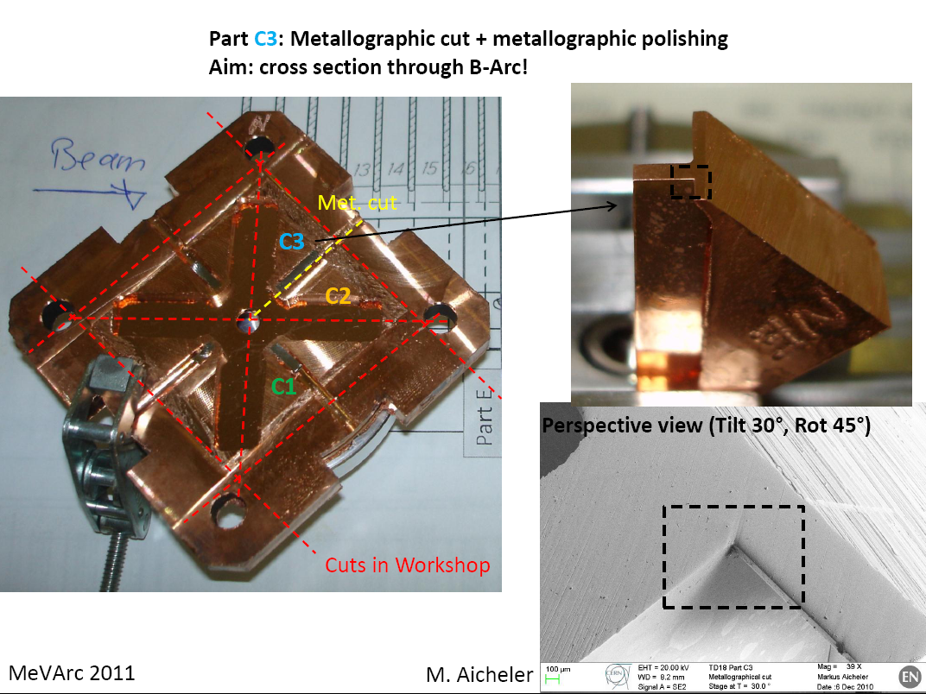

Slide 10
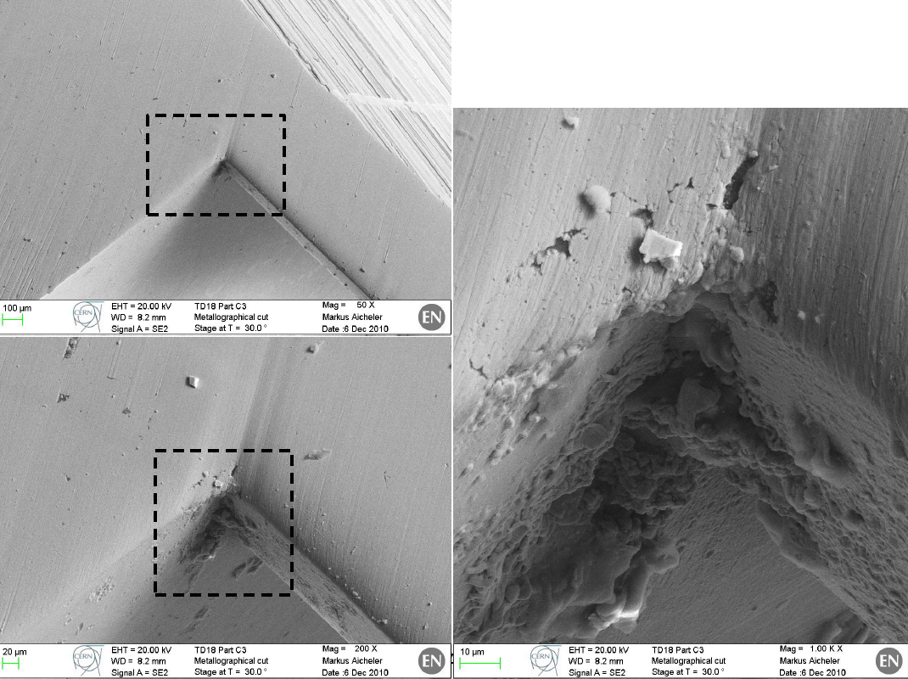

Slide 11
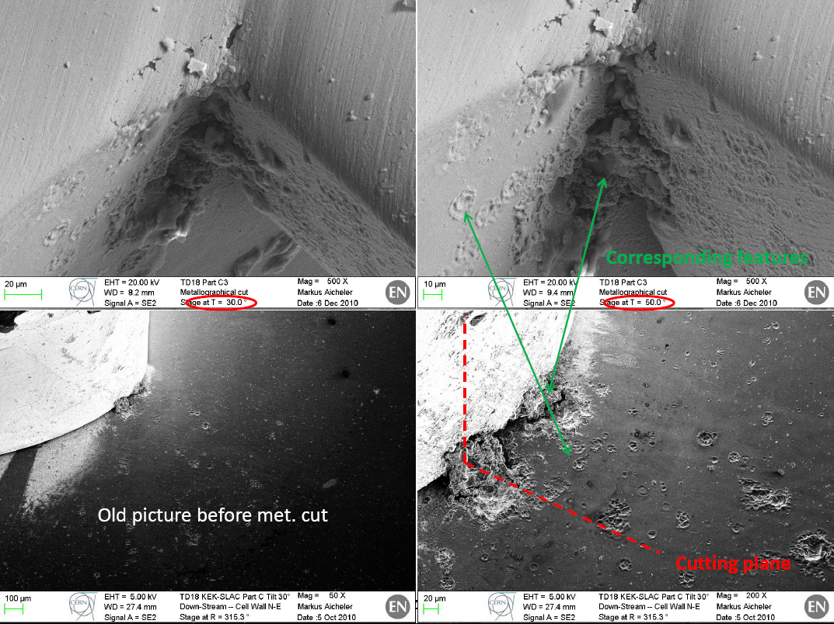

Slide 12
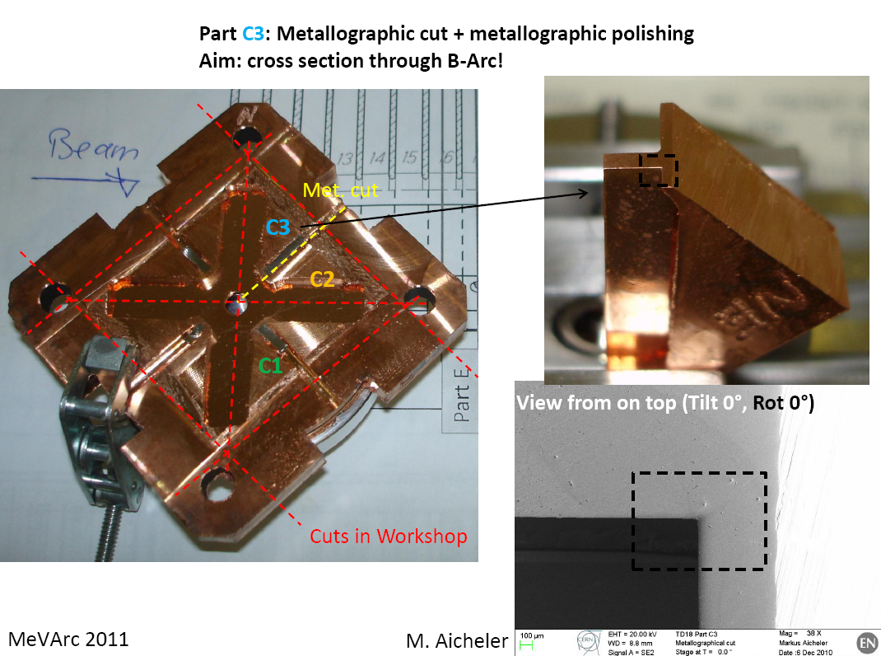

Slide 13
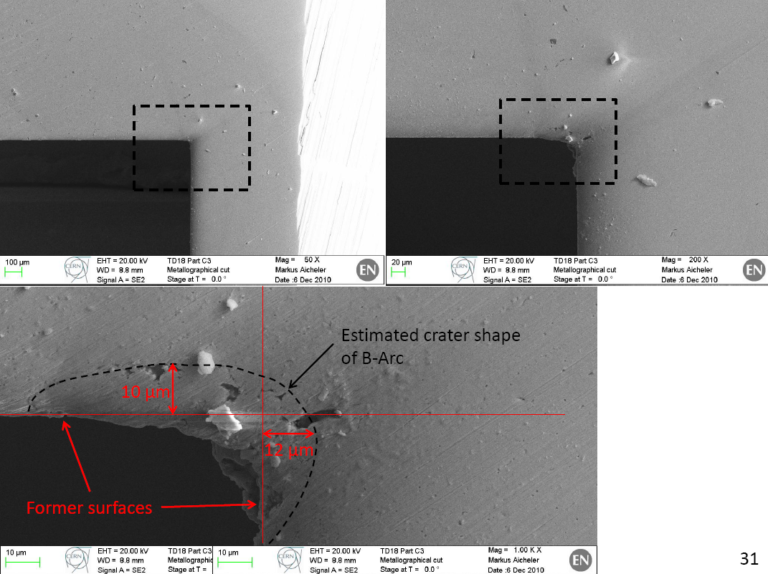

Slide 14
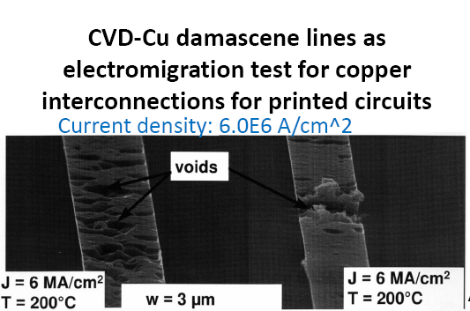
Electromigration
Our current(!) explaination is that these features are due to electromigration. Electromigration is the transport of atoms in a conductor due to momentum transfer from the current.
This can cause the formation of voids and breakup of the material.
The effect has been a problem in semiconductor interconnects – at current densities of

Slide 15
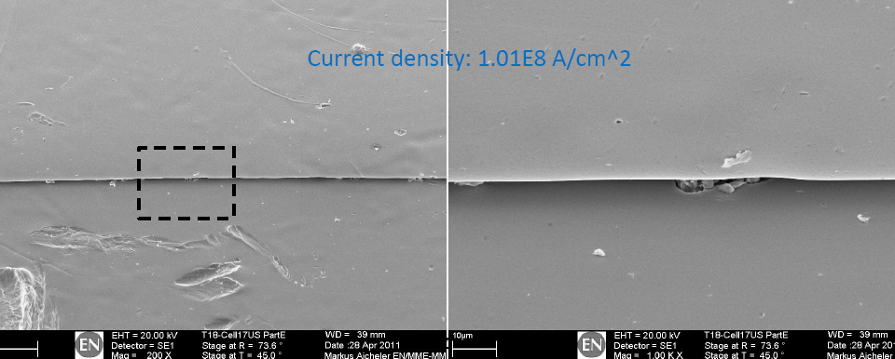
Random locations
In order to confuse things, we also see similar, but smaller, features at random locations in areas of lower current density. In T18 upstream cells for example.
Please note that these are all relatively new observations and we only realize what to look for now. Consequently we can only say where we see them, we cannot say where we do not see them.

Slide 16
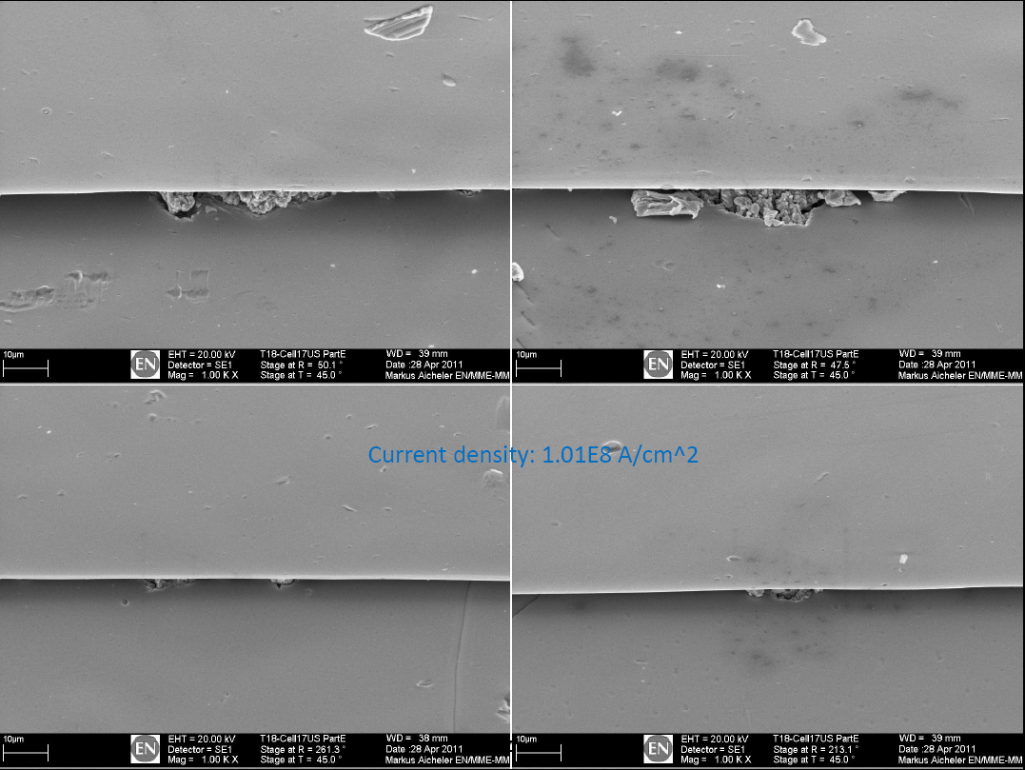

Slide 17
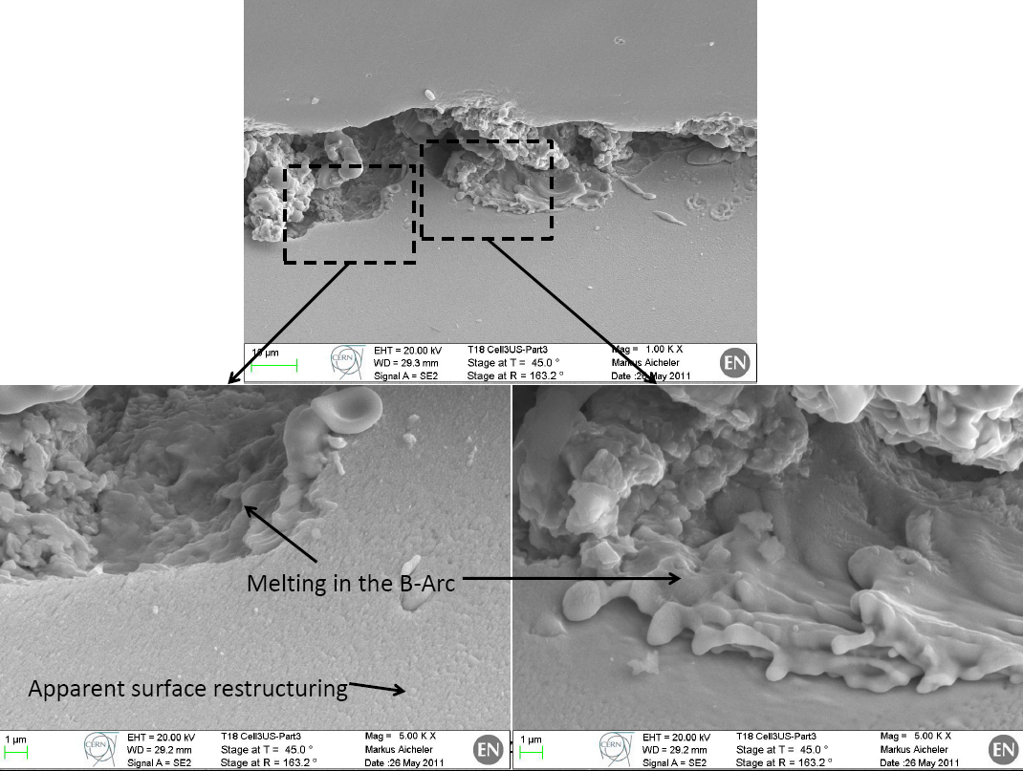

Slide 18
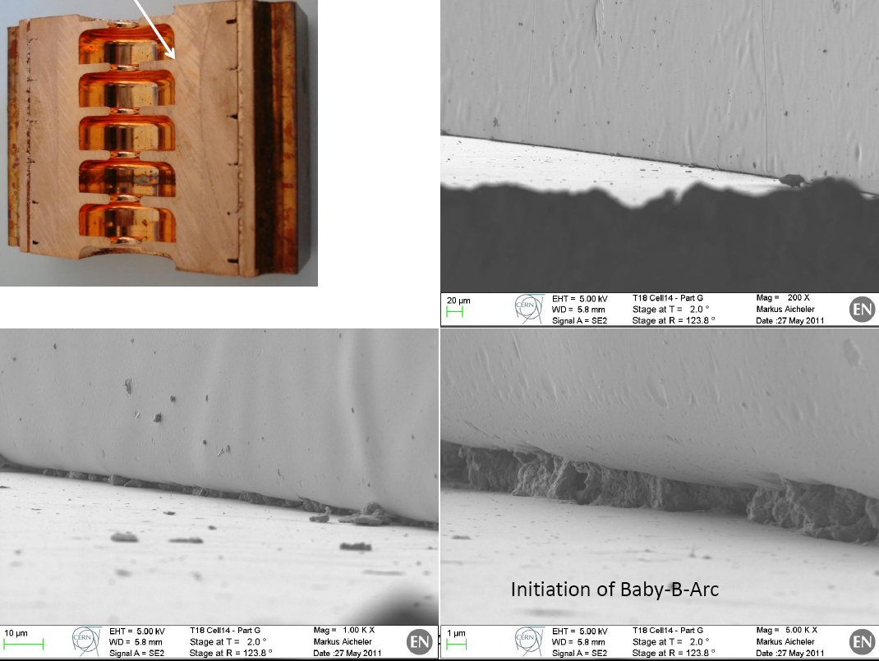

Slide 19
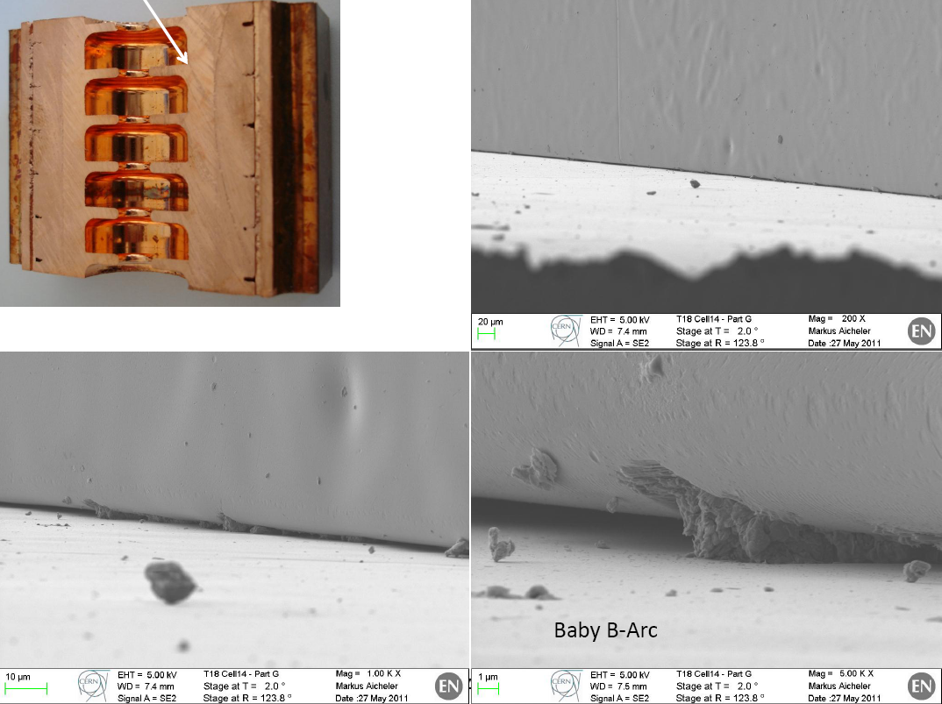

Slide 20
And now a single observation from before high-power testing. From EDMS document 1155046.
From a bonding test at Thales, under hydrogen with similar conditions to SLAC.

Slide 21
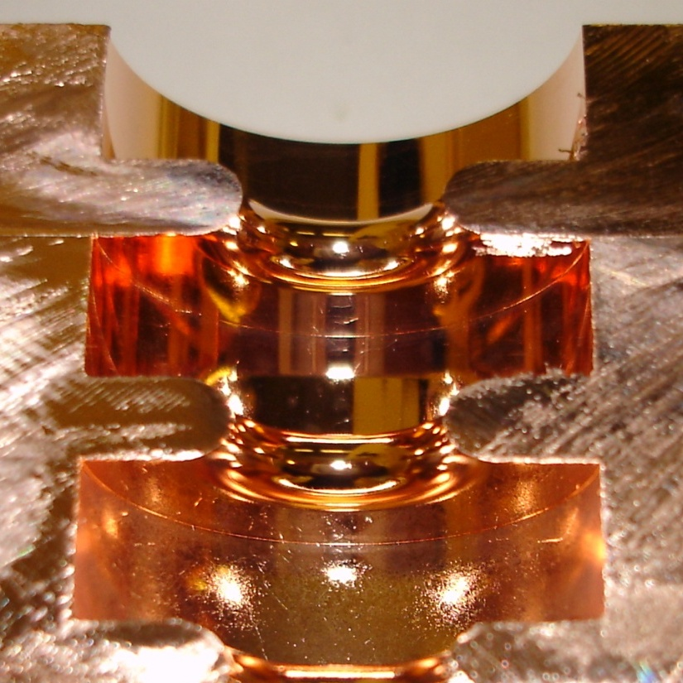

Slide 22
General feature of bonding?
It looks like there was a material flow driven by surface tension on the scale of microns during heating in this particular test.
The melting temperature is only a bulk quantity and it is known that surface tension is a useful concept on nanometer scales at room temperature, and we heat our structures close to the melting point. So this might have occurred.
I have no idea if such a flow is a common feature in our structures or not, if it occurs with our standard brazing technique or not.
We should look very carefully.
But if the flow feature is common…

Slide 23
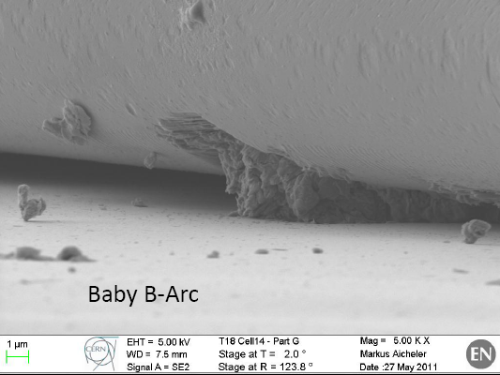
An effect of surface tension plus electromigration?
So does this evolve…
…into this?
If the such localized flow features exist, the surface currents will preferentially flow though them.
We get a current enhancement, increasing pulsed surface heating and electromigration.
These combined effects could then have a positive feedback and produce an instability.

Slide 24
Pulsed surface heating limit
TD24
Last
regular
cell: 19
Cell # (cell #1 is a input matching cell):
4
?16?
5
6
7
8
9
10
11
12
13
14
15
17
18
It seems that cell #10 (regular cell #9 ~ middle cell) exhibits the level of damage which could be considered as a limit.
A. Grudiev
Images courtesy of M. Aicheler: http://indico.cern.ch/getFile.py/access?contribId=0&resId=1&materialId=slides&confId=106251

