Slide 1
High Gradient Tests at SLAC
Presented on behalf of collaboration by
Valery Dolgashev,
SLAC National Accelerator Laboratory
2011 International Workshop on Future Linear Colliders (LCWS11),
26-30 September, 2011
Granada, Spain

Slide 2
This work is made possible by the efforts of SLAC’s
  S. Tantawi , J. Lewandowski, J. Neilson, J. Wang, A. Yeremian,
  C. Guo of Accelerator Technology Research
  E. Jongewaard, C. Pearson, A. Vlieks, J. Eichner, D. Martin, C. Yoneda, L. Laurent, A. Haase, R. Talley, J. Zelinski, J. Van Pelt,
  R. Kirby and staff of Klystron Lab.
  S. Weathersby, C. Hast, ARD Test Facilities
  Z. Li, Advanced Computation
In close collaboration with:
Y. Higashi, KEK, Tsukuba, Japan
B. Spataro, INFN, Frascati, Italy
Single-Cell-PBG structures done
in collaboration with R. Temkin, B. Munroe, R. Marsh, MIT
TW structures done in collaboration with W. Wuensch and CERN CLIC team
T18+resonat ring done in collaboration with J. Haimson and Haimson Research Corporation, data processing A. Palaia from Uppsala University

Slide 3
Outline
Motivation
Overview of experimental results
Recent results
  Cu-coated stainless steel structure
  Side-coupled structures
Planned experiments
  Dual mode accelerating cavity
  Triple choke cavity
More information on the program:
International workshop on Mechanisms of Vacuum Arcs, 27-30 June, 2011,University of Helsinki, Helsinki, Finland,
http://beam.acclab.helsinki.fi/hip/mevarc11/
5th Collaboration Meeting on X-band Accelerator Structure Design and Test Program,16-18 May, 2011, SLAC, https://slacportal.slac.stanford.edu/sites/ad_public/events/5th_collabmeet_xband_accel/Pages/agenda.aspx
US High Gradient Research Collaboration Workshop 2011, February 9-10, 2011, SLAC,
http://www-conf.slac.stanford.edu/hg2011/default.asp?id=home

Slide 4
Single Cell SW and short TW Accelerating Structures
Goals
Study rf breakdown in practical accelerating structures: dependence on circuit parameters, materials, cell shapes and surface processing techniques
Difficulties
Full scale structures are long, complex, and expensive
Solution
Single cell standing wave (SW) structures with properties close to that of full scale structures
Short traveling wave (TW) structures
Reusable couplers
We want to predict breakdown behavior
for practical structures

Slide 5
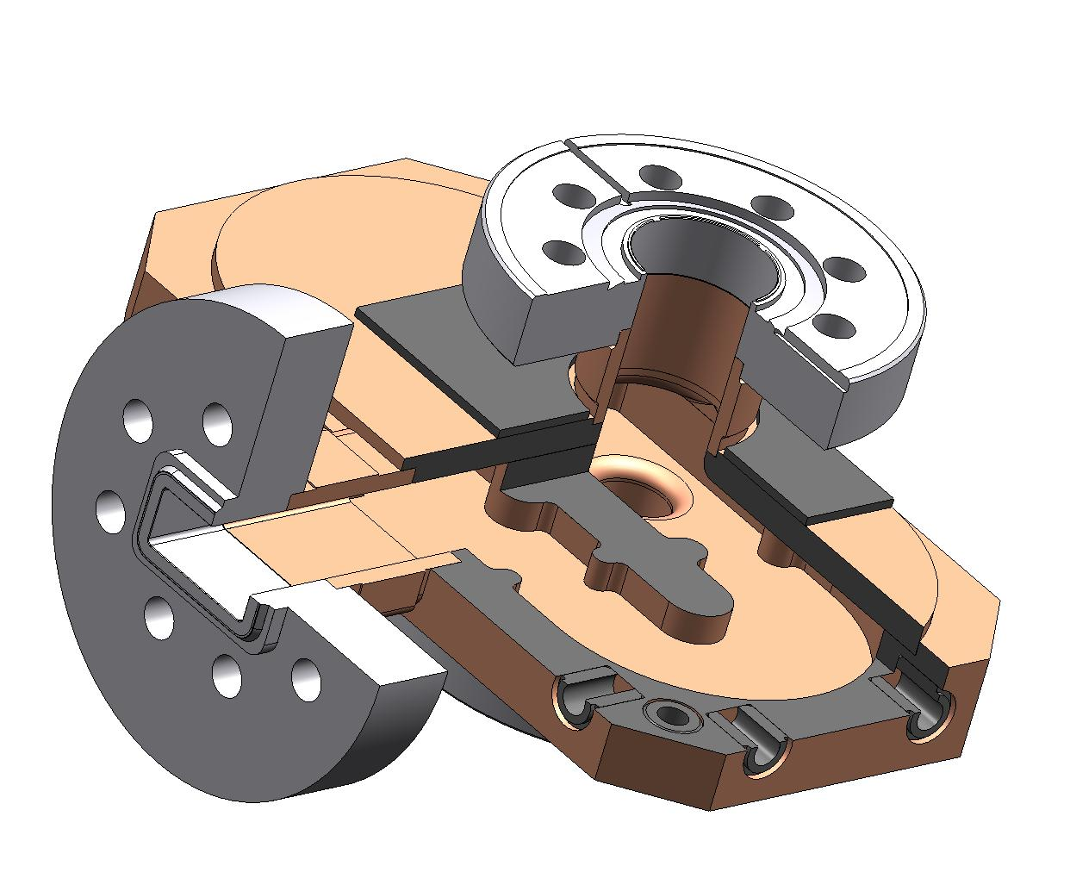
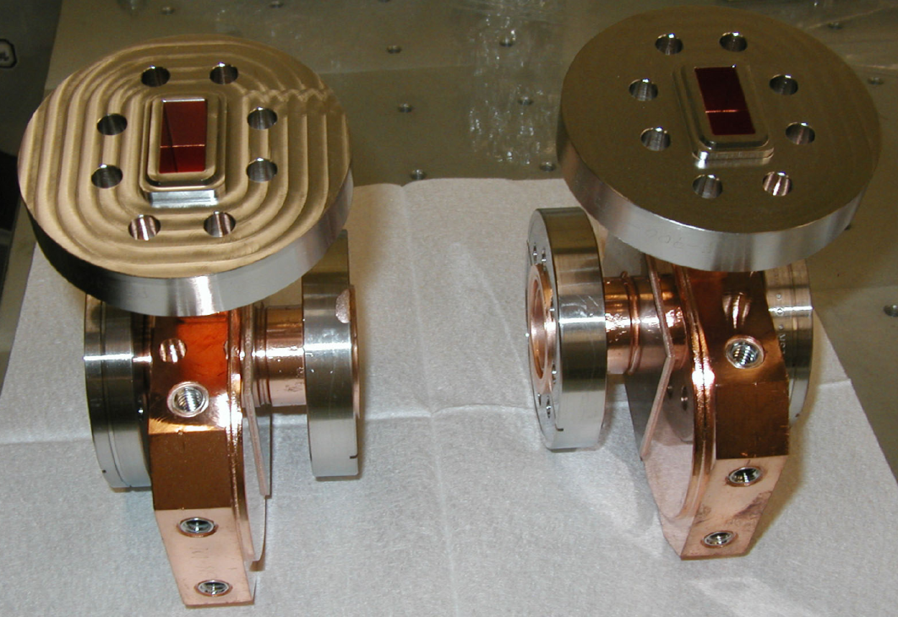
Reusable coupler: TM₀₁ Mode Launcher
Pearson’s RF flange
Cutaway view of the mode launcher
Two mode launchers
Surface electric fields in the mode launcher E_{max}= 49 MV/m for 100 MW
S. Tantawi, C. Nantista

Slide 6
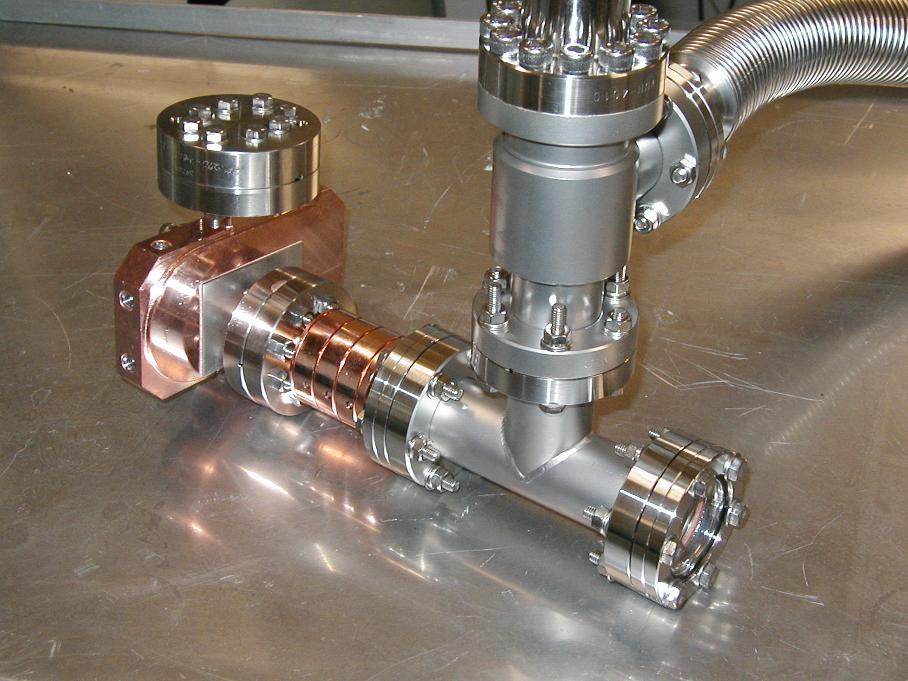
Yasuo Higashi, KEK

Slide 7
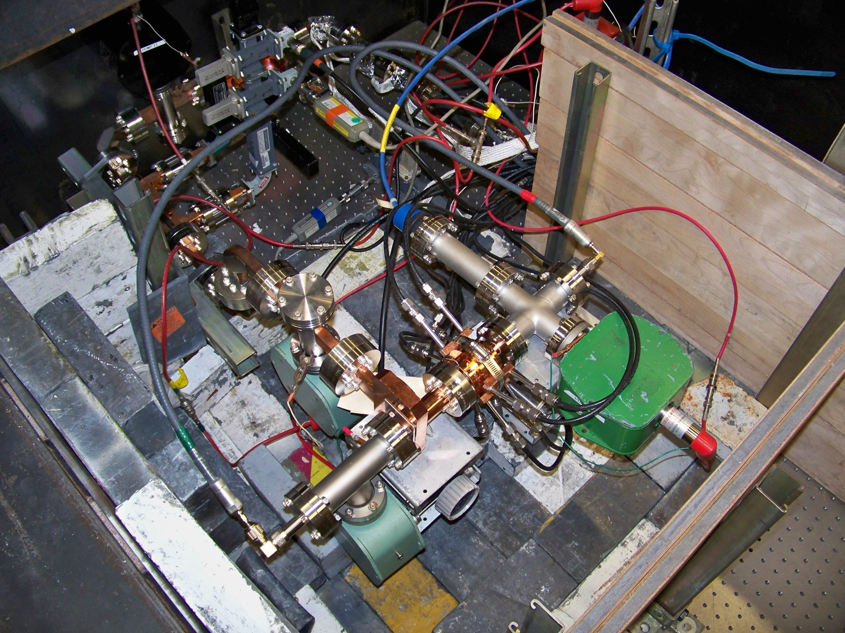
1C-SW-A5.65-T4.6-PBG2-Cu-SLAC-#1, 26 January 2011

Slide 8
High Power Tests of Single Cell Standing Wave Structures
Tested
Low shunt impedance, a/lambda = 0.215, 1C-SW-A5.65-T4.6-Cu, 5 tested
Low shunt impedance, TiN coated, 1C-SW-A5.65-T4.6-Cu-TiN, 1 tested
Three high gradient cells, low shunt impedance, 3C-SW-A5.65-T4.6-Cu, 2 tested
High shunt impedance, elliptical iris, a/lambda = 0.143, 1C-SW-A3.75-T2.6-Cu, 1 tested
High shunt impedance, round iris, a/lambda = 0.143, 1C-SW-A3.75-T1.66-Cu, 1 tested
Low shunt impedance, choke with 1mm gap, 1C-SW-A5.65-T4.6-Choke-Cu, 2 tested
Low shunt impedance, made of CuZr, 1C-SW-A5.65-T4.6-CuZr, 1 tested
Low shunt impedance, made of CuCr, 1C-SW-A5.65-T4.6-CuCr, 1 tested
Highest shunt impedance copper structure 1C-SW-A2.75-T2.0-Cu, 1 tested
Photonic-Band Gap, low shunt impedance, 1C-SW-A5.65-T4.6-PBG-Cu, 1 tested
Low shunt impedance, made of hard copper 1C-SW-A5.65-T4.6-Clamped, 1 tested
Low shunt impedance, made of molybdenum 1C-SW-A5.65-T4.6-Mo, 1 tested
Low shunt impedance, hard copper electroformed 1C-SW-A5.65-T4.6-Electroformed-Cu, 1 tested
High shunt impedance, choke with 4mm gap, 1C-SW-A3.75-T2.6-4mm-Ch-Cu, 2 tested
High shunt impedance, elliptical iris, a/lambda = 0.143, 1C-SW-A3.75-T2.6-6NCu, 1 tested
High shunt impedance, elliptical iris, a/lambda = 0.143, 1C-SW-A3.75-T2.6-6N-HIP-Cu, 1 tested
High shunt impedance, elliptical iris, a/lambda = 0.143, 1C-SW-A3.75-T2.6-7N-Cu, 1 tested
Low shunt impedance, made of CuAg, 1C-SW-A5.65-T4.6-CuAg-SLAC-#1, 1 tested
High shunt impedance hard CuAg structure 1C-SW-A3.75-T2.6-LowTempBrazed-CuAg, 1 tested
High shunt impedance soft CuAg, 1C-SW-A3.75-T2.6-CuAg, 1 tested
High shunt impedance hard CuZr, 1C-SW-A3.75-T2.6-Clamped-CuZr, 1 tested
High shunt impedance single feed side coupled, 1C-SW-A3.75-T2.6-1WR90-Cu-SLAC-#1, 1 tested
High shunt impedance hard CuCr, 1C-SW-A3.75-T2.6-Clamped-CuCr, 1 tested
High shunt impedance double feed side coupled 3C-SW-A3.75-T2.6-2WR90-Cu-SLAC, 2 tested
Highest shunt impedance hard copper structure 1C-SW-A2.75-T2.0-Clamped-Cu, 1 tested
Low shunt impedance Photonic-Band Gap with elliptical rods 1C-SW-A5.65-T4.6-PBG2-Cu-SLAC-#1, 1 tested
Highest shunt impedance, copper coated stainless steel 1C-SW-A2.75-t2.0-Clamped-SS-SLAC-#1, 1 tested
Now 36th test is about to start,
Highest shunt impedance, hard copper 1C-SW-A2.75-t2.0-Clamped-Cu-SLAC-#2

Slide 9
Next experiments, as for September 2011
New diagnostics:
High shunt impedance, full choke cell with a viewport, 1C-SW-A3.75-T2.6-Ch-View-Port-Cu
Geometry tests:
High shunt impedance, triple choke, copper, 1C-SW-A3.75-T2.6-4mm-TripleCh-Cu
High shunt impedance, reduced magnetic field, copper 1C-SW-A3.75-T2.2-Cu
Materials:
High shunt impedance, made of hard CuAg, 1C-SW-A3.75-T2.6-Clamped-CuAg,
Highest shunt impedance, made of hard CuCr, CuAg, CuZr, 1C-SW-A2.75-T2.0-Clamped-CuCr,
CuAg, CuZr
High shunt impedance, triple choke, Molybdenum, 1C-SW-A3.75-T2.6-4mm-TripleCh-Mo
High shunt impedance, Cu-Mo, 1C-SW-A3.75-T2.6-Cu-Mo
High shunt impedance, Cu-Stainless Steel, 1C-SW-A3.75-T2.6-Cu-SUS
Highest shunt impedance, cryogenic test, 1C-SW-A2.75-T2.0-Cryo-Cu
Reproducibility tests:
High shunt impedance, round iris, 1C-SW-A3.75-T1.66-Cu
Three high gradient cells, low shunt impedance, 3C-SW-A5.65-T4.6-Cu

Slide 10
Material tests
Highest shunt impedance, copper coated stainless steel
1C-SW-A2.75-t2.0-Clamped-SS-SLAC-#1
Specified coating thickness
0.0001-0.0002 inch

Slide 11
Motivation
Study effect of thin copper layer (few skin depth) on breakdown behavior:
Processing
Ultimate breakdown rate
Pulse length dependence
Behavior with high pulse heating
Bulk material with melting temperature and higher yield stress higher then copper may improve the breakdown performance of the structure.

Slide 12
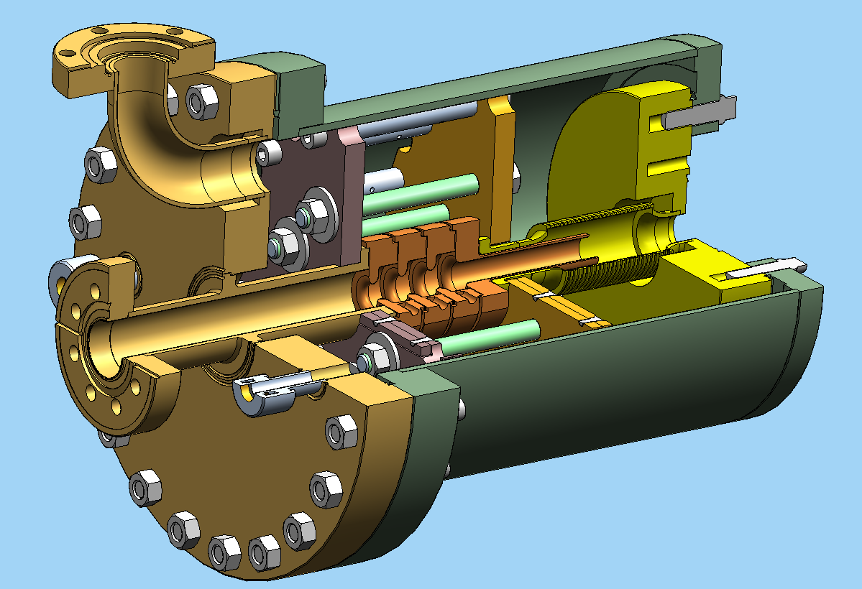
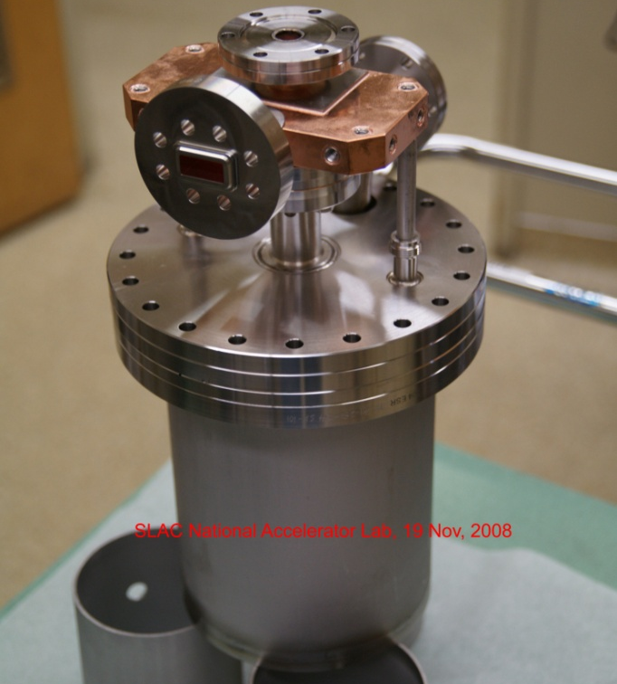
Material Tests Without Brazing
Clamped Structure
The clamped structure will provide a method for testing materials without the need to develop all the necessary technologies for bonding and brazing them.
Once a material is identified, we can devise constriction methods to building structures.
Furthermore, it will provide us the opportunity to test hard materials without annealing which typically accompany the brazing process

Slide 13
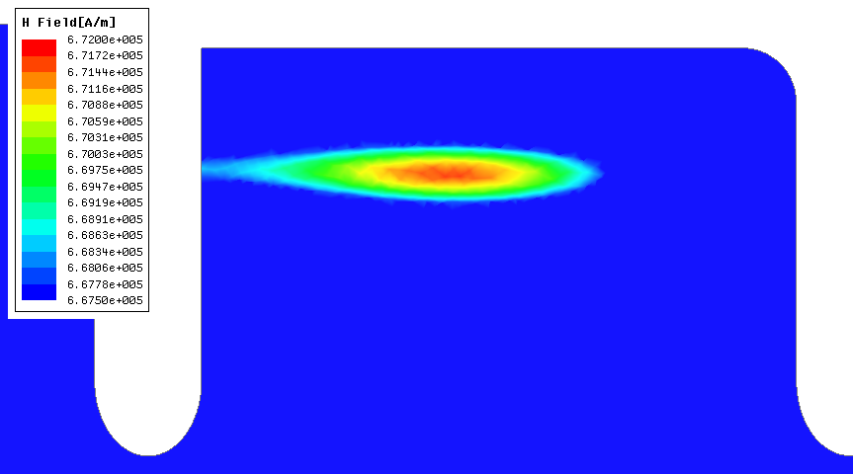
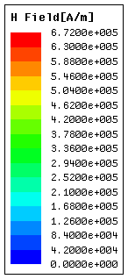
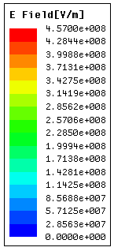
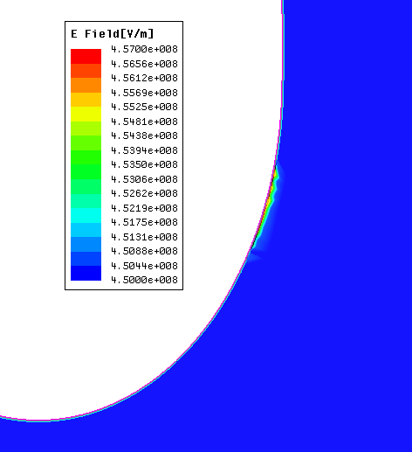
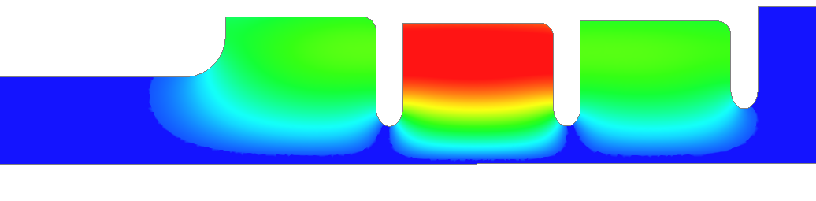
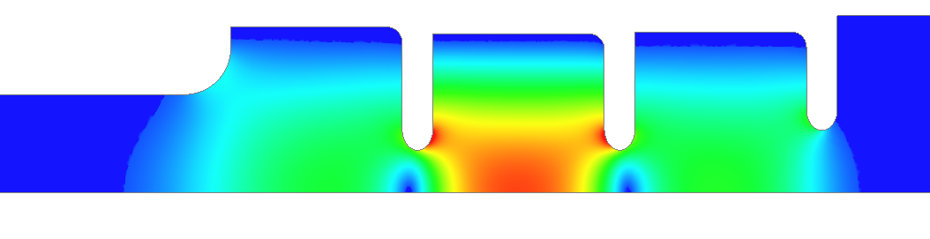
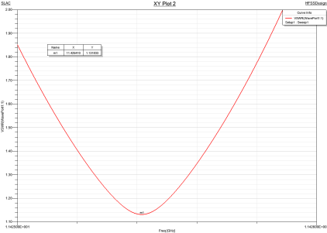
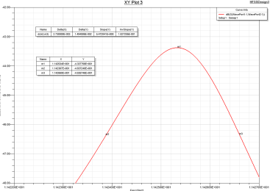
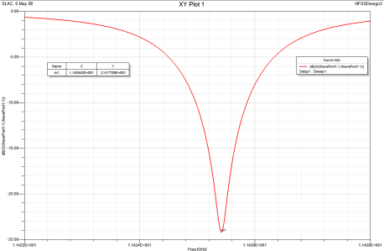
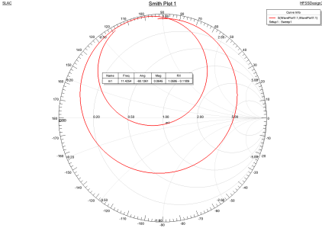
Highest Shunt Impedance SW-A2.75-T2.0-Cu
10 MW input
Maximum magnetic field 667.5 kA/m
(SLANS 666.8 kA/m)
Maximum electric field 457 MV/m
(SLANS 456.3 MV/m )
Resonance at 11.42542 GHz
β = 1.131
Over-coupled loaded Q
(SLANS 11.42398 GHz)
(SLANS 1.164)
Unloaded Q=8,919
(SLANS 8,9594)
V.A. Dolgashev, 6 May 2008

Slide 14
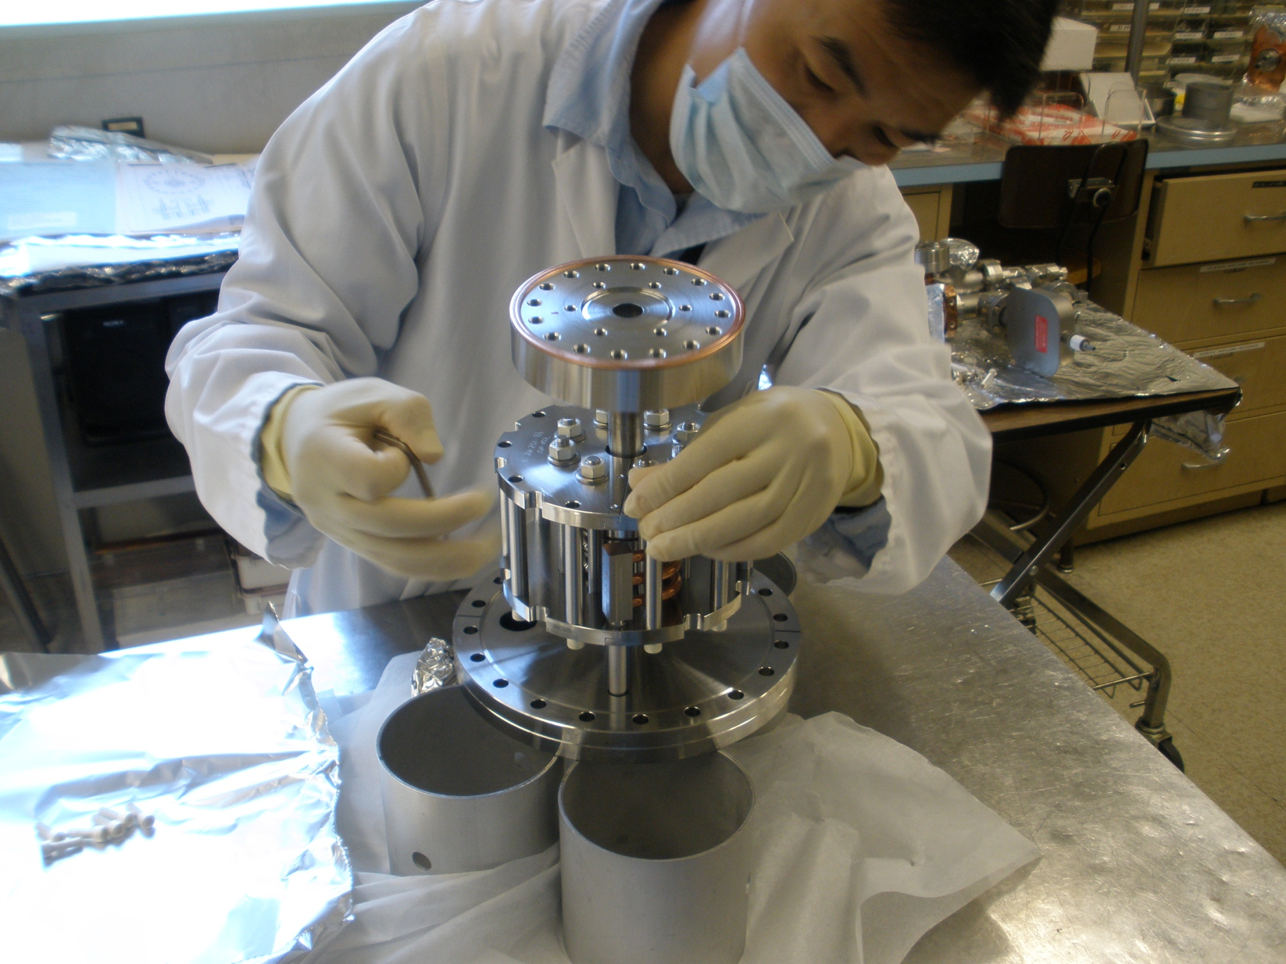
SLAC, 14 September 2011

Slide 15
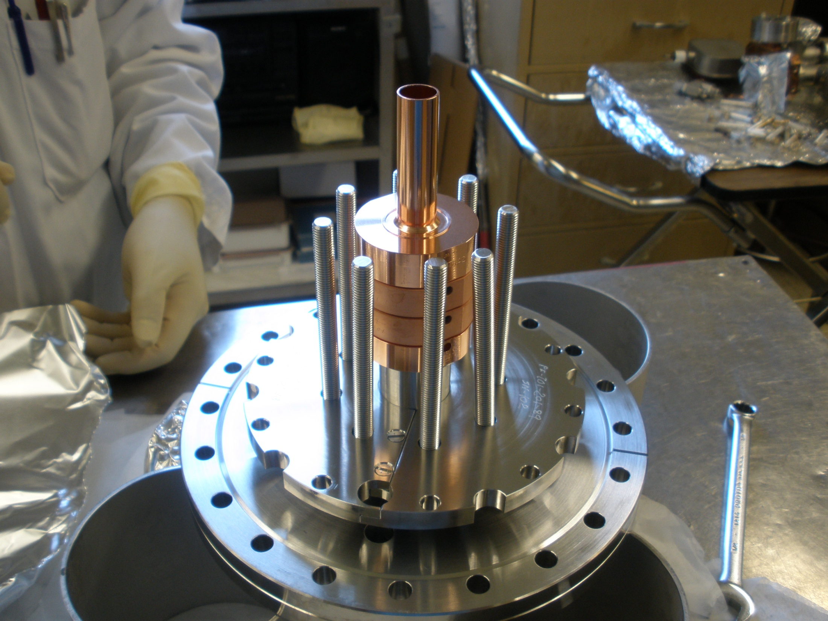
1C-SW-A2.75-t2.0-Clamped-SS-SLAC-#1
SLAC, 14 September 2011

Slide 16
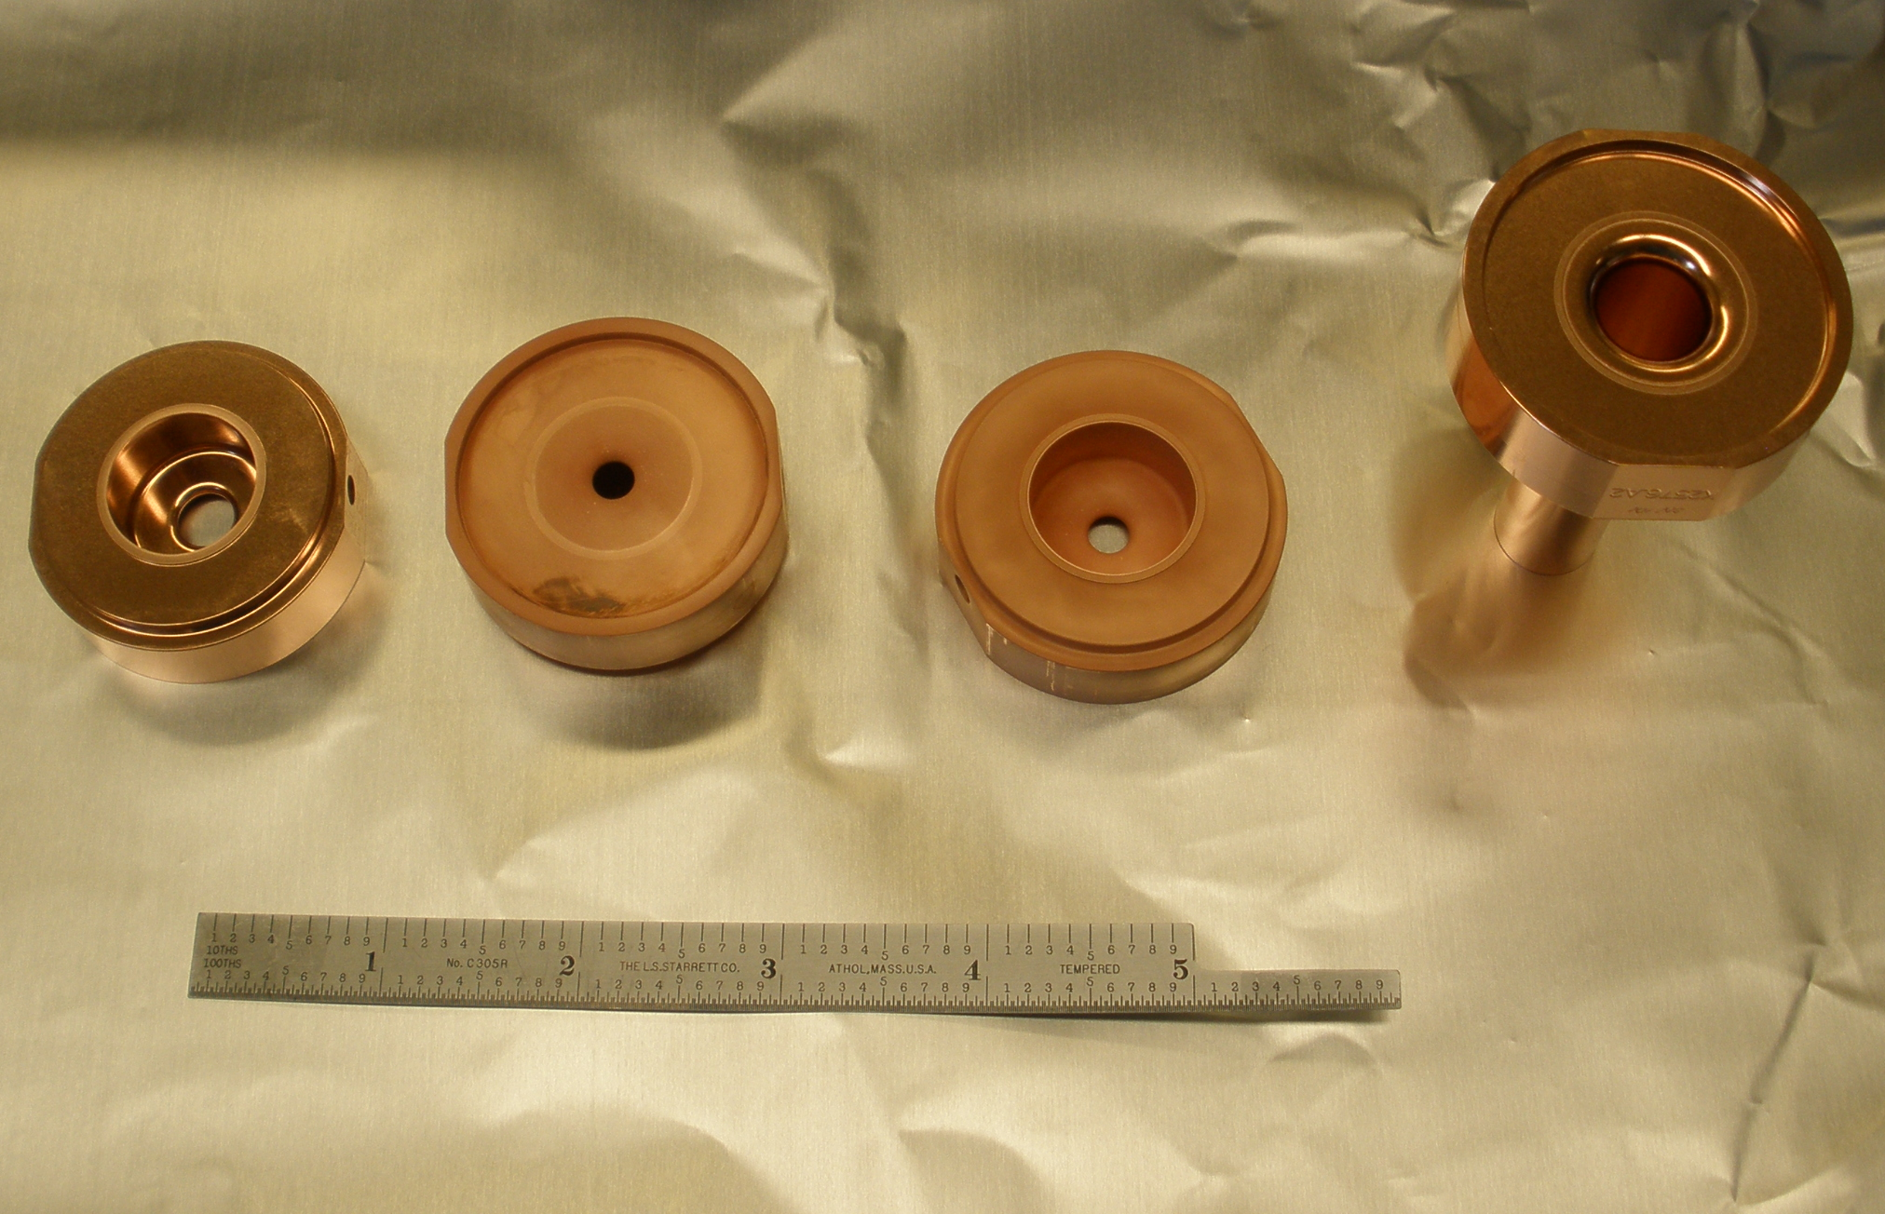
1C-SW-A2.75-t2.0-Clamped-SS-SLAC-#1
Low –field side of the coated cells
SLAC, 14 September 2011

Slide 17
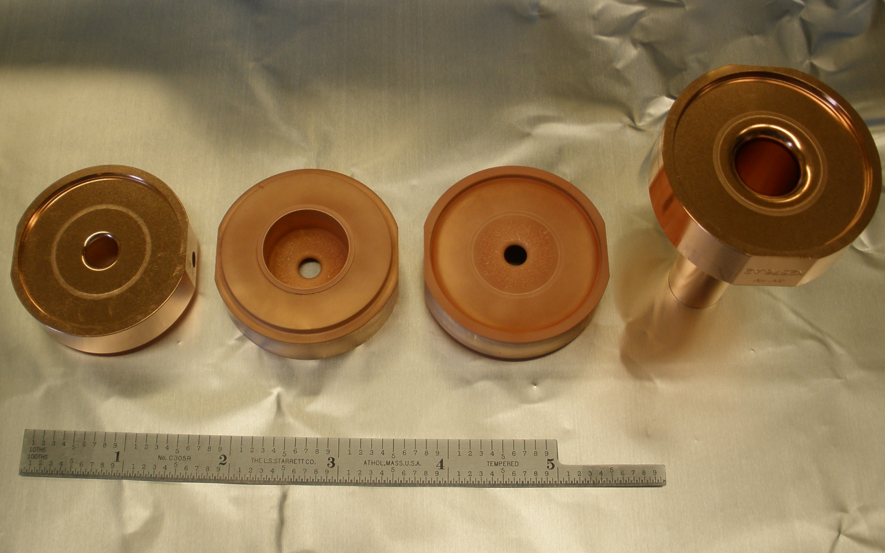
1C-SW-A2.75-t2.0-Clamped-SS-SLAC-#1
High –field side of the coated cells
SLAC, 14 September 2011

Slide 18
Slow Initial conditioning
~20,000 breakdowns
Gradient [MV/m]
7/5- 7/28/2011
All breakdowns
8/8- 8/11/2011
Peak temp. [deg. C]
First breakdowns
Processing on 6 July 2011
8/8- 8/11/2011
7/5- 7/28/2011
150 ns flat

Slide 19
Comparison of soft and copper-plated stainless steel 1C-SW-A2.75-T2.0 structures, different pulse length
Copper-plated stainless steel
Soft copper
600 ns
400 ns
600 ns
150 ns
150 ns
200 ns
400 ns
600 ns
150 ns
600 ns
400 ns
400 ns
150 ns
200 ns

Slide 20
Comparison of soft and copper-plated stainless steel
1C-SW-A2.75-T2.0 structures, different pulse length
Cu-on-SS
Cu-on-SS
soft Cu
soft Cu
soft Cu
soft Cu
Cu-on-SS
Cu-on-SS
150 ns flat
400 ns flat

Slide 21
Double Pulse Experiment, mapping time dependence of rf breakdown rate

Slide 22
Double Pulse Experiment,
Practical pulse shapes
No second pulse
Second pulse with 100 ns delay

Slide 23
Double Pulse Experiment, mapping time dependence of rf breakdown rate

Slide 24
Results of tests of Cu-coated stainless steel structure
Structure processed to ultimate breakdown rate relatively slow (in ~ 20,000 breakdowns) but in regular manner – after consequent power increase the rate dropped in about an hour.
The coated structure higher breakdown rate then the soft-Cu structure.
Breakdown rate is correlated with peak pulse heating similar to soft-copper structure. But the coated structure has much higher temperature for the same breakdown rate (40 deg. C vs. 180 deg. C for ~3 10⁻⁴ /pulse/meter, 150 ns flat pulse).

Slide 25
Overview of results from three side-coupled structures
High shunt impedance single-feed side coupled,
1C-SW-A3.75-T2.6-1WR90-Cu-SLAC-#1, and two
High shunt impedance dual-feed side coupled 3C-SW-A3.75-T2.6-2WR90-Cu-SLAC-#1, #2
V.A. Dolgashev et al., Status of High Power Tests of Normal Conducting Short Standing Wave Structures, MOPC071, Proc. of IPAC´11, San Sebastian, Spain, 2011

Slide 26
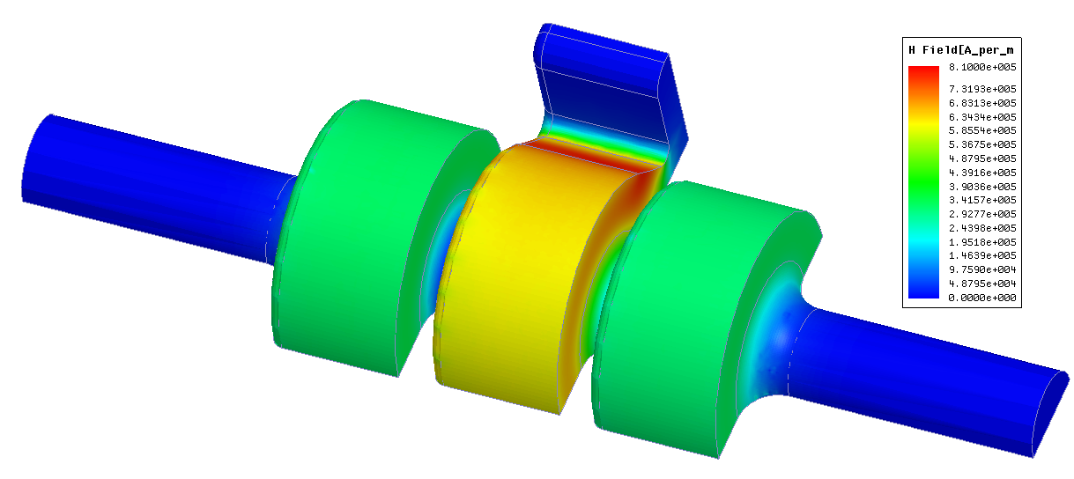
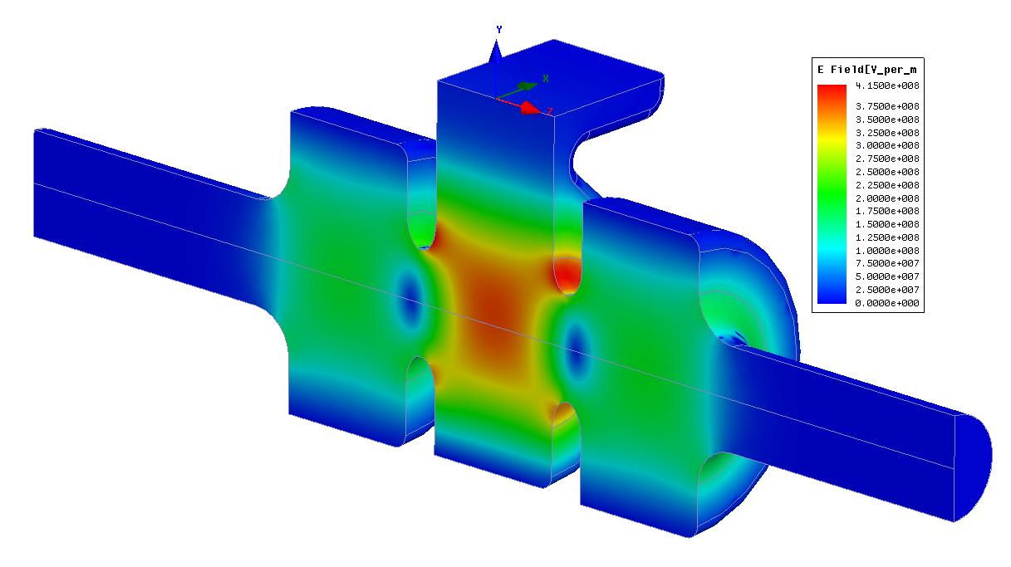

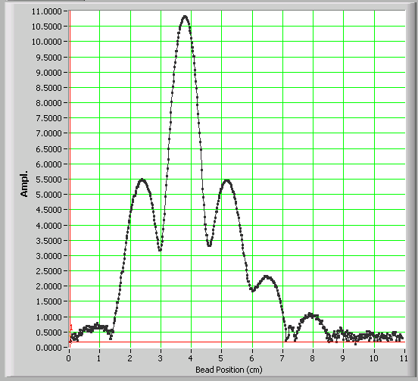
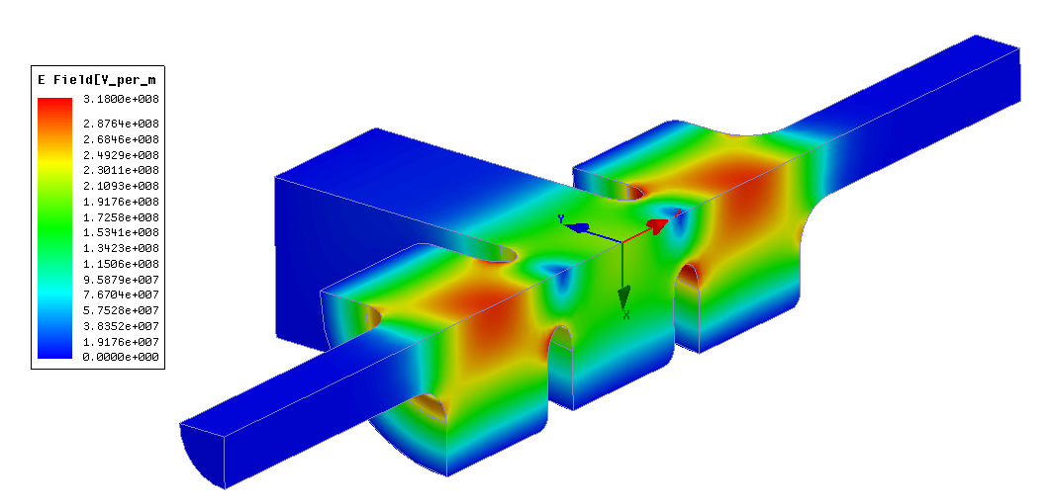
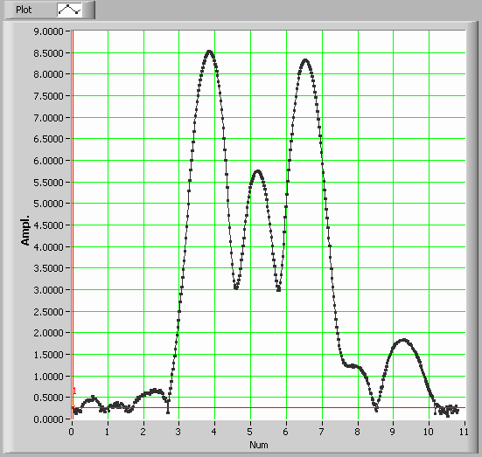
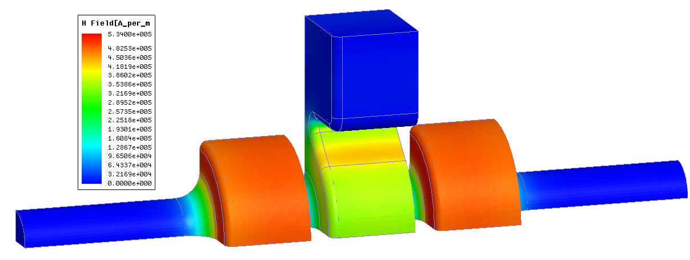
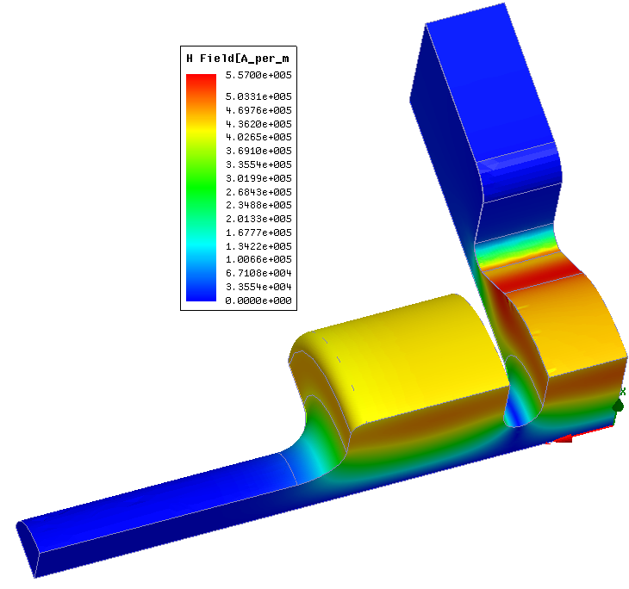
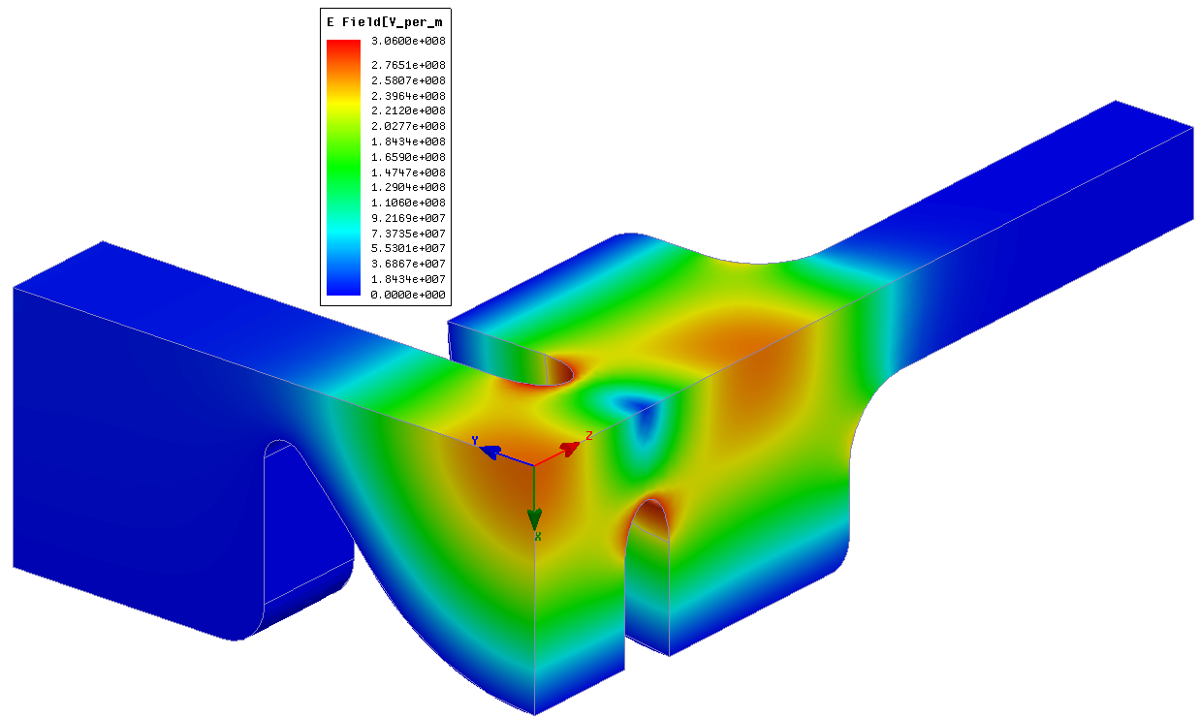
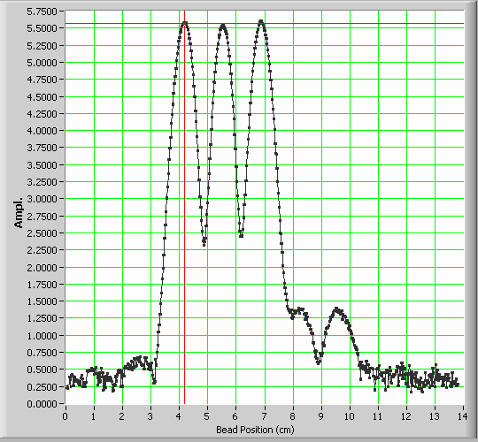
Tested side-coupled structures,
field normalized to 10 MW of rf loss
1)
RF magnetic field, Hmax=0.8MA/m
RF electric field, Emax=0.4 GV/m
On axis electric fields
Single feed, a/λ= 0.143, 1C-SW-A3.75-T2.6-1WR90-Cu-SLAC-#1
2)
RF magnetic field, Hmax 0.53 MA/m
RF electric field, Emax=0.3 GV/m
On axis electric fields
Dual feed, a/λ= 0.143, low coupler fields, 3C-SW-A3.75-T2.6-2WR90-Cu-SLAC-#1
3)
RF magnetic field, Hmax=0.56 MA/m,
RF electric field, Emax=0.3 GV/m,
Dual feed, a/λ= 0.143, equal fields, 3C-SW-A3.75-T2.6-2WR90-Cu-SLAC-#2
On axis electric fields
Bead-pulls by Jim Lewandowski

Slide 27
Breakdown rate for different pulse length for the single-feed structure 1WR90-Cu-SLAC-#1
vs. gradient and pulse heating
600 ns
150 ns
600 ns
400 ns
150 ns
400 ns
Correlation of the breakdown rate with peak pulse heating is typical for most of the single cell structures.

Slide 28
Breakdown rate vs. gradient and peak pulse heating for one single-feed coupled and three on axis coupled structures:
single-feed structure 1WR90-Cu-SLAC-#1;
on-axis coupled Cu-SLAC-#1, 6N-HIPKEK-#1, and 7N-KEK-#1 .
The rf pulse is shaped with flat-top of 150 ns.
6N-HIPKEK-#1
7N-KEK#1
Single-feed
6N-HIPKEK-#1
Single-feed
SLAC-#1
SLAC-#1
Single-feed structure have similar performance
as on-axis coupled structures although it has higher peak pulse heating.

Slide 29
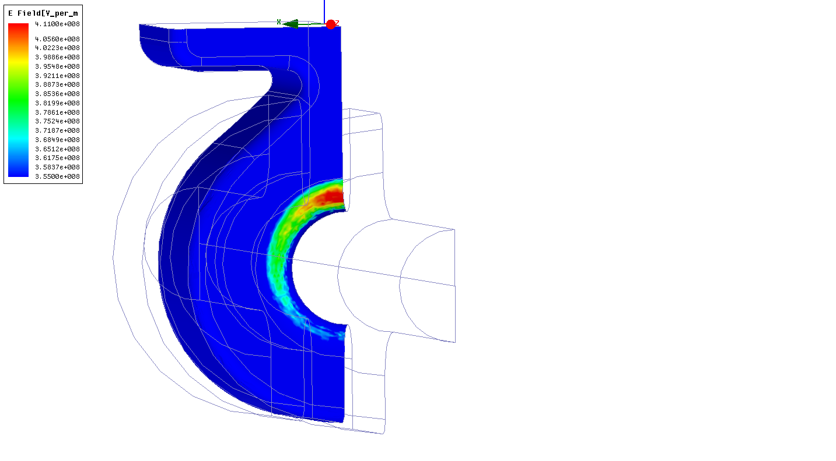
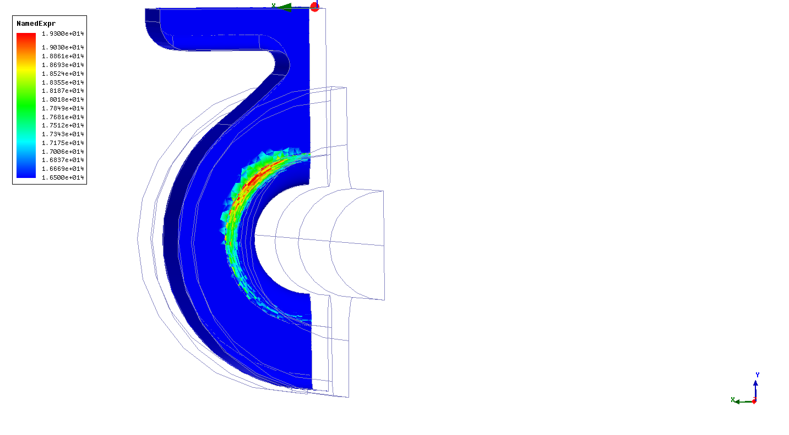
SEM inspection of single-feed
1C-SW-A3.75-T2.6-1WR90-Cu-SLAC-#1
Area with maximum peak Poyniting vector with intense breakdown damage.
Area with maximum peak electric fields with little breakdown damage.
The breakdown damage in this structure was correlated more with the location of the peak Poyning vector than with the location of the peak electric or magnetic fields field.
SEM by Lisa Laurent

Slide 30
Breakdown rate vs. gradient and peak pulse heating
for two dial-feed and one on-axis-coupled structures.
The structures are: dual-feed 2WR90-Cu-SLAC-#1and 2WR90-SLAC-#2, and on-axis-coupled Cu-SLAC-#1. RF pulse with 200 ns flat-top.
dual-feed #1
dual-feed #1
dual-feed #2
on-axis
SLAC-#1
on-axis
SLAC-#1
dual-feed #2
Both dual-feed structures show similar behavior
and higher breakdown rate then on-axis coupled structure.
There is no obvious correlation of the breakdown rate and peak pulse heating.

Slide 31
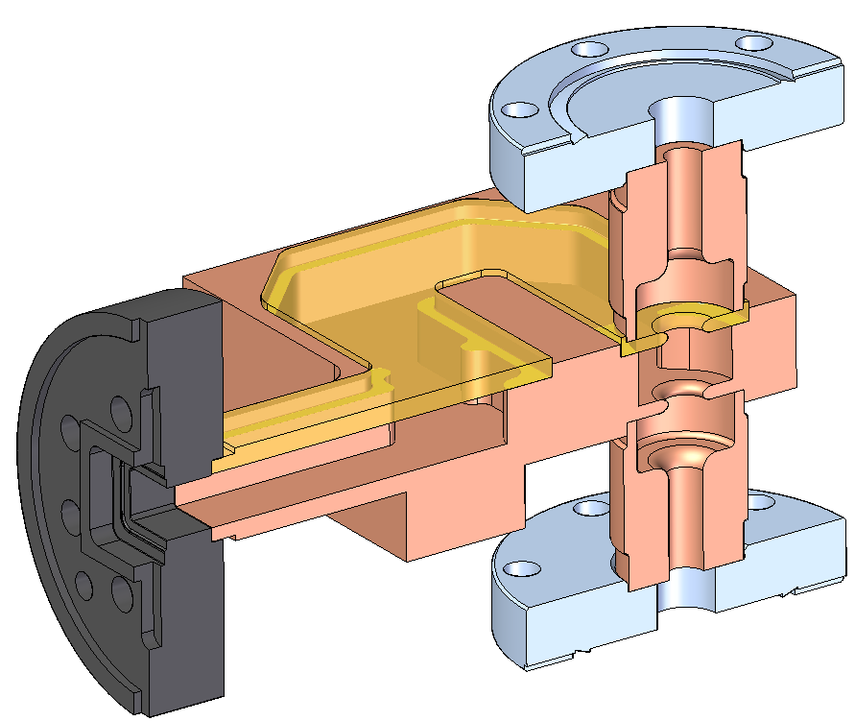
Breakdown rate for different pulse length for the two dual-feed structures 1WR90-Cu-SLAC-#1, #2 vs. pulse heating
150 ns
150 ns
400 ns
600 ns
600 ns
400 ns
Two dual feed structures show same behavior: breakdown rate does not show obvious correlating with peak pulse heating temperature.

Slide 32
SEM inspection of dual-feed, low coupler fields,
3C-SW-A3.75-T2.6-1WR90-Cu-SLAC-#1
Coupler iris area including area of manufacturing error, no breakdown damage.
End cell wall, typical pulse heating damage.
End cell iris, typical breakdown damage on end cell side.
SEM by Lisa Laurent

Slide 33
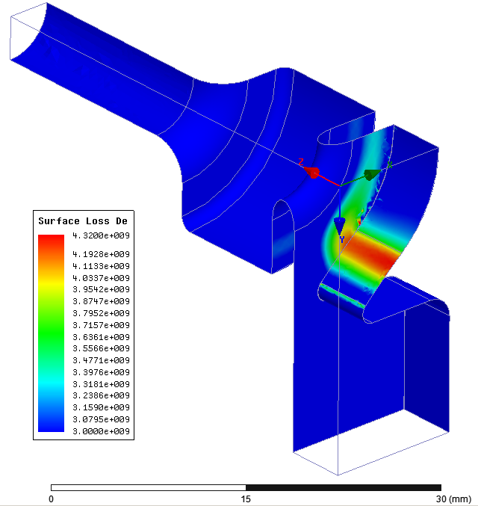
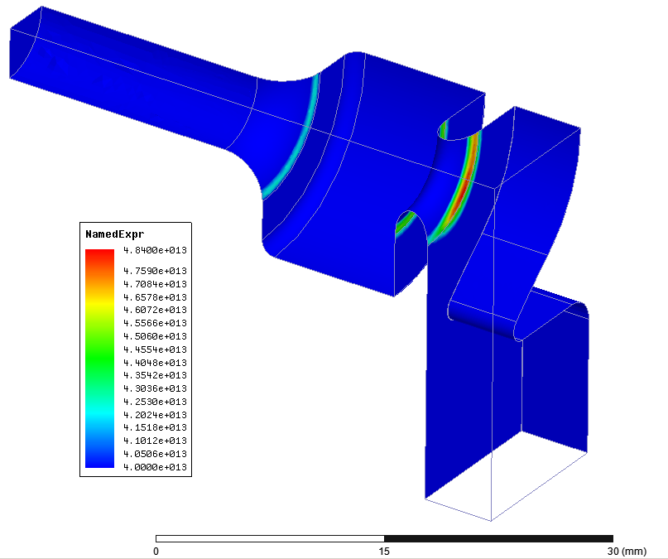
1C-SW-A3.75-T2.6-2WR90-Cu-SLAC-#2
Calculating Zenghai’s geometry with HFSS, first order elements, driven, 10 MW input
4.2 GW/cm²
4.4 GW/cm²
0.3 MW/cm²
4.8 GW/cm²
0.43 MW/cm²
Surface loss density
Im(E×H*)
Peak electric, peak magnetic, and peak Poynting vector
are all located in the coupler cell which has minimal breakdown damage.
V.A. Dolgashev, 24 June 2011

Slide 34
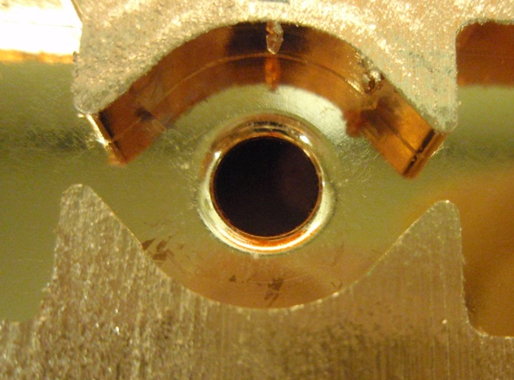
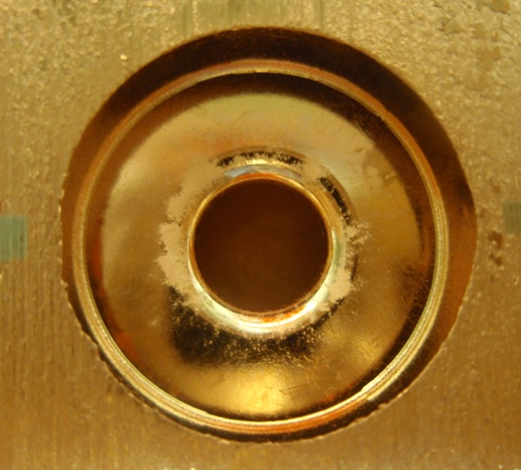
Autopsy of dual-feed, equal fields,
3C-SW-A3.75-T2.6-1WR90-Cu-SLAC-#1
Coupler cell
End cell
L. Laurent

Slide 35
SEM inspection of dual-feed, equal fields,
3C-SW-A3.75-T2.6-1WR90-Cu-SLAC-#1
Coupler cell, typical pulse heating damage near coupling irises, but little breakdown damage.
Coupler cell, area near WR90 waveguide coupling iris, no breakdown damage associated with increased magnetic field.
End cell, little pulse heating damage and intense breakdown damage.
SEM by Lisa Laurent

Slide 36
Results from tests of three side-coupled structures
We tested three side coupled structures: one single feed and two double-feed. All structures had different on-axis field profile.
The single-feed structure did not show higher rf breakdown rate due to increased magnetic field in the coupler. The breakdown damage in this structure was correlated more with the location of the peak Poyning vector than with the location of the peak electric field.
Two dual-feed structures showed moderately higher breakdown rate as compared with both the on-axis coupled structures and the single-feed structure. SEM examination of both structures showed breakdown damage in the end-cells, even for the dual-feed structure #2 with fields higher in coupler cell.
We believe that these experiments represent a good test-bed for the subsystems of the full scale parallel coupled structures. The results are promising because they do now show obvious degradation of the breakdown performance due to enhanced magnetic field near the couplers.

Slide 37
Future experiments

Slide 38
Dual Mode Cavity
Motivation:
The goal for a dual mode cavity is to study the effect of the rf magnetic field on the operational accelerating gradient determined by rf breakdowns in a geometry as close as practical to a standing wave accelerator cell.
S. Tantawi, "Experimental Evaluation of Magnetic Field Effects on Breakdown Rates", CERN Breakdown Physics Workshop, May 2010
A. D. Yeremian et al., A Dual-mode Accelerating Cavity to Test RF Breakdown Dependence on RF Magnetic Fields, MOPC073, Proc. of IPAC´11, San Sebastian, Spain, 2011

Slide 39
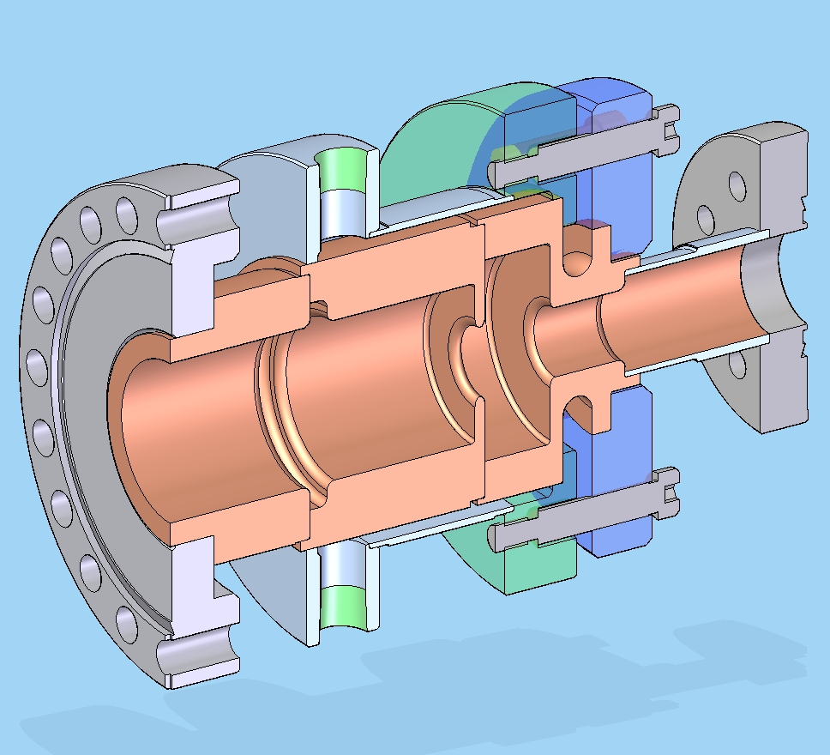
Dual mode accelerating structure
TM01 in
TE01 in
Engineering: Gordon Bowden
Solid model: Bob Reed

Slide 40
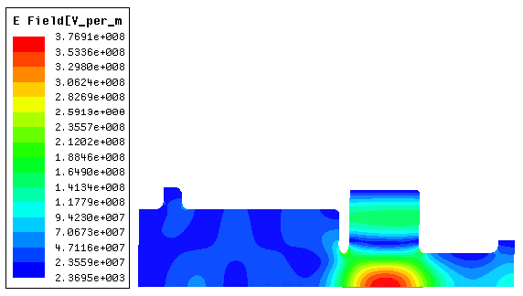
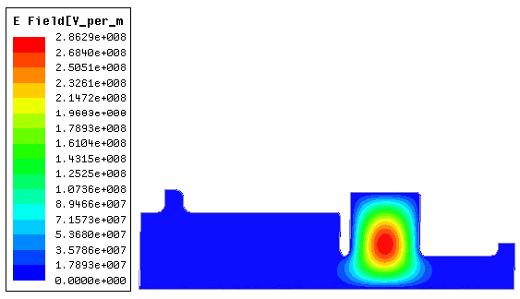
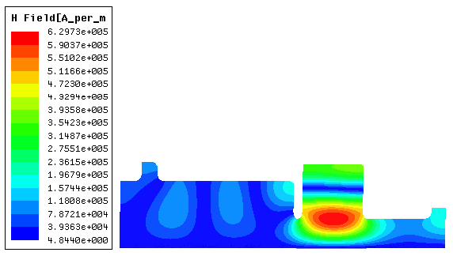

RF Electric and Magnetic Fields for 10MW Power Loss
TM020 Mode
TE011 Mode
a)
a)
Electric Field
Electric Field
RF in
RF in
b)
b)
Magnetic Field
Magnetic Field
RF in
RF in
A.. D. Yeremian, V. A. Dolgashev, S. G. Tantawi, 2011

Slide 41
Cavity Parameters for Speed-of-Light Electron
TM020 mode
Shunt Impedance = 29.40 MOhm/m 10MW Loss 100 MV/m
Ave on-axis Acc. (MV/m) 121.78 100.00
Accel. Across Cav. (MeV) 2.41 1.98
Max. Surface E (MV/m) 278.26 229.30
Max. Surface H (kA/m) 506.40 416.29
Stored Energy (J) 2.69 1.81
Power Loss (MW) 10.00 6.74
For the same gradient surface electric and magnetic fields are similar to those in single cell standing wave structures

Slide 42
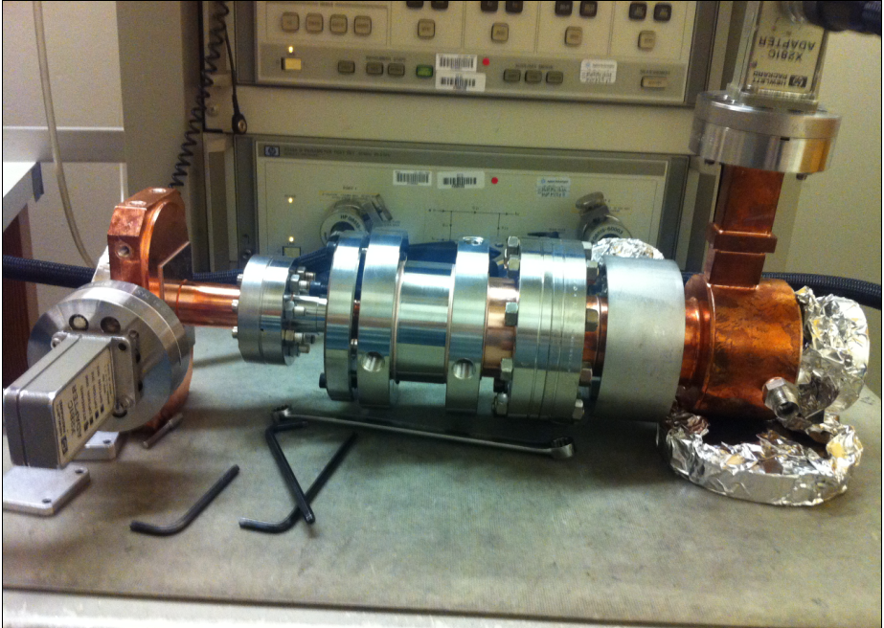
Dual-mode cavity tuning
Jim Lewandowski, 18 August 2011
Simulation
Parameter | Simulation | Meas. @ Rm T
f_{TE011} - GHz | 11.42419 | 11.42175
f_{TM020} - GHz | 11.42413 | 11.42119
Qo_{TE011} | 19754 | 20240
Qo_{TM020} | 19292 | 19485
S11_{TE011}-dB (fraction) | -22 (0.078) | -22 (0.08)
S11_{TM020}-dB (fraction) | -25 (0.056) | -25 (0.05)
b_{TE01} | 1.17 | 1.18
b_{TM01} | 1.11 | 1.11
Shunt Imp. - MOhm/m | 29.4 | -
TE01
TM01
Measurement

Slide 43
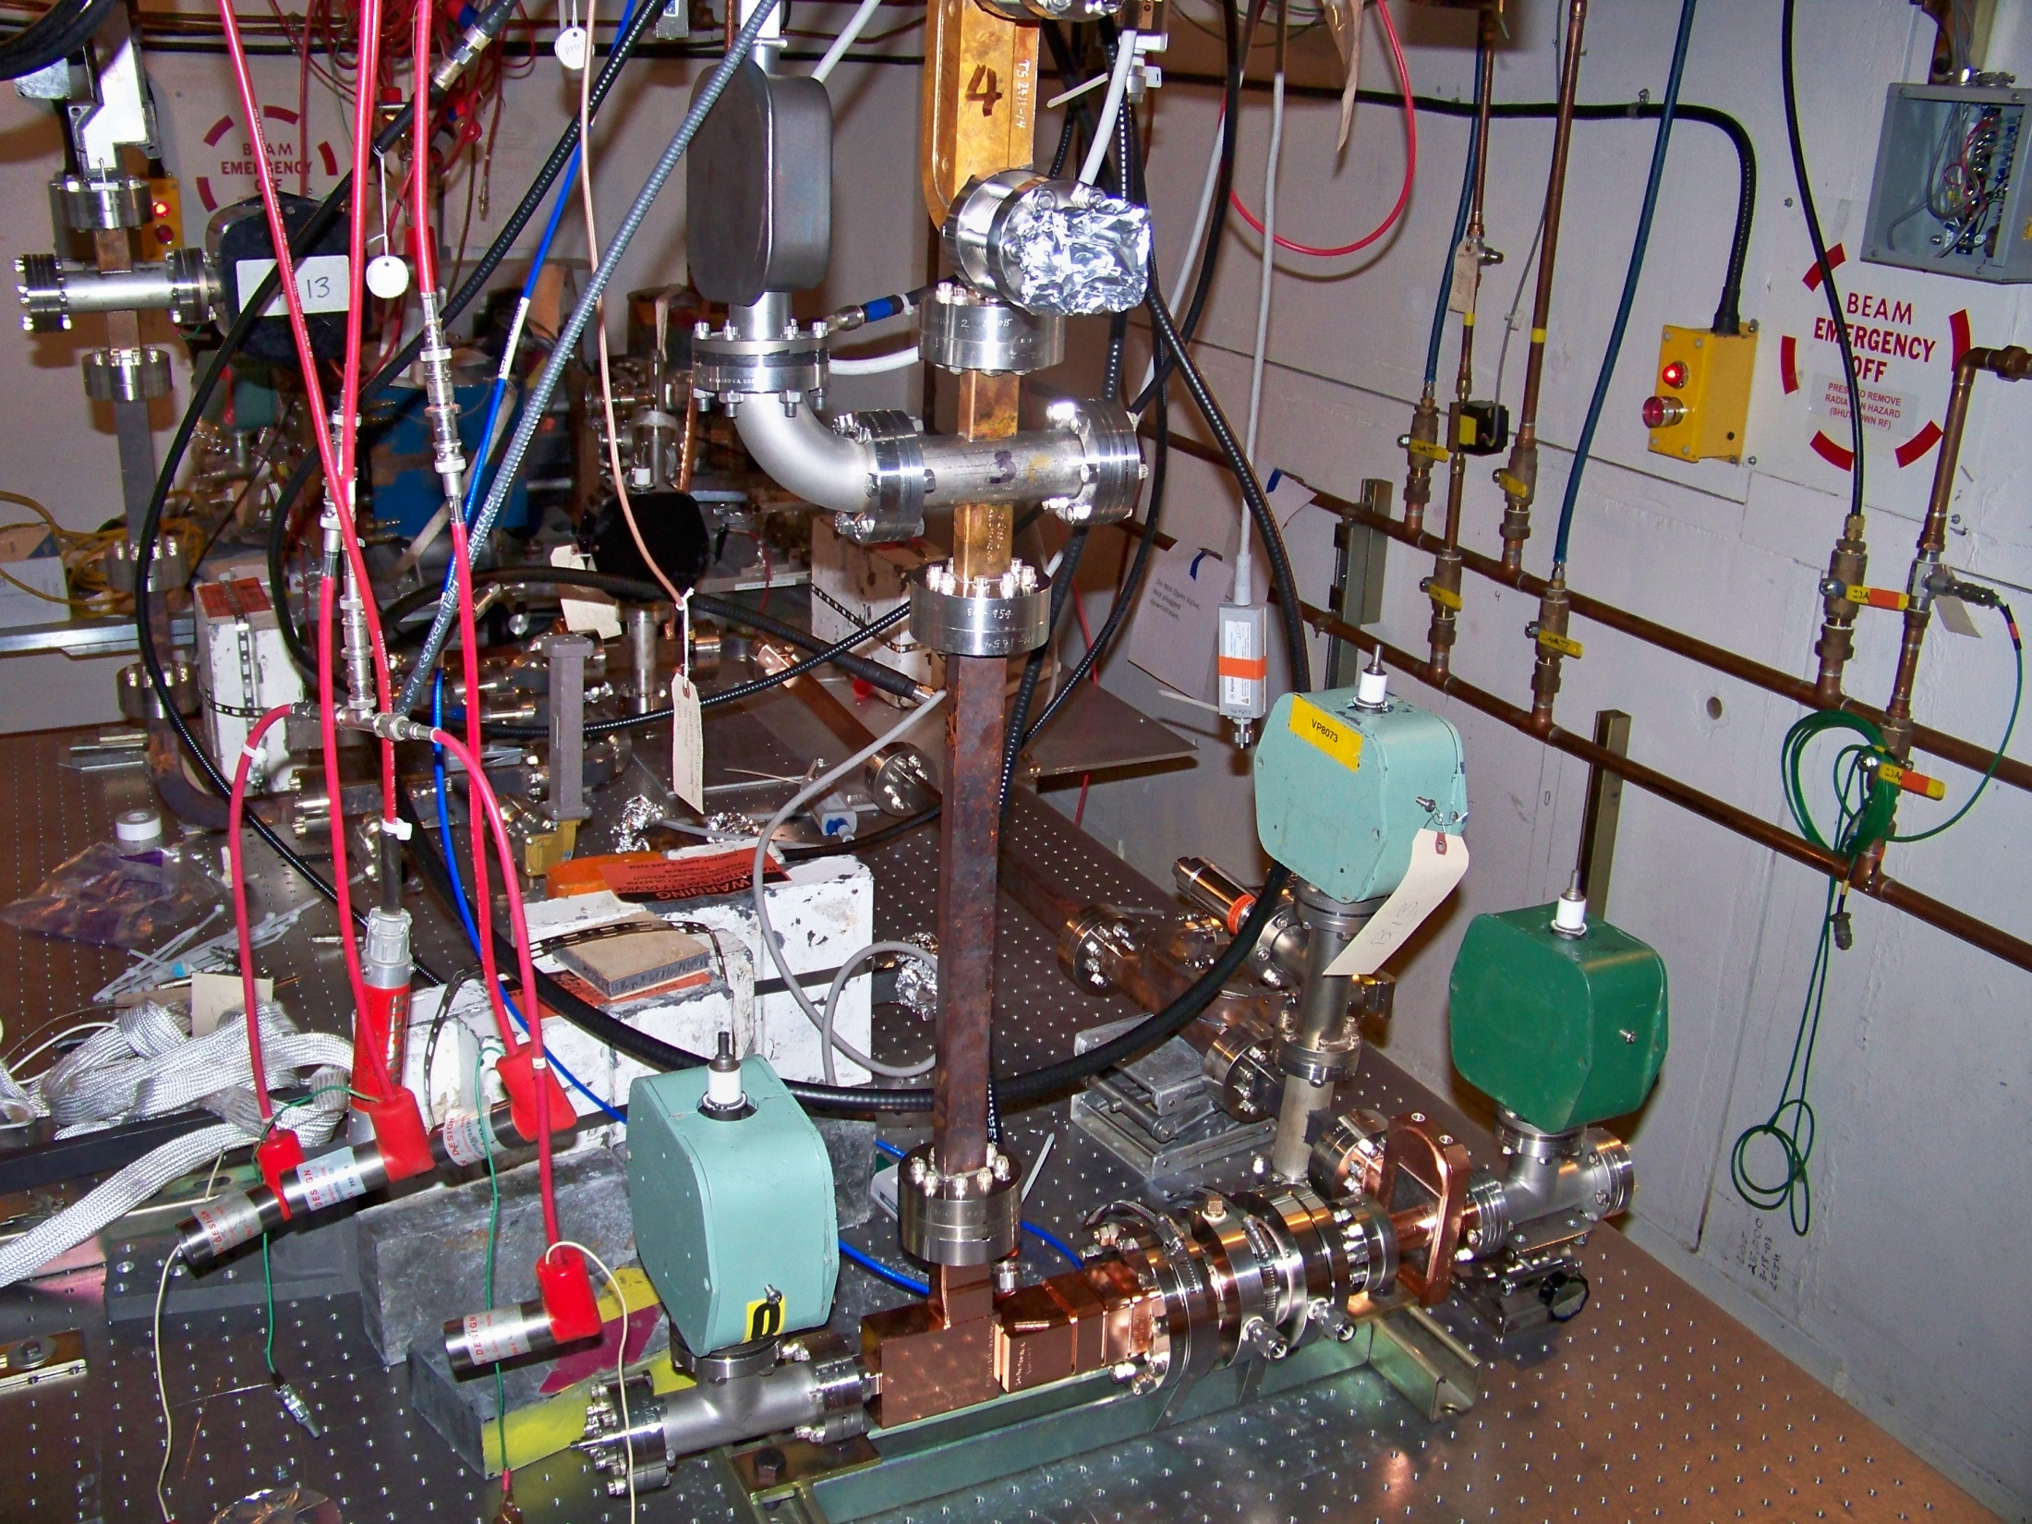
SLAC, 23 September 2011

Slide 44
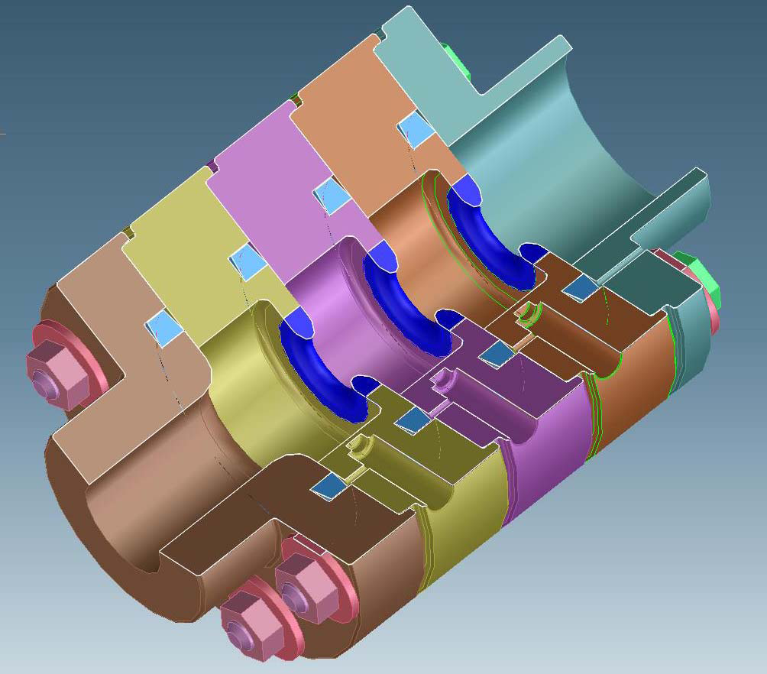
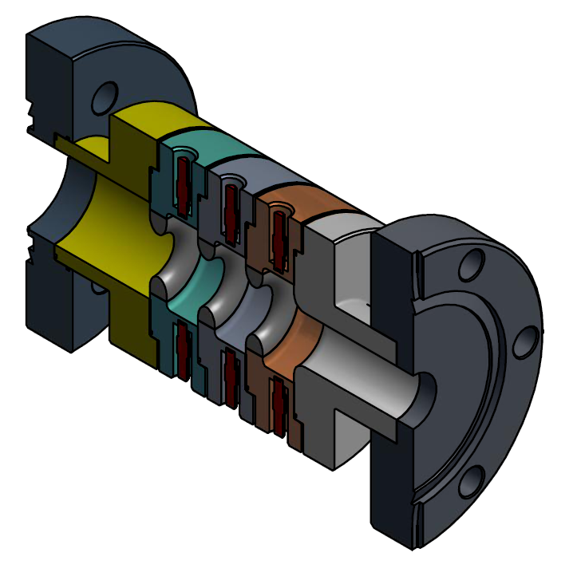
Clad Structures
1C-SW-A3.75-T2.6-Clamped-Cu-SS-KEK
1C-SW-A5.65-T4.6-Cu-SS-Frascati

Slide 45
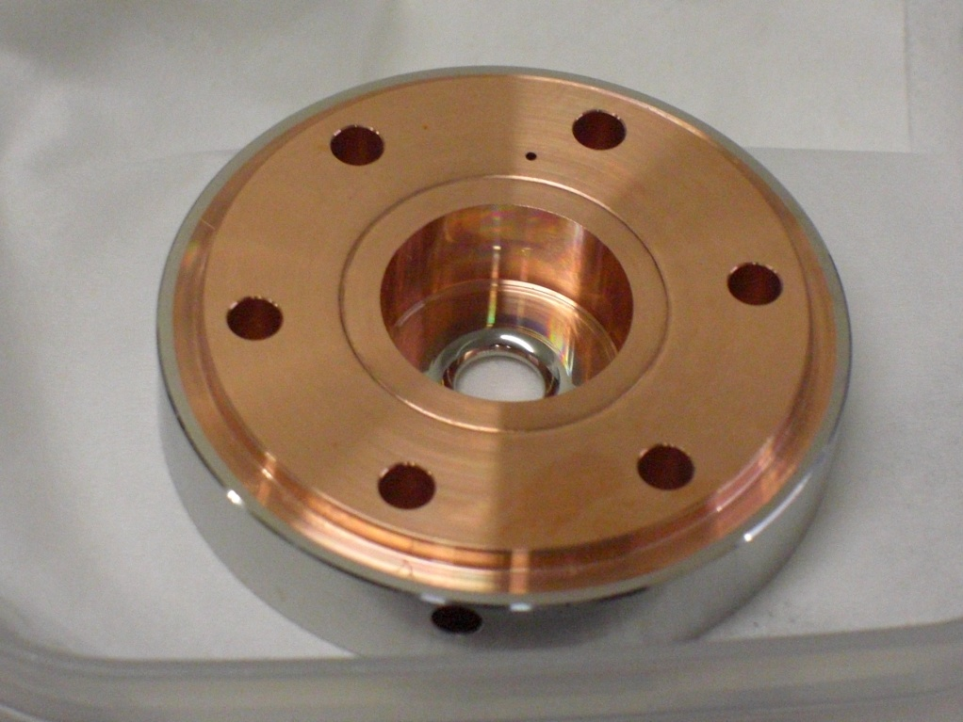
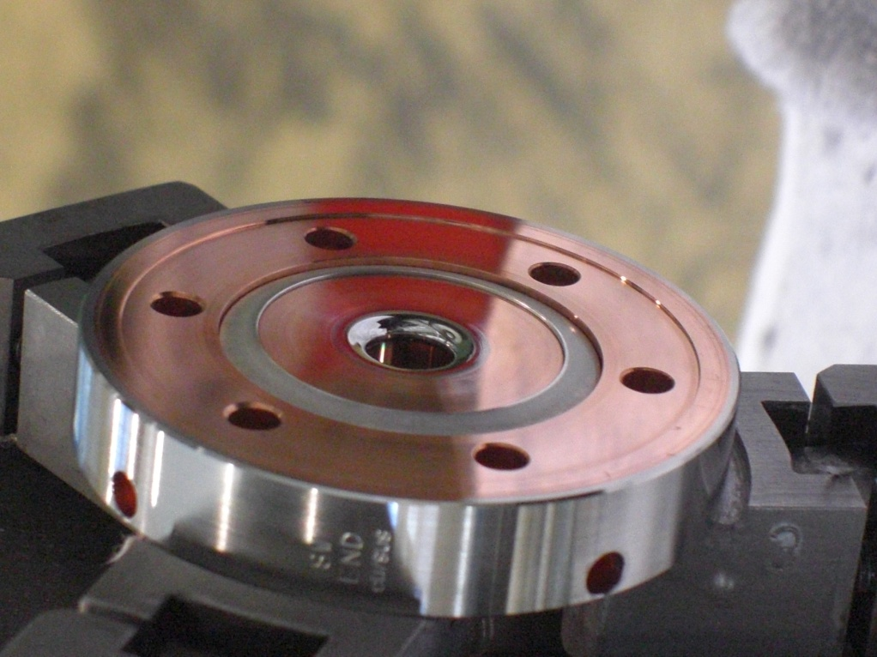
1C-SW-A3.75-T2.60-Cu/SUS, Cu/Mo
surface polished cell
Cu/Mo
Cu/SUS
Bulk surface skin
resistivity resistivity depth
(Ohm-m) (Ohm) (mm)
Cu 1.724x10E-8 0.034 0.505
SUS 304 6.4 x10E-7 0.208 3.07
Mo 5.7x 10E-8 0.062 0.918
Yasuo Higashi, KEK, September 2011

Slide 46
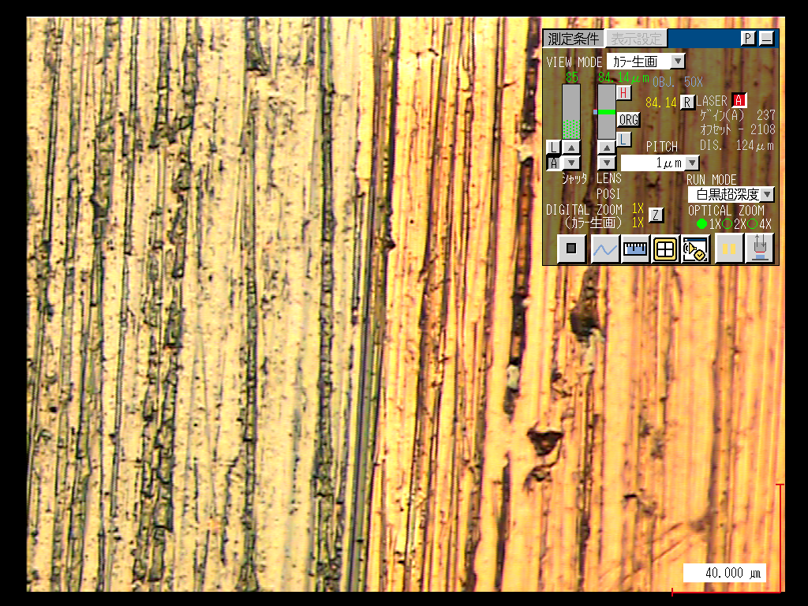
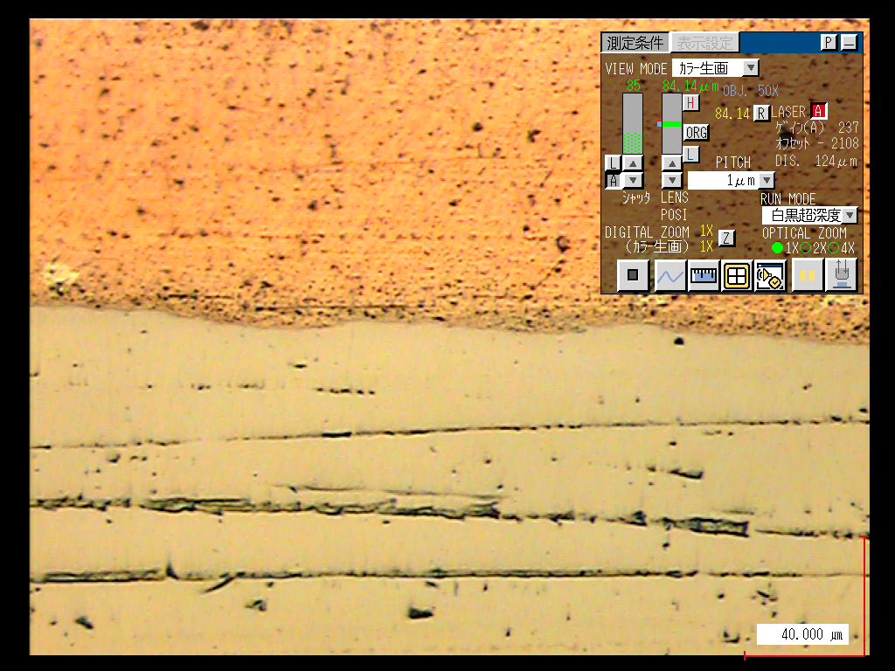
Cu/Mo cell surface before and after polishing
Cu
Mo
Cu
Mo
Note:
This cell is a sample for polishing test.
Actual cell turning surface is smoother than this sample cell surface.
Mo surface will have perfect mirror surface.
Yasuo Higashi, KEK, September 2011

Slide 47
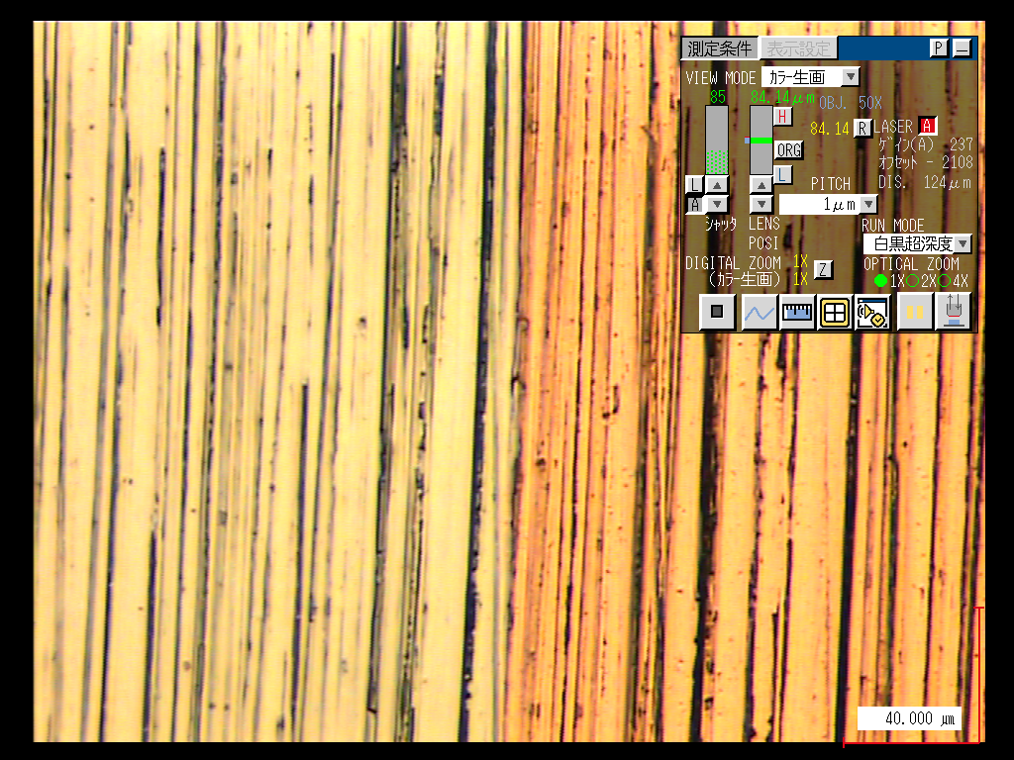
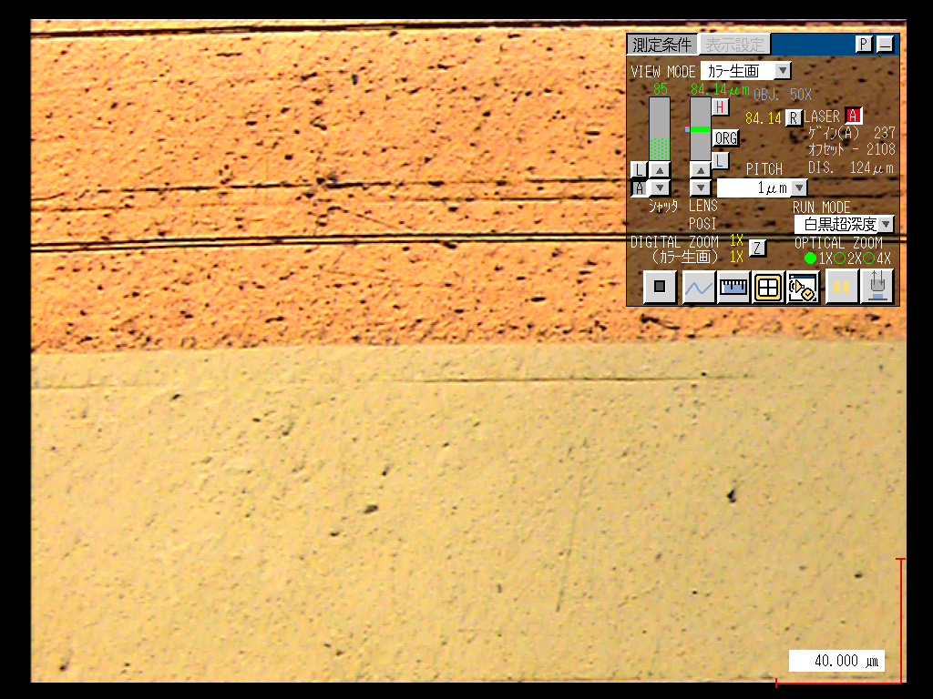
Cu/SUS cell surface before and after polishing
Cu
SUS
Cu
SUS
Yasuo Higashi, KEK, September 2011

Slide 48


Triple choke standing wave structures
Structure joining techniques that avoid high temperature treatment
1C-SW-A3.75-T2.2-Cu,Mo-KEK
1C-SW-A3.75-T2.2-Cu-Frascati

Slide 49

Triple choke standing wave structures
1C-SW-A3.75-T2.2-Cu-HTC-Frascati-#1 and
1C-SW-A3.75-T2.2-Cu-ENEA-Frascati-#2
This design separates vacuum and RF-joint,
so we can test molybdenum and hard copper alloy structures (no high temperature treatment).
Bruno Spataro, INFN-Frascati

Slide 50




Electron Beam Welding of structure cells,
1C-SW-A3.75-T2.2-Cu-HTC-Frascati-#1
pre-bonding zone
The welding meets the requirements
of the applicable specification SI 01.003 revA
No cracks have been found in the fusion zone
and in the heat affected zone.
There are only small porosities at the root-side of the weld joint which are, however, within the limits of the specs.
Moreover dimensional mechanical tests before and after welding gave negligible difference.
The joints in the pre-bonding region
demonstrated to work well and
additional tests are in progress, too.
EBW zone
Bruno Spataro, INFN-Frascati

Slide 51






Fields profile on axis measurements
p mode
Q₀=8368
2p /3
mode
Q₀=8289
p /3
mode
Q₀=7962
Bruno Spataro, INFN-Frascati

Slide 52


Material testing,
Mo spattering on Cu
SEM Picture of copper dish machined at very low roughness sputtered with 300nm of Molybdenum after a thermal treatment of 2 hours at 300 °C.
Schematic diagram of a DC magnetron
plasma source
See Bruno Spataro‘s talk this morning
Bruno Spataro, INFN-Frascati

Slide 53

Geometry Test
Highest shunt Impedance, reduced magnetic field,
1C-SW-A3.75-T2.2-Cu
Solid model: Philipp Borchard, 13 May 2011
Jeff Neilson and Sami Tantawi

Slide 54

New diagnostics
In-situ microscopic observation of surface change and rf breakdowns:
Full cell choke and two view ports 1C-SW-A3.75-T2.6-Ch-View-Port-Cu-SLAC-#1,2
Solid model: David Martin, 28 April 2010

Slide 55

Test setup at SLAC klystron lab, June 2011
viewport
cavity
Lamp
Mode converter
prism
microscope
Fast CCD camera
Jiquan Guo and Yasuo Higashi

Slide 56

Experiments
at cryo temperatures
Refrigerator head
Accelerating structure
RF in
Solid model: David Martin, 10 January 2011

Slide 57
Conclusion
We continue high-power tests of with focus on understanding breakdown physics and developing technologies suitable for practical structures of new shapes and materials.
We prepare novel experiments than may help us to indentify the rf breakdown trigger: in-situ microscopic observation of metal surface, cryogenic and dual-mode cavity

