Slide 1
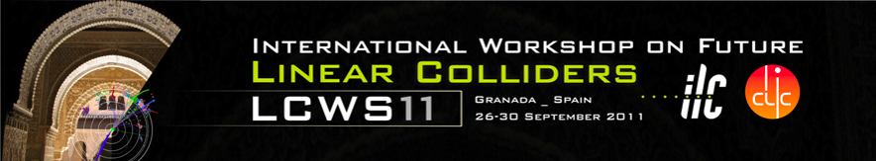
Toward 50 MV/m SRF Acceleration without Field Emission
Rong-Li Geng
Jefferson Lab
LCWS11, Granada, Spain, September 26-30, 2011

Slide 2
Outline
Brief review of SRF gradient status
  World wide experience and status
  Jefferson Lab Status
Required SRF cavity performance for 1 TeV ILC
Need for fighting against field emission
  Sudden field emitter turn on
  Cavity gradient degradation from vertical qualification test to real cryomodule operation
R&D plan at JLab toward field emission free SRF acceleration at 50 MV/m

Slide 3
Worldwide Experience and Status

Slide 4
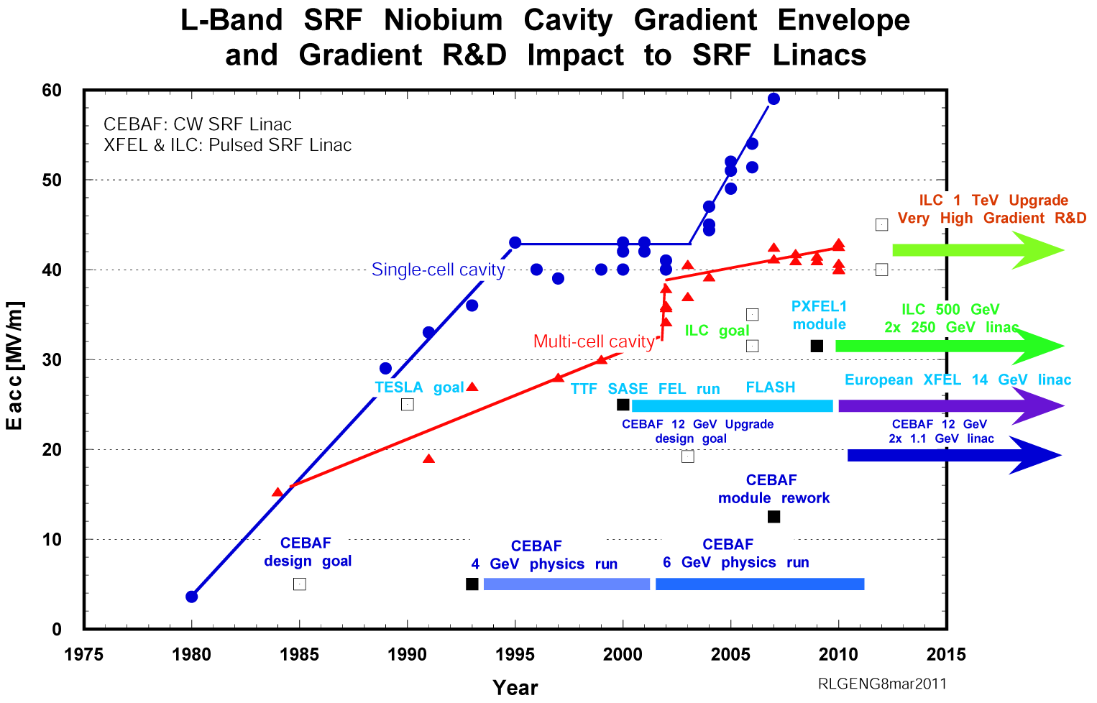
SRF Acceleration Progress till 2004…
Bjoern Wiik
vision
R&D needed
TDR by 2012
Under construction
Under construction
Steady progress in SRF acceleration gradient : 42 MV/m in 1-cell; 40 MV/m in 9-cell
TESLA collaboration started in 1990: push cavity gradient and lower cryomodule cost
Operation of CW SRF electron linac in CEBAF since 1993 for 4 GeV physics run (later on for 6 GeV)
Operation of Pulsed SRF electron linac in DESY TTF since 2000 for SASE FEL

Slide 5
Development since 2004 ITRP recommendation of SRF for ILC
Björn Wiik
vision
R&D needed
TDR by 2012
Under construction
Under construction
ITRP Recommendation
Continued progress in SRF gradient : breakthrough of 45 MV/m in 1-cell, ~60 MV/m record; 45 MV/m in 9-cell
GDE began in 2005: produce a design for ILC and coordinate worldwide R&D efforts
New SRF Test Facilities in operation: STF at KEK and NML at Fermilab
Upgrade of CEBAF to 12 GeV underway at Jefferson Lab (80 cavities)
FLASH operation and construction of European XFEL underway (640 cavities)

Slide 6
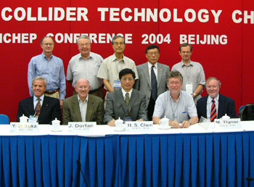
ITRP Recommended SRF Technology for the ILC
The recommendation of ITRP was presented to ILCSC & ICFA on August 19, 2004 in a joint meeting in Beijing.
ICFA unanimously endorsed the ITRP’s recommendation on August 20, 2004

Slide 7
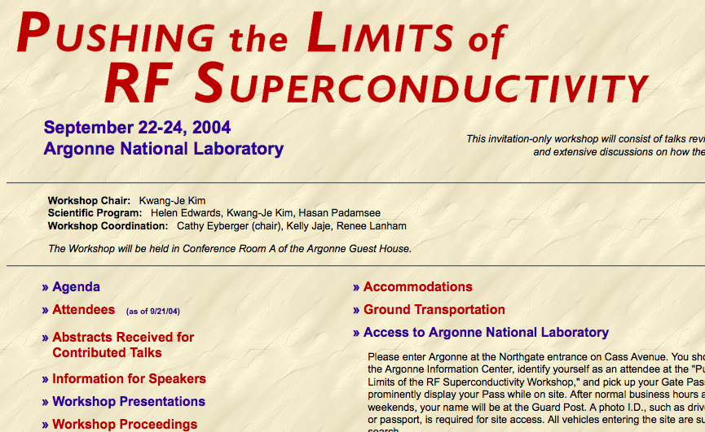
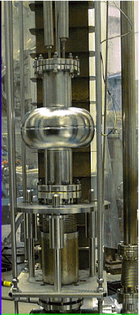
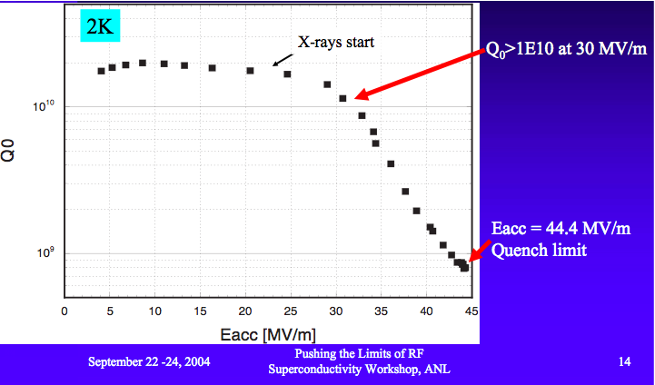
Cornell Re-entrant cavity
Dawn of 45 MV/m gradient
R.L. Geng, H. Padamsee
http://www.aps.anl.gov/News/Conferences/2004/RFSC-Limits/Presentations.html

Slide 8
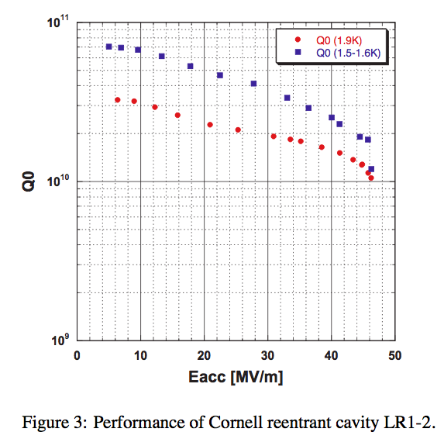
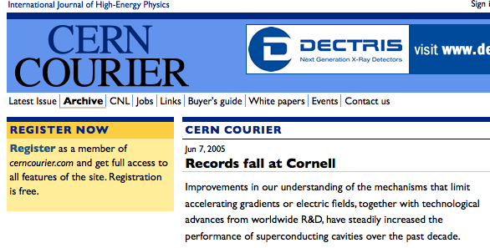
November 16, 2004 breakthrough of 45 MV/m SRF gradient in a 1300 MHz 1-cell cavity
Eacc 46 MV/m (CW),
47 MV/m (pulsed)
Q₀ > 1E10 at 1.9 K
Q₀ ~ 2E10 at 1.6 K
R.L. Geng, H. Padamsee, A. Seaman, V. Shemelin, PAC05, p.653-655 (2005).

Slide 9
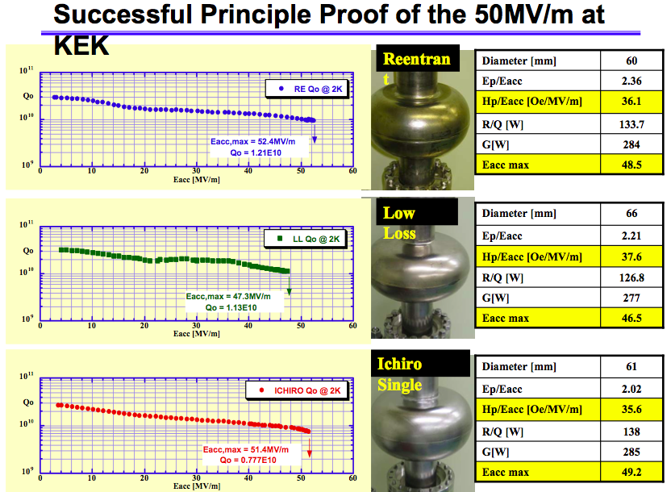
K. Saito, SRF2007, TU202, P.82-93 (2007).
F. Furuta, K. Saito, SRF2009, THPPO084, p. 821-823 (2009).

Slide 10
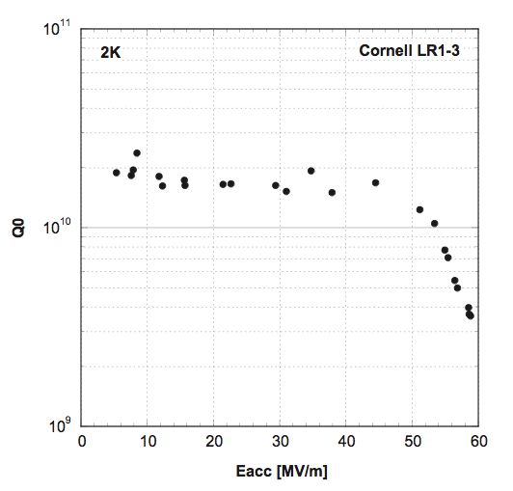
Realization of SRF gradient ~ 60 MV/m in a 1300 MHz 1-cell niobium cavity
under collaboration between Cornell and KEK (with contribution by Kenji Saito and his group)
Eacc 51 MM/m
Epk = 108 MV/m
Field emission starts
Quench
R.L. Geng, G. Eremeev, H. Padamsee, V. Shemelin, PAC07, WEPMS006, p. 2337-2339 (2007).

Slide 11
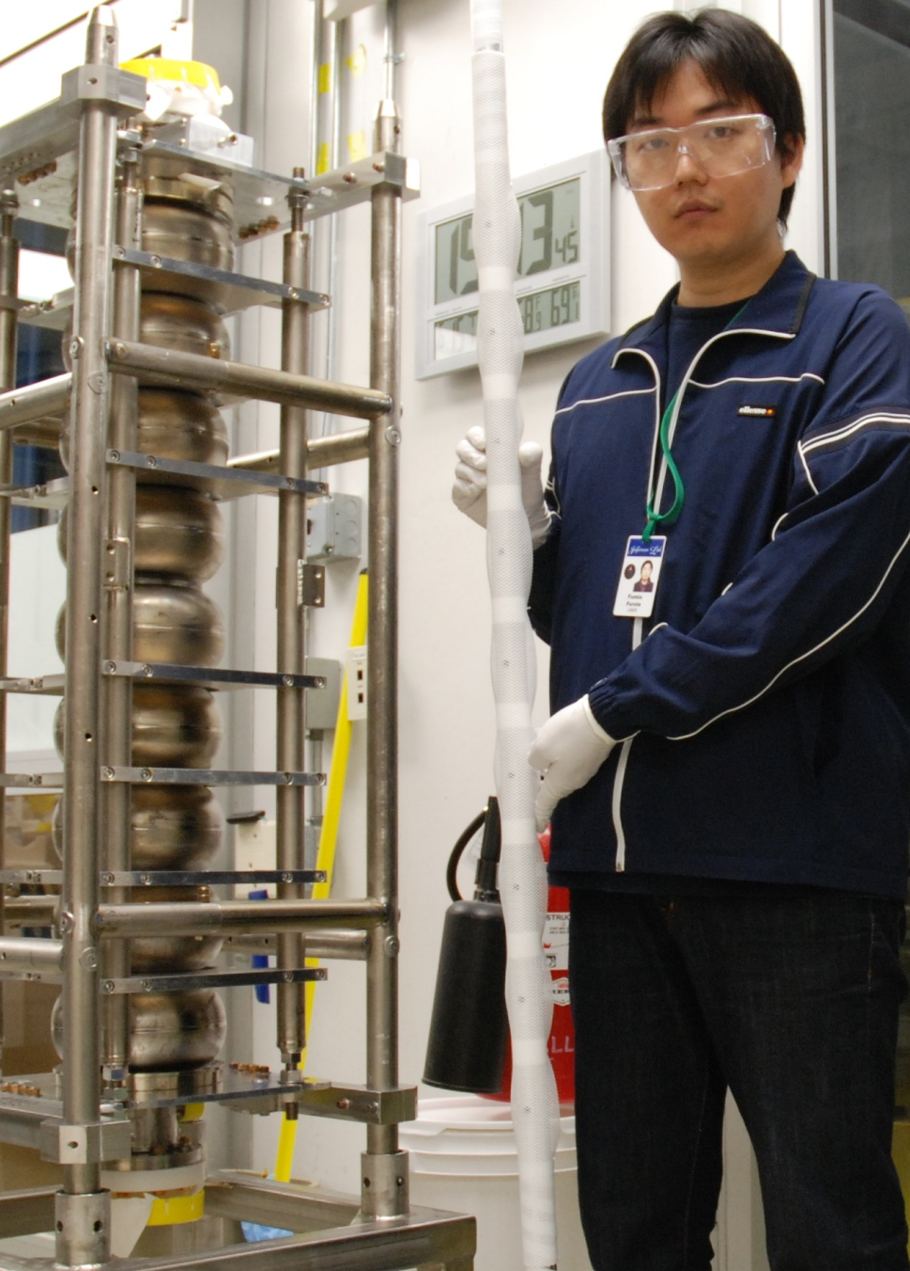
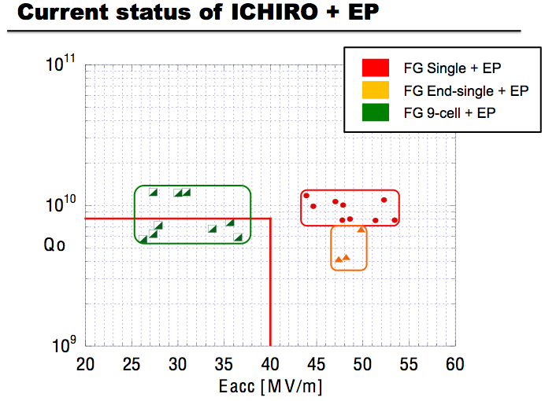
KEK 9-cell cavity ICHIRO7 achieved 40 MV/m acceleration gradient (potential > 50 MV/m)
under collaboration between KEK and JLab
Eacc 40 MV/m
-> Epk 95 MV/m
F. Furuta, T. Kaonomi, K. Saito, G. Eremeev, R.L. Geng, SRF2011, TUPO014 (2011).

Slide 12
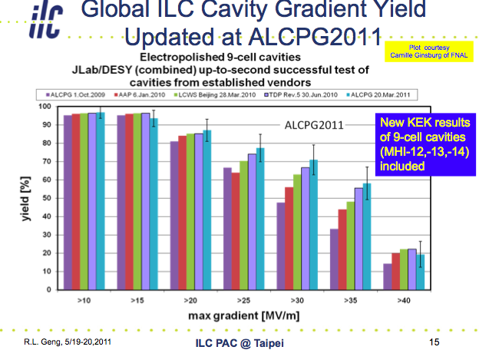
58% at 35 MV/m (up to second pass processing)
Global situation: Three vendors + three processing labs
Yield, yield, yield…

Slide 13
90% yield proof-of-principle: 9 out of 10 achieved 38 MV/m
10 cavities, one manufacturer, one processing lab
R.L. Geng, J. Dai, G. Eremeev, A. Palczewski, IPAC11, MOPC111 (2011).

Slide 14
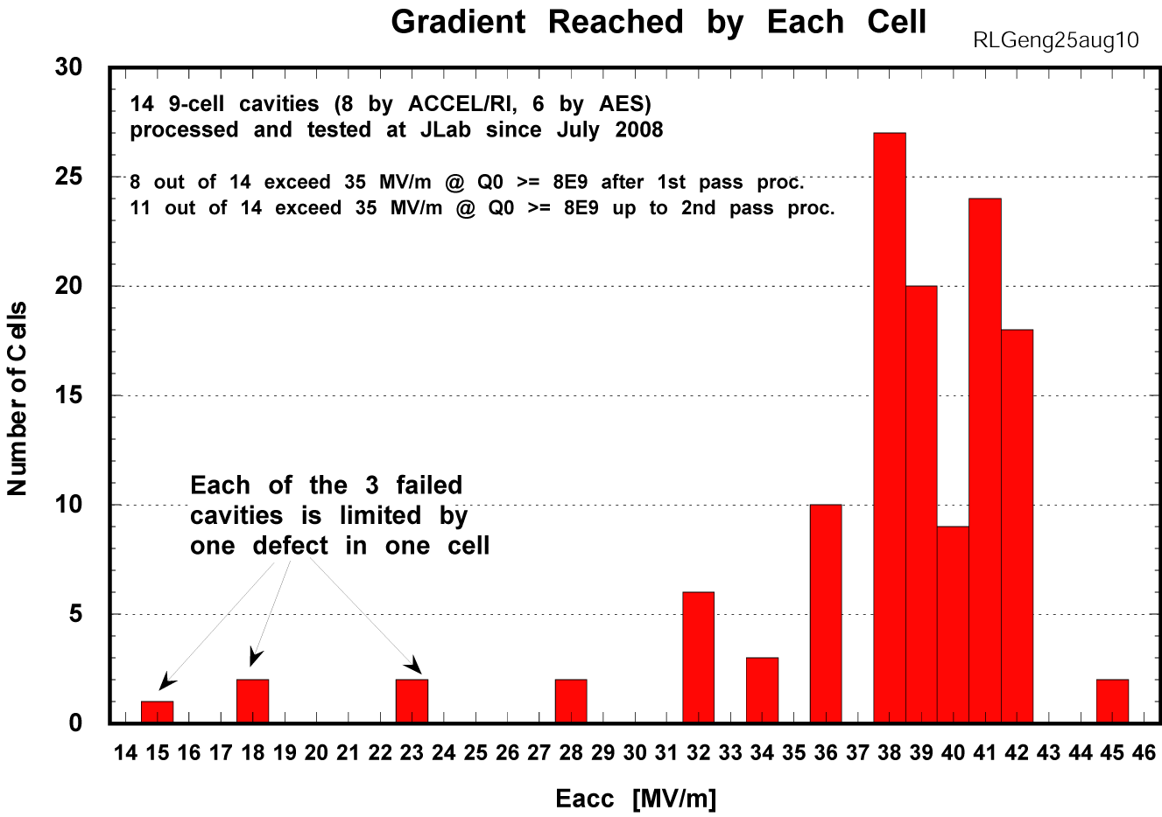
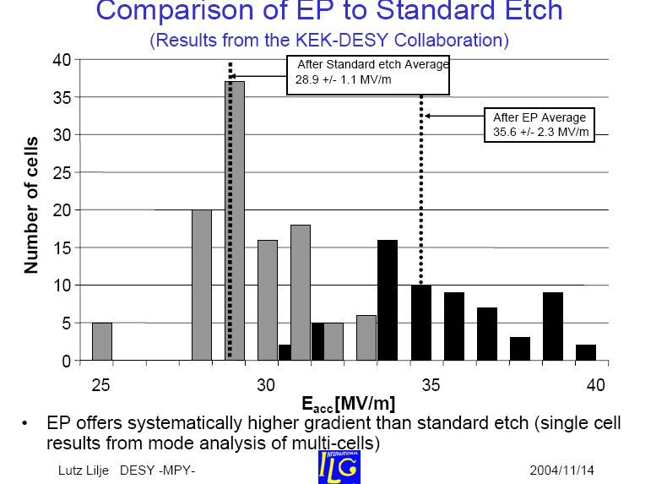
Noteworthy observation: Average gradient in state-of-art cavities improved to 38 MV/m
average
38.1 MV/m
2010
Gradient
State-of-the-art
then and now
35 MV/m
38 MV/m
2004
2004 DESY EP 9-cell cavities
Gradient distribution in cells from
pass-band measurements (~ 8 cavities)

Slide 15
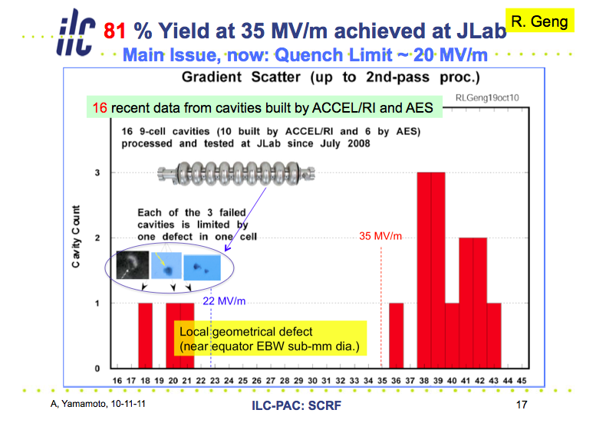
Understanding of low gradient quench limit

Slide 16



…and effect of repair of “permanent defect” by mechanical polishing
Presented to ILC ART Director Mike Harrison on his July 15, 2011 Visit of JLab
94%
JLAB + FNAL
Average gradient 39 MV/m
100% yield at ≥31 MV/m
+ +
Average gradient 39 MV/m
AES6 after CBP
At FNAL
✔
✔
AES5 After
Mechanical
Polishing
at Cornell
ACC15 after
Mechanical
Polishing
at FNAL

Slide 17
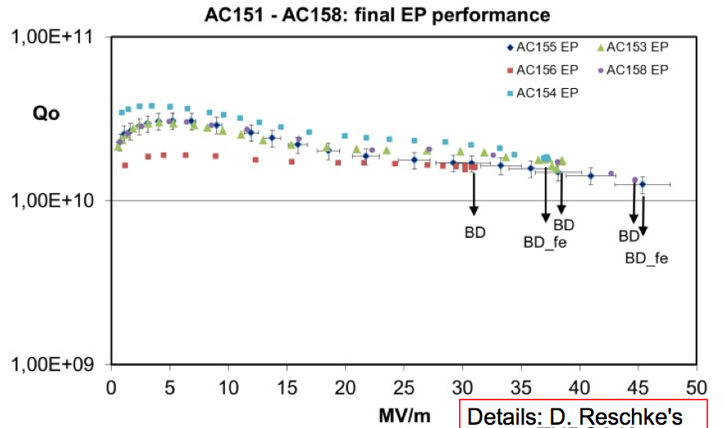
45 MV/m in 9-cell cavity proof-of-principle : AC155, AC158
Eacc 45 MV/m
Q0 > 1E10 at 2 K
Large grain niobium + electropolishing
D. Reschke, S. Aderhold, A. Goessel, J. Iversen, S. Karstensen, D. Kostin, G. Kreps,
Matheisen, W.-D. Moeller, F. Schlander, W. Singer, X. Singer, N. Steinhau-Kuehl, A. Sulimov,
K. Twarowski, SRF2011, TUPO046 (2011).

Slide 18
Jefferson Lab Status

Slide 19
Highlights of JLab Accomplishments for ILC Cavity Gradient R&D under ART (1)
Established a standard cavity electropolish processing and preparation procedure
  Repeatable electropolishing recipe with key process parameters identified and controlled
    Published at SRF2011: R.L. Geng, A.C Crawford, Standard procedures of ILC high gradient cavity processing and handling at Jefferson Lab (2011).
    Transferred effectively for final processing of CEBAF 12 GeV cavities
      Real “production style” processing: 5 EP cycles every two weeks
      70 out of 86 CEBAF upgrade cavities (fabricated by RI) are completed for EP processing

Slide 20
Highlights of JLab Accomplishments for ILC Cavity Gradient R&D under ART (2)
The standard JLab processing and preparation procedure resulted in high quality cavity gradient results
  9 out of 10 ILC 9-cell cavities fabricated by an experienced vendor reached a gradient of ≥ 38 MV/m up to a second pass processing
  CEBAF 12 GeV upgrade 7-cell cavities routinely achieve at least Eacc 27 MV/m (well above the project spec of 19 MV/m) with only one electropolish processing cycle

Slide 21
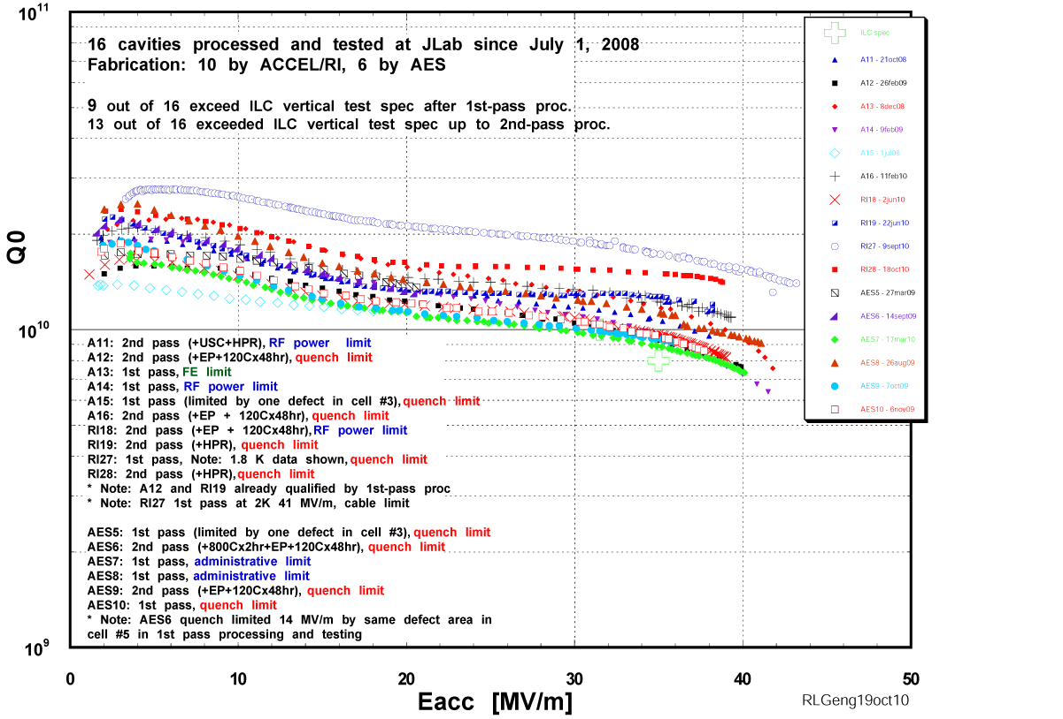
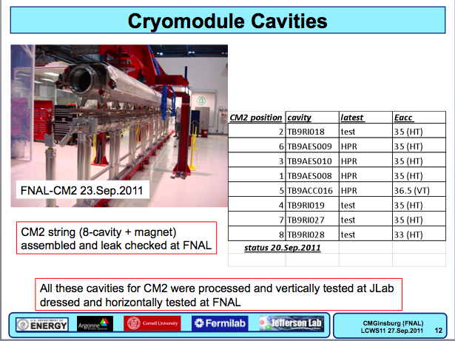
All cavities contained in Fermilab’s CM2 (first ILC style cryomodule made in US) were processed and tested at JLab and qualified to Eacc ≥ 35 MV/m (with an average Eacc of ~ 39 MV/m). All horizontally tested at FNAL to Eacc ≥ 35 MV/m (except one to 33 MV/m)
See: C. Ginsburg’s talk

Slide 22
Highlights of JLab Accomplishments for ILC Cavity Gradient R&D under ART (3)
Demonstrated significant throughput for high quality processing and cryogenic RF testing
  Accumulated ILC 9-cell cavity throughput since 2006
    50+ 9-cell cavities (some were processed at various level only)
    100+ electropolishing cycles (330+ voltage-on time)
    150+ cryogenic RF testing cycles
  FY11 alone
    ~ 90 EP cycles (CEBAF upgrade 7-cell & ILC 9-cell cavities)

Slide 23
Need for Adaptation
New reality
  CEBAF 12 GeV cavity work is foreseen to intensify in future months
  Major SRF facility relocation is foreseen due to civil construction of TEDF and Test Lab renovation
New challenge
  High gradient high Q cavity R&D becoming imminent due to increased perspective of 1 TeV ILC
  We have been asked by ART to consider how to contribute to very high gradient cavity R&D for he period of 2013-1015

Slide 24
Required SRF Cavity performance for 1 TeV ILC
From Nick Walker’s straw man list
  Gradient 45 MV/m
  Q0 2E10
We believe the most promising technical approach to accomplish this challenging goal in the time frame of 2013-1015 is “New” shape cavity – but must address the field emission issue as an urgent topic

Slide 25
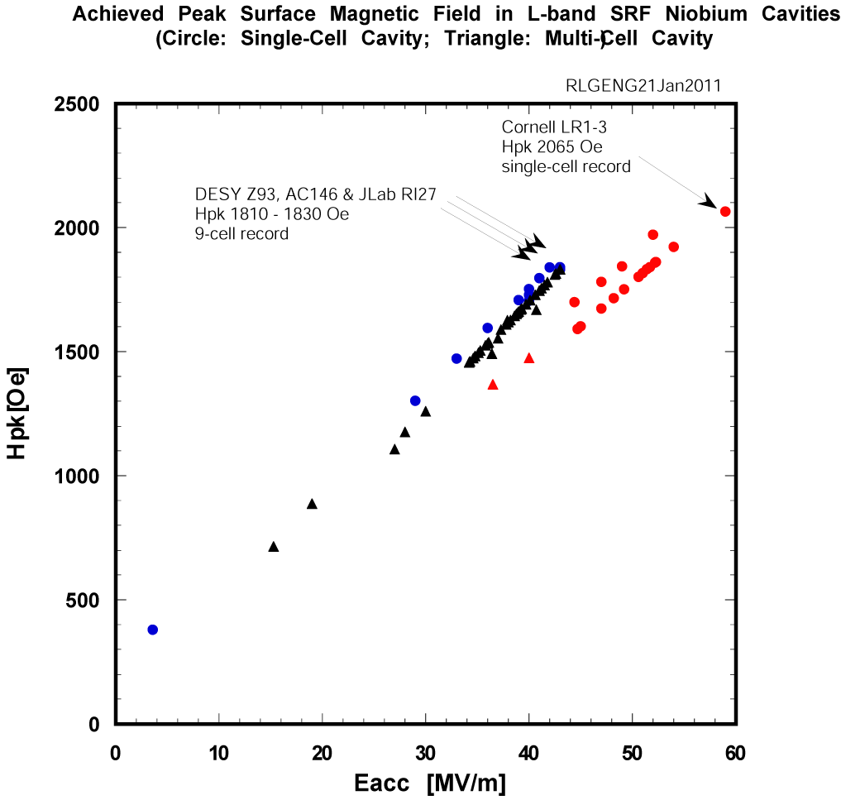
Here is why…
Recent cavity results established a peak surface magnetic field of 190-200 mT is possible and practical
45 MV/m in TTF shape means effectively > 50 MV/m in Re-entrant, low-loss or ICHIRO, and Low-Surface-Field shape cavities
In fact, this is already shown in many 1-cell cavities
But…
DESY AC155, AC158
Hpk 1910-1950 Oe
New 9-cell record
ILC 1 TeV
ILC 500 GeV
XFEL
CEBAF 12 GeV
CEBAF 4 GeV

Slide 26
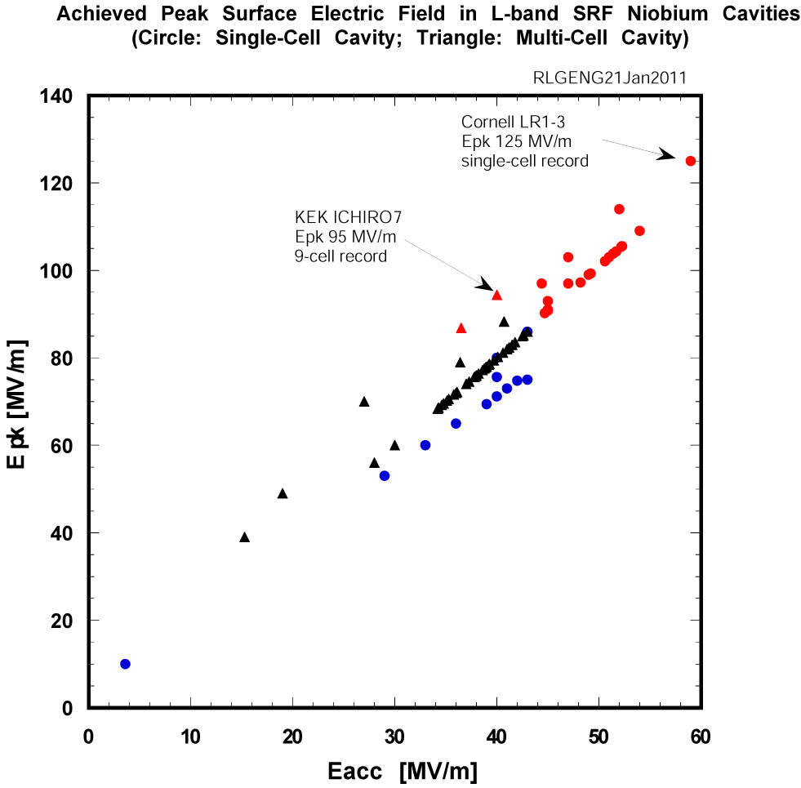
At Eacc 45-50 MV/m in 9-cell cavity, Epk reaches 100-120 MV/m.
This is a very much unexplored phase space (see left)
ILC 1 TeV
ILC 500 GeV
XFEL
CEBAF 12 GeV
CEBAF 4 GeV

Slide 27
Other Urgent Reasons for
Fighting Against Field Emission
Sudden field emission turn on
  Observed independently in all labs engaged in high gradient SRF cavity R&D
  Literally no understanding…and no early warning
    Forced some projects to adopt “admin limit” to gradient
Cavity and hardware activation in case of strong field emission at high gradient during vertical test
  Two cases established at JLab
Gradient degradation in cryomodule
  Field emission likely the leading cause?
Need to establish criterion and develop countermeasure for dark current

Slide 28
JLab R&D Plan Towards Field Emission Free SRF Acceleration at 50 MV/m – FY12
Field emission characterization
  Develop diode-based at-cavity X-ray monitoring
    Enables tracking of field emission from vertical test to cryomodule test
      One step forward to understand role of field emission in gradient degradation from vertical test to cryomodule test
    Enables cross checking across facilities
  Develop probe-based (inside cavity vacuum) or block-based (outside cavity vacuum) sensors for direct dark current measurement
  Model field emission
    Begin with single cavity
    Benchmark model through field emission measurements during vertical test

Slide 29
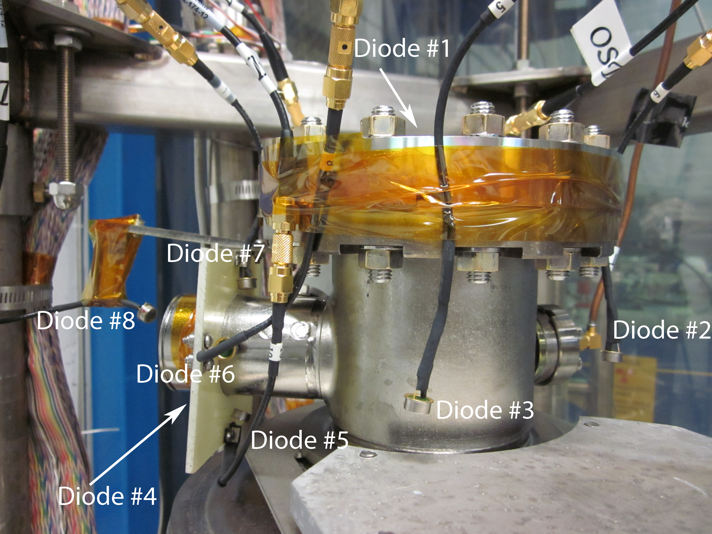
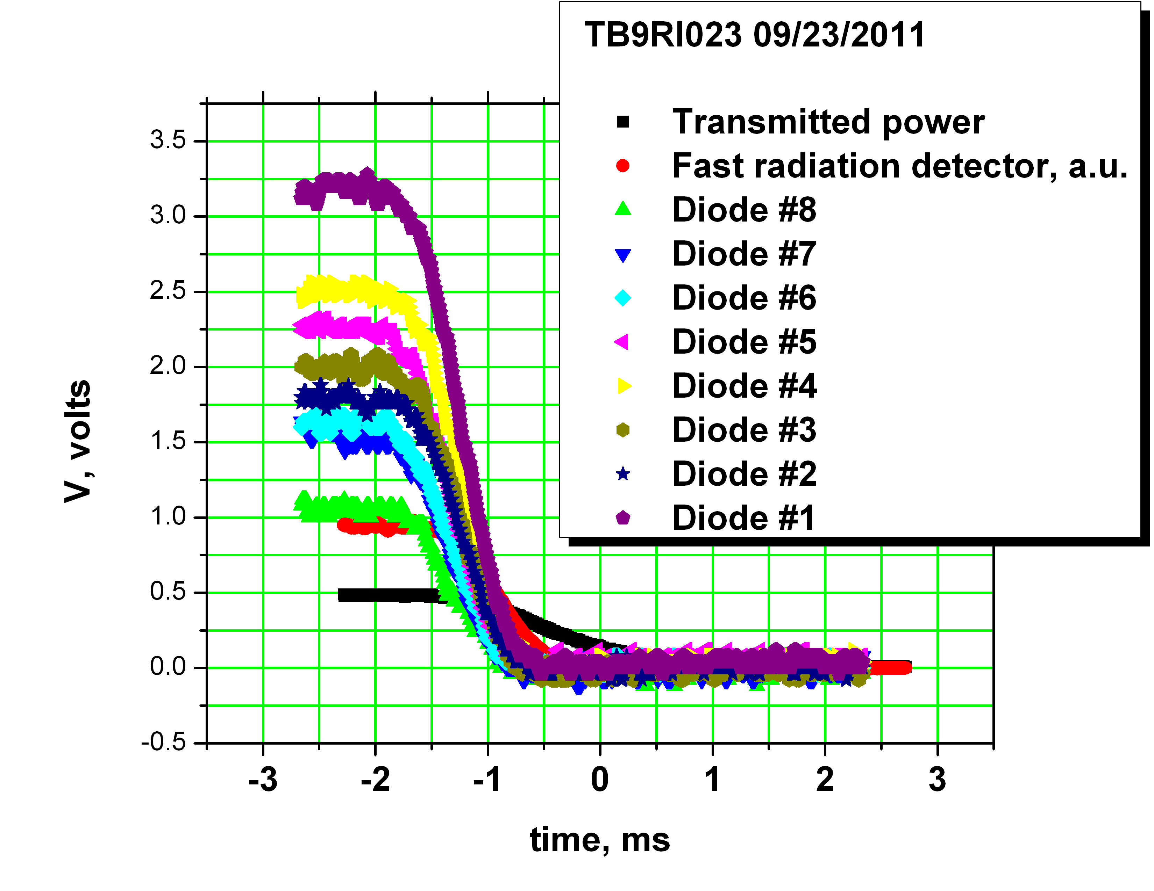
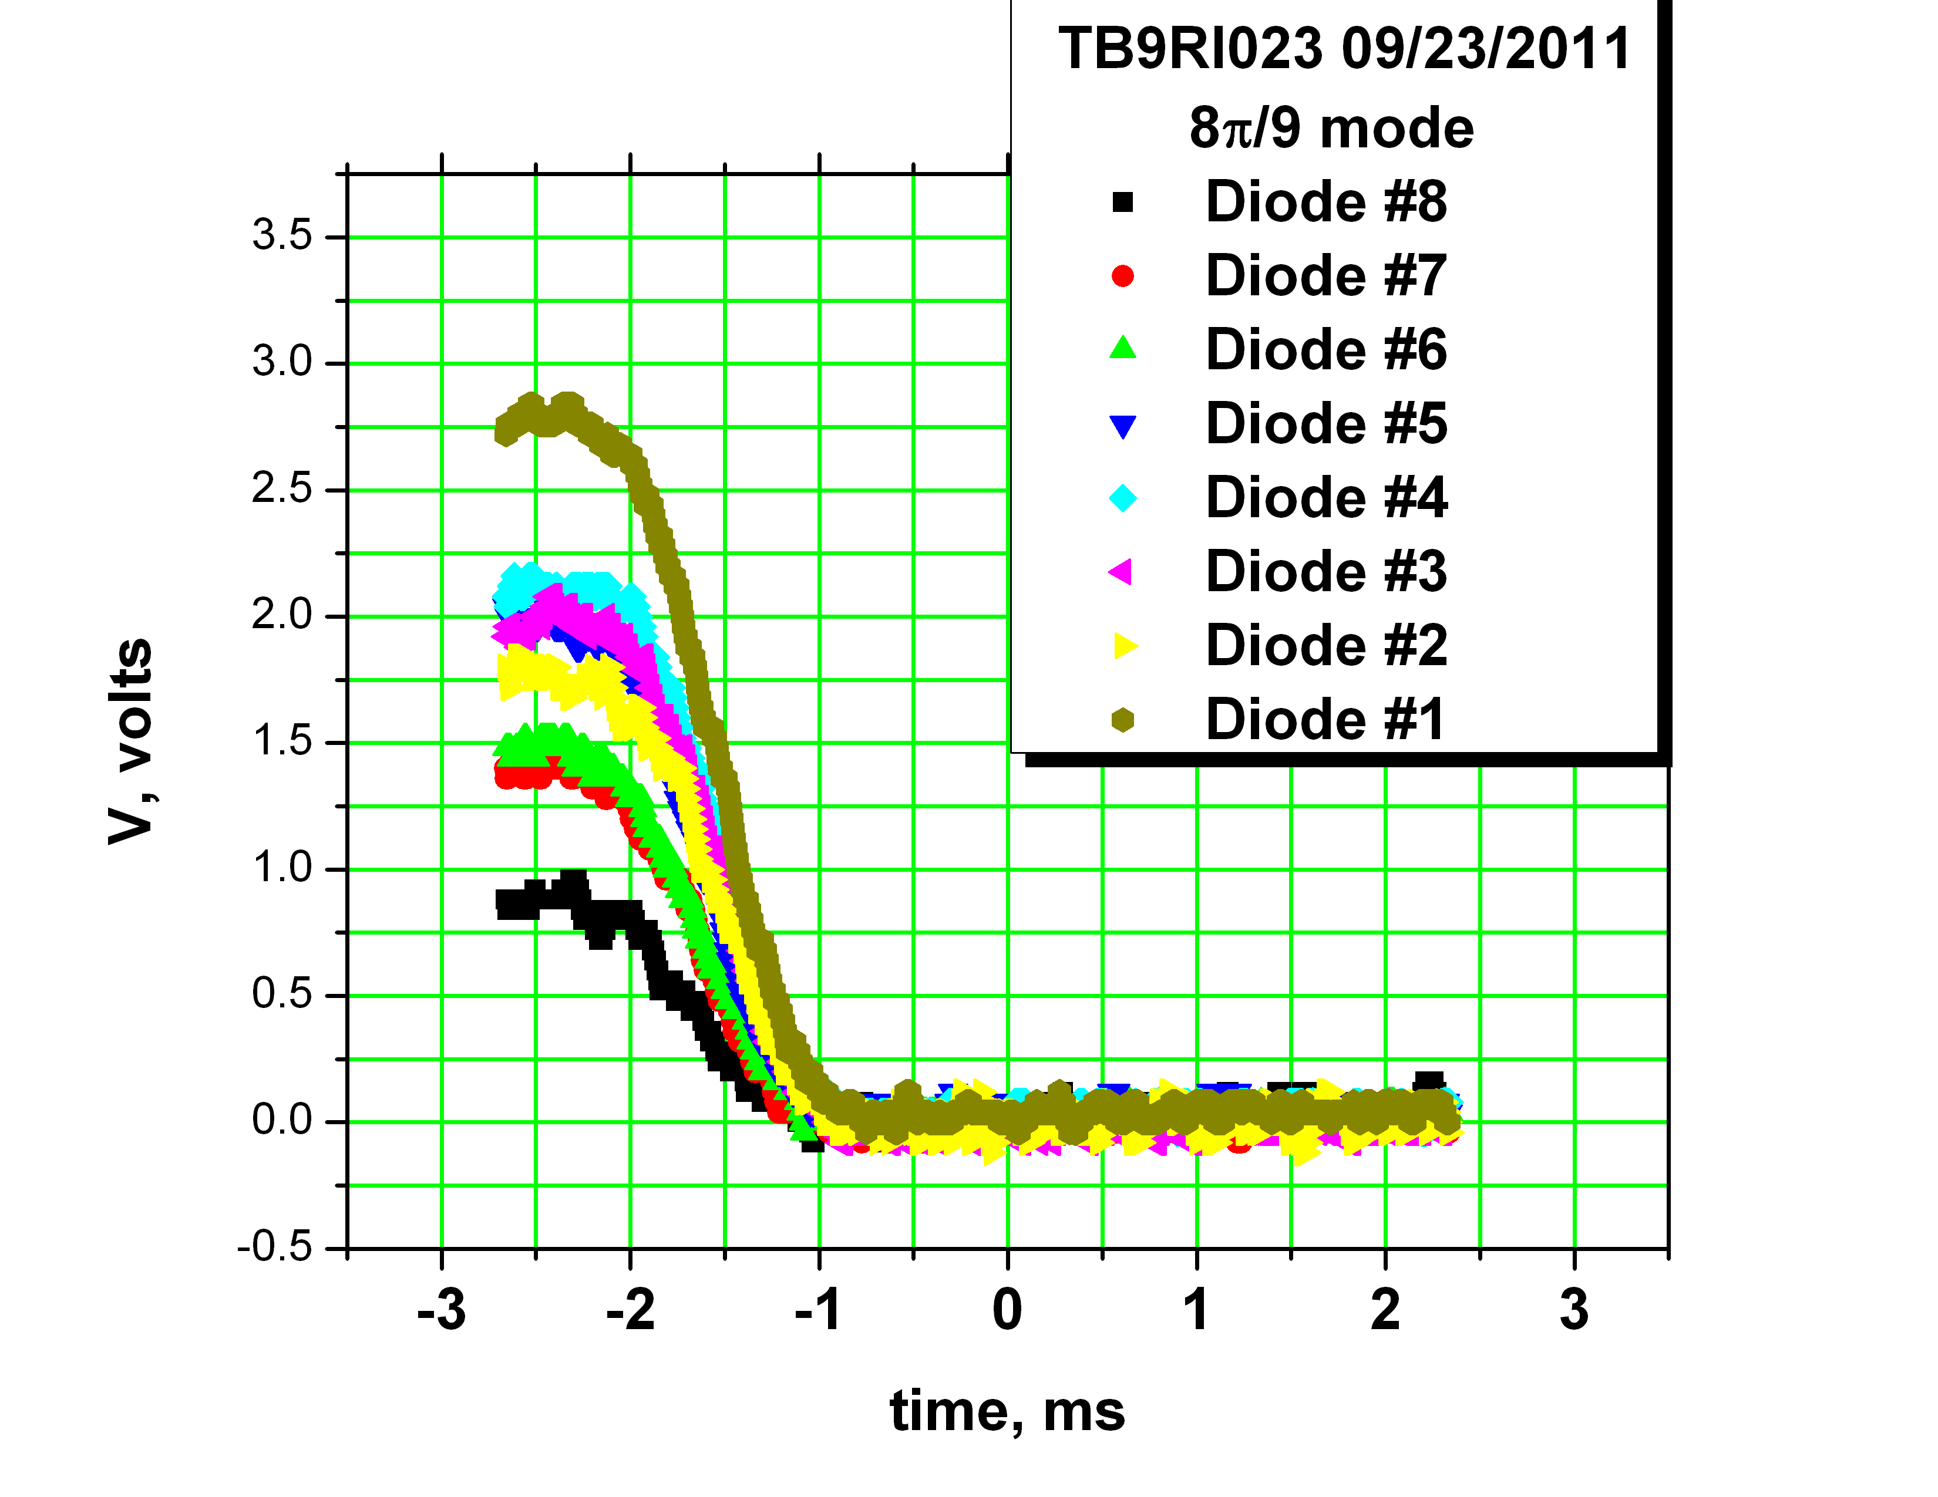
Initial effort is to validate sensor choice and to clarify role of HOM can in harboring field emitters
9-cell cavity RI23 vertical test with 8 diodes attached
Test done September 20, 2011

Slide 30
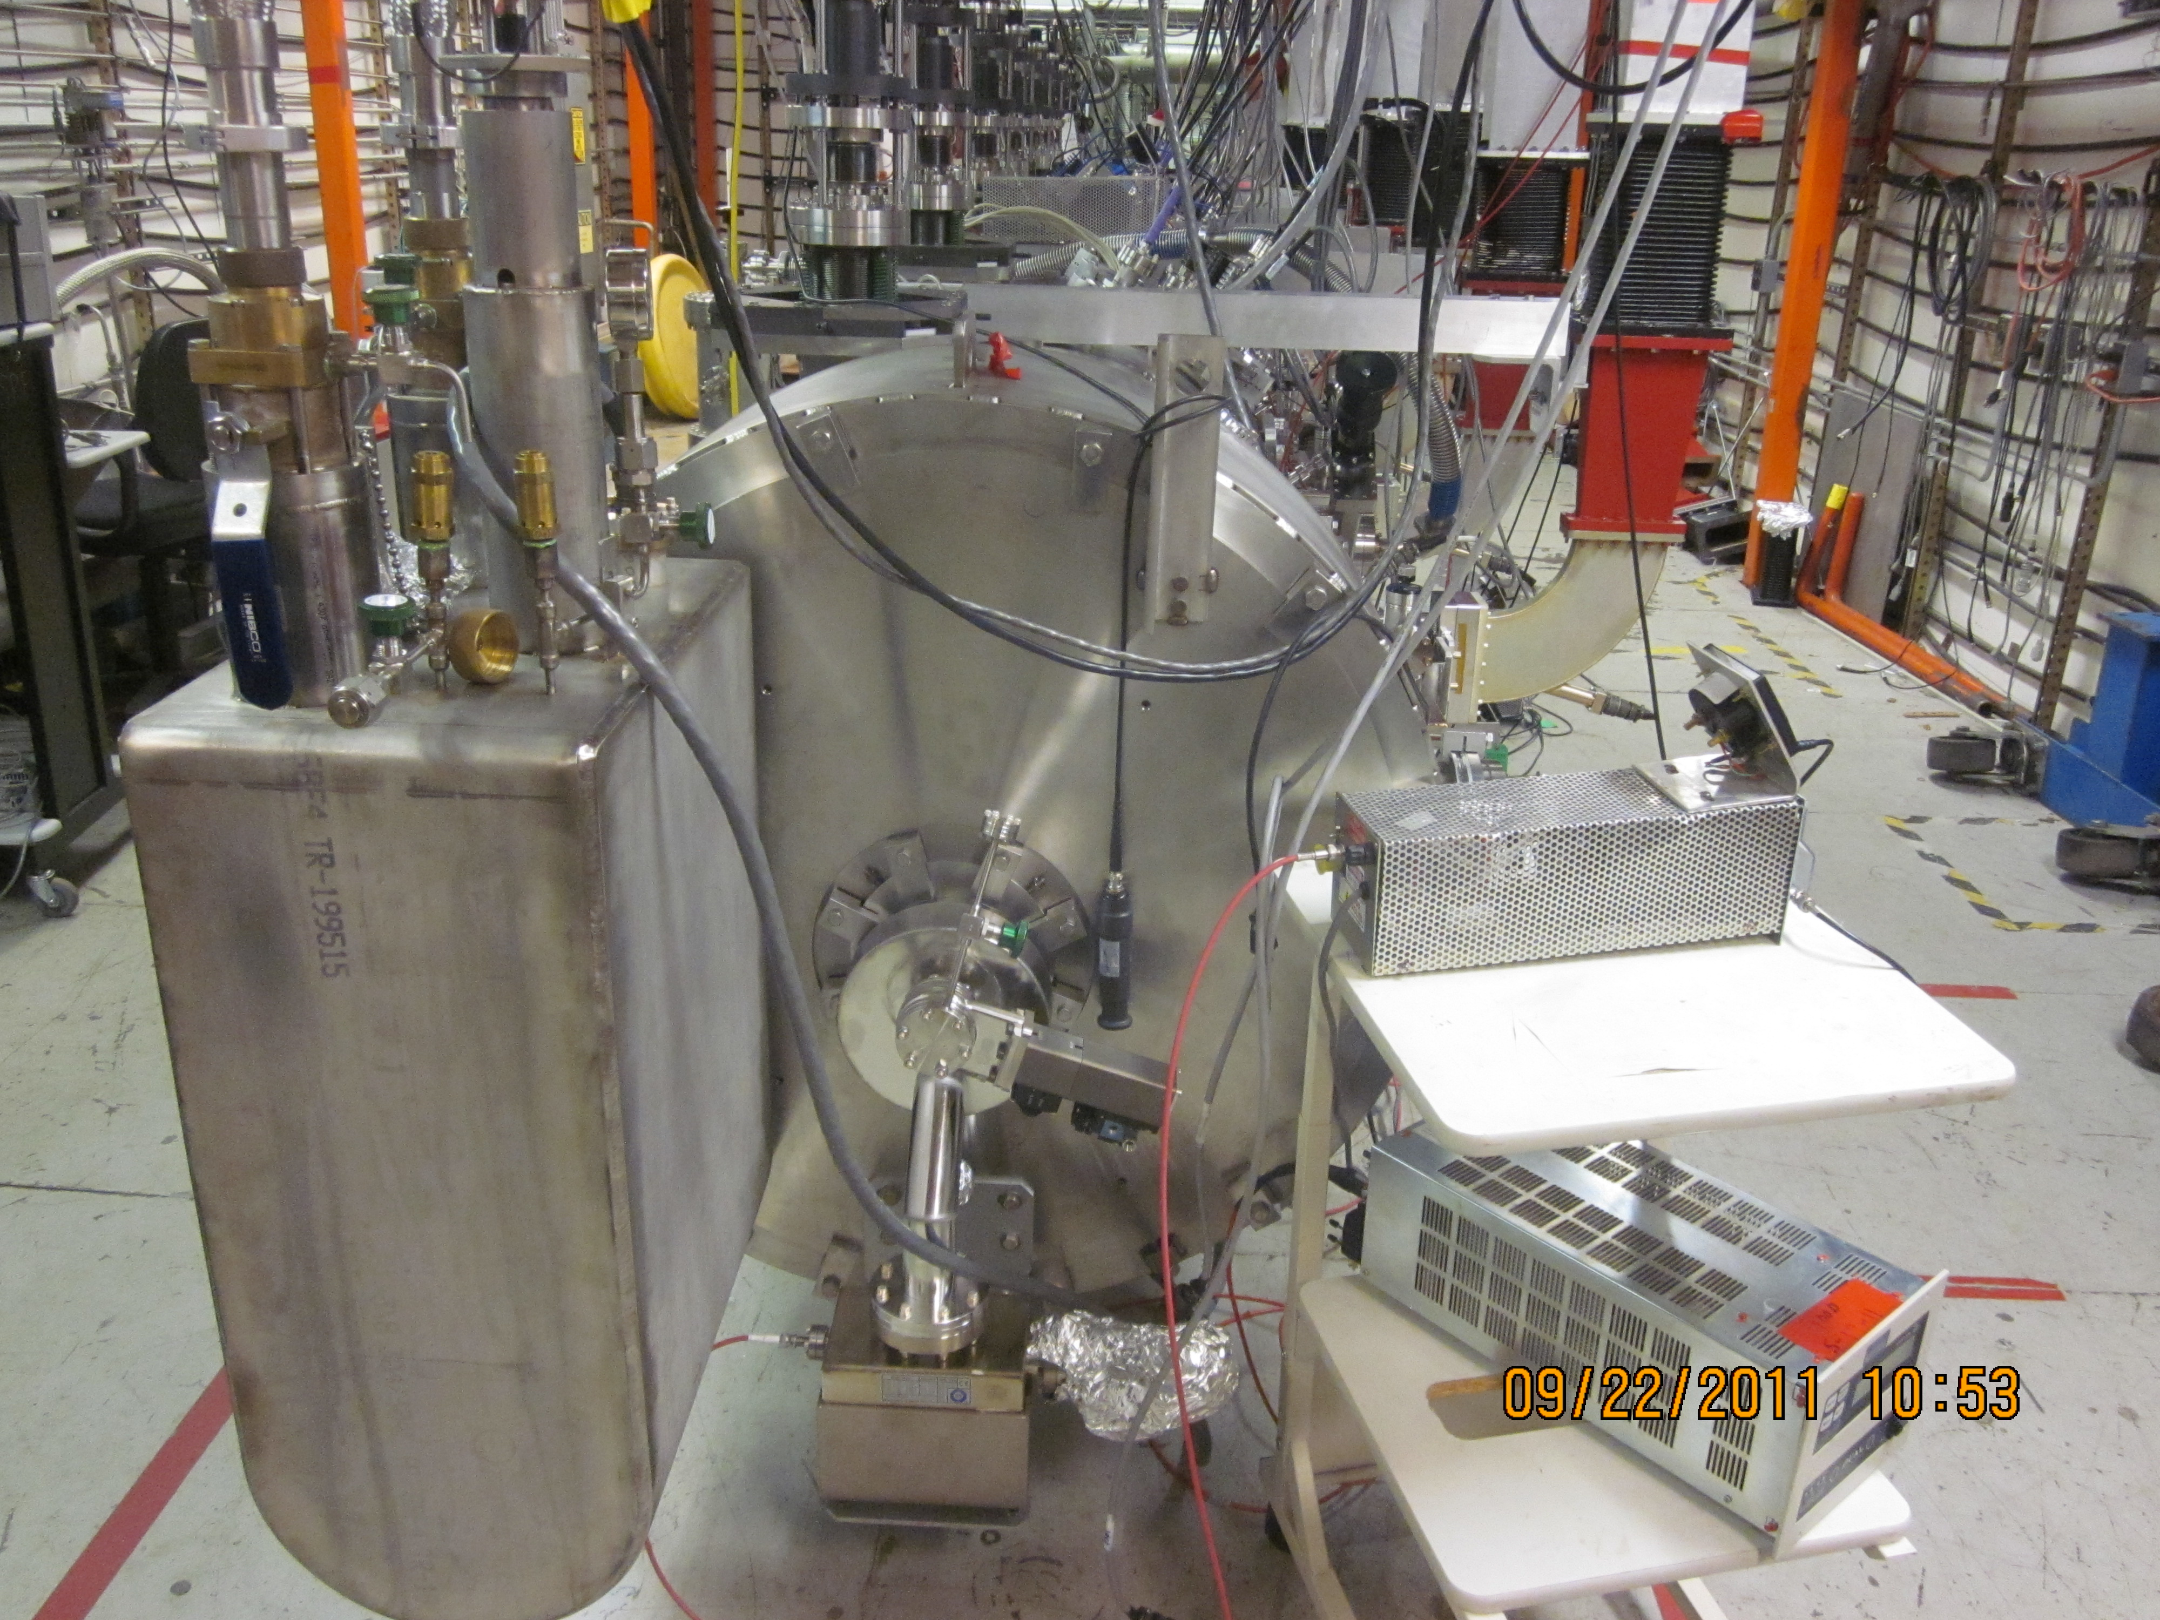
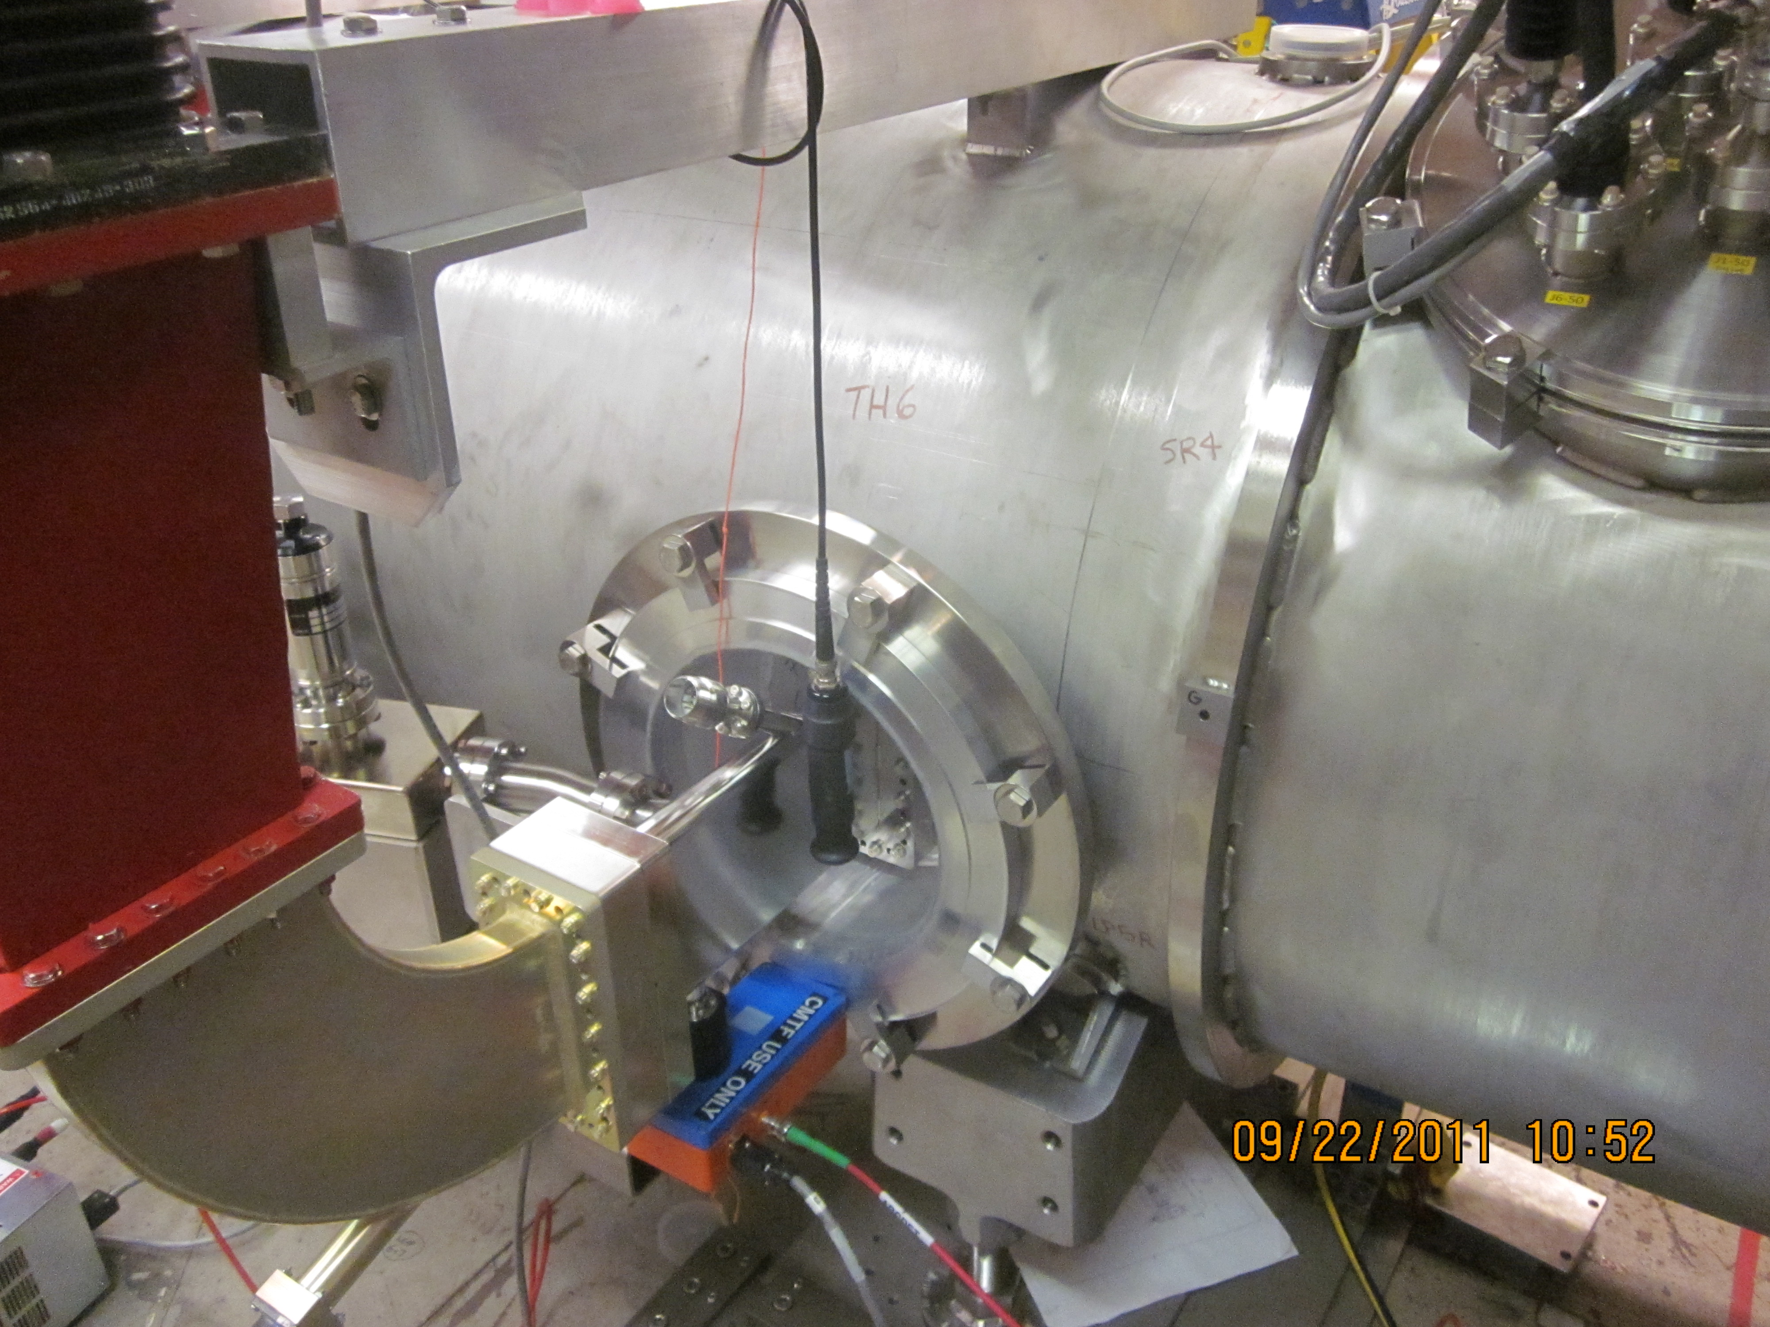
A Possible ILC-CEBAF Collaboration for Field Emission Studies
Install X-ray diodes at fixed cavity location and track from vertical test to horizontal cryomodule test to cryomudle operation in tunnel with beam
Install dark current detector outside cavity vacuum and track from vertcial test to horozontal cryomodule test
Extend dark current model to SRF linac and bench mark model
Present X-ray monitor for cryomodule test: 1 each at end of module + 6 more near RF windows

Slide 31
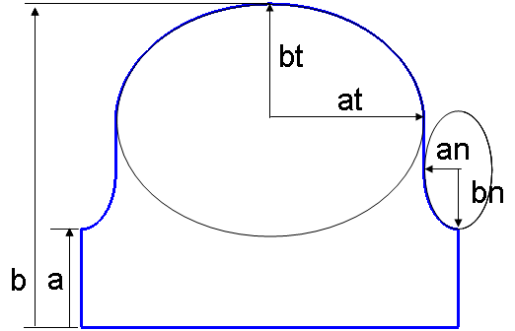
JLab R&D Plan Towards Field Emission Free SRF Acceleration at 50 MV/m – FY12
Build a 9-cell Low-surface-field (SLAC design) niobium cavity
Z. Li, C. Adolphsen, LINAC08, THP038, p.867-869 (2008).

Slide 32
JLab R&D Plan Towards Field Emission Free SRF Acceleration at 50 MV/m – 2013-2015
Develop improved cleaning technique
  Exploit understanding from field emission instrumentation
Develop in-situ field emitter removal/destruction technique
Built cavities using Nb-Cu clad material
Explore coated cavities with 1-cell 1300 MHz cavities

Slide 33
Backup Slides

Slide 34
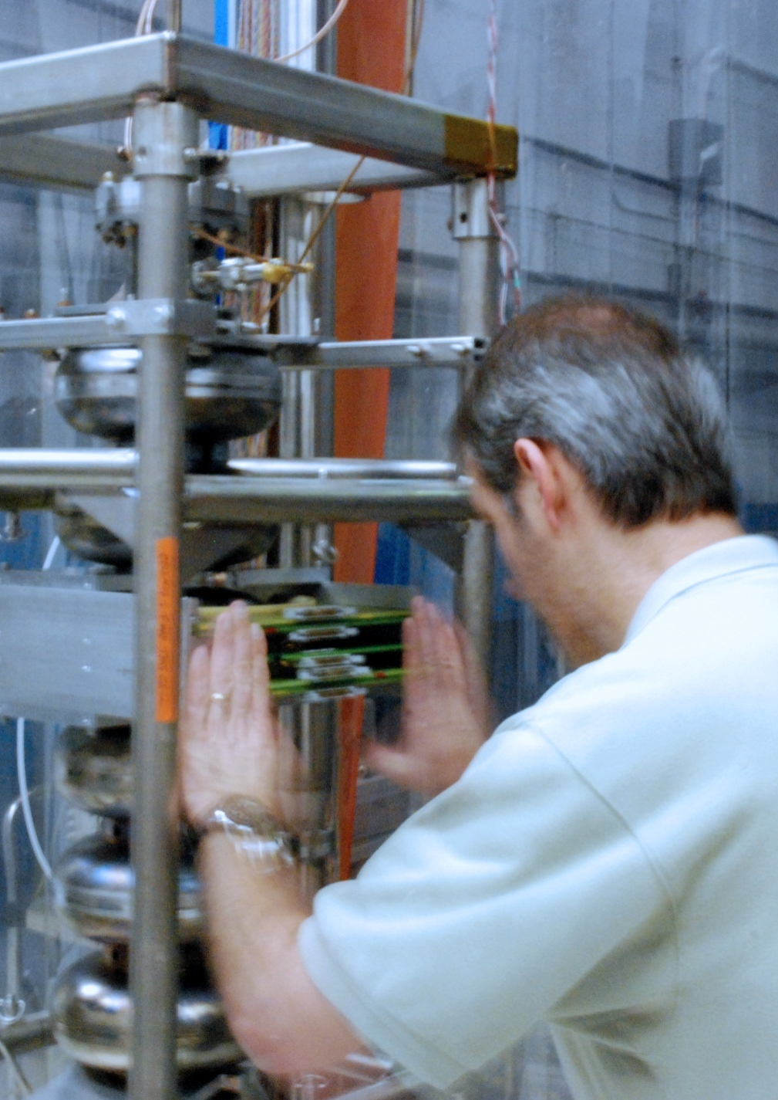
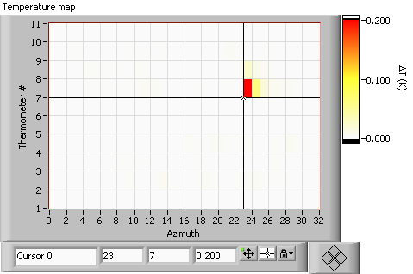
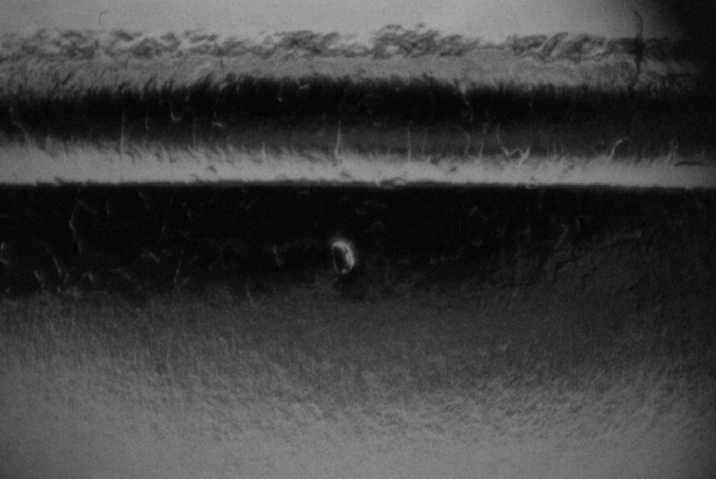
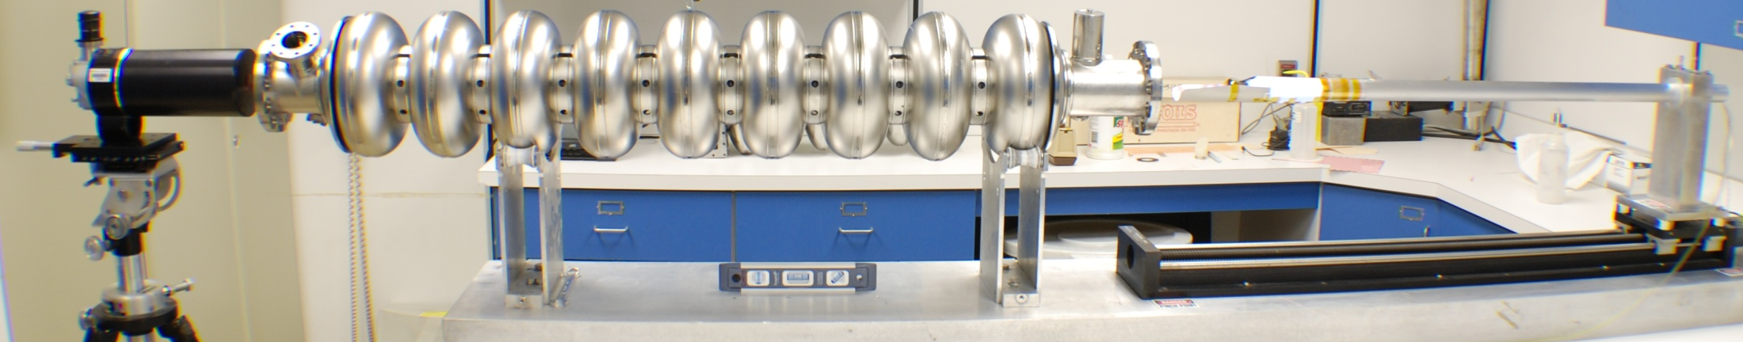
9-cell cavity thermometry + optical inspection
-> understanding of quench limit at < 20 MV/m
To EBW seam
200-300 µm
A pit outside equator EBW
at boundary of heat affected zone

Slide 35
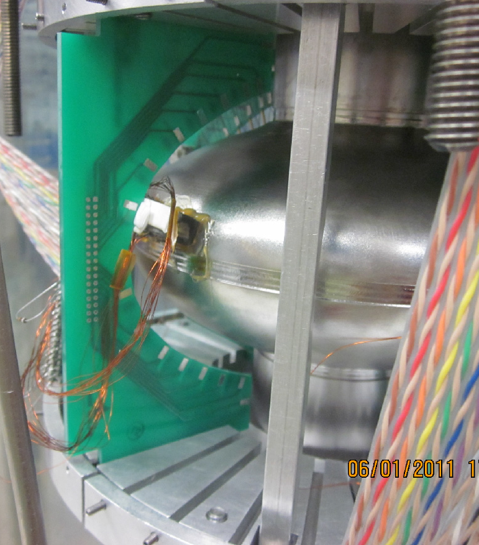
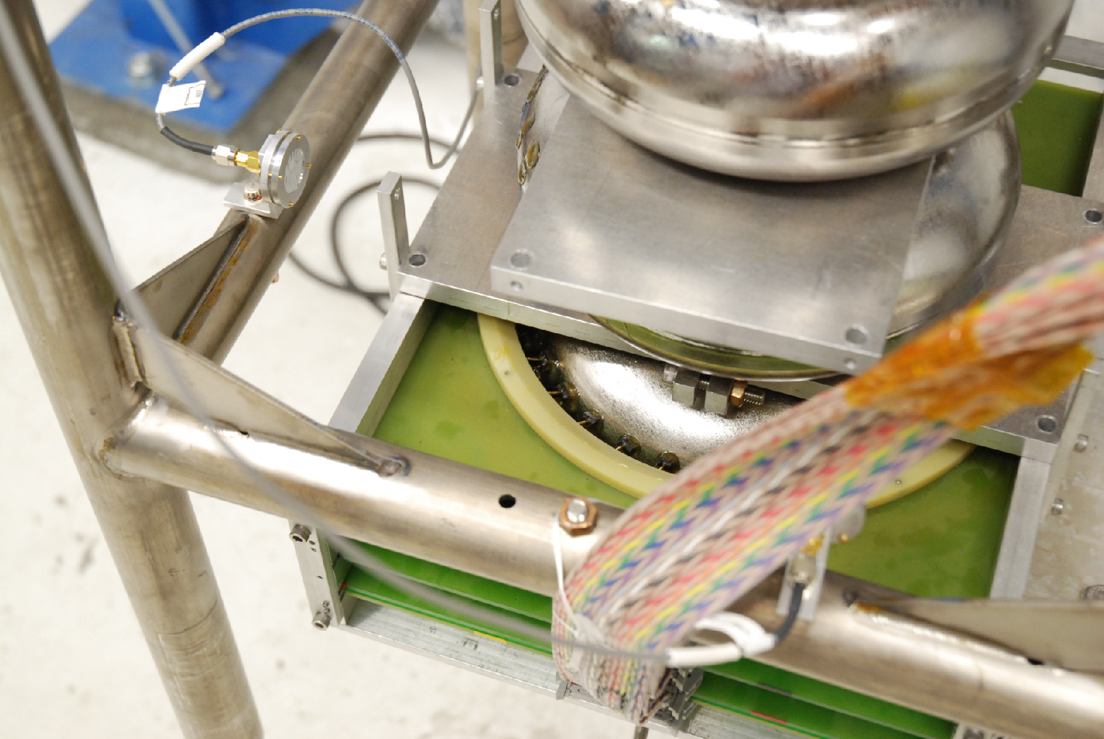
Additional Quench Study Instrumentation
Cornell OST
High-resolution Local thermometry

