Slide 1
Proposed Date and Venue
Proposed dates
  Oct. 8 – Oct. 12, 2012 : Conflicts with ATLAS & ALICE week
  Oct. 22 – Oct. 26, 2012: Conflicts with LHCB week
    IEEE 2012 in LA is from Oct. 27 through Nov. 3, 2012
Lodging
  Many hotels at various star levels around the city
    Most of them offer state rates
    Price range: $65 - $120
Meeting site:
  The University Center which has rooms of varying sizes
    Lunch in the same building
  Plus Additional Large Class rooms and Physics Executive Conference room + additional conference rooms for small meetings

Slide 2
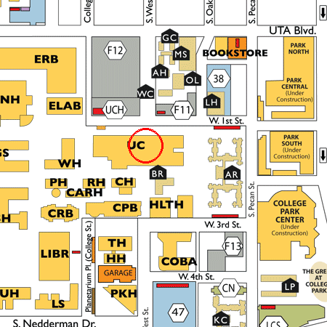
The Venue

Slide 3
Cost and Funding
Proposed registration fee
  Early registration: $375 (based on 300 participants)
  Late registration: $375+$50
  Includes
    Lunch everyday for the duration of the conference
    Snacks and drinks at the pre-registration
    Reception
    Banquet
    Coffee breaks
    Conference gift and stationary
    Equipment rental and purchase
Additional funding expected ~20 - 30k?
  DOE and NSF: $5k to $10k each?
  DPF: $5k
Young physicist help

Slide 4
Proposed Organizational Schedule
Completion of agenda for each session: D – 1mo
Completion of room and session assignments: D – 3mos
Completion of convener assignments: D – 6mos
Completion of committee assignments: D – 9mos
Committees
  Conference local organization committee
  Program committee (Physics and Detector R&D + AC)
  International Advisory Committee
Companion program?

Slide 5
Proposed Conference Schedule
Pre-registration: Sunday from 5pm
Reception: Monday
Banquet: Thursday
Proposed daily session time slots
  Morning sessions: 8:30 – 12:30pm
  Lunch: 12:30 – 2:00pm
  Afternoon sessions: 2:00 – 6:00pm

