Slide 1

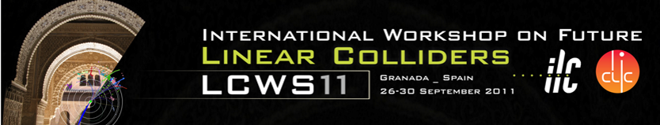



Recent improvements and achievements for the nm-stabilization of CLIC main beam quadrupoles
C. Collette*, K. Artoos, M. Esposito, P. Fernandez Carmona,
M. Guinchard, S. Janssens**, A. Kuzmin, R. Leuxe, R. Morón-Ballester
* Associate ULB
** PhD student ULB-CERN
http://clic-stability.web.cern.ch/clic-stability
The research leading to these results has received funding from the European Commission under the FP7 Research Infrastructures project EuCARD

Slide 2






Collaborations
CERN is collaborating on the stabilization of accelerator components with the following institutes:
Active Structures Laboratory
Department of Mechanical Engineering and Robotics
Université Libre de Bruxelles (ULB), Belgium
Institut de Recherche sur les lois Fondamentales de l'Univers
CEA (Commissariat à l'énergy atomique) Saclay, France
Laboratories in Annecy (France) working on VIbration STAbilisation

Slide 3
Outline
Introduction/ Reminder
Status and Results
  1. Characterisation of system and sources
  2. Mechanical design
  3. Electronics
  4. Controller design + sensor
  5. Results + Integrated Luminosity Simulations
Five R&D themes
Conclusions + next steps

Slide 4
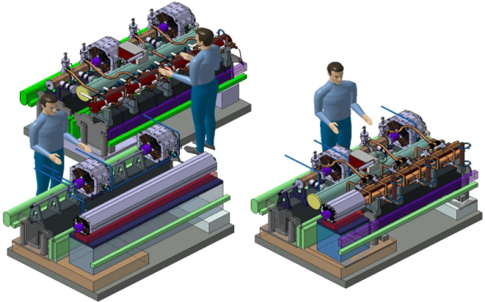
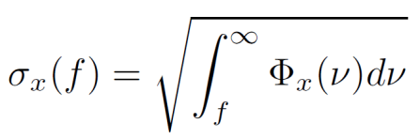
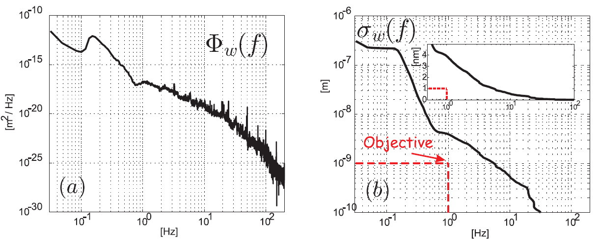
Introduction/Reminder:
Initial requirements
3992 CLIC Main Beam Quadrupoles:
Four types :
~ 100 to 400 kg, 500 to 2000 mm
A. Samoshkin
Nano-positioning
Stability (magnetic axis):
Type 4: 2m, 400 kg
Type 1: 0.5 m, 100 kg
Vertical MBQ | 1.5 nm > 1 Hz
Vertical Final Focus | 0.2 nm > 4 Hz
Lateral MBQ, FF | 5 nm > 1 Hz 5 nm > 4 Hz

Slide 5
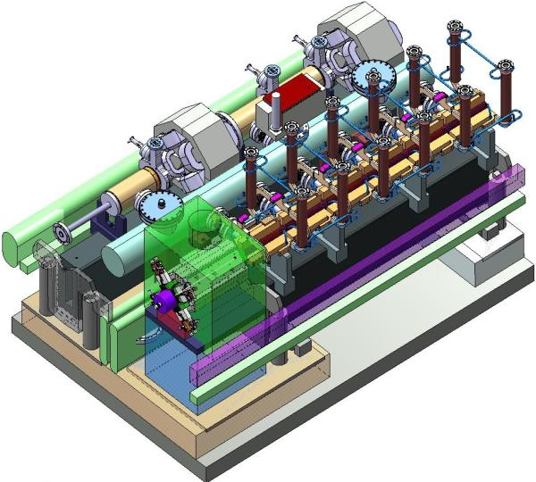
Introduction/Reminder:
Other requirements
Stiffness-Robustness
Applied forces
Compatibility alignment
Uncertainty
Transportability
Strategy STIFF support
Available space
Integration in two beam module
620 mm beam height
Accelerator environment
- High radiation
- Stray magnetic field
A. Samoshkin

Slide 6
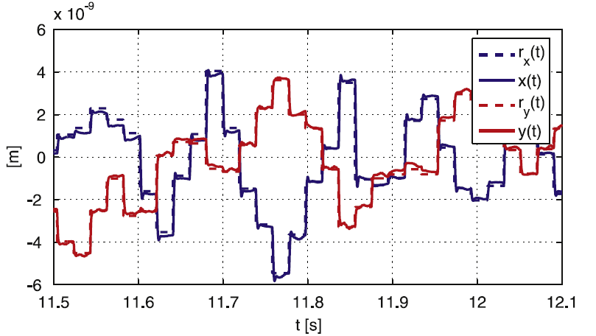
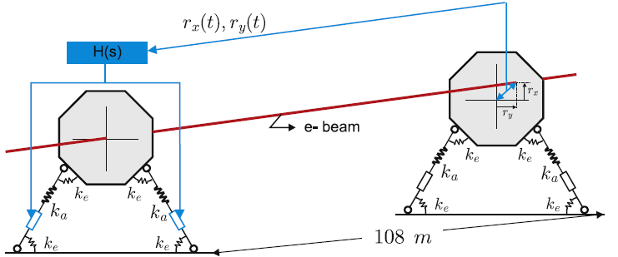
Introduction/Reminder:
Additional study
6
« Nano-positioning» feasibility study
Modify position quadrupole in between pulses (~ 5 ms)
Range ± 5 μm, increments 10 to 50 nm, precision ± 1nm
In addition/ alternative dipole correctors
Use to increase time to next realignment with cams

Slide 7
Introduction/Reminder:
Actuating support strategy
Very Soft (1 Hz)
Soft (20 Hz)
Stiff (200 Hz)
Pneumatic actuator
Hydraulic actuator
+ Broadband isolation
Stiffness too low
Noisy
Electromagnetic in parallel with a spring
Piezo actuator in series with soft element (rubber)
+ Passive isolation at high freq.
+ Stable
Low dynamic stiffness
Low compatibility with alignment and AE
Piezoelectric actuator in series with stiff element (flexible joint)
+ Extremely robust to forces
+ Fully compatible with AE
+ Comply with requirements
Noise transmission
Strong coupling
k~0.01 N/µm
k~1 N/µm
k~100-500 N/µm
COMPARISON

Slide 8
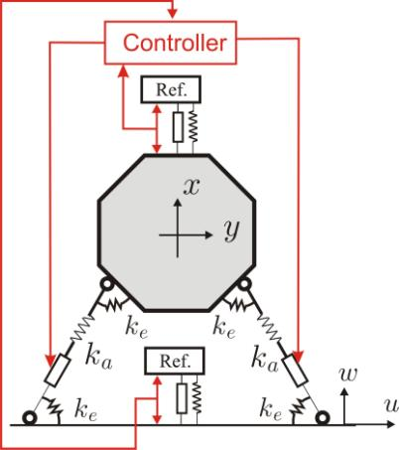
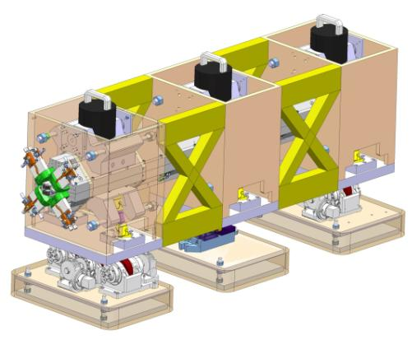
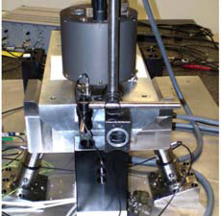
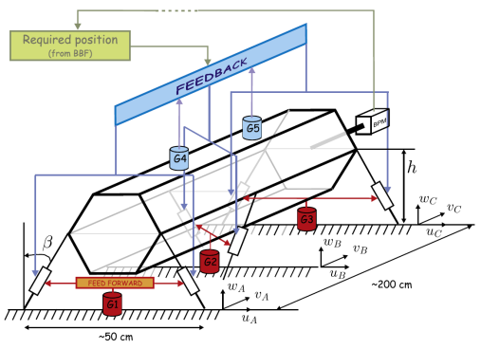
Introduction/Reminder:
Concept
Inclined stiff piezo actuator pairs with flexural hinges (verical + lateral motion)
(four linked bars system)
X-y flexural guide to block roll + longitudinal d.o.f.+ increased lateral stiffness.
(Seismometers)/ inertial reference masses for sensors

Slide 9
Outline
Introduction/ Reminder
Status and Results
  1. Characterisation of system and sources
  2. Mechanical design
  3. Electronics
  4. Controller design + sensor
  5. Results + Integrated Luminosity Simulations
Five R&D themes
Conclusions + next steps

Slide 10

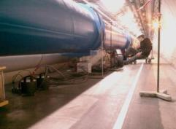
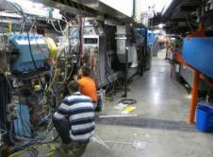
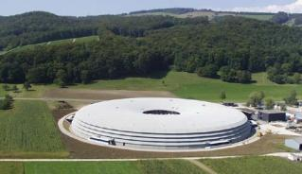
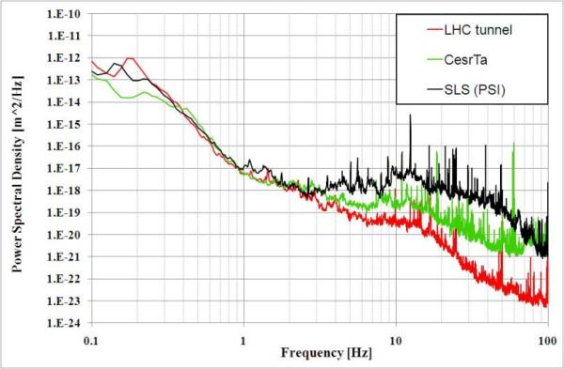
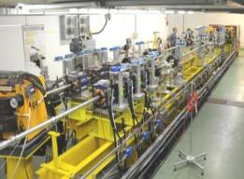
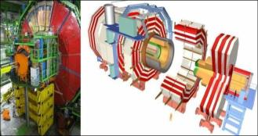
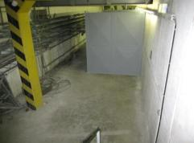
Status/ Results:
1. Characterisation vibration sources
Ground motion: seismic motion + technical noise transmitted through ground
Already well covered and known , refer to presentations last year + website
Conclusion: stabilisation is needed
Direct vibration forces on magnet: water cooling, ventilation, interconnects,…
Modal Analysis + First results with water cooling
SLS
CesrTA
LHC
CLEX
CMS
ISR
M. Sylte, M. Guinchard, A. Kuzmin, A. Slaathaug

Slide 11
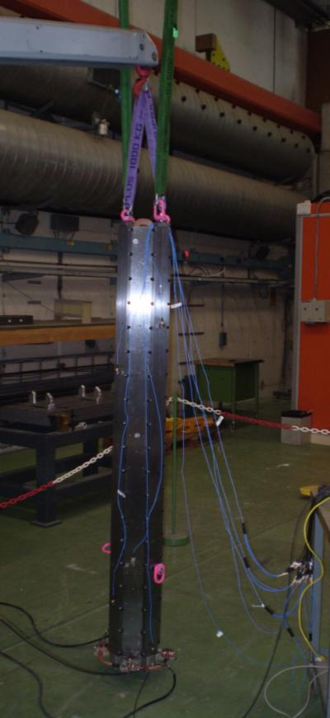
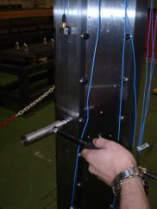
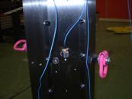
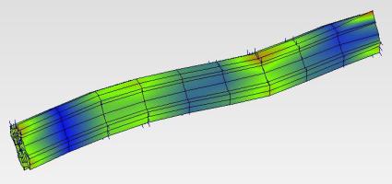
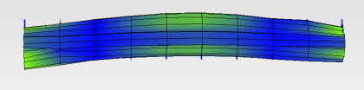
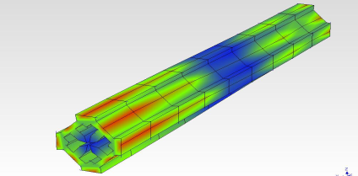
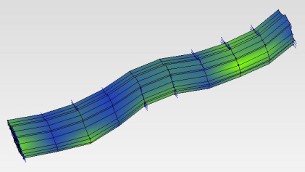
Status/Results:
Experimental modal analysis MBQ
MBQ Type 4 in free-free condition
Mode | Freq. (Hz) Measured | Damping (%) Measured
1 & 2 | 264 | 1.26
3 & 4 | 628 | 3.32
5 | 656 | 1.94
6&7 | 1090 | 3.54
Model 1
1&2
3&4
6&7
5
M. Guinchard, R. Morón Ballester

Slide 12
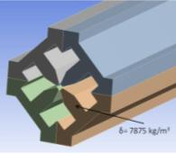
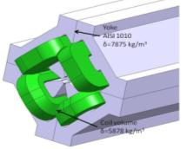
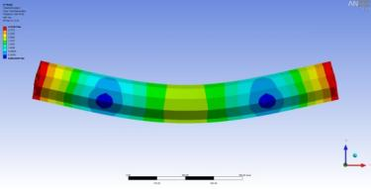
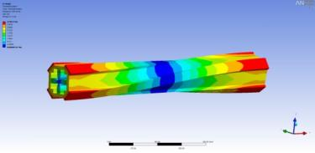
FE Modal analysis MBQ Type 4
The measurements were compared with several FE models to understand:
Effect of mounting with bolts on stiffness
Influence of coil mass and stiffness
The coil and yoke Young modulus and mass were more precisely applied to obtain a tuned model very close to the measurements:
1
2
Mode | Freq. (Hz) Model 1 | Freq. (Hz) Model 2 | Freq. (Hz) Tuned model | Freq. (Hz) Measured
1 & 2 | 279 | 281 | 266 | 264
3 & 4 | 676 | 669 | 646 | 628
5 | 684 | 905 | 654 | 656
6&7 | - | 1153 | 1105 | 1090
1&2
M. Esposito, G. Deleglise

Slide 13
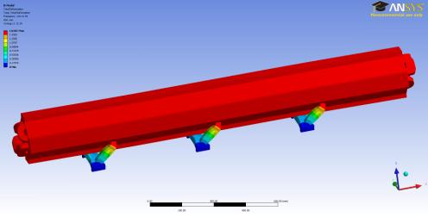
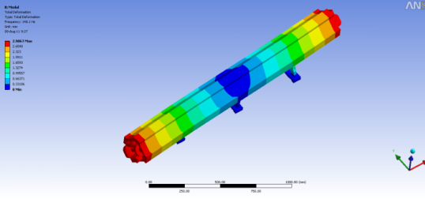
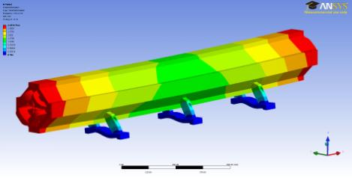
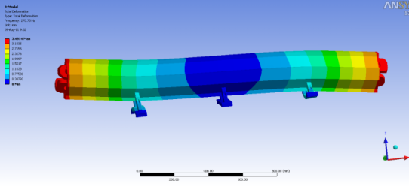
FE Modal analysis MBQ Type 4 with supports
FE analysis magnet on equivalent “dummy” supports with adaptable stiffness
Magnet suspension modes:
Longitudinal: 124 Hz
Yaw: 134 Hz
Lateral: 164 Hz
Pitch: 257 Hz
Conclusions Modal analysis:
Magnet assembled with bolts is sufficiently stiff
The coil does not participate to the magnet stiffness
Complete FE model now available that corresponds well to measurements
There are no internal modes of the magnet pole tips in the frequency region of interest,
nor in the measurements neither in the model i.e. The magnet stability can be measured on the outside
Most important modes are the magnet suspension modes > important input for design

Slide 14
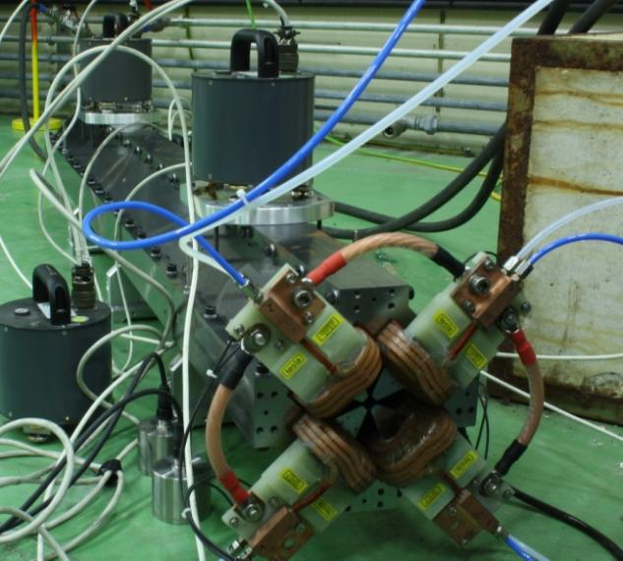
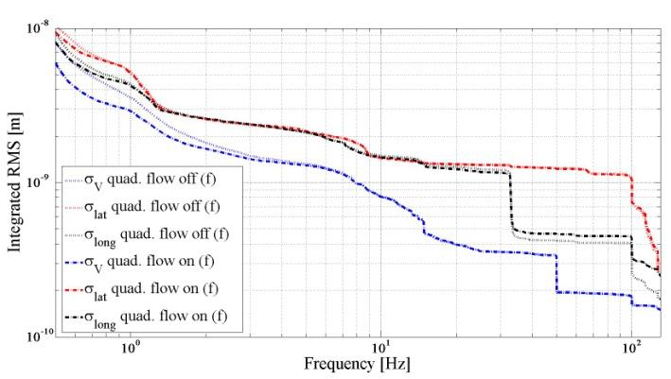
Status/ Results:
Water cooling tests
T4 MBQ on equivalent supports
~ nominal water flow 1 l/min
Very small measured increase (< 1 nm)
Very conservative estimate increase of r.m.s. displacement of 2 nm (without stabilisation)
S. Janssens

Slide 15
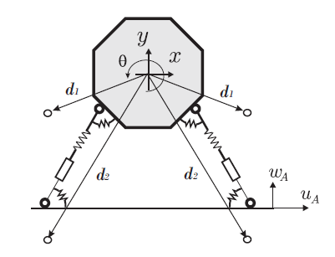
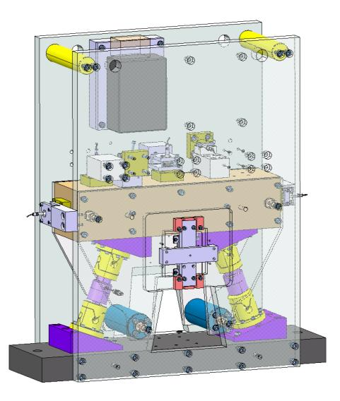
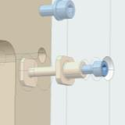
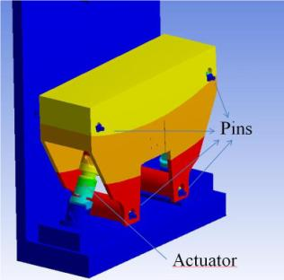
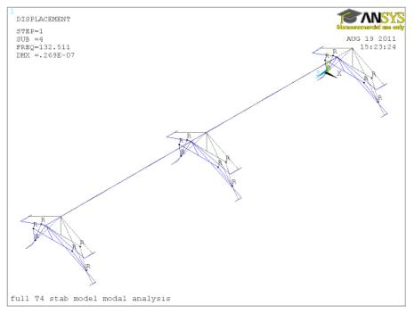
Status/Results
2. Mechanical design
Design of the flexural x-y guide
  4 link model + x-y guide fully analysed
  Increases lateral stiffness by factor 500
  FE element models made
1&2
Type 4 on 3 supports
  Prototype x-y guide under production
  = next test bench for stabilisation and nano positioning
M. Esposito, R. Leuxe

Slide 16
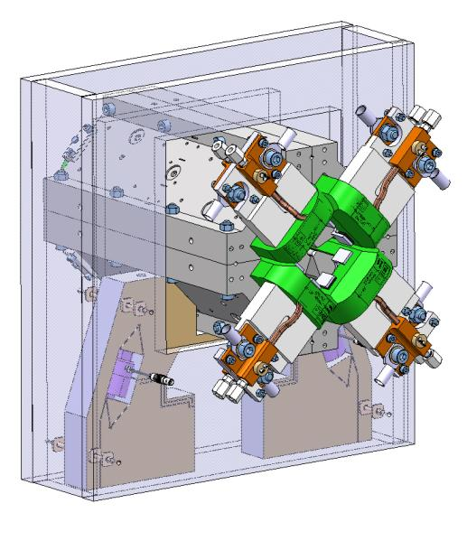
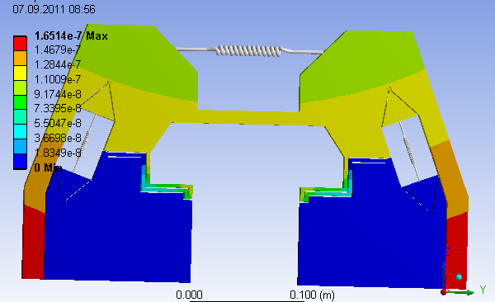
Status/Results
Mechanical design
Monolithic approach of the design:
To simplify the assembly + increase precision
Reduce assembly stresses on actuator
Improve sensor installation: inertial ref. mass
and displacement gauges
Optimise vertical, lateral and longitudinal stiffness
Mechanical locking for transport
1&2
Work in progress: T1 test module design

Slide 17
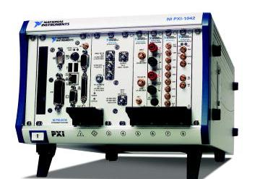
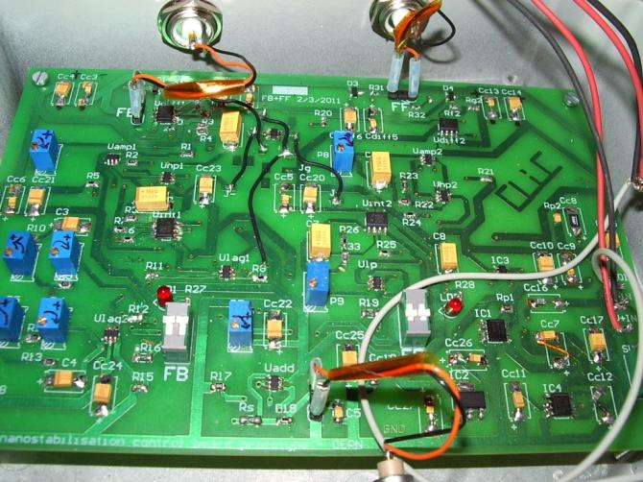
Status/Results:
3. Controller electronics
Power ≈80W
Cost ≈15000CHF
Volume ≈13 l
From Digital to Analogue
+ Low enough noise
+ Low cost
+ Small volume
+ Lower latency
+ Less sensitive to single events
+ Low power consumption
Limited flexibility, no external communication
(next step hybrid circuit)
P. Fernandez-Carmona
1&2
Power ≈2 W
Cost ≈100CHF
Volume ≈0.15 l
CLIC Stabilisation controller board

Slide 18
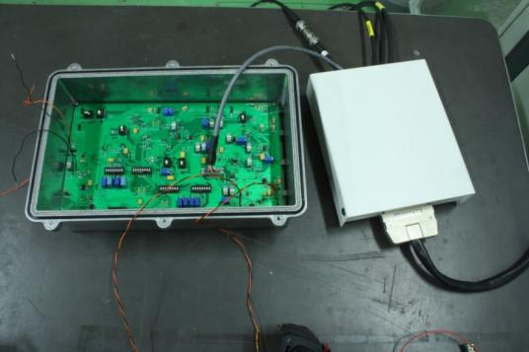
Status/Results:
Controller electronics: Hybrid
Hybrid circuit:
Analogue controller with digital part
To change parameters analogue part: gain, frequencies,… from central control
To communicate status (values, errors,…) to central CLIC control
Status:
SPI
Results:
The gain, frequencies etc of this prototype was successfully changed from a standard I/O DAQ card with Labview
Stabilisation was achieved but not yet same performance as analogue board
→ Cost optimization, Integration and Pre inustrialisation of controller hardware well advanced
P. Fernandez-Carmona

Slide 19
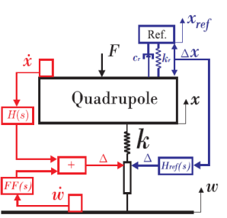
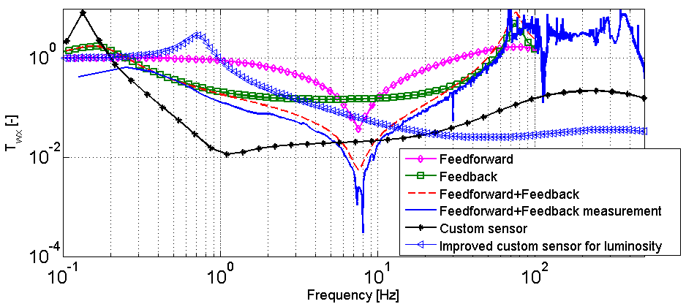
Status/Results
4. Stabilisation controller
Main objectives:
Increase performance
Sensor design
Improve compatibility with integrated luminosity
Complete the stabilisation model
Identification of the system, stability limits

Slide 20
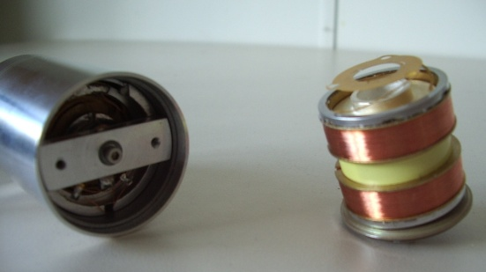
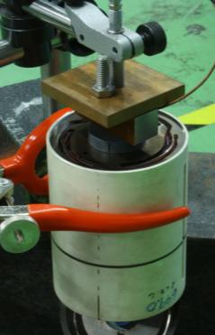
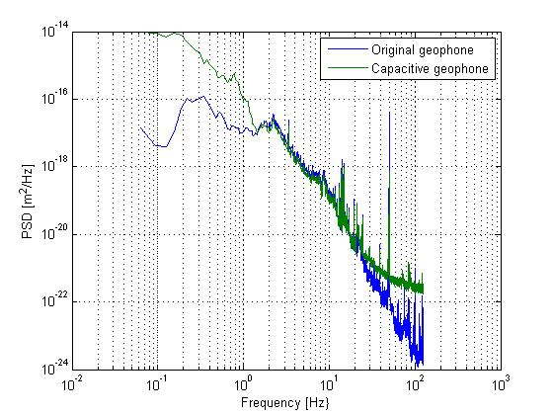

Status/Results
Development Inertial reference
Goal: Improved transfer function
Radiation and magnetic field hard
Lower noise, higher resolution
Several Prototypes under preparation + testing
Interferometer
1&2
Geophone
Geophone withh capacitive gauge

Slide 21


5. Results
Tripod: 2 d.o.f. , 100 kg
1&2
Results with low and high vibration back ground
Integrated r.m.s. ratio was increased from 2-3 to 7-8
Integrated RMS at 1 Hz : 0.3 nm on membrane
0.5 nm on tripod
Membrane: 1 d.o.f.

Slide 22

Results test benches
Long term stability (∆T< 0.5°C)
With analogue board and tripod
1&2
A test with heaters is under preparation.

Slide 23


Results test benches
Nano positioning
* With a gain correction for lateral x measurement
Vertical measured with SIOS interferometer
1&2
Some improvement for « style of writing »
Main difficulty is not the positioning but the support/alignment of the sensors
Next development with x-y guide prototype

Slide 24
Integrated luminosity simulations
Courtesy J. Snuverink et al.
No stabilization | 68% luminosity loss
Seismometer FB maximum gain | 13%
Seismometer FB medium gain | 6% (reduced peaks @ 0.1 and 75 Hz)
Seismometer FB+FF | 7%
Inertial reference mass | 11%
Inertial reference. mass. + HP filter | 3%
Notes:
Comparison of FB and FB + FF at maximum gain ( 13% to 7 %).
Mention measured/ model transfer functions
The best luminosity is not obtained at the best result for integrated r.m.s but rather for a medium gain with reduced peaks in the transfer function

Slide 25
Status/Results
Integrated luminosity simulations
Courtesy J. Snuverink et al.
Notes:
To ilustrate what stabilisation adds with respect to other mitigation techniques

Slide 26


Status/Results:
Type 1MBQ stabilisation
Ongoing now
Planned:
Stabilisation with water flow and magnetic field
Long term measurements
Stabilisation controlled from office via hybrid board and internet
Intermediate step before construction of test module T1
1&2

Slide 27
R &D Strategy after CDR
Five R&D themes:
Performance increase | →Reach requirements from higher background vibrations → Increase resolution (Final focus)
Compatibility with environment | → Radiation, magnetic field
Cost optimization | → Standardize and optimize components, decrease number of components, simplify mounting procedures,…
Overall system analysis | → Interaction with the beam-based orbit and IP feedback to optimise luminosity Integration with other CLIC components → Adapt to changing requirements
Pre-industrialization | → Ability to build for large quantities

Slide 28
Conclusions
The characterisation of the MBQ and direct vibration forces was started: modal analysis and water cooling. Nothing critical was measured so far but the magnet suspension modes should be increased.
Good progress was made on the mechanics, electronics and controller design of the stabilisation system.
Integrated simulations show good luminosity performances and clear plans for further improvements: The best r.m.s. does not give the best luminosity. We look at the requirements differently now.
A dedicated sensor is under development.
1&2

Slide 29
Conclusions
The results on the test benches were improved. A good margin exists now on the r.m.s. requirements. The stabilisation system meets the requirements during days.
Final focus stability requirement was reached on the membrane.
A new series of more elaborate test benches are under construction/ ready for testing.
1&2
Thank you!

