Slide 1
SIT, SET, ETD: integration and simulation brief progress report
Konstantin Androsov, Alexandre Charpy, A. Savoy-Navarro
ILD Meeting at LCWS 2011, Sept 29, 2011
The software work reported here is essentially achieved by Alexandre and Konstantin, also with special thanks to S. Aplin, F. Gaede and Z. Drasal for their very helpful collaboration.

Slide 2
Outline
Some news on the integration of these components
Progress report on simulations
Remaining pending points, next improvements and schedule

Slide 3
Integration of Si components
The integration studies of the various Si components of the
barrel (SIT & SET) and the End Cap (ETD) were developed already since several years (starting around 2007).
Details of these integration studies were reported on various LC
Workshops and to some extend in the ILD Concept LoI.
The corresponding detector description was installed by Alexandre
in the ILD simulation.
The different issues we are still working on/improving are:
- Where/how to fix the SIT and SET?
- How to further decrease the material budget? Thus work on the mechanical structure, cooling, cabling and mechatronics related aspect.
alignement of Si components between them and with other detector component (EUDET notes)

Slide 4
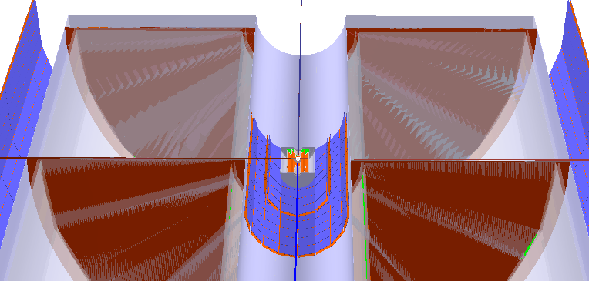
Max deviation: 4mm
over ½ overall SET length

Slide 5
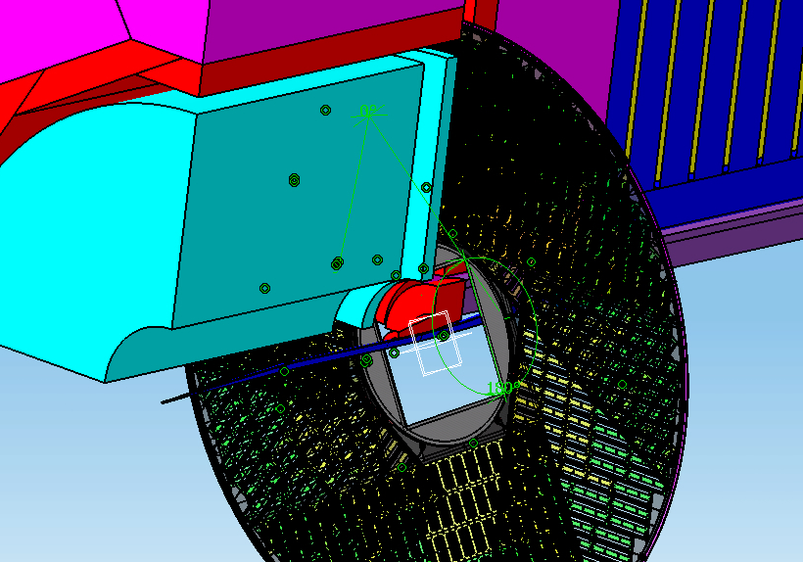
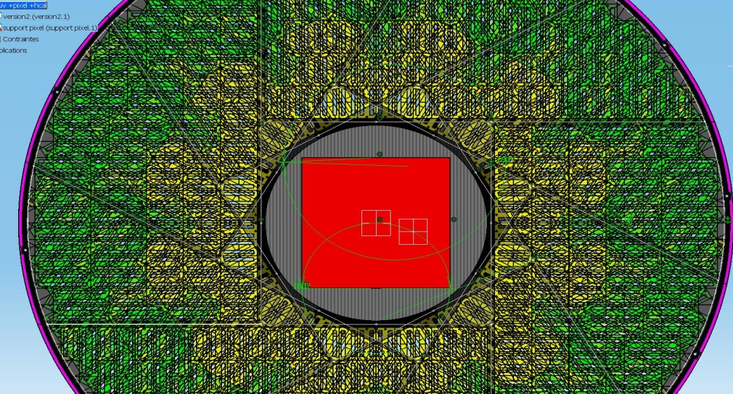
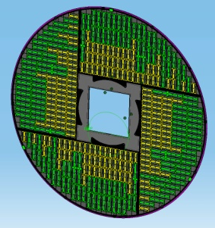
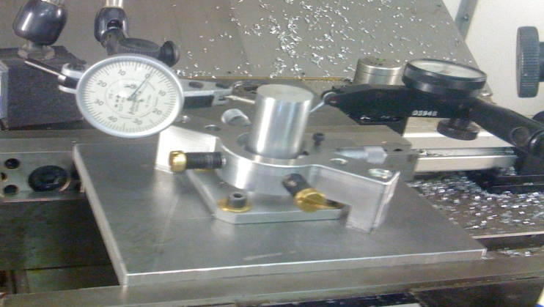
Integration - Fixation
ETD: work with endcaps based on discussion with ECAL fixation (D.Grondin), done since 2.5 years.
SIT: A standalone structure is designed (via Geant4 and is under developement) but we need to discuss with other components in order to fix later aspects=> Need mechanical engineer study with other concerned components to finalize things.
SET: How to fix it? Question without answer since 2 years. We would like to have standalone support for the reason written in the LOI some of the SET goals:
  Calibrate the alignment and deformation of the TPC with the VXD and ECAL with a high position resolution
  Time stamping: nice result shown in CLIC case
  improvement of the linking efficiency and momentum resolution for PFA
ETD fixation to the End Cap ECAL

Slide 6
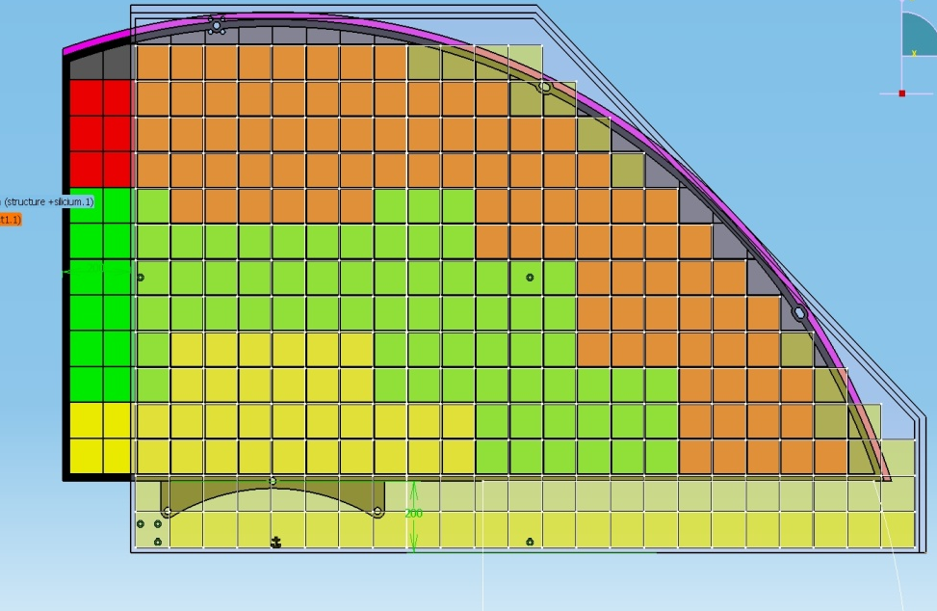
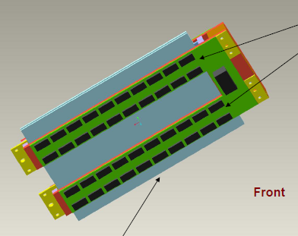
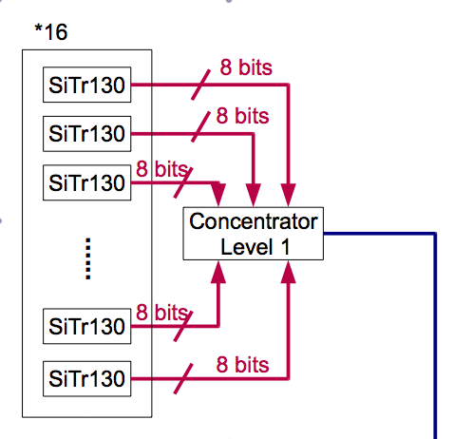
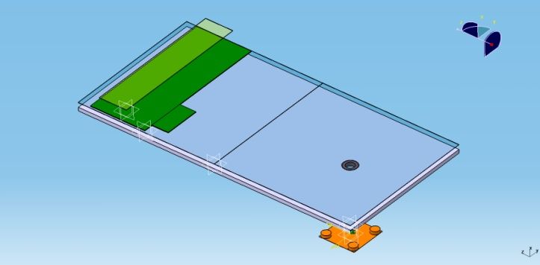
Integration – Mechatronic aspect
Module:
  Common concept for all the components of the silicon tracking
  Edge less sensors
  Chip and concentrator on sensors => kapton link (TAB-based?)
  DAQ integration => different level of concentrator
  Polarisation through the support
  Need to take into account the mechanical integration that has different constraints between SIT and SET for example.
ATLAS
Supermodule (or staves?):
  Common concept for all the components of Si tracking
  We are working on the assembly of several modules => for time being following what is underway for HL-LHC
  Also for making “intelligent’” support structures=> decreasing %X0

Slide 7
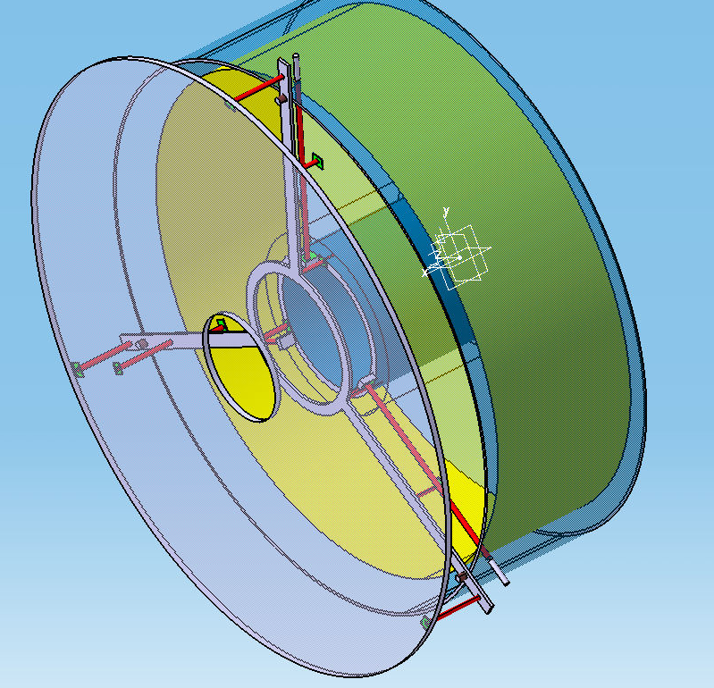
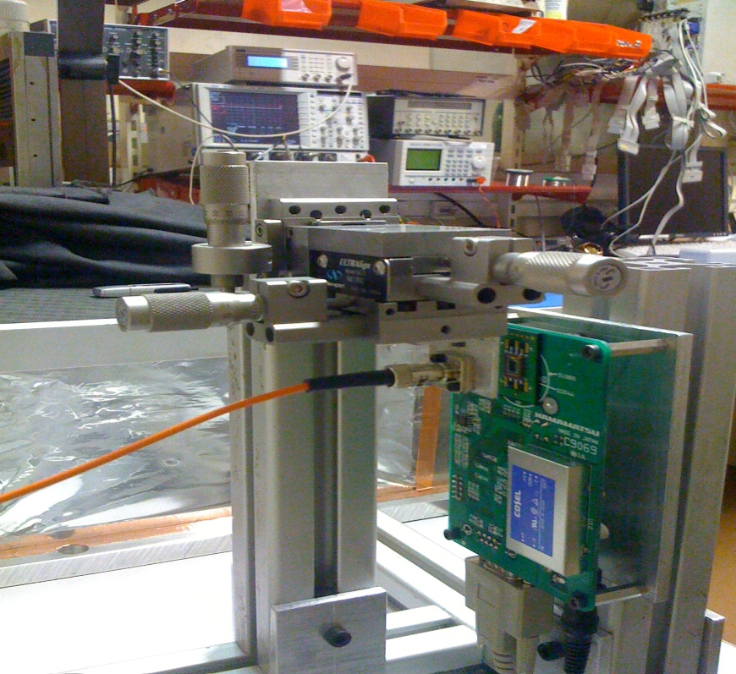
Integration - Alignment
  ETD process of installation partially define
  SIT and SET depend of the engineer discussion
  concerning solution for fixation of their support structure
  Alignment Purpose: monitoring of the relative displacement between components (push-pull, environmental vibration)
  Laser + dedicated pixel sensors in the strategic position. All parts are equipped with sensors for alignment direct optical fibre
Optical fiber
TPC
Pixel for alignment
ETD
SET
Feasibility studies and concept:
achieved

Slide 8
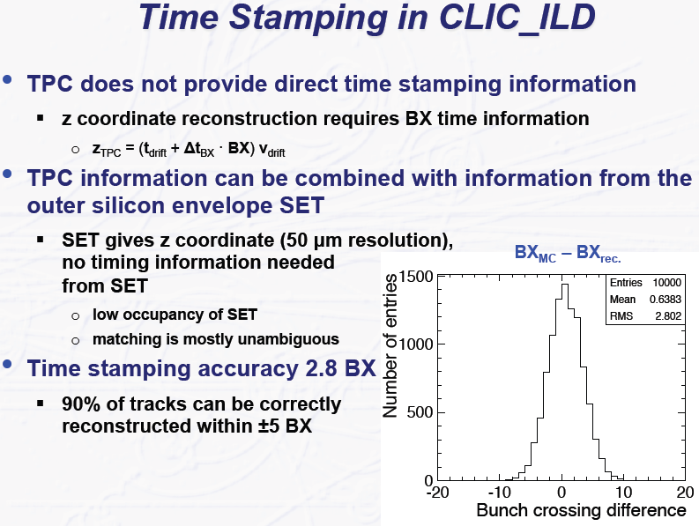
(Haustchild’s presentation at LCWS2011)

Slide 9
Integration – need to do ...
ETD integration is well defined
Decision about the SET support (standalone wheel is better for several reason => to be discussed especially with TPC)
SIT:
  Independent support directly fix on the ISS: need to know the cable density to integrate the fix system
  Under study: how to split it in two “half” cylinders
  Under study: the manufacturing of the false DSSD (coded in GEANT4)
  What's up about the VXD ? Cryostat ? What are the constraints around ?
Integration with the VXD and with FTD

Slide 10
2) Development of the Silicon tracking simulation software framework

Slide 11
Synoptic view of the main connections of the SIT, SET, ETD sub-detectors software
The SIT, SET, ETD geometry description models are the same for both these sub-detector digitization via Marlin processor and these sub-detectors GEANT4 simulation via Mokka geometry drivers.
The same set of main parameters for each sub-detector geometry model is included both into the Mokka and GEAR databases

Slide 12
Definition of Si sub-detectors parameters in GEAR
The full GEAR representation of SIT, SET and ETD models is ready
ZPlanarParameter interface filling with SIT and SET information is implemented and currently under verification and debugging
The interface (RPhiParameter?) common to all endcap and forward tracking components that includes the ETD is not yet defined

Slide 13
Digitization
Base source code for digitization and clustering processors are provided by Z. Drasal.
Our changes to the base source:
Definition of silicon geometry provider common to SIT, SET, ETD
Modifications in digitization and clustering processor to be compatible with SSD technology and new geometry description
Modifications in the clustering processor to include the support of ≥ 2 silicon sensor into a single module.
Modification of the output of the clustering processor in order to fit with the new LCIO class ‘TrackerHitPlane’

Slide 14
Current progress on the digitizer
The digitizer processor code was adapted to the SSD technology and our geometry description
The work on the common geometry provider is in progress
The adaptation of the clustering processor to the SSD technology is in progress
For the current version of the clustering processor the following ‘’simplification’’ is considered: all the chained sensors (most usual case: 2 sensors/module) into a single module are considered as one single sensor (longer strip length).

Slide 15
Available versions
In the current ‘trunk’ branch of the Mokka repository:
  The parameterized detailed GEANT4 description of SIT, SET, ETD is available.
  A preliminary export to GEAR is available
In the current ‘trunk’ branch of the ILCSoft repository:
  A preliminary version of the digitizer processor is available
  A version of the developer of the geometry description and the clustering processor is available

Slide 16
Work Plan on simulation side:
Finish the “clusterization” for SIT and SET
Perform same for ETD, but now the framework is well developed, thus should be easier.
The barrel Si part is expected to be finished in one week.
The End Cap part should be fully achieved by the end of October.
We will continue to report at the Simulation
regular ILD meetings and make available the
developed software for tests as soon as achieved.

Slide 17
backup

Slide 18
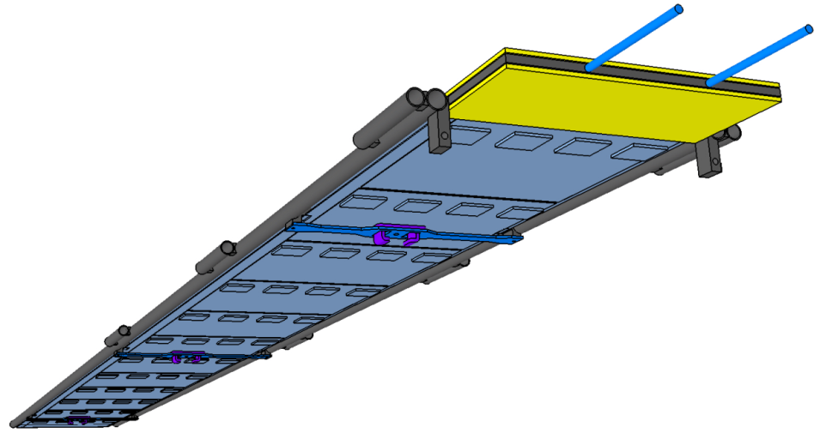
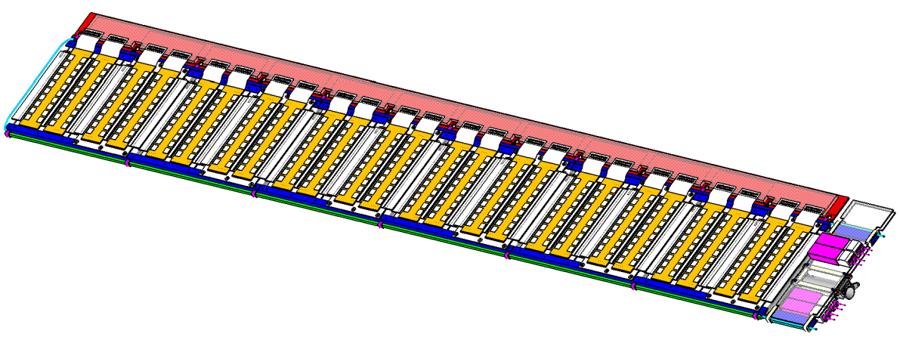
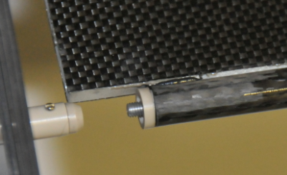
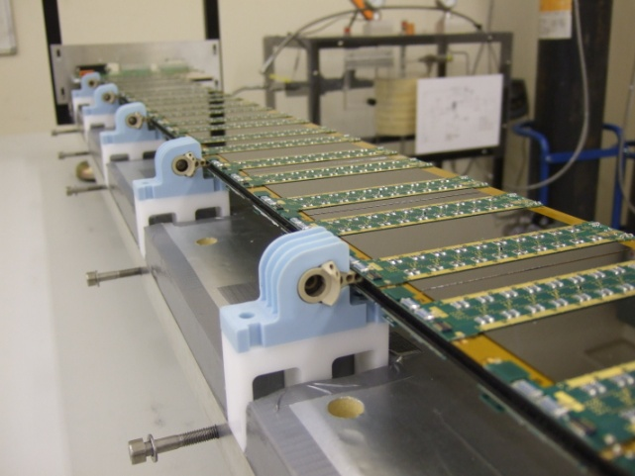
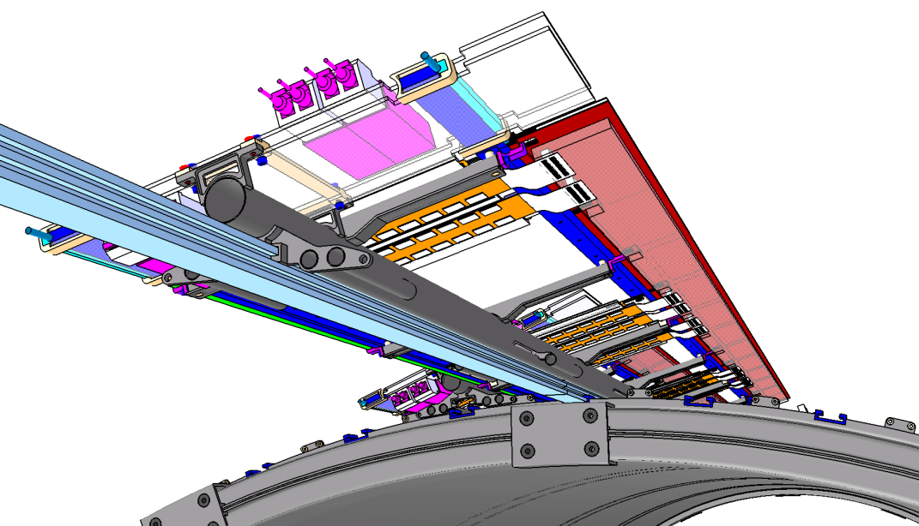
2 approaches in parallel to hold 12 modules (or more…): Staves & SuperModules
- Self supporting structure to be assembled / inserted into barrels (5 barrels)
- Independent part including Modules, Services, and its own Cooling
- to be assembled after barrel assembly
- Replacement at any moment (thanks to End Insertion)
A kind of sandwich plate,
double sided with modules…see next
Cable bus
Service module
(connectors)
Cooling pipe
CRFP Honeycomb
Insertion from one end
CFRP Backbone
Stave approach
SuperModule approach
(Courtesy of ATLAS HL-LHC studies)

