Slide 1
Update on the analysis of the high-power test results
Grudiev, CERN
28.09.2011
LCWS11, Granada, September 2001

Slide 2
Outline
Update on the analysis of the field quantities in the high gradient structures
  T24_KEK_disk
  TD24_SLAC_disk
  Single cell data analysed by Jiaru
  Dual mode cavity
Analysis of the results of high power testing TD18 from the pulse surface heating perspective
Summary on the high-gradient RF constraints

Slide 3
Analysed structures (X-band only)
RF design name | L [mm] | dphi [deg] | a1 [mm] | d1 [mm] | e1 | vg1 [%]
DDS1 | 1800 | 120 | 5.7 | 1 | 1 | 11.7
T53VG5R | 530 | 120 | 4.45 | 1.66 | 1 | 5
T53VG3MC | 530 | 120 | 3.9 | 1.66 | 1 | 3.3
H90VG3 | 900 | 150 | 5.3 | 4.2 | 1 | 3
H60VG3 | 600 | 150 | 5.3 | 4.4 | 1 | 2.8
H60VG3R18 | 600 | 150 | 5.5 | 4.6 | 1.15 | 3.3
H60VG3R17 | 600 | 150 | 5.3 | 3.7 | 1.34 | 3.6
H75VG4R18 | 750 | 150 | 5.3 | 3.04 | 1.36 | 4
H60VG4R17 | 600 | 150 | 5.68 | 3.65 | 1.37 | 4.5
HDX11-Cu | 48 | 60 | 4.21 | 1.45 | 2.4 | 5.1
CLIC-X-band | 228 | 120 | 3 | 2 | 1 | 1.1
T18VG2.6-In | 180 | 120 | 4.06 | 2.794 | 1.21 | 2.6
T18VG2.6-Out | 180 | 120 | 2.66 | 1.314 | 1.15 | 1.03
T18VG2.6-Rev | 180 | 120 | 2.66 | 1.314 | 1.15 | 1.03
T26VG3-In | 260 | 120 | 3.9 | 1.66 | 1 | 3.3
T26VG3-Out | 260 | 120 | 3.2 | 1.66 | 1 | 1.65
TD18_KEK_In | 180 | 120 | 4.06 | 2.794 | 1.21 | 2.4
TD18_KEK_Out | 180 | 120 | 2.66 | 1.314 | 1.15 | 0.9
T24_KEK_In | 240 | 120 | 3.307 | 1.753 | 1.16 | 1.83
T24_KEK_Out | 240 | 120 | 2.467 | 1.05 | 1.13 | 0.92
TD24_SLAC_Rev | 240 | 120 | 2.467 | 1.05 | 1.13 | 0.81
SW1A5p65T4p6 | 13 | 180 | 5.65 | 4.6 | 1.5 | 0
SW1A3p75T2p6 | 13 | 180 | 3.75 | 2.6 | 1.7 | 0
SW1A3p75T1p66 | 13 | 180 | 3.75 | 1.66 | 1 | 0
SW1A2p75T2p0 | 13 | 180 | 2.75 | 2 | 1.4 | 0
Dual Mode Cavity | 25
First analysis was published in 2009: A. Grudiev, S. Calatroni, and W. Wuensch, PRST-AB 12, 102001 (2009)
Yellow indicates the structures made by CERN, all the rest is SLAC,KEK,FNAL, production
Green indicates new structure or data since the 2009.
Many thanks to the people who helped me a lot in collecting the data (S. Doebert, C. Adolphsen, F. Wang, J. Shi, V. Dolgashev, T. Higo)
Moreover, Jiaru analysed independently data for 3 standing-wave cavities (remember his talk yesterday) so the cross-check is done at least for the SW cavities

Slide 4
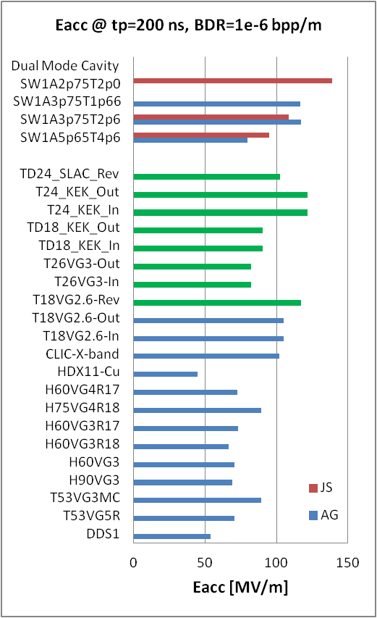
Scaling the data to 200 ns, 1e-6 bpp/m
For rectangular pulse of length t_{p}
For a fixed pulse length
For a fixed BDR
For pulse with a ramp (SW and some of TW structures), effective pulse length is used which is the time when the
P_{in}(t) > 0.85 P_{in}^{max}
N.B. Brown and Green are new data points. JS = Jiaru Shi; AG = Alexej Grudiev

Slide 5
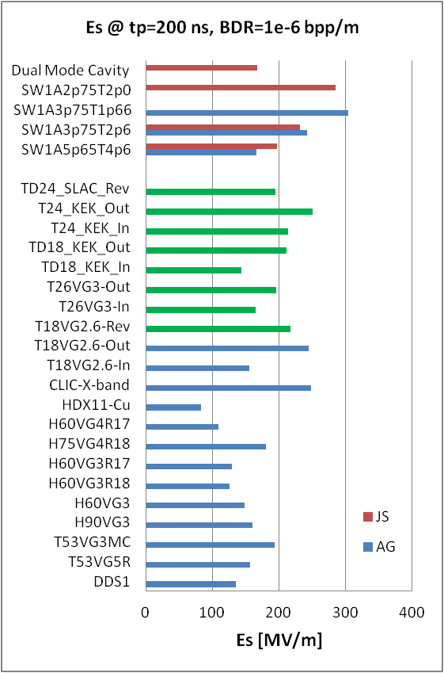
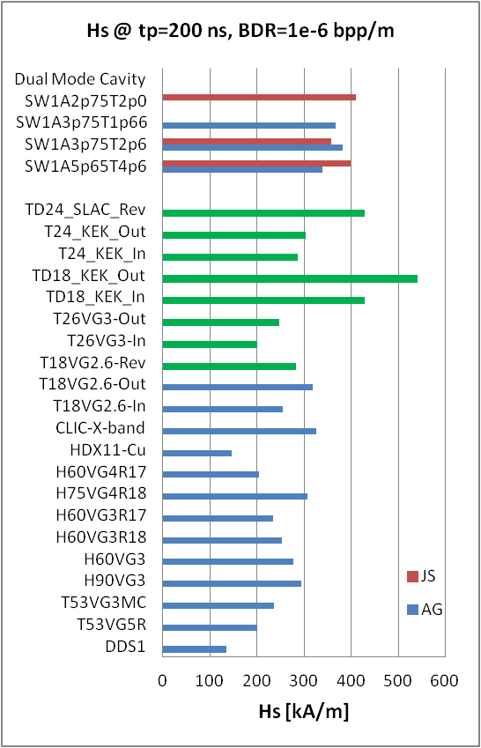
Maximum surface electric and magnetic fields
Waveguide
damped
Es = 250 MV/m or higher has been achieved in several cases: very low or zero group velocity

Slide 6
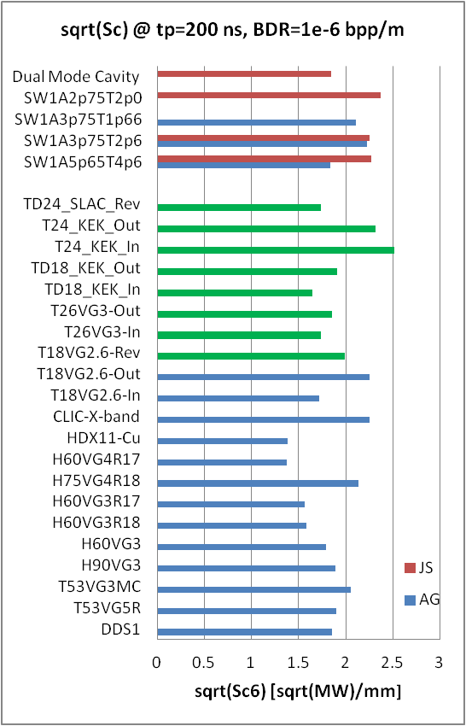
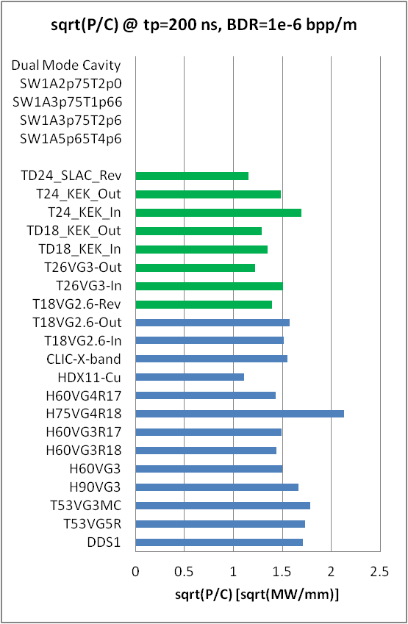
Power flow related quantities: Sc and P/C
Sc = 4 - 5 MW/mm²
P/C = 2.3 – 2.9 MW/mm

Slide 7
Pulsed surface heating in TD18 tested at SLAC

Slide 8
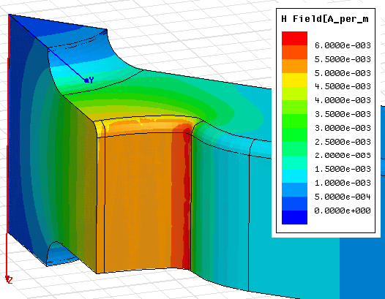
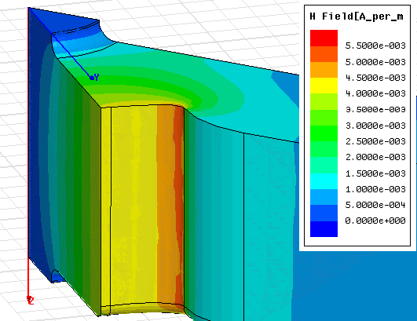
TD18 parameters
Cell | First | Middle | Last
a [mm] | 4.06 | 3.36 | 2.66
a/λ (%) | 15.4 | 12.8 | 10.1
d [mm] | 2.794 | 2.054 | 1.314
e | 1.21 | 1.18 | 1.15
f [GHz] | 11.424 | 11.424 | 11.424
Q(Cu) | 5100 | 5400 | 5500
vg/c [%] | 2.23 | 1.45 | 0.87
r’/Q [LinacΩ/m] | 10200 | 12600 | 15100
Es/Ea | 2.0 | 1.95 | 1.95
Hs/Ea [mA/V] | 6.0 | 5.6 | 5.0
Sc/Ea² [mA/V] | 0.52 | 0.40 | 0.31
43.6 K
In regular cells
P = 59.8 MW
for <G> = 100 MV/m
Regular cells length = 157.5 mm

Slide 9
High power operation at NLCTA
Pulse shape
Images courtesy of F. Wang:
http://indico.cern.ch/getFile.py/access?contribId=1&sessionId=0&resId=1&materialId=slides&confId=75374
History
About 5 degree additional PSH temperature rise due to SLED pre-pulse

Slide 10
Pulsed surface heating temperature rise during high power operation
<dT> - step-wise function of const dT_{n} during dN_{n} rf pulses.
Average temperature rise in the last cell:
[∑dT_{n}dN_{n}]/N = 67.5 K,
where N = 276394719 is the total number of pulses
BUT
Accumulated stress cannot be averaged like this to get equivalent value for the whole operation period !!!

Slide 11
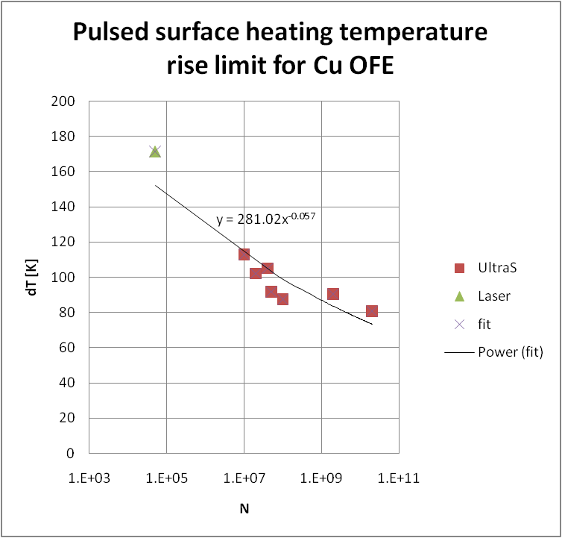
S-N curve for Cu OFE (cold worked)
Based on the data from ref [1] and assuming that it is power low, following dependence is found:
dT = aN^{b},
where
a = 281; b = -0.057 ≈ -1/18
It is a very strong non-linear dependence of the number of cycles till failure N caused by mechanical stresses at a certain value of pulse surface heating temperature rise dT.
(BTW, it is quite similar to BDR versus gradient and pulse length dependence: BDR~E³⁰t_{p}⁵)
[1] ‘MATERIAL SELECTION AND CHARACTERIZATION FOR HIGH GRADIENT RF APPLICATIONS’, G. Arnau-Izquierdo, et al., Proc. of PAC07, or CLIC-NOTE-725

Slide 12
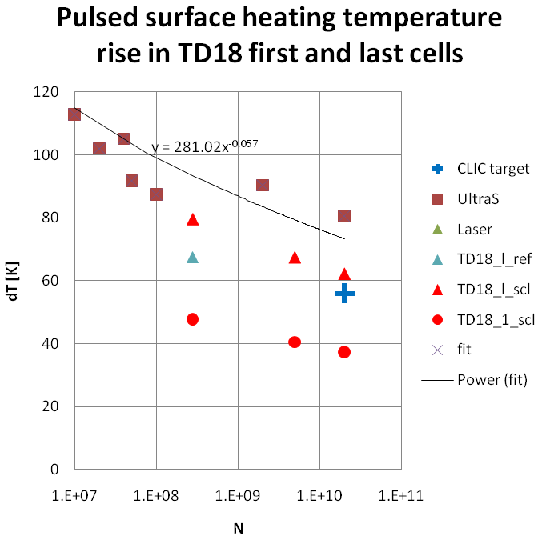
Scaling the TD18 data
All data points {dT_{n}, dN_{n}} scaled to the same temperature rise dT_{ref} = 67.5 K, using the scaling low: dT~dN^{-0.057}. dN_{n,ref} = dN_{n}(dT_{ref}/dT_{n})^{-1/0.057} = dN_{n}(dT_{ref}/dT_{n})^{-17.5}.
New data point is obtained as {dT_{ref} ,∑dN_{n,ref}}, where ∑dN_{n,ref} = 4921000000 is an effective number of cycles to get the same damage state at dT_{ref} = 67.5 K.
We also can get the effective temperature to get to the same damage state at the achieved number of pulses N = 276394719 using the same scaling low. dT_{eff} = dT_{ref}(276394719/4921000000)^{-0.057} =79.5K.
We also can get the effective dT for the total number of cycles during CLIC life time 2e10 using the same scaling: dT_{CLIC} = 62.3 K
3.
1.
2.
4.
effective
Red triangles describe the dependence of the dT versus number of pulses which are necessary to make the damage observed in the TD18 last cell

Slide 13
Which cell to take as a limit ?
Last
regular
cell: 19
Cell # (cell #1 is a input matching cell):
4
?16?
5
6
7
8
9
10
11
12
13
14
15
17
18
It seems that cell #10 (regular cell #9 ~ middle cell) exhibits the level of damage which could be considered as a limit.
Images courtesy of M. Aicheler: http://indico.cern.ch/getFile.py/access?contribId=0&resId=1&materialId=slides&confId=106251

Slide 14
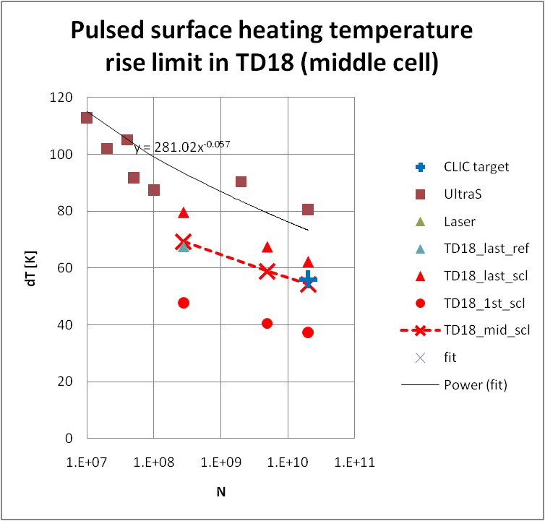
Summary on pulsed surface heating dT
Conclusions
The high power test results of TD18 at SLAC have been considered from the point of view of a pulsed surface heating experiment
Based on these results a limiting value of dT = 50 K is found to be acceptable as an RF design constraint with a few percents margin
This limit is to be applied to
  structures made of annealed Cu,
  with CLIC life time number of cycles : (2-5)e10
  for the regions with no or low level of surface electric field
  ...
...
Taking damage in the middle cell as a limit, dT limit is calculated for different number of cycles:
  dT_{eff} = 69.3 K; N = 276394719
  dT_{CLIC} = 54.3 K; N = 2e10

Slide 15
Maximum dT in TD24 prototypes
 | 100 MV/m unloaded 100 ns | ~120 MV/m unloaded for 100 MV/m loaded at 240 ns with 156 ns flat top (CLIC nominal)
TD24_11.424GHz | 27 K | 54 K
TD24_11.994GHz | 28 K | 56 K
TD24_R05_11.994GHz | 21 K | 43 K

Slide 16
Summary on the high-power RF constraints
RF breakdown and pulsed surface heating constraints used for CLIC_G design (2007):
E_{s}^{max} < 250 MV/m
P_{in}/C_{in}·(t_{p}^{P})^{1/3} = 18 MW·ns^{1/3}/mm
and
ΔT^{max}(H_{s}^{max}, t_{p}) < 56 K
Updated RF breakdown and pulsed surface heating constraints for BDR=10⁻⁶ bpp/m (2011):
E_{s}^{max} < 250 MV/m
P_{in}/C_{in}·(t_{p}^{P})^{1/3} < 2.8 MW/mm · (200ns)^{1/3} = 17 MW/mm·ns^{1/3}
S_{c}^{max} ·(t_{p}^{P})^{1/3} < 5 MW/mm² · (200ns)^{1/3}
and
ΔT^{max}(H_{s}^{max}, t_{p}) < 50 K

