Slide 1
TDR Part 2:
3.3 Cavity Integration
(10 pages)
Baseline Design based on the SCRF-BTR@KEK meeting discussion
H. Hayano

Slide 2
Write-up contents will be;
3.3 Cavity integration
3.3.1 Coupler design
TTF-III coupler design
3.3.2 Tuner design
Blade tuner design
3.3.3 He Jacket and interface
Ti jacket, bellows in-between support tabs
magnetic shield inside
Nb-Ti flange with aluminum hexagonal seal
3.3.4 Plug compatible design
3.3.4.1 Plug compatible performance specification
specification tables
3.3.4.2 Interface definition
interface drawings

Slide 3
TTF-III coupler (baseline)

Slide 4
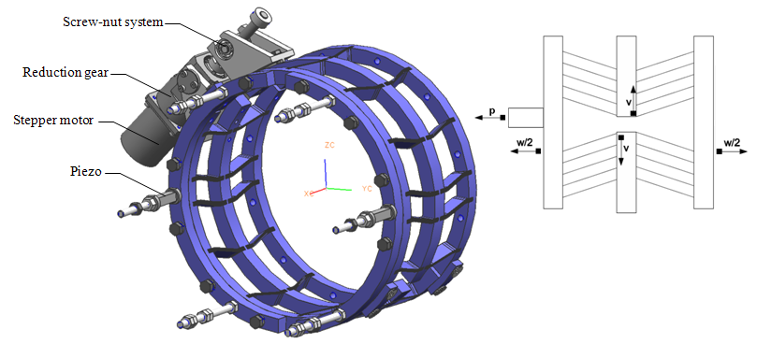
Blade tuner (baseline)

Slide 5
cavity | specification item | specification | unit and comments | further comments
RF properties | Frequency | 1.30 | GHz
 | Number of cells | 9.00 | cells
 | Gradient | 31.50 | MV/m | operational
 |  | 35.00 | MV/m | Vertical test
 | Q0 | 0.80 | 10^10 | at 35
 |  | 1.00 | 10^10 | at 31.5
 | HOM damping |  | Q | decide later
 |  |  | R/Q | decide later
 | Short range wake |  |  | decide later
 | Operating temperature | 2.00 | K
Physical properties | Length | 1247 | mm | TESLA-short length
 | Aperture |  | mm | must be compatible with beam dynamics
 | Alignment accuray | 300.00 | um | rms
 | Material | Niobium
 | Wall thickness | 2.80 | mm
 | Stiffness |  |  | decide later
 | Flange/Seal system |  | Material | decide later
 | Maximum overpressure allowed | 2 | bar
 | Lorentz force detuning over Flat-top at 35 MV/m | 1.00 | kHz | maximum
 | Outer diameter He vessel | 230.00 | mm(inner diameter) | Mag shield outside, decide later for precise number
 |  | 230.00 | mm(inner diameter) | KEK Mag shield inside, decide later for precise number
 | Magnetic shielding |  | inside/outside | decide later
* yellow boxes indicate ‘not fixed’

Slide 6
tuner | specification item | specification | unit and comments | further comments
Slow tuner | Tuning range | >600 | kHz
 | Hysteresis in Slow tuning | <10 | µm
 | Motor requirement | step-motor use, Power-off Holding, magnetic shielding
 | Motor specification | ex) 5 phase, xxA/phase, … | match to driver unit, match to connector pin asignment,… | decide later
 | Motor location | insdie 4K? / outside 300K? / inside 300K accessible from outside? | need availability discussion, MTBF | decide later
 | Magnetic shielding | <20 | mG at Cavity surface, average on equater
 | Heat Load by motor | <50 | mW at 2K
 | Physical envelope | do not conflict with GRP, 2-phase line, vessel support, alignment references, Invar rod, flange connection,… |  | cable connection, Mag shield
 | Survive Frequency Change in Lifetime of machine | ~20 Mio. steps | could be total number of steps in 20 years,
* yellow boxes indicate ‘not fixed’

Slide 7
Fast tuner | Tuning range | >1 | kHz over flat-top at 2K
 | Lorentz detuning residuals | <50 | Hz at 31.5MV/m flat-top | (LD and microphinics? or LD only?) :decide later
 | Actuator specification | ex) low voltage piezo 0-1000V, … | match to driver unit, match to connector pin asignment, … | decide later
 | Actuator location | insdie 4K?/inside 4K accessible/inside 100K? accesible / inside 300K accessible from outside? |  | decide later
 | Magnetic shielding | <20 | mG at Cavity surface average
 | Heat Load in operation | <50 | mW
 | Physical envelope | do not conflict with GRP, 2-phase line, vessel support, alignment references, Invar rod, flange connection,…
 | Survive Frequency Change in Lifetime of machine | >10¹⁰ | number of pulses over 20 years, (2x10⁹:operational number)
* yellow boxes indicate ‘not fixed’

Slide 8
Coupler | condition | specification | unit and comments | further comments
Power requirements | Operation | >400 | kW for 1600 us
 | Processing | >1200 | kW upto 400 us | need after vac break, cool-down
 |  | >600 | kW larger than 400 us | need after vac break, cool-down
 | Processing with reflection mode | >600 | kW for 1600us | in Test stand
Processing time | warm | <50 | hours | after installation, definition of power/pulse_width target are the same as 'Power Requirement' above.
 | cold | <30 | hours | after installation, definition of power/pulse_width target are the same as 'Power Requirement' above.
Heat loads /coupler | 2K static | < 0.063 | W
 | 5K static | < 0.171 | W | depend on tunability
 | 40 K static | < 1.79 | W
 | 2K dynamic | < 0.018 | W
 | 5K dynamic | < 0.152 | W
 | 40K dynamic | < 6.93 | W
Cavity vacuum integrety | # of windows | 2
 | bias capablity | yes
RF Properties | Qext | Yes | tunable
 | Tuning range | 1-10 | 10^6 if tunable
Physical envelope | Position |  | compatible to TTF-III | decide later
 | Flange |  | compatible to TTF-III | decide later (to cavity, to cryostat)
 | waveguide |  | compatible to TTF-III | decide later
 | support |  | compatible to TTF-III | decide later
Instrumentation | vacuum level | >= 1
 | spark detection | 0 | at window
 | electron current detection | >= 1 | at coax
 | temperature | >= 1 | at window
* yellow boxes indicate ‘not fixed’

Slide 9
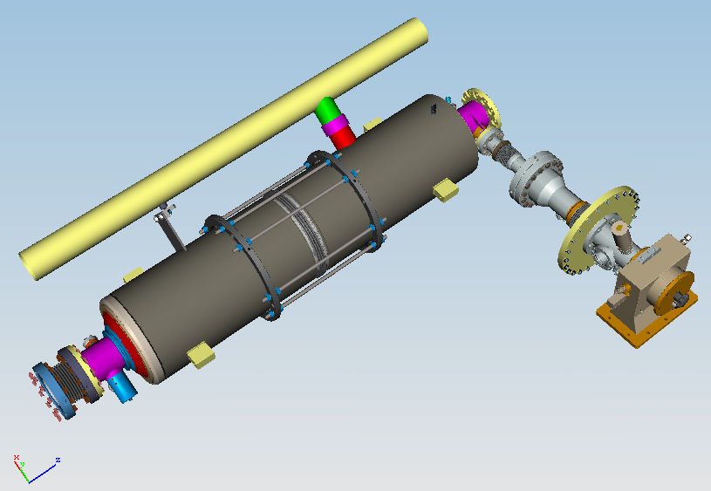
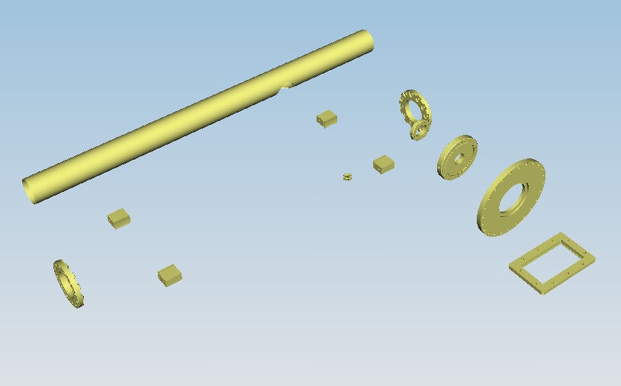
Cavity boundary
BCD: TESLA-short cavity
cavity boundary
(1) beam pipe port flange ( beam pipe diameter )
(2) coupler port flange ( port pipe diameter )
(3) 4 support tabs
(4) He pipes

Slide 10
Cavity boundary
BCD: TESLA-short cavity
beam port
beam port
DN78 interface
DN78 interface
L = 750
L = 104.8
coupler port
DN40 interface
this pipe should be weld-connection
L = 1247
from FNAL drawing

Slide 11
Al hexagonal

Slide 12
Cavity boundary
BCD: TESLA-short cavity
cut-end for bellows welding
L = 1247
cut-end for bellows welding
L = 750
support tab
support tab
from FNAL drawing

Slide 13
Input coupler boundary
BCD: TTF-III coupler
input coupler boundary
cavity port flange ( port diameter )
(2) cold/warm part interface flange
(3) cryostat vessel flange
(4) waveguide flange

Slide 14
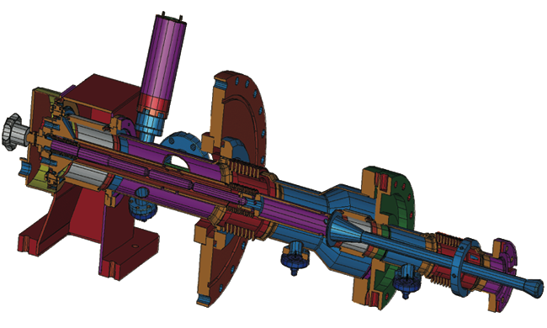
cryomodule coupler port
( Ø260 OD flange? ) interface
O-ring DN200
cavity coupler port
L = 126
DN40 interface
waveguide port
L = 190.5
WR650
waveguide flange interface
L = 385.5

