Slide 1
TDR Writing:
FLASH 9mA Experiment
John Carwardine

Slide 2
Outline

Slide 3
Outline (2)

Slide 4
New since Interim Report
Pseudo-Pk / Ql studies for flat gradients
Operation close to quench with beam loading
Klystron saturation studies with beam loading
Include background for rf power overhead and gradient margins (cost drivers)?
Need to explain principles of Pk/Ql control

Slide 5
Impact of beam loading

Slide 6
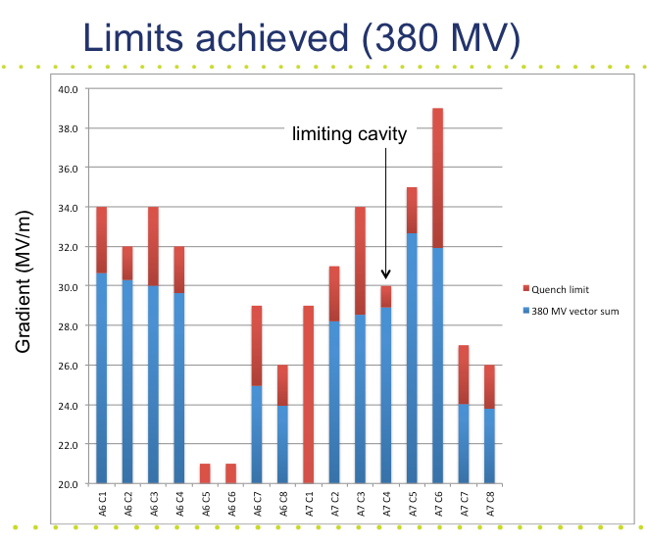
9mA Studies: beam operation close to cavity gradient limits
(4.5mA/800us bunch trains)
Operation at 380MeV on ACC67
(13 cavities)
Tailored cavity Loaded-Qs to cancel beam-loading induced gradient tilts
Red: quench limit
Blue: operating gradient
Normalized cavity gradients during the beam pulse
10
Before correction (large tilts)
5
Normalized Gradient (%)
15% p-p
0
-5
-10
800
0
100
200
300
400
500
600
700
Time from start of beam pulse (us)
The limiting cavity is within 5% of quench
Normalized cavity gradients during the beam pulse
  Flattened individual gradients to <<1% p-p
  Several cavities within 10% of quench
  ‘Crash test’: very rapid recovery of 800us / 4.5mA after beam trip
  Ramped up current from ~zero to 4.5mA with ACC67 gradients approaching quench
  ‘Cavity gradient limiter’ to dynamically prevent quenching without turning off the rf
1.5
1
After correction
~0.5% p-p
0.5
0
Normalized Gradient (%)
-0.5
-1
-1.5
0
100
200
300
400
500
600
700
800
Time from start of beam pulse (us)

Slide 7
9mA Studies: evaluating rf power overhead requirements
(4.5mA/800us bunch trains)
Klystron high voltage was reduced from 108KV to 86.5KV so that the rf output just saturated during the fill
The required beam-on power ended up being ~7% below saturation
Response to step up is slower because the klystron cannot deliver the power demanded

Slide 8
Extrapolation to ILC baseline
Long bunch trains, heavy beam loading
  6mA / 800us demonstrated (baseline)
  9mA / 800us marginally achieved (upgrade)
  Energy stability demonstrated
Vector Sum control of RF unit
  Operation of RF unit demonstrated with 24 cavities and 16 caviities
  Relevance to KCS control…?
Gradient
  FLASH: average is ~28MV/m, but cavities go to 35MV/m
  Gradient spread is comparable
  Lorentz-force detuning

Slide 10
Extrapolation to ILC baseline
Pk/Ql control
  Demonstrated flat gradient solutions to << 1% pk-pk
  ILC baseline has more knobs, so easier
Operation close to quench
  Several cavities within 10% of quench at 4.5mA, 800us
  One cavity within 5% of quench
Klystron overhead
  Preliminary results: operation within 7% of saturation
  Need to evaluate effect on energy stability

Slide 11
Extrapolation to ILC baseline
Operability
  Ramp-up to 4.5mA, 800us within 10% of quench demonstrated without quenching
  Rapid recovery after quench
  Quench detection / prevention with beam loading
Taking credit for FLASH FEL operations…
  Many 1000’s hours of routine operation
  LLRF control and automation
  Energy and arrival time stability better than RTML requirements

