Slide 1
Experimental hall in Japanese mountain site
Y. Sugimoto
2012.4.25
@KILC2012

Slide 2
Outline
Design criteria
Underground detector assembly
  Assembly area
  Timeline
Comparison with RDR design

Slide 3
Design criteria
Experimental hall in Japanese mountain site could be quite deep (>100m) → Horizontal access tunnel instead of vertical shafts
Since “CMS style assembly” is not applicable, we need enough space in the cavern for detector assembly
Enough size of alcoves is necessary for assembly and maintenance (opening) of detectors
Good geology of granite allows bullet shape cavern rather than egg shape cavern
Horizontal access tunnel should be large enough (~11m) in order to let large solenoids (φ~8m) go through

Slide 4
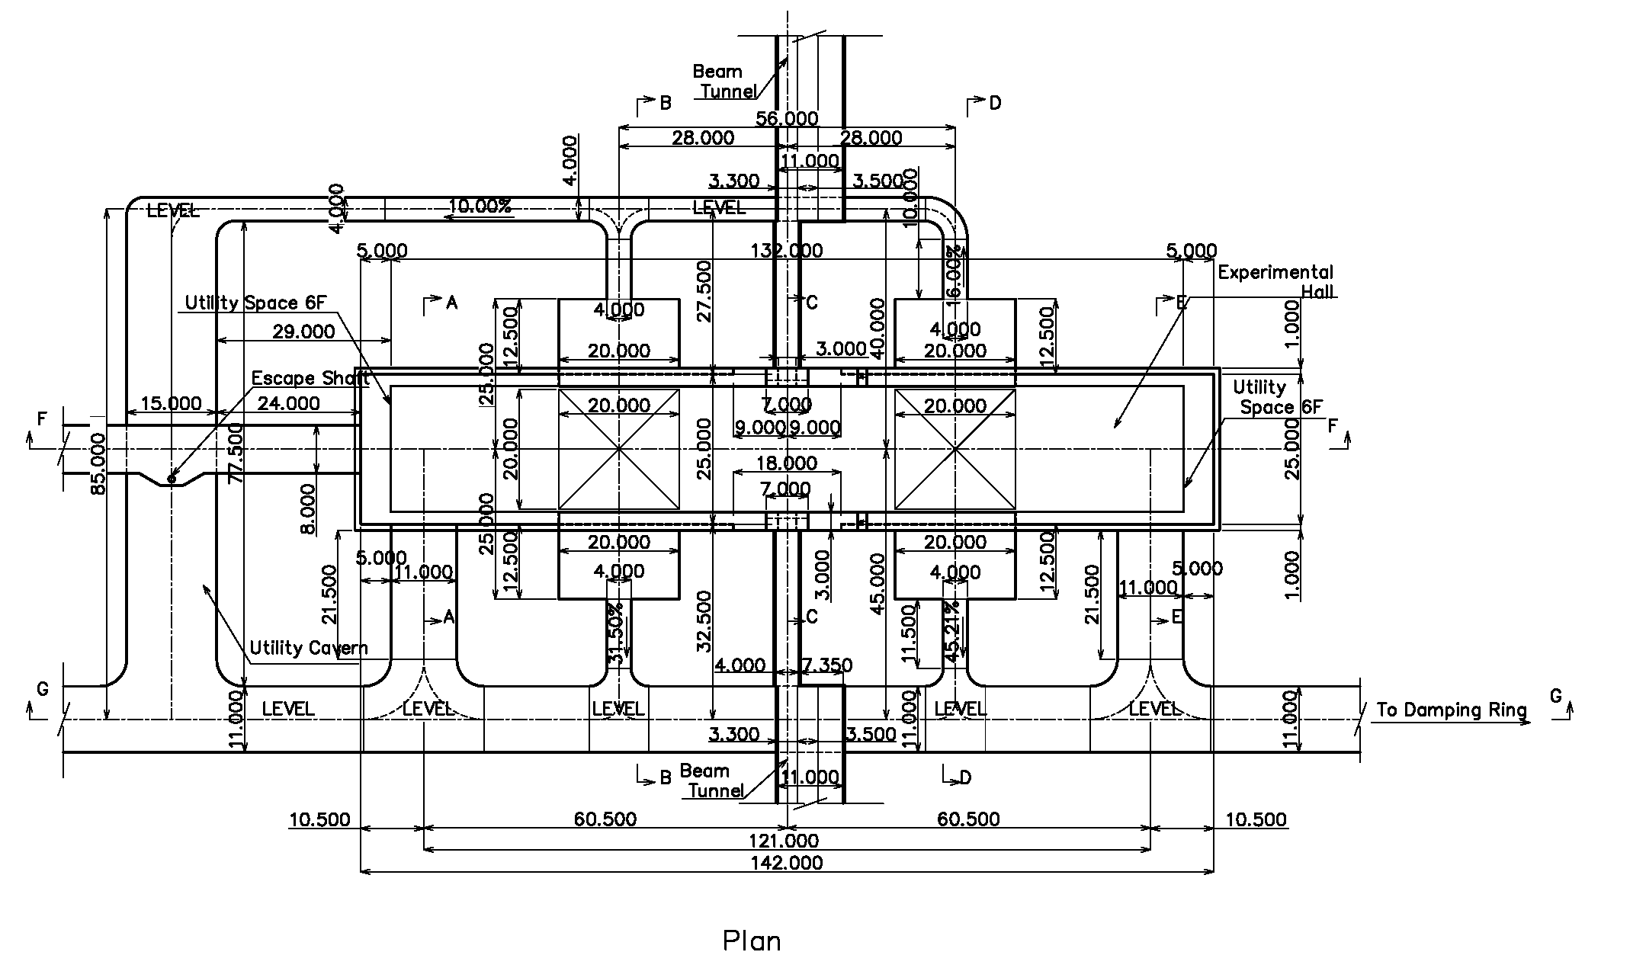
Design shown at CFS BTR

Slide 5
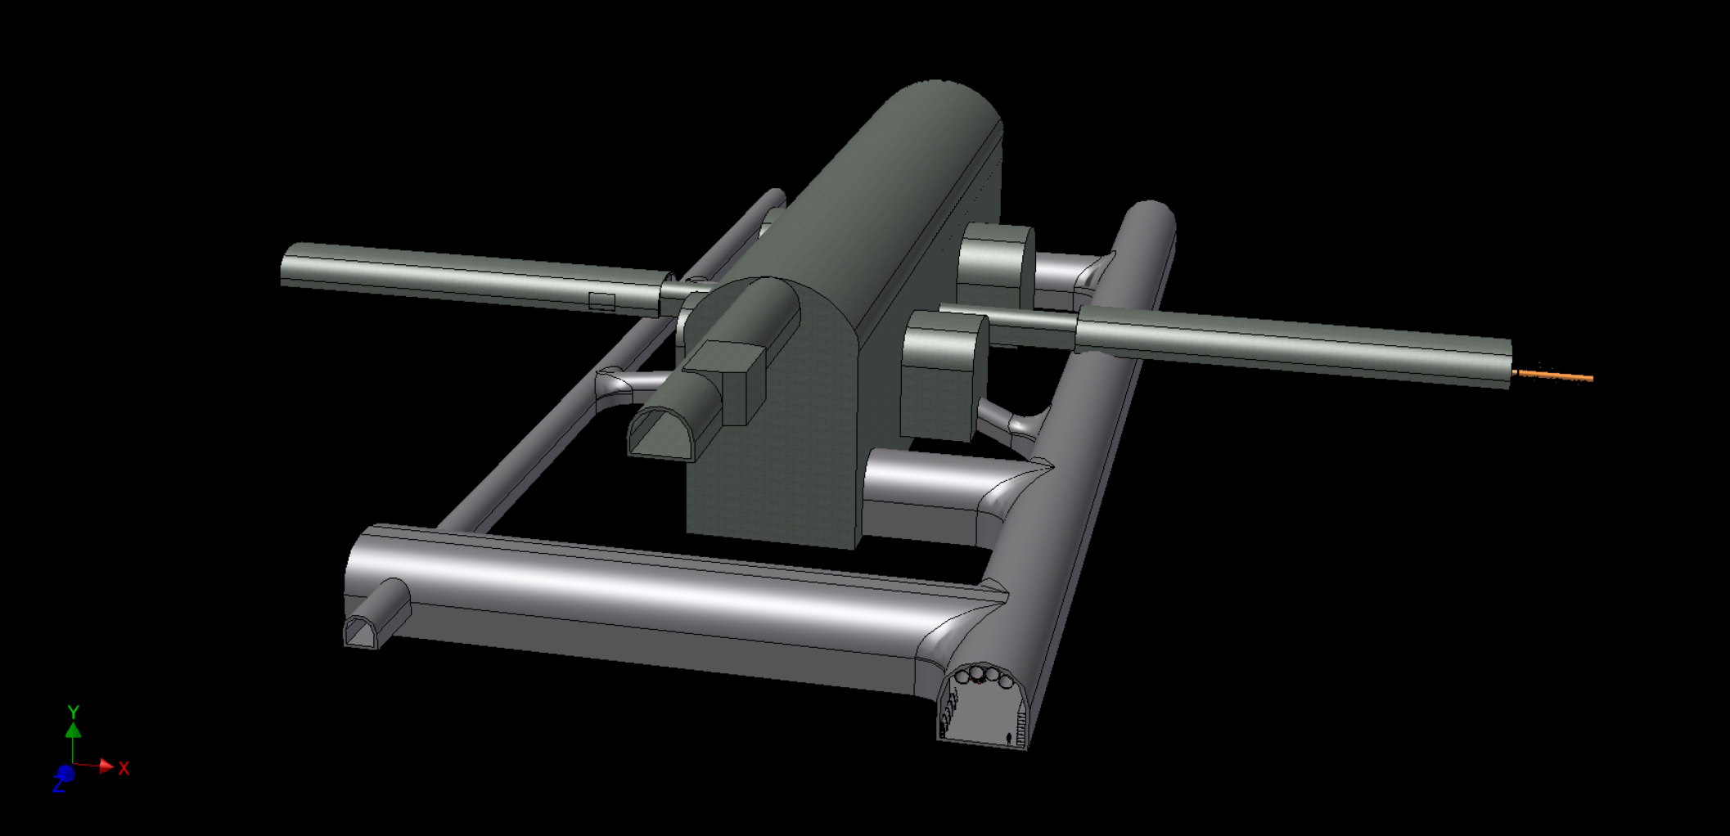
Design shown at CFS BTR

Slide 6
Underground detector assembly
A possible detector assembly scenario for ILD has been drawn to see if the underground cavern area is large enough

Slide 7
Detector assembly area
Area 1: Platform
  YB0 assembly
  Barrel detectors installation/cabling
  Endcap calorimeters installation
Area 2/3: Alcoves
  Endcap calorimeters cabling
  QD0 support tube assembly
  FCAL install/cabling
Area 4: Tentative platform on beam line side
  YE, YB+, YB- (iron yoke and muon detector) assembly/install/cabling
Area 5: Loading area side
  HCAL rings assembly
  Tooling assembly
  Storage area

Slide 8
Boundary conditions
Cranes
  250 ton crane for each detector on beam line side
  30 ton crane for each detector on loading area side
  2.8 ton crane in each alcove
    In order to minimize the size of alcoves, the crane rails should be supported from the arch part → Only small cranes can be used
    The height of alcoves have to be increased from 19.6m to 20.5m (for ILD) to let the crane girder pass over the detector
Work conflicts
  In order to avoid conflicts of parallel works, first few hours of each working day should be dedicated to transportation to each assembly area

Slide 9
Step 1
Tentative platform is assembled in Area4 using a crawler crane
Central barrel yoke YB0 is assembled on the platform using 250 ton crane
HCAL modules are assembled to a ½-z ring in Area5 using 30 ton crane
Cradle for coil installation is assembled in Area5 using a crawler crane

Slide 10
Step 2
Solenoid coil is moved to the platform using two sets (one from SiD) of 250 ton crane

Slide 11
Step 3
Endcap iron yoke (YE+) is assembled in Area 4
Solenoid coil installation to the YB0 in Area 1

Slide 12
Step 4
Muon detector installation to YB0

Slide 13
Step 5
YE+ is moved to platform using air-pads after muon detector installation
HCAL barrel ½-z ring is assembled in Area 5

Slide 14
Step 6
Endcap yoke YE- is assembled in Area4
Muon detector of YB0 cabling
HCAL barrel ring assembly in Area5

Slide 15
Step 7
YB0 shifted in z direction
Endcap HCAL installation in Area 1
Scaffold for endcap cabling is assembled in Area 5

Slide 16
Step 8
YE- is moved to platform
½ of barrel HCAL is moved to platform using two 250 ton cranes, and installed
Endcap yoke (+) is pushed into Area 2
Endcap HCAL cabling in Area 2
Scaffold for barrel cabling is assembled in Area 5

Slide 17
Step 9
Another barrel yoke ring YB+ is assembled in Area 4
Central barrel YB0 is shifted in z direction
Barrel HCAL (+) cabling in Area 1
Endcap HCAL (-) installation in Area 1

Slide 18
Step 10
Endcap yoke (-) is pushed to Area 3
½ of barrel HCAL is moved to platform using two 250 ton cranes, and installed

Slide 19
Step 11
YB+ muon detector installation and cabling in Area 4
Endcap ECAL (+) installation using 30 ton crane in Area 1
Barrel HCAL (-) cabling in Area 1
Endcap HCAL (-) cabling in Area 3

Slide 20
Step 12
Endcap yoke (+) pushed into area2
Endcap ECAL(+) cabling
Endcap ECAL(-) installation in area1 using 30 ton crane

Slide 21
Step 13
YB+ is moved to Area 1
Another barrel yoke ring YB- is assembled and muon detectors installed in Area 4
Endcap ECAL (-) cabling in Area 3
Barrel ECAL is installed in Area 1

Slide 22
Step 14
Barrel ECAL cabling in Area 1

Slide 23
Step 15
Detector is closed and field mapping is performed
QD0 support tubes assembly in Area 2/3
QD0 and BCAL installation/cabling in Area 2/3
After removing the tentative platform in Area 4, beam line shield is constructed

Slide 24
Step 16
Detector is opened again
TPC installation in Area 1
Lumical installation using 2.8 ton cranes in Area 2/3

Slide 25
Step 17
Si inner trackers are installed in Area 1

Slide 26
Step 18
Detector is closed again and ready for detector pre-commissioning

Slide 27
A possible timeline
Assumptions
  YB rings: 50d each
  YE: 100d each including muon detector installation/cabling
  Muon detector: 20d+20d for each barrel ring
  Liquid He becomes available 8 months after the cavern gets ready
  Field mapping will be done after ECAL installation and cabling: 20d for cool down, 60d for mapping, 20d for warm up
  Others
    Estimation by calorimeter groups
    Rough guess for other detectors

Slide 28
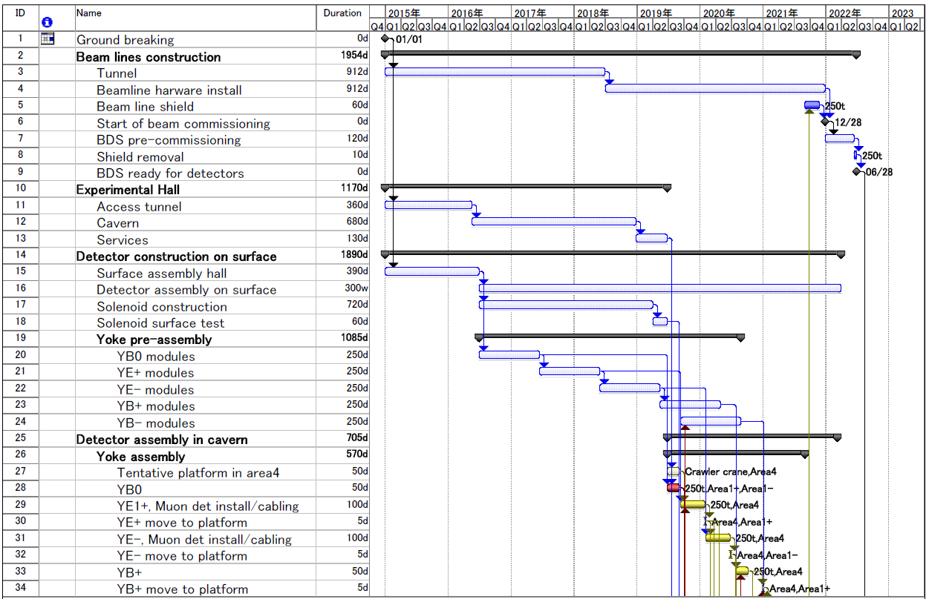
A possible timeline

Slide 29
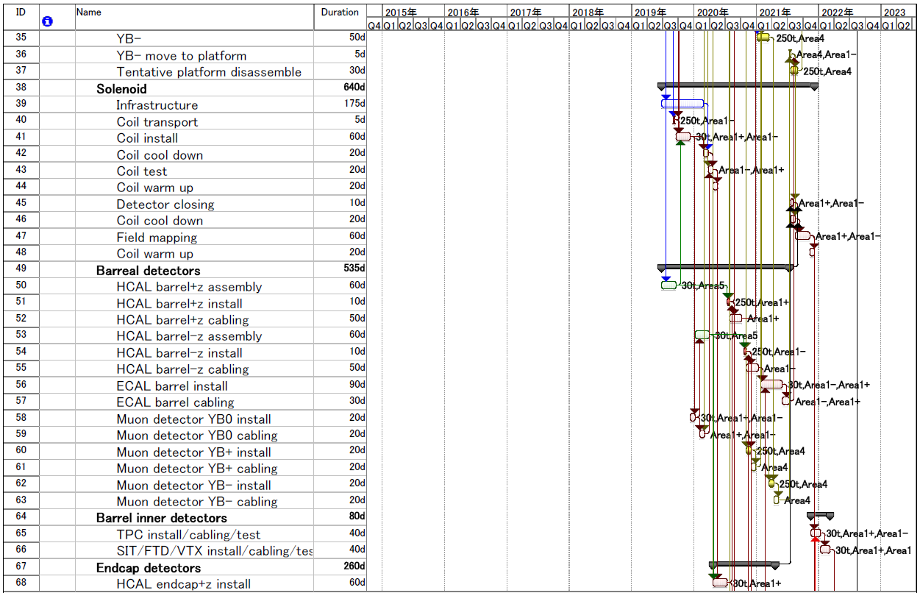
A possible timeline

Slide 30
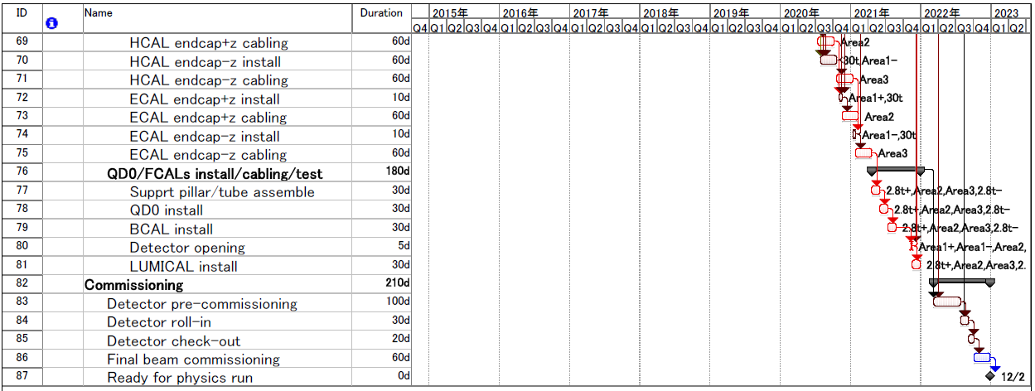
A possible timeline
Detector can barely be ready for physics run within 8 years from the ground breaking
If GDE intends to change the schedule of accelerator construction and commissioning, it should be discussed with physics groups

Slide 31
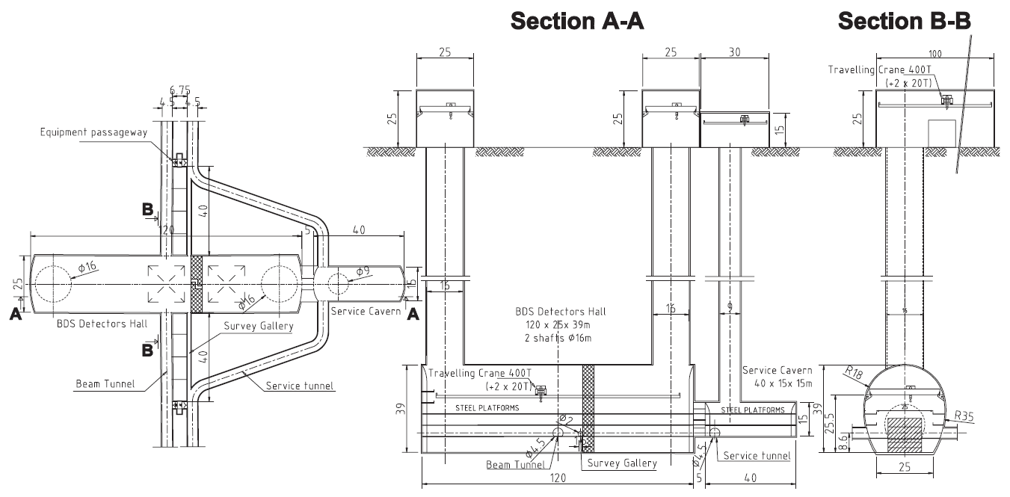
Comparison with RDR
RDR design

Slide 32
Comparison with RDR
Cavern cross section for excavation
New
RDR
1259.3m²
1094.2m²

Slide 33
Comparison with RDR
Cost consideration for experimental cavern
 |  | RDR | New | Difference
Main cavern |  | Egg shape | Bullet shape
 | Nominal size (m) | 120(L)x39(H)x25/36(W) | 142(L)x42(H)x25(W)
 | Excavation cross section (m²) | 1259 | 1094
 | Excavation volume (m³) | 151080 | 157560 | +6480
Alcoves |  |  | (ILD/SiD)
 | Size (m) | 40(L)x15(H)x15/18(W) | 12.5(L)x19.6/18(H)x20(W)
 | Quantity | 1 | 2/2
 | Excavation cross section (m²) | 211 | 361/329
 | Excavation volume (m³) | 8440 | 9013/8213 | +8786
Cavern total
 | Excavation volume (m³) | 159520 | 174786 | +15266
 | Cost (Oku-Yen) |  |  | ~+x

Slide 34
Comparison with RDR
Cost consideration for access shaft/tunnel and utility cavern
 |  | RDR | New | Difference
Access route |  | Vertical shafts | Horizontal tunnel
 | Size (m) | φ16x100(L) | 1000(L)x11(H)x11(W) + branches
 | Quantity | 2 | 1+α
 | Total cost (Oku-yen) | ~y* | yy** | -17
Utility cavern
 | Size (m) | -- | 77.5(L)x13.5(H)x15(W)
 | Cost (Oku-yen) | -- | z** | (+z***)
* RDR estimation x 117yen/ILCU
** Estimation by J-Power
*** Utility cavern is mainly used for accelerator utilities

Slide 35
Summary
The 142m option of the cavern in Japanese mountain site looks OK for detector installation of ILD without extending the original schedule (8 years from ground breaking to physics run)
GDE should clarify the timeline for accelerator construction and commissioning, if there is some change from RDR
  when the beamline area in the cavern should be cleared
  when the detector can be rolled in
Cost of the new design of experimental hall would be less than that of RDR

