Slide 1
Beam Delivery Review
Andrei Seryi
With many thanks to GDE BDS team
And in particular Deepa Angal-Kalinin
25 April 2012

Slide 2
Info about this presentation
This presentation is based on BDS review slides given on Oct 24-25 2011 in DESY, during baseline review
Substantial progress, since then, is in
  MDI/CFS design (reviewed separately)
  ATF2 progress (special sessions)
  Beam dump system
    NIM review paper published (linked to the agenda)
    BARC is ready to build the beam dump system if needed
We have created a plan to finish the remaining optics and cost estimation work this summer, to fit in the timescale of the TDR

Slide 3
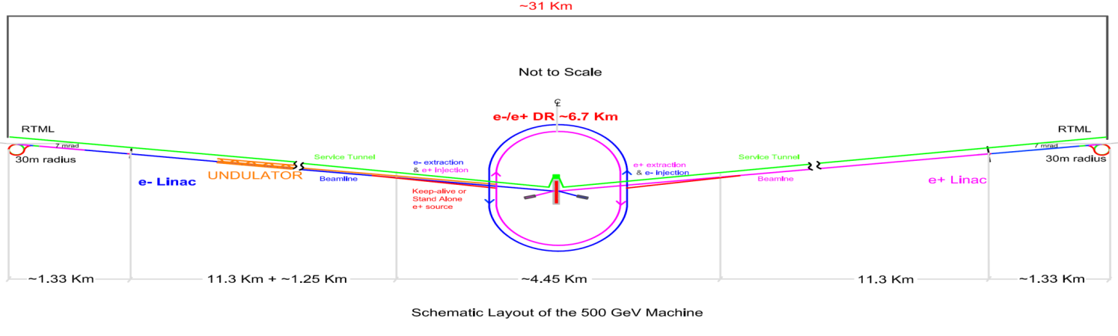
Beam Delivery System & MDI in ILC
ILC
BDS =>MDI

Slide 4
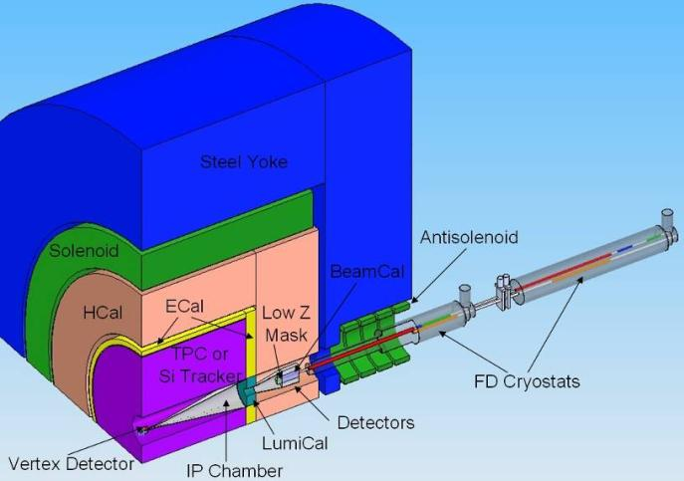
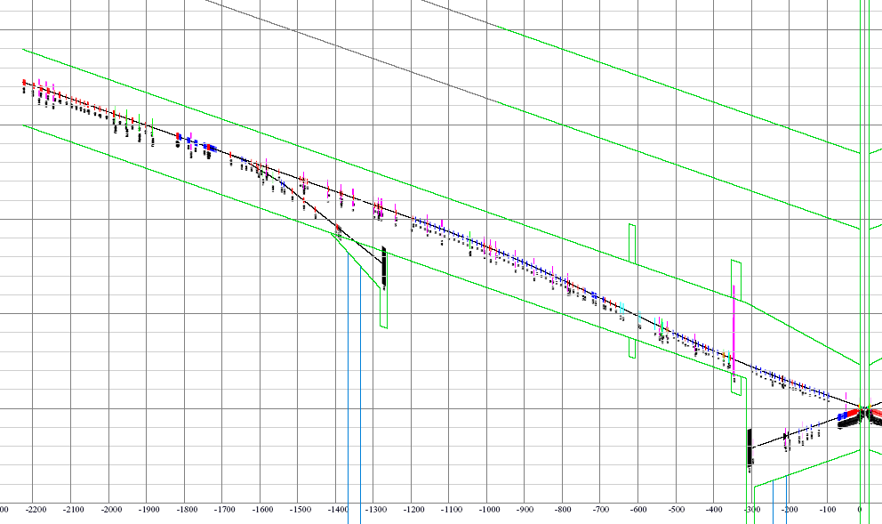
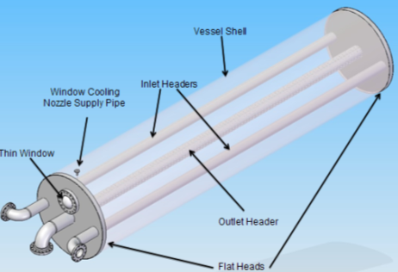
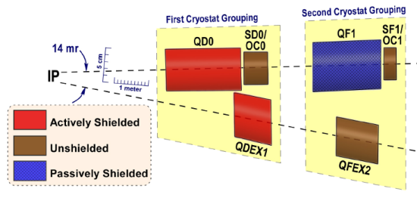
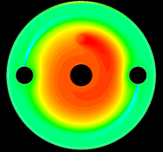
Beam Delivery & MDI elements
IR Integration
Very forward region
Beam-CAL
Lumi-Cal
Vertex
1TeV CM, single IR, two detectors, push-pull
grid: 100m*1m
Diagnostics
Beam
Switch
Yard
polarimeter
Sacrificial
collimators
Collimation: β, E
E-spectrometer
Final Focus
Tune-up & emergency Extraction
14mr IR
Tune-up dump
Muon wall
Main dump
Final Doublet
Extraction with downstream diagnostics

Slide 5
ILC BDS Optical Functions

Slide 6
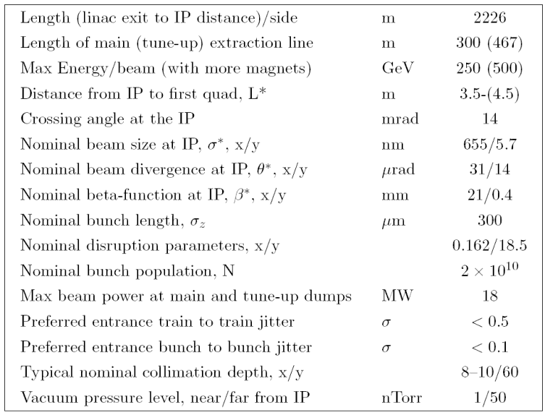
ILC BDS RDR Parameters

Slide 7
BDS & MDI Configuration Evolution
TRC review
GDE reviews
GDE reviews
Head on
Head on
Head on
1)
20mrad
14mrad
20mrad
20mrad
2mrad
2)
Evolution of BDS MDI configuration
  Head on; small crossing angle; large crossing angle
  MDI & Detector performance were the major criteria for selection of more optimal configuration at every review or decision point
  Found unforeseen losses of beamstrahlung photons on extraction septum blade
  Identified issues with losses of extracted beam, and its SR; realized cost non-effectiveness of the design
Notes:
4/24/2012 11:08 ΑΜ
7

Slide 8
Concept of single IR with two detectors
The concept is evolving and details being worked out
may be accessible during run
detector
A
accessible during run
detector
B
Platform for electronic and services. Shielded. Moves with detector. Isolate vibrations.

Slide 9
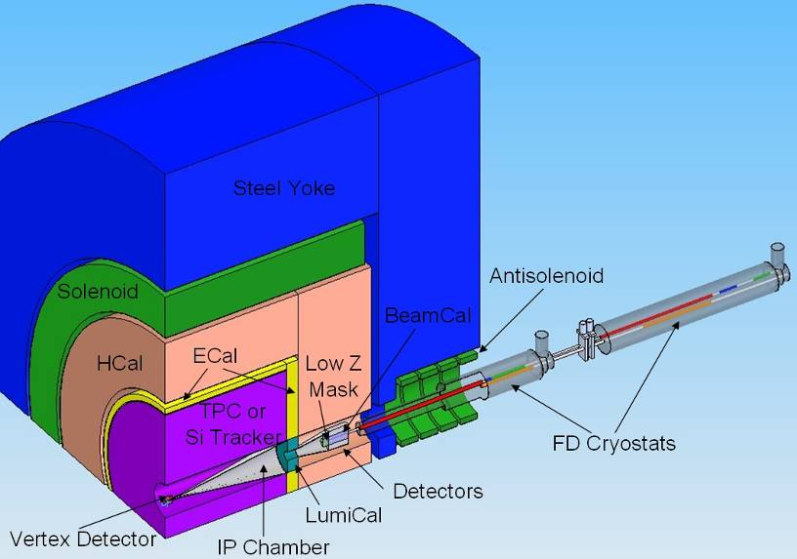
IR integration
Final doublet magnets are grouped into two cryostats, with warm space in between, to provide break point for push-pull
(old location)

Slide 10
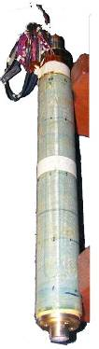
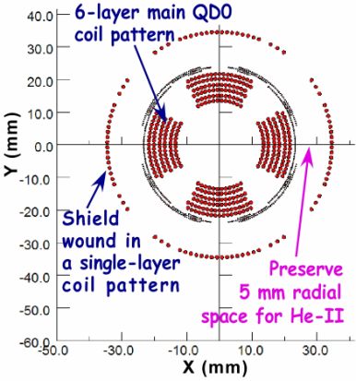
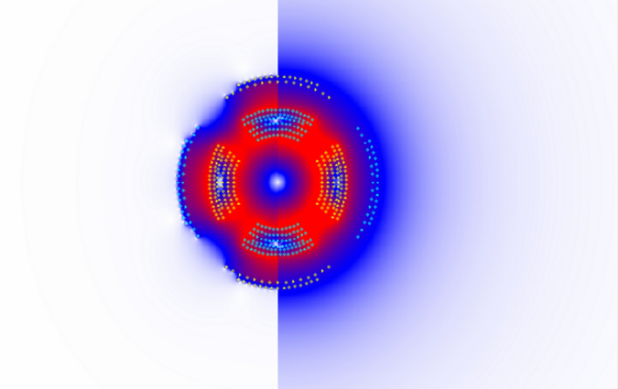

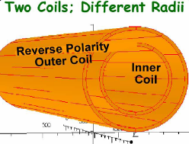
Actively shielded QD0
BNL
Shield ON
Shield OFF
Intensity of color represents value of magnetic field.
new force neutral antisolenoid
to be prototyped
during EDR
Interaction region uses compact self-shielding SC magnets
Independent adjustment of in- & out-going beamlines
Force-neutral anti-solenoid for local coupling correction

Slide 11
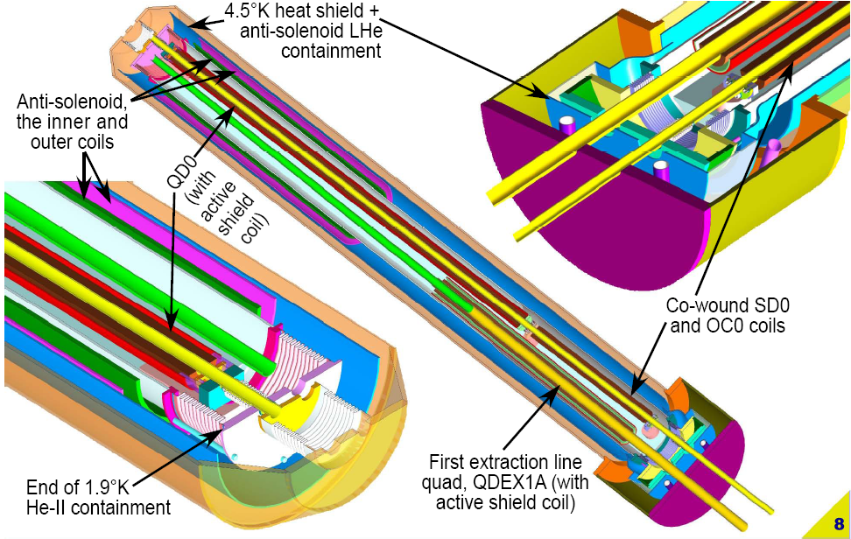
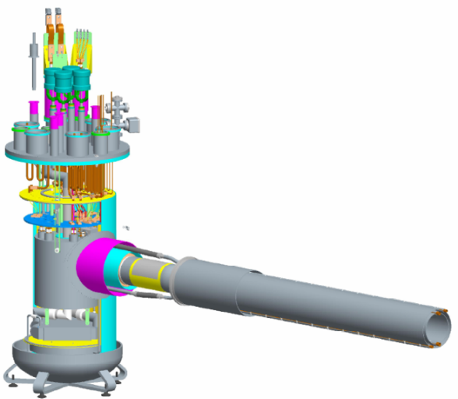
IR Magnets
BNL
Service cryostat & cryo connections

Slide 12
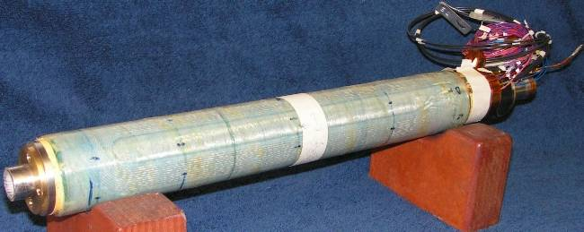
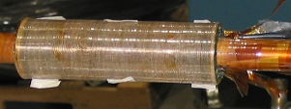
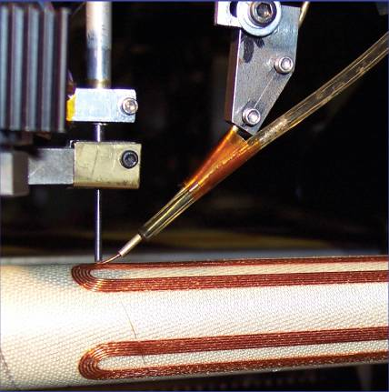
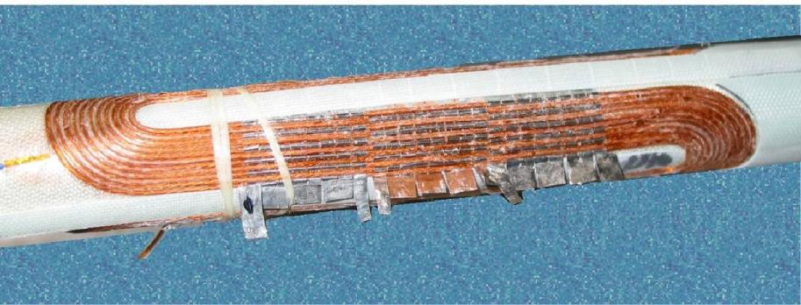
IR magnets prototypes at BNL
BNL prototype of self shielded quad
cancellation of the external field with a shield coil has been successfully demonstrated at BNL
prototype of sextupole-octupole magnet
winding process
Coil integrated quench heater

Slide 13
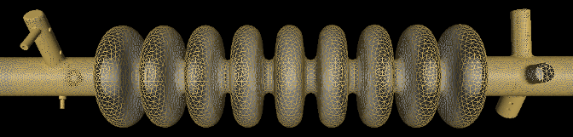
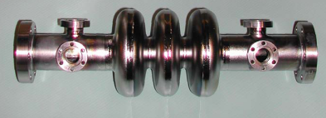
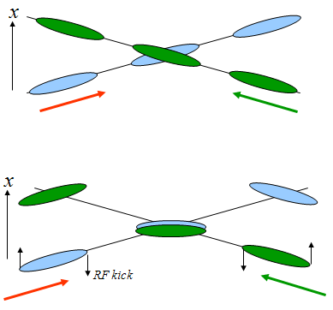
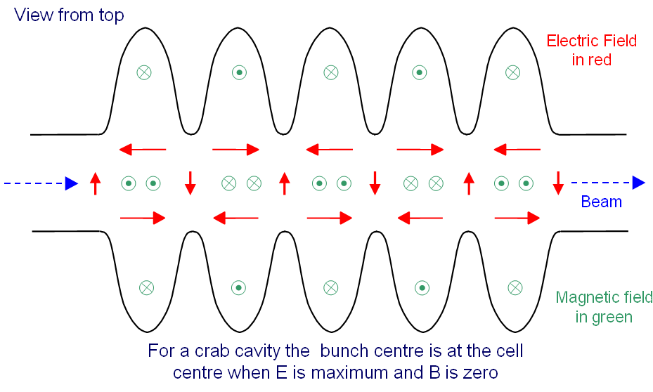
Crab cavity design
FNAL 3.9GHz 9-cell cavity in Opega3p. K.Ko, et al
Prototypes of crab cavity built at FNAL and 3d RF models
Design & prototypes been done by UK-FNAL-SLAC collaboration
3.9GHz cavity achieved 7.5 MV/m (FNAL)
TM110 Dipole mode cavity

Slide 14
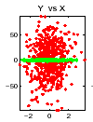
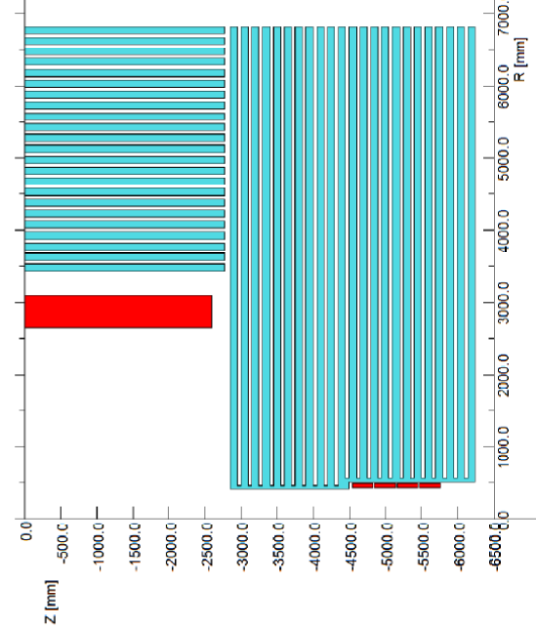

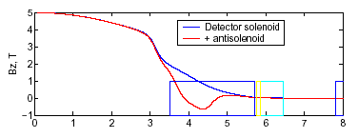
IR coupling compensation
When detector solenoid overlaps QD0, coupling between y & x’ and y & E causes large (30 – 190 times) increase of IP size (green=detector solenoid OFF, red=ON)
without compensation σ_{y}/ σ_{y}(0)=32
Even though traditional use of skew quads could reduce the effect, the local compensation of the fringe field (with a little skew tuning) is the most efficient way to ensure correction over wide range of beam energies
antisolenoid
QD0
SD0
with compensation by antisolenoid
σ_{y}/ σ_{y}(0)<1.01

Slide 15
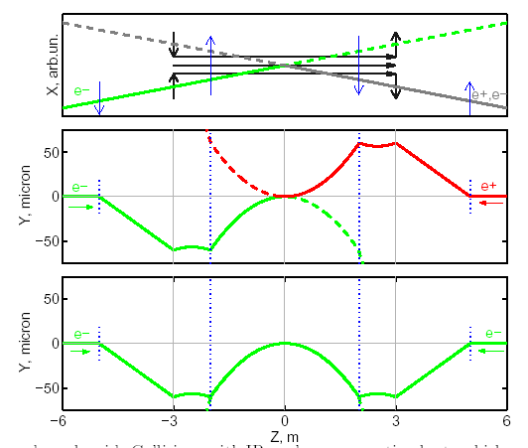
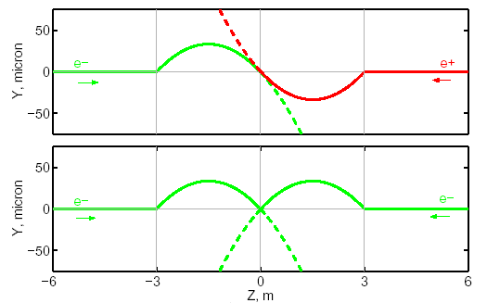
Detector Integrated Dipole
With a crossing angle, when beams cross solenoid field, vertical orbit arise
For e+e- the orbit is anti-symmetrical and beams still collide head-on
If the vertical angle is undesirable (to preserve spin orientation or the e-e- luminosity), it can be compensated locally with DID
Alternatively, negative polarity of DID may be useful to reduce angular spread of beam-beam pairs (anti-DID)

Slide 16
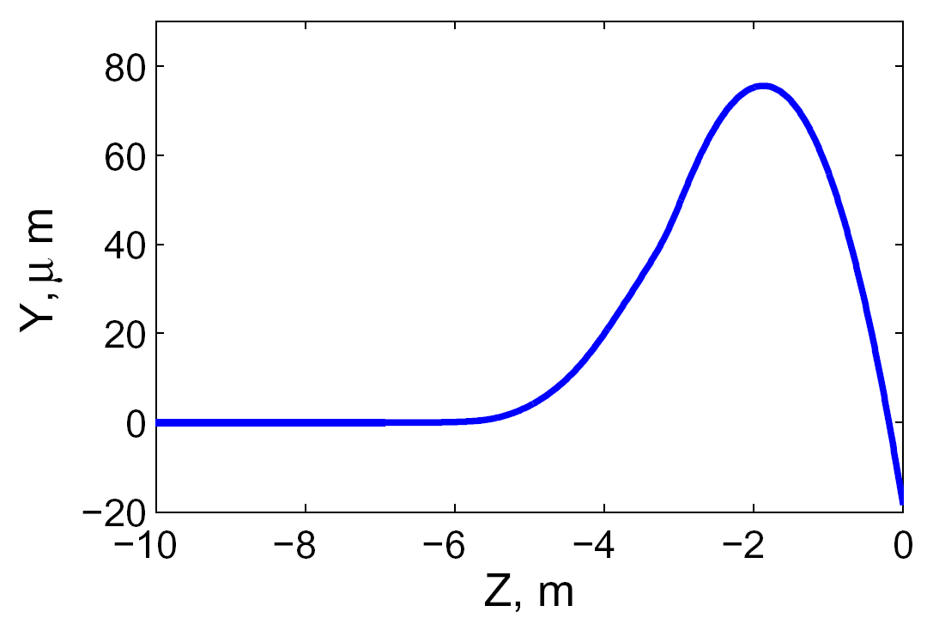
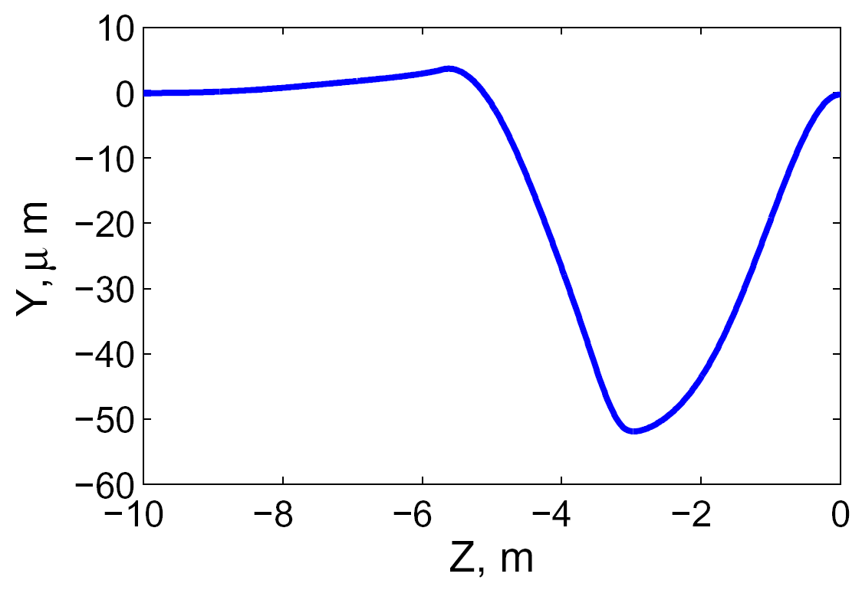
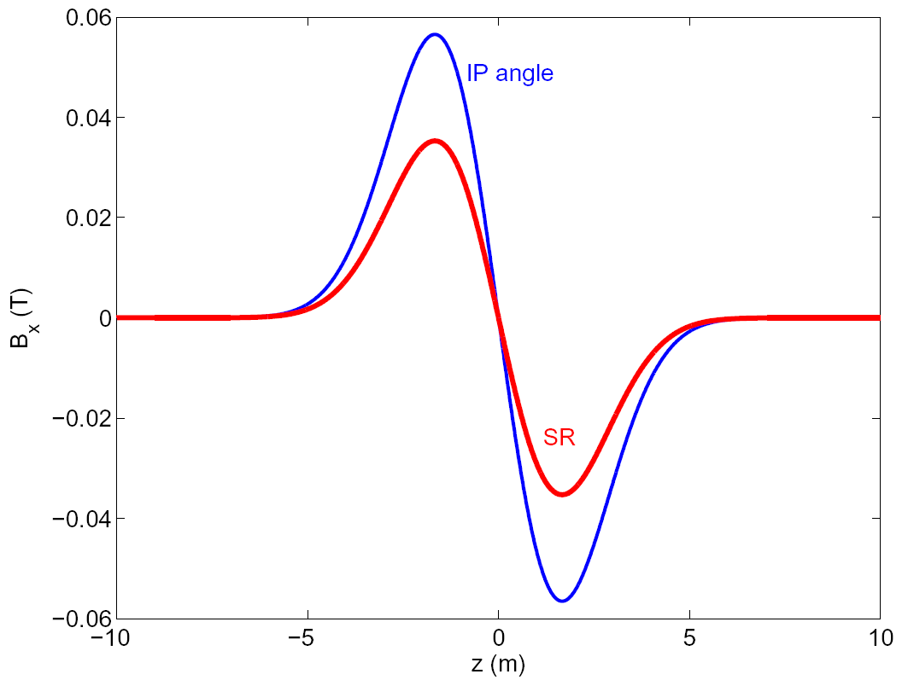
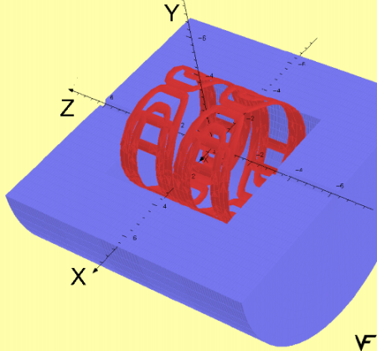
Use of DID or anti-DID
Orbit in 5T SiD
SiD IP angle
zeroed
w.DID
DID field shape and scheme
DID case
The negative polarity of DID is also possible (called anti-DID)
In this case the vertical angle at the IP is somewhat increased, but the background conditions due to low energy pairs (see below) and are improved

Slide 17
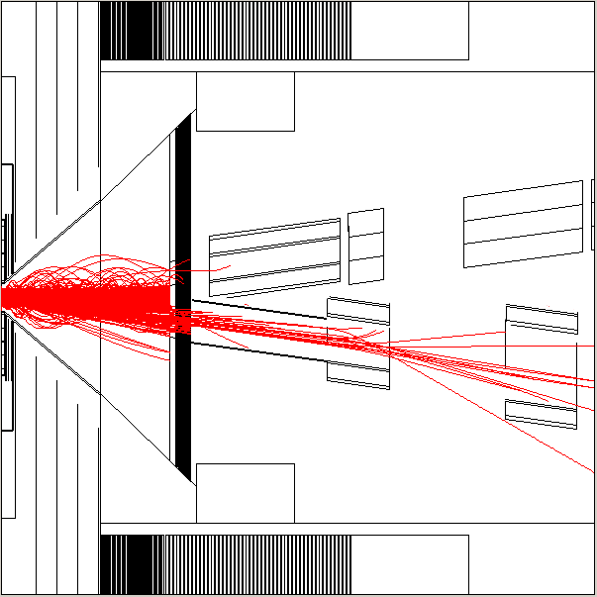
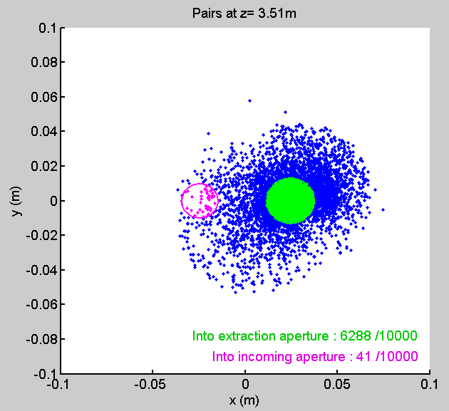
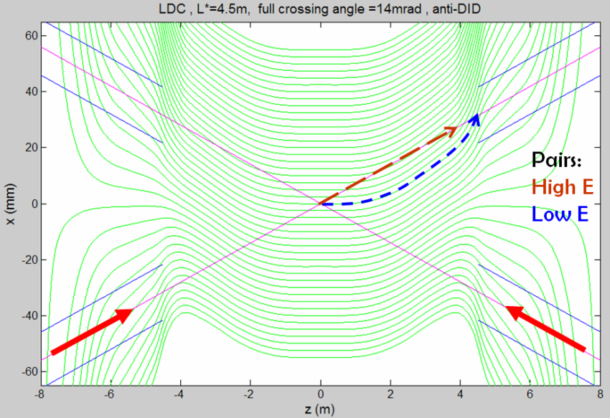
Use of anti-DID to direct pairs
Anti-DID field can be used to direct most of pairs into extraction hole and thus improve somewhat the background conditions
Pairs in IR region
anti-DID case

Slide 18
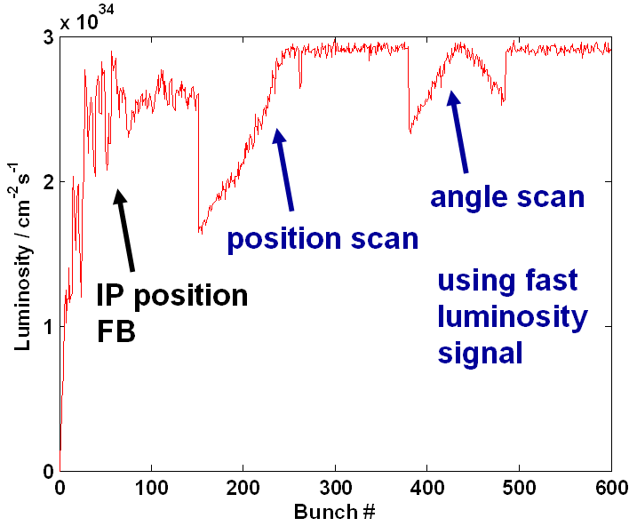
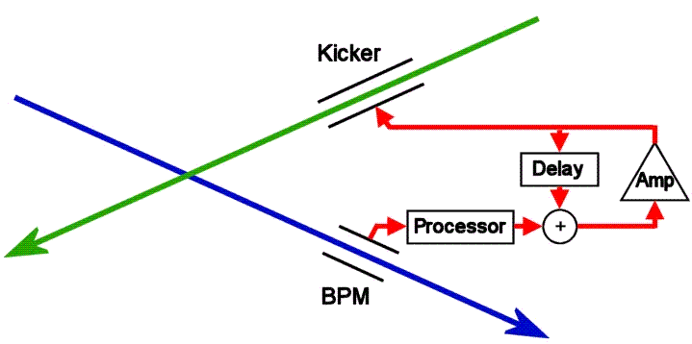
ILC intratrain simulation
ILC intratrain feedback (IP position and angle optimization), simulated with realistic errors in the linac and “banana” bunches.
[Glen White]

Slide 19
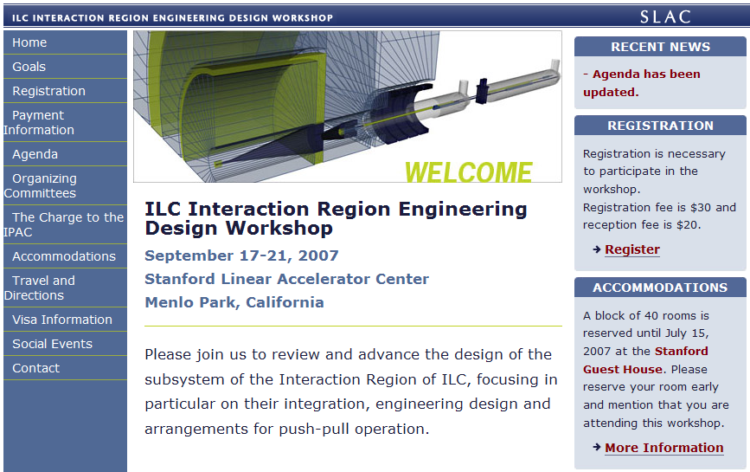
IRENG07 Workshop
http://www-conf.slac.stanford.edu/ireng07/

Slide 20
Work in preparation for IRENG07
WG-A: Overall detector design, assembly, detector moving, shielding.
  Including detector design for on-surface assembly and underground assembly procedures. Beamline pacman & detector shielding…
    Conveners: Alain Herve (CERN), Tom Markiewicz (SLAC), Tomoyuki Sanuki (Tohoku Univ.), Yasuhiro Sugimoto (KEK)
WG-B: IR magnets design and cryogenics system design.
  Including cryo system, IR magnet engineering design, support, integration with IR, masks, Lumi & Beamcals, IR vacuum chamber...
    Conveners: Brett Parker (BNL), John Weisend (SLAC/NSF), Kiyosumi Tsuchiya (KEK)
WG-C: Conventional construction of IR hall and external systems.
  Including lifting equipment, electronics hut, cabling plant, services, shafts, caverns, movable shielding; solutions to meet alignment tolerances...
    Conveners: Vic Kuchler (FNAL), Atsushi Enomoto (KEK), John Osborne (CERN)
WG-D: Accelerator and particle physics requirements.
  Including collimation, shielding, RF, background, vibration and stability and other accelerator & detector physics requirements…
    Conveners: Deepa Angal-Kalinin (STFC), Nikolai Mokhov (FNAL), Mike Sullivan (SLAC), Hitoshi Yamamoto (Tohoku Univ.)
WG-A, conveners meeting, July 5
WG-D, conveners meeting, July 11
WG-A, group meeting, July 12
WG-B, conveners meeting, July 13
WG-C, group meeting, July 17
WG-B, group meeting, July 23
WG-C, group meeting, July 24
WG-A, group meeting, July 30
WG-C, group meeting, July 31
WG-D, group meeting, August 1
WG-B, group meeting, August 2
WG-A, group meeting, August 6
WG-C, group meeting, August 7
WG-A, group meeting, August 13
WG-D, group meeting, August 15
WG-B, group meeting, August 16
WG-A, group meeting, August 20
WG-C, group meeting, August 21
WG-A, group meeting, August 27
WG-C, group meeting, August 28
Conveners and IPAC mtg, August 29
WG-B, group meeting, August 30
WG-B, group meeting, September 13
http://www-conf.slac.stanford.edu/ireng07/agenda.htm

Slide 21
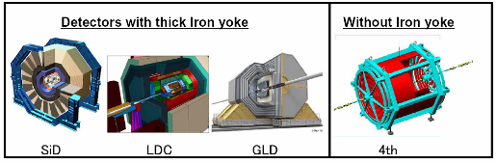
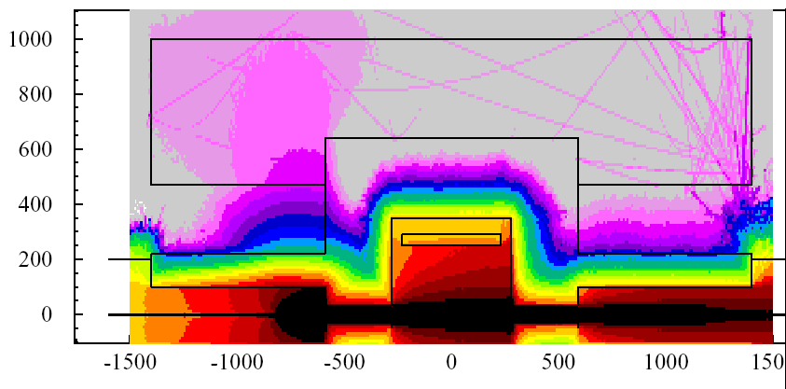
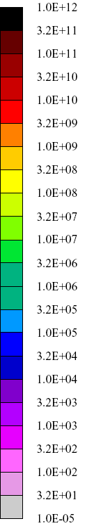
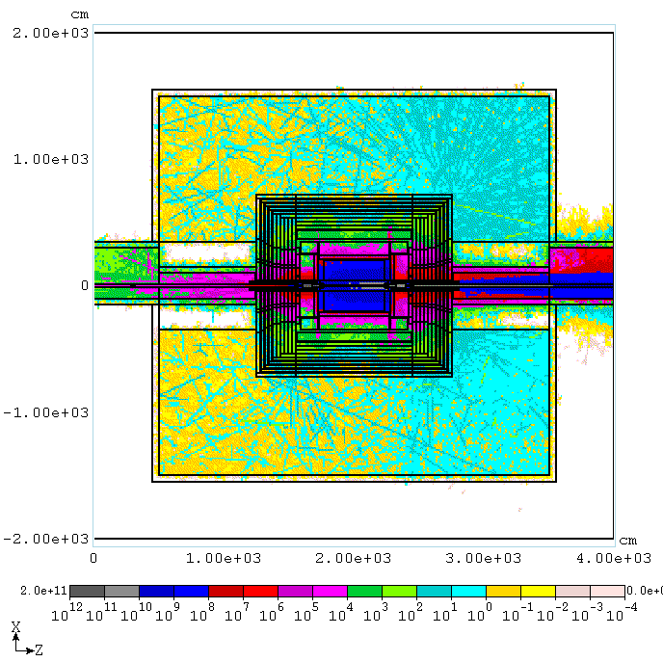
Shielding the IR hall
Detector itself is well shielded except for incoming beamlines.
A proper “pacman” can shield the incoming beamlines and remove the need for shielding wall.
Self-shielding of GLD
18MW on Cu target 9r.l at s=-8m
Pacman 1.2m iron and 2.5m concrete
Shielding the “4th“ with walls
18MW lost at s=-8m.
Pacman has Fe: 1.2m, Concrete: 2.5m
Dose at pacman external wall dose at r=7m
0.65rem/hr (r=4.7m) 0.23rem/hr
250mSv/h

Slide 22
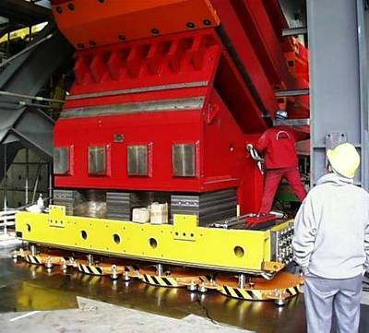
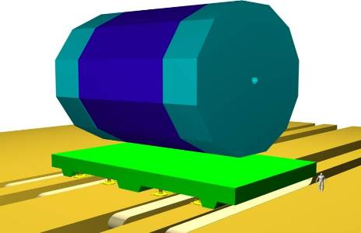
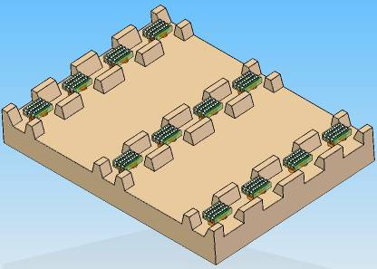
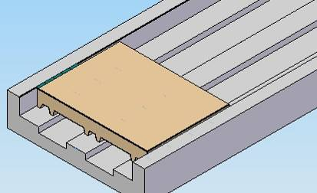
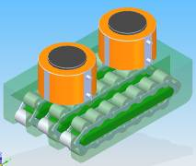
Moving the detector
Air-pads at CMS – move 2000k
Concept of the platform, A.Herve, H.Gerwig
J.Amann

Slide 23
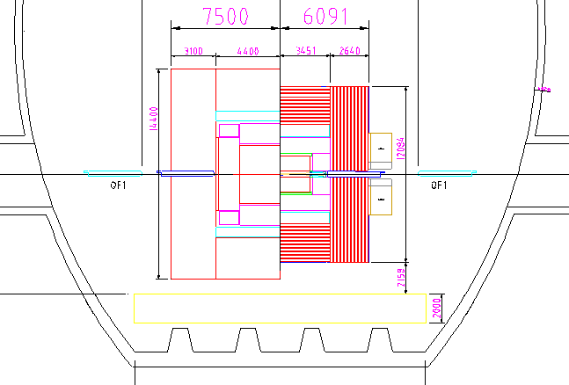
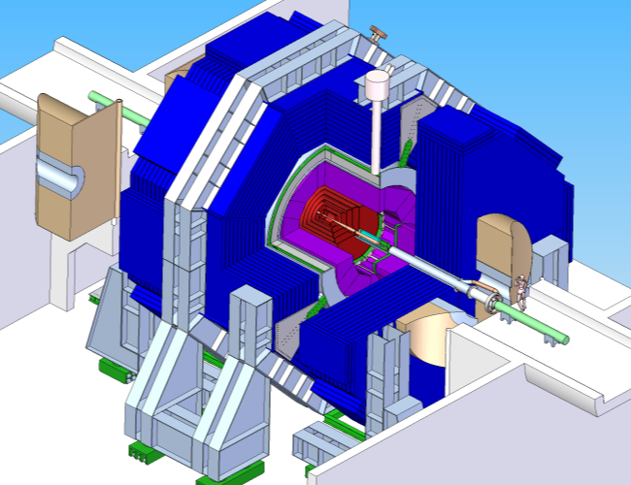
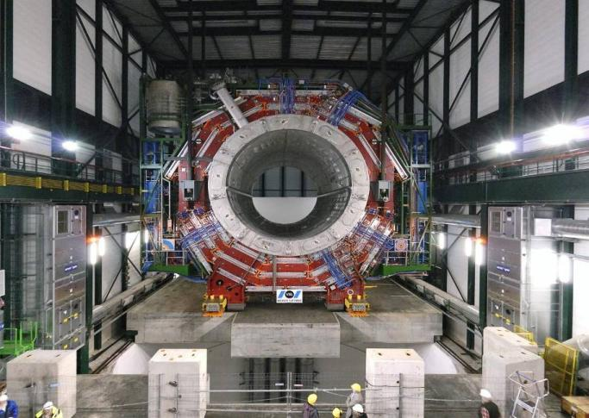
Example of MDI issues we are working on
Detector motion system with
or without an intermediate platform
CMS platform – proof of principle for ILC
Detector and beamline shielding elements

Slide 24
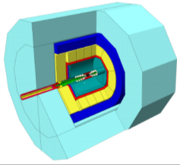


Evolution of ILC Detectors
Merged to ILD design
Thorough evaluation of performance, validation of the concepts
LDC
LDC
ILD
ILD validated
GLD
Technical design of detectors and R&D for critical sub-systems
GLD
SiD
SiD validated
Evolution, self-review and selection process are essential for meeting the challenging detector requirements motivated by physics
  Triggerless event collection (software event selection)
  Extremely precise vertexing
  Vertex, tracker, calorimeters integrated for optimal jet reconstruction
SiD
4th
4th
Notes:
4/24/2012 11:08 ΑΜ
24

Slide 25



Example of system where initially different designs converged on a single compatible solution:
CMS-Inspired Hinged PacMan w/ Cut-outs for ILD Pillar and Plugs
SiD
ILD
M.Oriunno, H.Yamaoka, A.Herve, et. al

Slide 26


Slide 27


All detectors without / with platform

Slide 28

Half Platform w/ Pocket Storage
A.Herve, M.Oriunno, K,Sinram, T.Markiewicz, et al

Slide 29

Preliminary
ANSYS analysis of Platform
Normal mode, 58 Hz
1nm
M.Oriunno
58Hz
First look of platform stability look rather promising: resonance frequencies are rather large (e.g. 58Hz) and additional vibration is only several nm

Slide 30


Detector stability analysis (SiD)
First vertical motion mode, 10.42 Hz
Global FE Model
First analysis shows possibilities for optimization
  e.g. tolerance to fringe field => detector mass => resonance frequency
1nm

Slide 31

Free vibration modes of SiD
M.Oriunno

Slide 32

QD0 supports in ILD and SiD

Slide 33


ILD FD stability analysis results
Hiroshi Yamaoka,
KEK

Slide 34

Stability studies at BELLE
Hiroshi Yamaoka,
KEK

Slide 35




CMS top of Yoke measurement
PSD of the signals Vertical direction
Geophones
Detector vibrations and QD0 support
  Alain Herve (ETH Zurich)
Cooling system OFF
PSD of the signals Beam direction
100 nm

Slide 36

From this….
…….to this
Vibration studies for SiD
Marco Oriunno, SLAC
Ground motion through the feet
36

Slide 37


Polarimeter chicane will be inserted (shrink FF to keep the length)
The central integration includes the sources in the same tunnel as the BDS. Relocation of the positron production system to the downstream end of the electron linac means placing it just before the beginning of the electron BDS. These changes need suitable design modifications to the layout of this area. Figure above shows the proposed new layout of the electron BDS

Slide 38
ILC Nominal and Low Power RDR
 | Nom. RDR | Low P RDR | new Low P | new Low P | new Low P | new Low P
Case ID | 1 | 2 | 3 | 30 | 4 | 5
E CM (GeV) | 500 | 500 | 500 | 500 | 500 | 500
N | 2.0E+10 | 2.0E+10 | 2.0E+10 | 2.0E+10 | 2.0E+10 | 2.0E+10
n_{b} | 2625 | 1320 | 1320 | 1320 | 1105 | 1320
F (Hz) | 5 | 5 | 5 | 5 | 5 | 5
P_{b} (MW) | 10.5 | 5.3 | 5.3 | 5.3 | 4.4 | 5.3
γε_{X} (m) | 1.0E-05 | 1.0E-05 | 1.0E-05 | 1.0E-05 | 1.0E-05 | 1.0E-05
γε_{Y} (m) | 4.0E-08 | 3.6E-08 | 3.6E-08 | 3.6E-08 | 3.0E-08 | 3.0E-08
βx (m) | 2.0E-02 | 1.1E-02 | 1.1E-02 | 1.1E-02 | 7.0E-03 | 1.5E-02
βy (m) | 4.0E-04 | 2.0E-04 | 2.0E-04 | 1.0E-04 | 1.0E-04 | 1.0E-04
Travelling focus | No | No | Yes | Yes | Yes | Yes
Z-distribution * | Gauss | Gauss | Gauss | Flat | Flat | Flat
σ_{x} (m) | 6.39E-07 | 4.74E-07 | 4.74E-07 | 4.74E-07 | 3.78E-07 | 5.54E-07
σ_{y} (m) | 5.7E-09 | 3.8E-09 | 3.8E-09 | 2.7E-09 | 2.5E-09 | 2.5E-09
σ_{z} (m) | 3.0E-04 | 2.0E-04 | 3.0E-04 | 3.0E-04 | 5.0E-04 | 2.0E-04
Guinea-Pig δE/E | 0.023 | 0.045 | 0.036 | 0.036 | 0.039 | 0.038
Guinea-Pig L (cm⁻²s⁻¹) | 2.02E+34 | 1.86E+34 | 1.92E+34 | 1.98E+34 | 2.00E+34 | 2.02E+34
Guinea-Pig Lumi in 1% | 1.50E+34 | 1.09E+34 | 1.18E+34 | 1.17E+34 | 1.06E+34 | 1.24E+34
The RDR “low power” option has large “beamstrahlung energy spread” (beam-beam phenomena) and cause larger background in detectors

Slide 39

Beam-beam: Travelling focus
Suggested by V.Balakin in ~1991 – idea is to use beam-beam forces for additional focusing of the beam – allows some gain of luminosity or overcome somewhat the hour-glass effect
Figure shows simulation of traveling focus. The arrows show the position of the focus point during collision
So far not yet used experimentally

Slide 40
New Low P parameter set
Travelling focus allows to lengthen the bunch
Thus, beamstrahlung energy spread is reduced
Focusing during collision is aided by focusing of the opposite bunch
Focal point during collision moves to coincide with the head of the opposite bunch
 | Nom. RDR | Low P RDR | new Low P | new Low P | new Low P | new Low P
Case ID | 1 | 2 | 3 | 30 | 4 | 5
E CM (GeV) | 500 | 500 | 500 | 500 | 500 | 500
N | 2.0E+10 | 2.0E+10 | 2.0E+10 | 2.0E+10 | 2.0E+10 | 2.0E+10
n_{b} | 2625 | 1320 | 1320 | 1320 | 1105 | 1320
F (Hz) | 5 | 5 | 5 | 5 | 5 | 5
P_{b} (MW) | 10.5 | 5.3 | 5.3 | 5.3 | 4.4 | 5.3
γε_{X} (m) | 1.0E-05 | 1.0E-05 | 1.0E-05 | 1.0E-05 | 1.0E-05 | 1.0E-05
γε_{Y} (m) | 4.0E-08 | 3.6E-08 | 3.6E-08 | 3.6E-08 | 3.0E-08 | 3.0E-08
βx (m) | 2.0E-02 | 1.1E-02 | 1.1E-02 | 1.1E-02 | 7.0E-03 | 1.5E-02
βy (m) | 4.0E-04 | 2.0E-04 | 2.0E-04 | 1.0E-04 | 1.0E-04 | 1.0E-04
Travelling focus | No | No | Yes | Yes | Yes | Yes
Z-distribution * | Gauss | Gauss | Gauss | Flat | Flat | Flat
σ_{x} (m) | 6.39E-07 | 4.74E-07 | 4.74E-07 | 4.74E-07 | 3.78E-07 | 5.54E-07
σ_{y} (m) | 5.7E-09 | 3.8E-09 | 3.8E-09 | 2.7E-09 | 2.5E-09 | 2.5E-09
σ_{z} (m) | 3.0E-04 | 2.0E-04 | 3.0E-04 | 3.0E-04 | 5.0E-04 | 2.0E-04
Guinea-Pig δE/E | 0.023 | 0.045 | 0.036 | 0.036 | 0.039 | 0.038
Guinea-Pig L (cm⁻²s⁻¹) | 2.02E+34 | 1.86E+34 | 1.92E+34 | 1.98E+34 | 2.00E+34 | 2.02E+34
Guinea-Pig Lumi in 1% | 1.50E+34 | 1.09E+34 | 1.18E+34 | 1.17E+34 | 1.06E+34 | 1.24E+34
*for flat z distribution the full bunch length is σ_{z}*2*3^{1/2}

Slide 41

Beam Parameters
Rate at IP = 2.5Hz,
Rate in the linac = 5Hz (every other pulse is at 150GeV/beam, for e+ production)
Low luminosity at this energy reduces the physics reach

Slide 42

SB2009 Lumi
1/E
L,E34
Rate at IP = 2.5Hz, Rate in the linac = 5Hz (every other pulse is at 150GeV/beam, for e+ production)
Low luminosity at this energy reduces the physics reach
0.5/E
0.5/E
Actual luminosity
0.25/E
E CM

Slide 43
Work on mitigations of L(E) with SB2009 during and after ILC2010
Discussion of double rep rate was initiated ~month before the ILC2010
this allowed achieving significant progress at LCWS10
Doubling the rep rate (below ~125GeV/beam)
  BDS WG discussed implications with other Working Groups:
    DR => ~OK (new conceptual DR design; duty factor issue)
    Sources => OK
    Linac, HLRF, Cryogenics => OK
FD optimized for ~250GeV CM
  Shorter FD reduce beam size in FD and increase collimation depth, reducing collimation related beam degradation
  Will consider exchanging FD for low E operation or a more universal FD that can be retuned

Slide 44
Lumi(E) dependence in SB2009
Factor determine shape of L(E) in SB2009
  Lower rep ( /2) rate below ~125GeV/beam
  Collimation effects: increased beam degradation at lower E due to collimation wakes and due to limit (in X) on collimation depth
Understanding the above limitations, one can suggest mitigation solutions:
  1) Consider doubling the rep rate at lower energy
  2) Consider Final Doublet optimized for 250GeV CM

Slide 45



FD & collimation
L*=3.5m, colldepthX=12, colldepthY=100
Reduced Collimation depth at lower E is responsible for large fraction of reduction of luminosity (w.r.to 1/E ideal curve)
Shorter, matched to lower E, final doublet, will give some reduction of beam size at FD, thus increase the collimation depth
mm
X
Y
z, m
L*=7.0m, colldepthX=10, colldepthY=60
y, mm
mm
VX
QD0
QF1
QD0
VX
EXT
EXT
x, mm
z, m
z, m
Rays show trajectories of possible SR photons. Amount of rays is not quantitative.

Slide 46



FD for low E
FD optimized for lower energy will allow increasing the collimation depth by ~10% in Y and by ~30% in X (Very tentative!)
One option would be to have a separate FD optimized for lower E, and then exchange it before going to nominal E
Other option to be studied is to build a universal FD, that can be reconfigured for lower E configuration (may require splitting QD0 coil and placing sextupoles in the middle)
Nominal FD & SR trajectories
FD for 1/2E & SR
trajectories

Slide 47
Beam Parameters & mitigation
Tentative! At 250 GeV CM the mitigations may give
  * 2 L due to double rep rate
  * about 1.4 L due to FD optimized for low E

Slide 48

SB2009 Lumi
Linac & IP rates are 8Hz
Linac rate 10Hz
(IP rate 5Hz)
and special FD

Slide 49
New parameters based on the following assumptions
  Starting point: parameters developed by the Physics Questions Committee (B. Foster, A. Seryi, J. Clarke, M. Harrison, D. Schulte, T. Tauchi) in December 2009.
  Take into account progress on 10Hz rep rate for low E achieved after LCWS10
    There are issues with DR duty cycle that are being studied, however assume that they will be solved
  Assume that we will develop and use new universal FD that gives additional luminosity improvement (only) for 200 and 250 GeV energies
  Consider the following energies: 200, 250, 350, 500 GeV CM
  Assume single stage bunch compressor (min sigma_z=230um – will use 300um and consider 230 as an overhead or safety margin)
  Assume 10Hz and 1300 bunches
  Consider separately the cases with and without Travelling Focus
  Energy and rep rate:
    E= 200 250 350 500 GeV CM
    IP rep rate 5 5 5 5 Hz
    Linac rate 10 10 5 5 Hz
        ( double pulsing )

Slide 50

BAW-2 Themes
Formally agreed parameter sets across energy range
ILC-EDMS document ID 925325
http://ilc-edmsdirect.desy.de/ilc-edmsdirect/document.jsp?edmsid=*925325

Slide 51


Slide 52

Arrows show location of
focal point for each bunch at a particular moment

Slide 53


Slide 54

SB2009 beam offset sensitivity
Higher Disruption
  Higher sensitivity to Δy
  Intratrain Feedback more challenging
  Vertical bunch-bunch jitter to be <200pm for <5% lumi loss
  However, twice longer bunch separation will help to improve bunch-bunch uniformity & jitter

Slide 55



Slide 56
The travelling focus can be created in two ways.
The first way is to have small uncompensated chromaticity and coherent E-z energy shift δE/δz along the bunch. One has to satisfy δE k L*_{eff} = σ_{z} where k is the relative uncompensated chromaticity. The δE needs to be 2-3 times the incoherent spread in the bunch. Thus, the following set may be used: δE=0.3%, k=1.5%, L*_{eff} =6m.
It is clear that additional energy spread affect the physics. Therefore, second method is considered:

Slide 57
The second way to create a travelling focus is to use a transverse deflecting cavity giving a z-x correlation in one of the FF sextupoles and thus a z-correlated focusing
The cavity would be located about 100m upstream of the final doublet, at the π/2 betatron phase from the FD
The needed strength of the travelling focus cavity can be compared to the strength of the normal crab cavity (which is located just upstream of the FD):
  U_{trav.cav.}/U_{crab.cav.} = η_{FD} R₁₂^{cc}/ (L*_{eff} θ_{c} R₁₂^{trav}).
  Here η_{FD} is dispersion in the FD, θ_{c} full crossing angle, R₁₂^{trav} and R₁₂^{cc} are transfer matrix elements from travelling focus transverse cavity to FD, and from the crab cavity to IP correspondingly.
For typical parameters η_{FD} =0.15m, θ_{c} =14mrad. R₁₂^{cc} =10m, R₁₂^{trav} =100m, L*_{eff} =6m one can conclude that the needed strength of the travelling focus transverse cavity is about 20% of the nominal crab cavity.

Slide 58


Slide 59


QD0 R&D Prototype Coil Winding Status
To control coil support tube position during winding, we split QD0 coil in order to have a fixed support.
Coil winding of all the quadrupole layers is complete and the measured harmonic agree with expectations.
Vertical cold test has been done; tested to 10% above operating current without quenching; forced quenches with spot heater, saw no degradation.
Have started winding octupole coil correction windings; next we will start winding the main sextupole coil sets.
QD0 coil production
Octupole coil test winding

Slide 60


Slide 61

Adopted Low-P parameters

Slide 62


Slide 63
Outline
RDR Design
Changes to BDS Design in SB2009
Few modifications in the design
Possible future changes
Optics updates
By Deepa Angal-Kalinin

Slide 64

RDR Beam Delivery System
ILC2006e (M. Woodley, A. Seryi et al) : Layout compatible for 1 TeV CM.
http://www-project.slac.stanford.edu/ilc/acceldev/beamdelivery/rdr/
e- →
← e+
Combined LW+pol +MPS
Betatron Collimation
Energy Spectrometer
Energy Collimation
Final Focus
MPS
Skew correction & emittance measurement
Fast abort/Tuning line
IP
2.2 km
2.2 km
0
500
1000
1500
2000
-2000
-1500
-1000
-500
0
S(m)
One interaction region @crossing angle of 14 mrad with push-pull arrangements for two detectors. R. Versteegen’s talk on IR simulations (WG5).

Slide 65
RDR Beam Delivery System
Concerns about combined functionality of MPS collimator, laser wire detector and upstream polarimeter measurements.
It was planned to separate these functionalities for precise
polarisation measurements.
Possible shortening of 1 TeV CM BDS to allow more emittance growth due to synchrotron radiation.
Push-pull requirement : location of QF1 unchanged. D1B adjusted according to L*.
Different L* decks were prepared (A. Seryi) to study collimation depths and muons. Optics was not tuned for beam size and band width etc.
L*
D1B
Recent attempt to address all these points alongwith required changes for SB2009.

Slide 66
SB2009 : Changes to BDS Design
e-BDS
Fast abort line
Photon target + remote handling
Undulator
Dogleg
Sacrificial collimators + chicane to detect off energy beams
400 m
Undulator based positron source moves to the end of the e- main Linac as part of central integration
Dogleg needs to provide 1.5m transverse offset at the target location at ~400m from the end of the undulator and ~40m drift near target area for remote handling.
Fast abort line in the beginning of the RDR BDS lattice before the undulator.

Slide 67

SB2009 e- BDS
e-BDS
Fast abort line
Chicane to detect LW photons
Polarimetry chicane
Undulator
Dogleg
Betatron collimation
Energy collimation
Sacrificial collimators + chicane to detect off energy beams
Final Focus
Skew correction & emittance measurement
DC Tuning
line
IP

Slide 68


SB2009 e- BDS Optics

Slide 69



The Dogleg Design
Theoretical Minimum Emittance (TME) lattice.
Provides 1.5m offset in ~400m
Emittance growth is ~3.8% (1TeV CM)
Decimation of dipoles is possible
The first and last dipoles in each of the two bending sections have lower bend angles to match the dispersion into, and out of, the dogleg.
These dipoles can be used to match and correct incoming errors to minimise the emittance growth seen in the dogleg sections.

Slide 70

The Dogleg Tolerances
Due to the space constraints and strong focusing in the dogleg design, the tolerances are tight.
The results of uncorrected mismatch entering the lattice, for a 10% emittance growth in the lattice at 1TeV CM (cf. 3.8% nominal).
WEPE031, IPAC10

Slide 71
The Dogleg Tolerances
Important to understand the implications to tuning and tolerances due to the strong focussing dogleg lattice.
Preliminary studies indicate that very tight tolerances on the incoming dispersion, as well as the required trajectory correction.
Correction of these errors using the 4 “end” dipoles in the design has shown that it is possible to widen the tolerance levels significantly.
Additional correction for the trajectory within the dogleg needs to be looked at further and to understand if decimation of dipoles will be useful to relax the tolerances at 500 GeV CM.

Slide 72


Positron BDS
Separated polarimetry chicane, combined functionality of laser wire and MPS still in the same chicane. Need laser wire simulations to see if this is okay.
Polarimetry chicane
LW photons+
MPS

Slide 73


Shortening of Energy Collimation and Final Focus
Emittance growth <1% @500 GeV beam for RDR.
First attempt to reduce the FFS length of push-pull deck by R. Versteegen (CEA).
Multiplied all the dipole lengths and drifts by 0.87 in the energy collimator and the FFS in order to approximately double emittance growth in these sections.
Re-tuned linear optics and sextupoles to optimise the luminosity and the bandwidth.
Push-pull long
250 GeV
500 GeV
Push-pull short
250 GeV
500 GeV

Slide 74


Shortening of Energy Collimation and FF
long
Reduced the total length by ~130 m and horizontal emittance increased to ~1.6%.
short
Shifted vertically for illustration
This length reduction is not yet implemented in SB2009.
Short
Long

Slide 75
Support for Travelling Focus in SB2009
A.Seryi, WE6PFP082, PAC09
Create Travelling focus using a transverse deflecting cavity giving a z-x correlation in one of the FF sextupoles and thus provide z-correlated focusing.
    The cavity will be located about 100m upstream of the final doublet, at the π/2 betatron phase from the FD.
    The strength required will be ~20% of the nominal crab cavity.
Such a cavity is not yet included in the lattice.
Tracking studies and possibly mitigation of higher order aberrations will be needed.
Optics updates
By Deepa Angal-Kalinin

Slide 76
Possible Future Changes
On e- BDS side:
Needs re-designing of shorter fast abort line before the undulator.
Needs design of DC tuning line on electron side. Replace kickers with DC dipoles→ will affect the region between LW chicane and polarimetry chicane.
Details of power deposition in the tunnel and radiation effects will need to be evaluated.
Start-to-end simulations including the dogleg design.
Possible decimation of dogleg dipoles may be necessary if start-to-end simulations indicate.
on e+ BDS side:
LW simulations for combined functionality of LW photon detection and MPS for fast abort.

Slide 77
Possible Future Changes
On both BDSs:
Implementing shorter Final focus in final decks.
Support for travelling focus and low power beam dynamics simulations including collimation depth changes.
Study the possibility of merging full power tuning (tuning + fast abort on e+ side)dump with the main beam dump.
SB2009 BDS Decks
No decks available publicly after RDR ILC2006e decks . The changes after the RDR need to be made available at some central place.
We will keep all these decks in present condition on EDMS soon with detailed comments for any future developments by interested colleagues.

Slide 78

http://projects.astec.ac.uk/ilcdecks/

Slide 79
DESIGN OF AN 18 MW VORTEX FLOW WATER BEAM DUMP FOR 500 GeV ELECTRONS/POSITRONS OF AN INTERNATIONAL LINEAR COLLIDER
Polepalle Satyamurthy, Pravin Rai, Vikas Tiwari, Kiran Kulkarni
ADS Target Development Section, Beam Technology Development Group, Bhabha Atomic Research Centre, Mumbai, India-400085
John Amann, Ray Arnold, Dieter Walz
SLAC National Accelerator Laboratory, Stanford, Menlo Park, CA, USA
Andrei Seryi, John Adams Institute for Accelerator Science, UK
Tristan Davenne, Ottone Caretta, Chris Densham Rutherford Appleton Laboratory, UK
Robert B Appleby
The University of Manchester and the Cockcroft Institute, UK

Slide 80
A 56 page report (paper for NIM) has been finalised and submitted
Abstract
Beam dumps are essential components of any accelerator system. They are usually located at the end of beam delivery systems and are designed to safely absorb and dissipate the particle energy. In the second stage of the proposed International Linear Collider (ILC), the electron and positron beams are accelerated to 500 GeV each (1TeV total). Each bunch will have 2x10¹⁰ electrons/positrons, and 2820 bunches form one beam bunch train with time duration of 0.95ms and 4 Hz frequency. The average beam power will be 18 MW with a peak power of 4.5 GW. The FLUKA code was used to determine the power deposited by the beam at all critical locations. This data forms the input into the thermal hydraulic analysis CFD code for detailed flow and thermal evaluation. Both 2D and 3D flow analysis was carried out at all the critical regions to arrive at optimum geometry and flow parameters of the beam dump. Analysis of generation and propagation of pressure waves due to rapid deposition of heat has also been analysed.
26 May 2011, Polepalle Satyamurthy, Pravin Rai, Vikas Tiwari, Kiran Kulkarni (BARC), John Amann, Ray Arnold, Dieter Walz (SLAC), Andrei Seryi (JAI), Tristan Davenne, Ottone Caretta, Chris Densham (RAL), Robert Appleby (Univ. of Manchester)

Slide 81






Results that were already reported earlier (examples)
26 May 2011, Polepalle Satyamurthy, Pravin Rai, Vikas Tiwari, Kiran Kulkarni (BARC), John Amann, Ray Arnold, Dieter Walz (SLAC), Andrei Seryi (JAI), Tristan Davenne, Ottone Caretta, Chris Densham (RAL), Robert Appleby (Univ. of Manchester)

Slide 82




New results – pressure wave analysis (example)
26 May 2011, Polepalle Satyamurthy, Pravin Rai, Vikas Tiwari, Kiran Kulkarni (BARC), John Amann, Ray Arnold, Dieter Walz (SLAC), Andrei Seryi (JAI), Tristan Davenne, Ottone Caretta, Chris Densham (RAL), Robert Appleby (Univ. of Manchester)

Slide 83
Recent updates:
1.1 The window can experiences a maximum pressure of 12.5 bar
1.2 The maximum pressure experienced by Beam dump (other than window) is 15 bar
1.3 The maximum of local transient pressure water sees is 44 bar
1.4 The minimum local transient pressure water sees during the train is 4 bar
1.5 The minimum local transient pressure water sees just after the train is -0.4 bar which is likely to cause cavitation
The dump and windows have sufficient strength safety margin, so 1.1 and 1.2 are OK.
The 1.3 by itself is not a problem.
Most of the concern is perhaps due to 1.4 and especially 1.5.
However, the calculations are for max beam power and also for the worst case scenario, when there are no bubbles in the water -- while they may reduce the pressure effects. Also, maybe there are other ways to mitigate this problem. Maybe we can also think about gradual reduction of the charge of the last ~100 bunches in the train (however the damping ring or the linac dynamics will likely preclude this – need to be discussed with DR and Linac colleagues).
26 May 2011, Polepalle Satyamurthy, Pravin Rai, Vikas Tiwari, Kiran Kulkarni (BARC), John Amann, Ray Arnold, Dieter Walz (SLAC), Andrei Seryi (JAI), Tristan Davenne, Ottone Caretta, Chris Densham (RAL), Robert Appleby (Univ. of Manchester)

Slide 84
PM’s notes
Optics:
Final doublet / IR configuration for push-pull
Split final doublet for low-energy running scenario
General optics solution for SB2009 IP parameters (focusing)
Impact of above on collimation/collimation depth
What will we be able to do for TDR?
Physics instrumentation – MDI Requirements
  (chicanes for spectrometer,
  upstream polarimeter and
  laser wires,…)
  Beamline space needed
6. Dumps (also RTML): rating/spec for all the BDS dumps foreseen.
  New results from dump studies
(relevant for TeV parameter set)

Slide 85
PM’s notes

Slide 86
To summarise:
After Oct 2011 (baseline review in DESY)
Substantial progress, since then, is in
  MDI/CFS design (reviewed separately)
  ATF2 progress (special sessions)
  Beam dump system
    NIM review paper published (linked to the agenda)
    BARC is ready to build the beam dump system if needed
We have created a plan to finish the remaining optics and cost estimation work this summer, to fit in the timescale of the TDR

Slide 87
Extra slides

Slide 88


Slide 89


Slide 90


