Slide 1
SiD EMCal Testbeam Prototype
M. Breidenbach for the SiD EMCal and Electronics Subsystems

Slide 2
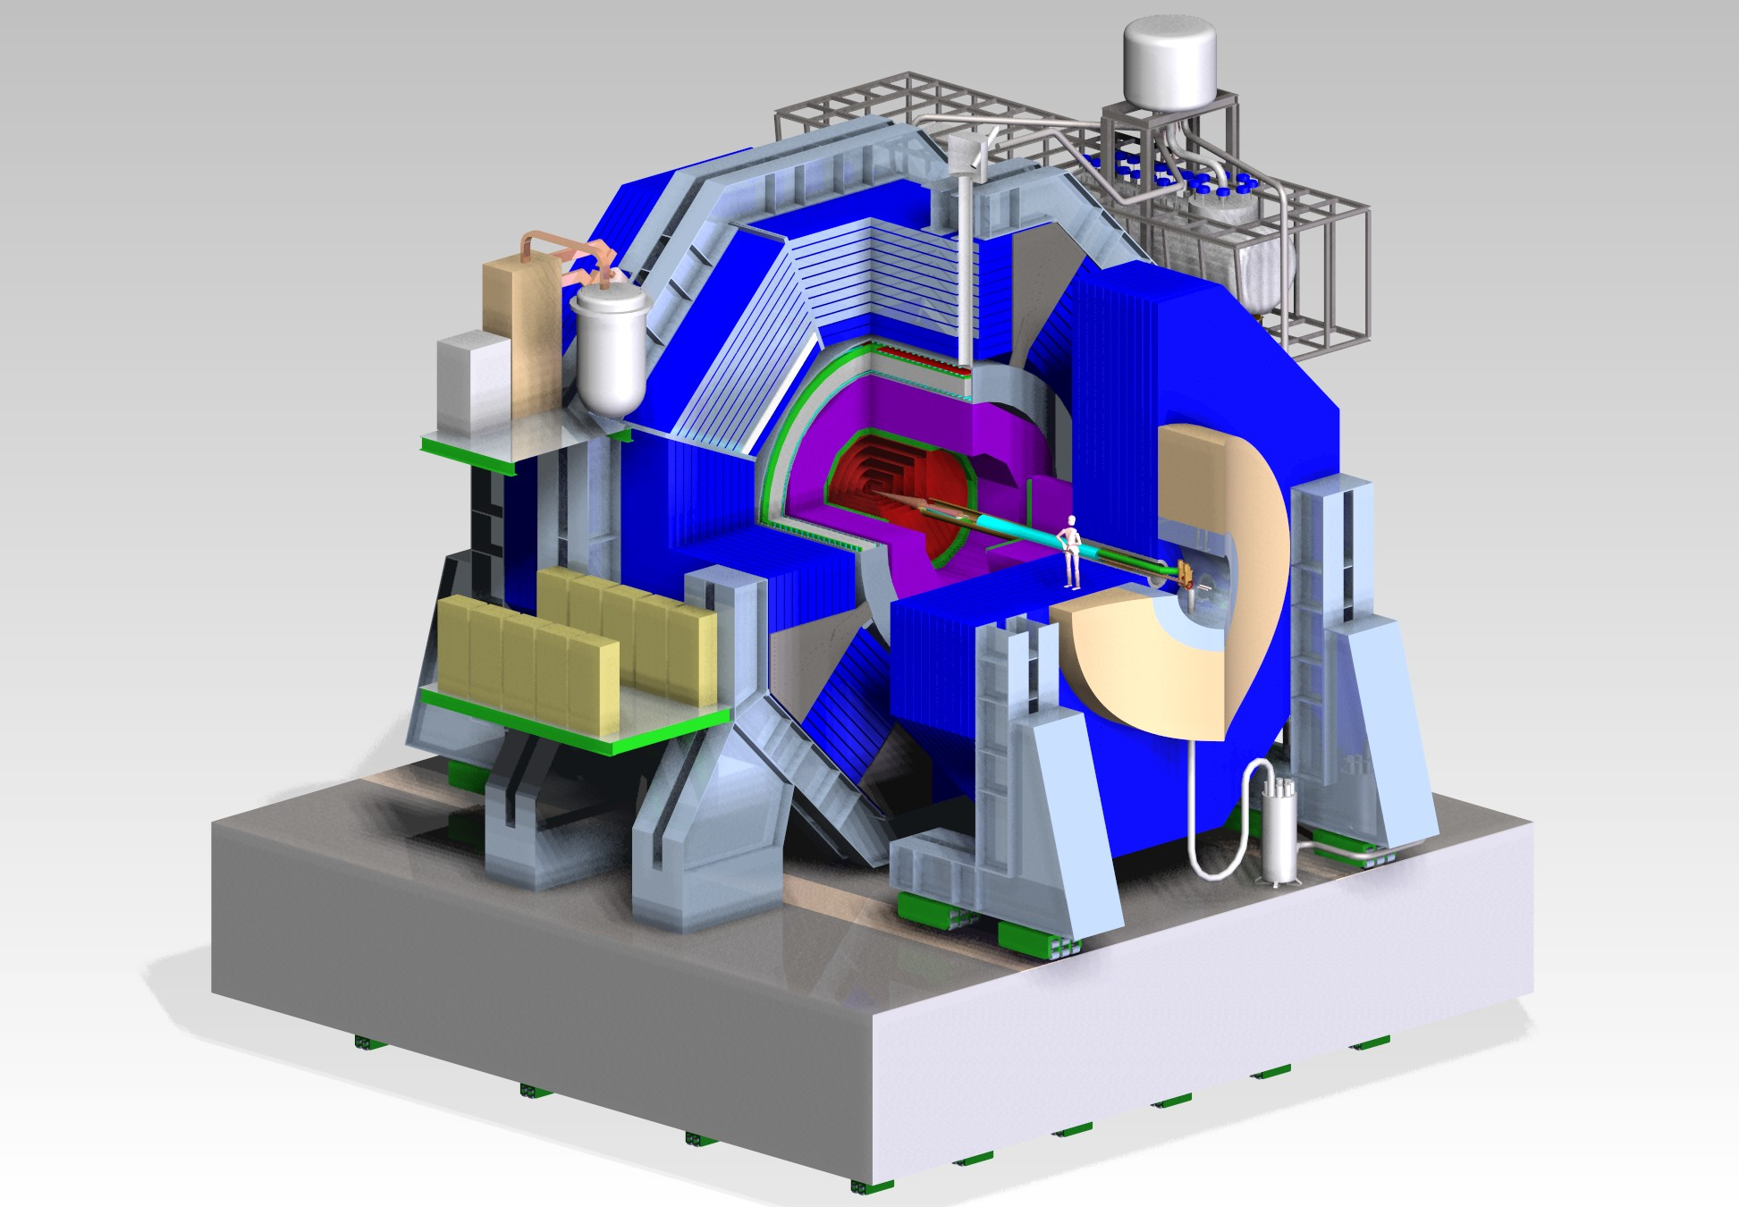

Slide 3
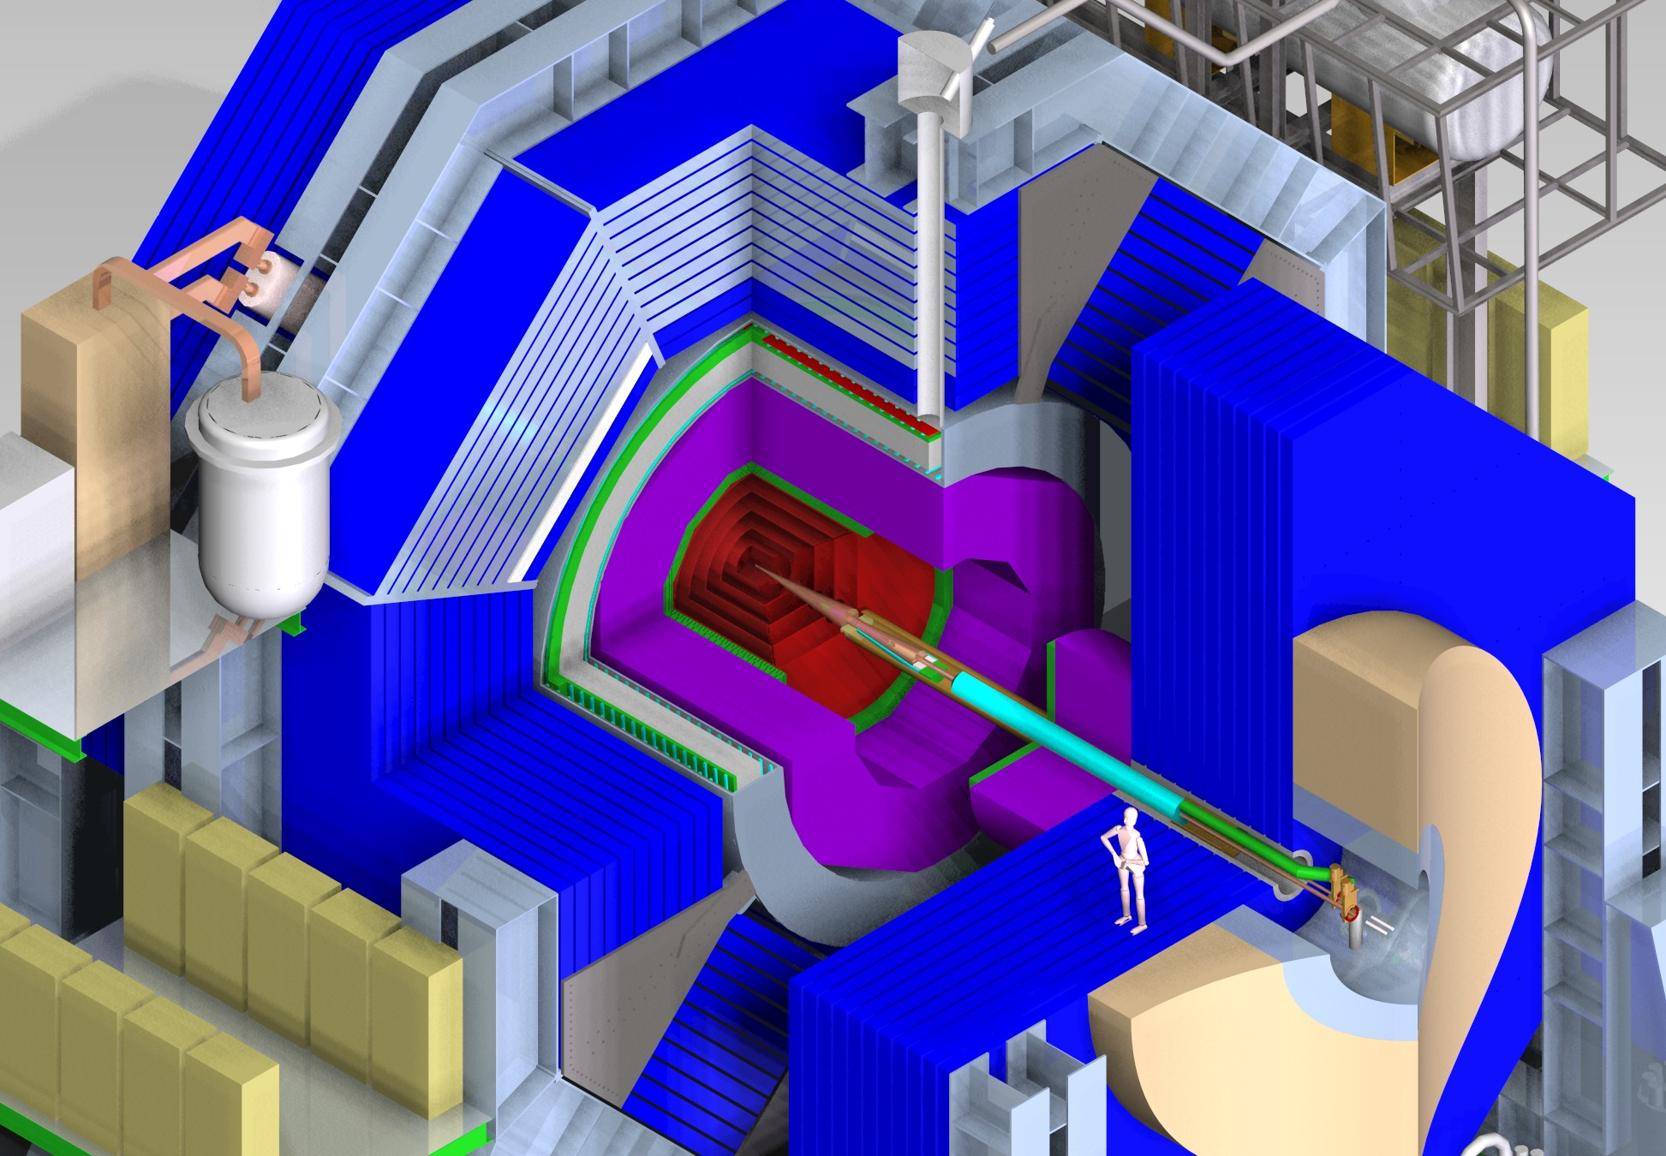
EMCal

Slide 4
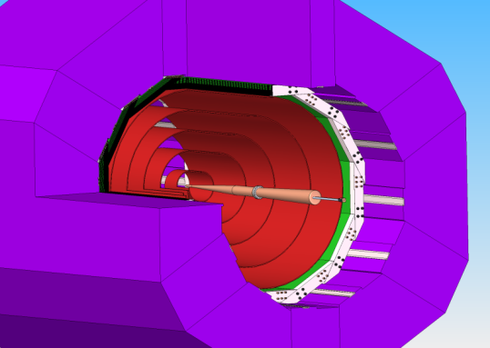
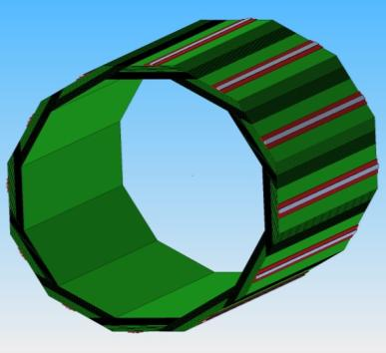
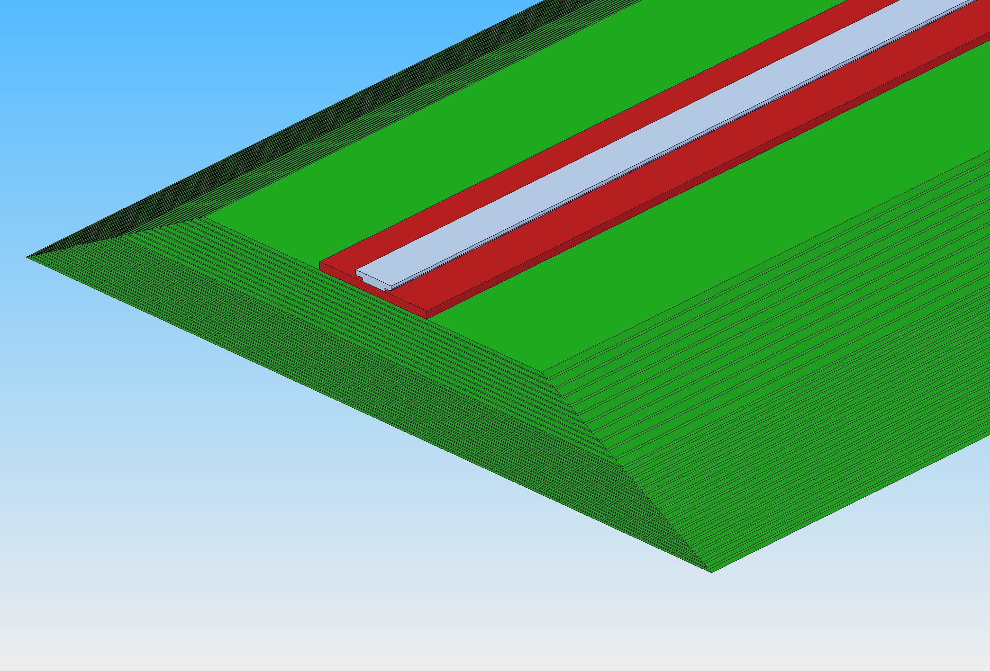
ECAL
Prototype Goals:
Replicate full EMCal stack and test – 30 sensors.
20 layers 2.5 mm W (5/7 X0)
10 layers 5 mm W (10/7 X0)
30 gaps 1.25 mm w Si pixels sensors
29 X₀; 1 λ
ΔE/E = 17%/√E;
Effective Moliere radius = 13 mm
D 2.5 m
L 4.36 m
t 142 mm
Notes:
Note: SiD Ecal is octagonal, not a dodecahedron as depicted in drawing

Slide 5
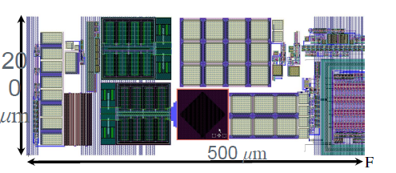
KPiX – System on a Chip
KPiX is a 1024 channel intended to bump bond to Si detectors, optimized for the ILC (1 ms trains, 5 Hz rate):
  Low noise dual range charge amplifier w 17 bit dynamic range.
  Power modulation w average power <20 μW/channel (ILC mode).
  Up to 4 measurements during ILC train; each measurement is amplitude and bunch number.
  Digitization and readout during the inter-train period.
  Internal calibration system
  Noise Floor: 0.15 fC (1000 e⁻ )
  Peak signal (Auto-ranging) 10 pC
  Trigger Threshold Selectable (0.1 – 10 fC)

Slide 6
KPiX – Simplified bock diagram of single channel

Slide 7
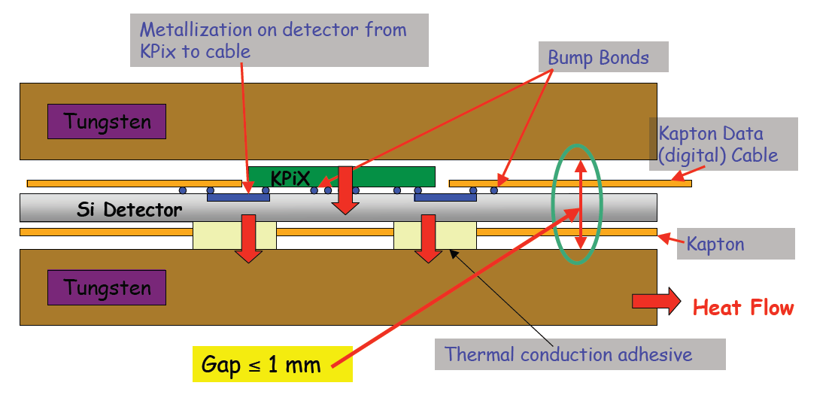
Detail of Structure.

Slide 8
Boundary Conditions
We have 40 nominally good Hamamatsu sensors.
We have ~20 nominally bad “mechanical prototype” sensors.
The KPiXa’s come from TSMC with eutectic Sn-Pb bumps in place in wells on the chip.
The Hamamatsu sensors (EMCal and Tracker) come with Al pads, so there is a layer of Al₂O₃ which must be removed…

Slide 9
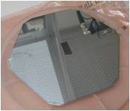

Under Bump Metallization (UBM)
UCD put a huge effort into UBM:
  Used the mechanical prototype sensors
  Zincate – chemistry to remove the Al₂O₃ and plate a stack ending with Au.
  Sputtering – to directly implant Ti and then a stack ending with Au.
With miserable results!
  Possible explanation is that there is something else on the pads, but SEM sees only Al and O.
We finally went to IZM in Germany who use a sputtering process.
  They have bonded two KPiXa’s to two mechanical prototype sensors.
X-ray image of bumps - IZM

Slide 10
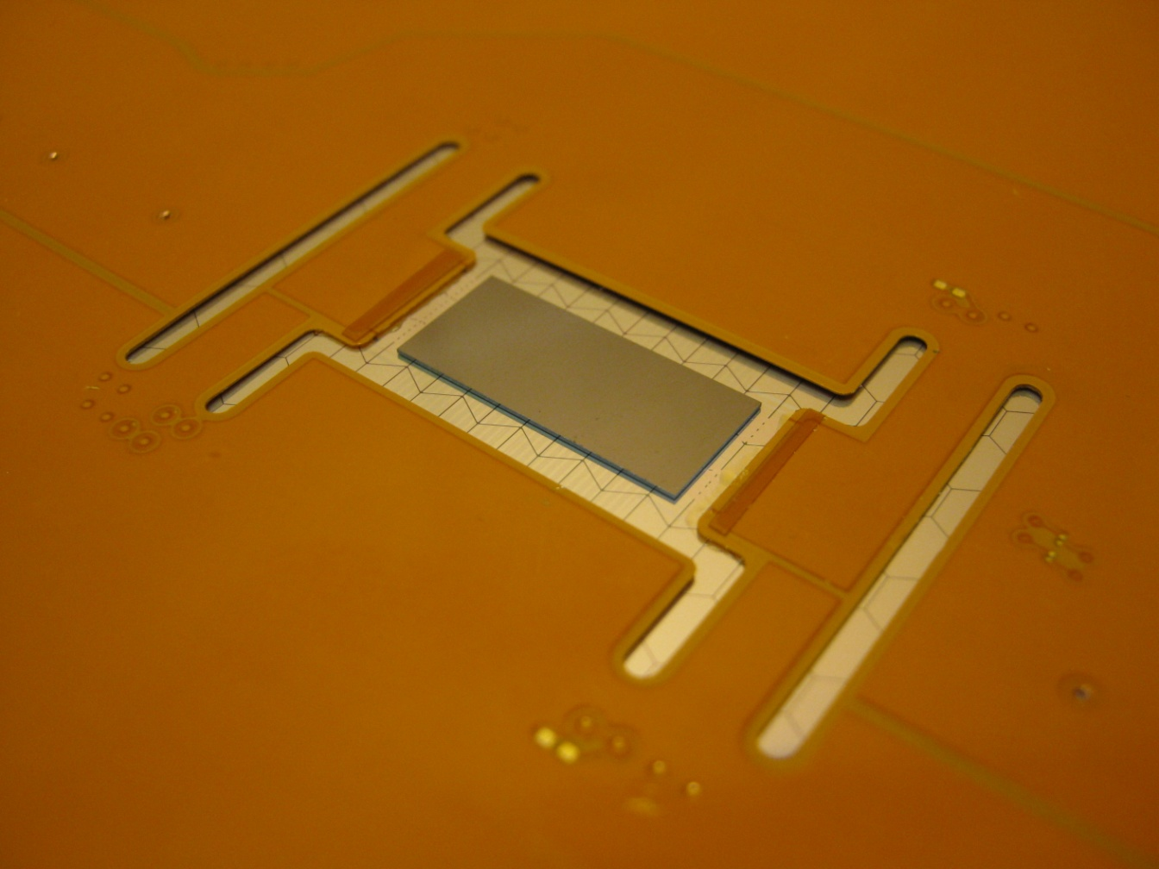
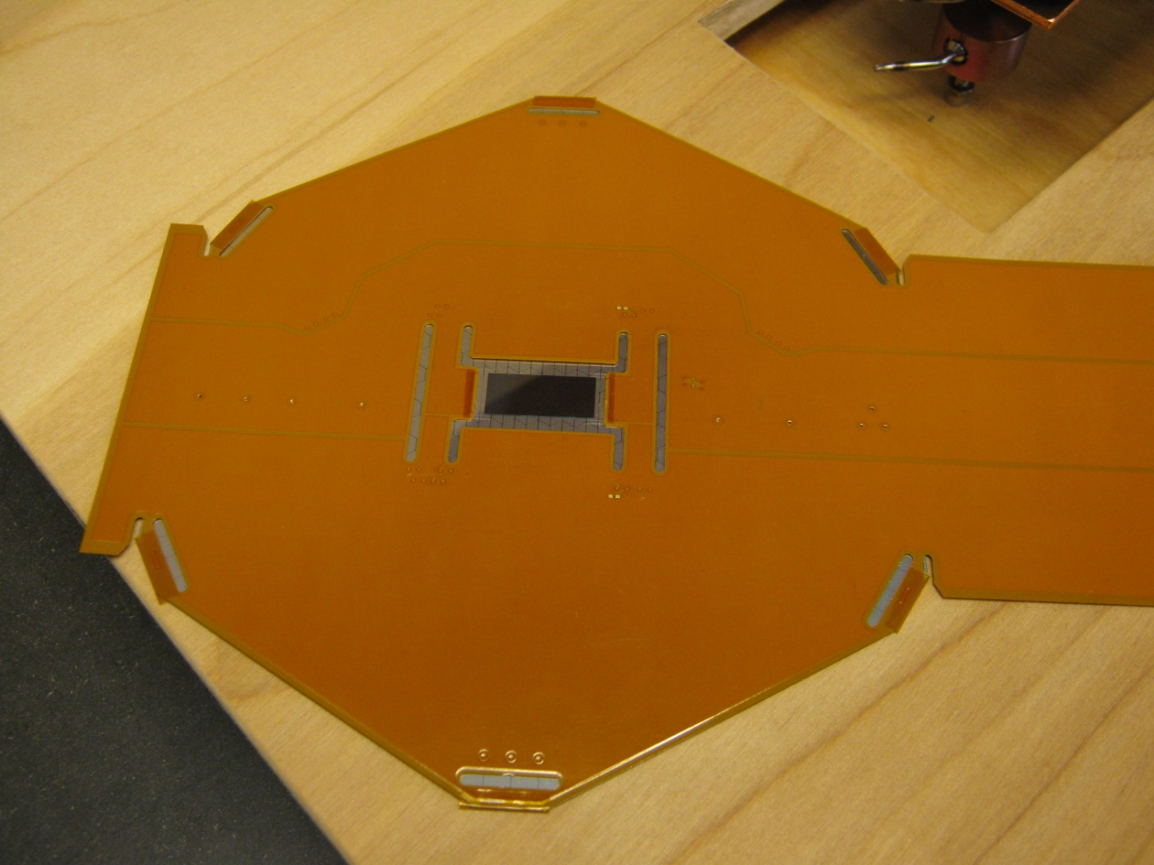
Bonded Sensor
  UCD has bonded a cable to one; it is being tested at SLAC.
  UO is probe testing the other. First results will be shown.
KPiX bump bonded to sensor
Cable bump bonded to sensor
Assembly 1 mm high

Slide 11
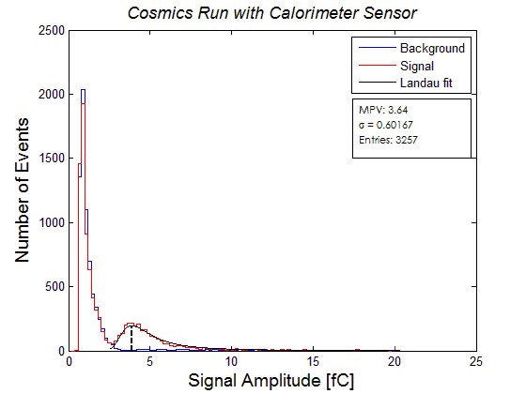
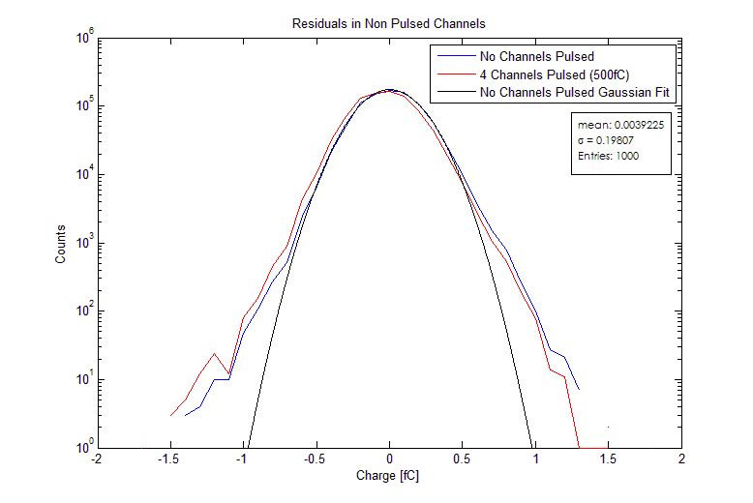
First Performance Studies
Cross talk Study: Red: 4 pixels pulsed at 500 fC,
All other channels shown. Blue: no pixels pulsed.
Cosmic telescope “forced” trigger

Slide 12
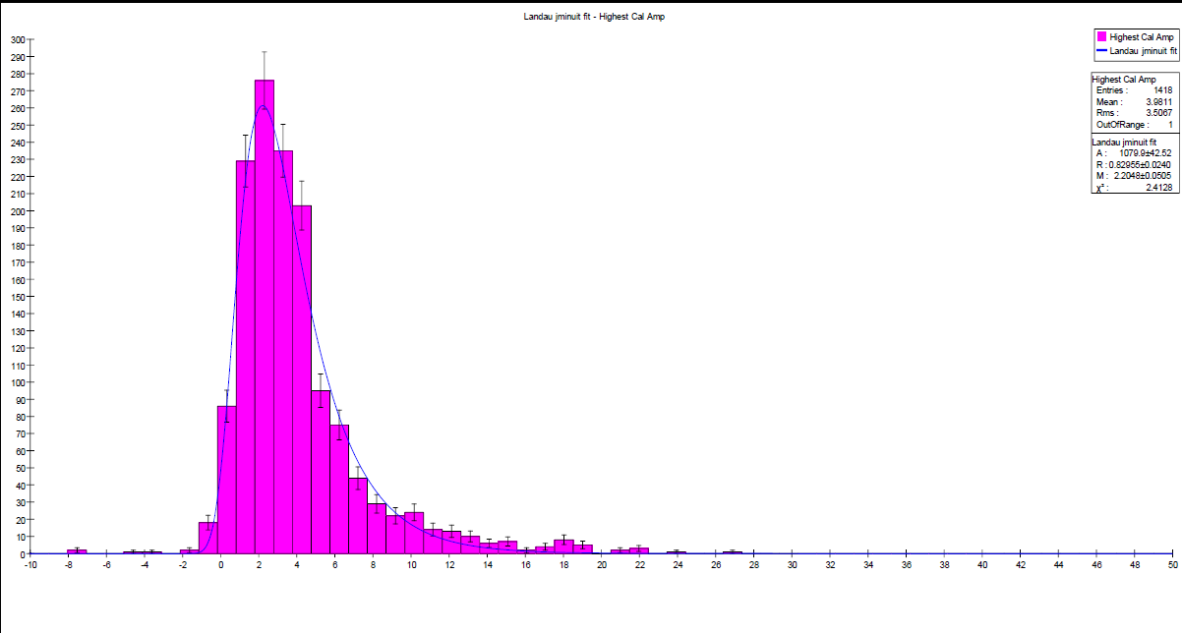
Cosmic Rays. KPiX Self Triggered (pixel by pixel)

Slide 13
Performance Comments
The first version of the electronics reading out KPiX gave excellent “analog” performance – e.g. self triggered multiplicity was ~1, and there were no “everything lights up” events.
This indicates that KPiX and its sensor, cable, and enclosure environment is satisfactory.
IZM is now completing bumping 15 good sensors, and are due this week. If those seem satisfactory, we will complete the rest.

Slide 14
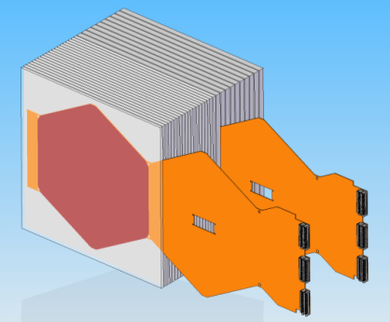
Prototype
Silicon sensors: Meet specs. for SiD Ecal
low leakage current; DC coupled
sufficient number for prototype (30 layers)
KPiX: prototypes meet SiD specs.:
low noise (10% of MIP)
large dynamic range: ~10⁴
full digitization and multiplexed output
passive cooling (power pulsing)
Interconnects:
Flex cable R&D ok so far – successful attachment to dummy sensors and 1 mechanical prototype.
Main focus of recent R&D is the KPIX – sensor interconnects … recently successful – we think…
Prototype module – circa LOI

Slide 15
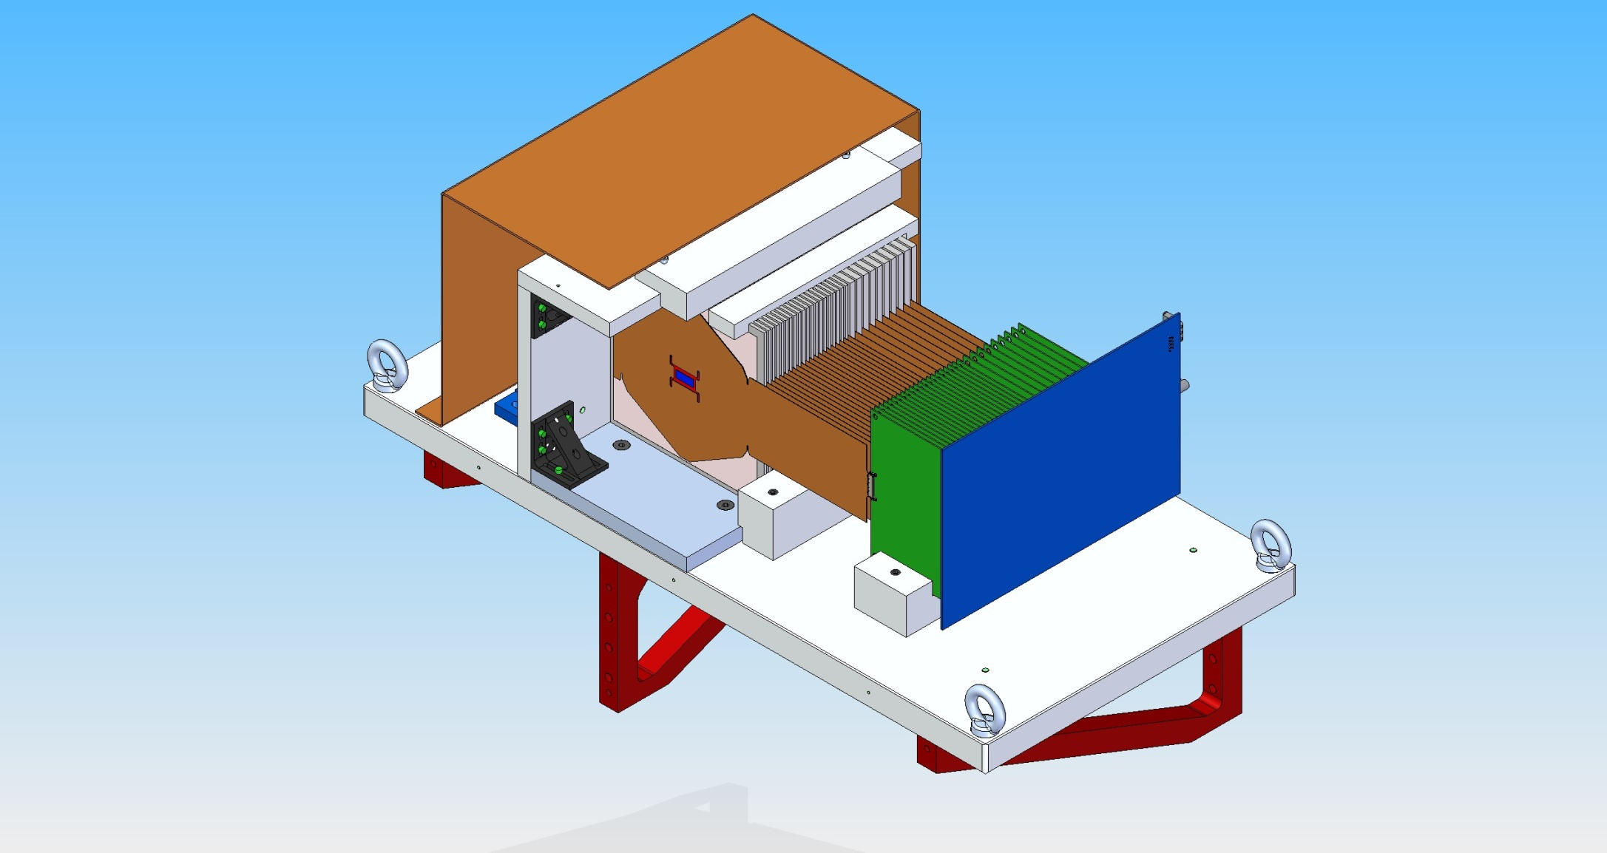

Slide 16
Cable Transition Board
PowerFilter
Cable
Clk Term
Edge
Connector
TrigTerm
Bias Filter
  Clock & trigger LVDS termination
  Power supply filtering
  Bias filtering

Slide 17
Cable Concentrator Board
Clock
Dist.
Control &
Data Fiber
Bias
Conn
Trigger
Dist.
FPGA
Clock &
Trig Fiber
Edge
Connectors (30)
Reset
Dist.
Power
Conn
Optional
Regulators
Optional
Trig. Conn.
Cmd /
Data
Buffers
Pwr Conn
  Clock, trigger & reset distribution
  Per sensor command & data connection
  Concentrator FPGA
  Optical control and data interface
    3.125gbps PGP
  Optical timing / trigger interface

Slide 18
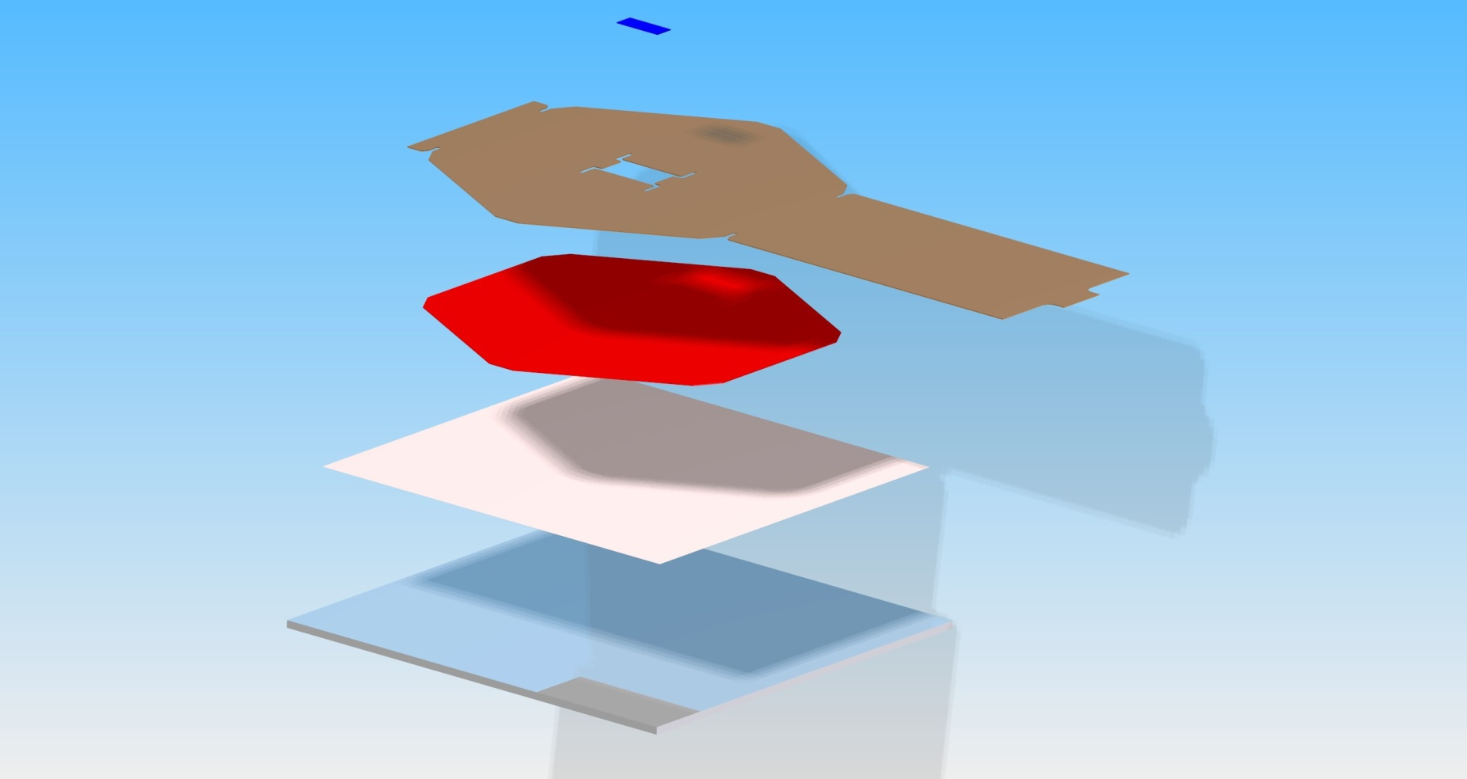
Layer Assembly

Slide 19
Production
All W plates are in hand.
Complete design drawings for mechanics complete; mechanical assembly complete, waiting for sensors.
Sensors and KPiX have been sent to IZM.
IZM has produced 1 batch of 15 for evaluation.
We hope to do a production run on more KPiX 1024 channel chips.
Probe testing available at UO.
UCD will manufacture and attach cables.
Testing of cabled sensors at SLAC.
Assembly and testing of system (pre-testbeam) at SLAC.

Slide 20
Software
A new back end system that will handle 32 KPiX is being built, and data and calibration formats have been set.
Data will be accessible with JAS3, and single KPiX testing is underway.
UO has built a single event display.

Slide 21
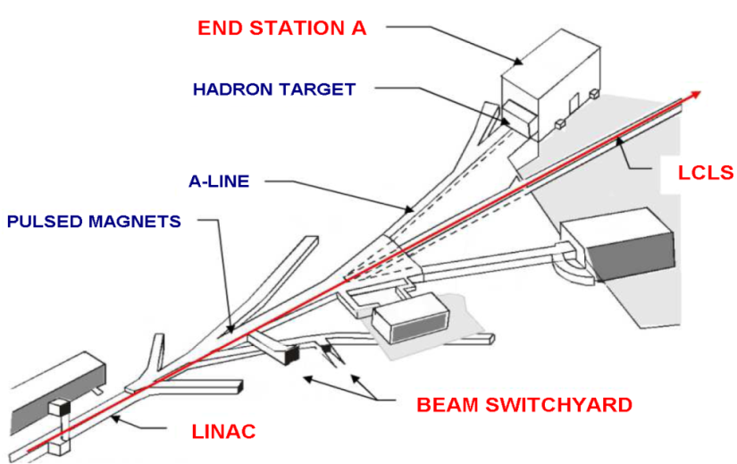
SLAC End Station Test Beam (ESTB) Layout
ESTB will be a unique HEP resource
  World’s only high-energy primary electron beam for large scale Linear Collider MDI and beam instrumentation studies
  Exceptionally clean and well-defined primary and secondary electron beams for detector development
Test EMCal
Pulsed magnets in beam switch yard
to send LCLS beam to ESA

Slide 22
Test Expectations
Expect to take data with a precisely synchronous bunch – what KPiX was designed for.
Expect to take data at a range of energies and with mean e⁺
multiplicity ~1.
Measure energy and spatial resolution.
Characterize KPiX in “synchronous” mode: noise, cross talk, channel uniformity, etc.
Most important – look for problems with the basic approach.

Slide 23
Backup

Slide 24
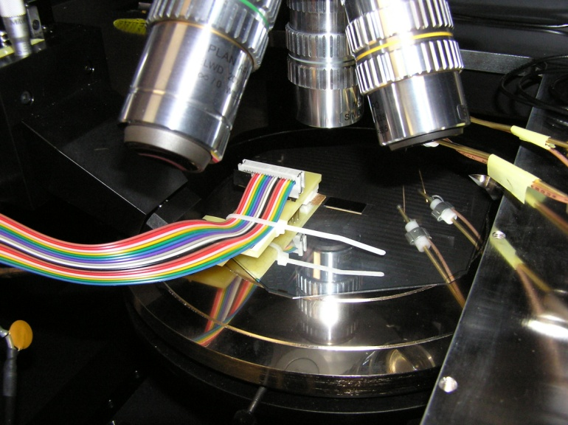
Results…
752 pixels seem ok.
114 pixels appear disconnected – no apparent increase in noise as expected from increased C.
158 pixels do not calibrate properly – leakage?
But this is a mechanical prototype!!!
UO has probed a few other prototype sensors, and sees ~3% opens.
We do not yet have the corresponding good/open/bad pixel numbers for the UO sensor.

Slide 25
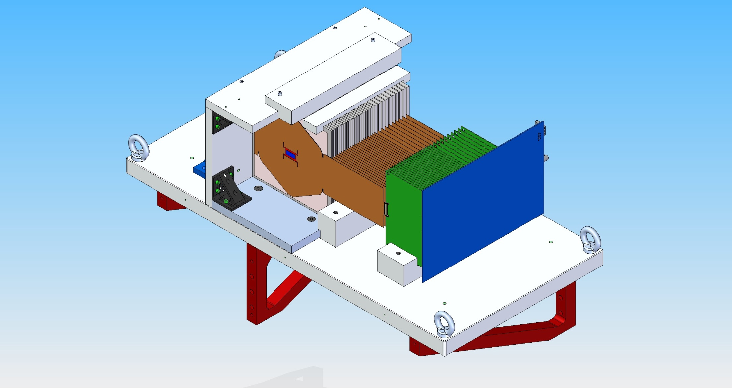
Prototype – Engineering Model

Slide 26
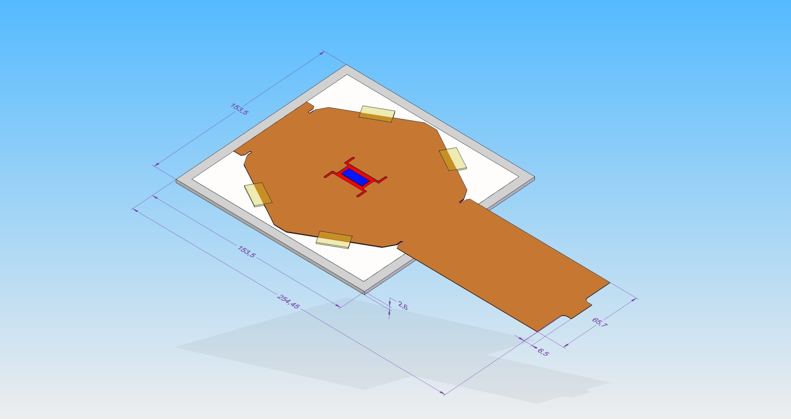
Layer

