Slide 1

Welcome!!

Slide 2
Logistics
Lunches
  12:30pm – 2:00pm everyday
  Monday – Wednesday and Friday: Bluebonnet Ballroom, University Center
  Thursday: Rio Grande Ballroom, UC, 2nd floor
  Please be sure to mark and drop your Friday lunch selection to the registration desk
Coffee breaks
  10:30 – 11:00am and 3:30 – 4:00pm everyday
  Monday and Friday: Rosebud Theater Foyer, UC
  Tuesday – Thursday: Palo Duro Lounge, ground floor

Slide 3
Logistics
Receptions
  Three receptions sponsored by Bailey Tool and Manufacturing
  One yesterday already
  Today, Monday, 7:00 – 9:00pm, in Palo Duro Lounge, Ground floor UC
  Wednesday, 6:00 – 7:30pm, in Rosebud Theater Foyer
    This is in preparation for the public lecture

Slide 4
Group Photo
During the afternoon coffee break at 3:30pm, Wednesday, Oct. 24
Out side UC in the South side of the mall

Slide 5
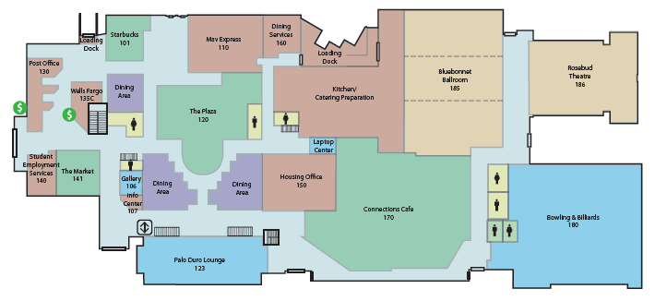
University Center 1st Floor
Coffee Breaks M, F
Plenary session
Lunches
M-W, F
Coffee Breaks Tu-Th

Slide 6
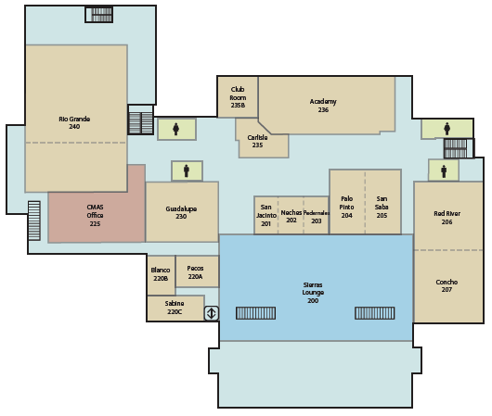
University Center 2nd Floor
Lunches
Th.
Public Computers

Slide 7
Conference Banquet
6:30pm – 9:30pm, Thursday, Oct. 25
Cowboy Stadium
Busses will depart from 5:30pm on East side of UC
  You can also drive yourselves
    Parking at the stadium for banquet is Free!!
  Busses will be assigned to specific hotels to drop off those of you who do not need to pick up the car
  Some busses will return to UTA parking garage for you to pick up your car afterward
Please bring your banquet ticket in your name tag since it will be collected at the entrance

Slide 8
Wireless Internet
Connection instructions are included in your registration packet
  Sorry, I cannot give it out on this slide…
This combination of username and the password can be used to log onto any of the public computers on campus

Slide 9
Public Lecture
7:30 – 9:00pm, Wednesday, Oct. 24
Texas Hall (see the campus map)
Steven Weinberg on “The Standard Model, Higgs Boson: Who Cares?”
Tickets will be distributed Wednesday at the standing registration desk
  You need this ticket for the reserved seats for LCWS12 participants
This lecture will be preceded by a light reception outside the Rosebud Theater

Slide 10
Special Events
UTA Physics Department Planetarium Shows
  1:20 – 1:50pm, Monday
  1:20 – 1:50pm, Tuesday
  Limited number of free tickets are available for you to pick up at the registration desk
Cowboy stadium VIP tour
  6:00 – 7:00pm, Thursday, Oct. 25, just before the banquet
  Available only through 3:30pm TODAY!!
  You need to go to the registration desk and pay $20 for the tour by 3:30pm!
  If we do not make over 20 (we now have 8), this tour will have to be cancelled!
  If we make over 50 people, we might be able to use a bus

Slide 11
Standing Registration Desk and Help
We will have a standing registration desk throughout the conference
  This desk will follow the coffee breaks
  Monday and Friday: Rosebud Theater Foyer
  Tuesday – Thursday: Palo Duro Lounge
Volunteers
  Many of our students volunteered to help
  They all wear a conference volunteer T-shirt

Slide 12
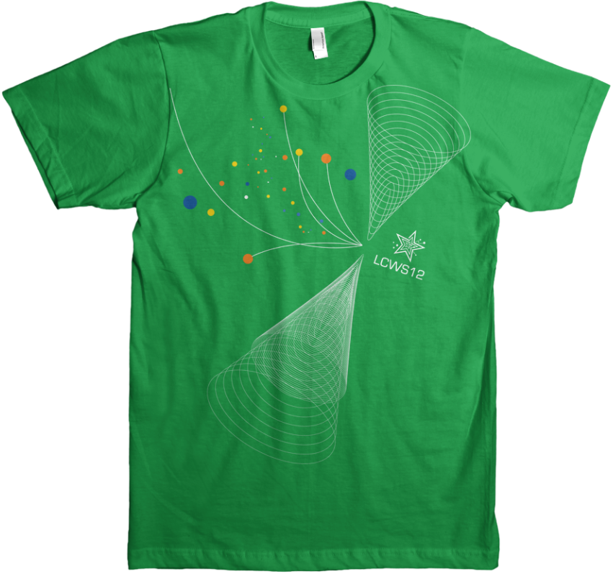

Slide 13
Standing Registration Desk and Help
We will have a standing registration desk throughout the conference
  This desk will follow the coffee breaks
  Monday and Friday: Rosebud Theater Foyer
  Tuesday – Thursday: Palo Duro Lounge
Volunteers
  Many of our students volunteered to help
  They all wear a conference volunteer T-shirt
  They will help you and the conveners
Any additional problems, please direct them to Alexia, Jae and Andy

Slide 14
Welcome again to LCWS12!!
Enjoy the conference!!
(and the nice weather we’ve specially ordered for you!!)

