Slide 1
Status of the CLIC main beam injectors
Overview of the CLIC main beam injectors complex as documented in the CDR

Slide 2
Layout
Pre-injector
e⁺ Linac
Primary 5 GeV e⁻ Linac
Injector Linac
gun
PDR
target
2.86 GeV
Booster Linac
2 GHz
e⁺ DR
BC1
0.2 GeV
Spin rotatator
DC gun
DL’s
Pre-injector
e⁻ Linac
e⁻ DR
9 GeV
PDR
Two hybrid positron sources (only one needed for 3 TeV)
Common injector linac
All linac at 2 GHz , bunch spacing 1 GHz before the damping rings

Slide 3
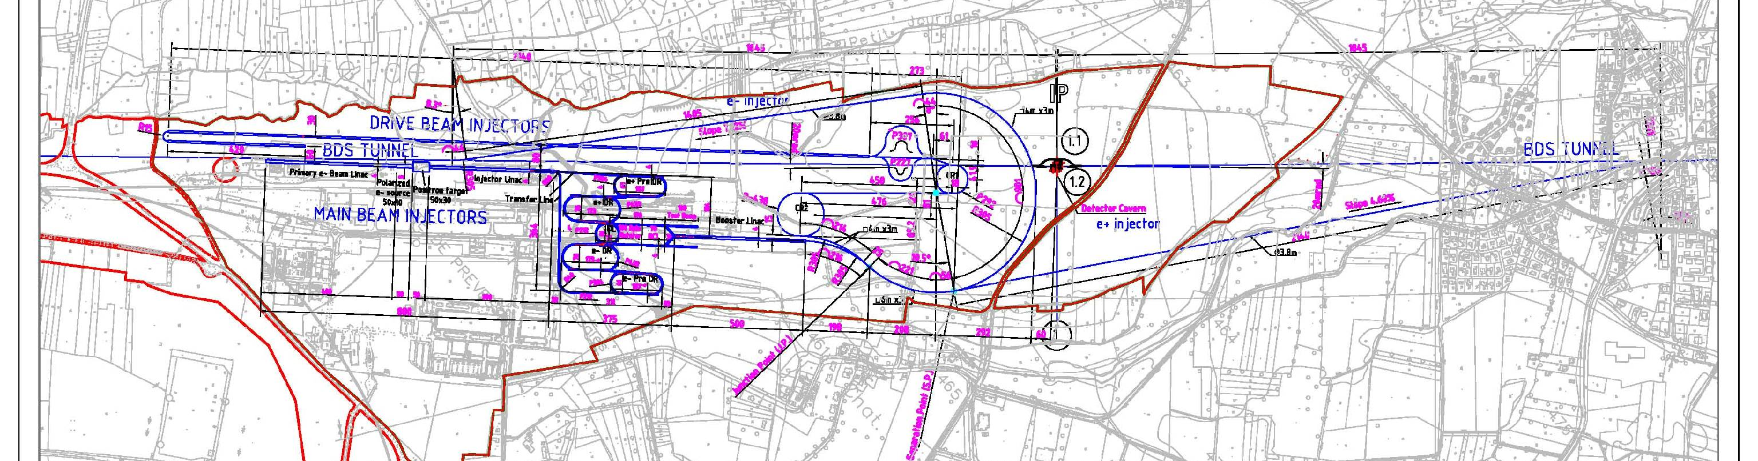
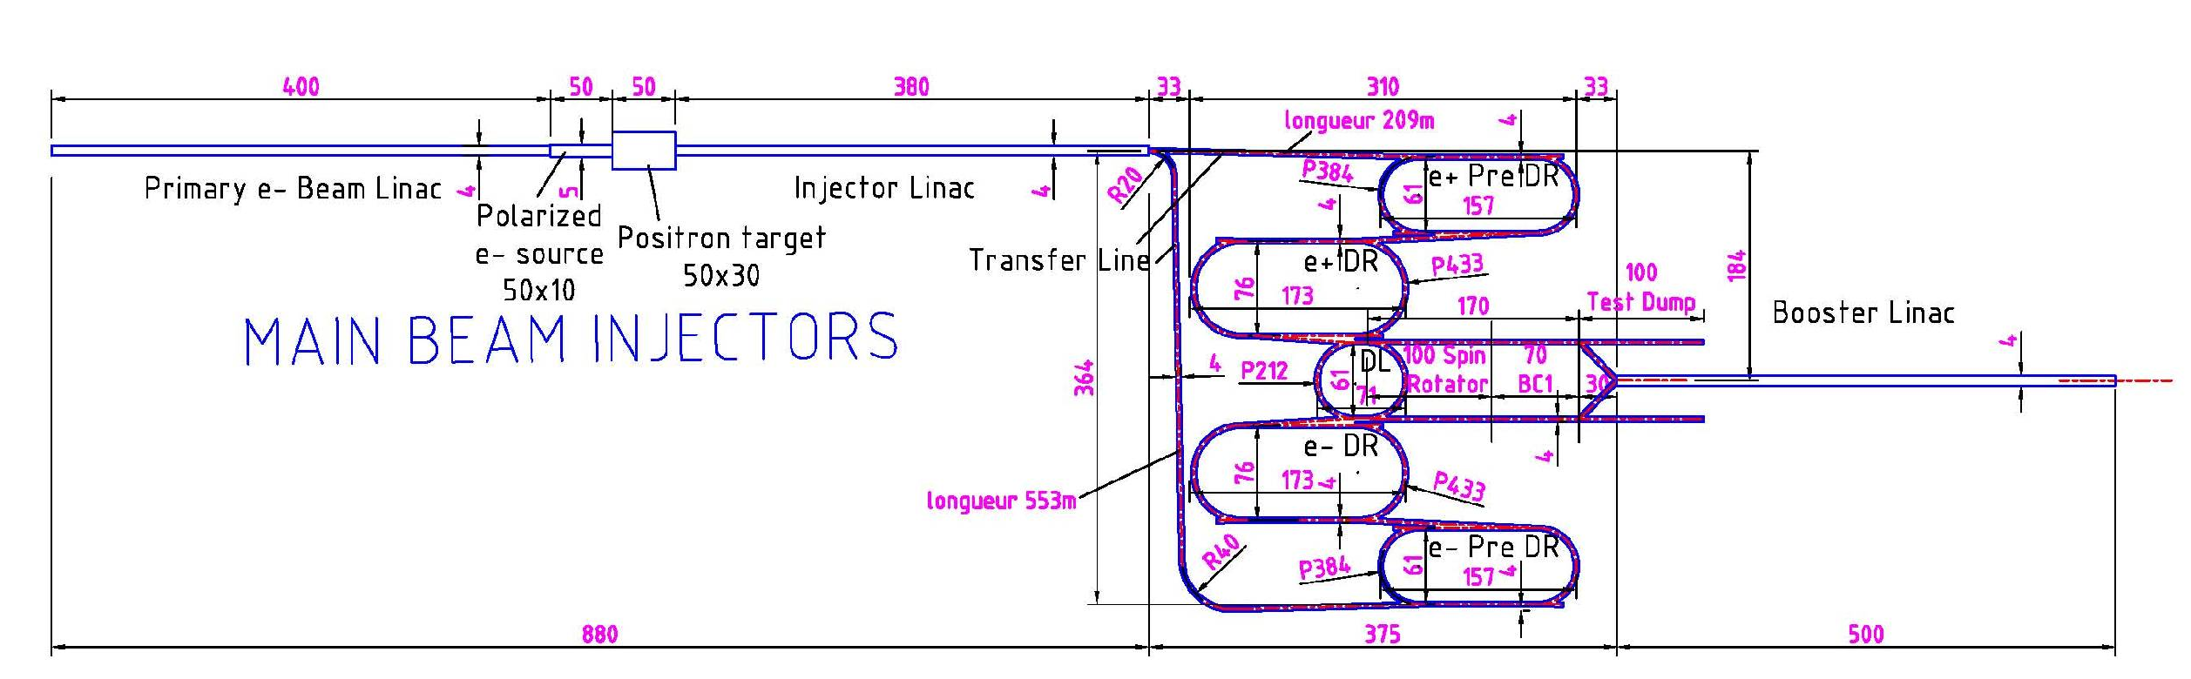
CLIC Main Beam complex
e⁻ transfer line
e⁻ and e⁺ sources
e⁻ and e⁺ Damping Rings
e⁺ transfer line
Zoom

Slide 4
Beam timing and operational modes
Before damping ring
(1 GHz bunch spacing)
After damping ring
(2 GHz bunch spacing)
156-556 ns
156-556 ns
156-556 ns
156-556 ns
156-556 ns
156-556 ns
e⁺
e⁺
e⁻
e⁻
e⁺
e⁻
717 ns
717 ns
1100 ns
2314 ns
Operational mode | Charge per bunch (nC) | Number of bunches
Nominal | 0.6 | 312
500 GeV | 1.2 | 312
Low energy scans | 0.6, 0.45, 0.4, 0.3, 0.23 | 312, 472, 552, 792, 1112

Slide 5
Beam parameters
Parameter | Unit | CLIC polarized electrons | CLIC positrons | CLIC booster
E | GeV | 2.86 | 2.86 | 9
N | 10⁹ | 4.3 | 4.3 | 3.75
n_{b} | - | 312 | 312 | 312
Δt_{b} | ns | 1 | 1 | 0.5
t_{pulse} | ns | 312 | 312 | 156
ε_{x,y} | μm | < 100 | 7071, 7577 | 600,10 ∙10⁻³
σ_{z} | mm | < 4 | 3.3 | 44 ∙10⁻³
σ_{E} | % | < 1 | 1.63 | 1.7
Charge stability shot-to-shot | % | 0.1 | 0.1 | 0.1
Charge stability flatness on flat top | % | 0.1 | 0.1 | 0.1
f_{rep} | Hz | 50 | 50 | 50
P | kW | 29 | 29 | 85

Slide 6
Polarized electron source
Classical polarized source wit bunching system
Charge production demonstrated by SLAC experiment
Simulations showed 87 % capture efficiency (F. Zou, SLAC)
DC-gun, 140 kV
GaAs cathode
1 GHz buncher
2 GHz buncher + accelerator
Polarized laser

Slide 7
Polarized electron source parameters
 |  | POLARIZED SOURCE FOR CLIC
 | Electrons | CLIC 1 GHz | CLIC DC/ SLAC Demo
Number of electrons per bunch (*10^9) |  | 3.72 | 1365
Charge/single bunch (nC) |  | 0.96 | NA
Charge/macrobunch (nC) |  | 300 | 300
Bunch spacing(ns) |  | 1 | DC
RF frequeny (GHz) |  | 1 | DC
Bunch length at cathode (ps) |  | 100 | DC
Number of bunches |  | 312 | NA
Repetition rate (Hz) |  | 50 | 50
QE(%) |  | 0.3 | 0.3
Polarization |  | >80% | >80%
Circular polarization |  | >99% | >99%
Laser wavelength (nm) | Laser | 780-880 | 865
Energy/micropulse on cathode (nJ) |  | 509 | NA
Energy/macropulse on cathode (μJ) |  | 159 | 190
Energy/micropulse laser room (nJ) |  | 1526 | NA
Energy/macrop. Laser room (μJ) |  | 476 | 633
Mean power per pulse (kW) |  | 1.5 | 2
Average power at cathode wavelength(mW) |  | 8 | 9.5
Laser scheme
For the 1 GHz approach cathode current densities of 3-6 A/cm² would be needed,
the dc approach uses < 1 A/cm²

Slide 8
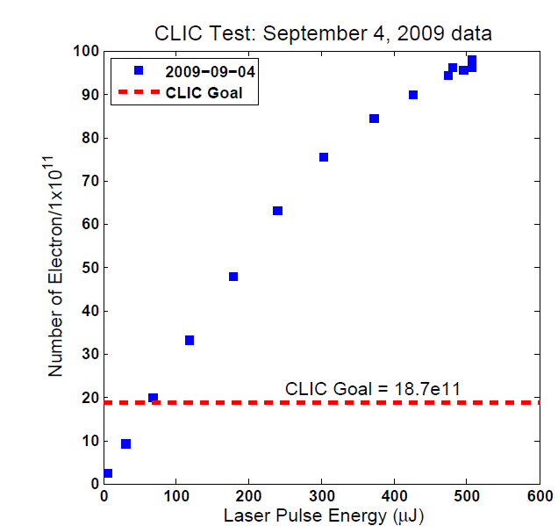
Polarized electron source
CLIC Goal 0.5 TeV: 35e11
J. Shepard

Slide 9
Positron source conventional ?
Hybrid target
Primary beam
Linac for e⁻
AMD
200 MeV
Primary beam
Linac for e⁻
Bunch compressor
Gun
5 GeV
RF-deflector
2 GHz
Hybrid target
Primary beam
Linac for e⁻
AMD
200 MeV
AMD: 200 mm long, 20 mm radius, 6T field

Slide 10
Hybrid target
Target Parameters Crystal
Material | Tungsten | W
Thickness (radiation length) | 0.4 | χ₀
Thickness (length) | 1.40 | mm
Energy deposited | ~1 | kW
Target Parameters Amorphous
Material | Tungsten | W
Thickness (Radiation length) | 3 | χ₀
Thickness (length) | 10 | mm
PEDD | 30 | J/g
Distance to the crystal | 2 | m

Slide 11
Primary electron beam and linac
Parameters
Energy | 5 | GeV
Number of e⁻ / bunch | 1.1x10¹⁰
Charge / bunch | 1.8 | nC
Bunches per pulse | 312
Pulse repetition rate | 50 | Hz
Beam radius (rms) | 2.5 | mm
Bunch length (rms) | 1 | ps
Beam power | 140 | kW
Can be done with thermionic gun or photo injector (CTF3 and Phin are nice references)
2 GHz rf system as used for other injector linac’s

Slide 12
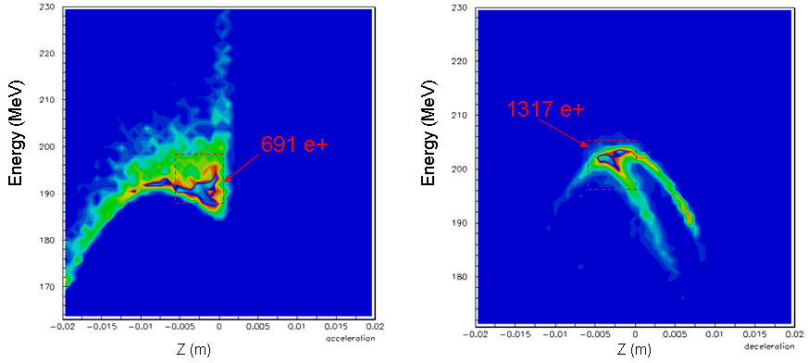
Yield simulations capture and pre-injector linac
Energy density at 200 MeV
Accelerating mode
decelerating mode
Positron yield: after target: ~8 e⁺/e⁻
at 200 MeV: 0.9 e⁺/e⁻
into PDR: 0.39 e⁺/e⁻
O. Dadoun

Slide 13
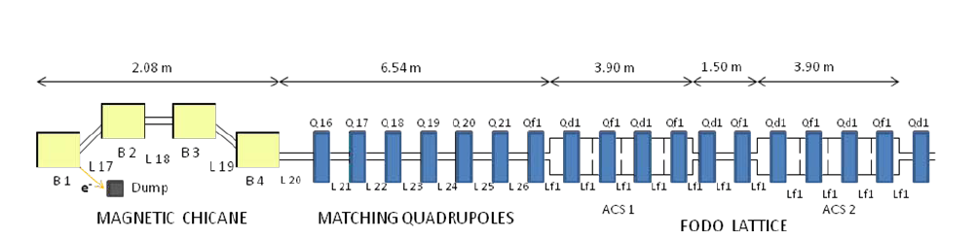
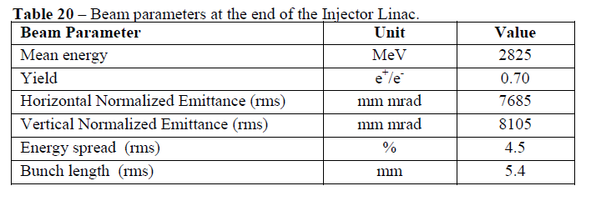
Common injector linac

Slide 14
Injector linac rf system
Kly 1
Structure Parameter | Value
Frequency | 1998 MHz
Structure length (30 cells) | 1.5 m
Filling time | 389 ns
Cell length and iris thickness | 50 mm, 8 mm
Shunt impedance | 54.3 – 43.3 MΩ/m
Aperture a | 20 – 14 mm
Cell size b | 64.3 – 62.9
Group velocity vg/c | 2.54 -0.7 %
Phase advance per cell | 2π/3
50 MW, 8 μs
Mod
Pulse compressor
250 MW, 1.5 μs
Kly 2
BPM
Quad
Acc 1
Acc 2
Acc 3
Acc 4

Slide 15
Linac structure beam loading and power flow
Parameters:
tapered
f= 1998 MHz
L= 1.5 m
Pin= 53.4 MW
Nb= 312
N = 4.0 e9
Eacc = 16 MV/m
Eff = 16.5%
Almost full loading for 500 GeV parameters,
will need amplitude modulation for beam loading compensation

Slide 16
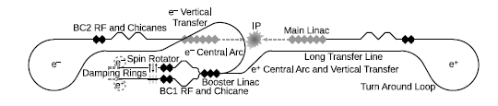
Bunch compressors
Two stages of bunch compressors, CSR, wake fields and tolerances have been studied
 | BC1, 2.86 GeV | BC2, 9 GeV
Rf frequency | 2 GHz, 15 MV/m | 12 GHz, 74 MV/m
Phase tolerance | 0.1 deg | 0.1 deg
Bunch length after compression | 300 μm factor 5.3 | 44 μm factor 6.8
Enegy spread after compression | 0.25 % | 1.7 %
Voltage | 447 MV | 1776 MV

Slide 17
Linac Parameters
Pre-injector
e⁺ Linac
Primary 5 GeV e⁻ Linac
Injector Linac
gun
PDR
target
2.86 GeV
Booster Linac
2 GHz
e⁺ DR
BC1
0.2 GeV
Spin rotatator
DC gun
DL’s
Pre-injector
e⁻ Linac
e⁻ DR
9 GeV
PDR

Slide 18
CDR, what’s next ?
Start work on low energy machine
Cost optimization, Pre-damping ring, positron driver linac
Follow up some issues from the CDR within the CLIC work package structure
More focus on polarized positron studies in the future,
revisit undulator scheme, study polarization transport

Slide 19


Potential for cost reduction
Cut pre-damping ring for electrons:
Which transverse and longitudinal emittance is needed from 200 MeV linac ?
Emittance possible: 25 - 50 μm, do we need more energy ?
Reduce beam power of positron drive linac:
Lower beam current and use multiple injection into PDR, timing ?
Lower beam energy (less yield) and use multiple injection
Saving potential ?
Use booster linac as well as positron drive linac:
Save entire linac +tunnel (>160 MCHF), need more rf power in booster linac,
Put injector linac in same tunnel as booster (see layout)

Slide 20
Alternative layout
Without positron driver linac
156ns
156ns
e⁻
e⁻
e⁺
Positron production pulse
3300 ns
Pre-injector
e⁻ Linac
2.86 GeV
0.2 GeV
PDR
Injector Linac
DC gun
e⁺ DR
BC1
target
DL’s
e⁻ DR
gun
Booster Linac
2 GHz
6 GeV
PDR

Slide 21
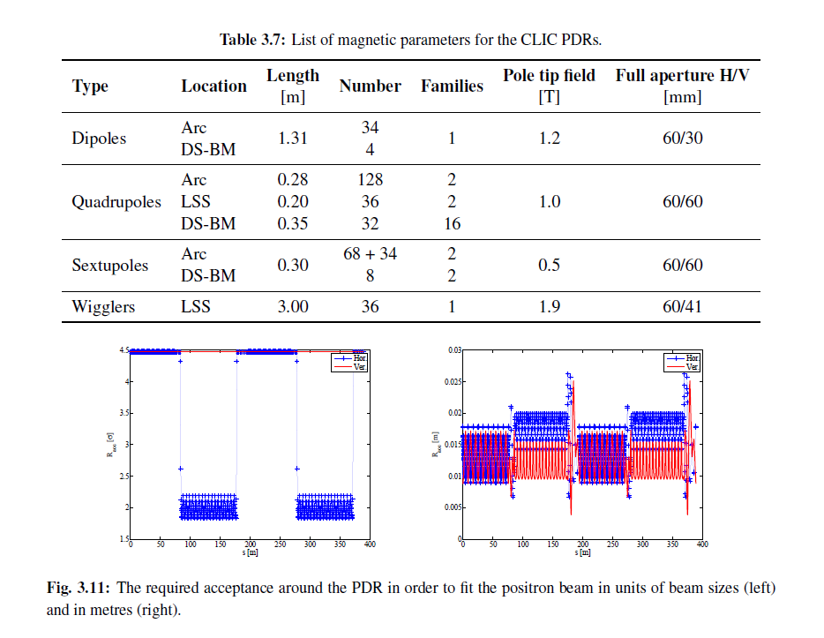
Pre-Damping ring acceptance

Slide 22
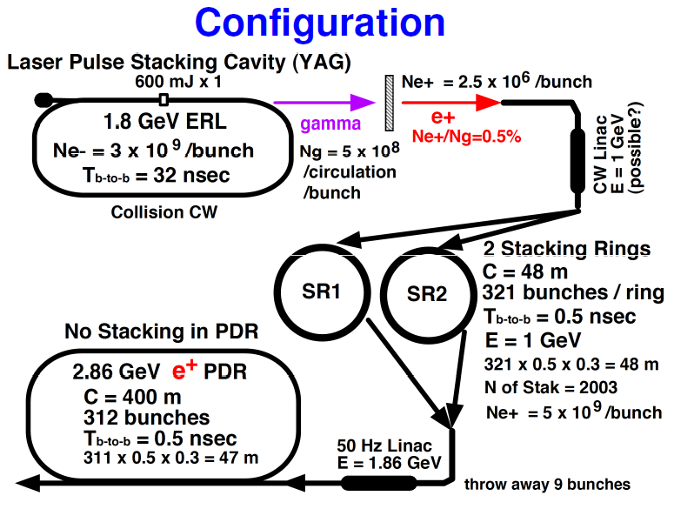
Omori’s ERL scheme for CLIC

Slide 23
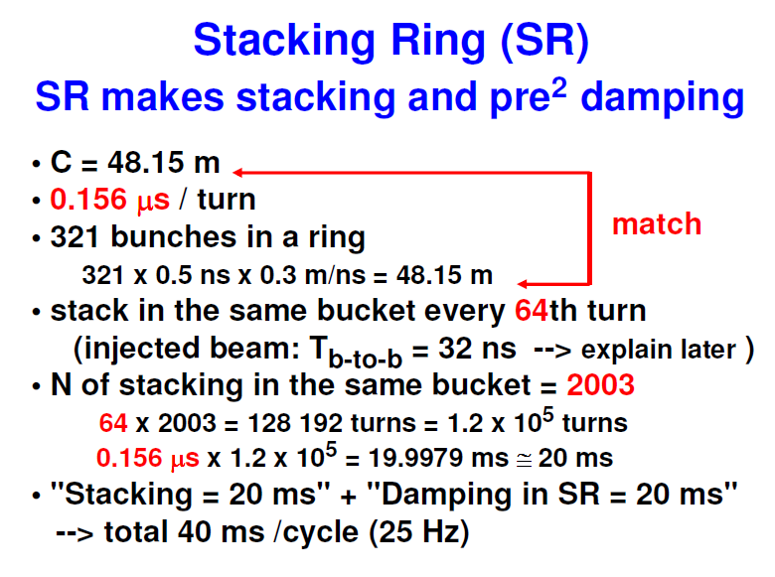
Omori’s ERL scheme for CLIC

Slide 24
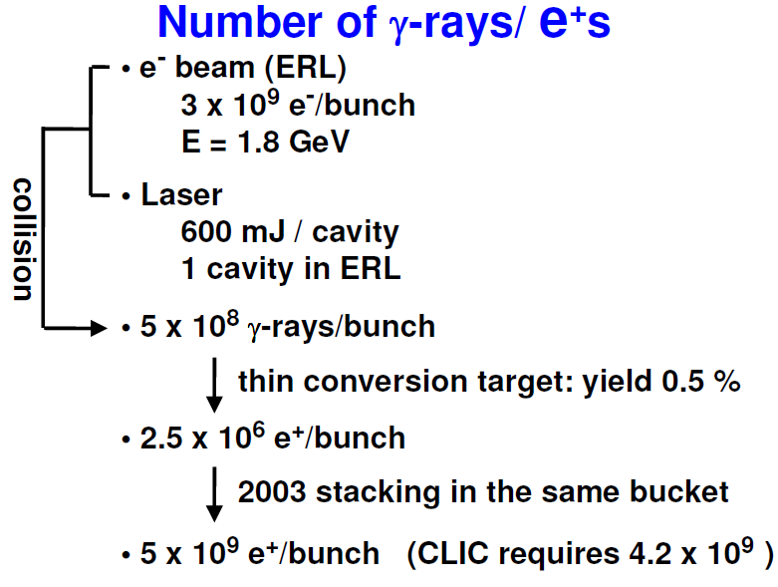
Omori’s ERL scheme for CLIC

Slide 25
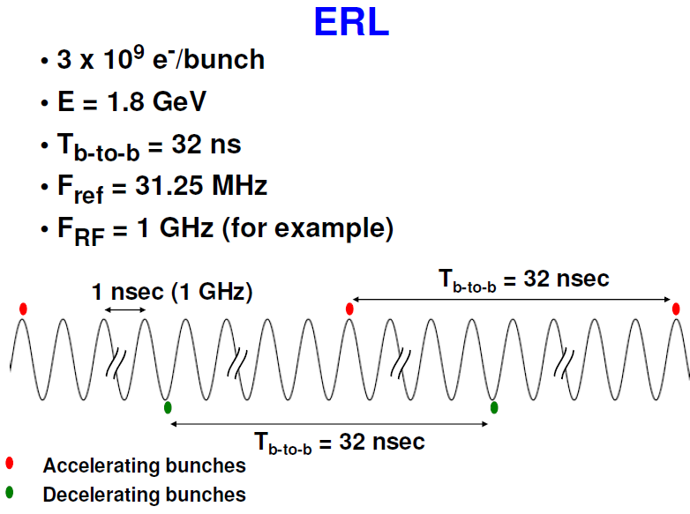
Omori’s ERL scheme for CLIC

Slide 26
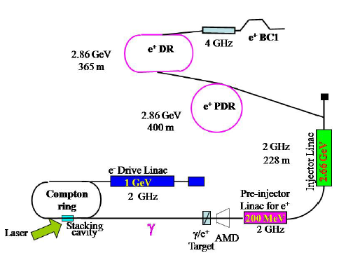
Compton-ring for CLIC

Slide 27
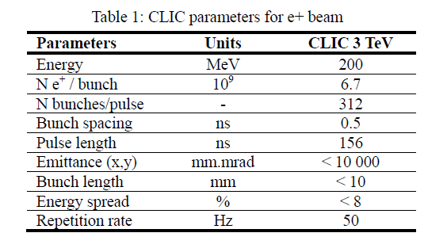
Compton-ring for CLIC

Slide 28
Compton-ring for CLIC
Compton Ring Parameters:
E=1 GeV, 2 GHz, 312 bunches, 6.2 10¹⁰ e⁻/bunch,
156 ns Circumference
60% polarization
Laser Energy 590 mJ
Yield: 2.1 10⁹ photons/turn/bunch
10⁷ e⁺.turn/bunch
440 turn stacking in Pre-damping ring to get 4.2 10 ⁹ positrons
Compton Linac option:
10 laser IP’s, 4 GeV linac with 5 nC/bunch,
(could we use the drive beam linac)
How realistic are 10 laser IP’s ?

Slide 29
CLIC Compton schemes for polarized positron production
Not much done since 2010, ring scheme by Eugene et al., ERL scheme by Omori-san, Linac scheme studied as well
Stacking needed either in PDR or dedicated rings
Compton-ring was considered most promising
Difficult to judge how realistic the schemes are
Any comments ?
How about direct conversion from polarized electrons as done by JLAB ? Any feelings ?
Conversion yield ~10⁻³, 1000 x times stacking ?
What would be optimized parameters

Slide 30
Conclusions
Big effort to get the conceptual design of the CLIC main beam injectors, rather conceptual in many places but main problems studied and identified
General believe that the injectors are feasible and relatively conservative approaches are used
Obviously more work remains to be done

Slide 31
Collaborations
Polarized electron source: SLAC, TJNAF
Positron source: KEK, LAL
Polarized positrons: KEK, LAL, ANL, CI, KIPT, Ankara University

Slide 32
Linac Parameters and cost
LINAC | Energy Gain (MeV) | Bunch charge (10^9) | rf pulse length (ns) | Power per structure (MW) | Loaded gradient (MV/m) | Configuration (structure/2 klystrons) | No of rf modules | pulse compressor gain | No of structures | Length (m) | Energy gain per module (MeV) | Cost
e- pre-injector | 200 | 4.3 | 1300-1700 | 54 | 18 | 4 | 2 | 2.3-2.5 | 8.0 | 30 | 108 | 5830
e+ pre-injector | 200 | 11 | 1300-1700 | 56 | 15 | 4 | 3 | 2.3-2.5 | 9.0 | 40 | 90 | 8745
injector linac | 2660 | 6 | 3600-4000 | 44 | 15 | 2 | 60 | 1 | 119.0 | 300 | 45 | 127950
positron drive linac | 5000 | 11 | 1300-1700 | 56 | 15 | 4 | 56 | 2.3-2.5 | 223.0 | 400 | 90 | 163240
booster linac | 6140 | 4 | 1700-2000 | 53 | 16 | 4 | 64 | 2-2.3 | 256.0 | 473 | 96 | 186560
Pre-injector
e⁺ Linac
Primary 5 GeV e⁻ Linac
Injector Linac
gun
PDR
target
2.86 GeV
e⁺ DR
Booster Linac
2 GHz
0.2 GeV
BC1
Spin rotatator
DL’s
DC gun
Pre-injector
e⁻ Linac
9 GeV
e⁻ DR
PDR

Slide 33
Linac structure beam loading and power flow
Parameters:
tapered
f= 1998 MHz
L= 3 m
Pin= 77 MW
Nb= 624
N = 4.0 e9
Eacc = 15 MV/m

