Slide 1



Silicon-Tungsten EM calorimeter
Rémi Cornat
Laboratoire Leprince-Ringuet
Ecole Polytechnique – IN2P3/CNRS
On behalf of the SiW-ECAL ILD project*
within CALICE coll.

Slide 2
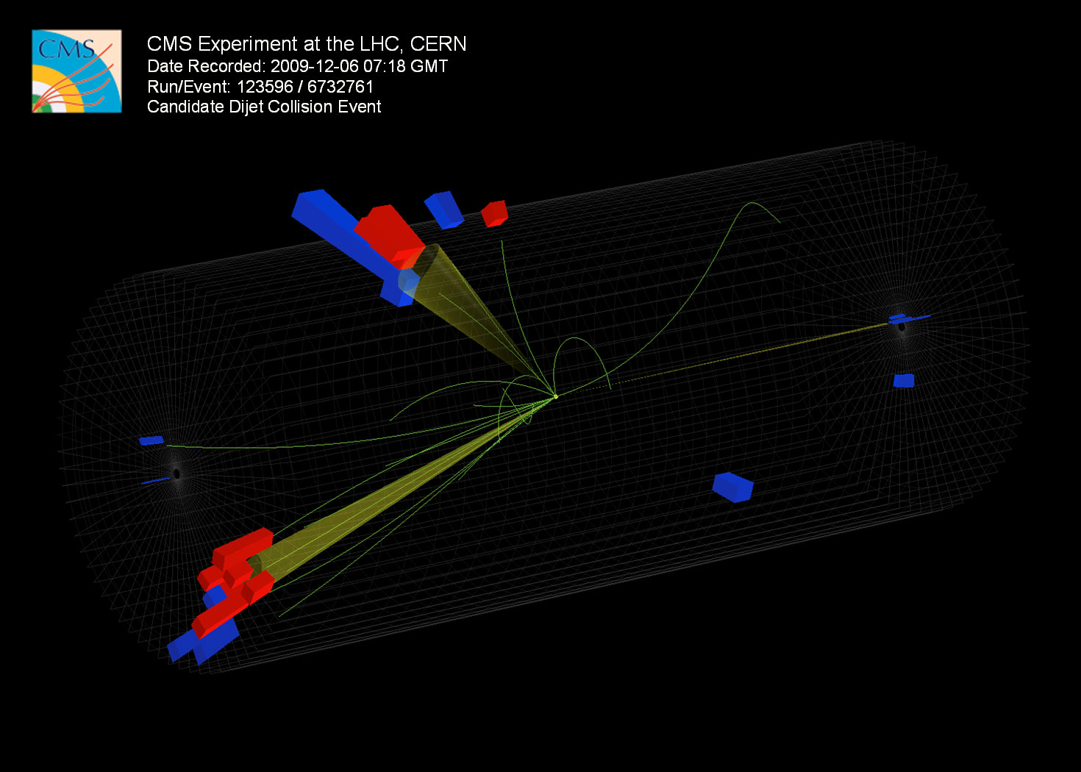
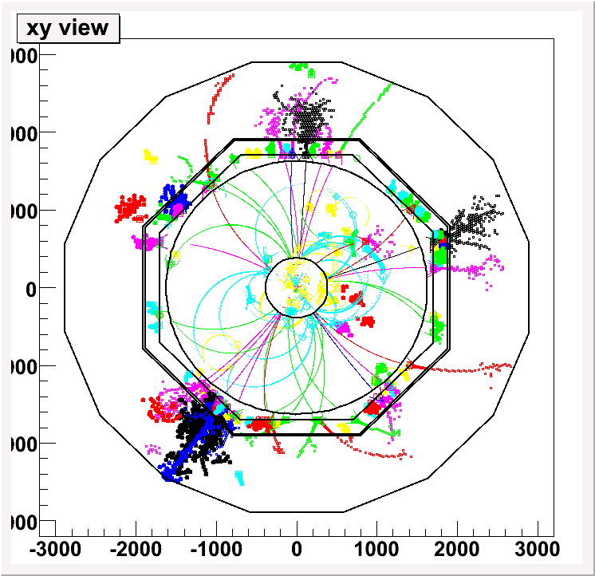
From this...
to this :
HCAL
ECAL
A mix of technologies validated with prototypes

Slide 3
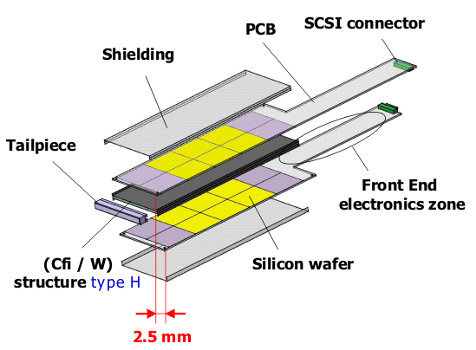
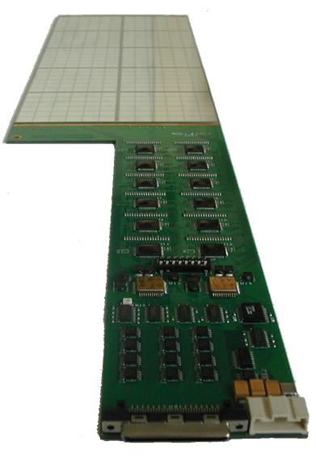
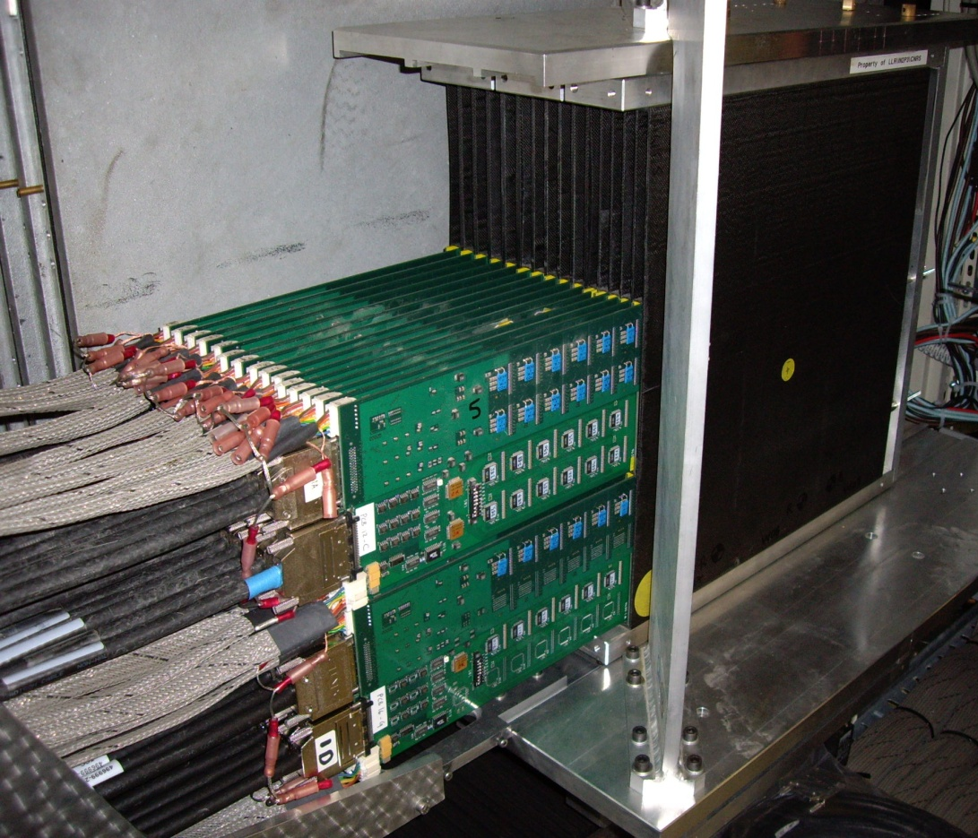
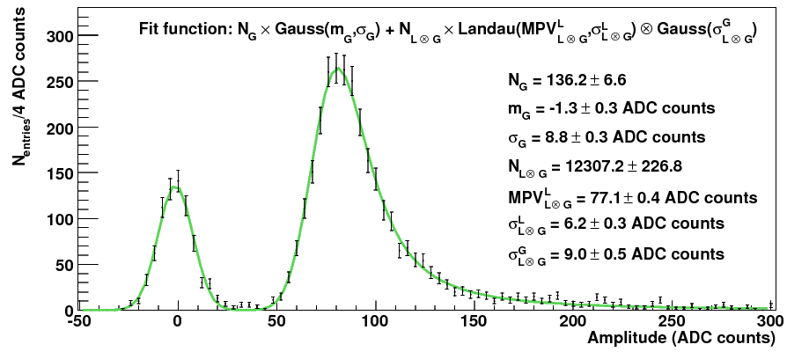
First prototype (2006) : validation of physics perf.
First generation prototype
and tested on beam 2006-2008
30 layers - ~10000 channels
Mechanical structure: carbon fibre
composite, incorporating tungsten layers
Standard printed circuit slabs hold
silicon sensors & electronics
(outside detection area)
S/N ~ 7.5

Slide 4
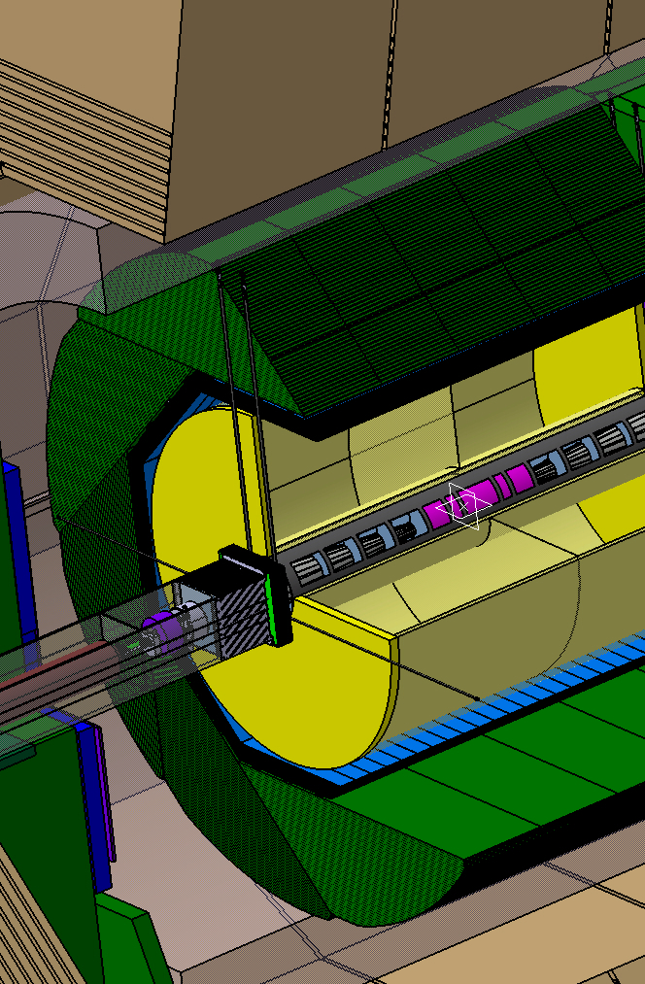
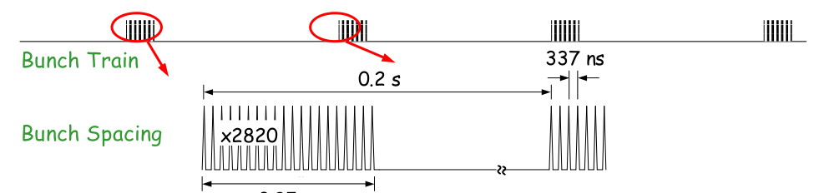
Calorimeters for ILC
ECAL :
~24 X0, 20 cm thick
~2500 m² active detectors
~100M readout channels
Reduce dead material,
calorimeters inside coil,
Extreme compactness
Work with specific beam structure
ILC: 5Hz trains each of 3k bunches @ 340 ns
low occupancy, low noise : S/N >10

Slide 5
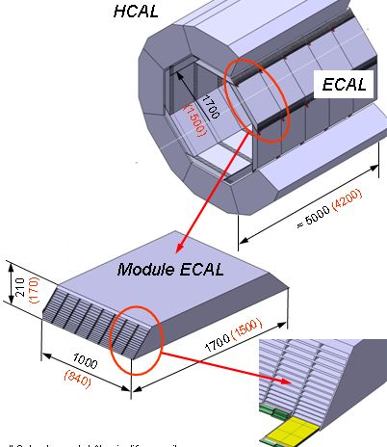
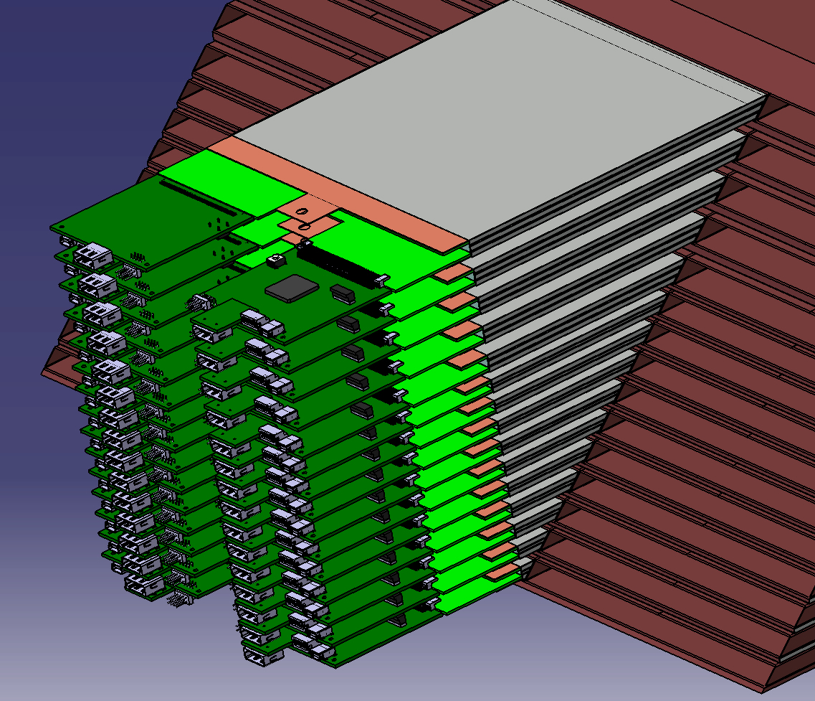
  Technological prototype (2011) : Proof of feasibility
→ embedded “system on chip” electronics,
→ extremely low power consumption typ. 25 µW/ch,
→ wide sensors (81 cm², pure silicon),
→ large composite mechanical structure,
→ readout technology insensitive to ~4T field,
→ integrated DAQ system
Goal : 1 instrumented tower
  (40k channels, 20 cm² crossection)

Slide 6
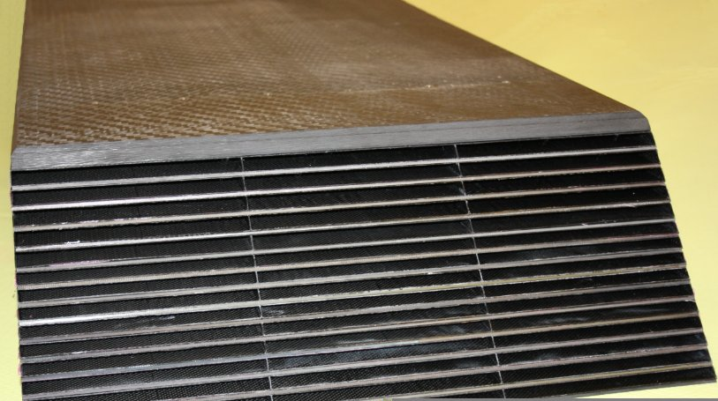
Large mechanical structure done
Each layer build separately then “coked” together.
Deeply simulated : mechanical constraints, thermal behavior
Next step : wider assembly with 5 columns
Tungsten plates wrapped into carbon fibre: 15 layers
7 mm tick detector slab slided into alveola

Slide 7
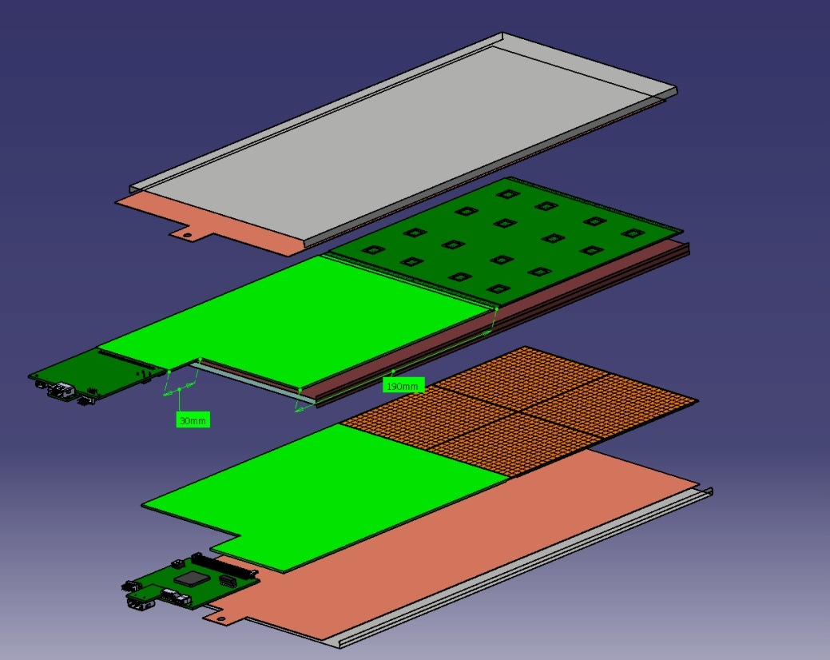
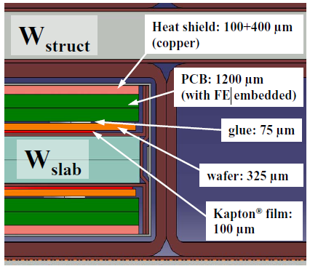
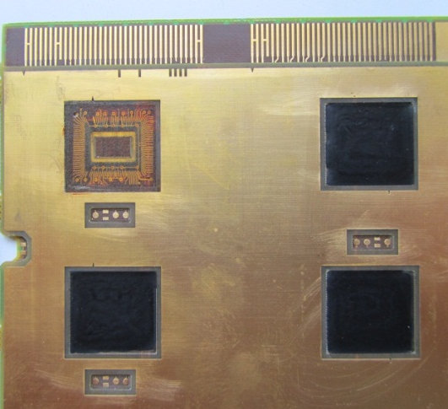
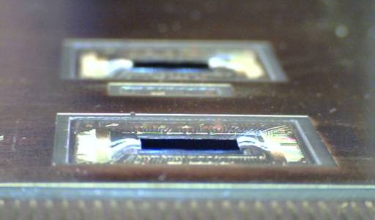
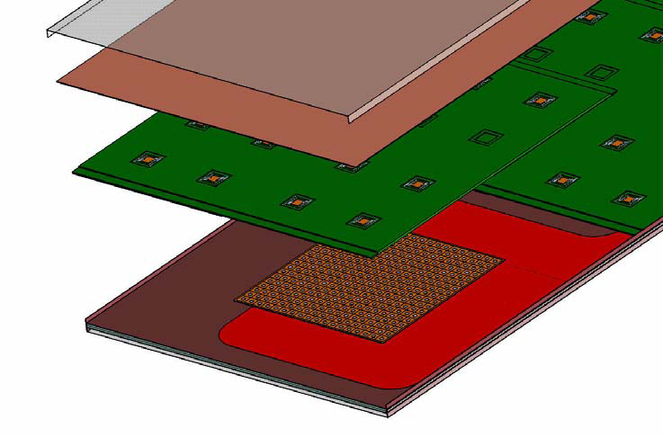
Detector slab : “extreme” design
Compact assembly of 2 layers of 1 to 8 Active Sensor Units (ASU)
1 ASU = 1 kapton (HV bias for PIN diodes)
+ 1 layer PIN diodes
+ 1 PCB with microchips embeded
+ 1 thermal drain (copper)
PCB is critical : 1 mm tick, 8 layers, 1% flatness , chips bounded into
Short version
Heat shield
PCB
wafer
glue
Kapton film

Slide 8
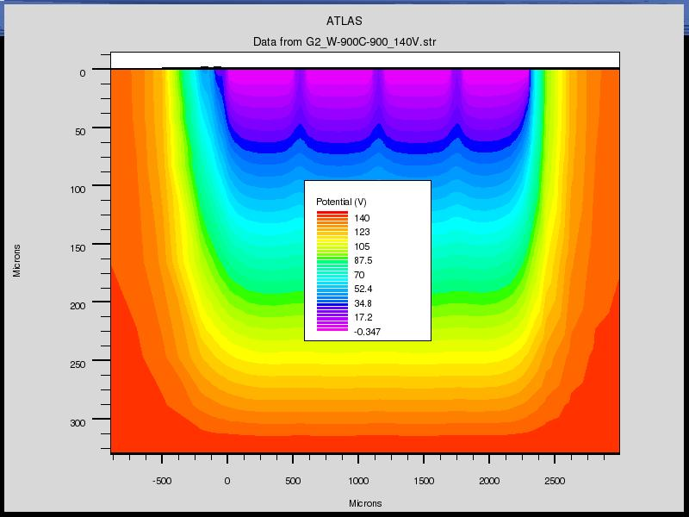
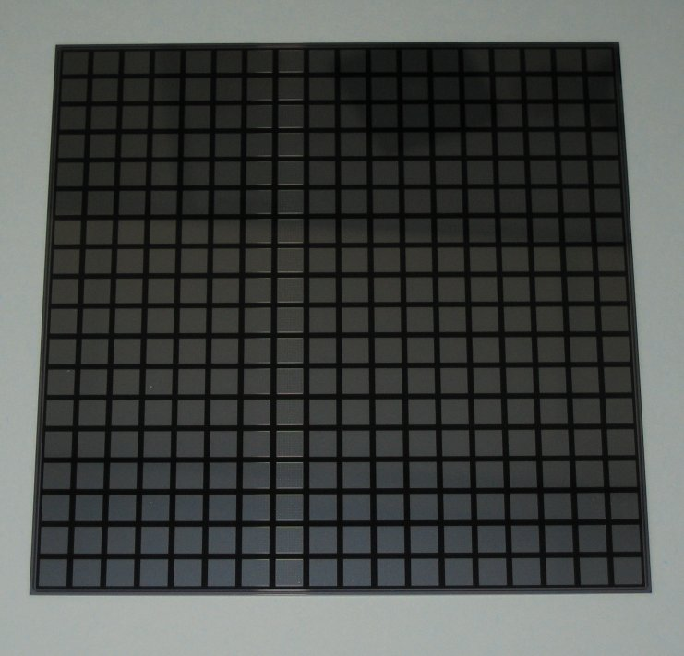
PIN diode matrices design
P++ implants (pixels)
The simplest design to control the cost
  Few thousands of m² needed for ILD
  Glued on PCB : Floating Guard Rings
Drawbacks :
  Large dead zone at the edges (>1 mm)
  Crosstalk with GR
R&D in close collaboration with HPK
  Split GR and/or complete removal of GR
  Laser dicing : gain a factor 2 on dead zone
  Smaller size abutted matrices may improve yield
Also tried edgeless techno. from VTT
Guard Rings
I region
N++ implant
HPK : 9x9 cm², 256 pixels

Slide 9
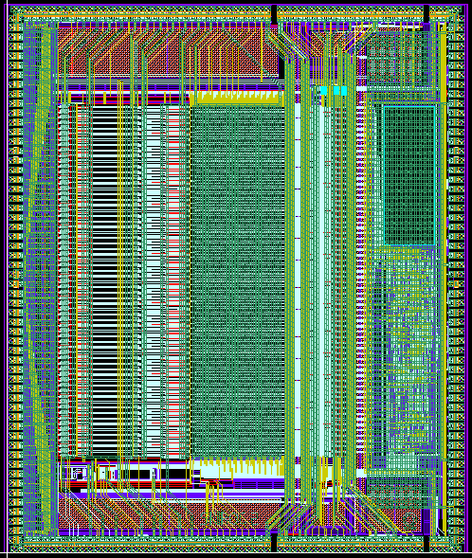
SKIROC chip
Silicon Kalorimeter Integrated Read Out Chip
  Technology SiGe 0.35µm AMS.
  Production batch received Q3’10
  64 channels, variable gain charge amp, 12-bit ADC, digital logic
  Power-pulsed → 25 μW/channel
Power pulsing
  Variable current consumption
according to state
  1 slab : 0 to 10 Amps pulses
  of 1 ms at 5 Hz

Slide 10
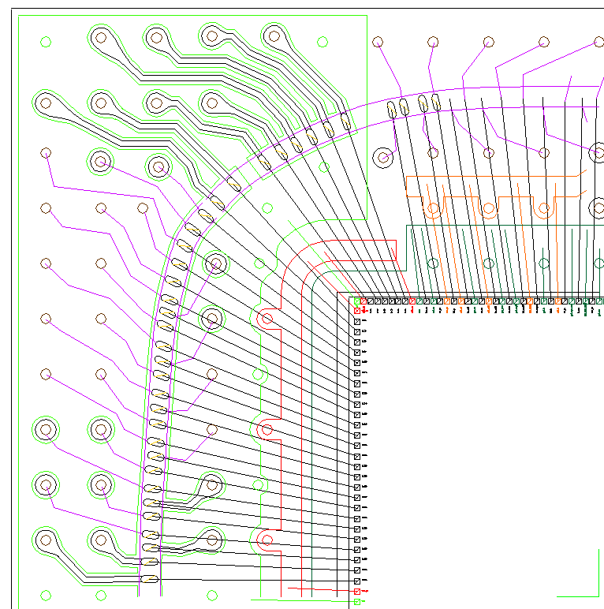
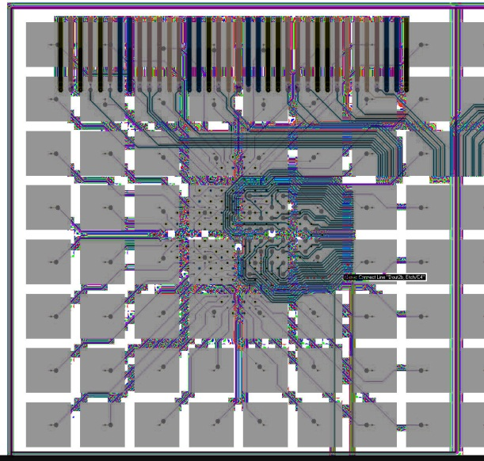
Detector slab : conservative design
Same concepts but with chips in package
BGA design requires additional 3 mm in SLAB thickness
Ultra thin BGA under study : promising
  Feasibility of lidframe : done
  Impact on Xtalk, noise : to be studied
  Length of pixel-chip traces divided by 2-3 w.r.t. PQFP design
Advanced package technologies
Thicknesses as low as 0.5mm
Ball bonded Flip chip
Allow efficient routing of pcb traces and digital/analog separation : longest analog trace is ~2 cm
(today prototype are build using PQFP to ease debugging)
BGA pattern : 1/16th of the PCB

Slide 11
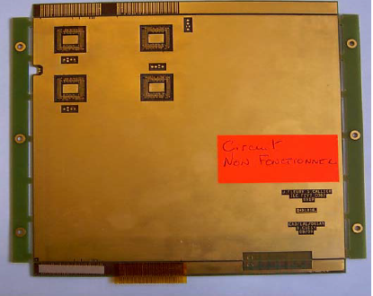
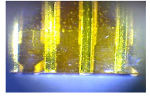
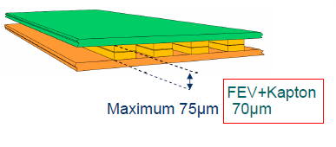
Long SLAB assembly
Up to 9 equipped PCBs interconnected to make detector slab
Electrical and mechanical connection made thanks to Kapton connecting cable
Technique under investigation
  Soldering with Flat Cable (Kapton)
  Easy for mass production
Full size kapton for interconnects
18 cm, 4 slots of 36 pins each

Slide 12
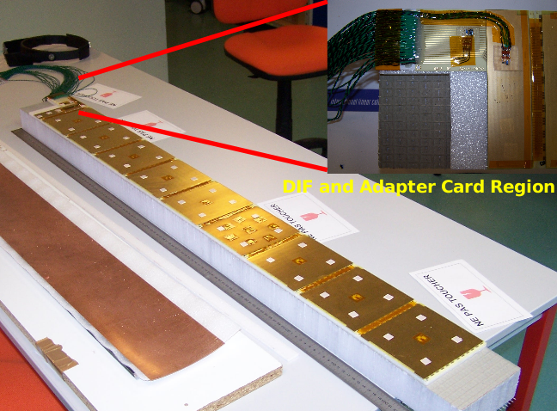
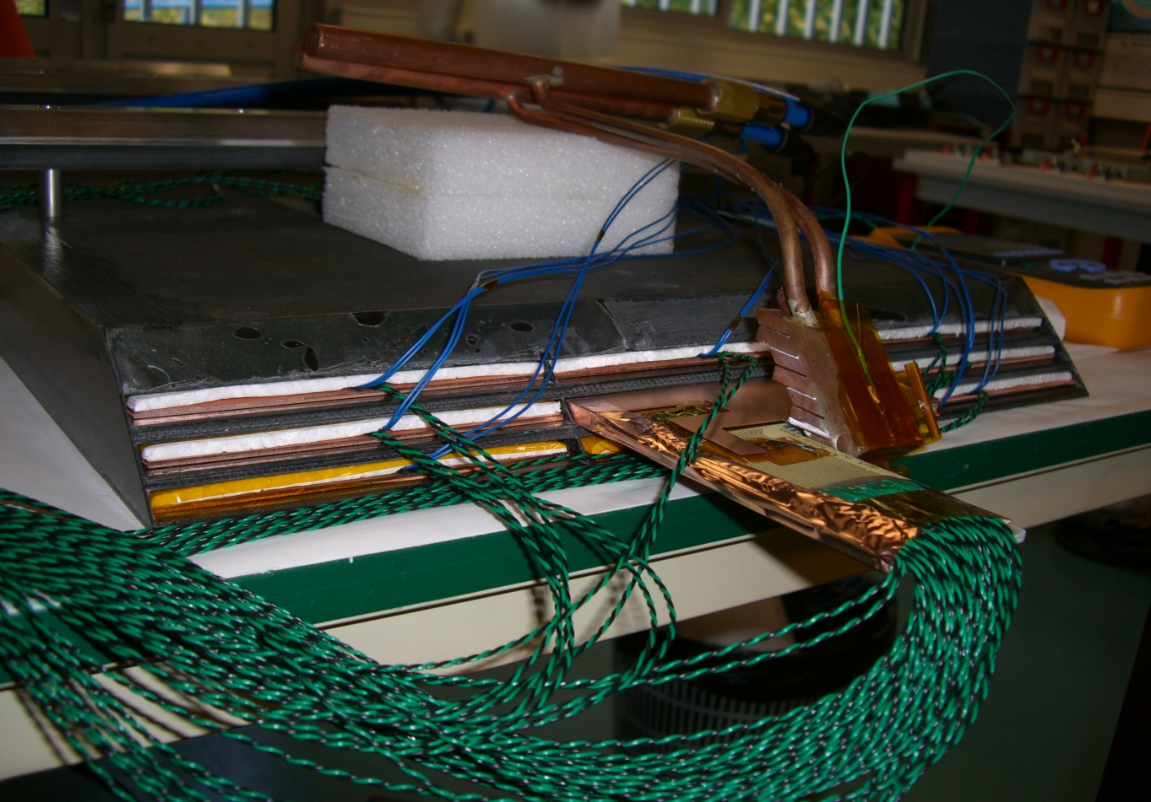
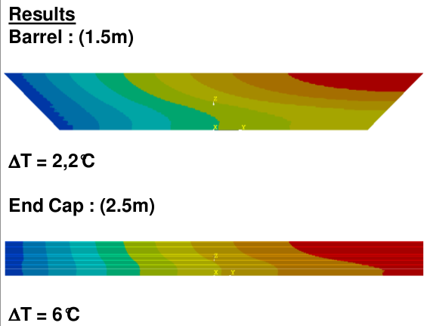
Developing a leakless water cooling system
Total ECAL power dissipation O(10 kW) even at 25 µW/ch
Need active cooling system (cold water pipe + radiator)
Limit : temperature differences within ECAL
heat transfer to neighboring detectors
Thermal simulations of detector modules
Cooling tests in demonstrator module

Slide 13
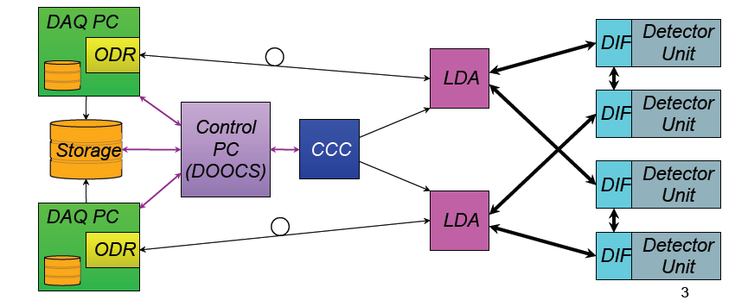


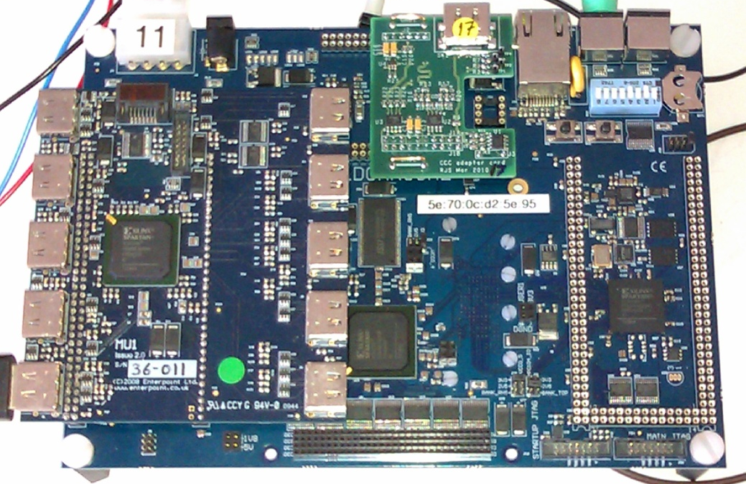
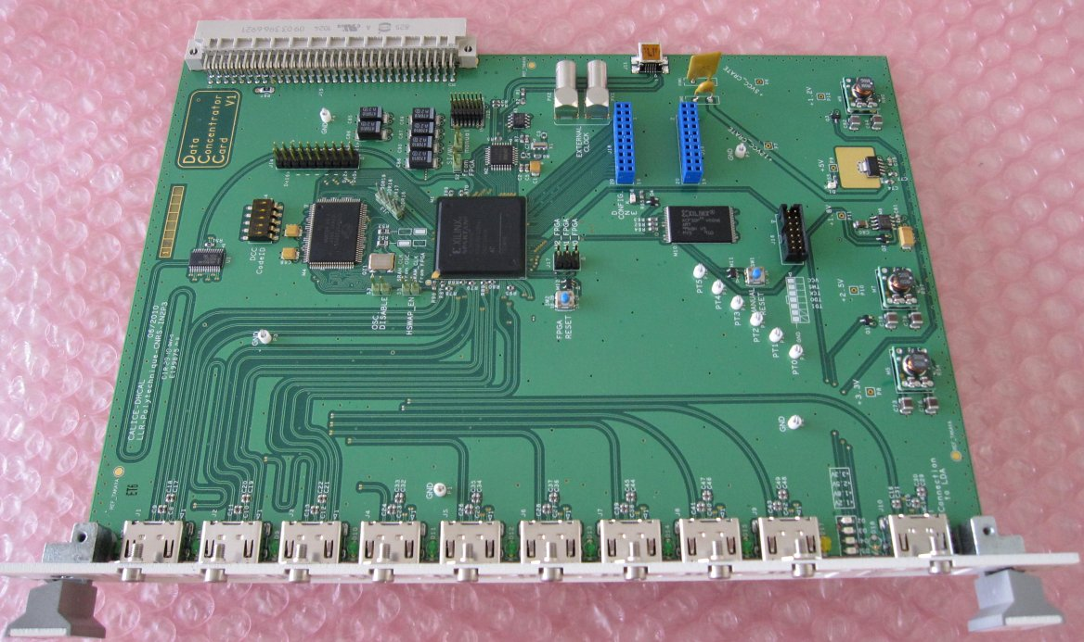
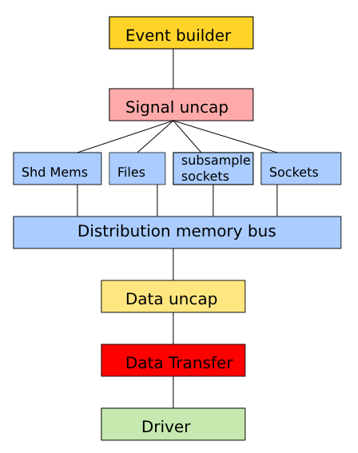
DAQ : hardware and software
Scalable : Computing network architecture
Standard : Giga-Ethernet, Serial 8b10B
    Backplane-less
Compact
  “one cable for everything”
Data Acquisition, Timing, Slow control
Flexible and highly modular software
Multiple output formats
  Files (offline)
  Shared memory (online H. Perf)
  TCPSockets (remote online)
  Subsampling (real time processing)
Used for test beams

Slide 14
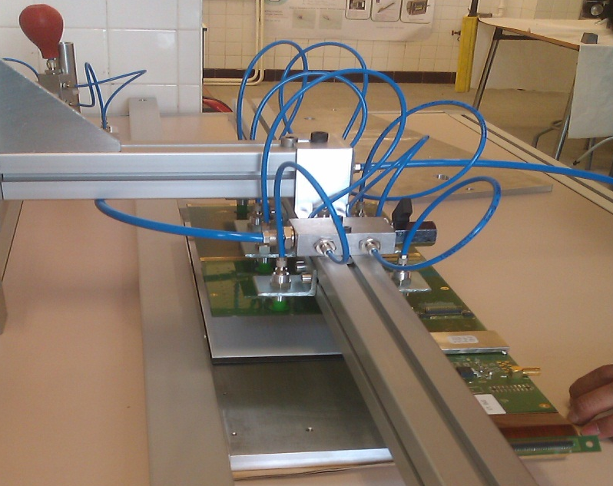
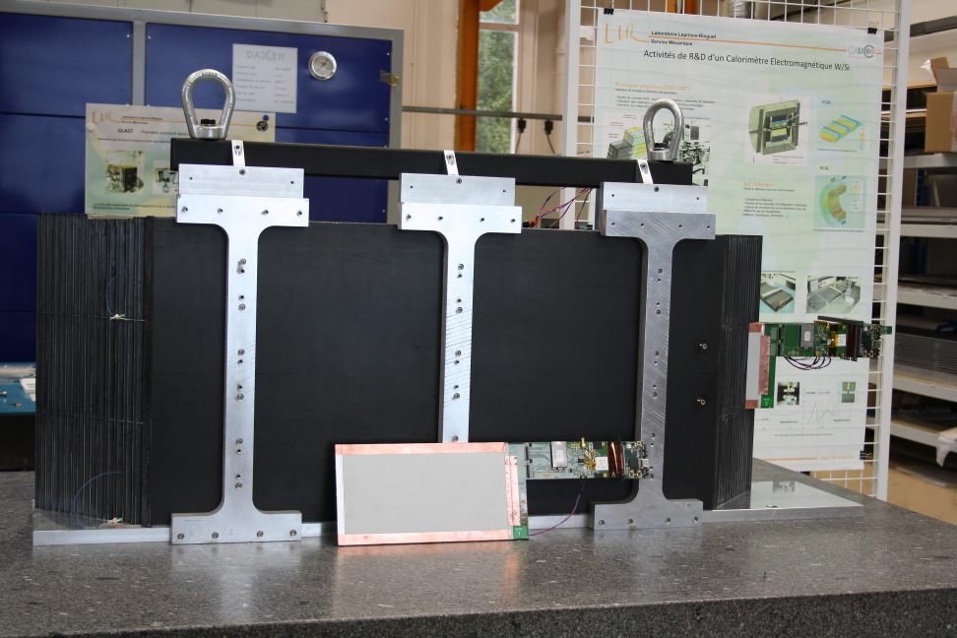
Assembly of first SLABs
Most of technologies described above used to build first SLABs
First approach of an assembly procedure
Toward automation and indistrialization
Simplified SLABS including
1 ASU with 4 SKIROCs in PQF package
1 Si Wafer (256 chn)
Succesfuly put into structure

Slide 15
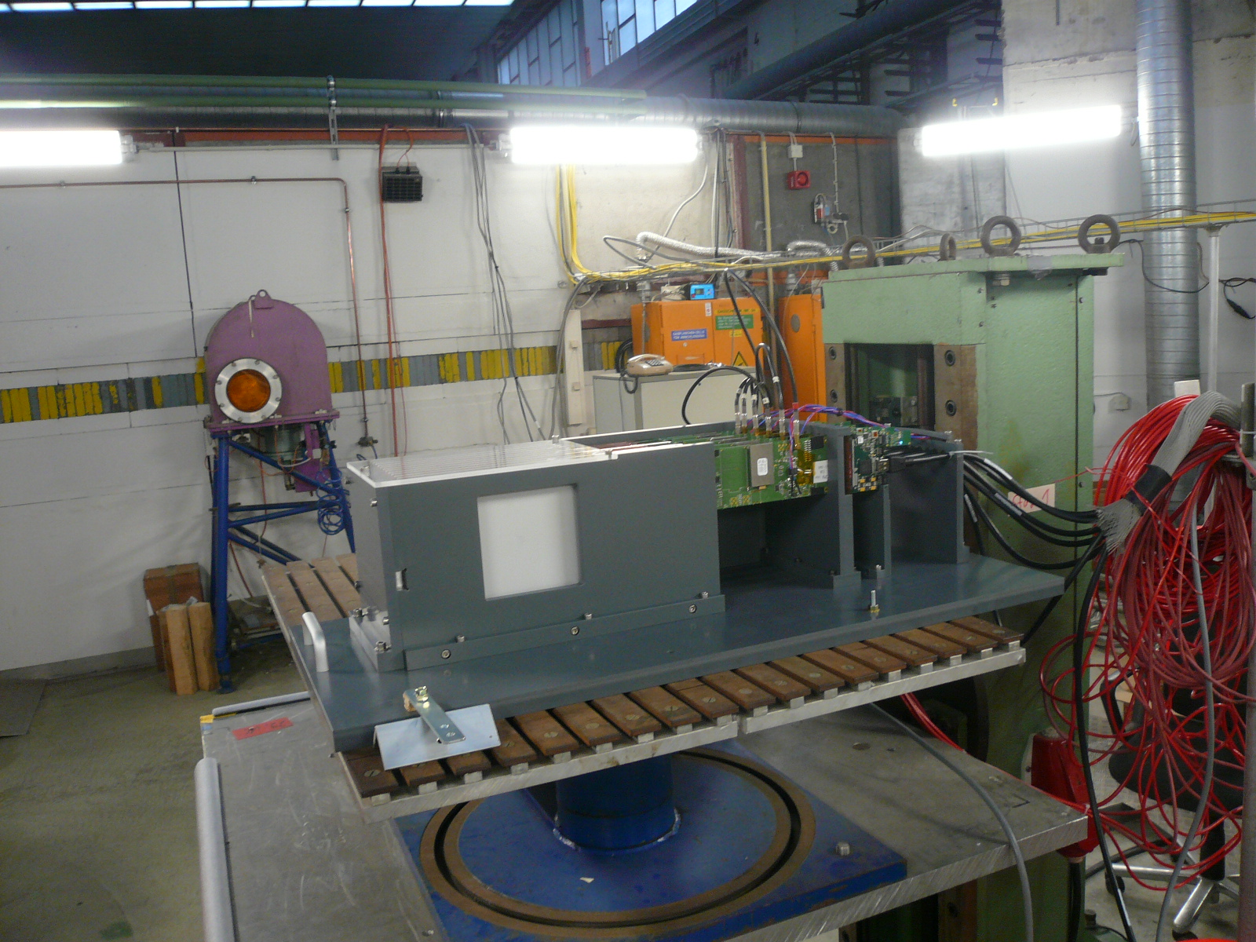
First 6 SLABS tested @DESY (July’12)
See next talk
S/N > 14

Slide 16
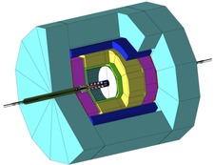
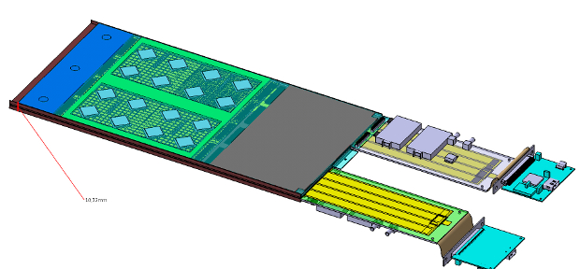
Summary
CALICE Si-W ECAL technologies with emphasis on
Low power FE electronics incorporated in detector volume
Integration (Structure, DAQ, cooling, services)
Sensor improvements & industrialization
Step by step prototyping allow tracking
the best feasibility/cost compromise
Optimization of overall design is based on accurate physics simulations
Number of layers
Number of pixels
Dead area
Allowed material
Connection between 2 A.S.U.
Now have a good understanding of how to build a complete ECAL
with affordable technologies

