Slide 1



Higgs self-coupling studies at CLIC
(preliminary)
Tomáš Laštovička (IoP AC, Prague)
Jan Strube (CERN, Geneva)
LCWS2012, Arlington, TX
October 22-26, 2012
Notes:
1

Slide 2
Overview
CLIC environment
Higgs trilinear coupling
Event reconstruction and selection
Results for 1.4 TeV and 3 TeV CLIC
  Cut-and-count method
  Template fitting
126 GeV Higgs
Polarised CLIC beams
Analysis prospects
Summary

Slide 3
CLIC environment

Slide 4
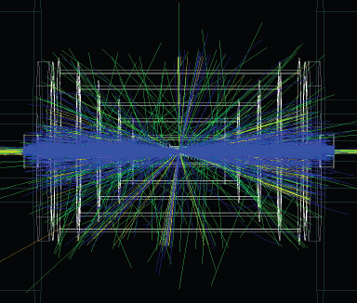
The CLIC accelerator environment
Center of mass energy | 500 GeV | 1.4 (1.5) TeV | 3 TeV
Bunch spacing | 0.5ns | 0.5 ns | 0.5 ns
Bunches per train | 354 (312) | 312 | 312
Train repetition rate | 50 Hz | 50 Hz | 50 Hz
γγ → hadrons per BX | 0.3 | 1.3 | 3.2
Staging scenario A(B)
Challenging environment
γγ overlay → 19TeV visible energy @ 3 TeV
  Reduced by a factor of 16 in 10ns readout window.
  Requires to employ “LHC-style” jet reconstruction algorithms (typically FastJet k_{T}).
For CLIC staging see D. Schulte’s presentation.

Slide 5
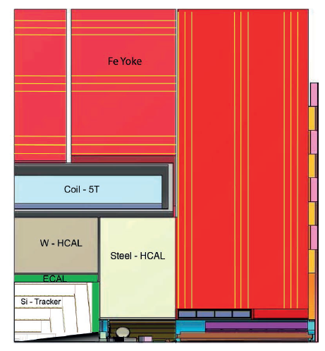
The CLIC detectors
CLIC_SiD and CLIC_ILD
  based on SiD and ILD detector concepts for ILC Letters of Intent.
CLIC_SiD concept
  CDR Light Higgs analyses
    H → bb, H → cc, H → μμ
    H → HH
  Inner vertex layer @ 27mm was 14mm for the SiD
  7.5 λ W-HCAL barrel
  Tracking down to 10°
  5T magnetic field
CLIC_SiD

Slide 6
CLIC Higgs studies
Event generation, both signal and background: Whizard 1.95
  realistic beam spectrum, ISR
  unpolarised beams
Hadronisation: Pythia 6.4
Full event simulation
  Geant4 via SLIC (CLIC_SiD)
  60 BX γγ→hadrons overlaid in each event @ both 3.0 and 1.4 TeV
Full event reconstruction
  PFA with PandoraPFA
  10 ns readout window; except HCAL: 100 ns
Target integrated luminosity: 2 ab⁻¹ (3 TeV) and 1.5 ab⁻¹ (1.4 TeV)
CLIC @ 3.0 (1.4) TeV: σ_{hhνν} = 0.63 (0.164) fb; via WW fusion

Slide 7
Data samples
Due to historical reasons most of the analysis is done for 120 GeV Higgs.
Higgs decay modes
  The final state is HHνν; Pythia consequently decays Higgs to: b, c, s, μ, τ, g, γ, Z, W
126 GeV samples generated and tested
  small degradation of results w.r.t. 120 GeV Higgs is observed
SM Background
  Standard Model 4Q and 2Q backgrounds
    qqqqνν, qqqqeν, qqqqll, qqqq
    Hνν, qqνν, qqeν, qqll, qq – (3 TeV only)
  Due to technical difficulties qqqqeν background is not included at 3 TeV
    currently being simulated and reconstructed

Slide 8
Higgs trilinear coupling

Slide 9
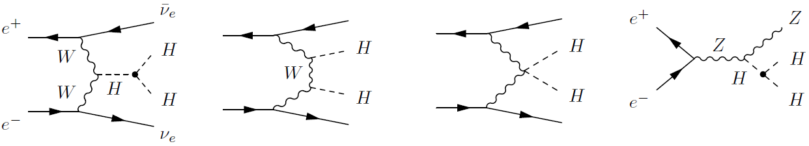
Higgs trilinear coupling
λ represents the trilinear coupling
  and quartic coupling (difficult to measure)
  direct determination of the Higgs potential
  the force that makes Higgs condense in the vacuum
WW fusion HHνν dominates over Higgs-strahlung ZHH for √s ≈ 1.2 TeV and above
  In WW (ZHH) channel the cross section increases (decreases) with decreasing λ.

Slide 10
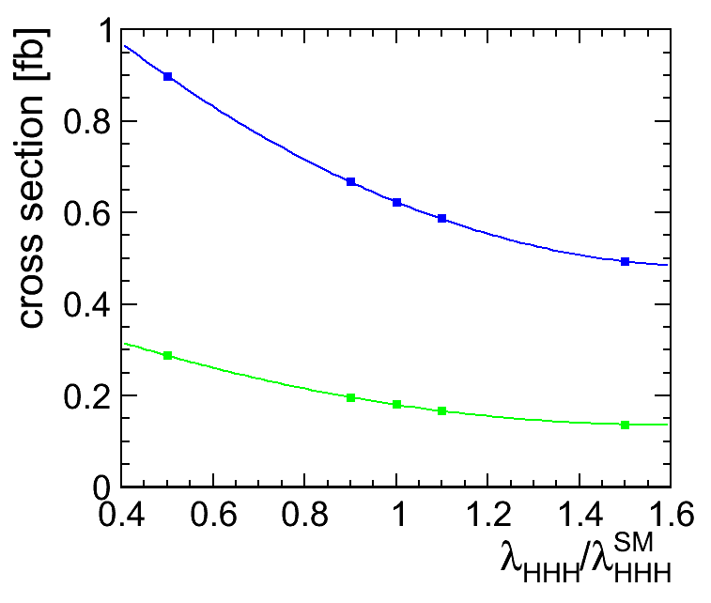
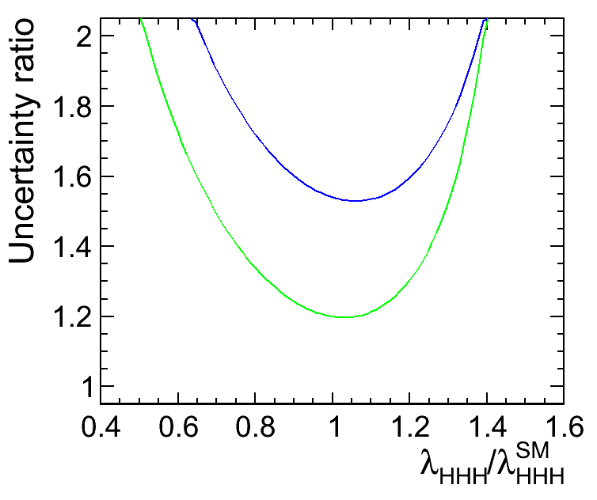
Extraction of λ from σ_{HHνν} cross section
An option to change the Higgs self-coupling parameter was added to Whizard.
Cross section σ_{hhνν} calculated with various λ_{HHH}/ λSM_{HHH}
  3 TeV and 1.4 TeV CLIC beam spectrum, ISR
Cross section dependence fitted by a 2nd order polynomial.
Values of “uncertainty relating factor R” at λ_{HHH}/ λSM_{HHH} = 1 (Whizard 2):
3.0 TeV
1.4 TeV
  3.0 TeV: 1.54
  1.4 TeV: 1.20
3.0 TeV
1.4 TeV

Slide 11
Experimental challenges at CLIC
Multi-jet final state with missing energy
Missing energy leads to low energy jets
Pile-up from γγ→hadrons beam background
  Jet flavour tagging affected
  Downgrades jet/event reconstruction
Small separation between H and W/Z

Slide 12
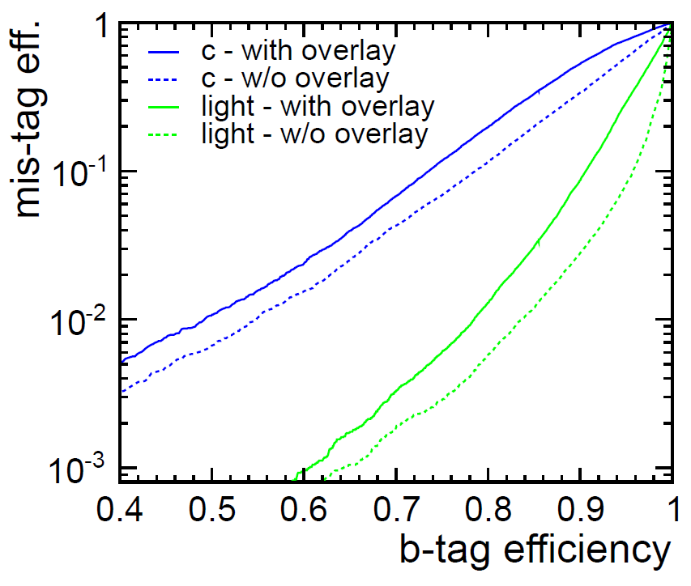
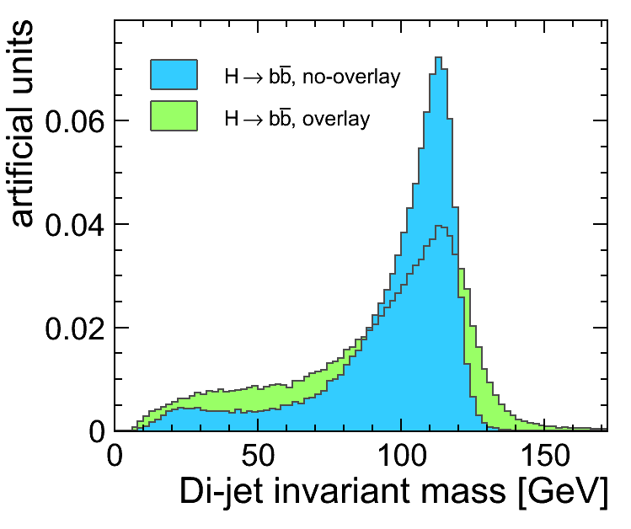
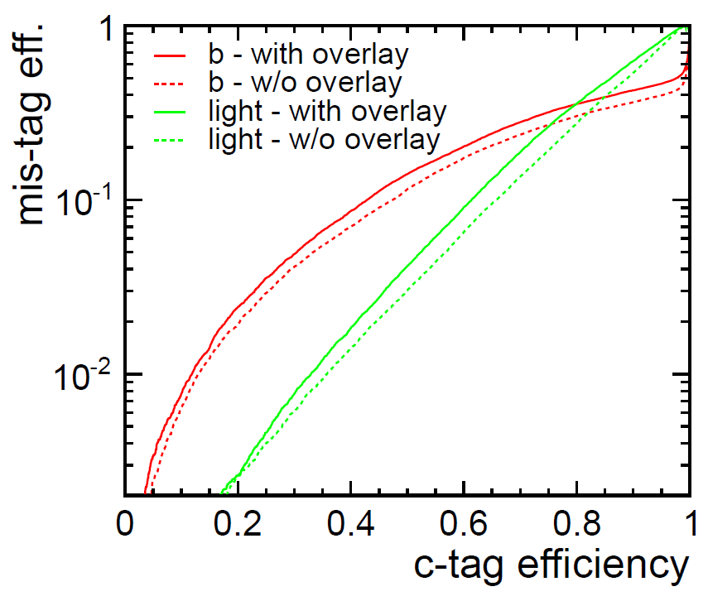
Jet flavour tagging at 3TeV with γγ overlay
LCFIVertex package
  FANN neural net package used throughout the Higgs analysis both for the flavour tag and the event selection.
  Presence of γγ overlay (60BX considered) degrades both the jet-finding and the jet flavour tag quality (shown for di-jet events).
Forward jets

Slide 13
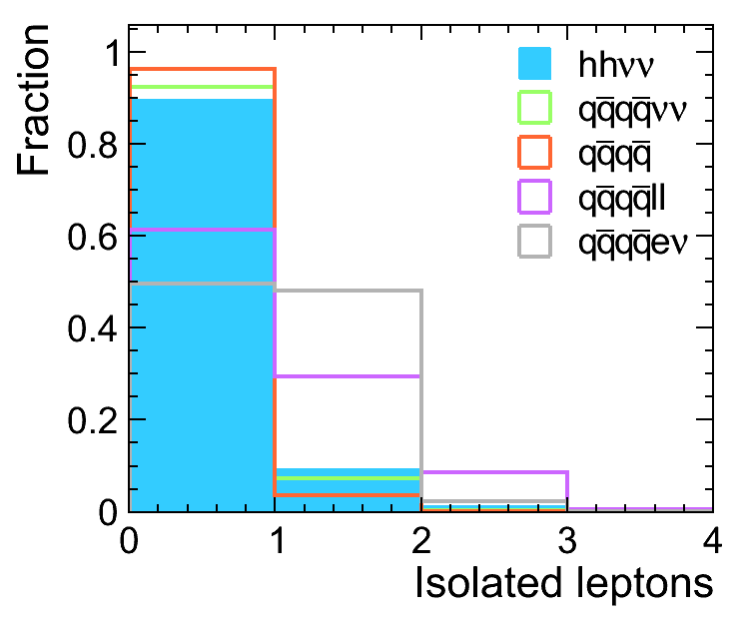
Event selection
4 jets reconstructed with FastJet
  3 possible combinations to make two Higgs bosons.
  Jets paired in hemispheres.
  A purely geometric criterion to pair jets is less biased than a kinematic one.
  Forward jet reconstruction is difficult and at some point leads to losing particles and replacing them with background.
No isolated leptons
  Suppression of qqqqll and qqqqeν.
Neural network classifier
  Combining 22 quantities into one.
1.4 TeV

Slide 14
Neural net inputs
invariant masses of jet pairs
event invariant mass and visible energy
missing transverse energy E_{t}
y_{min} and y_{max} from FastJet
p_{t}^{min}, p_{t}^{max} of jets
#leptons and #photons in event
max(|η_{i}|) and sum(|η_{i}|) of jet pseudorapidities η_{i}
angle between jet pairs
sums of LCFI flavour tag outputs (per jet pair):
b-tag, c(b)-tag, c-tag and b(light)-tag

Slide 15
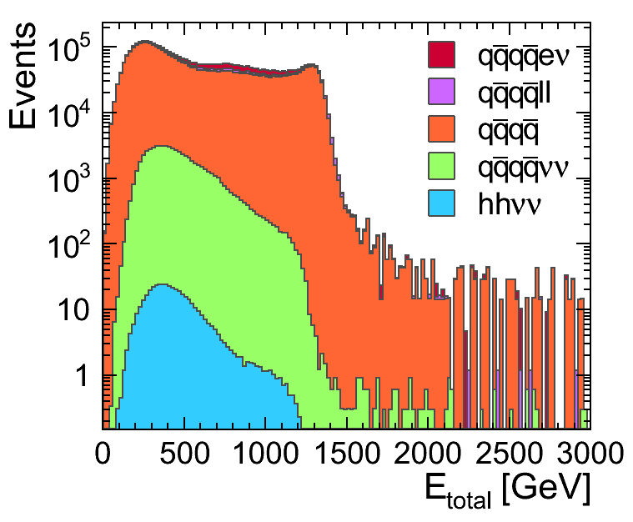
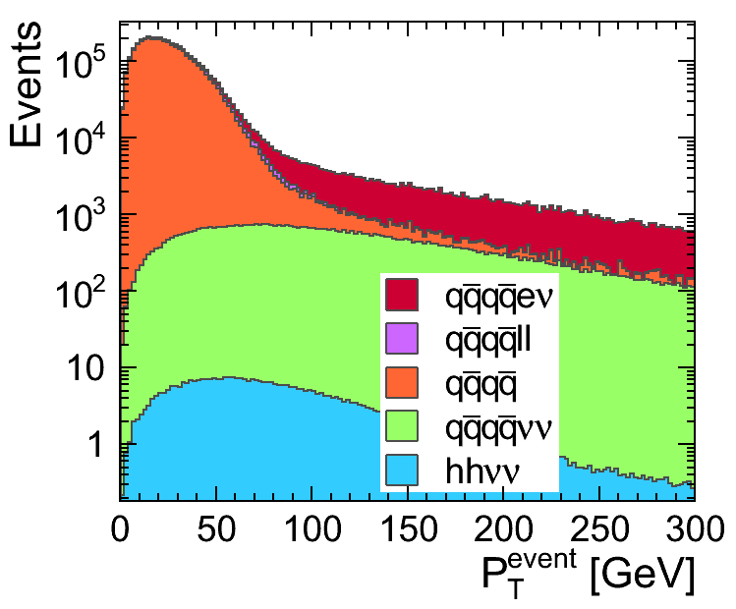
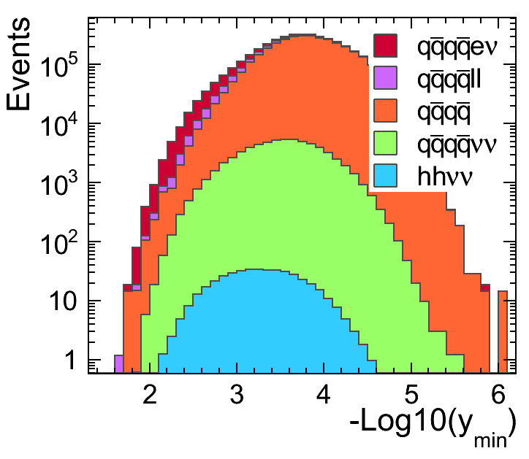
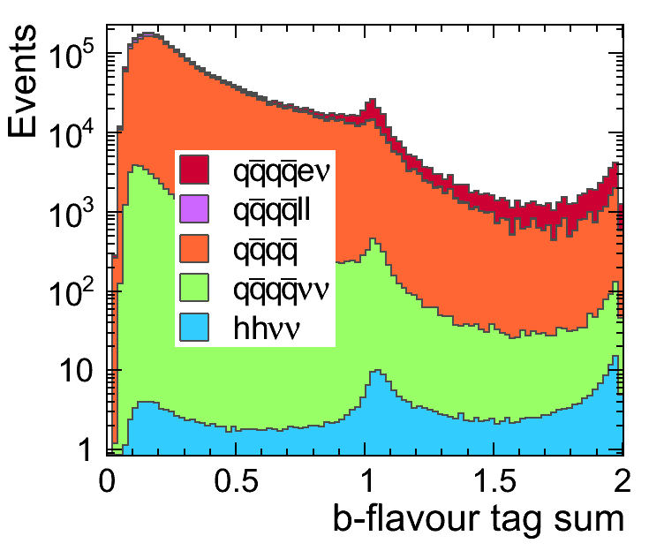
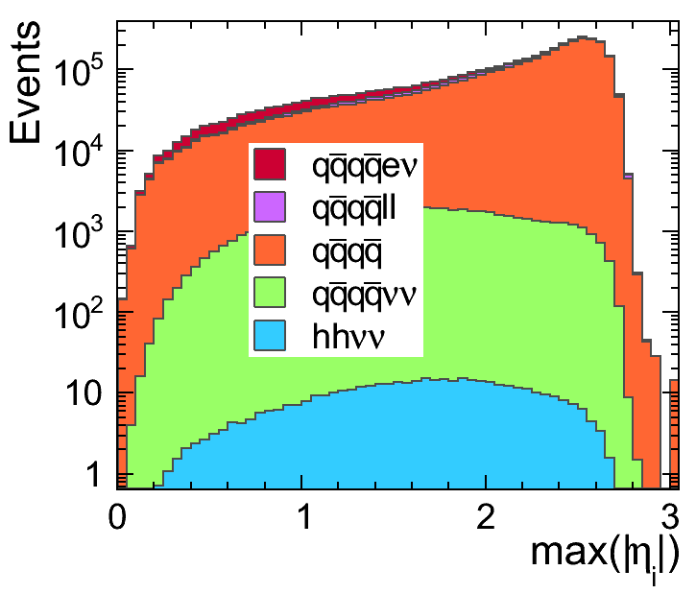
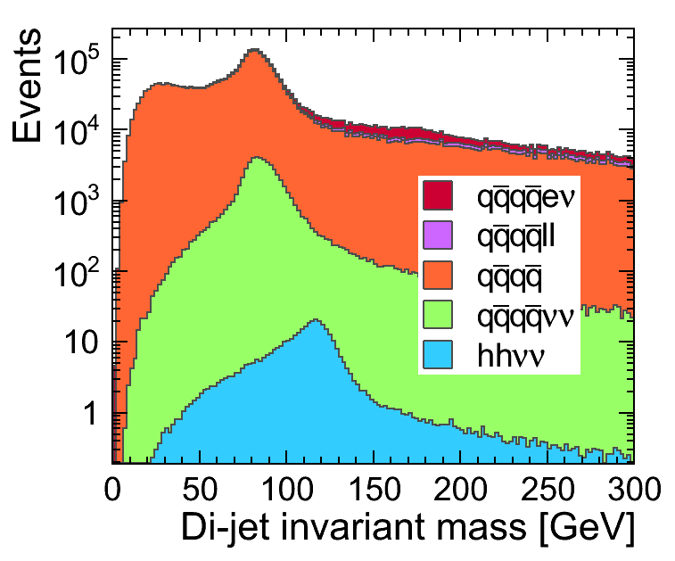
Event selection
Example variables/inputs for 1.4 TeV; signal and 4q backgrounds shown.

Slide 16
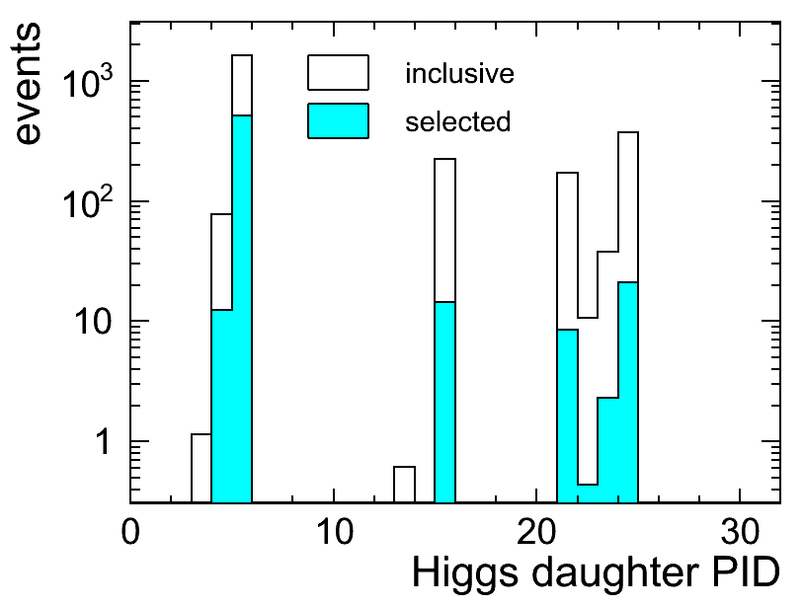
Cut-and-count method
Find a cut on the neural network output which minimises
  Signal (HHνν) cross section uncertainty
  - or -
  Directly the λ_{HHH} uncertainty
    Uncertainty ratio R may depend on the event selection.
    Signal samples with 0.8 λ_{SM} and 1.2 λ_{SM} added to evaluate λ_{HHH} uncertainty per cut.
No explicit channel selection enforced
  H→bb channel naturally dominates after the neural net selection.
Statistical uncertainty evaluation
  Count signal (S) and background events (B): √(S+B)/S
b
Z
g
W
c
3 TeV
τ
γ
s
μ

Slide 17
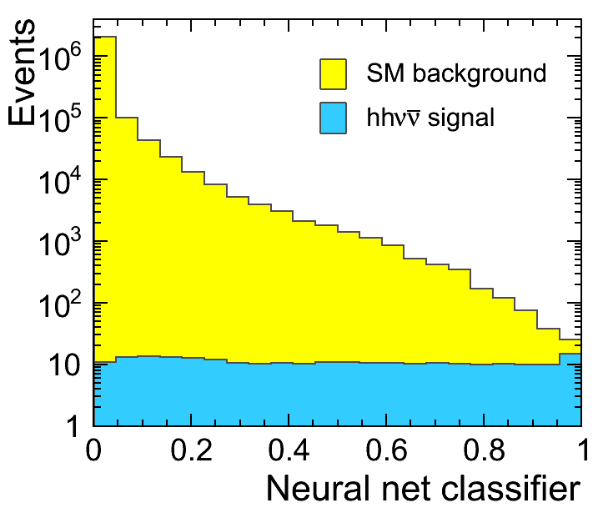
1.4 TeV Results for 1.5 ab⁻¹
 | σ_{HHνν} minimisation | λ_{HHH} minimisation
σ_{HHνν} uncertainty | 30%
λ_{HHH} uncertainty | 36% (R = 1.2) | 35%
Signal | 28^{+8.8}_{-8.1} | 28^{+8.8}_{-8.1}
Background | 43 | 43
Signal total | 246 | 246
Signal efficiency | 11% | 11%
Both minimisations give about the same result.
Background dominated by
  qqqqνν, qqqqlν and qqqq (4xCS than at 3 TeV)

Slide 18
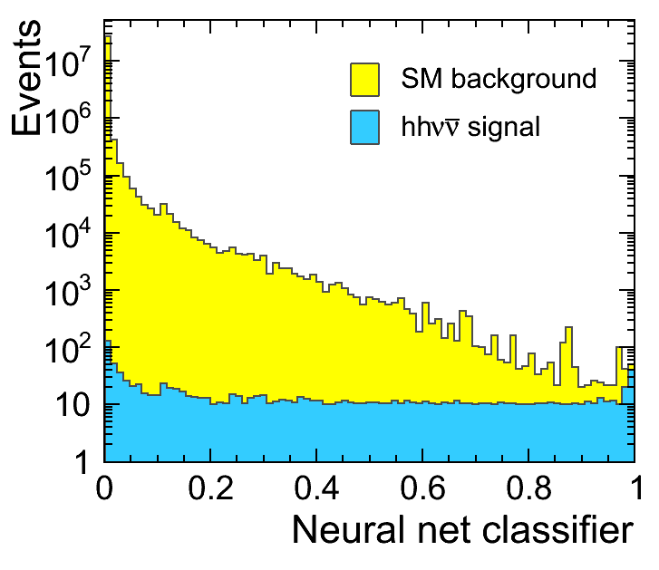
3.0 TeV Results for 2 ab⁻¹
 | σ_{HHνν} minimisation | λ_{HHH} minimisation
σ_{HHνν} uncertainty | 13%
λ_{HHH} uncertainty | 20% (R = 1.54) | 21.3%
Signal | 151 | 291
Background | 229 | 1235
Signal total | 1260 | 1260
Signal efficiency | 12% | 23%
Direct λ_{HHH} minimisation prefers almost twice as many events compared to σ_{HHνν} minimisation.
Complete set of backgrounds except qqqqlν
  Currently being generated and simulated.

Slide 19
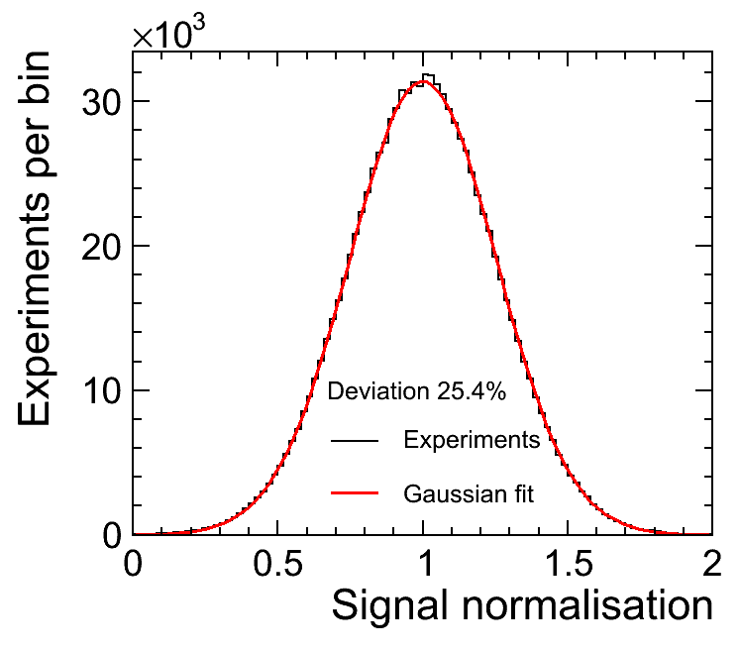
Template fitting
Neural network (BDT, … ) should digest all available information from its inputs and concentrate it in its output.
Cut-and-count method does not fully harvest the neural net output information, however, the template fitting should.
Template fitting merely considered as an indicator of measurement limits.
  Binned template fitting
  Neural net output binned into a fine-binned histogram
  re-binned: at least N signal and bkgr. events per bin
  10⁶ “experiments” generated and fitted
  Unbinned template fitting
  RooFit employed to obtain signal and bkgr. PDFs
  work in progress…
1.4 TeV, min. 10 events

Slide 20
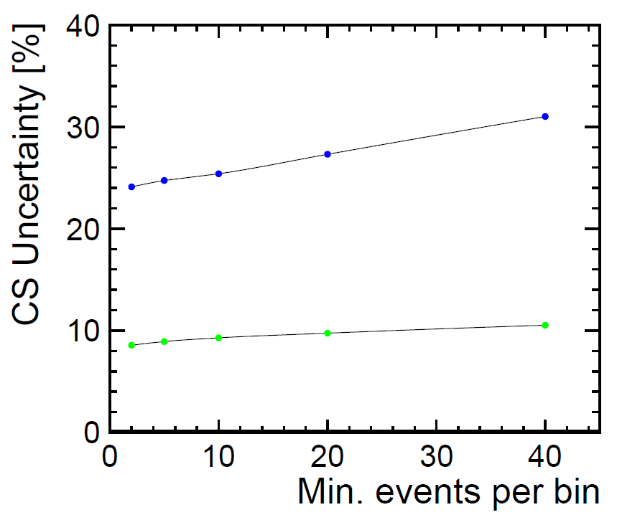
Results
1.4 TeV | σ_{HHνν} uncertainty | Ratio R | λ_{HHH} uncertainty
 | 24 – 26% | x 1.20 | 29 – 31%
3.0 TeV
 | 9 – 10% | x 1.54 | 13.5 – 15%
There is a dependency of the σ_{HHνν} uncertainty on the expected number of events per bin
  When the number of entries per bin is large, the information in the “distribution shape” is lost.
  On the other hand, when it is small, we fit the template/event noise.
Unbinned template fitting.
  under progress
loosing shape information
1.4 TeV
fitting template noise
3 TeV

Slide 21
126 GeV Higgs
Analysis was repeated with 126 GeV Higgs samples.
Default self-coupling value only
  Modified coupling samples will be added.
σ_{HHνν} uncertainty degradation observed. Effect on λ_{HHH} yet to be evaluated.
1.4 TeV |  | σ_{HHνν} unc. 126 GeV | σ_{HHνν} unc. 120 GeV
 | Cut-and-count: | 35% | 30.2%
 | Template fit: | ~30% | 24-26%
3.0 TeV
 | Cut-and-count: | 13.5% | 13%
 | Template fit: | 10.5-11% | 9-10%

Slide 22
CLIC with polarised beams
Polarisation considered: 80% – 0%
  The signal cross sections are about 1.4-1.7x larger (qqqqνν, qqνν 2.2x larger)
  The following results are merely indicative
    only cross sections changed, no events simulated/reconstructed, no NN re-training
1.4 TeV |  | σ_{HHνν} unc. (80%-0%) | σ_{HHνν} unc. (0%-0%)
 | σ_{HHνν} | 0.233 fb | 0.164 fb
 | Cut-and-count: | ~26% | 30.2%
 | Template fit: | ~20-21% | 24-26%
3.0 TeV
 | σ_{HHνν} | 1.05 fb | 0.63 fb
 | Cut-and-count: | ~10% | 13%
 | Template fit: | ~7-8% | 9-10%

Slide 23
Analysis prospects
Background samples will be completed.
There may be some potential in improving the jet reconstruction.
  Few paths pursued: e.g. vertex assisted jet finding and jet reconstruction (small effect).
  FastJet was not tuned for e⁺e– collissions.
126 GeV Higgs
  Modified coupling samples
Polarised beams
  80% – 0% considered, uncertainty improved by a factor of 1.2-1.3 when compared to unpolarised beams
  @ 80% – 30% the signal cross section is even larger (1.364 fb @ 3 TeV)
    This would, naively, lead to a factor of ~1.5, compared to unpolarised beams.
    Eventually reaching 10% λ_{HHH} uncertainty (?)

Slide 24
Summary
Preliminary results were presented of the Higgs self-coupling measurement with 1.4 TeV and 3 TeV CLIC machine.
  Full simulation and reconstruction in CLIC_SiD; realistic beam spectrum, ISR, …
  Unpolarised beams
  Accounted for realistic γγ→hadrons event pile-up/overlay.
  Event selection based on neural networks.
  Two methods: cut-and-count, template fitting.
  We observe 30 – 35% λ_{HHH} uncertainty @ 1.4 TeV and 15 – 20% uncertainty @ 3 TeV
    for 120 GeV Higgs
    Note: qqqqlν background will be added at 3 TeV.
  For 126 GeV Higgs a degradation of cross section uncertainty has been observed.
    Effect on λ_{HHH} yet to be evaluated.
  Beam polarisation will significantly improve σ_{HHνν} and λ_{HHH} uncertainties due to higher signal cross sections.

