Slide 1
STF-LLRF system and its study plan
Shin MICHIZONO (KEK)
Outline
STF system configuration
  S1-Global (~2011 Feb.)
  Quantum Beam (QB) (2012 Mar. ~)
Digital feedback system at STF (cPCI, uTCA, IF-Mix)
Performance of llrf system upto S1-global
Study plan during QB operation
  Beam based calibration
  PkQl control
  High Ql operation
  Other items

Slide 2
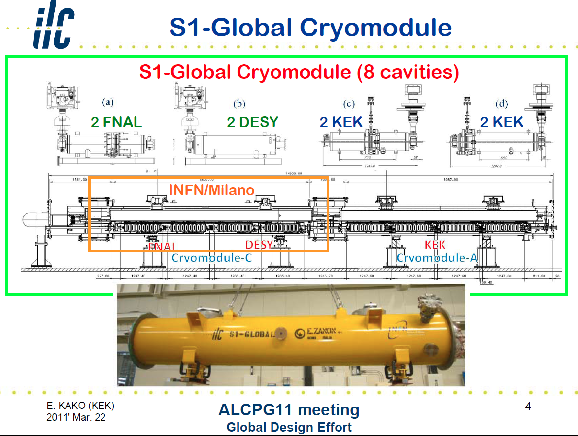
(2010,2011)
No beam

Slide 3
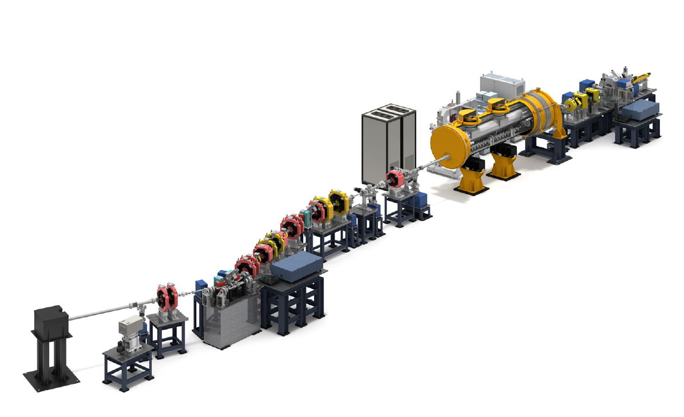
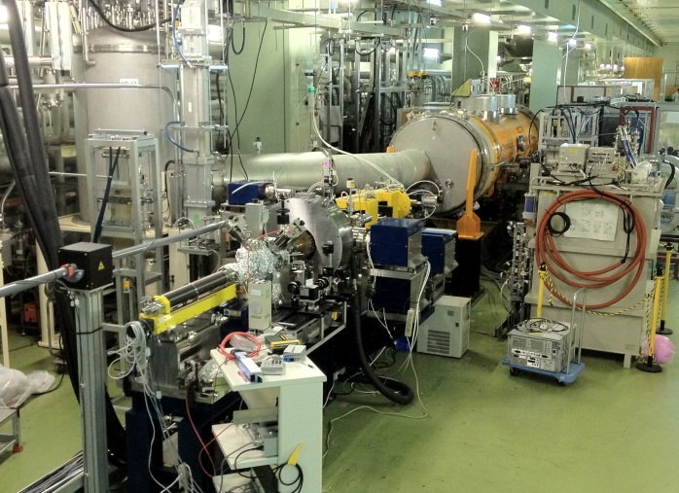
KEK STF Quantum Beam Project
(2012)
Demonstration of high brightness X-ray generation
by inverse laser Compton scattering.
Photo-cathode RF gun*
(5 MW Klystron on ground level)
*operated using digital LLRF
control techniques
With beam
800 kW klystron
with capture cryomodule (CCM)
including two superconducting
9-cell cavities*
Beam dump
Optical cavity for
X-ray creation
(not yet installed)
Pulse length: 1 ms
Repetition rate: 5 Hz
Bunch spacing: 162.5 MHz
Bunch number: 162500
Beam current: 10 mA
Energy: 40 MeV
Charge: 62 pC
X-ray detector

Slide 4
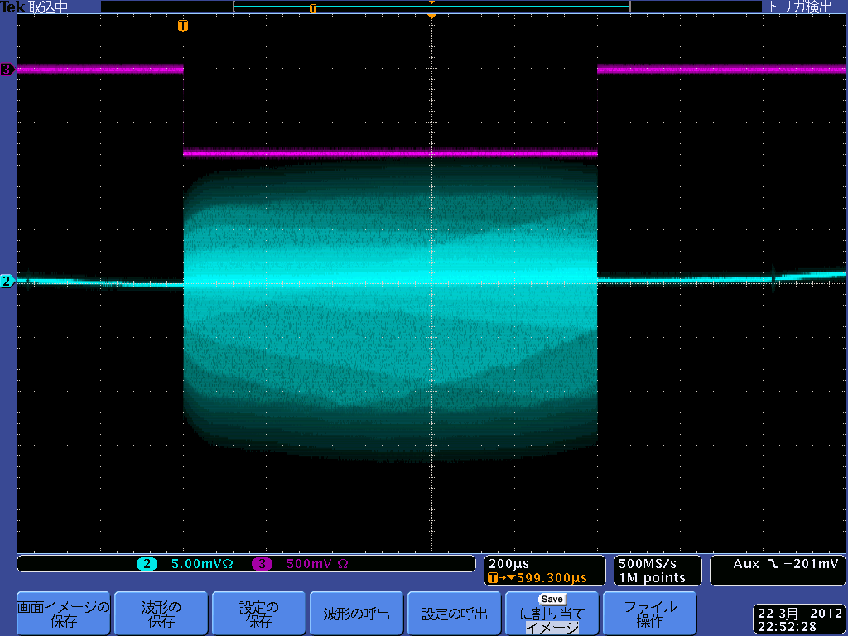
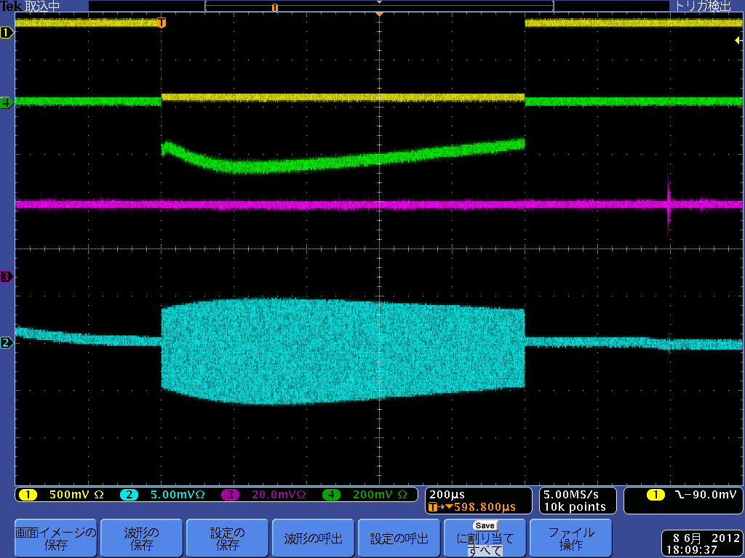
Beam Operation of STF Accelerator
RF Gun
Capture cryomodule
Beam on gate
Beam on gate
Fiber Beam loss monitor
BPM signal
PIN Beam loss monitor
1ms
BPM signal
1ms
Beam length of 1 ms at RF gun
（March/2012）
Beam acceleration with 20% beam power
(40 MeV, 15 pC/bunch, 162500 bunches)
（June/2012）
⇒ Demonstration of ILC-like beam acceleration
(beam length: 1 ms, beam intensity: 3.2-6.5 mA)

Slide 5
STF-LLRF system and its study plan
Shin MICHIZONO (KEK)
Outline
STF system configuration
  S1-Global (~2011 Feb.)
  Quantum Beam (QB) (2012 Mar. ~)
Digital feedback system at STF (cPCI, uTCA, IF-Mix)
Performance of llrf system upto S1-global
Study plan during QB operation
  Beam based calibration
  PkQl control
  High Ql operation
  Other items

Slide 6
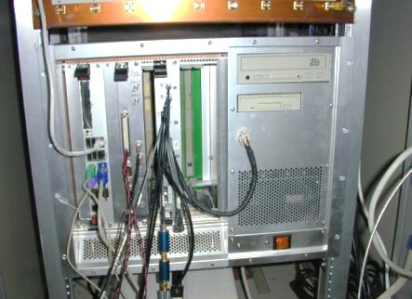
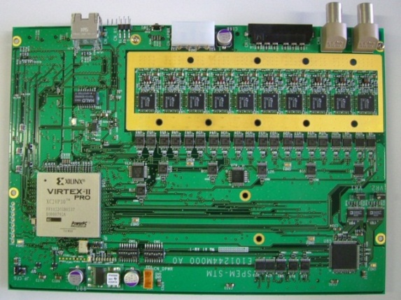
cPCI digital FB system (2007~)
cPCI system has been used from STF-1 (2007~).
FPGA board is a daughter card of a commercial DSP board.
ADC-inputs
(Multi-connector)
I,Q DAC outputs
cPCI crate
FPGA
CPU
board
Digital
I/O board
FPGA digital
FB board
10ch 16-bit ADC (LTC2208)
2ch 14-bit DACs (AD9764)
FB calc.
FPGA
Complex calc. like derivation of Q_{L}
Data communication
DSP

Slide 7
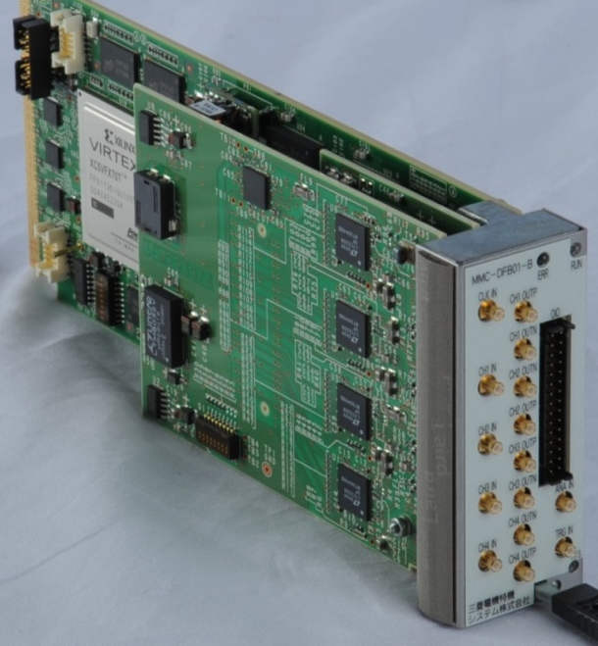
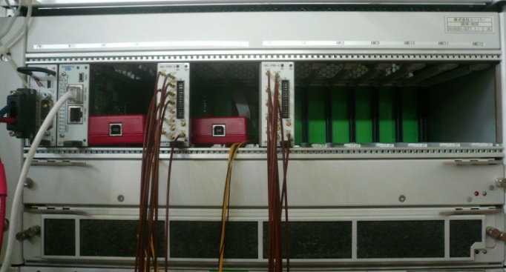
Micro-TCA digital FB system (2011~)
uTCA system is a new system developed for cERL and is used from 2011.
FPGA board is a inteligent EPICS-IOC.
Shelf
Clock input
FPGA
Virtex5-FX
16-bit ADC x 4
(LTC2208)
DIO
Power Module
MCH
uTCA1
(for KLY#1)
uTCA2
(for KLY#2)
16-bit DAC x 4(AD9783)
RF gate
Data communication is performed through Gb Ethernet bus at the backplane.
AMC(Advanced Mezzanine Card)
The board has been developed for cERL-project (CW operation) at KEK.
For DRFS, the logic was changed for pulse operation.
EPICS was installed in the digital board for communication control.
EPICS: Experimental Physics and Industrial Control System

Slide 8
STF-LLRF system and its study plan
Shin MICHIZONO (KEK)
Outline
STF system configuration
  S1-Global (~2011 Feb.)
  Quantum Beam (QB) (2012 Mar. ~)
Digital feedback system at STF (cPCI, uTCA, IF-Mix)
Performance of llrf system upto S1-global
Study plan during QB operation
  Beam based calibration
  PkQl control
  High Ql operation
  Other items

Slide 9
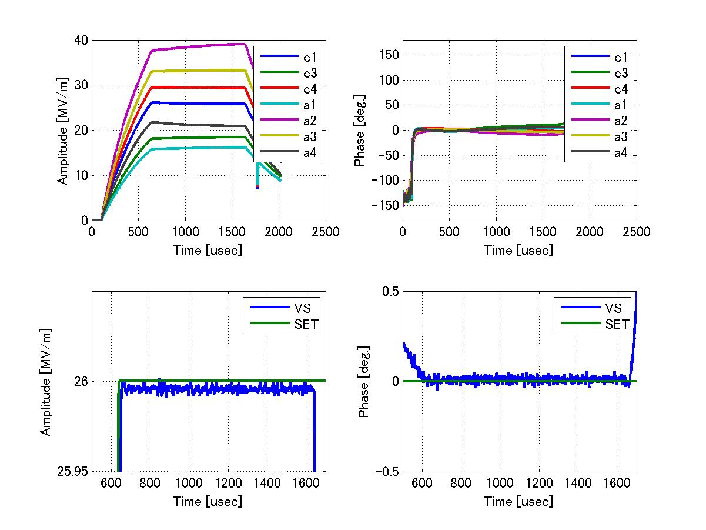
Stabilities at 26 MV/m operation
By T. Matsumoto
0.0067%rms（in amplitude),16.5mdeg.rms(in phase) @690～1590us

Slide 10
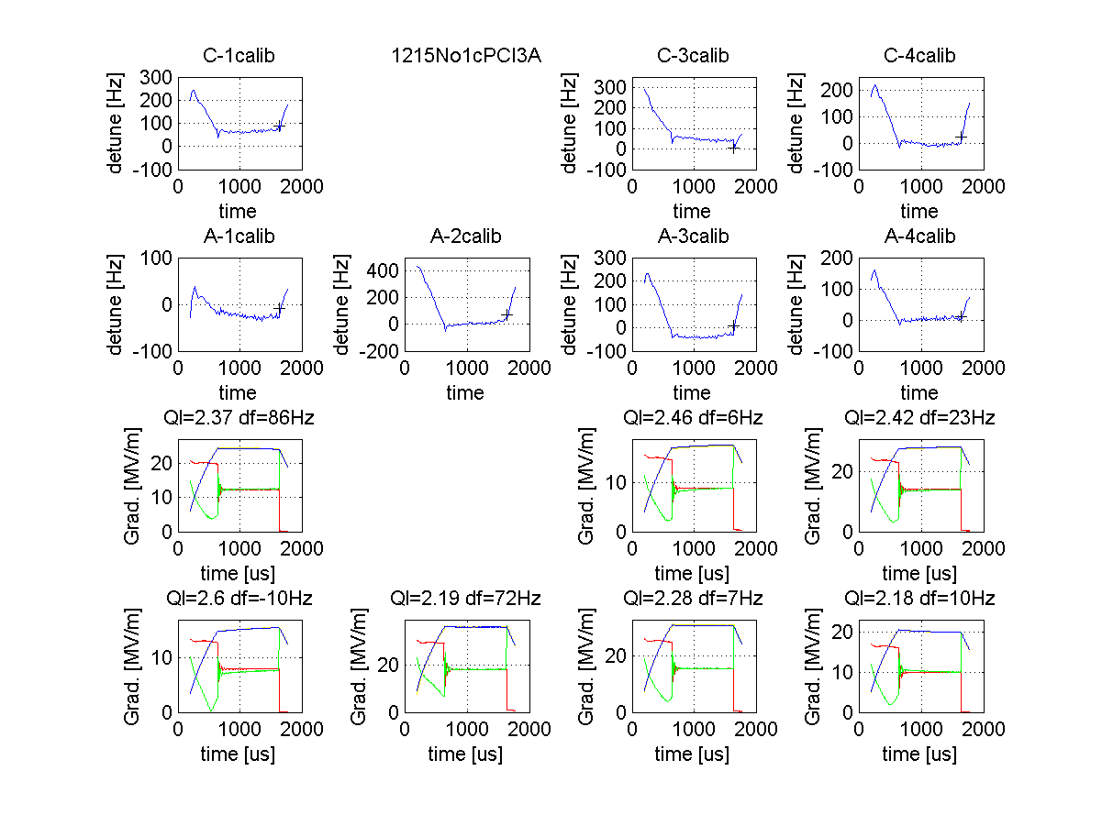
IF mixture
The number of ADCs in a FPGA board is limited due to the substrate. The idea is based on the ‘digital radio’ and obtaining cavity signals with a ADC.
Example of 3 signal IF-mix
Mixture of two signals decrease the resolution of analog signals but averaging increases the resolution.
Vector sum stabilities
⊿A/A：7×10^-4(rms)
⊿φ：0.06deg.(rms)

Slide 11
STF-LLRF system and its study plan
Shin MICHIZONO (KEK)
Outline
STF system configuration
  S1-Global (~2011 Feb.)
  Quantum Beam (QB) (2012 Mar. ~)
Digital feedback system at STF (cPCI, uTCA, IF-Mix)
Performance of llrf system upto S1-global
Study plan during QB operation
  Beam based calibration
  PkQl control
  High Ql operation
  Other items

Slide 12
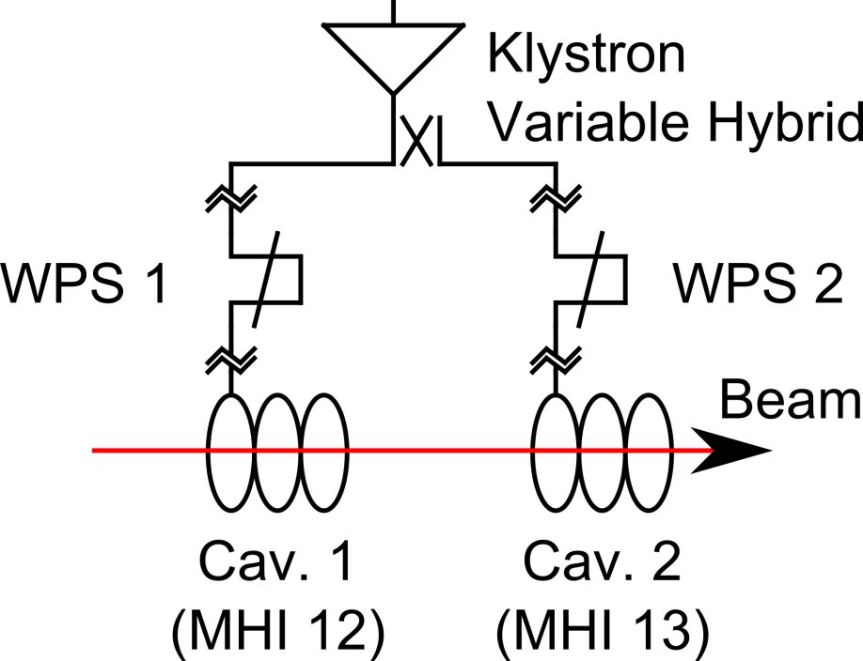
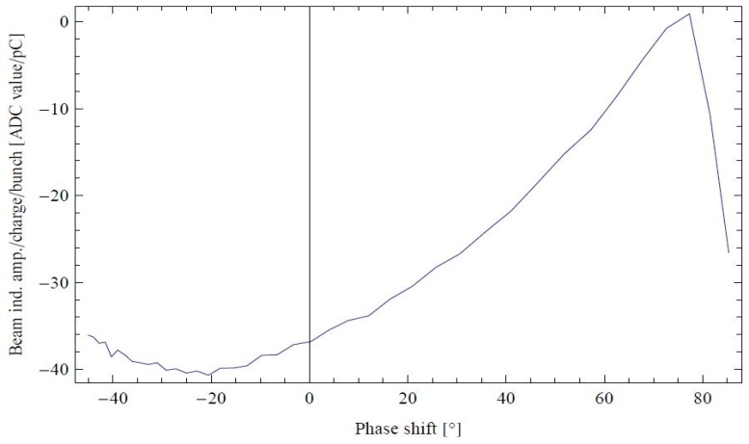
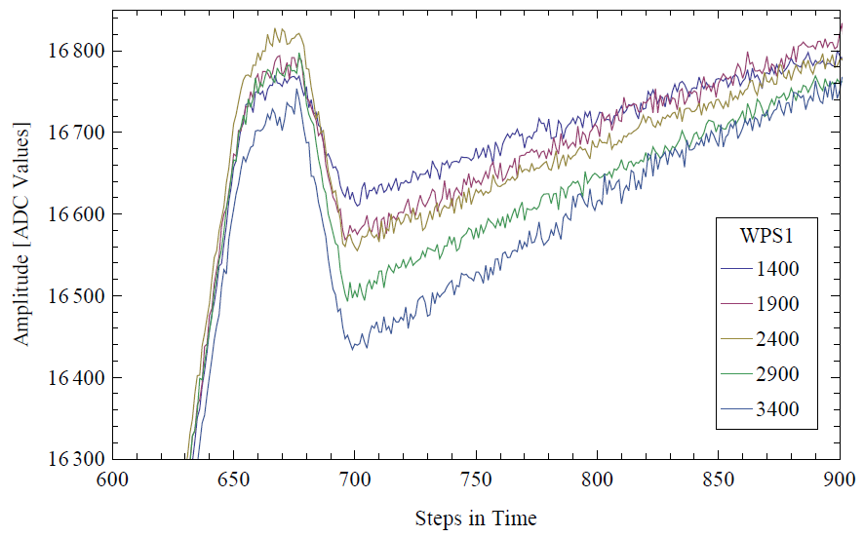
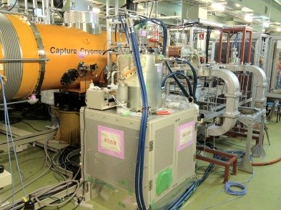
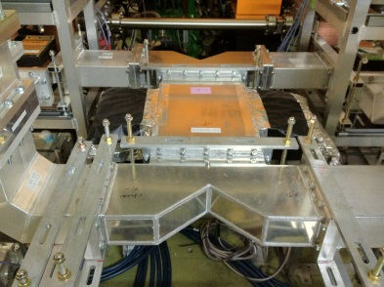
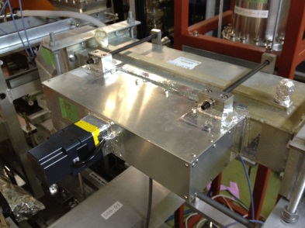
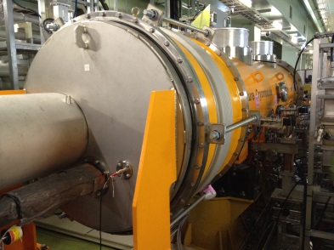
Beam based calibration
Scan phase shifter and observe beam loading
Mathieu OMET | 9回日本加速器学会年会 | The 9th Annual Meeting of Particle Accelerator Society of Japan | 2012/08/10 | 12

Slide 13

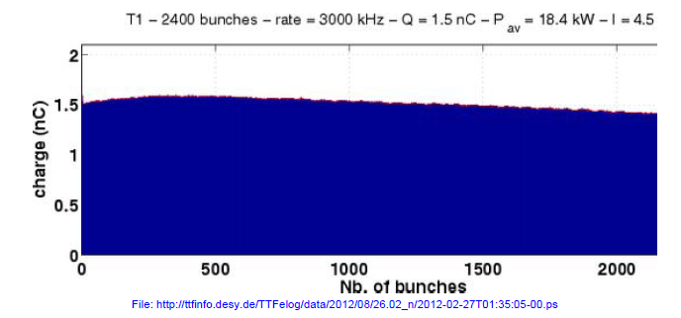


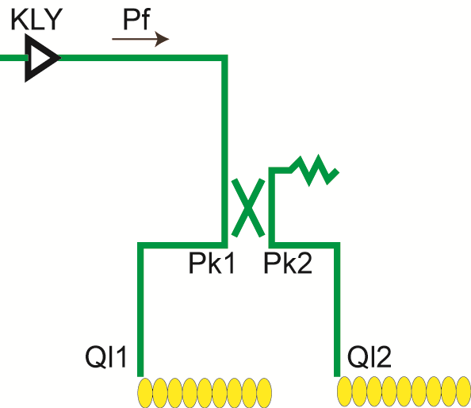
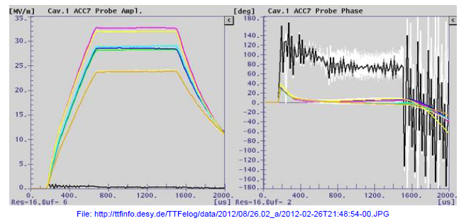
PkQl control
In case of the Pk-Ql control near the quench limit condition, the values of Pks and Qls are calculated as followings.
Select operational gradient of each cavity (Vcav)
Find out the Pk and Ql of each cavity under the specific beam current (Ibeam) and injection timing (Tinj).
PkQl control at FLASH

Slide 14
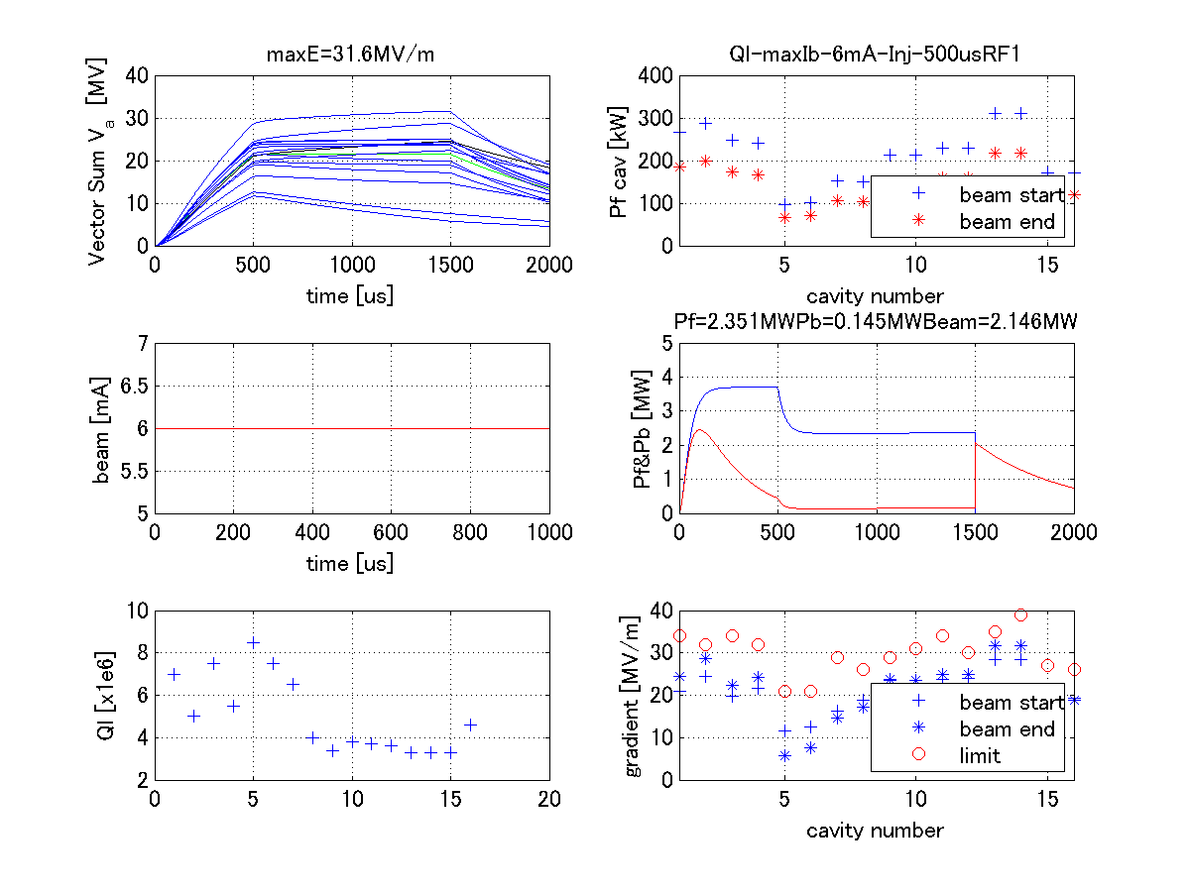
High Ql operation
ilc operation requires high Q operation (Ql 6e6~1e7)
It is difficult to examine at FLASH because of the limitation of Qls (some of them are max. 3e6) and fixed Pks.
In KEK, we can change Qls ~1e7 and variable Pks.
PkQl control at high Qls will be possible (same to ilc spec.)
Gradient
Ql

Slide 15
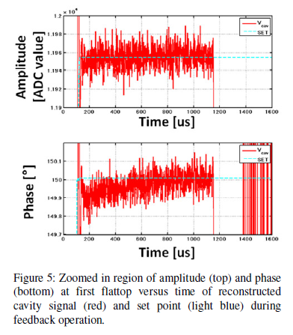
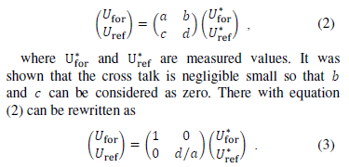
Other itmes (off-line studies)
Detuning monitor with beam
Beam based rf correction
RF gun pick-up calibration (directivity compensation)

