Slide 1
Renormalization of the Higgs sector in the triplet model
Kei Yagyu （National Central Univ.）
Collaborators:
Mayumi Aoki, Shinya Kanemura, Mariko Kikuchi
LCWS2012, Texas University at Arlington, Oct. 23rd
1/17

Slide 2

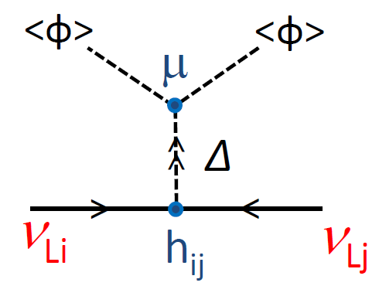
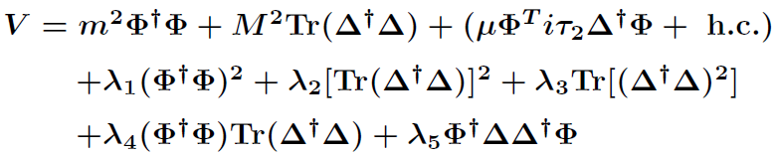
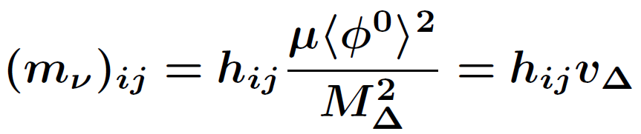
The Higgs Triplet Model
 | SU(2)I | U(1)Y | U(1)L
Φ | 2 | 1/2 | 0
Δ | 3 | 1 | -2
The Higgs triplet field Δ is added to the SM.
Cheng, Li (1980);
Schechter, Valle, (1980);
Magg, Wetterich, (1980);
Mohapatra, Senjanovic, (1981).
・Neutrino Yukawa interaction:
・Higgs Potential:
Lepton number breaking parameter
・Neutrino mass matrix
M_{Δ} : Mass of triplet scalar boson.
v_{Δ} : VEV of the triplet Higgs
2/17

Slide 3

The Higgs Triplet Model
 | SU(2)I | U(1)Y | U(1)L
Φ | 2 | 1/2 | 0
Δ | 3 | 1 | -2
The Higgs triplet field Δ is added to the SM.
Cheng, Li (1980);
Schechter, Valle, (1980);
Magg, Wetterich, (1980);
Mohapatra, Senjanovic, (1981).
・Neutrino Yukawa interaction:
・Higgs Potential:
Lepton number breaking parameter
・Neutrino mass matrix
O(0.1) eV
246 GeV
The HTM can be tested at colliders !!
O(0.1) eV
O(100) GeV
O(1)
2/17

Slide 4
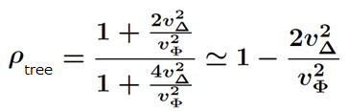

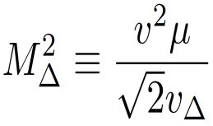
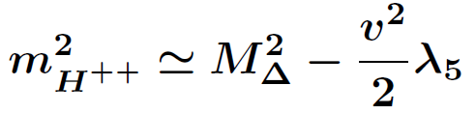
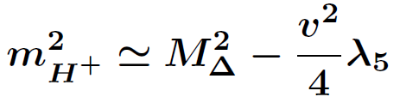

Important predictions
★ Rho parameter deviates from unity.
★ Extra Higgs bosons
Doubly-charged H±±, Singly-charged H±, CP-odd A and CP-even Higgs boson H
★ Characteristic mass relation is predicted.
m_{H++}² － m_{H+}² ≃ m_{H+}² － m_{A}²
Under v_{Δ} << v_{Φ} (From experimental data ρ_{exp} ~ 1)
Case I (λ₅ > 0)
Case II (λ₅ < 0)
Mass
Mass
A, H
H⁺⁺
_{Φ}
H⁺
H⁺
H⁺⁺
A, H
3/17

Slide 5


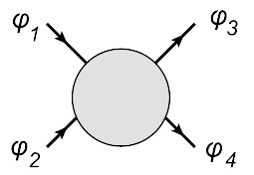

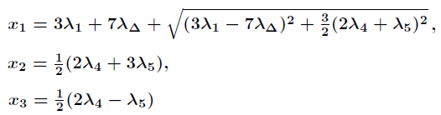
Theoretical bounds
‣Vacuum stability bound (Bounded from below)
Arhrib, et al., PRD84, (2011)
lim
(4)
V (rv₁, rv₂, …, rv_{n}) > 0
r→∞
λ₂ = λ₃ = λ_{Δ}
Lee, Quigg, Thacker, PRD16, (1977)
‣Perturbative unitarity bound
Aoki, Kanemura, PRD77, (2008); Arhrib, et al., PRD84, (2011)
ϕ_{i} : Longitudinal modes of weak gauge bosons and physical Higgs bosons
or 1
Eigenvalues of the matrix
|x_{i}| < 8π or 16π
4/17

Slide 6
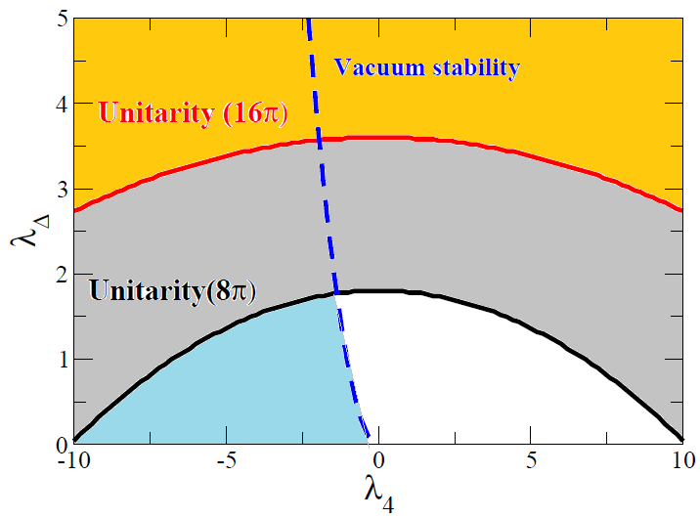
Theoretical bounds
Case for λ₅ = 0 (Δm = 0 )
Allowed
5/17

Slide 7

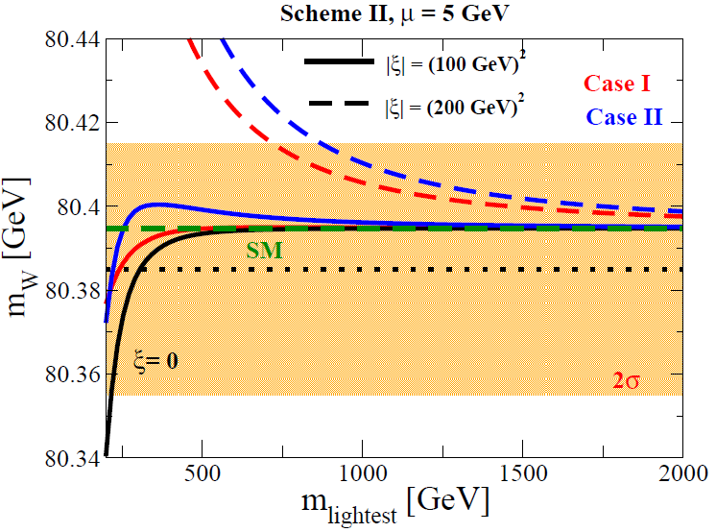
1-loop corrected W mass
ξ = m_{H++}² – m_{H+}²
mh = 126 GeV, mt = 173 GeV
Case I
Mass
μ = 5 GeV
A, H
H⁺
|ξ| = (200 GeV)²
H⁺⁺
Case II
Mass
|ξ| =
(100 GeV)²
H⁺⁺
H⁺
|ξ| = 0
A, H
In the large mass limit, the HTM can be decoupled to the SM.
6/17

Slide 8
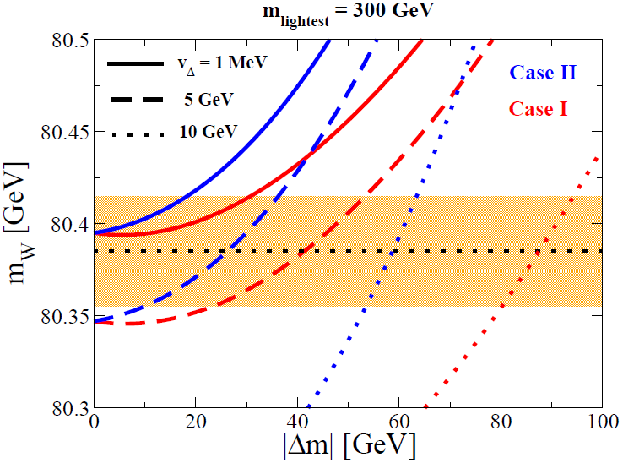
1-loop corrected W mass
Case I
Mass
Δm = m_{H++} – m_{H+}
mh = 126 GeV, mt = 173 GeV
A, H
H⁺
H⁺⁺
Case II
Mass
v_{Δ} = 1 MeV
H⁺⁺
v_{Δ} = 5 GeV
H⁺
v_{Δ} = 10 GeV
A, H
For large triplet VEV case, large mass difference is favored.
7/17

Slide 9
Testing the Higgs Triplet Model at colliders
Indirect way (Decoupling case)
-Precise measurement for the Higgs couplings
Ex. hγγ, hhh, hWW, hZZ, …
Direct way
-Discovery of extra Higgs bosons
Ex. Doubly-charged Higgs boson, Singly-charged Higgs boson, …
- Testing the mass spectrum among the triplet like Higgs bosons.
H⁺⁺, H⁺, H, A
126 GeV
h
8/17

Slide 10
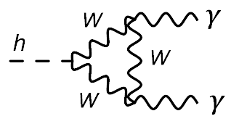
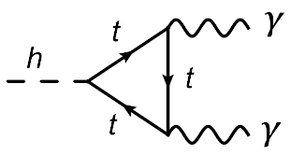
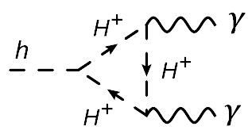
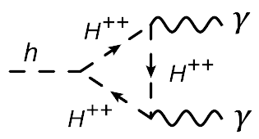

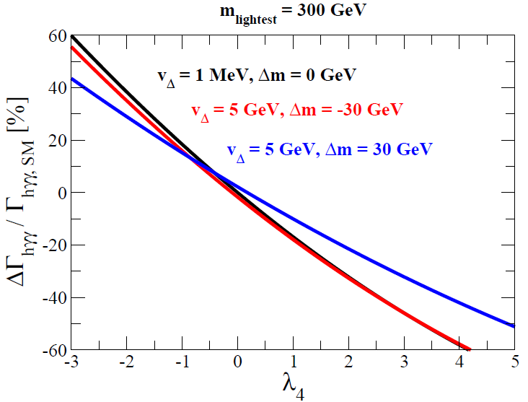

Higgs → γγ
Arhrib, et al. JHEP04 (2012);
Kanemura, KY, PRD85 (2012); Akeroyd, Moretti PRD86 (2012)
+
SM contribution ＋
Triplet-like Higgs loop contribution
$$λ_{hH^{+}H^{−}}≈−(λ_{4}+λ_{5}/2)v$$
If λ₄ < 0 → Constructive contribution
Sign of λ₄ is quite important!
If λ₄ > 0 → Destructive contribution
Signal strength (σ_{obs}/σ_{SM}) is
1.56± 0.43 (CMS) and 1.9±0.5 (ATLAS).
Disallowed
by vacuum stab.
When triplet Higgs mass ~ 300 GeV,
hγγ can be enhanced by ~ +40 % ~ +50% .
9/17

Slide 11
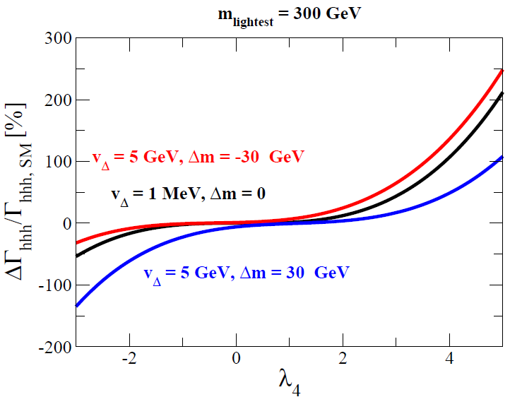
Renormalized hhh coupling
Aoki, Kanemura, Kikuchi, KY, PLB714 (2012)
h
Tree
1PI
Counter
term
=
+
+
h
h
Corresponds to
Δhγγ ~ +50 %
When hγγ (HTM) > hγγ (SM) [λ₄ <0], hhh (HTM) < hhh (SM).
In the case of λ₄ ~ -2, deviation of the hhh coupling is -10 ~ -60 %.
10/17

Slide 12
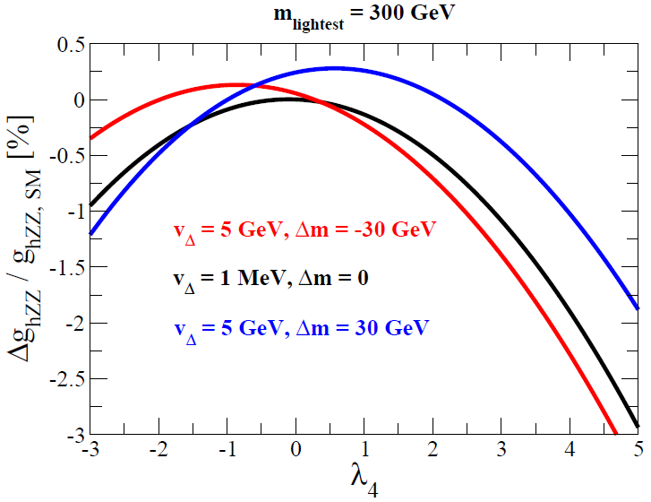
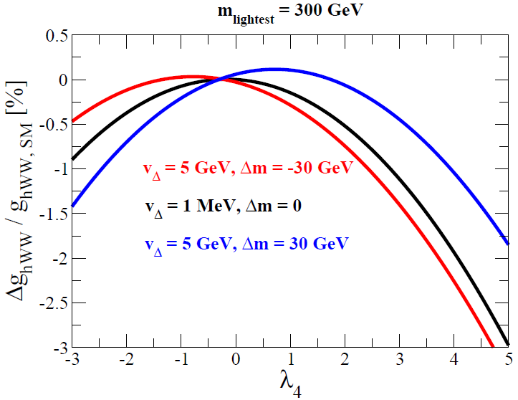
Renormalized hZZ and hWW coupling
Z, W
Tree
Counter
term
1PI
=
+
+
h
Z, W
hZZ
hWW
In the case of λ₄ ~ -2,
deviation of the hZZ (hWW) coupling is 0 ~ -0.5% (-0.1 ~ -0.7)%.
11/17

Slide 13
Testing the Higgs Triplet Model at colliders
Indirect way (Decoupling case)
-Precise measurement for the Higgs couplings
Ex. hγγ, hWW, hZZ, hhh, …
Direct way
-Discovery of extra Higgs bosons
Ex. Doubly-charged Higgs boson, Singly-charged Higgs boson, …
- Testing the mass spectrum among the triplet like Higgs bosons.
H⁺⁺,
H⁺,
H, A
126 GeV
h
12/17

Slide 14
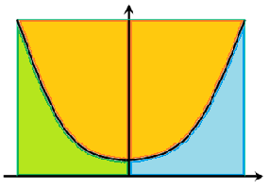
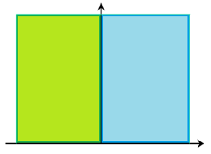
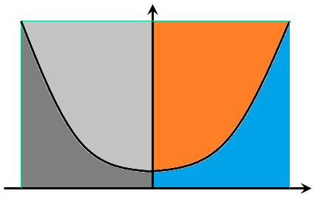
Decay property of the triplet-like Higgs bosons
[O(100) GeV case]
Decay of H⁺⁺
Δm
Decay of H⁺
Δm
Decay of H or A
Δm
H⁺ W⁺
H W⁺
νν
bb
l⁺l⁺
W⁺W⁺
l⁺ν
v_{Δ}
W⁺Z
1 eV
0.1 MeV
10 GeV
v_{Δ}
v_{Δ}
W⁺
W⁺
b
H⁺⁺
H⁺
H
b
W⁺
l⁺
H⁺⁺
H⁺⁺
W⁺
l⁺
Discussed by Chiang, Nomura,
Tsumura, PRD85, 2012
Excluded @ LHC
13/17

Slide 15
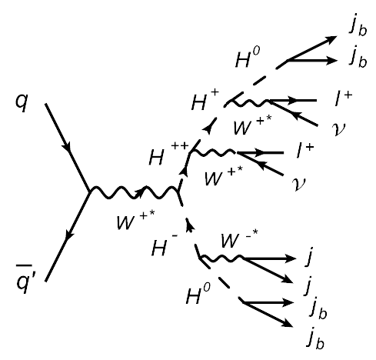
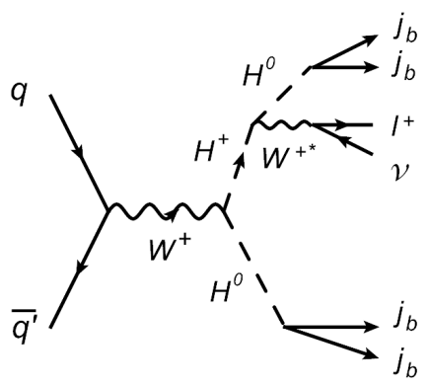
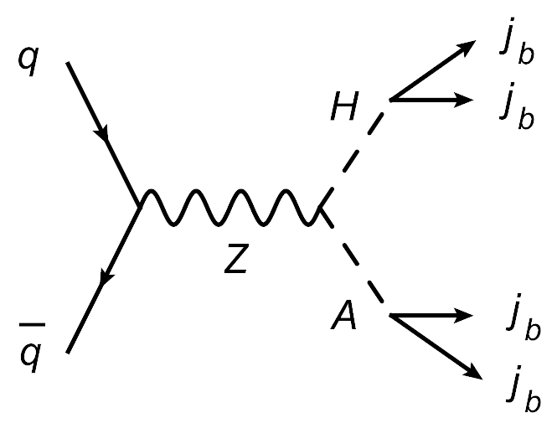
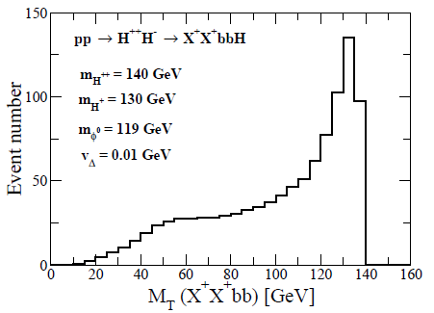
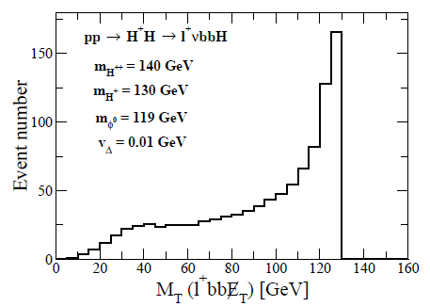
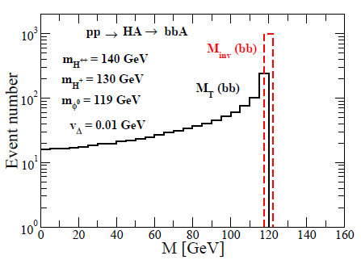
Mass reconstruction at LHC
H⁺⁺
140 GeV
H⁺
130 GeV
Aoki, Kanemura, KY, PRD85(2012)
H, A
119 GeV
h
114 GeV
qq’ → H⁺⁺H⁻ → (l⁺l⁺ννbb)(jjbb)
qq’ → H⁺H → (l⁺νbb)(bb)
qq → HA → (bb)(bb)
M_{T}, M_{inv}
M_{T}
M_{T}
8.0 fb (14 TeV)
2.8 fb (7 TeV)
33 fb
12 fb
130 fb
42 fb
Signal only
mH++
mH+
mH, mA
All the masses of the Δ-like scalar bosons may be reconstructed.
14/17

Slide 16
Decay property of the triplet-like Higgs bosons
[O(100) GeV case]
Decay of H⁺⁺
Δm
Decay of H⁺
Δm
Decay of H or A
Δm
H⁺ W⁺
H W⁺
νν
bb
l⁺l⁺
W⁺W⁺
l⁺ν
v_{Δ}
W⁺Z
1 eV
0.1 MeV
10 GeV
v_{Δ}
v_{Δ}
W⁺
W⁺
ν
W⁺
W⁺
b
H⁺⁺
H⁺
H
ν
H⁺⁺
H⁺
H
b
Challenging to detect at LHC
W⁺
l⁺
H⁺⁺
H⁺⁺
W⁺
l⁺
Discussed by Chiang, Nomura,
Tsumura, PRD85, 2012
Excluded @ LHC
15/17

Slide 17
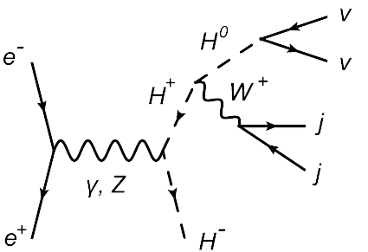
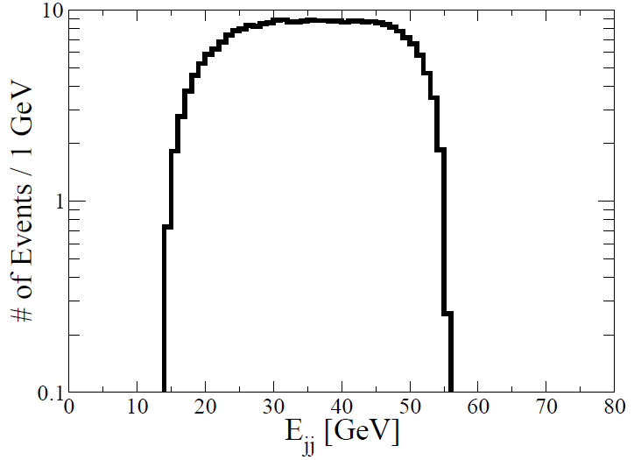
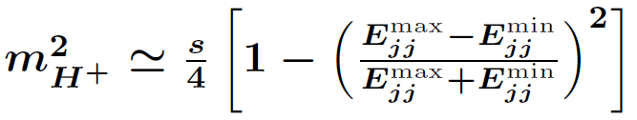
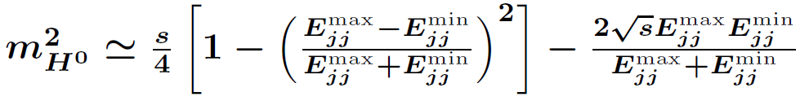
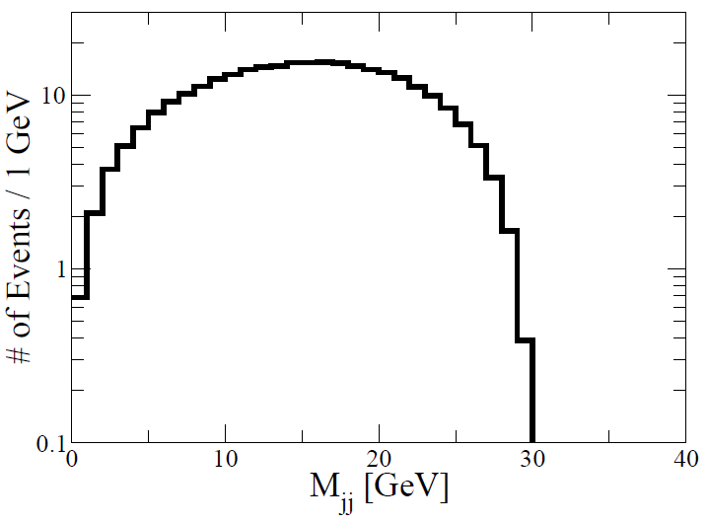

Mass reconstruction at ILC
Root(s)
mH+ = 200 GeV, mH = 170 GeV,
Root(s) = 500 GeV, 100 fb⁻¹
σ ~ 20 fb
E_{jj}^{min}
E_{jj}^{max}
Dijet Energy E_{jj}
Dijet Invariant mass M_{jj}
M_{jj}^{max}
H⁺⁺ can be measured by looking at the
excess of the SS dilepton + jets + missing event.
16/17

Slide 18
Summary
‣The Higgs Triplet Model (HTM)：
Tiny neutrino masses can be explained.
‣Indirect way to test the HTM at colliders (Decoupling case):
Measuring the deviation of the Higgs coupling from the SM prediction.
Ex) Triplet Higgs mass = 300 GeV case
・ hγγ → +50% Current LHC data can be reproduced.
・ hhh → -60 % ~ +100 % Direction of the correction is opposite to hγγ.
・ hZZ, hWW → ~-1 % O(1%) deviation of hVV can be measured at the ILC.
‣Direct way to test the HTM at colliders (Light triplet Higgs case):
At the LHC, mH > mH+ > mH++ with small vΔ case is challenging to test the model.
At the ILC, even if this scenario is realized, triplet-like Higgs bosons may be
detectable by using the dijet energy and invariant mass distribution.
ILC is necessary to test the HTM in both indirect way and direct way!!
17/17

Slide 19
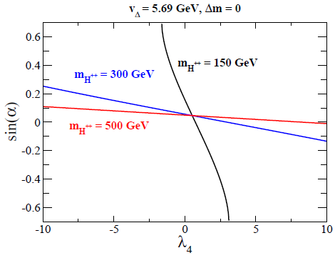

Slide 20
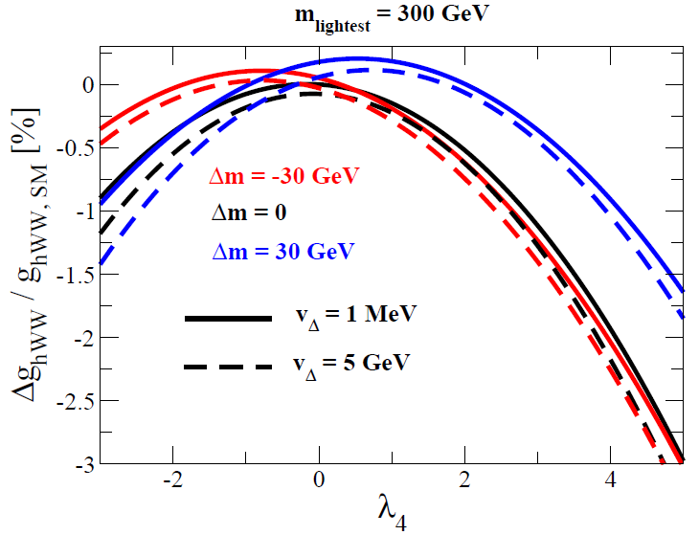
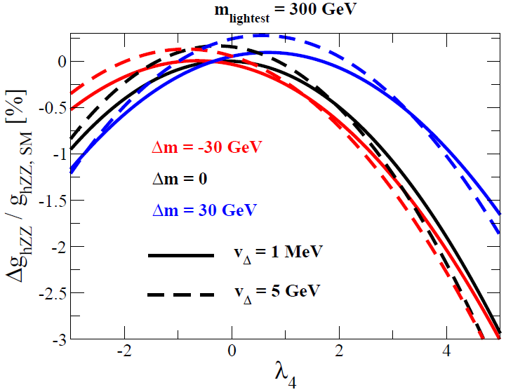

Slide 21
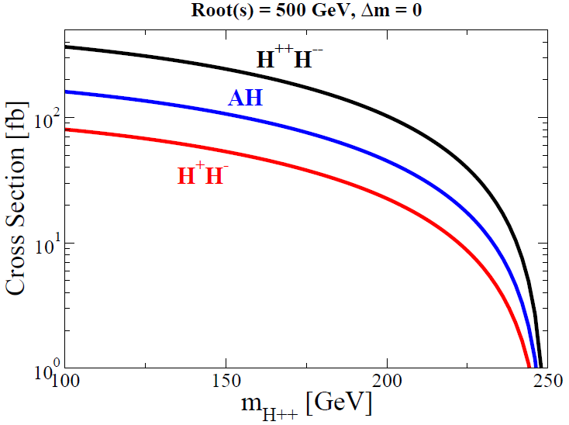
Cross section

Slide 22
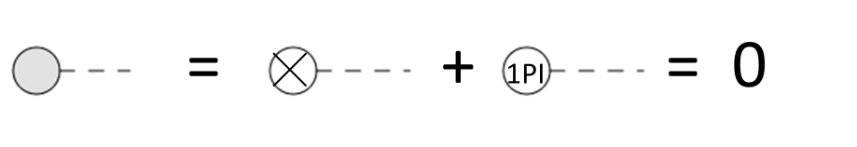

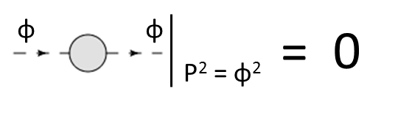

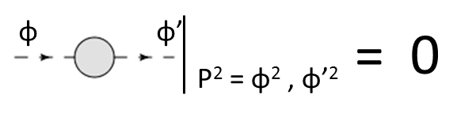

Renormalization of the Higgs potential
Aoki, Kanemura, Kikuchi, KY, PLB714
8 parameters in the potential
8 physical parameters
μ , m , M , λ₁ , λ₂ , λ₃ , λ₄ , λ₅
v , m_{H++} , m_{H+} , m_{A} , m_{h} , m_{H} , α, β’ (vΔ)
δv , δm_{H++}² , δm_{H+}² , δm_{A}², δm_{h}² , δm_{H}² , δα, δβ’
Counter terms
Tadpole： δT_{φ ,} δT_{Δ ,}
Wave function renormalization：δZ_{H++,} δZ_{H+,} δZ_{A,} δZ_{H,} δZ_{h}
Reno. of EW parameters
δv
Vanishing 1-point function
δT_{φ ,} δT_{Δ}
On-shell condition
δm_{H++}² , δm_{H+}² , δm_{A}², δm_{H}² , δm_{h}²
δZ_{H++,} δZ_{H+,} δZ_{A,} δZ_{H,} δZ_{h}
No-mixing condition
δα, δβ’
where 2-point function is defined by
Notes:
Next, we go to the discussion about the renormalization of the Higgs potential in the HTM based on the
On-shell renormalization scheme.
In the HTM, there are eight parameters in the potential.
These parameters can be rewritten in terms of the eight physical parameters.
These are two VEVs, five mass parameters and one mixing angle between CP-even scalar states.
To renormalize the Higgs potential, we prepare following the couter terms.
In addition to the counter terms for the above 8 parameters,
We have two Tadpole counter terms, and wave function renormalization factors.
To determine these counter terms, we impose following the renormalization conditions.
First, counter terms for the VEVs are determined by the renormalization of the EW parameters such as
The GF and sw.
Next, tadpole couter terms are determined by the condition for vanishing the one-point function.
Third, by imposing the on-shell condition, the counter terms for the mass parameters as well as the wave function renormalization can be
Determined.
Finally, the counter terms for the mixing angle can be determined by imposing the no mixing condition.
From these renormalization conditions, we can calculate finite quantities.

Slide 23
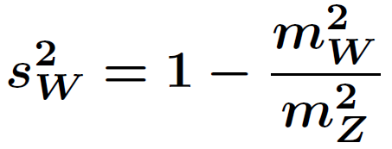
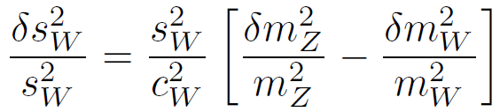
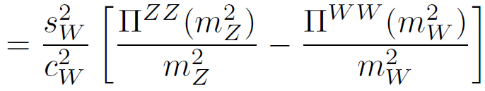
Constraints from EW precision data
There are 3 parameters: g, g’ and v in the kinetic term of Higgs fields.
The electroweak observables are described by the 3 input parameters.
We can choose α_{em}, m_{W} and m_{Z} as the 3 input parameters.
The weak angle sin²θ_{W} = s_{W}² can be described in terms of the gauge boson masses.
The counter term of δs_{W}² is derived as
~ δρ = ρ-1 = α_{em} T
The quantity δρ (or T) measures the violation of the custodial symmetry.

Slide 24
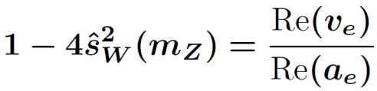
Constraints from EW precision data
There are 4 parameters (instead of 3 in the SM):
g, g’, v and v_{Δ} in the kinetic term of Higgs fields.
The electroweak observables are described by the 4 input parameters.
The weak angle sin²θ_{W} = s_{W}² cannot be given in terms of the gauge boson masses.
Scheme 1
Input parameters:
m_{W}, m_{Z}, α_{em}, s_{W}²
Blank, Hollik (1997)
Scheme 2
Input parameters:
m_{W}, m_{Z}, α_{em}, v_{Δ}
Chankowski, Pokorski, Wagner (2007);
Chen, Dawson, Jackson (2008)
e
Z
e

Slide 25
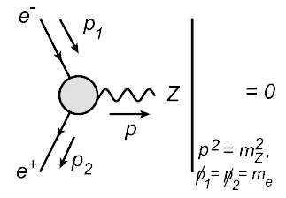

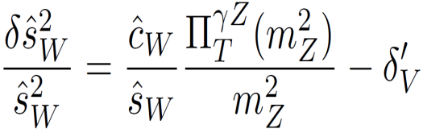
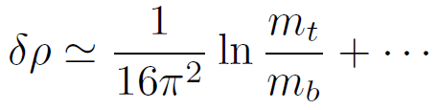
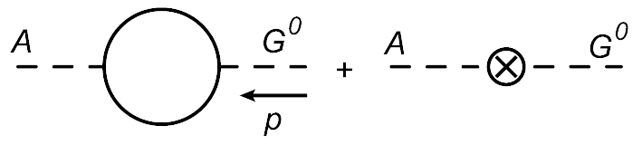

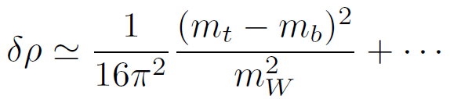
Additional renormalization condition
Scheme 1
= 0
1PI diagram
Counter term
Scheme 2

Slide 26



Diboson decay scenario
Realizing v_{Δ} > 0.1 MeV with Case I
Chiang, Nomura, Tsumura, 2012
‣Signal: Same-sign dilepton + Jets + Missing
When mH++ = 100 GeV, root(s) = 7 TeV
the signal cross section is ~ 3 fb.
‣Chiang, Nomura and Tsumura studied discovery
potential for this scenario at the LHC.
ATLAS, data 2011
‣Data: L~2 fb⁻¹, root(s) = 7 TeV at ATLAS
6 events have been discovered, which is consistent
with the SM prediction.
Can we set a lower bound for the mass of H⁺⁺
in the case of H⁺⁺ decays into diboson?

Slide 27




Mass reconstruction at ILC
Ex. mX+ = 200 GeV, mX0 = 70 GeV

Slide 28


Experimental bounds (Direct)
Assuming 100% same-sign leptonic decay of the doubly-charged Higgs boson
CMS PAS HIG-12-005, 7TeV, 4.6 fb⁻¹
mH⁺⁺ > 400 GeV
~

Slide 29




Dilepton decay scenario
Realizing v_{Δ} < 0.1 MeV with Case I.
‣By measuring the pattern of leptonic decay, we can direct test the neutrino mass matrix.
Akeroyd, Aoki, Sugiyama, 2008
l_{i}⁺
BR
H⁺⁺
∝ |h_{ij}|²
l_{j}⁺
‣Lepton flavor violation (μ → 3e, μ-e conversion, etc)
h_{eμ}
Chun, Lee, Park, 2003; Kakizaki, Ogura, Shima, 2003;
Abada, Biggio, Bonnet, Gavela, Hambey, 2007, …
h_{ee}
‣LHC phenomenology
-4 lepton , 3 lepton signature
Perez, Han, Huang, Li, 2008 ; Akeroyd, Chiang, Gaur, 2010, …
-Using tau polarization
Discrimination of chiral structure of the Yukawa coupling
Sugiyama, Tsumura, Yokoya, arXiv:1207.0179
-Same sign tetra-lepton signature
Chun, Sharma, arXiv:1206.6278

Slide 30








Experimental bounds (Indirect)
Gauge boson
self-energies
6 nondec. d.o.f.
Model w/ ρ_{tree} = 1
=
3 input parameters
→ 6-3 (Ren. conditions) = 3 nondec. d.o.f.
= S, T, U
Peskin, Takeuchi, PRL65, (1990)
=
=
Model w/o ρ_{tree} = 1
4 input parameters
→ 6-4 (Ren. conditions) = 2 nondec. d.o.f.
Blank, Hollik, NPB514, (1998)
=
1-loop corrected W mass
Kanemura, KY, PRD85 (2012)
Case I
Case II
A, H
H⁺⁺
H⁺
H⁺
H⁺⁺
A, H

Slide 31






Radiative corrections to the mass spectrum
Aoki, Kanemura, Kikuchi, KY, arXiv: 1204.1951
Ratio of the squared mass difference R
Case I
Tree level:
Less than 10⁻³
Loop level:
Loop correction
(m_{A}²)_{tree}is determined by m_{H++}² and m_{H+}² :
In favored parameter sets by EW precision data: m_{H++} = O(100)GeV,
|Δm|～100GeV, ΔR can be as large as O(10)%.
Notes:
Then, we discuss the radiative corrections to the mass spectrum.
First, we define the squared mass difference R as follows.
At the tree-level, this quantity can be expressed like this.
This terms can be neglected, because the triplet vev is constrained from above about 8 GeV,
So that this terms is less than 10 to minius 3.
At the loop level, this expreesion is modified like this.
This Delta R represents the loop correction.
By imposing the on-shell conditions as we discuss previous slide,
Delta R can be obtained in terms of two point 1PI diagrams,
Where mAtree is …
This figure shows the Delta R as a function of the doubly charged Higgs boson mass in case of the case I,
Where H++ is the lightest.
As you can see, the sign of the correction is negative and its magnitude can be as large as O(10) %

Slide 32











Custodial Symmetry
The SM Lagrangian can be written by the 2×2 matrix form of the Higgs doublet:
When we take g’ and y_{A} → 0,
Lagrangian is invariant under SU(2)_{L}×SU(2)_{R}
★ Kinetic term
,
After the Higgs field gets the VEV:
this symmetry is reduced to
SU(2)_{L}＝SU(2)_{R} =SU(2)_{V} (custodial symmetry).
★ Higgs potential
SU(2)_{V} breaking by g’ is included in the definition of the rho parameter,
while that by y_{A} is not.
There is a significant contribution to the deviation of rho = 1 from the
top-bottom sector by the loop effect.
★ Yukawa interaction (top-bottom sector)
Notes:
Let us consider following the SU(2)_L and SU(2)_R transformation.
The terms proportional to g’ and yA are not invariant under this SU(2)_R transformation,
Because these two terms are inserted the tau3 Pauri matrix.
Namely, tau3 and UR cannot be commuted each other.
The other terms are invariant.
This means that only the transformation by the same angles of SU(2)_L and SU(2)_R is invariant.
When we introduce the triplet field, and it gets the VEV like this,
Then we can see that the triplet VEV is breaking the custodial symmetry in the kinetic term,
So that in the HTM, the rho parameter already deviates from unity at the tree level.

Slide 33

1-loop corrected W mass
Case I
Case II
ξ = m_{H++}² – m_{H+}²
Mass
Mass
A, H
H⁺⁺
H⁺
H⁺
Scheme 1
Scheme 2
H⁺⁺
A, H
In Scheme II, decoupling limit can be taken in the heavy mass limit.

Slide 34




Production mechanisms at LHC
Main production process
Drell-Yan
- depends on the
gauge coupling
g
g
Vector Boson Fusion
- depends on v_{Δ} → Suppressed
v_{Δ}
W associate
- depends on v_{Δ} → Suppressed
v_{Δ}

Slide 35


Slide 36


Decay
The decay of Δ-like Higgs bosons can be classified into 3 modes.
1. Decay via h_{ij}
2. Decay via v_{Δ}
3. Decay via g
l
V
f, V
W
Δ
Δ
Δ
×
Φ
v_{Δ}
Δ
h_{ij}
v_{Δ}
g_{W}
l
f, V
V
Δ’
Decay of H⁺⁺
Δm (= mH⁺⁺ - mH⁺)
Decay modes of 1 and 2 are related to
each other by the relation:
H⁺⁺ → H⁺W⁺
H⁺ W⁺
Case II
v_{Δ}
H⁺⁺ → l⁺l⁺
H⁺⁺ → W⁺W⁺
Case I
Decay of the triplet like scalar bosons strongly depend on v_{Δ} and Δm (≡ m_{H++} - m_{H+}).
l⁺l⁺
1 GeV
W⁺W⁺
1 eV
0.1-1 MeV
10 GeV

