Slide 1
9 mA study at FLASH on Sep., 2012
Shin MICHIZONO (KEK)
Outline
Achievement before Sep.2012
Study items for ILC
III. Study plan
IV. Study results
Gradient study for near quench limit operation
Klystron output linearization
RF operation near klystron saturation
V. Summary and future plan

Slide 2
R&D results (upto Feb. 2012)
High beam power and long bunch-trains (Sept 2009)
Metric | ILC Goal | Achieved
Macro-pulse current | 9mA (5.8mA) | 9mA
Bunches per pulse | 2400 x 3nC (3MHz) | 1800 x 3nC 2400 x 2nC
Cavities operating at high gradients, close to quench | 31.5MV/m +/-20% | 4 cavities > 30MV/m
Gradient operating margins (updated following Feb 2012 studies)
Metric | ILC Goal | Achieved
Cavity gradient flatness (all cavities in vector sum) | 2% ΔV/V (800μs, 5.8mA) (800μs, 9mA) | <0.3% ΔV/V (800μs, 4.5mA) First tests of automation for Pk/Ql control
Gradient operating margin | All cavities operating within 3% of quench limits | Some cavities within ~5% of quench (800us, 4.5mA) First tests of operations strategies for gradients close to quench
Energy Stability | 0.1% rms at 250GeV | <0.15% p-p (0.4ms) <0.02% rms (5Hz)

Slide 3
9 mA study at FLASH on Sep., 2012
Shin MICHIZONO (KEK)
Outline
Achievement before Sep.2012
Study items for ILC
III. Study plan
IV. Study results
Gradient study for near quench limit operation
Klystron output linearization
RF operation near klystron saturation
V. Summary and future plan

Slide 4
Study items for ILC
High beam current
  From 4.5 mA (Feb. 2012) to 6 mA
Gradient study for near quench limit operation
  PkQl control was carried out on Feb. 2012.
  In February, we had some cavities within 10% of quench, ILC design parameters assume all cavities operate within 5% of quench
Klystron output linearization
  To operate the klystron near saturation, linearization would be essential for high gain feedback operation.
RF operation near klystron saturation
  In February, we got to within 7% of the saturation power by reducing the klystron anode voltage
  The ILC design assumes 5% power overhead
Combination of these results
  High beam (6 mA), rf operation near saturation, cavity gradient near quench limit

Slide 5
9 mA study at FLASH on Sep., 2012
Shin MICHIZONO (KEK)
Outline
Achievement before Sep.2012
Study items for ILC
III. Study plan
IV. Study results
Gradient study for near quench limit operation
Klystron output linearization
RF operation near klystron saturation
V. Summary and future plan

Slide 6
Intended studies program
 | Sep. 17 Mon | Sep.18 Tues | Sep.19 Wed | Sep.20 Thurs | Sep.21 Fri | Sep.22 Sat
M | Switch to 3MHz/5Hz | Set up long fill time, flat rf pulse | Gradient studies | Gradient studies | Integrate main studies tracks, with goal of high current operation close to quench with klystron saturation
A | Set up machine with high charge long pulses | Set up long fill time, flat rf pulse | Klystron saturation studies | Klystron saturation studies
N | Tuning towards 6mA, 2400 bunches | Tuning towards 6mA, 2400 bunches | Saturation studies, machine tuning | Saturation studies, machine tuning

Slide 7
Actual studies
 | Sep. 17 Mon | Sep.18 Tues | Sep.19 Wed | Sep.20 Thurs | Sep.21 Fri | Sep.22 Sat
M | Switch to 3MHz/5Hz | Set up long fill time, flat rf pulse | Gradient studies | Gradient studies | Integrate main studies tracks, with goal of high current operation close to quench with klystron saturation
A | Set up machine with high charge long pulses | Set up long fill time, flat rf pulse | Klystron saturation studies | Klystron saturation studies
N | Tuning towards 6mA, 2400 bunches | Tuning towards 6mA, 2400 bunches | Saturation studies, machine tuning | Saturation studies, machine tuning
RF studies (waiting for beam)
Gradient studies
(partial)
Gradient studies
(partial)
Klystron studies
Klystron studies
(partial)
About 6 shifts were available and these were not sufficient to complete the studies.

Slide 8
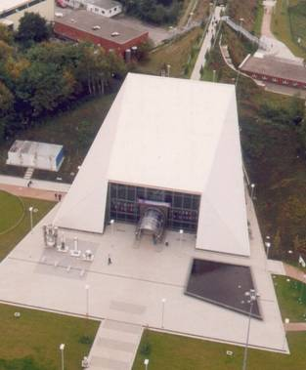
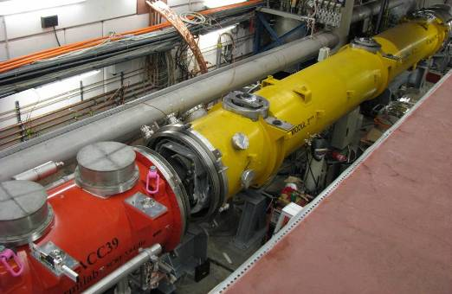
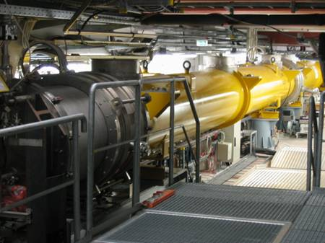
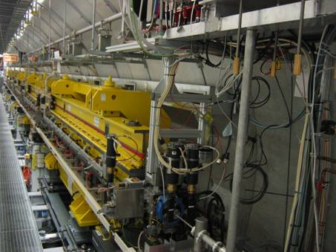
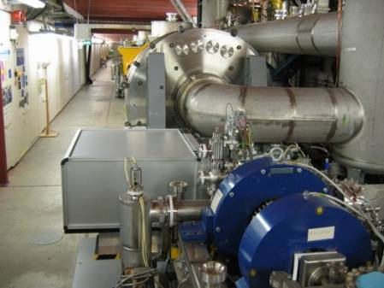
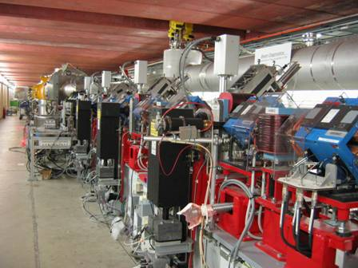
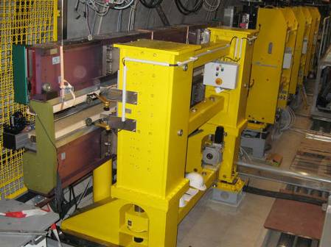
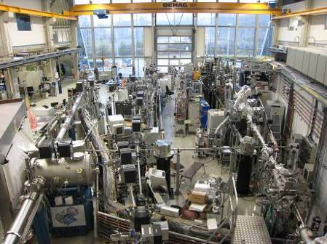
FLASH layout
Diagnostics
Accelerating Structures
sFLASH
Undulators
Bunch Compressor
Bunch Compressor
ACC6&7 (total 16 cav.)
FEL Experiments
5 MeV
160 MeV
500 MeV
1200 MeV
Bypass
315 m

Slide 9
9 mA study at FLASH on Sep., 2012
Shin MICHIZONO (KEK)
Outline
Achievement before Sep.2012
Study items for ILC
III. Study plan
IV. Study results
Gradient study for near quench limit operation
Klystron output linearization
RF operation near klystron saturation
V. Summary and future plan

Slide 10
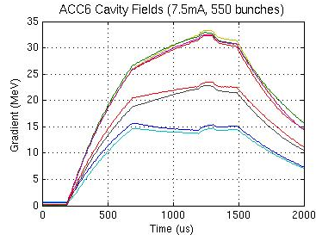
Cavity gradient tilts from beam loading
A ‘feature’of running cavities with a spread of gradients when the are all fed from same RF source
Steady-state cavity voltage
(Note: Vector Sum is constant)
Solution: adjust individual Pks and Qls so each cavity is ‘matched’ for the same beam current
Ratios of power required by each cavity are different between beam off and beam on
Klystron power increases linearly with beam current
Higher gradient cavities get too much extra power
Lower gradient cavities get not enough extra power
Must be solved uniquely for a given beam current and set of gradients

Slide 11
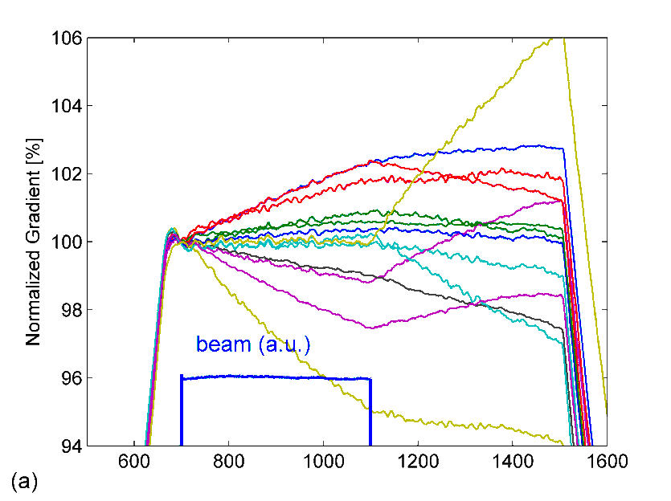
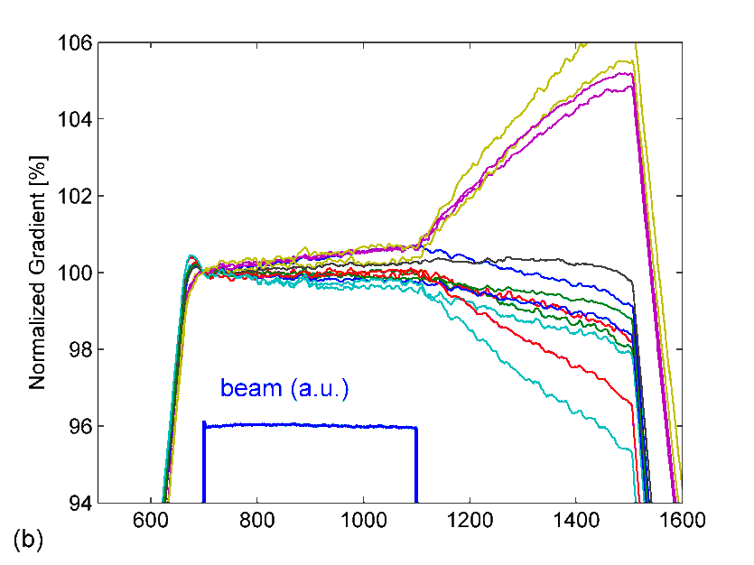
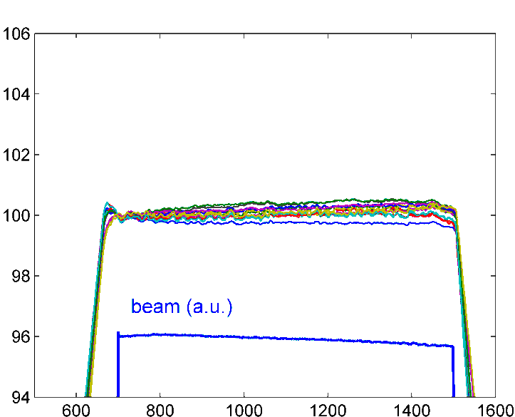
ILC: 9mA @ FLASH: Gradient Study
Results from FLASH 9mA study (Feb. 2012): I_{beam} = 4.5 mA
Results from FLASH 9mA study (Sep. 2012):
QL optimization algorithm now includes exception handling (Piezo, Ql,…)
Still not fully understood about optimization procedure (next study):
A
B
C
400 usec
400 usec
800 usec
A
Time [usec]
B
Time [usec]
C
Time [usec]
short bunch train
default Q_{L} = 3x10⁶
short bunch train
optimized Q_{L}
long bunch train
optimized Q_{L}

Slide 12
9 mA study at FLASH on Sep., 2012
Shin MICHIZONO (KEK)
Outline
Achievement before Sep.2012
Study items for ILC
III. Study plan
IV. Study results
Gradient study for near quench limit operation
Klystron output linearization
RF operation near klystron saturation
V. Summary and future plan

Slide 13
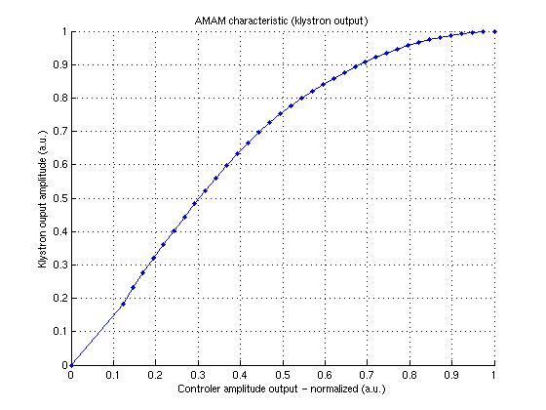
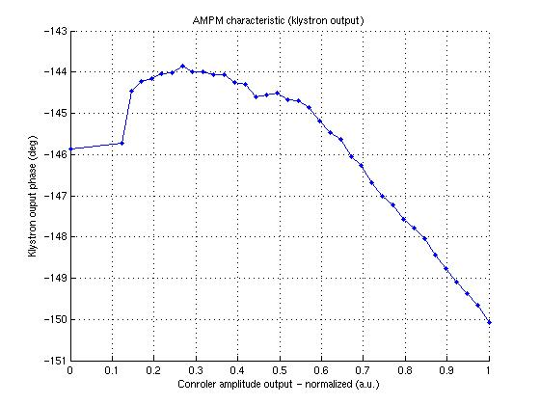
Measured input-output characteristics of klystron
One of the key assumption for ILC design is to operate the RF station near to klystron saturation region (about 5% below hard saturation). In order to determine such inconvenient range of operation (where gain rapidly decreases to 0) the set of measurement has been performed to characterize system behavior (gain change) in function of controller (input) signal change.
Transfer characteristics achieved for high power chain for modules ACC67 @ FLASH (for reduced cathode voltage value =~86kV) revealed saturation points for given controller output level.
As the nonlinearity and saturation issue is only signal amplitude level dependent – figures shows measured dependence between controller signal amplitude and klystron output (for amplitude and phase). It has to be emphasize that transfer characteristics includes not only klystron behavior but also gain and phase modification caused by preamplifiers.

Slide 14
Linearization tool concept and implementation
Correction inside digital system
linearization
The nonlinearities identified during the system characterization has been used to find inverse function that is described in look-up tables in LLRF controller (FPGA side). The LUT table is indexed by calculated controller signal amplitude. Complex multiplication of the control signal with correction signal from LUT's result in corrected signal generation. This signal is amplified by nonlinear klystron and is distributed.

Slide 15
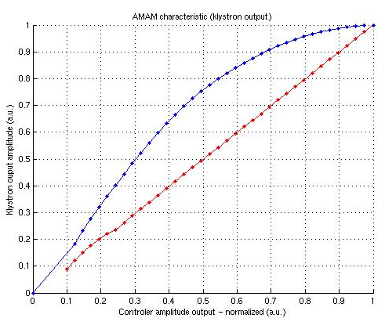
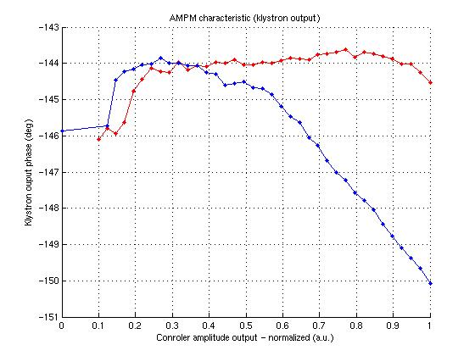
Linearization results
The results of linearization achieved during last high beam current studies at FLASH (RF station for accelerating modules ACC67 – 10 MW klystron) (red characteristics).
Proposed and implemented method allowed for klystron behavior linearization. Although some system weak points can be recognize (eq. poor phase detection for low signal levels) amplitude and phase characteristic correction can be considered as satisfactory.
The main benefit of constant gain maintenance can be clearly noticed especially for operation with wide working point range (eq. high feedback gain control).

Slide 16
9 mA study at FLASH on Sep., 2012
Shin MICHIZONO (KEK)
Outline
Achievement before Sep.2012
Study items for ILC
III. Study plan
IV. Study results
Gradient study for near quench limit operation
Klystron output linearization
RF operation near klystron saturation
V. Summary and future plan

Slide 17
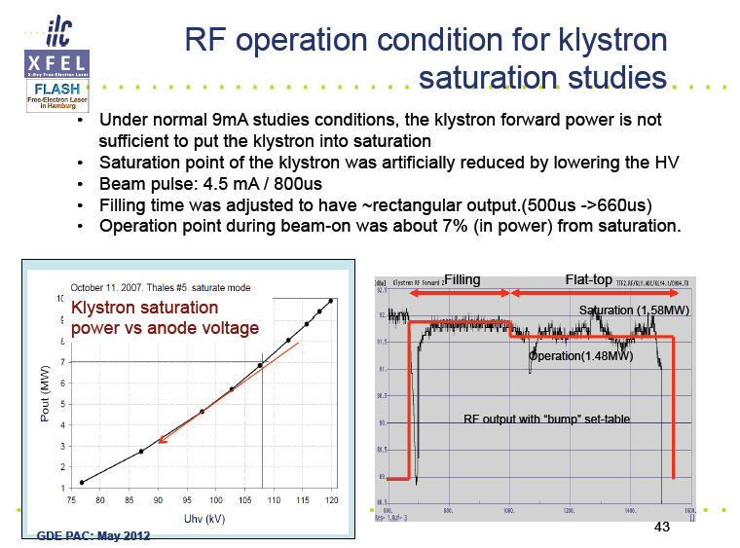

Slide 18
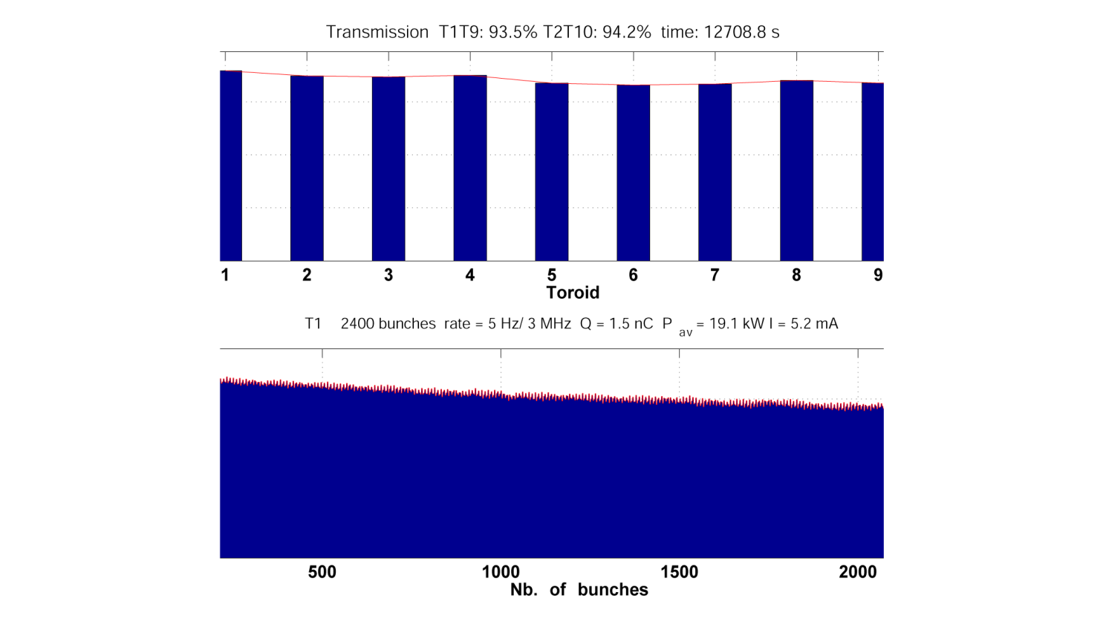
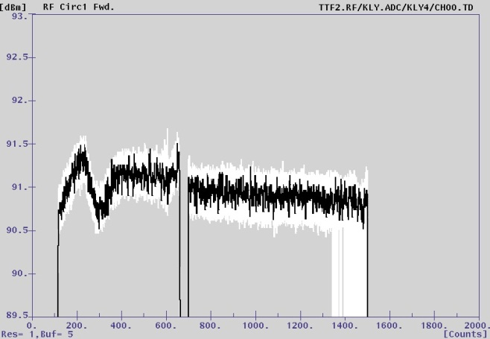
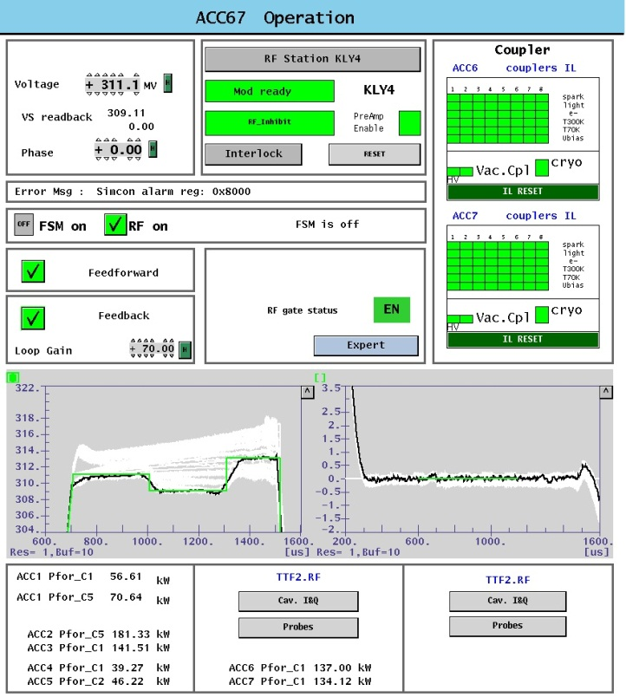
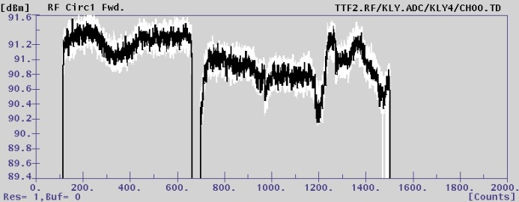
Preparation for saturation study
We adjust filling time (550 us or 590 us) to have a flat rf output at 5.2 mA (800 us).
We decrease HV of the klystron to operate near saturation.
ILC specification requires to operate -0.22dB (-5%) from saturation.
Artificial step is introduced to confirm the saturation point during rf pulse
Beam profile
RF output
Beam current is ~20% different during pulse.
Further study will be necessary with flat beam
Filling beam
-0.3dB
beam

Slide 19
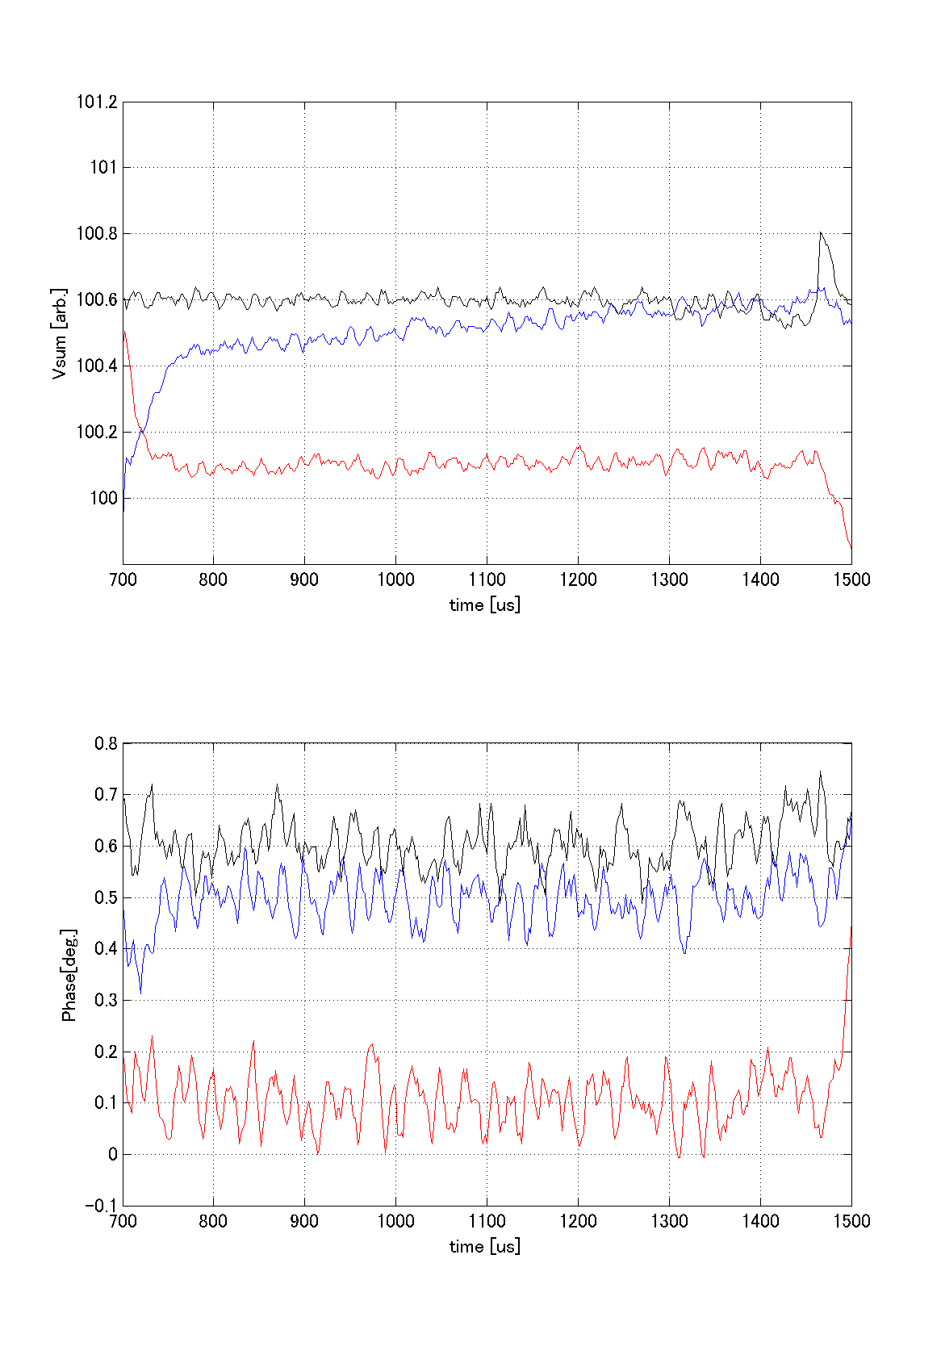
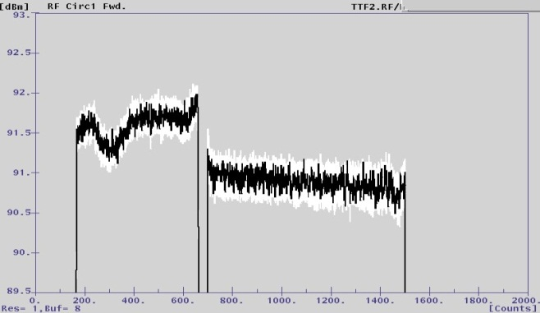
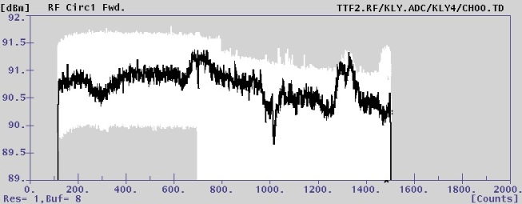
Measured stability
Vector sum amplitude [arb.]
beam
nominal
RF output with artificial step
-0.3dB
Vector sum phase [deg.]
-0.3dB
operation
Stability just after the beam is insufficient probably due to the limited FB gain.
Further study will be necessary.
with longer time (> hours), higher gain
beam
-0.2dB
operation
-0.2dB
beam

Slide 20
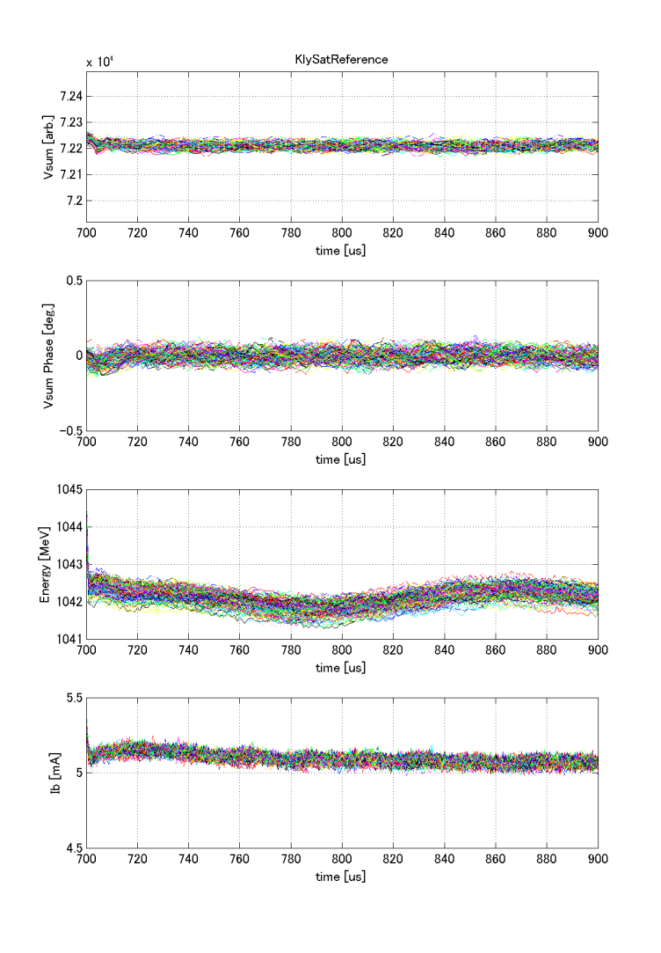
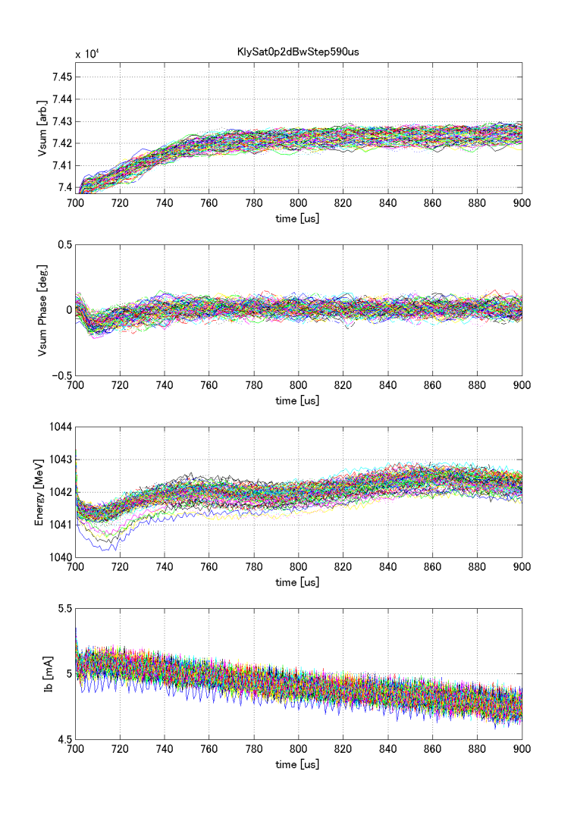
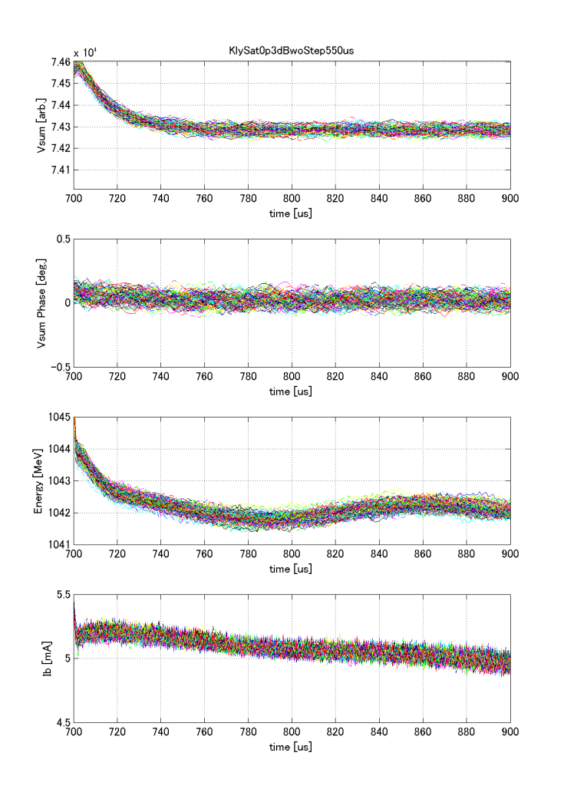
150 pulse envelope
Amp., phase, beam energy, current are compared. (initial 200us of pulse)
VS amplitudes at the beginning of -0.3dB and -0.2dB show some slope due to the limited beam loading suppression. -> Further study will be necessary.
Nominal -0.3dB operation -0.2dB operation
with gap without gap -
VS amplitude
VS phase
Beam Energy
Beam current
0.4%
0.4%
0.4%
0.5deg.
0.5deg.
0.5deg.
2MeV
2MeV
2MeV
5.5mA
5mA
4.5mA
“nominal” and “-0.3dB” have a gap between filling and beam.
“-0.2dB” has no gap between filling and beam. -> response is opposite.

Slide 21
Summary and future plan
Several studies have been carried out at FLASH for technical demonstration of ILC specification.
  PkQl control (Ql adjustment) for near quench limit operation
  Klystron linearization and rf operation near saturation
  High current beam loading with long bunch train.
For the engineering phase (post TDR), we need to accumulate more experience for stable operation.
XFEL and ILC have many common study items because of the similar beam parameters.
Further studies will be necessary.
  -> strategy for automation (reach near quench limit without exceeding etc.)
  -> Beam energy stability, long term stability with flat beam current
  -> High beam, high gradient, near klystron saturation study
FLASH
(10% of XFEL)
 | EU-XFEL | ILC (250GeV)
Gradient | 23.6 MV/m | 31.5 MV/m +-20%
Bunch charge | 1 nC | 3.2 nC
Beam current | 5 mA | 5.8 mA
Energy stability | 2.5MeVrms/20GeV (0.013%) | 0.1% rms
Operate FLASH as if it were XFEL
EU-XFEL
(10% of ILC)
Operate EU-XFEL as if it were ILC
ILC

