Slide 1
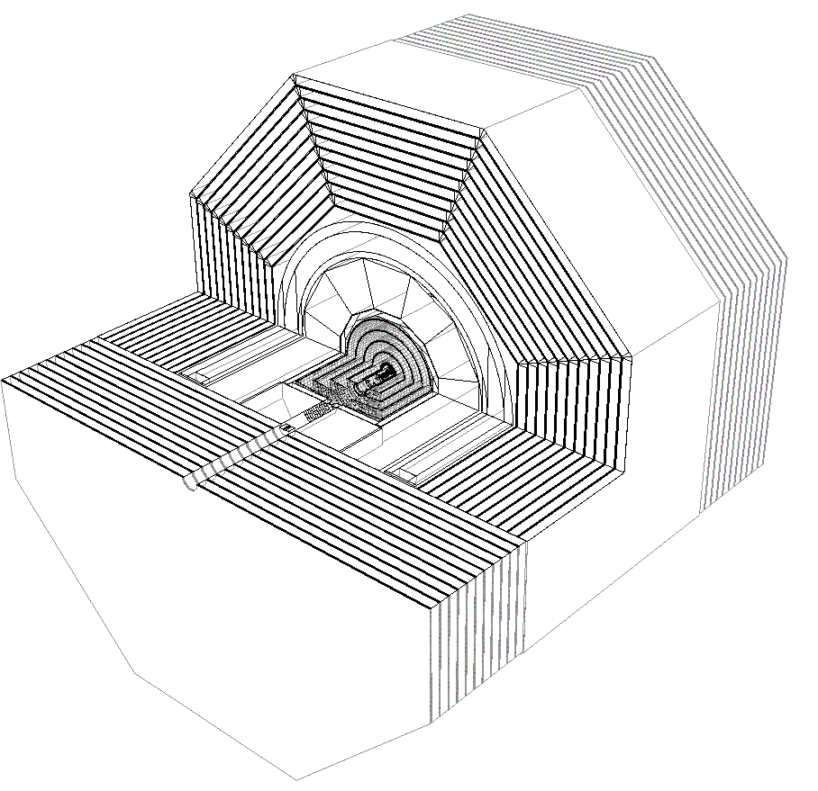



ALCPG Software Tools
Jeremy McCormick, SLAC
LCWS 2012, UT Arlington
October 23, 2012

Slide 2
Framework
APPLICATIONS
DATA
Generation
Pythia,
WHIZARD, etc.
StdHep
LCDD
SLIC
LCIO Events
Simulation
Reconstruction
Pandora XML
Tracking
PFA
LCIO PFOs
Compact
Flavor-tagging,
Jet-finding, etc.
LCIO,
AIDA
Analysis
Tuple Analysis
&Visualization
JAS3/Wired
Publication

Slide 3
LC Detector Full Simulation
MC Event (StdHep)
SLIC
Raw Event (LCIO)
Geometry (LCDD)
Geant4
Compact Geometry Description
(compact.xml)
Reconstruction, Visualization, …

Slide 4
SLIC
Simulator for the LInear Collider
Full detector simulation
  4 PI detectors
  test beams
  other custom detector setups
Integration
  Geant4
  GDML / LCDD
  HEP PDT
  LCIO
  StdHep
Minimal runtime dependencies
  No database
  No user code for geometry description

Slide 5
Recent Features Added to SLIC
Full 3D magnetic field map support
  Grid => (x, y, z, Bx, By, Bz)
Option to store step information for all energy depositions in CalorimeterHits.
  Turn on via macro option.
  Useful for detailed analysis of detector reponse
Z smearing of generated event vertices
  Gaussian smearing
Geant4 version was updated to 9.5.1
LCIO version updated to 2.0

Slide 6
SimDist
Since compiling SLIC from scratch is complicated, a build kit is provided.
Based on well-worn and understood GNU tools
  Autoconf, Make, GCC, etc.
Works on many flavors of Linux, OSX
  Windows support is deprecated.
Options for different run modes
  visualization
  debugging
  batch
Binaries distributed on lcsim.org

Slide 7
Geant4
“Geometry and Tracking”
Standard HEP toolkit for detector simulation
Features
  extensive and flexible physics process library
  visualization
  detailed and flexible geometry description
  macro commands
Advertised as a “toolkit” so need to put the pieces together to build your own app

Slide 8
LCIO
Linear Collider IO
Implementations in C++, Java, Python, FORTRAN
Supported throughout ALCPG tool chain
Physics object interfaces
  hits/digits, tracks, particles, etc.
Allows data interchange between apps/frameworks
  This has been very successful! (SiD LOI, DBD)
  Can even read your LCIO files into ROOT. (built-in support)
See other talk(s) at this workshop for more details

Slide 9
GDML & LCDD
XML geometry description
  avoid completely user-defined geometry in code
GDML
  constants and definitions
  materials
  shapes
  volumes
  hierarchical geometry structure
LCDD
  sensitive detectors
  identifiers
  magnetic fields
  visualization
  physics limits
  regions

Slide 10
GeomConverter
LCDD is too low-level for most users to hand code.
Compact description provided for writing a high-level description of the geometry.
  detector names, number of layers, layer thicknesses/materials, readout identifiers, B-fields
Java program converts from compact to different formats.
  LCDD
  HepRep
  Runtime Geometry (Java objects)
  XML for Pandora
  HTML
    http://www.lcsim.org/detectors/sidloi3.html
  SVG (experimental)
Focus on data formats as different applications have different required levels of detail
Data interchange

Slide 11
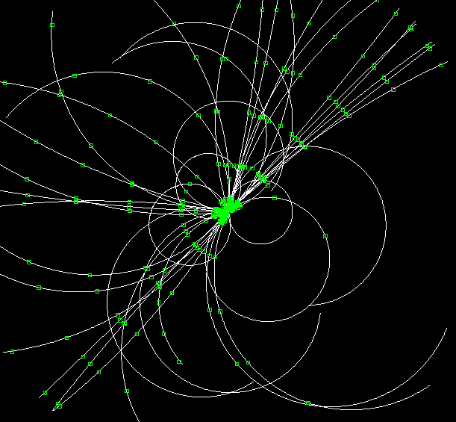
LCSim
Fully featured application framework for HEP analysis and reconstruction
Written in Java
  No more seg faults or mysterious memory leaks!
Tracking
  digitization
  finding and fitting
PFA
  clustering
  track/cluster association
Analysis
  jet finding, cluster finding,
  vertexing

Slide 12
slicPandora
Interface from SLIC to PandoraPFA
  But not actually limited to SLIC input; could accept any LCIO file with hits + tracks.
LCIO compatible
  read hits, tracks
  write reconstructed particles
XML geometry description generated by GeomConverter
Used extensively for SiD LOI

Slide 13
AIDA
Abstract Interfaces for Data Analysis
Analysis classes
  1, 2, & 3D Histograms + Clouds
  1 & 2D Profiles
  DataPointSet
  Tuples
Java implementation
  Other impl. exist in Python & C++
compressed XML file format
Readable in JAS

Slide 14
JAS & Wired
Java Analysis Studio
Workbench
  Wired event display
  LCSim Event Browser
  view/edit AIDA files
  Load analysis drivers
  Simple code editing
Plugin architecture
  extensible by writing loadable code modules

Slide 15
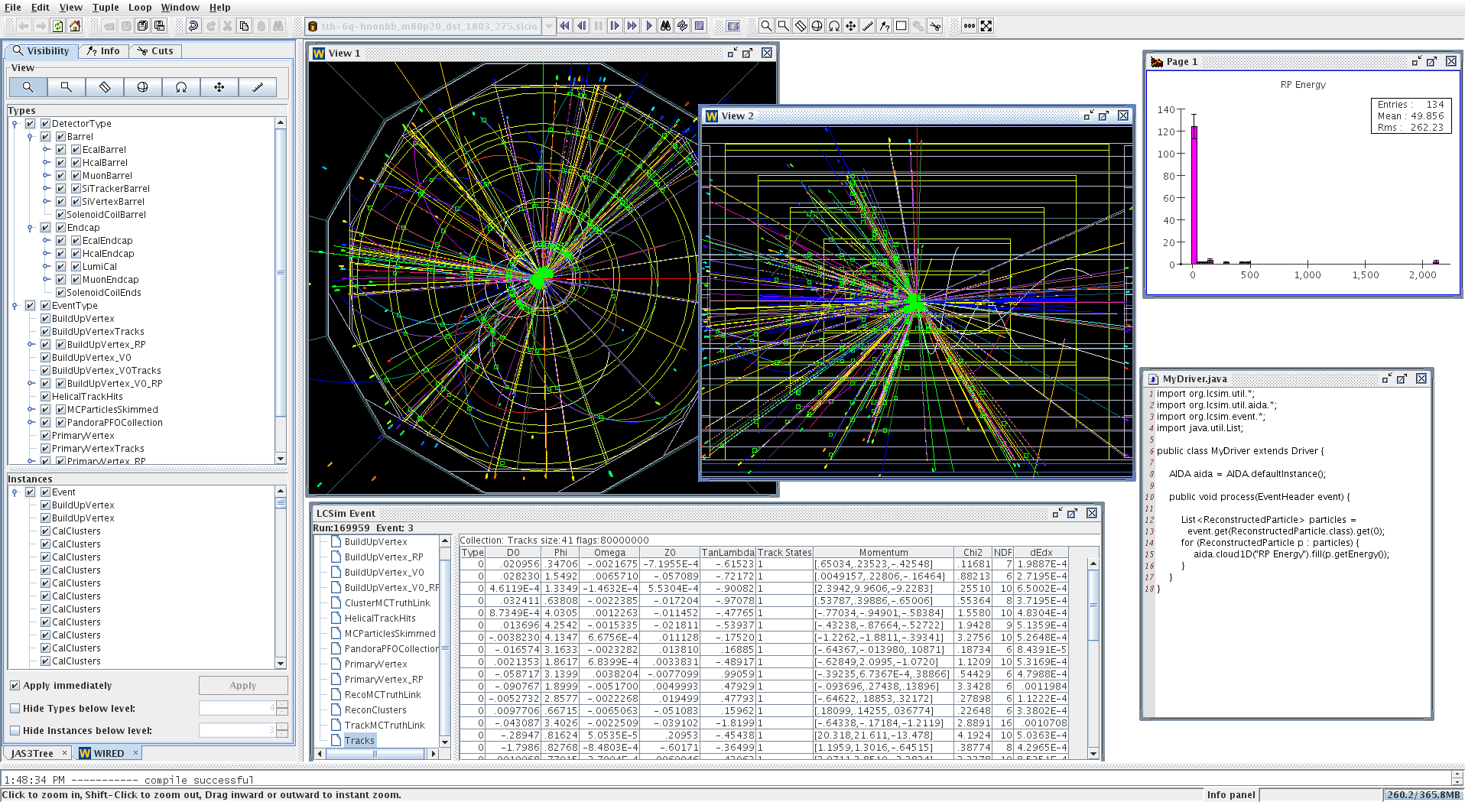
Analysis Session

Slide 16
Who uses LCSim Framework?
SiD
  LOI
  DBD (ongoing)
CLiC
  CDR
  CERN-based SiD studies
Muon Collider
  work ongoing
HPS
  Heavy Photon Search experiment at JLAB
Dual Readout Calorimetry
  FNAL

Slide 17
Summary
ALCPG software framework is mature, robust and well-tested.
Supports standard ILC IO formats and applications
Used for multiple rounds of iterative detector studies by different physics groups
If you would like to use the framework, please contact us. New comers welcome.

Slide 18
Links
Wiki - http://confluence.slac.stanford.edu/display/ilc/Home
lcsim.org - http://www.lcsim.org
ILC Forum - http://forum.linearcollider.org
LCIO - http://lcio.desy.de
SLIC - http://www.lcsim.org/software/slic
LCDD - http://www.lcsim.org/software/lcdd
JAS3 - http://jas.freehep.org/jas3
AIDA - http://aida.freehep.org
WIRED - http://wired.freehep.org

