Slide 1


Undulator Based Positron Sources for Future Colliders
Simulations with ‘Realistic’ Photon Spectra
Mike Jenkins
Lancaster University and The Cockcroft Institute

Slide 2
Presentation Overview
‘Realistic’ undulator spectra
Simulation results
  Yield and Polarization for Ideal Undulator
  Yield and Polarization for ‘Realistic’ Undulator
A different undulator

Slide 3
Realistic Undulator Spectra
Analytical expression used by most simulations
E.g. PPS-Sim uses Kincaid76
Codes to generate ‘Realistic’ Spectrum developed at Cockcroft Institute by
  David Newton
  Duncan Scott

Slide 4
Realistic Undulator Spectra Simulations
David Newton’s code generates a photon spectra for a given magnetic field map:
  The code tracks particles through field map
  Photon flux calculated by integrating along track
To produce ‘realistic’ undulator photon spectra use:
  Non-ideal field maps
  Field map errors similar to field errors in the RAL prototypes

Slide 5
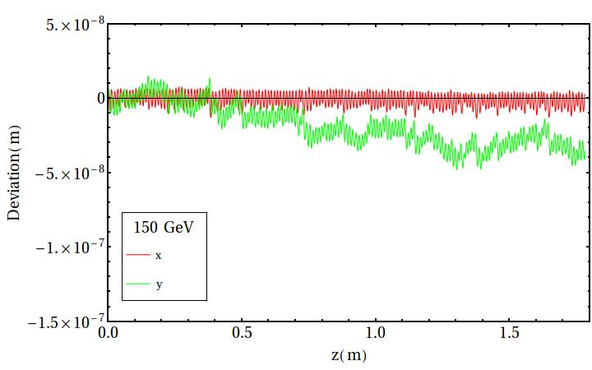
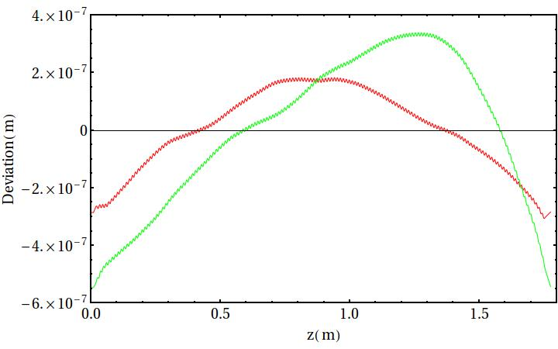
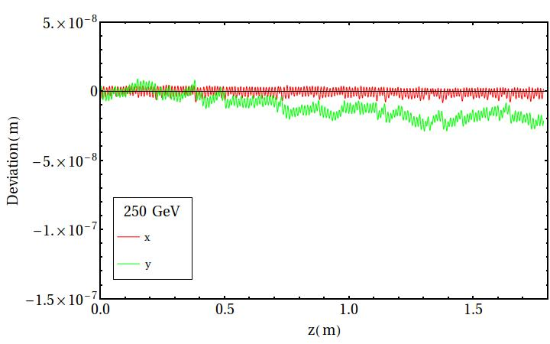
Tracking Particle Through ‘Realistic’ Field Maps
Largest deviation seen in RAL prototype
max deviation is 10⁻⁶ m due to construction methods
Deviation from field maps used is ~5x10⁻⁸ m
RAL Prototype 150 GeV

Slide 6
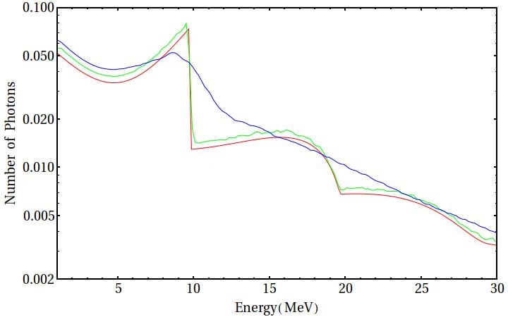
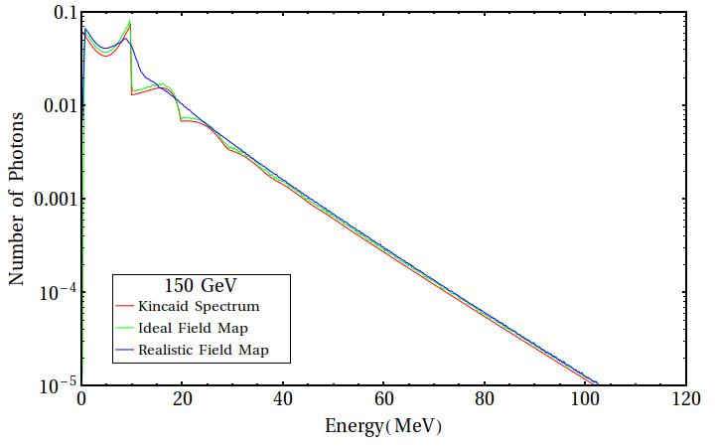
‘Realistic’ Undulator Spectra 150 GeV

Slide 7
PPS-SIM
PPS-SIM is a code originally developed at DESY that utilizes Geant4 to simulate the ILC positron source http://pps-sim.desy.de
PPS-SIM currently simulates from the undulator to the first Capture RF cavity
Simulations carried out using:
  147m long undulator 425m from the target
  Flux Concentrator B_{ini} = 3.2 T, length = 12.0 cm, distance from target = 2.0 cm

Slide 8
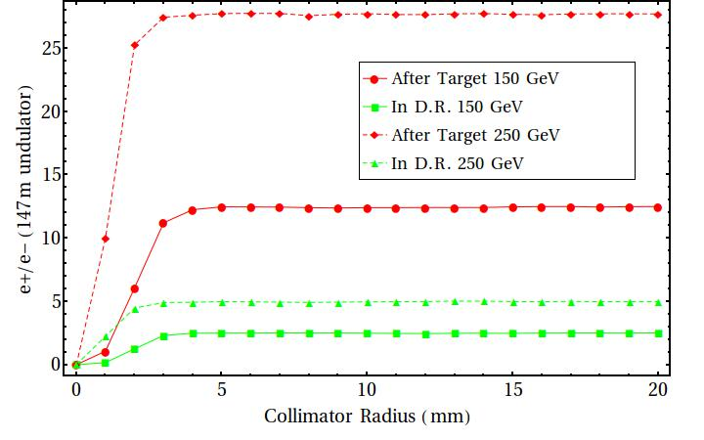
Positron Yield Ideal Undulator

Slide 9
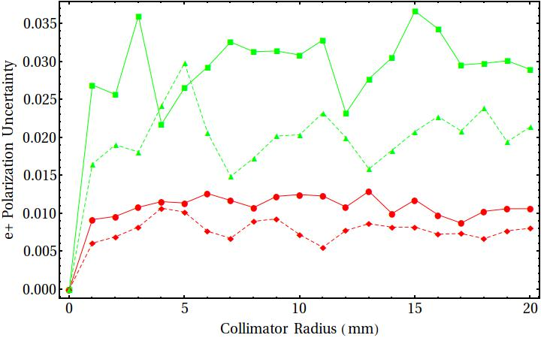
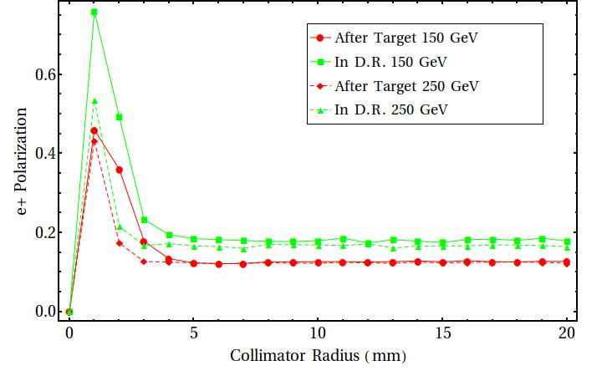
Positron Polarization Ideal Undulator
Polarization uncertainty is numerical
uncertainty from PPS-Sim

Slide 10
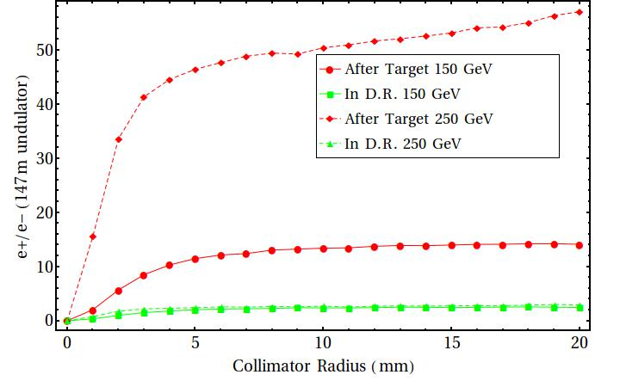
Positron Yield Real Undulator

Slide 11
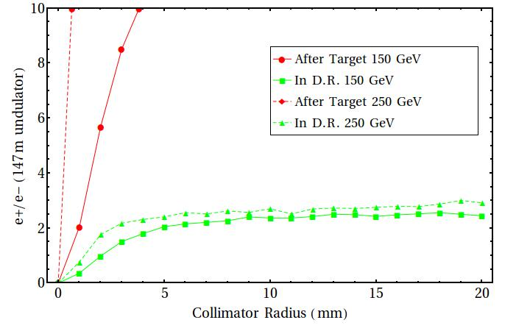
Positron Yield Real Undulator

Slide 12
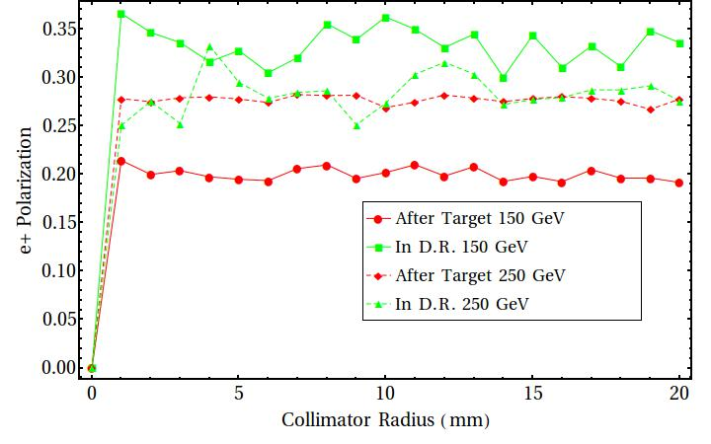
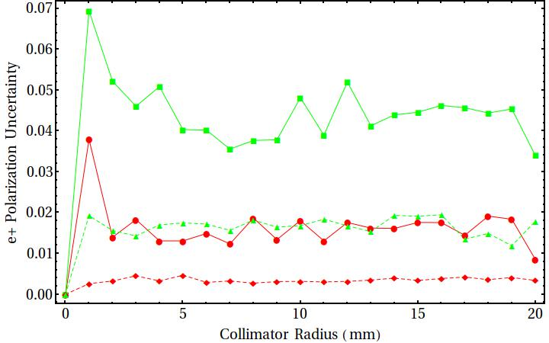
Positron Polarization Real Undulator
Polarization uncertainty is numerical
uncertainty from PPS-Sim

Slide 13
Conclusions of Simulations
Ideal undulator gives broad agreement with results in TDR – polarization with high collimator radius still lower
Collimation of ‘realistic’ spectra increases polarization
Tight collimation of ‘realistic’ spectra is not optimal as yield drops rapidly
  For 150GeV to get 1.5 e+/e- with r=1 mm need undulator length ~ 1000m

Slide 14
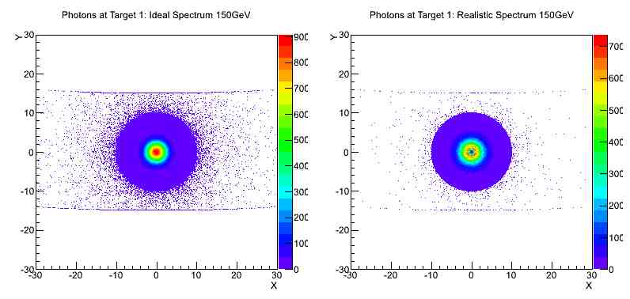
Distribution of Photons Realistic Spectra

Slide 15
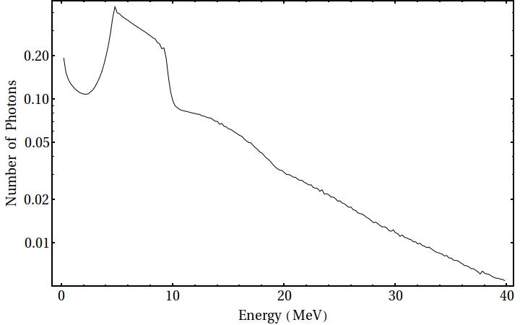
Undulator Spectrum to Increase Polarization
Preliminary work into the effects of different field maps on the photon spectra
Making systematic changes to the undulator produces this photon spectrum
It produces higher positron polarization whilst maintaining yield
PPS-Sim results imply positron polarization of about 50% without collimation

Slide 16
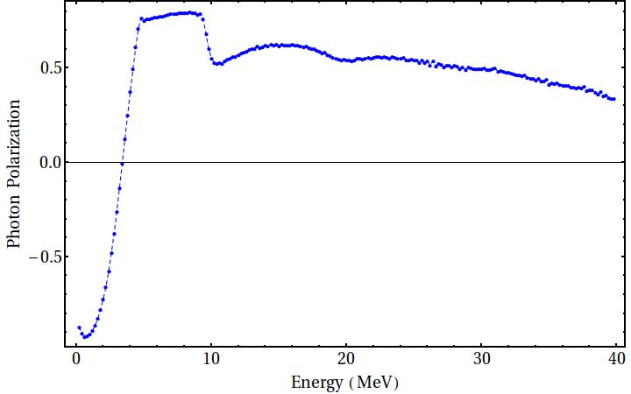
Undulator Spectrum to Increase Polarization
Preliminary work into the effects of different field maps on the photon spectra
Making systematic changes to the undulator produces this photon spectrum
It produces higher positron polarization whilst maintaining yield
PPS-Sim results imply positron polarization of about 50% without collimation

Slide 17
Conclusions
‘Realistic’ spectra simulations suggest higher polarization without collimation
Tight collimation of a ‘realistic’ spectra impacts yield significantly
Possibility to increase polarization with a different undulator configuration
TDR recommendation:
“Simulations show that small errors in the undulator field will not reduce positron yield in the case of a large collimator aperture. The polarization strategy presented in the TDR assumes field errors in the undulator have a negligible impact on the angular distribution of the photon beam. In practice, the quality of the undulator field will determine the maximum possible polarization achievable for yields above 1.5 e⁺/e⁻.”

Slide 18
Thank you for listening, are there any questions

Slide 19
Back Up Slides

Slide 20
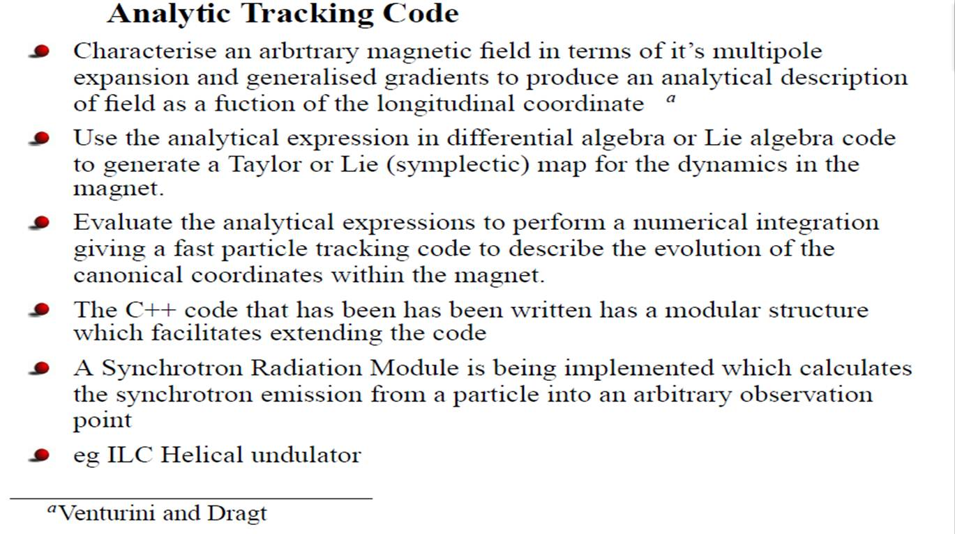
Implementation of Tracking Code Taken from talk by D. Newton, Synchrotron Radiation Output from the ILC Undulator, ILC Positron Source Workshop 2010

Slide 21
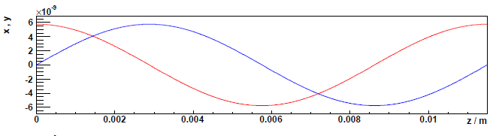
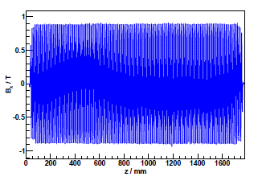
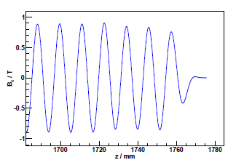
Tracking through Field Maps
Taken from Synchrotron Radiation Output from the ILC undulator talk by D. Newton at ILC Positron Source Workshop 2010

Slide 22
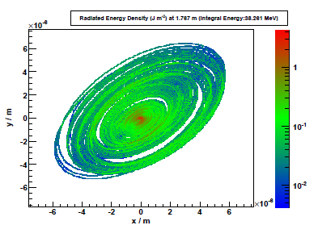
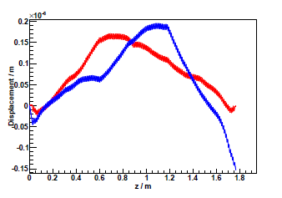
Tracking through Field Maps
Taken from Synchrotron Radiation Output from the ILC undulator talk by D. Newton at ILC Positron Source Workshop 2010
These plots are for one of the 2m undulator prototypes constructed at RAL
One shows the power radiated at the end and the other shows the trajectory through the undulator in x and y for a beam that enters at a correction angle
The angular deviations off axis are of the order 1 μrad which when compared with k/γ (3.13 μrad for a drive beam energy of 150 GeV) are significant

