Slide 1




Low Emittance Tuning through Dispersion Free Steering
Simone Maria Liuzzo (PhD) (ESRF, LNF-INFN, Università Di Roma Tor Vergata)

Slide 2
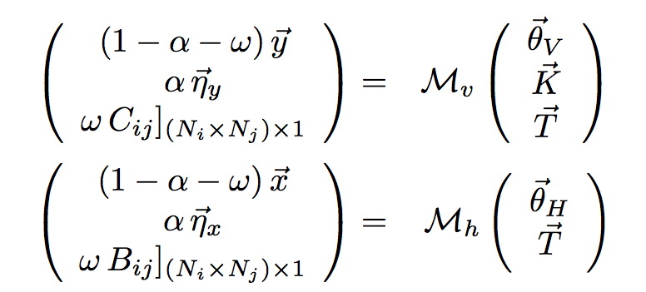
Response matrix
Response Matrix M
Orbit correction
Dispersion response matrix
(deviation from reference)
BPM H
BPM V
Steerers H
Steerers V
SVD of M to calculate Correction
Reshape
to a vector
Mainly determined by sextupoles
Same for

Slide 3
Low Emittance Tuning Technique
CORRECTORS USED
V steerers
Skew quad
gradients
Bpm Roll (Gains in progress)
H Steerers
Bpm Roll
N_{j} may be only 1 corrector
Deviation from reference off diagonal
block of the ORM reshaped to be a vector
Off axis orbit in quadrupoles and sextupoles used as correctors
Deviation from reference diagonal
block of the ORM reshaped to be a vector
Matrix M simulated from Model without errors
SVD inversion for simultaneous minimization of dispersion coupling and β-beating

Slide 4
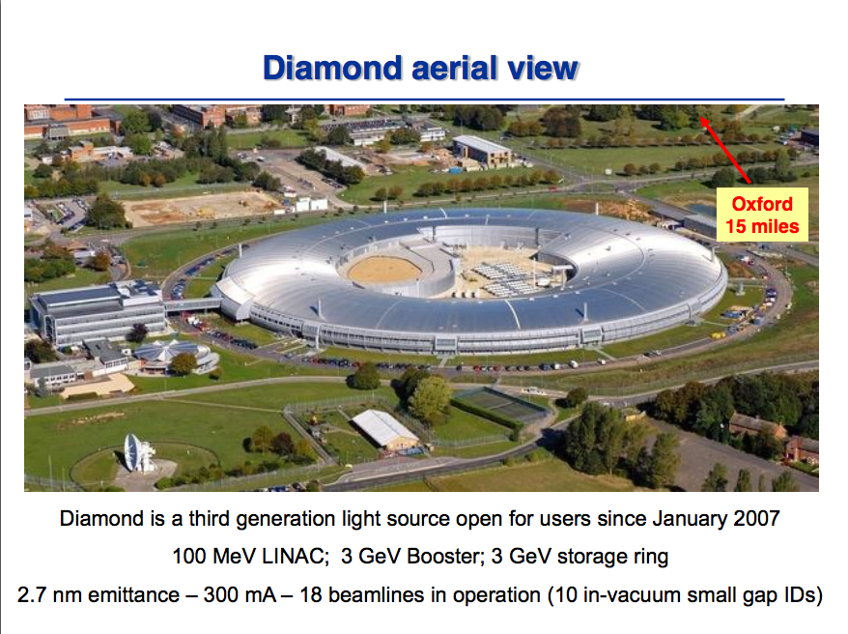
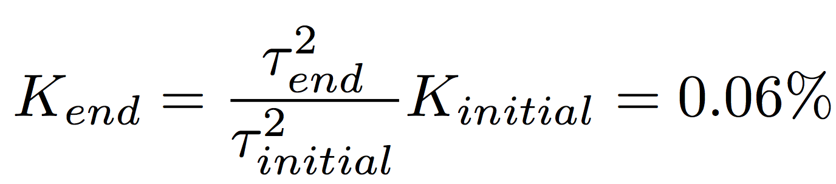
Measurements at Diamond (UK)
Lifetime [h]
LET RED
LOCO BLUE
5.5 h
5.9 h
Coupling from Lifetime [h]
0.06 %
0.07 %
LET
Vertical dispersion [m]
Curtesy R.Bartolini
350 μm (LOCO:700 μm)
Skew quadrupole Correctors only
Coupling estimated from lifetime:
ε_{y} =1.7 10⁻¹² m rad
Residual Vertical orbit
32 μm (LOCO: 1 μm)

Slide 5
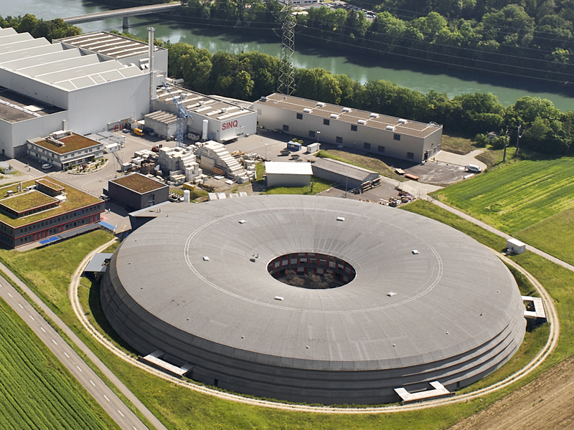
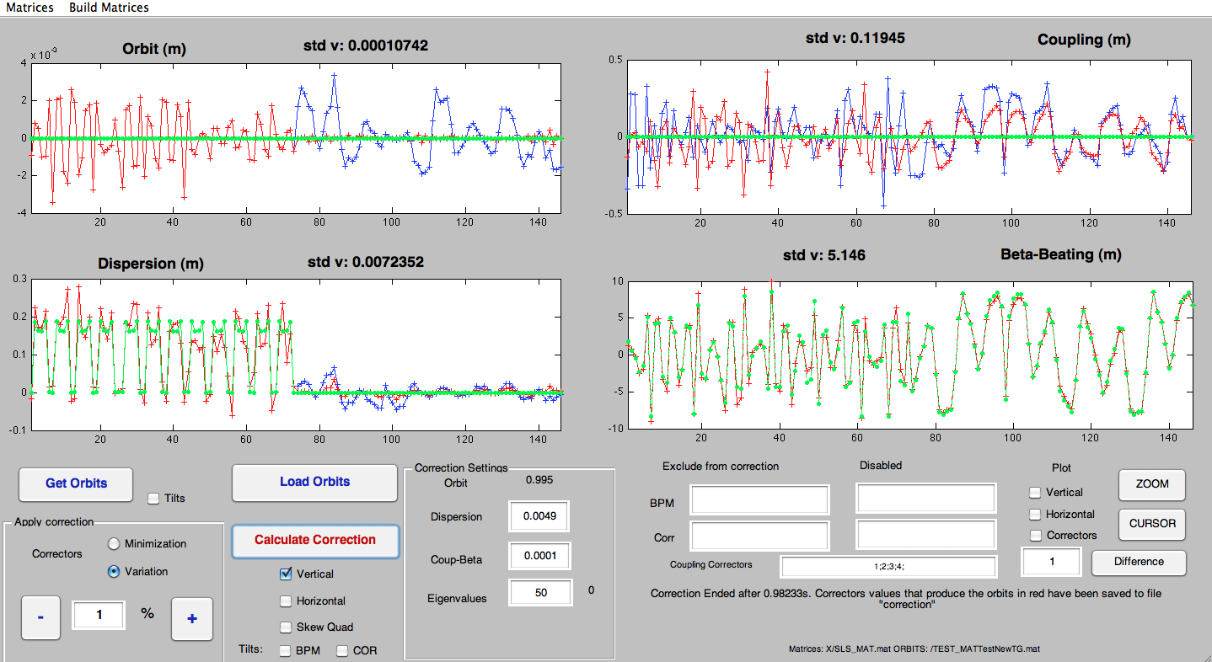
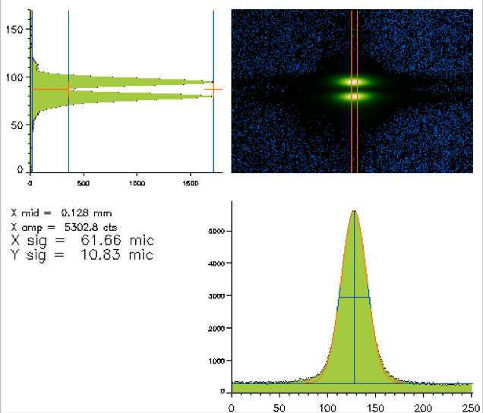
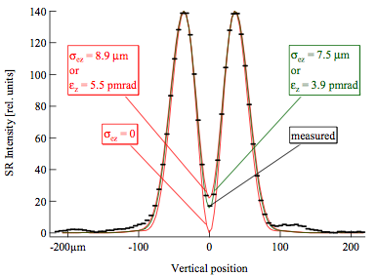
Measurements at SLS
Measurements aimed to achieve low vertical emittance in the TIARA framework
SWISS LIGHT SOURCE
2.411 GeV, 288m, 12 beamlines, 400 mA, 5.4 nm Hor. Emit.
Same Tool used for Diamond, modified for direct access to Control System
Vertical beam size measurements performed
using vertically polarized Shynchrotron Light Monitor
TUPB27 Proceedings of DIPAC 2007, Venice, Italy

Slide 6
SLS measurements
Vertical steerers only
σ_{y} from 16 μm to 7 μm
Before correction
After correction

Slide 7
SLS measurements
Skew Quadrupoles only
ε_{y} =1.6 10⁻¹² m rad
σ_{y}=4.7 ± 0.7 μm
Before correction
After correction

Slide 8
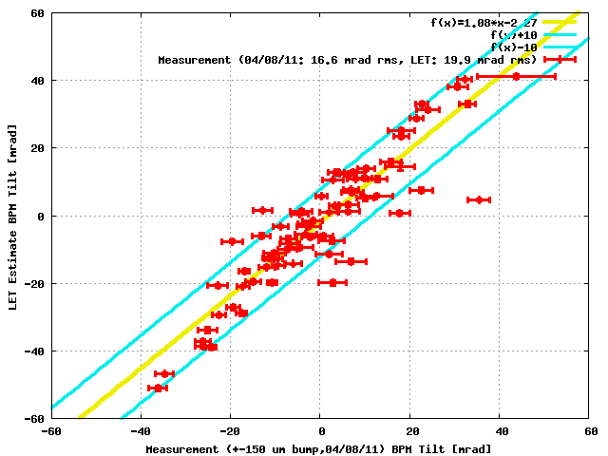
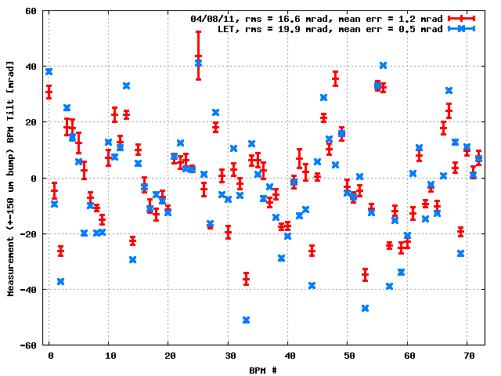
BPM ROLL error estimation
Ex. For dispersion:
Evaluated simultaneously to the correction set evaluation
Courtesy Michael Boge (PSI-SLS)
Comparable to the previous BPM roll estimates measured at SLS

Slide 9
SLS measurements
Skew Quad followed by vertical correctors and bpm roll estimations
ε_{y} =1.3 10⁻¹² m rad
σ_{y}=4.4 ± 0.9 μm
Before correction
After correction

Slide 10
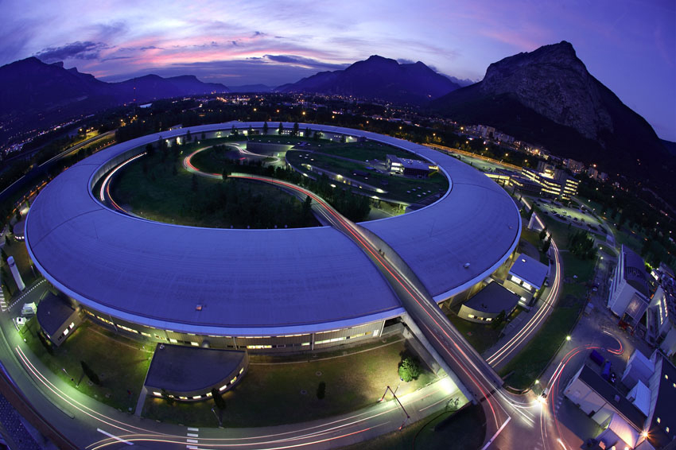

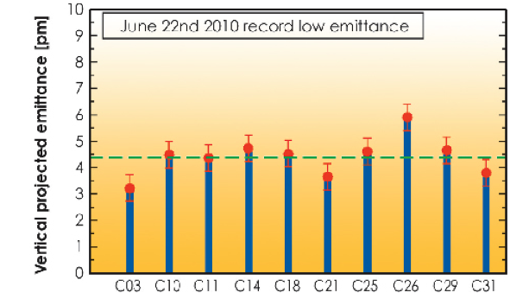
ESRF
6.03 GeV
844 m
200mA
992 bounches
ε_{x}=4 nm rad
ε_{y}=4 pm rad
Coupling feedback system
using skew quadrupoles
Various vertical beam size monitors,
2 pinhole monitors and 11 In-Air-X-Ray- projection monitors
Measurements at the
in air x-ray monitors

Slide 11
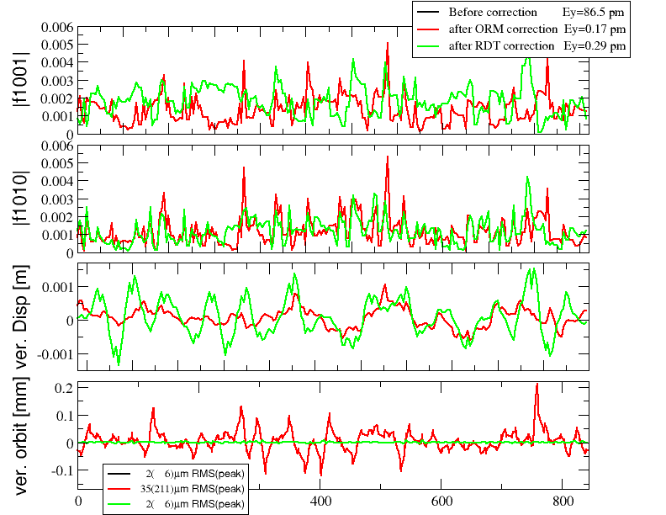
Simulated Comparison with RDT
Comparison of the methods using RDT calculations on simulated distorted lattice.
Starting from the same set of errors we calculate a correction set and evaluate the resiudual RDT.
A.Franchi

Slide 12
Tests of the Tool
Correction with skew quad and vertical correctors, applied 80%
Uncorrected
Predicted
Observed 80%
VERTICAL DISPERSION
The tool does what it predicts!
VERTICAL ORBIT

Slide 13
Skew Correction Starting from zero set
First correction
Correction iteration
11.8 pm
Beam size reduction applying skew quad. correction only.
7.7 pm
7.1 pm
11.8 pm
New measurement. Further improvements with various correction settings

Slide 14
Horizontal Steerers
Correction of horizontal dispersion and
beta-beating using horizontal steerers only

Slide 15
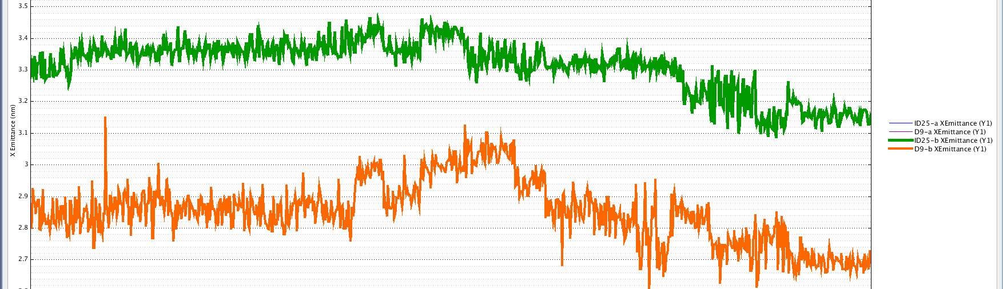
Horizontal Steerers
Correction of horizontal dispersion and
beta-beating using horizontal steerers only
3.15 nmrad
3.3 nmrad
2.95 nmrad
2.7 nmrad

Slide 16
Beam Position Monitor Roll estimations
Roll errors may be estimated from all the measurements taken.
Not used for the correction

Slide 17
Conclusions
Low emittance technique that exploits the off axis orbit in sextupoles and quadrupoles is tested at Diamond, at SLS and at ESRF:
  Releasing the vertical orbit constraint to reduce dispersion and coupling allows reduction of vertical beam size
  Skew quadrupole correction reach beam sizes and emittance comparable to previously obtained results at SLS (using skew quadrupoles) and at ESRF (using RDT)
  Vertical steering including the evaluation of psudo-bpm roll errors allows further improvement in the correction
  Horizontal dispersion and Beta-Beating correction leads to an improvement in Horizontal emittance

Slide 18
Future steps
Include Quadrupoles correctors, steerers tilts and BPM gain errors in the correction parameters.
Human readable quantities (coupling and beta functions)
More measurements
Introduce the possibility to exclude a region from the correction (ID’s, IP’s).

Slide 19
Backup

Slide 20
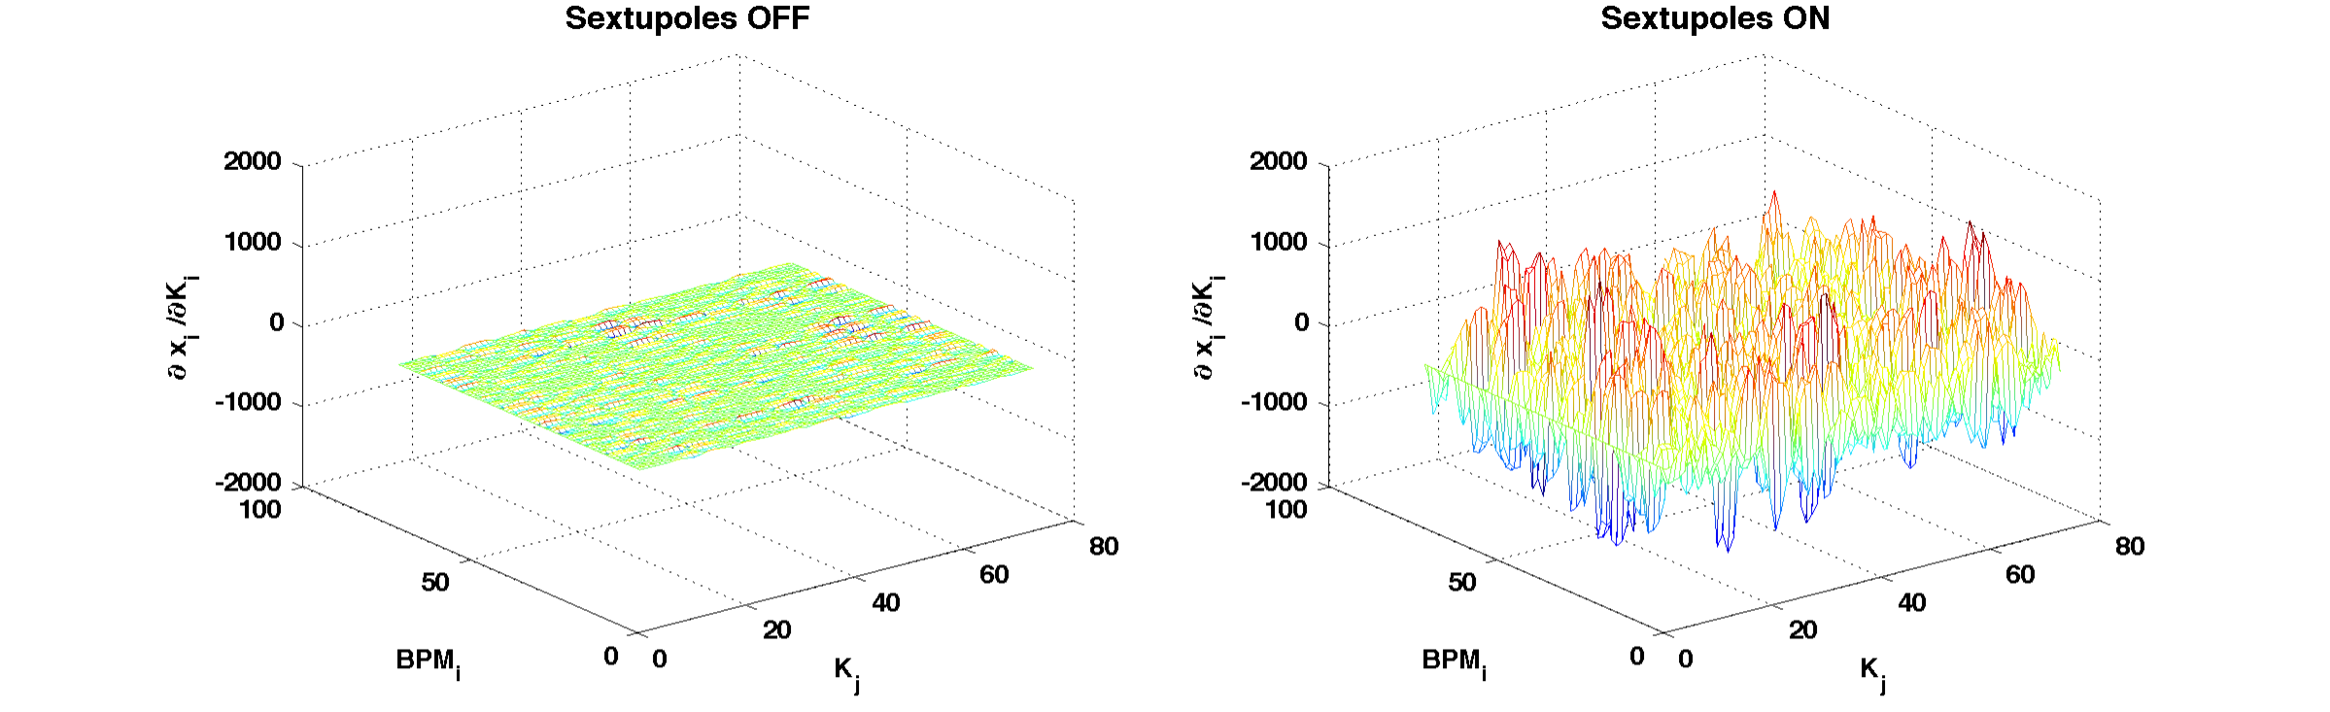
C_{ij} and B_{ij} mainly determined by sextupoles (corrector 1 (j=1))

Slide 21
Minimum observed vertical dispersion AT ESRF during May-8-2012 MDT
2 iterations of correction with skew quadrupoles lead to 810 micron vertical dispersion.

