Slide 1
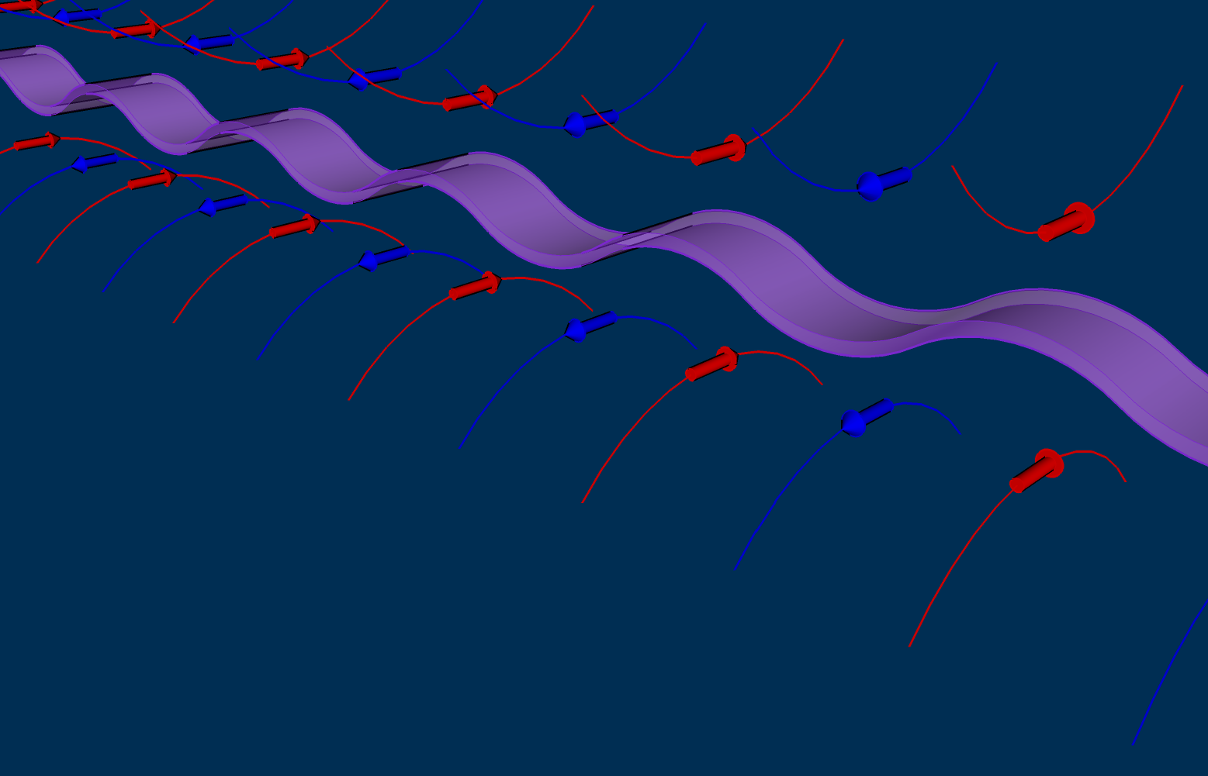






Measurements of ultra-low emittances using a vertical undulator
K.P. Wootton, G.N. Taylor, R.P. Rassool
The University of Melbourne
M.J. Boland, B.C.C. Cowie, R. Dowd, Y.-R.E. Tan
Australian Synchrotron
Y. Papaphilippou
CERN

Slide 2

Motivation
Collider damping rings and Super B-factory storage rings demand ε_{y} = 0.5-2.0 pm rad
Collective effects lead to growth
  Intra-beam scattering, electron cloud
Storage ring light sources as test accelerators
  SLS, ATF2, CESR, ASLS, Diamond, …
Need measurements of vertical emittance
  I want your beamline!

Slide 3
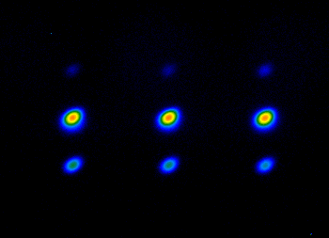
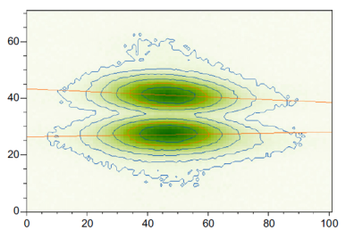
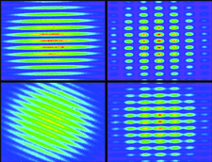

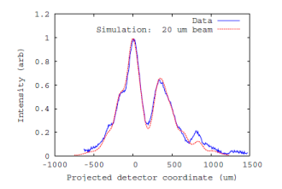
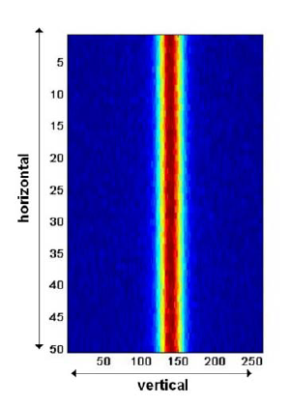
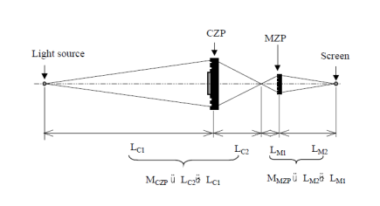
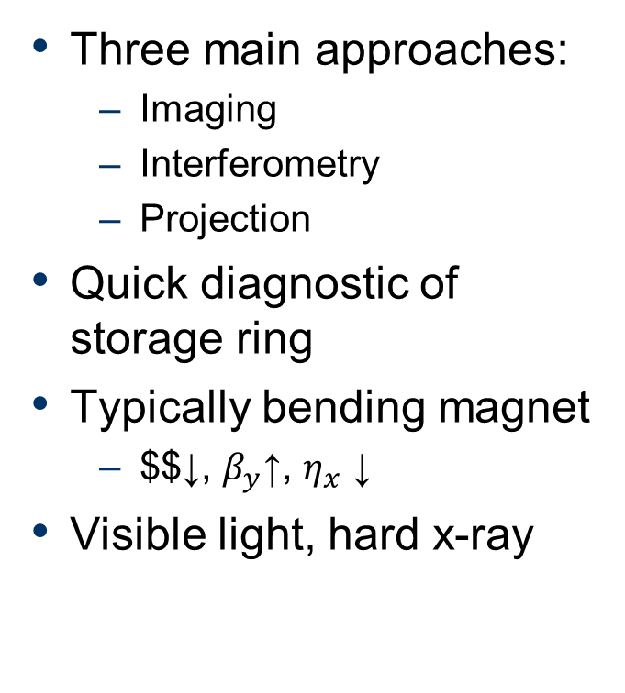
Synchrotron light vertical emittance monitors
Three main approaches:
  Imaging
  Interferometry
  Projection
Quick diagnostic of storage ring
Typically bending magnet
  $$↓, $β_{y}$↑, $η_{x}$ ↓
Visible light, hard x-ray
Andersson, NIMA 591, 437-446 2008
Masaki DIPAC01, PS17
Flanagan PAC09, TH5RFP048
Nakamura PAC01, TPAH307
Scheidt, DIPAC05 CTWM01

Slide 4
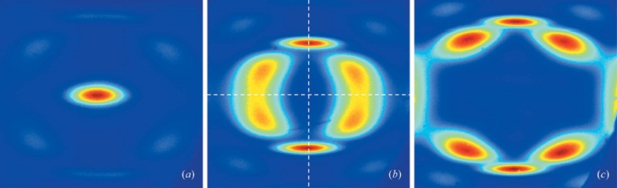
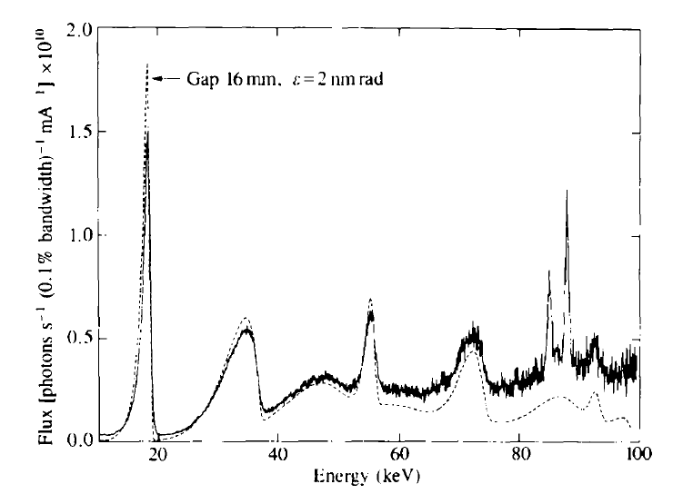
Undulator diagnostics
Focus on odd (useful!) harmonics
Horizontal undulators
  Imaging
  Projection
  Absolute spectral brilliance (pinhole flux)
Energy spread, dispersion, ‘large’ emittance
Moreno JSR, 19 179-84 (2012)
Hahn JSR 4, 1-5 (1997)

Slide 5
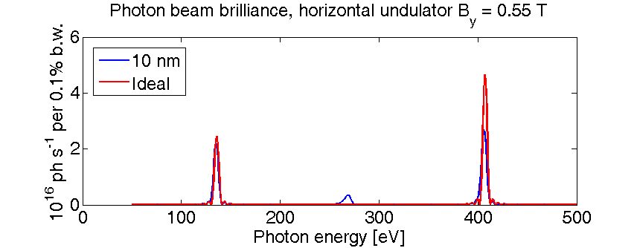
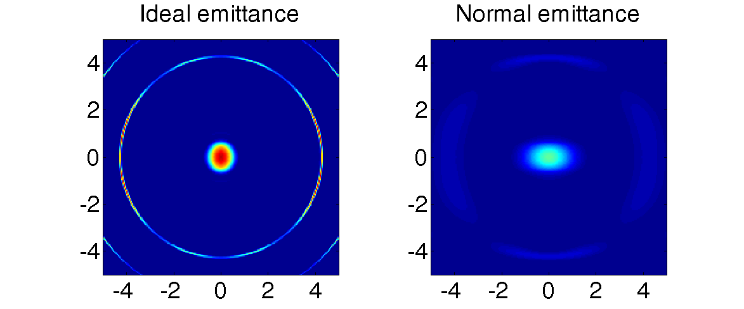
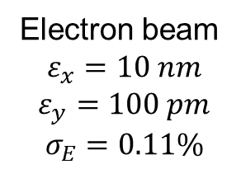
Undulator beam projection
Horizontal Undulator
25 periods
75 mm period
K = 3.85
Pinhole
50 x 50 um
15m distance
Electron beam
$$ε_{x}=10 nm$$
$$ε_{y}=100 pm$$
$$σ_{E}=0.11\%$$
Tanaka & Kitamura, JSR 8 1221 (2001)

Slide 6
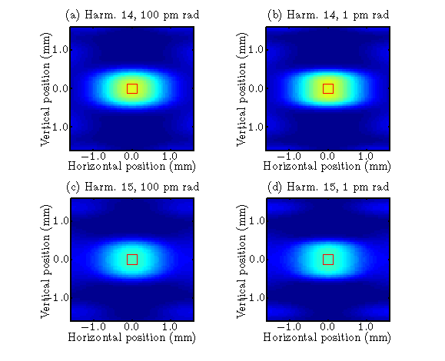
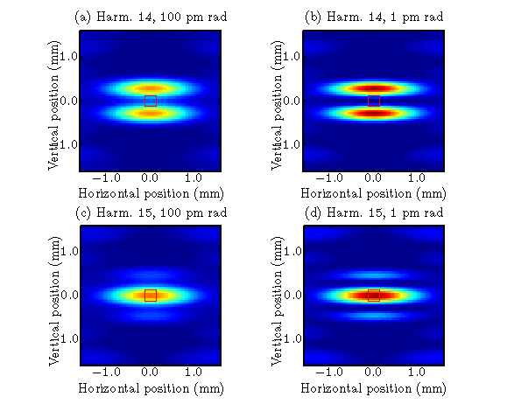
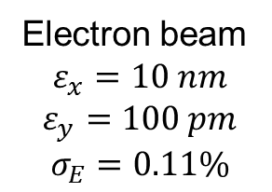
Undulator projection measurements
Horizontal undulator
Vertical undulator
Undulator
25 periods
75 mm period
K = 3.85
Electron beam
$$ε_{x}=10 nm$$
$$ε_{y}=100 pm$$
$$σ_{E}=0.11\%$$

Slide 7
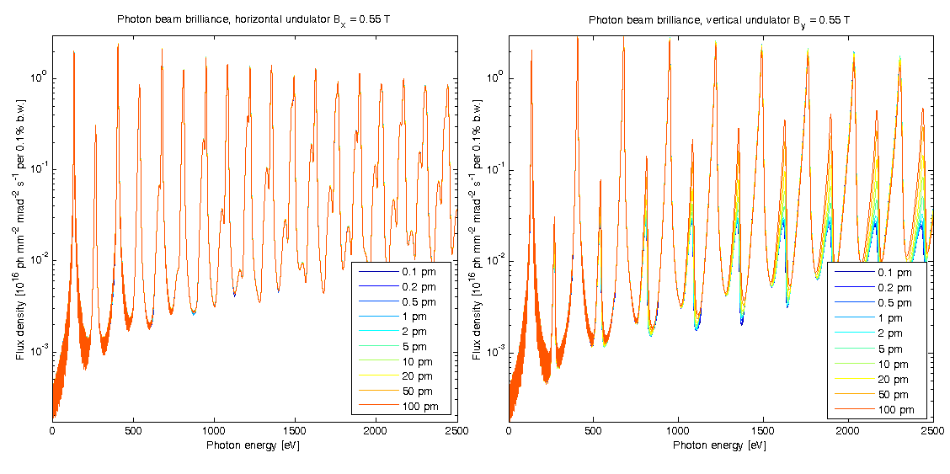
Photon beam brilliance
Horizontal undulator
  No contrast
Vertical undulator
  Even harmonics
Wootton, et. al. IBIC’12, MOCB04 (2012)

Slide 8
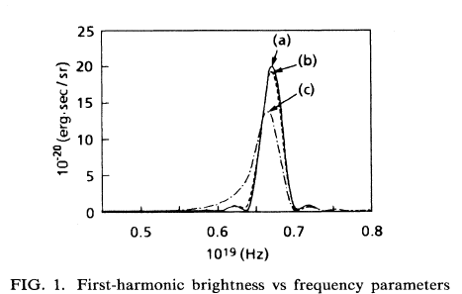
Fitting spectra
_{ε→small}
‘It is evident that the second-harmonic brightness is proportional to the beam emittance …’ Dattoli PRE 52(6) 6809-17 (1995)
I add to this: … the emittance in the direction of undulations
  How do we measure photon beam brilliance?
Dattoli PRE 52(6) 6809-17 (1995)

Slide 9
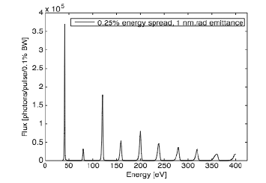
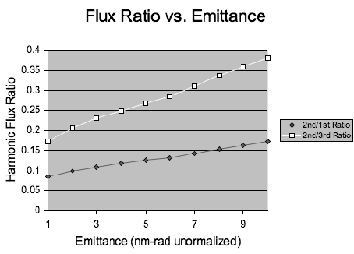
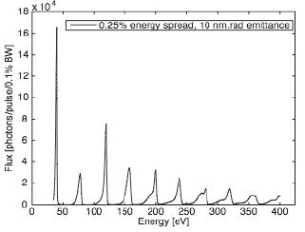
Pinhole flux ratio
Electron wakefield accelerator
Flux ratio F_{n-1} / F_{n}
F₃
F₂
M. Bakeman et al., PAC 2009, WE6RFP074
M. Bakeman, et al., PAC 2011, MOP161

Slide 10
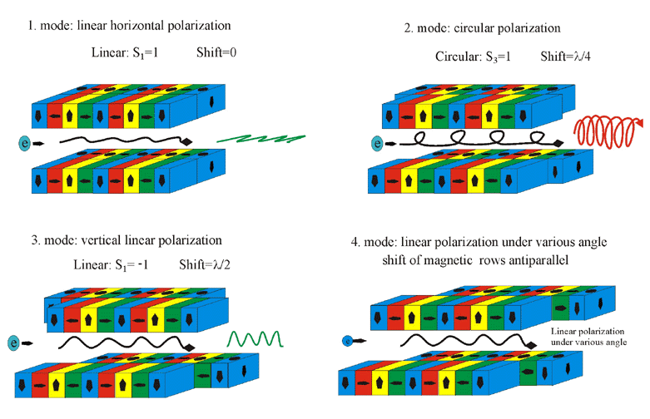
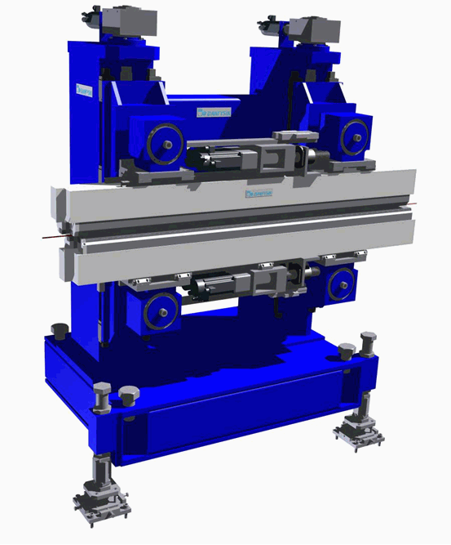
Advanced Planar Polarised Light Emitter-II
Modes of operation
Sasaki, Nucl. Instrum. Methods A 347, 83 (1994)

Slide 11
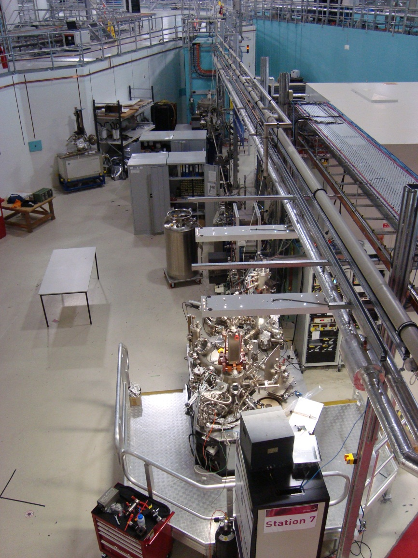
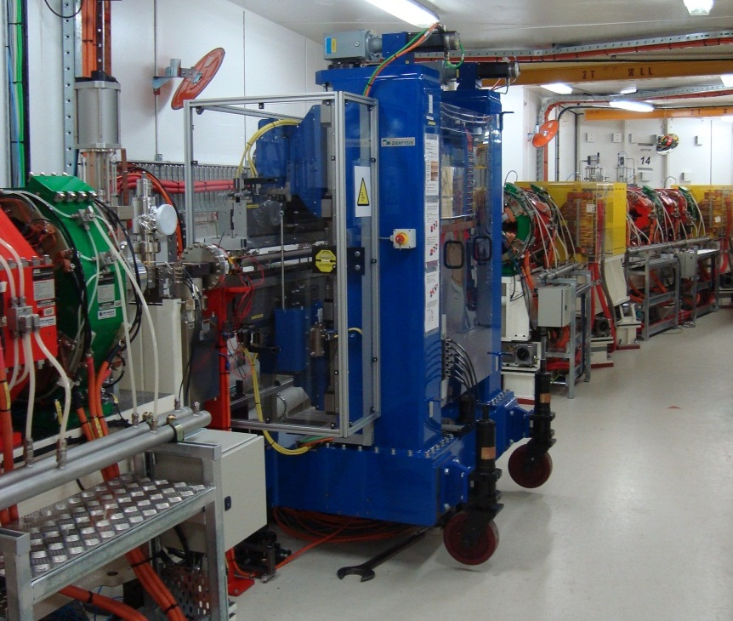
Soft x-ray undulator beamline

Slide 12
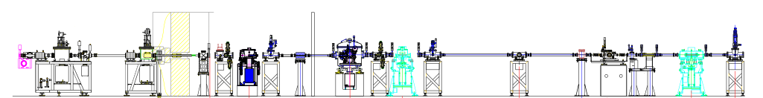

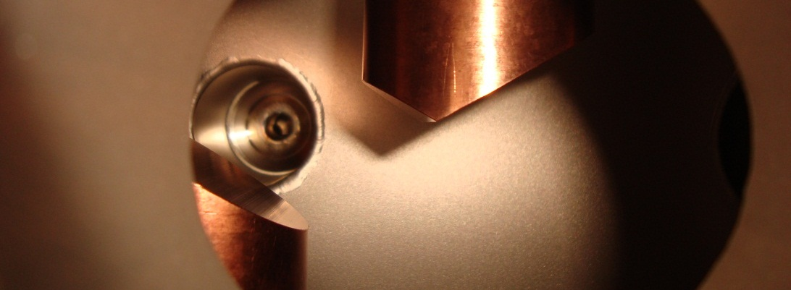
Soft x-ray undulator beamline
APPLE-II undulator
White beam slits first optical element
All focussing, monochromator downstream
Slits
Monochromator
Photodiode
Beam

Slide 13
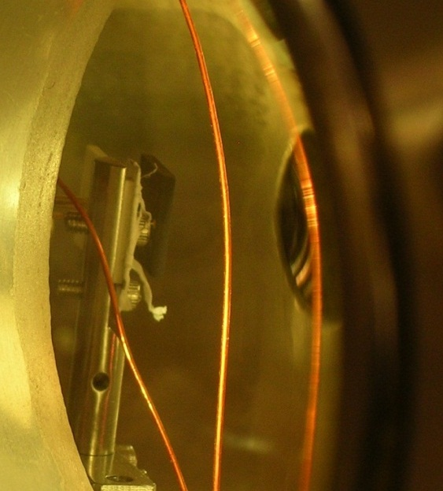
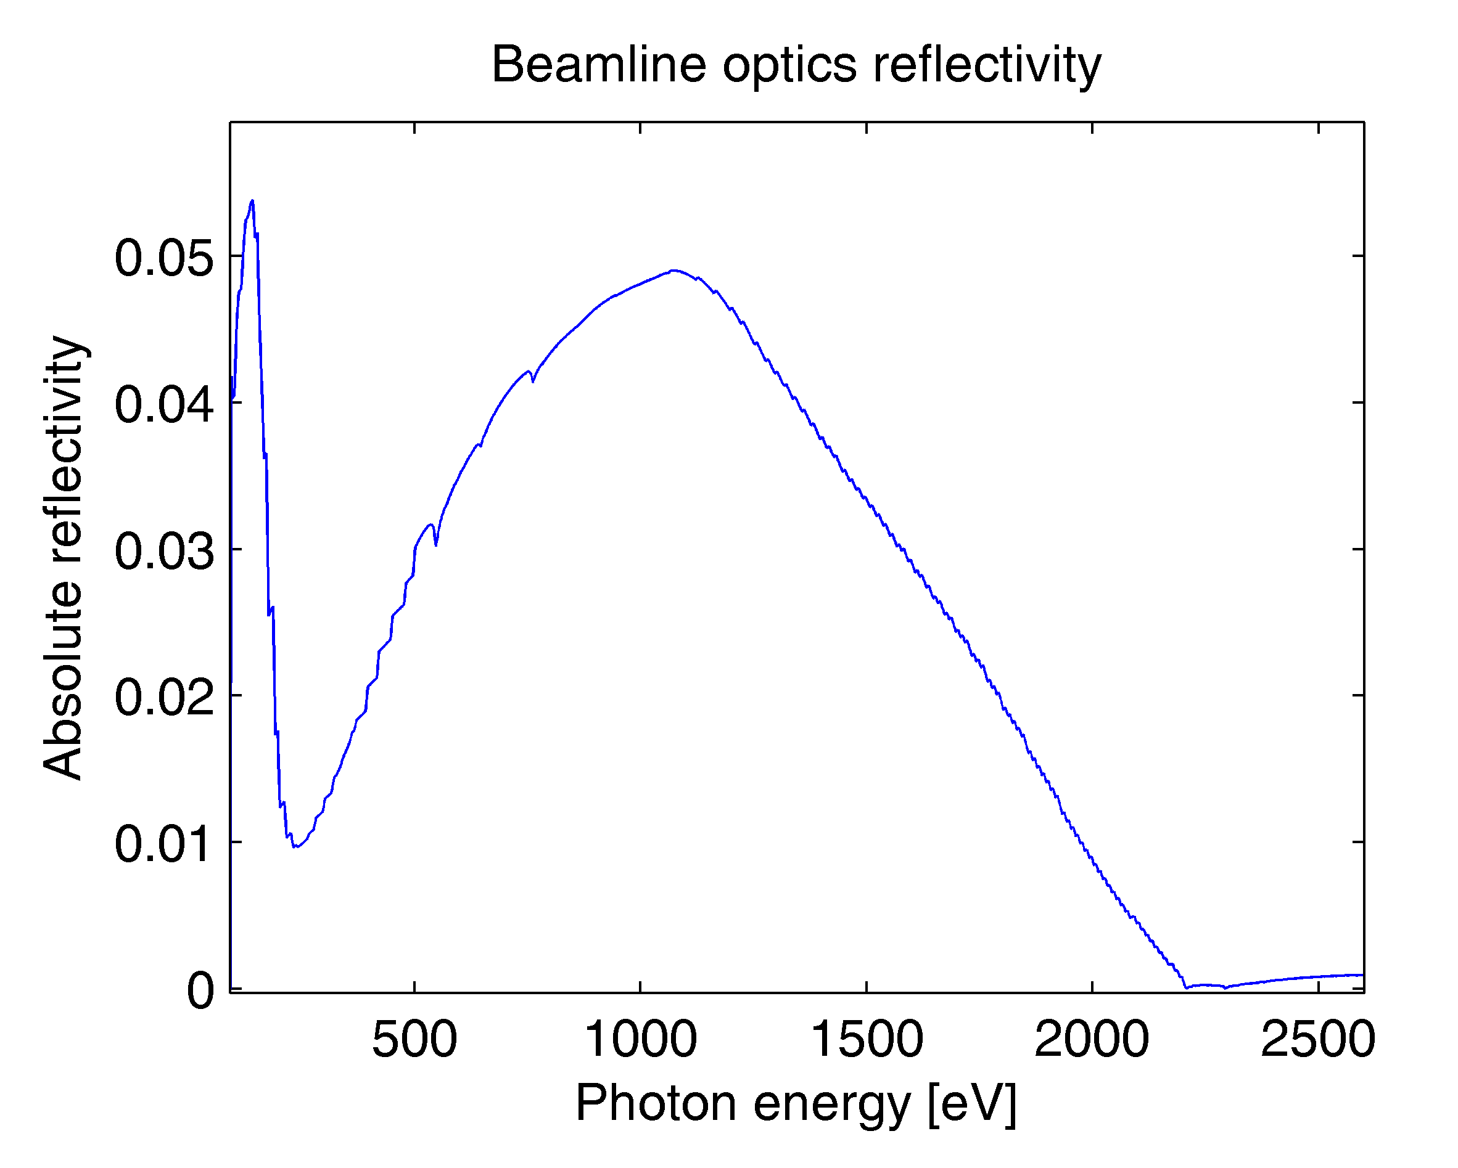
Detector
Measuring vertical emittance with one large pixel!
Beamline optics
  Grating monochromator
  Au-coated mirrors
  Energy-defining slit
  Photodiode (GaAsP, Si)
B.C.C. Cowie, et al., AIP Conf. Proc. 1234, 307 (2010)
Au-coated mirrors
  Transmission varies with photon energy

Slide 14
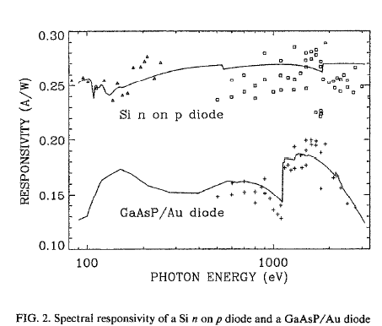
Photodiode choice
Early experiments
  Hamamatsu GaP/Au
Wootton, et. al. IBIC’12, MOCB04 (2012)
Ratio of peaks
Absorption edges
  Silicon photodiode
Keithley picoammeter
  Spans many orders of magnitude in current
Krumrey, Tegeler (1992) Rev Sci Instrum 63 (1), p. 797-801

Slide 15
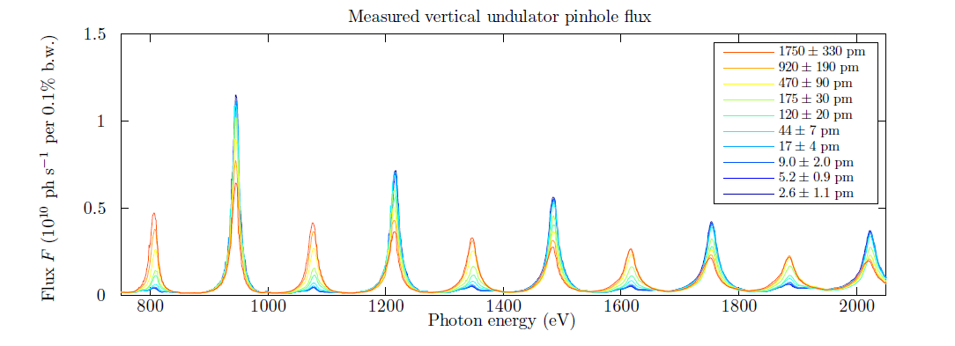
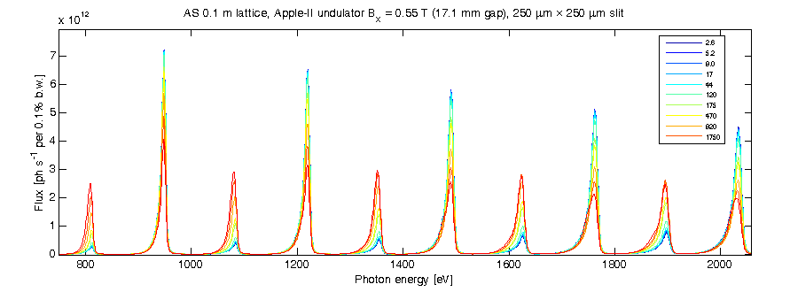
Measured undulator spectrum
Measured
Modelled
F₇
Flux ratio
F_{n-1} / F_{n}
F₆
K.P. Wootton, M.J. Boland, R. Dowd, Y.-R.E.Tan, B.C.C. Cowie, Y. Papaphilippou, G.N. Taylor, R.P. Rassool ‘Observation of picometer vertical emittance with a vertical undulator’ Phys. Rev. Lett. (in press).

Slide 16
Undulator projection measurements
Vertical undulator
Even
Odd
Undulator
25 periods
75 mm period
K = 3.85
Electron beam
$$ε_{x}=10 nm$$
$$ε_{y}=100 pm$$
$$σ_{E}=0.11\%$$

Slide 17
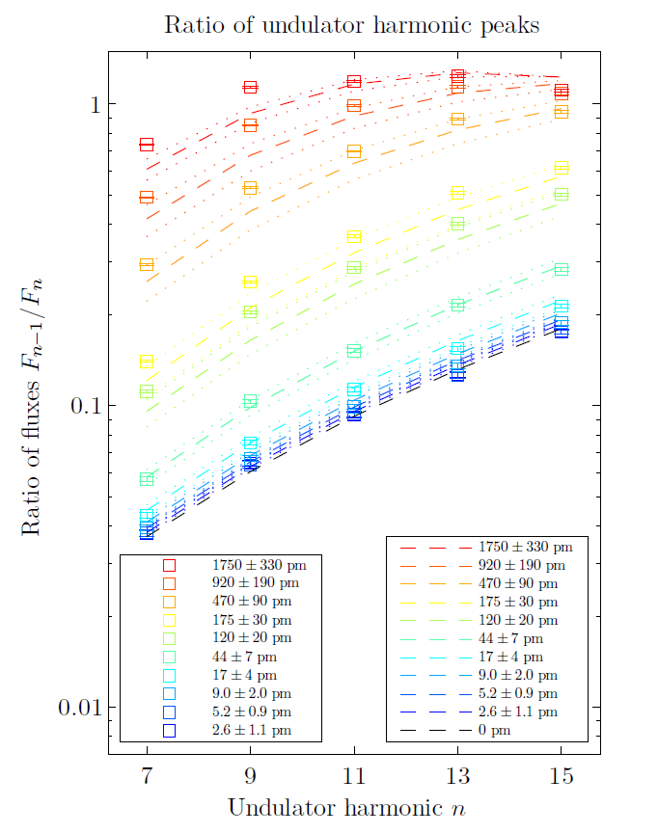
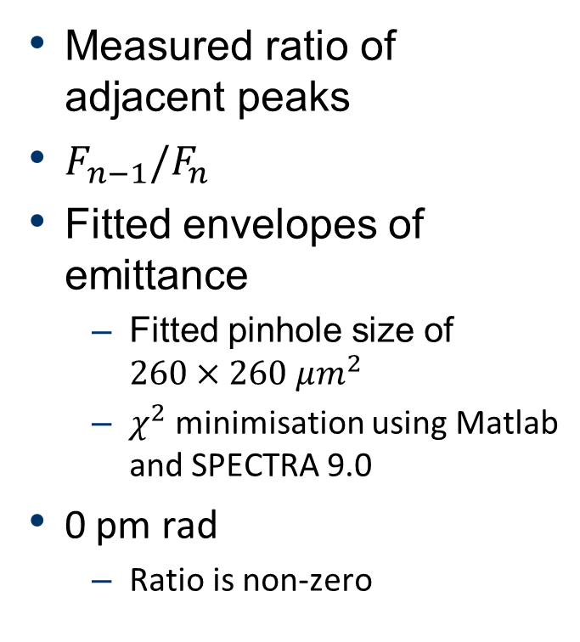
Emittance envelopes
Measured ratio of adjacent peaks
$F_{n−1}/F_{n}$
Fitted envelopes of emittance
  Fitted pinhole size of $260×260 μm^{2}$
  $χ^{2}$ minimisation using Matlab and SPECTRA 9.0
0 pm rad
  Ratio is non-zero
K.P. Wootton, M.J. Boland, R. Dowd, Y.-R.E.Tan, B.C.C. Cowie, Y. Papaphilippou, G.N. Taylor, R.P. Rassool ‘Observation of picometer vertical emittance with a vertical undulator’ Phys. Rev. Lett. (in press).

Slide 18
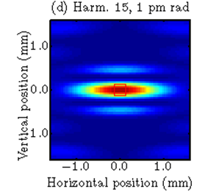
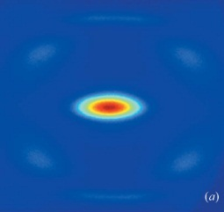
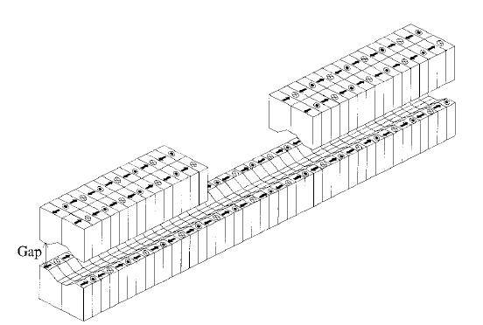
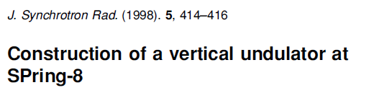
Where to?
Fixed pinhole diameter
SOLEIL DiagOn (fixed energy 367.5 eV)
SPring-8 BL45XU (vertical IVU)
Higher undulator K
Rejection of horizontal polarisation
1.5 GeV for IBS
Moreno JSR, 19 179-84 (2012)
Tanaka JSR 5, 414 (1998)

Slide 19
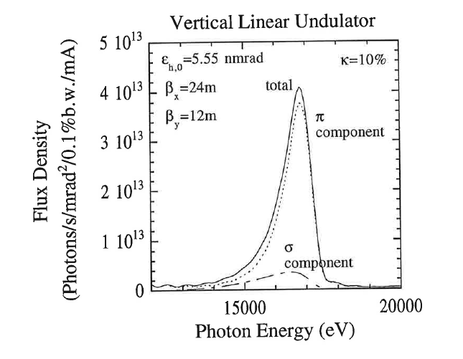
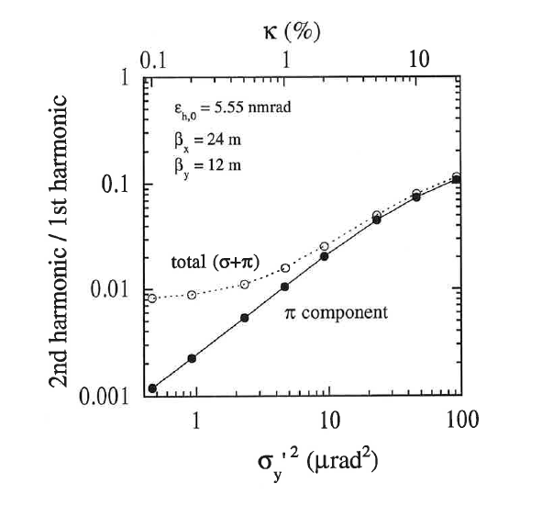
Rejection of horizontal polarisation
S. Takano, EMIT’ 97, KEK Proceedings 97-20 (1997)

Slide 20
New experiments
Looking for beamlines!
APPLE-II or vertical undulator (EM-EPU?)
High undulator K (4?), lots of harmonics
White beam slits first optical element
All focussing, monochromator downstream
Rejection of horizontal polarisation a plus
Slits
Monochromator
Photodiode
Would like a pinhole we can scan vertically
Interested?
k.wootton@student.unimelb.edu.au

Slide 21
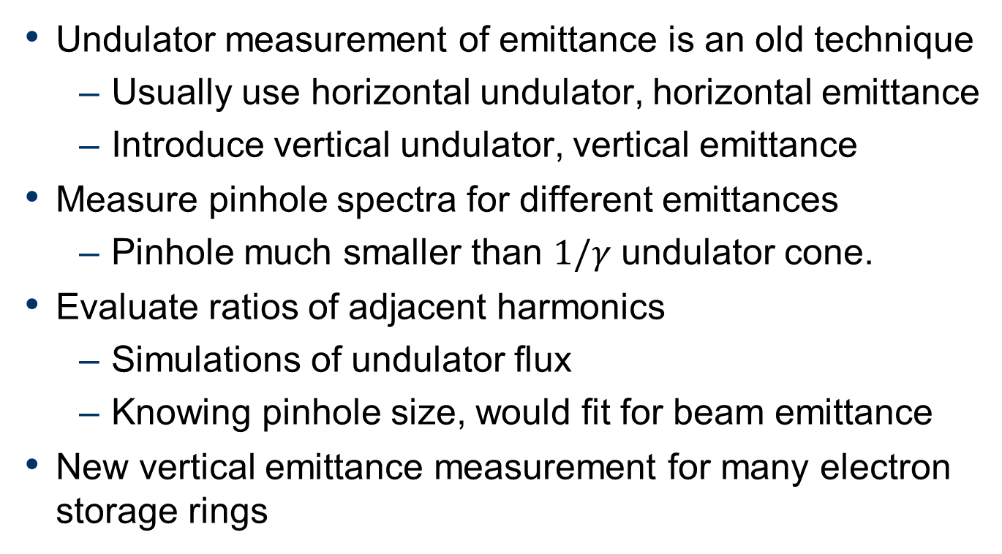
Summary
Undulator measurement of emittance is an old technique
  Usually use horizontal undulator, horizontal emittance
  Introduce vertical undulator, vertical emittance
Measure pinhole spectra for different emittances
  Pinhole much smaller than $1/γ$ undulator cone.
Evaluate ratios of adjacent harmonics
  Simulations of undulator flux
  Knowing pinhole size, would fit for beam emittance
New vertical emittance measurement for many electron storage rings

Slide 22


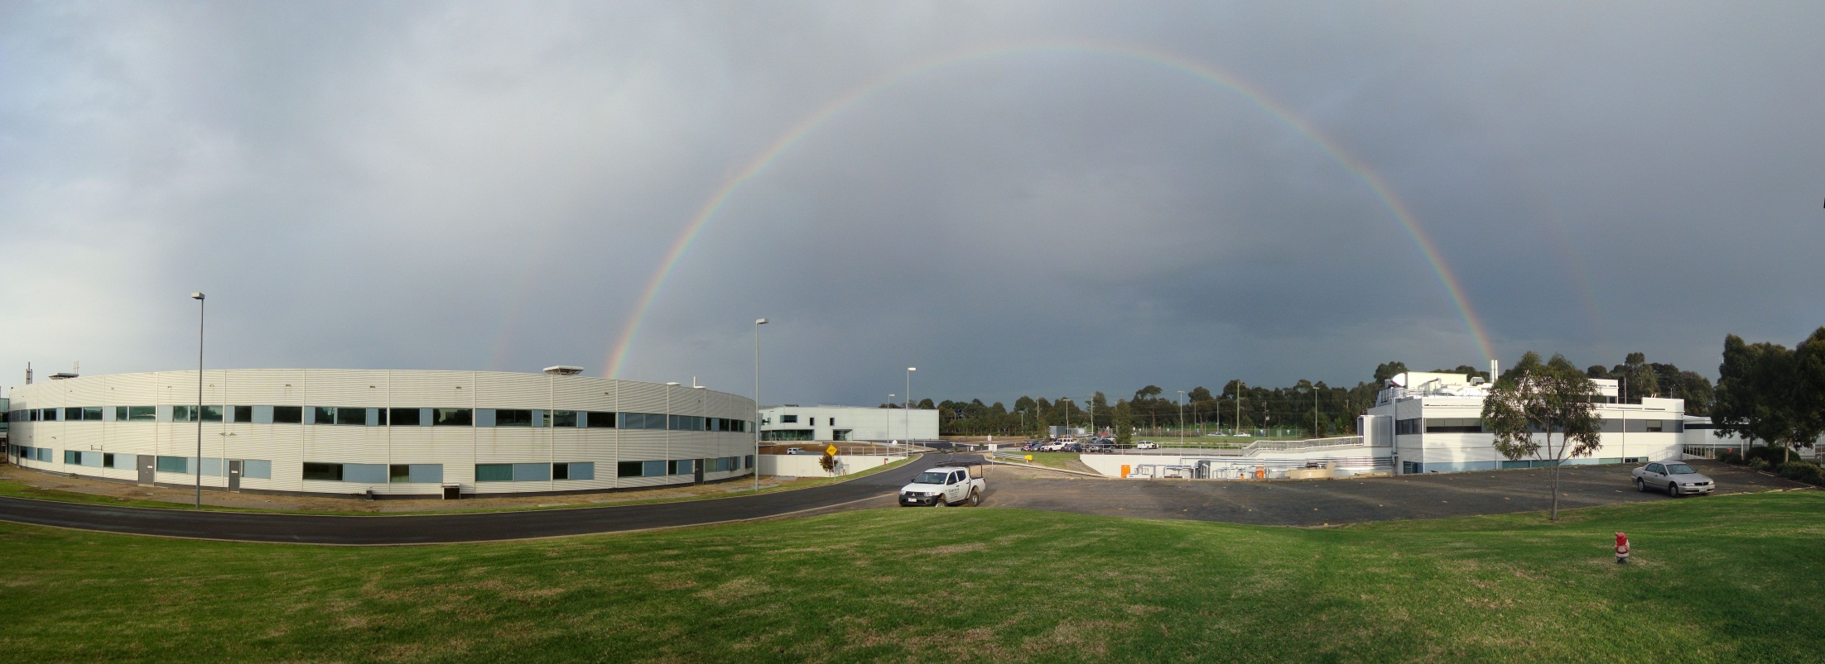
Thank-you!
k.wootton@student.unimelb.edu.au

Slide 23
References
Bakeman, et al., PAC 2009, WE6RFP074
Bakeman, et al., PAC 2011, MOP161
Cowie, et al., AIP Conf. Proc. 1234, 307 (2010)
Dattoli PRE 52(6) 6809-17 (1995)
Hahn JSR 4, 1-5 (1997)
Krumrey, Tegeler Rev Sci Instrum 63 (1), 797 (1992)
Moreno JSR, 19 179-84 (2012)
Sasaki, NIM:A 347, 83 (1994)
Shintake NIM:A 311, 453-464 (1992)
Takano (1997) ‘On Emittance diagnostics of electron beam by observing synchrotron radiation from a vertical undulator’. KEK Proceedings 97-20.
Talman NIM:A 489, 519 (2002)
Tanaka, et al., JSR 5, 414 (1998)
Tanaka & Kitamura, JSR 8 1221 (2001)
Wootton, IBIC’12, MOCB04 (in press)
Wootton et al. ‘Observation of picometer vertical emittance with a vertical undulator’ Phys. Rev. Lett. (in press) [link]

